Slide 1



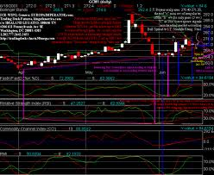
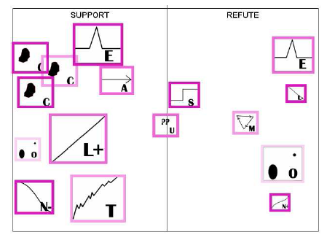

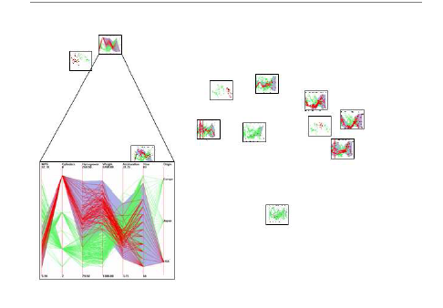
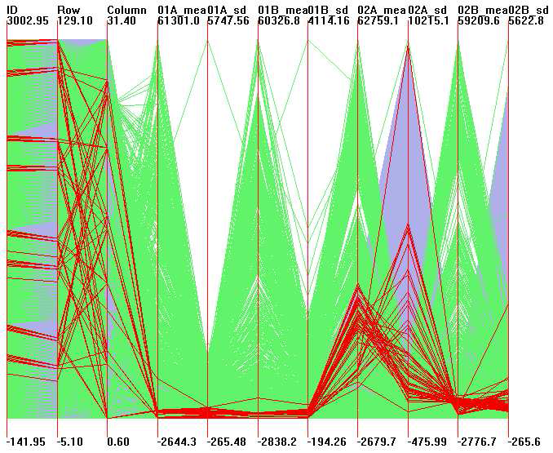
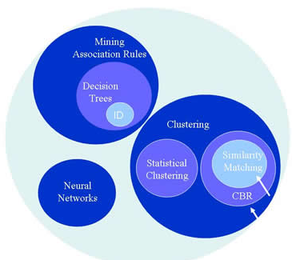
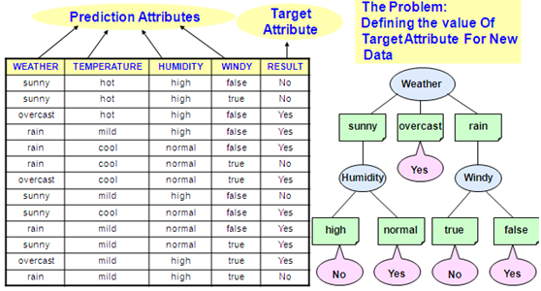
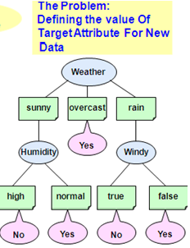
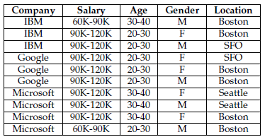
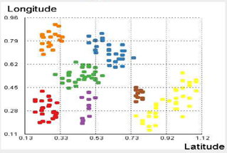
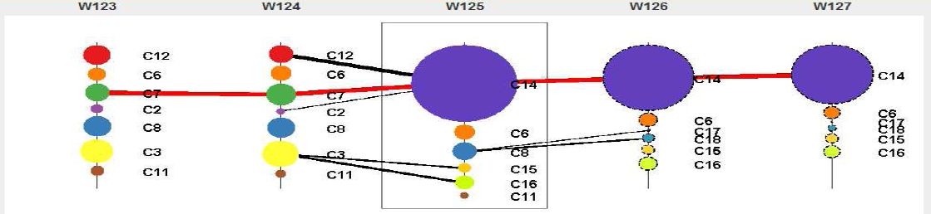
Visual Discovery Management: Divide and Conquer
Abhishek Mukherji, Professor Elke A. Rundensteiner, Professor Matthew O. Ward
XMDVTool, Department of Computer Science
This project is supported by NSF under grants IIS-080812027 and CCF-0811510.
MOTIVATION
WHAT WE AIM TO GIVE THEM
PROPOSED TASKS
Hypothesis view
Nugget definition, modeling and storage
  Classes of nuggets and their inter-relationships
  Provenance links to data
Nugget discovery and capture
  Explicit, implicit and automated generation
Nugget lifespan management
  Validation & refinement (meaning & quality)
    Visually examine the extracted nuggets and derivation traces
    Annotate and classify nuggets
    Associate confidence to a nugget
    Employ computational techniques (nearness measures)
    Eliminate redundant nuggets
  Structuring
    Clusters or hierarchy of nugget subsets
    Ordering / sequencing
    Correlations or causal relationships
Nugget-supported Visual Exploration
  Interactive visual analytics
WISDOM
Insight
Nugget view
What analysts work with
Huge datasets
Primarily data views
Cluttered displays
Limited sharing
KNOWLEDGE
Meaning
Target Scenarios
Terrorist attacks
Flu pandemic
Tornado touch-down
Electric grid overload
INFORMATION
Data view
Context
DATA
MODELING NUGGETS
ASSOCIATION RULES VIEWS
MORE RELEVANT TOPICS
A traditional database view
(defined using an SQL query)
A model-based database view*
(defined using a statistical model)
CREATE ASSOCIATION RULES VIEW
Rules ({antecedent itemset}--> {consequent itemset}) -- [Label, Supp, Conf , DSubset]
SELECT *
FROM transactions
WHERE ATTRIB_k BETWEEN K_min AND K_max
INTERESTINGNESS MEASURE minSupport = S and minConfidence = C
Relationships across nugget types
Cascading changes
User
User
CREATE VIEW
RegView(time [0::1], x [0:100:10], y[0:100:10], temp)
AS
FIT temp USING time, x, y
BASES 1, x, x^{2,} y, y²
FOR EACH time T
TRAINING DATA
SELECT temp, time, x, y
FROM raw-temp-data
WHERE raw-temp-data.time = T
avg-balances
select zipcode, avg(balance)
from accounts
group by zipcode
temperatures
Use Regression to predict
missing values and to
remove spatial bias
SELECT RV1.label, RV2.label
FROM RULES_VIEW1, RULES_VIEW2
WHERE RULES_VIEW1.DSubset CONTAINS RULES_VIEW2.DSubset
acct-no | balance | zipcode
101 | a | 20001
102 | b | 20002
.. | ..
.. | ..
time | id | temp
10am | 1 | 20
10am | 2 | 21
.. | .. | …
10am | 7 | 29
{R11(x1:x6) , R12(x3:x20)} , {R21 (x3:x5), R22(x10:x32)} => {(R11, R21), (R12, R21)}
{R11(XY->Z) , R12(ABC->D)} , {R21 (DE->FG), R22(Y->ZW)} => {(R12, R21)}
accounts
raw-temp-data
SELECT RV1.label, RV2.label
FROM RULES_VIEW1, RULES_VIEW2
WHERE RULES_VIEW1.consequent CONTAINS RULES_VIEW2.antecedent
data-> nuggets -> relationships-> meta-nuggets -> hypothesis
*MauveDB: Supporting Model-based User Views in Database Systems; Amol Deshpande, Sam Madden; SIGMOD 2006.
RELATIONSHIPS
HANDLING USER UPDATES
☺ PROJECT IMPACT
S
New arriving tuples.
Update to existing tuples.
Providing analysts the capability of managing their discoveries online,
Enhanced visualization using the hierarchical views
Superior evidence management supporting reasoning and decision making,
Knowledge sharing between groups of analysts.
Between data and nugget
  is-valid-for, forms-support-for, is-member-of.
Between two or more nuggets
  is-similar-to, is-derived-from, is-evidence-for
UPDATE WEATHER_INFO
SET RESULT = “No”
WHERE WEATHER = “overcast”
NO
Keep track of data and nuggets prone to change.
Incremental updates.

