Slide 1
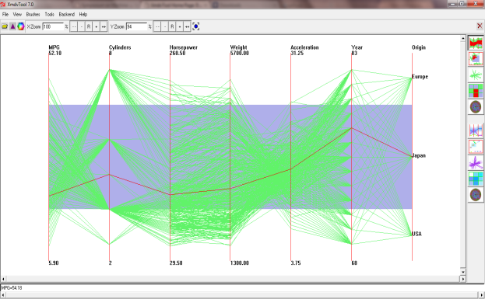
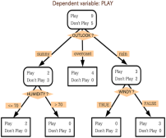
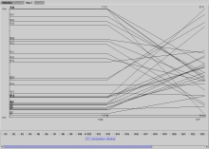
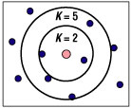
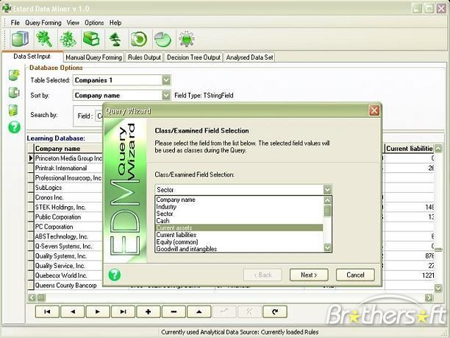
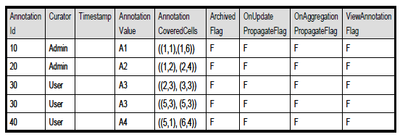
An Algebraic Approach to Visual Discovery Management
Abhishek Mukherji, Professor Elke A. Rundensteiner, Professor Matthew O. Ward
XMDVTool, Department of Computer Science
This project is supported by NSF under grants IIS-080812027 and CCF-0811510.
MOTIVATION
Are these patterns related?
How do I compare heterogeneous discoveries?
NAÏVE APPROACH
THE 3-SPACE FRAMEWORK
How do I know my discovery is accurate given this huge clutter of data?
Is my discovery novel? Are there others who have drawn the same conclusion?
Can I derive the results to the new queries from my stored observations or I need to run all operations from scratch ?
Data space
Visualization Tool
☹ Limitations
Limited exchange of data and control,
Separate optimization mechanisms,
Query optimization limited to data exploration,
Limited knowledge sharing,
Exploration limited to data space.
Nugget space
Provenance/ membership information
Sharable nugget features
DT
AR
9
DBC
RQ
14
18
2
3
13
19
6
Data Miner
5
7
12
8
15
11
1
17
16
10
20
4
Annotation space
Provenance
information
Provenance information
1. Huge datasets
2. Knowledge sharing
3. Advanced exploration
TECHNICAL CHALLENGES
EXTRACTING ASSOCIATION RULES
REWRITE EXAMPLES
Nugget creation and storage
Granularity and amount of storage,
Provenance links between spaces,
Trade-off: sharable features vs. DM specific storage.
Query execution and optimization
Advanced nugget-level and annotation-level operators,
Creation of unified query plans of visual and data mining operators,
Query rewrites and optimization for new operators.
Knowledge sharing
Merging new discoveries with existing storage,
Query refinement,
Trade-off: data privacy and sharing.
ARM on data space
Disjoint subsets of data and corresponding rules
∩
εsAR(D2)
AR1
AR2
AR4
D1
{AR1}
D2
{AR1,AR2}
D3
{AR3}
εAR(D1)
εAR(D2)
=
εAR(D1)
D2
AR3
AR5
D0
{Ø}
D4
{AR4}
D6
{AR4,AR5}
D5
{AR5}
D1
D2
D1
User query on the data space
Step 1: Subset identification
U
εDC(D1UD2)
DQ (user chosen subset)
= Di
= Di U Dj U …..
= ΔDi
= Di U ΔDj U …..
= ΔDi U ΔDj U …..
εDC(D1)
εDC(D2)
=
U
D1
D2
D1
D2
ALGEBRA OPERATORS
☺ CONTRIBUTIONS
S
null
Extraction
Similarity
Refinement
Step 2: Rule verification using FP-Tree
Integrated storage of data, nuggets and annotations,
Unified query processing and visualization mechanism allowing better optimization,
Advanced exploration of the 3 spaces using novel nugget and annotation space queries,
Knowledge sharing between groups of analysts.
εKC
εDC
εAR
εRQ
ЅD
ЅN
ЅA
RM
RR
A:7
B:3
B:5
C:1
D:1
C:3
Consolidation
Visualization
General purpose
Header table
C:3
D:1
E:1
D:1
E:1
CC
CO
VB
VH
π
σ
x
∩
U
-
D:1
E:1
D:1

