Slide 1
Basic Game Physics
IMGD 4000
With material from: Introduction to Game Development, Second Edition. Edited by Steve Rabin. Cengage Learning, 2009. (Chapter 4.3)
Notes:
Original versions of these slides are courtesy professor Charles Rich, IMGD 4000 Technical Game Development II, B-term 2012.

Slide 2
Introduction (1 of 2)
What is game physics?
  Computing motion of objects in virtual scene
    Including player avatars, NPC’s, inanimate objects
  Computing mechanical interactions of objects
    Interaction usually involves contact (collision)
  Simulation must be real-time (versus high-precision simulation for CAD/CAM, etc.)
  Simulation may be very realistic, approximate, or intentionally distorted (for effect)

Slide 3
Introduction (2 of 2)
And why is it important?
  Can improve immersion
  Can support new gameplay elements
  Becoming increasingly prominent (expected) part of high-end games
  Like AI and graphics, facilitated by hardware developments (multi-core, GPU)
  Maturation of physics engine market

Slide 4
Physics Engines
Similar buy vs. build analysis as game engines
  Buy:
    Complete solution from day one
    Proven, robust code base (hopefully)
    Feature sets are pre-defined
    Costs range from free to expensive
  Build:
    Choose exactly features you want
    Opportunity for more game-specification optimizations
    Greater opportunity to innovate
    Cost guaranteed to be expensive (unless features extremely minimal)

Slide 5
Physics Engines
Open source
  Box2D, Bullet, Chipmunk, JigLib, ODE, OPAL, OpenTissue, PAL, Tokamak, Farseer, Physics2d, Glaze
Closed source (limited free distribution)
  Newton Game Dynamics, Simple Physics Engine, True Axis, PhysX
Commercial
  Havok, nV Physics, Vortex
Relation to Game Engines
  Native, e.g,. C4
  Integrated, e.g., UE4 + PhysX
  Pluggable, e.g., C4 + PhysX, jME + ODE (via jME Physics)

Slide 6
Basic Game Physics Concepts
Why are we studying this?
  To use an engine effectively, you need to understand something about what it’s doing
  You may need to implement small features or extensions yourself
  Cf., owning a car without understanding anything about how it works (possible, yes, but ideal?, no)
Examples
  Kinematics and dynamics
  Projectile motion
  Collision detection and response

Slide 7
Outline
Introduction (done)
Kinematics (next)
Rigid Body Simulation
The Firing Solution
Collision Detection
Ragdoll Physics
PhysX

Slide 8
Kinematics (1 of 3)
Study of motion of objects without taking into account mass or force
Basic quantities: position, time
... and their derivatives: velocity, acceleration
Basic equations:
  d = vt
  v = u + at
  d = ut + ½at²
  v² = u² + 2ad
Where:
t - (elapsed) time
d - distance (change in position)
v - (final) velocity (change in distance per unit time)
a - acceleration (change in velocity per unit time)
u - (initial) velocity
Note, equation #3 is the integral of equation #2 with respect to time (see next slide). Equation #4 can be useful.
Notes:
distance = velocity * time
velocity = initial velocity + acceleration * time
If you take the integral over time of (v = u+at) you get: distance = initial velocity + ½ acceleration * time^2

Slide 9
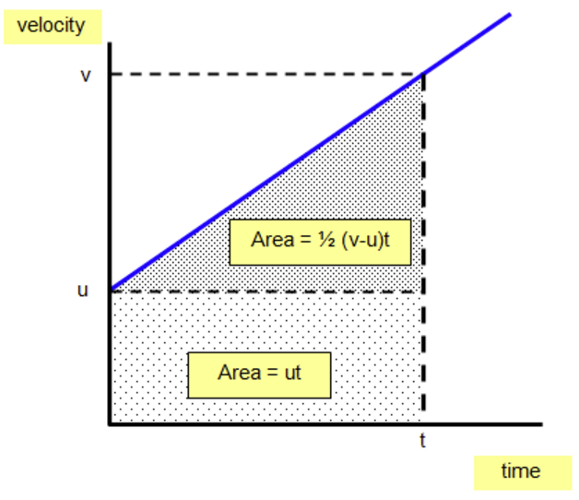
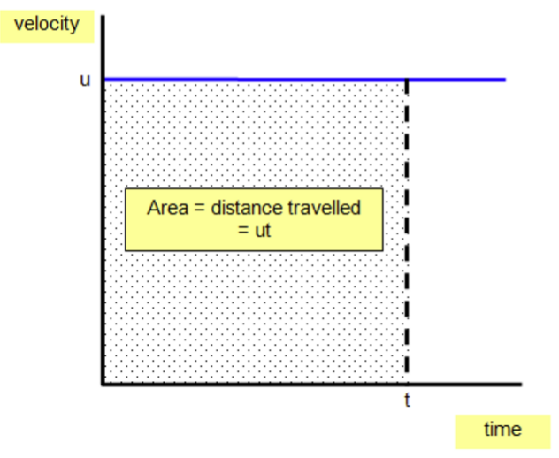
Kinematics (2 of 3)
Non-accelerated motion
Accelerated motion
  d = ut
  Example:
  u = 20 m/s, t = 300 s
  d = 20 x 3000 = 6000 m
  d = ut + ½at²
  Example:
  u=0 m/s, a=4m/s², t=3s
  d = 0x3 + 0.5x4x9 = 18m
Notes:
http://www.schoolphysics.co.uk/age14-16/Mechanics/Motion/text/Equations_of_motion/index.html

Slide 10
Kinematics (3 of 3)
Prediction Example: If you throw a ball straight up into the air with an initial velocity of 10 m/sec, how high will it go?
v² = u² + 2ad
u = 10 m/sec (initial speed upward)
a = -10 m/sec² (approx gravity)
v = 0 m/sec (at top of flight)
0 = 10² + 2(-10)d
d = 5 meters
v = 0
d
a = -10
u = 10
(Note, answer independent of mass of ball!)

Slide 11
Doing It In 3D
Mathematically, consider all quantities involving position to be vectors:
d = vt
v = u + at
d = ut + at²/2
Computationally, using appropriate 3-element vector datatype

Slide 12
Dynamics
Notice that preceding kinematic descriptions say nothing about why an object accelerates (or why its acceleration might change)
To get a full “modern” physical simulation you need to add two more basic concepts:
  force
  mass
Discovered by Sir Isaac Newton
Around 1700 ☺

Slide 13
Newton’s Laws
A body will remain at rest or continue to move in a straight line at a constant speed unless acted upon by a force.
The acceleration of a body is proportional to the resultant force acting on the body and is in the same direction as the resultant force.
For every action, there is an equal and opposite reaction.

Slide 14
Motion Without Newton’s Laws
Pac-Man or early Mario style
  Follow path with instantaneous changes in speed and direction (velocity)
  Not physically possible
Note - fine for some casual games (especially with appropriate animations)

Slide 15
Newton’s Second Law
F = ma
At each moment in time:
F = force vector, in Newton’s
m = mass (intrinsic property of matter), in kg
a = acceleration vector, in m/sec²
Player cares about state of world (position of objects). Equation is fundamental driver of all physics simulations.
  Force causes acceleration (a = F/m)
  Acceleration causes change in velocity
  Velocity causes change in position

Slide 16
How Are Forces Applied?
May involve contact
  Collision (rebound)
  Friction (rolling, sliding)
Without contact
  Rockets/Muscles/Propellers
  Gravity
  Wind (if not modeling air particles)
  Magic
Dynamic (force) modeling also used for autonomous steering behaviors

Slide 17
Computing Kinematics in Real Time
start = getTime() // start time
p = 0 // initial position
u = 10 // initial velocity
a = -10
function update () { // in game loop
now = getTime()
t = now – start
simulate(t)
}
function simulate (t) {
d = (u + (0.5 * a * t)) * t
move object to p + d // move to loc. computed since start
}
d
a = -10
u, p
d = ut + at²/2
Note! Number of calls and time values to simulate() depend on (changing) game loop time (frame rate)
Is this a problem? It can be! For rigid body simulation with colliding forces and friction (e.g., many interesting cases) …

Slide 18
Outline
Introduction (done)
Kinematics (done)
Rigid Body Simulation (next)
The Firing Solution
Collision Detection
Ragdoll Physics
PhysX

Slide 19
Rigid-Body Simulation
If no rotation, only gravity and occasional frictionless collision, basic Kinematic equations are fine
  Closed form solution can be integrated
  (e.g., d = ut + ½at²)
But in many games (and life!), interesting motion involves non-constant forces and collision impulse forces
  Unfortunately, often no closed-form solutions
What to do? → Numerical simulation
Numerical Simulation techniques for incrementally solving equations of motion when forces applied to object are not constant, or when otherwise there is no closed-form solution

Slide 20
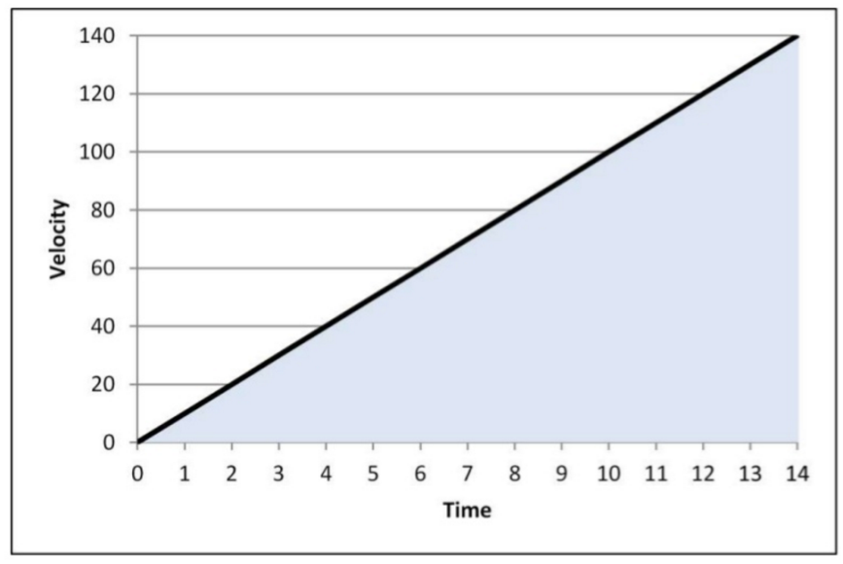
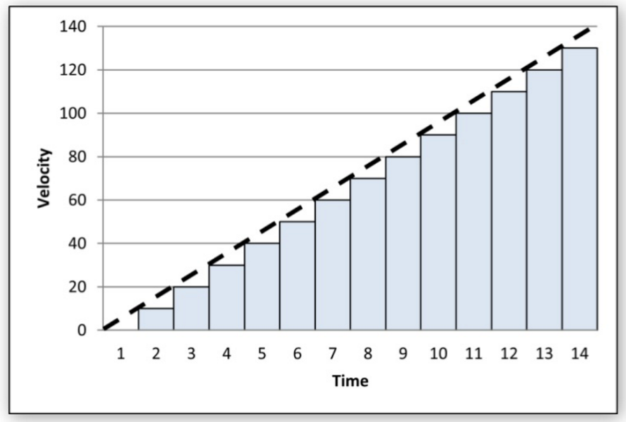
Numerical Simulation of Newtonian Equation of Motion (1 of 2)
Suppose know position (p), velocity (v) and acceleration (a) at time (t_{i}) and frame time (∆t)
Want position at next frame time (t_{i+1})
  Don’t know exactly how forces are affecting (wind, friction, gravity …)
Can compute:
  p_{i+1} = s_{i} + v_{i} * ∆t
  v_{i+1} = v_{i} + a * ∆t
vs.
What is this doing? → Instead of integrating a curve, sum over discrete time-slices

Slide 21

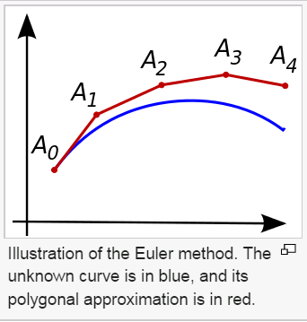
Numerical Simulation of Newtonian Equation of Motion (2 of 2)
Family of numerical sim techniques called finite difference methods
  Incremental “solution” to equations of motion
  Most common for rigid-body dynamics simulation
Derived from Taylor series expansion of properties interested in
S(t+Δt) = S(t) + Δt d/dt S(t) + (Δt)²/2! d²/dt S(t) + …
In general, not know values of any higher order. Truncate, remove higher terms
S(t+Δt) = S(t) + Δt d/dt S(t) + O(Δt)²
  Can do beyond, but always higher terms
  O(Δt)² is called truncation error
    Size is proportional to Δt (step size)
Can use to update properties (position)
  Called “simple” or “explicit” Euler integration
(Taylor series are used to estimate unknown functions)
Notes:
Numerical “solutions” are never true solutions. They are approximate solutions. Their very derivation introduces error, called truncation error, that is always present in finite difference methods.

Slide 22
Explicit Euler Integration (1 of 2)
A “one-point” method since solve using properties at exactly one point in time, t, prior to update time, t+Δt
  S(t+Δt) is only unknown value so can solve without solving system of simultaneous equations
  Every term on right side is evaluated at t, right before new time t+Δt
View: S(t+Δt) = S(t) + Δt d/dt S(t)
new state
prior state
state derivative

Slide 23
Explicit Euler Integration (2 of 2)
Write numerical integrator over arbitrary properties as change over time
For single particle, S = (mV, p) and d/dt S = (F, V)
  Derivative of position (p) is velocity (V)
    i.e., how position changes with respect to time
  Derivative of momentum (mass m * V) is force (F)
    i.e., how momentum changes with respect to time
Integrate state vector of length N
Vector ExplicitEuler(int N, Vector prior_S, Vector deriv_S, float delta_t)
Vector new_S[N];
for (i=0; i<N; i++)
new_S[i] = prior_S[i] + delta_t * deriv_S[i];
return new_S;
Note, for 3D, mV and p have 3 values each
  S(t) = (m₁V₁,p₁,m₂V₂,p₂, …, m_{N}V_{N},p_{N})
  d/dt S(t) = (F₁,V₁,F₂,V₂, …,F_{N},V_{N})

Slide 24
Explicit Euler Integration Example (1 of 2)
V_{init} = 30 m/s
Launch angle: 75.2 degrees (all motion in xz plane)
Mass of projectile, m: 2.5 kg
t_{init}
p_{init}
mV_{init}
F=Weight = mg
V_{init}
S = <mV_{init}, p_{init} >
dS/dt = <mg,V_{init}>
Notes:
Initial state and state derivative are derived from initial position and velocity
mV is the linear momentum of the particle

Slide 25
Explicit Euler Integration Example (2 of 2)
Δt = .2 s
Δt = .1 s
Δt = .01 s
Notes:
Note that the numerical prediction for linear momentum is the same as the exact solution. This is because the first state derivative of linear momentum is a constant, mg. All of the higher-order time derivatives of linear momentum are exactly zero, and so the truncated Taylor series for explicit Euler integration happens to exactly represent linear momentum. Truncation error for these terms is zero, and the numerical solution is just as good as the closed-form solution. In fact, you can show that it turns out to be exactly the same as the equation on slide #14 for V(t), multiplied by m to obtain a linear momentum equation.
Also note that the numerical prediction of px and py are exact. This is because the velocity is constant in x and y. The acceleration (second derivative of state) is zero in x and y and so in these two directions the truncated Taylor series (which does not contain second or higher time derivatives) happens to be exact.
In z, however, pz for the numerical prediction is NOT correct. Reason being, the acceleration is nonzero and the truncated Taylor series for explicit Euler integration of position does not contain the second time derivative of position.
Explicit Euler integration is what is known as a consistent numerical method. This means that as the time step, Δt, is reduced, the solution approaches the exact solution. If Dt goes to zero in the limit, explicit Euler would produce the exact, perfect solution.

Slide 26
Pseudo Code for Numerical Integration (1 of 2)
Vector cur_S[2*N]; // S(t+Δt)
Vector prior_S[2*N]; // S(t)
Vector S_deriv[2*N]; // d/dt S at time t
float mass[N]; // mass of particles
float t; // simulation time t
void main() {
float delta_t; // time step
// Set current state to initial conditions
for (i=0; i<N; i++) {
mass[i] = mass of particle i;
cur_S[2*i] = particle i initial momentum;
cur_S[2*i+1] = particle i initial position;
}
// Game simulation/rendering loop
while (1) {
doPhysicsSimulationStep(delta_t); // update state of all particles
for (i=0; i<N; i++) {
render particle i at position cur_S[2*i+1];
}
}

Slide 27
Pseudo Code for Numerical Integration (2 of 2)
// Update state of all particles based on physics
void doPhysicsSimulationStep(float delta_t) {
copy cur_S to prior_S;
// Calculate state derivative vector
for (i=0; i<N; i++) {
S_deriv[2*i] = CalcForce(i); // could be just gravity
S_deriv[2*i+1] = prior_S[2*i]/mass[i]; // since S[2*i] is mV → divide by m
}
// Integrate equations of motion
ExplicitEuler(2*N, cur_S, prior_S, S_deriv, delta_t);
// By integrating, effectively moved simulation time forward by delta_t
t = t + delta_t;
}

Slide 28
Computing Position Over Time
Solution proceeds step-by-step, each time integrating from prior state
p_init = <10,0,2> meters
p_target = <50,0,20> meters
v_init = 30 meters per second
Notes:
pinit=<10,0,2> meters
ptarget-=<50,0,20> meters
Vinit=30 meters per second

Slide 29
Truncation Error
Numerical simulation can be different from exact, closed-form solution
  Difference primarily truncation error
Truncation error can accumulate causing instability
  Ultimately produces floating point overflow
  Unstable simulations behave unpredictably (not same each time)
Sometimes, truncation error can become zero
  In other words, produces exact, correct result
  For example, when zero force is applied or frictionless and constant force
But, more often truncation error is non-zero. Control by:
  Select different numerical integrator (Vertlet, Runge-Kutta or others). Typically, more state kept. Stable within bounds.
  Reduce time step, Δt (next slide)

Slide 30
Truncation Error Example
Euler
Error per step proportional to step size squared
Global error (error at given time) proportional to step size
(At lower limit, error goes to 0)
Trade-off: truncation error and computation interval
Guidelines? Step more often than frame rate (otherwise, no update!)
→ Δt under 30 ms (20 ms a good choice)
Notes:
This chart illustrates that explicit Euler integration if first-order accurate in time, e.g., truncation error grows as a linear function of dt.
The truncation error clearly goes to zero when Dt goes to zero, in the limit. This is a characteristic of a consistent numerical method. The only valid numerical methods are those that are consistent, whose error goes to zero in the limit as Dt goes to zero.
For more general problems, e.g., those with non-constant forces, the truncation error remains O(Δt); however, in practice the error is never a perfectly linear curve (or, for O(Dt²) methods, a perfect parabola, etc.)
See the text and references for more details on truncation error

Slide 31
Frame Rate Independence
Complex numerical simulations used in physics engines are sensitive to time steps (due to truncation error and other numerical effects)
But results need to be repeatable regardless of CPU/GPU performance
  for debugging
  for game play
So, if frame rate drops (game loop can’t keep up), then physics will change
Solution: Control physics simulation interval independently of frame rate

Slide 32
Frame Rate Independence
delta
simulation ticks
lag
frame updates
previous
now
start = ...
delta = 0.02 // physics simulation interval (sec)
lag = 0 // time since last simulated
previous = 0 // time of previous call to update
function update() { // in game loop
now = getTime()
t = (previous - start) – lag // previous simulate()
lag = lag + (now - previous) // additional lag
while ( lag > delta ) // repeat until caught up
t = t + delta
simulate(t) // note: kinematics. If dynamic, use delta
lag = lag - delta
previous = now // simulation caught up to current time
}

Slide 33
Outline
Introduction (done)
Kinematics (done)
Rigid Body Simulation (done)
The Firing Solution (next)
Collision Detection
Ragdoll Physics
PhysX

Slide 34
The Firing Solution (1 of 3)
How to hit target
  Beam weapon or high-velocity bullet over short ranges can be viewed as traveling in straight line
  But projectile travels in parabolic arc
    Grenade, spear, catapult, etc.
d = ut + at²/2
a = [0, 0, -9.8] m/sec²
(but can use higher value, e.g., -18)
d
u = velocity vector
Most typical game situations, magnitude of u fixed. We only need to know relative components (orientation) → Challenge:
Given d, solve for u

Slide 35

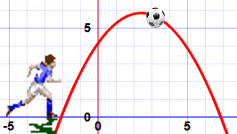

Remember Quadratic Equations?
Make nice curves
  Like firing at target!
Solutions are where equals 0. E.g., when firing with gun on ground:
  At gun muzzle
  At target
But unlike in algebra class, not just solving quadratic but finding angle with y = gun, y = target
Angle changes speed in x-direction, but also time spent in air
After hairy math [Millington 3.5.3], three relevant cases:
  Target is out of range (no solution)
  Target is at exact maximum range (single solution)
  Target is closer than maximum range (two possible solutions)
Solve with quadratic formula
Notes:
http://www.mathsisfun.com/algebra/quadratic-equation.html

Slide 36
The Firing Solution (2 of 3)
long time trajectory
short time trajectory
[Millington 3.5.3]
u = (2Δ - at²) / (2 (muzzle_v) t)
where muzzle_v = max muzzle speed
Δ is difference vector from d to u
a is gravity
d
u = muzzle velocity vector
Usually choose short time trajectory
  Gives target less time to escape
  Unless shooting over wall, etc.
Project Firing

Slide 37

The Firing Solution (3 of 3)
function firingSolution (start, target, muzzle_v, gravity) {
// Calculate vector back from target to start
delta = target - start
// Real-valued coefficents of quadratic equation
a = gravity * gravity
b = -4 * (gravity * delta + muzzle_v * muzzle_v)
c = 4 * delta * delta
// Check for no real solutions
if ( 4 * a * c > b * b ) return null
// Find short and long times to target
disc = sqrt (b * b - 4 * a *c)
t1 = sqrt ( ( -b + disc ) / (2 * a ))
t2 = sqrt ( ( -b - disc ) / (2 * a ))
// Pick shortest valid time to target (ttt)
if ( t1 < 0 ) && ( t2 < 0) return null // No valid times
if ( t1 < 0 ) ttt = t2 else
if ( t2 < 0 ) ttt = t1 else
ttt = min ( t1, t2 )
// Return firing vector
return ( 2 * delta - gravity * ttt * ttt ) / ( 2 * muzzle_v * ttt )
}
Note, a, b and c are scalars so a normal square root.
Note scalar product of two vectors using *:
[a,b,c] * [d,e,f] = a*d + b*e + c*f
[Millington 3.5.3]

Slide 38
Outline
Introduction (done)
Kinematics (done)
Rigid Body Simulation (done)
The Firing Solution (done)
Collision Detection (next)
Ragdoll Physics
PhysX

Slide 39
Collision Detection
Determining when objects collide is not as easy as it seems
  Geometry can be complex
  Objects can be moving quickly
  There can be many objects
    naive algorithms are O(n²)
Two basic approaches:
  Overlap testing
    Detects whether collision has already occurred
  Intersection testing
    Predicts whether collision will occur in future

Slide 40
Overlap Testing
Basics – discussed and implemented in IMGD 3000!
Most common technique used in games
Exhibits more error than intersection testing
Basic idea:
  at every simulation step, test every pair of objects to see if overlap
Easy for simple volumes (e.g., spheres), harder for polygonal models
Results of test:
  collision normal vector (useful for reaction)
  time that collision took place

Slide 41
Overlap Testing: Finding Collision Time
Calculated by doing “binary search” in time, moving object back and forth by 1/2 steps (bisections)
In practice, five iterations usually enough

Slide 42
Limitations of Overlap Testing
Fails with objects that move too fast (no overlap during simulation time slice)
Solution approach:
  constrain game design so that fastest object moves smaller distance in one physics “tick” (delta) than thinnest object
  may require reducing simulation step size (adds computation overhead)

Slide 43
Intersection Testing
Predict future collisions
Extrude geometry in direction of movement
  e.g., “swept” sphere turns into capsule shape
Then, see if extruded shape overlaps objects
When collision found (predicted)
  Move simulation to time of collision (have collision point)
  Resolve collision
  Works for bullet/window example (bullet becomes line segment)

Slide 44
Speeding Up Collision Detection
Bounding Volumes
  Oriented
  Hierarchical
Partitioning
Plane Sweep

Slide 45
Bounding Volumes
Commonly used volumes
  sphere - distance between centers less than sum of radii
  boxes
    axis aligned (loose fit, easier math)
    oriented (tighter fit, more expensive)
If bounding volumes don’t overlap, then no more testing is required
  If overlap, more refined testing required
  Bounding volume alone may be good enough for some games

Slide 46
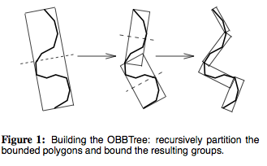
Complex Bounding Volumes
Multiple volumes per object
  e.g., separate volumes for head, torso and limbs of avatar object
Hierarchical volumes
  e.g., boxes inside of boxes
[Gottschalk, Lin, Minocha, SIGGRAPH ’96]

Slide 47
Partitioning for Collision Testing
To address the n² problem...
Partition space so only test objects in same cell
In best case (uniform distribution) reduces n² to linear
  Can happen for uniform size, density objects (e.g., cloth/fluids)
In worst case (all objects in same cell) no improvement

Slide 48
Plane Sweep for Collision Testing
Observation: many moveable objects stay in one place most of the time
Sort bounds along axes (expensive to do, so do just once!)
Only adjacent sorted objects which overlap on all axes need to be checked further
Since many objects don’t move, can keep sort up to date very cheaply with bubblesort (nearly linear)

Slide 49
Outline
Introduction (done)
Kinematics (done)
Rigid Body Simulation (done)
The Firing Solution (done)
Collision Detection (done)
Ragdoll Physics (next)
PhysX

Slide 50
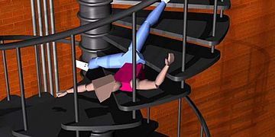
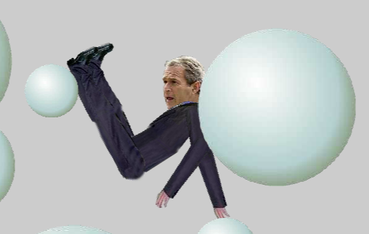
What is Ragdoll Physics?
Procedural animation often used as replacement for traditional (static) death animation
  Generated by code, not hand
  Using physics constraints on body limbs & joints in real-time
Still from early animation using ragdoll physics
https://en.wikipedia.org/wiki/Ragdoll_physics
http://www.freeonlinegames.com/game/ragdoll-physics-2

Slide 51

Diablo 3 Ragdolls
“How to Smack a Demon”
Erin Catto
(Game Developer’s Conference, San Francisco, California, USA, 2013)
Physics Programmer for Diablo 3 (Blizzard, 2012)
Notes:
<title page>
http://box2d.googlecode.com/files/GDC2012_ErinCatto_Ragdolls.pdf
Hello everyone!
My name is Erin Catto and I want to thank you for coming to my tutorial.
Today I’m going to discuss my work on the Diablo 3 ragdoll system. I learned a lot working on this project and I hope you find this information useful in your own projects. And as I promised, you will learn how to smack a demon.
First let me give you a little background about myself.

Slide 52
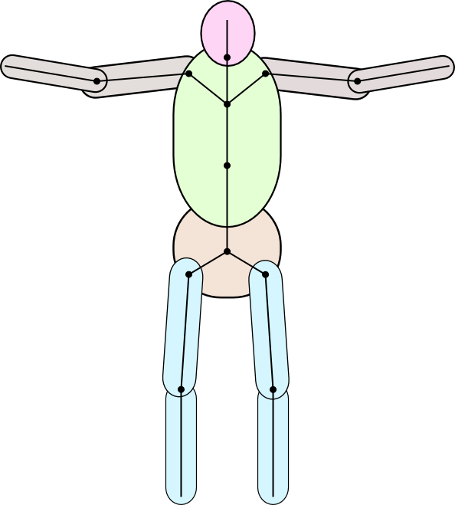
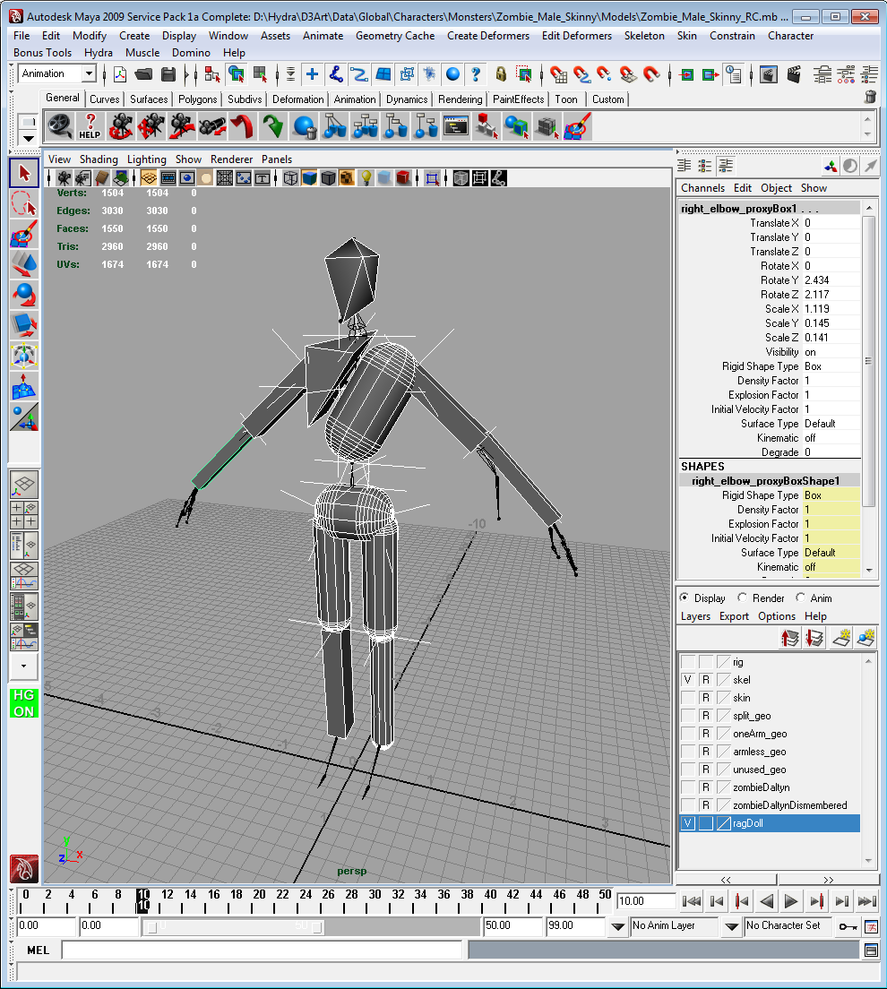
A ragdoll is a collection of collision shapes connected to bones
Notes:
<explanation>
The ragdoll geometry is created by a technical artist in Maya.
We start with a standard character skeleton. The ragdoll is defined in the so-called bind pose. A skeleton’s bind pose fits the original character mesh that was created by a modeler. The bind pose is the pose where the mesh is bound to the skeleton in a process called skinning.
We attach collision shapes to the skeleton bones. Each bone has zero or more collision shapes. These implicitly define the rigid bodies. Physics joints are represented as locator transforms that connect two bones.
With this framework, we can author all the physics objects in the game as ragdolls, except for the static environment.

Slide 53
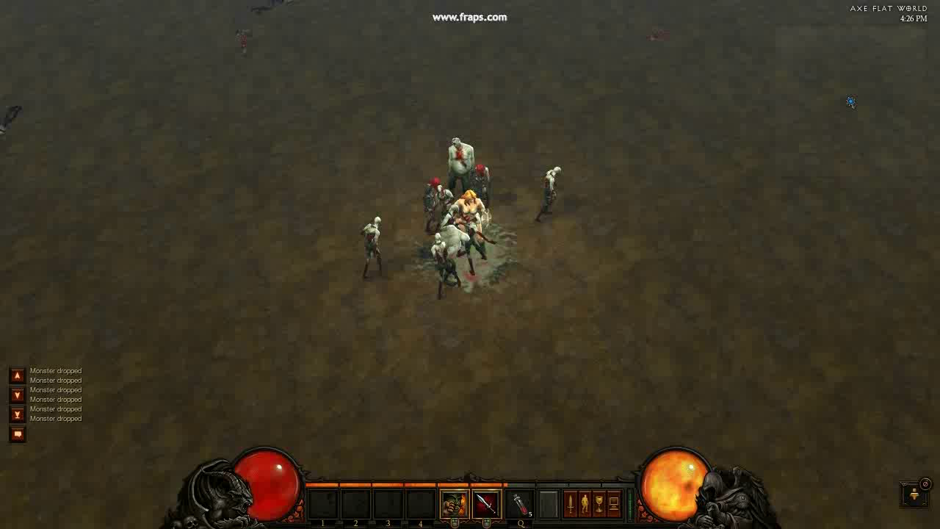
Notes:
Video: Zombie Fest
Here are your standard death ragdolls.

Slide 54
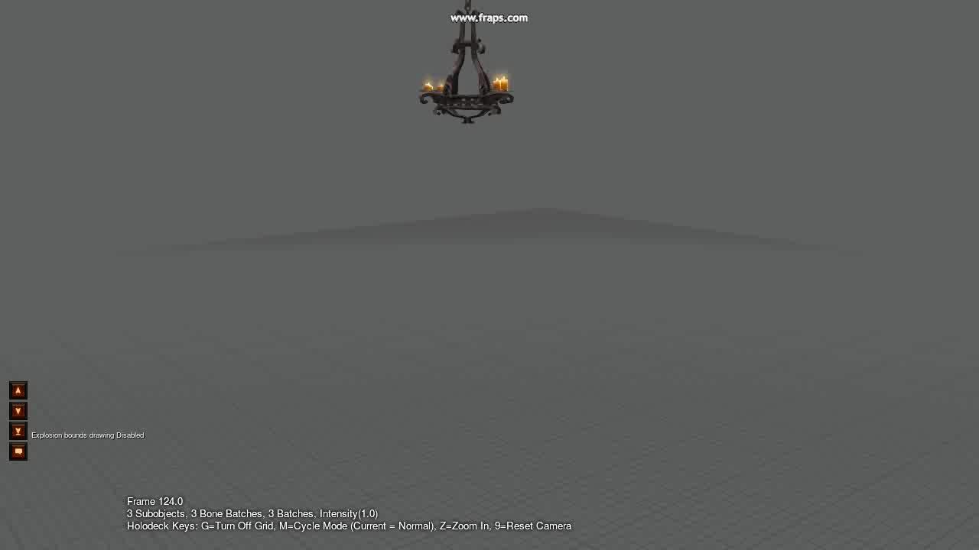
Notes:
Video: Chandelier
Here is a destructible chandelier. The entire chandelier is one model with a single skeleton. You’ll have fun dropping these on top of zombies in Diablo3.

Slide 55
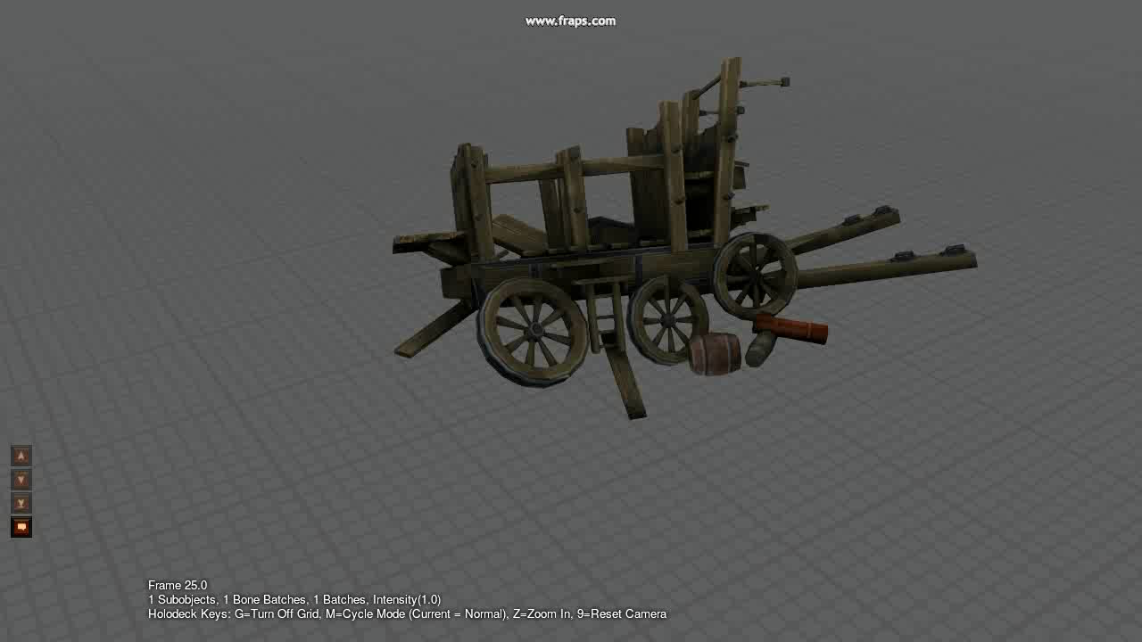
Notes:
Video: Wagon
Even a destructible wagon is a ragdoll. So a ragdoll in Diablo is not just a character. This simplifies our authoring path and our code. Also, by having all physics props as ragdolls we keep draw calls low since the moving parts are just bones, not separate actors.

Slide 56
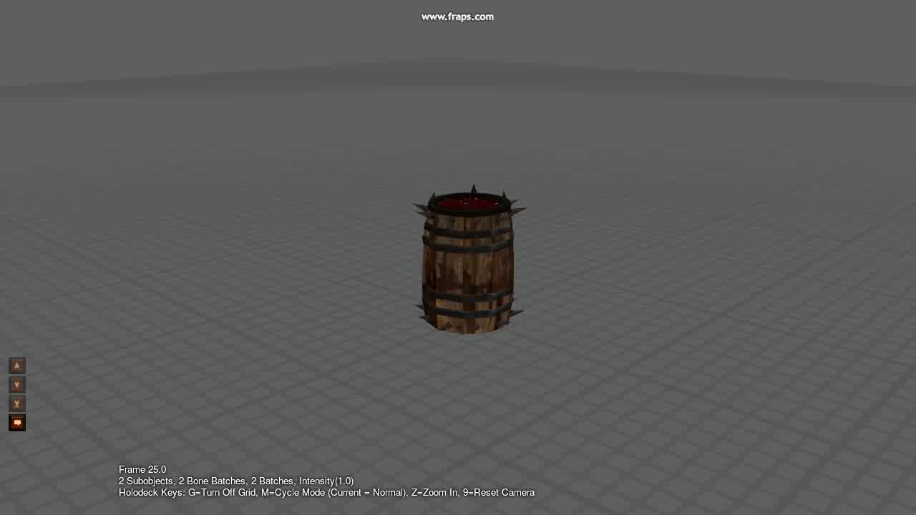
Notes:
Video: Barrel
This barrel mixes destruction with a character ragdoll. But it is still one draw call.

Slide 57
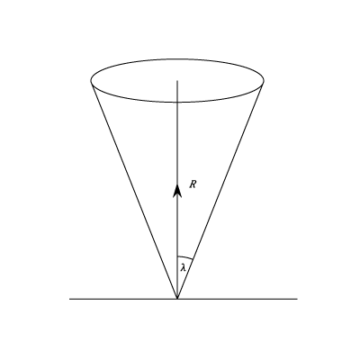
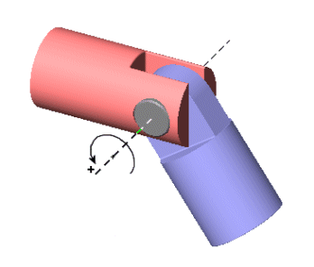
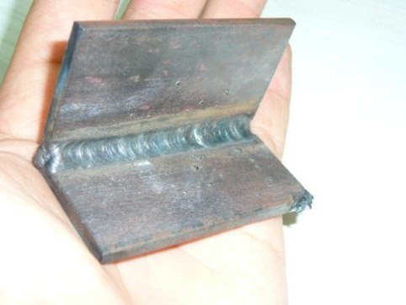
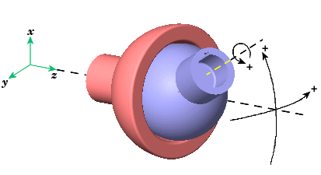
Physics joints connect two bones
Cone Joint
(like shoulder)
Revolute Joint
(like elbow)
Tech artist connects bones with Physics joints
Spherical Joint
(for chandeliers)
Weld Joint
(locks two bodies, for advanced)
Notes:
The technical artist connects bones with physics joints. The physics joints do not necessarily line up with the bones and we support branch crossing loop joints.
We use cone, revolute, spherical, and weld joints.
Cone joint: like a shoulder with cone and twist angle limits
Revolute joint: like an elbow with a single axis of rotation and angular limits
Spherical joint: a pure point to point constraints with no rotation restriction, useful for chandeliers where rotation is naturally limited by collision.
Weld joint: locks two bodies together, useful for some advanced effects you’ll see later.
We author physics joints using a Maya locator, which is basically a transform with position and orientation. So they are just coordinate axes. We have conventions to relate locator axes to joint axes. For example, the z-axis is the hinge axis for a revolute joint.

Slide 58
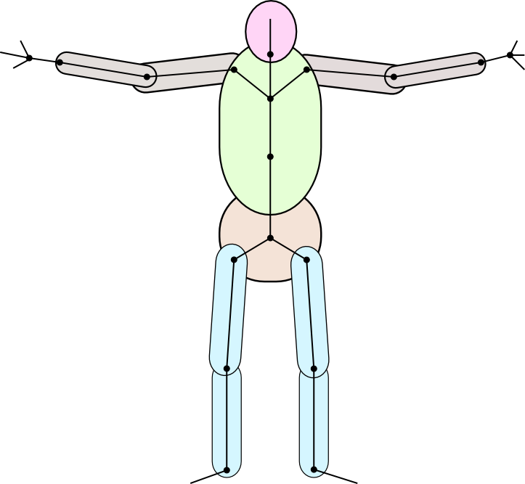
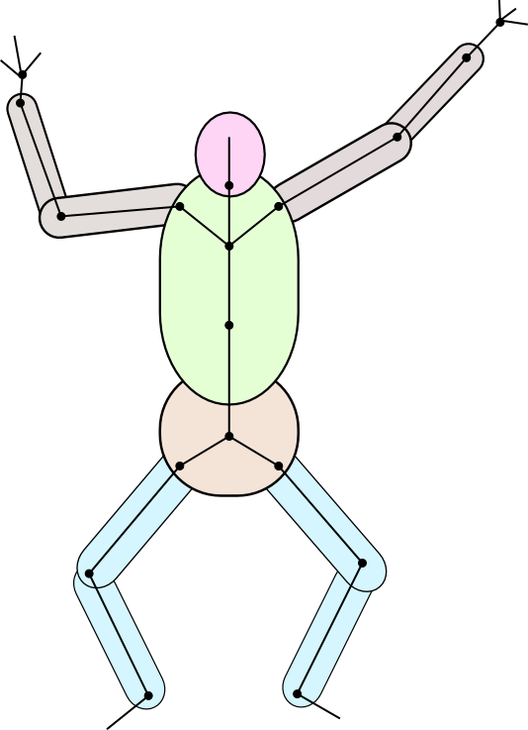
We use the ragdoll bodies to adjust the pose
model space keyed animation
world space ragdoll
Notes:
<explanation>
As I mentioned before, the ragdoll bodies map to a subset of the bones. Active bones follow their rigid body exactly. But how shall we handle leaf and intermediate bones?
Keep in mind that each rigid body can only drive a single bone. So leaf and intermediate bones need another source of data to fully determine their transforms.

Slide 59
Update the actor bounding sphere using the bone transforms
actor transform
Notes:
In Diablo we maintain a bounding sphere on our actors. This sphere is used for lighting and visibility culling. When a character goes ragdoll they may move very far from the actor transform. They may even fall off a cliff.
Further, we support breakable ragdolls and gibbing of ragdolls, so the ragdoll pieces may be widely separated. So we have to adjust the bounding sphere to contain all the bones, not matter where they are. To do this, we have a local bounding sphere for each bone and sum up all the spheres according to the final bone positions.

Slide 60
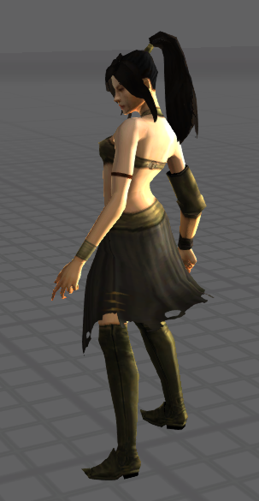
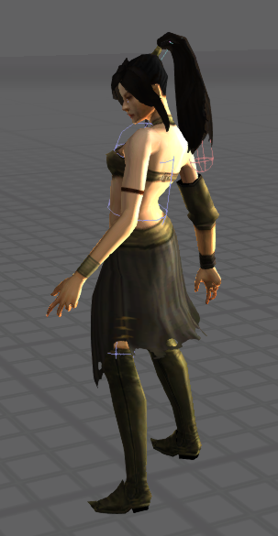
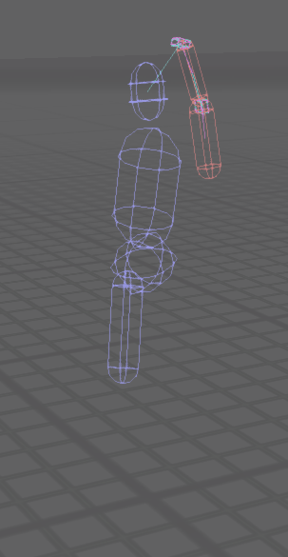
Partial ragdolls add flavor to living characters
Not just for death and destruction
Notes:
We made a big effort to make the characters in Diablo 3 visually interesting. So the question naturally arose how we could use the ragdoll system to enhance our living characters. Out of this we developed our so-called partial ragdoll system.
Our canonical example of the partial ragdoll system is the wizard’s pony tail. Here you can see how the partial ragdoll is set up. We have a couple red capsules for the dynamic pony tail. The blue capsules are kinematic bodies. Kinematic bodies follow the animation rigidly and provide a collision barrier so that the pony tail doesn’t swing through her body.

Slide 61
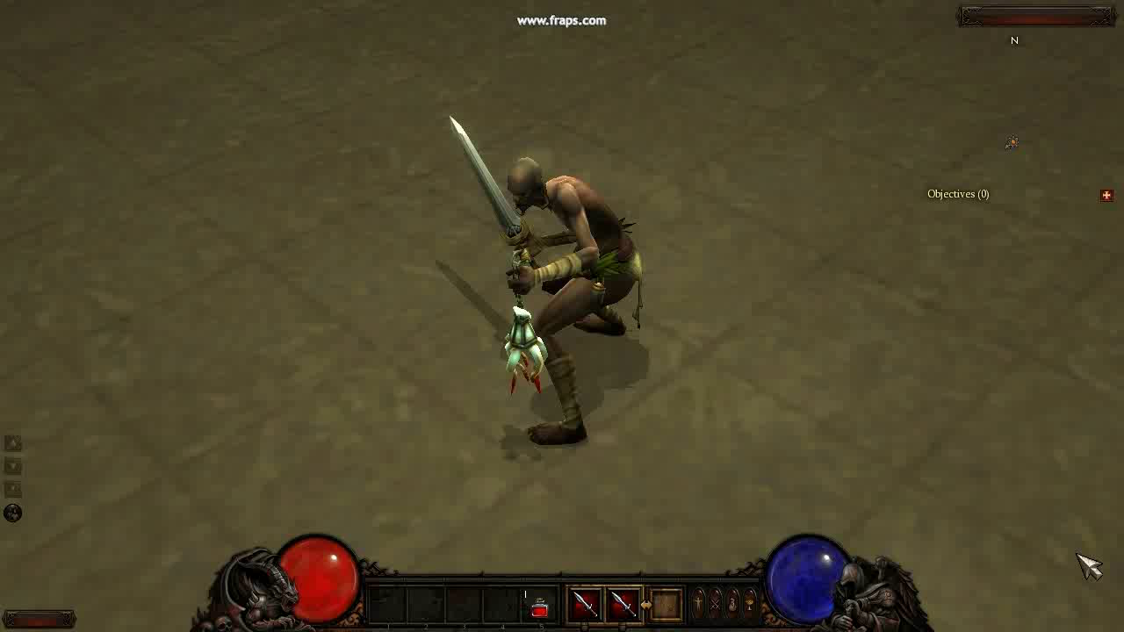
Notes:
Video: witch doctor

Slide 62
More Physics We Are Not Covering
Collision response
Conservation of momentum
Elastic collisions
Non-elastic collisions – coefficient of restitution
Rigid body simulation (vs. point masses)
Joints as constraints to motion
Soft body simulation
[see excellent book by Millington, “Game Physics Engine Development”, MK, 2007]

Slide 63
Outline
Introduction (done)
Kinematics (done)
Rigid Body Simulation (done)
The Firing Solution (done)
Collision Detection (done)
Ragdoll Physics (done)
PhysX (next)

Slide 64
PhysX Overview
Developed by NVIDIA for C++ applications
Windows, Mac, Linux, Playstation, Xbox, Android, Apple iOS and Wii
Simulate
  Fluids
  Soft bodies (cloth, hair)
  Rigid bodies (boxes, bones)

Slide 65
Why Does NVIDIA Make Physics Software?
NVIDIA is mainly known as a developer and manufacturer of graphics hardware (GPU’s)
So taking advantage of GPU for hardware acceleration of their physics engine
  Algorithms can be tuned to their hardware
  Giving a competitive advantage over other GPU manufacturers

Slide 66
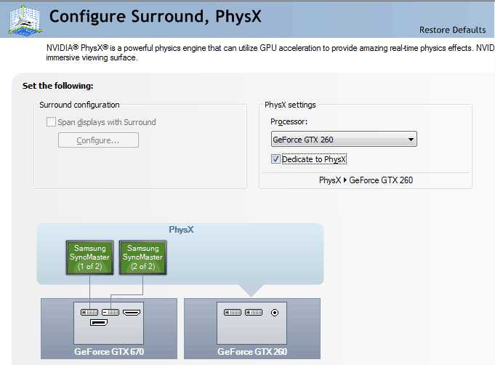
Configure Video Card as Dedicated PhysX Processor
Dedicated to PhysX

Slide 67
What Algorithms Does PhysX Use?
Hard to know exactly, because algorithm details are NVIDIA’s intellectual property (IP)
However from various forums and clues, it is clear PhysX uses:
  Both sweep and overlap collision detection
  AABB and OBBT and (both axis-aligned and oriented bounding bounding box trees)
  Constraints: hinges, springs, etc.
  and lots of other hairy stuff, see
  https://devtalk.nvidia.com/default/board/66/physx-and-physics-modeling/

Slide 68
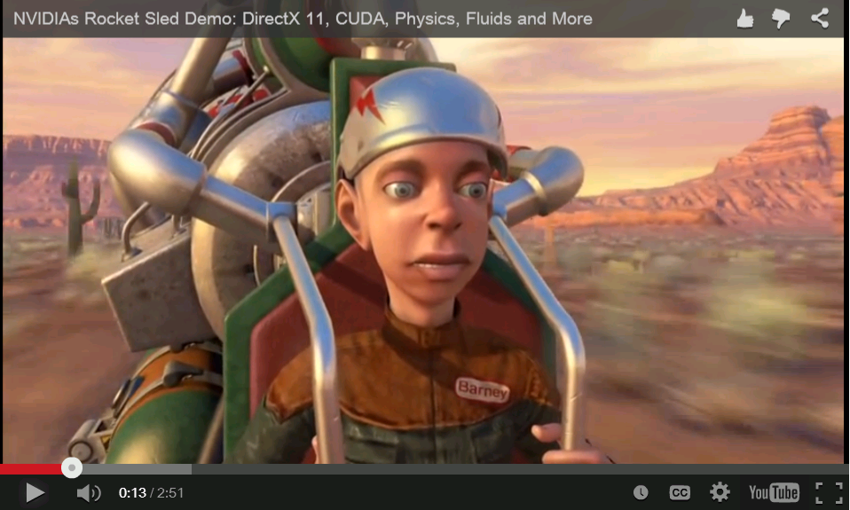
Rocket Sled
CES 2010, Rocket Sled demonstrates both graphics and physics computing capabilities of new GF100 (Fermi) GPUs.

Slide 69
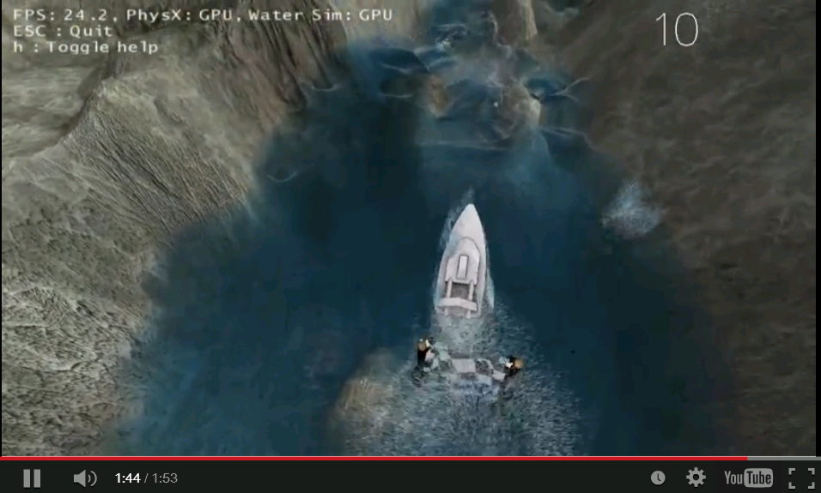
Raging Rapids Ride
Graphics ok, but with intensive and complex real-time fluid simulation

Slide 70
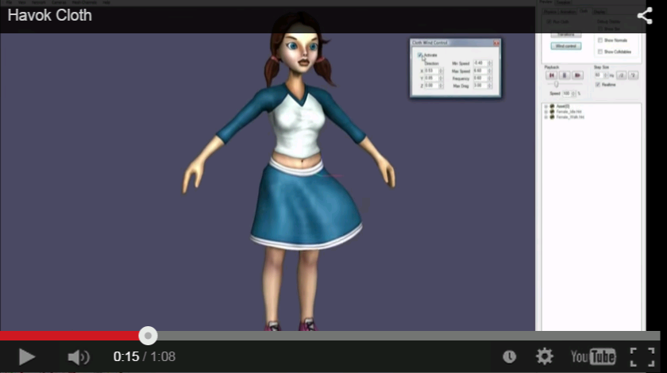
Havok Cloth
PhysX competitor bought by Microsoft

Slide 71

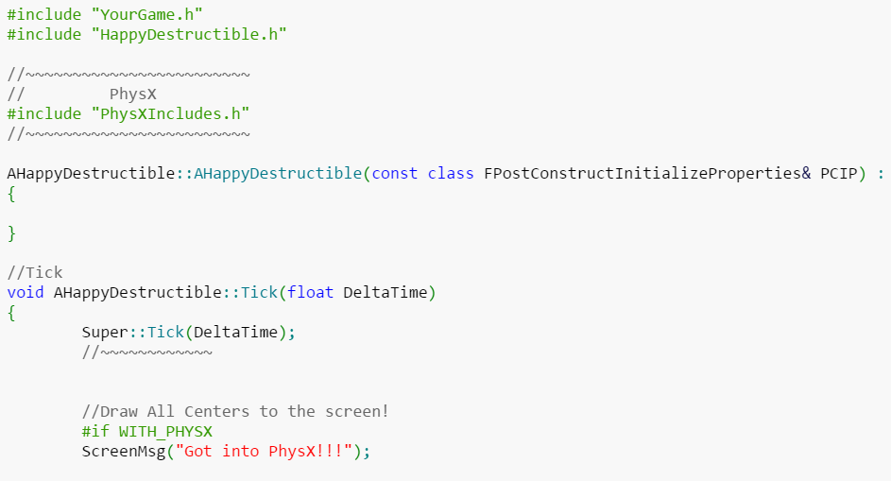
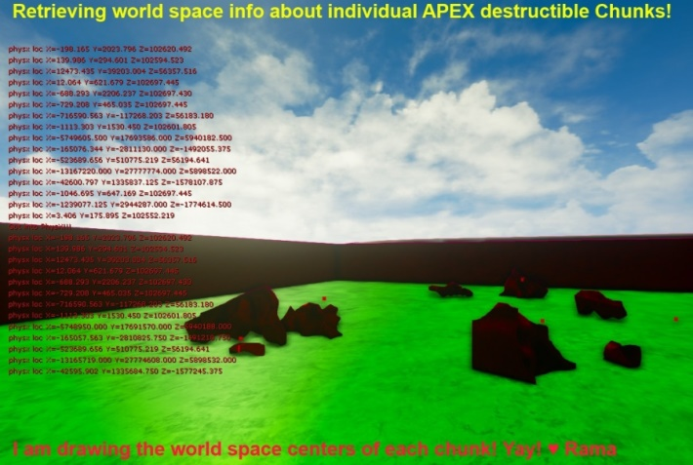
How to Use PhsyX
Binary – Free!
Source code (e.g., to modify), costs
General documentation NVIDIA® PhysX® SDK Documentation
  http://docs.nvidia.com/gameworks/content/gameworkslibrary/physx/guide/Index.html
UE4 guide – PhysX, Integrating PhysX Code into Your Project (by Rama)
  https://wiki.unrealengine.com/PhysX,_Integrating_PhysX_Code_into_Your_Project

