Slide 1
Game Engines
IMGD 4000
Notes:
Original versions of these slides are courtesy professor Charles Rich, IMGD 4000 Technical Game Development II, B-term 2012.

Slide 2
Pedagogical Goal
Your technical skills should not be tied to any particular game engine
Just like your programming skills should not be tied to any particular programming language
Use best tools for each job
... or tools you were given ☺

Slide 3
Game Engine Definition
Game Engine
“A series of modules and interfaces that allows a development team to focus on product game-play content, rather than technical content.”
[Julian Gold, O-O Game Dev.]
But this class is about “the technical content”! ☺

Slide 4
Buy versus Build
Depends on your needs, resources and constraints
Technical needs (e.g., “pushing the envelope”?)
Financial resources (e.g., venture capital?)
Time constraints (e.g., 1 month or 2 years?)
Platform constraints (e.g., Flash?)
Other factors (e.g., sequel?)
Most games commonly built today with some sort of “engine layer”

Slide 5
Why Build?
Need – Technical needs of game not supported by existing engines
Pedagogy – learn specific skill/concept
Control – Provide a better understanding of engine-game interaction when making game
Can extend/adjust engine if needed
Genre – have engine especially fit genre (lightweight, just features required)
Licensing – don’t want to pay out royalty fees
Note, simple cost should not be a reason – there are many excellent cheap/free engines → it will “cost” more to build an engine!

Slide 6
Why Buy?
Financial – don’t have the time/money to build and engine
Support – existing engine has large user community and/or documentation and/or technical support
Robust – existing engine has fewer bugs, tried and true code base
Experience – development team has prior experience with engine

Slide 7
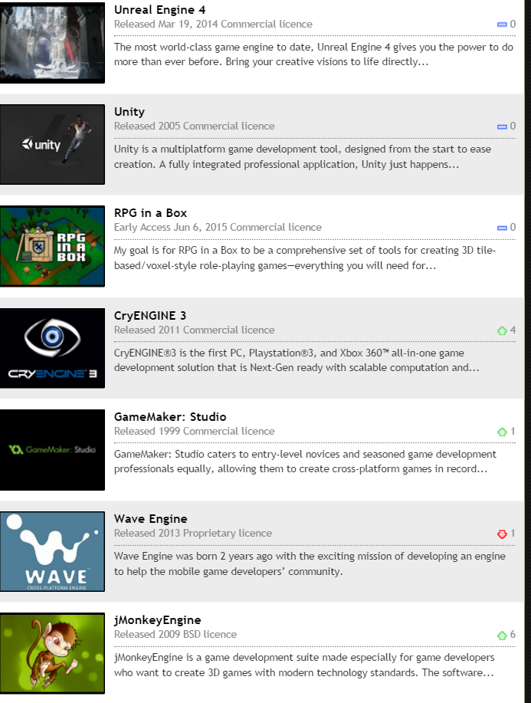
Choices: “It’s a Jungle Out There”
375 3D engines reviewed at DevMaster.net
IndieDB shows 470 engines
Most popular (left)
We are not going to try to review them all here

Slide 8
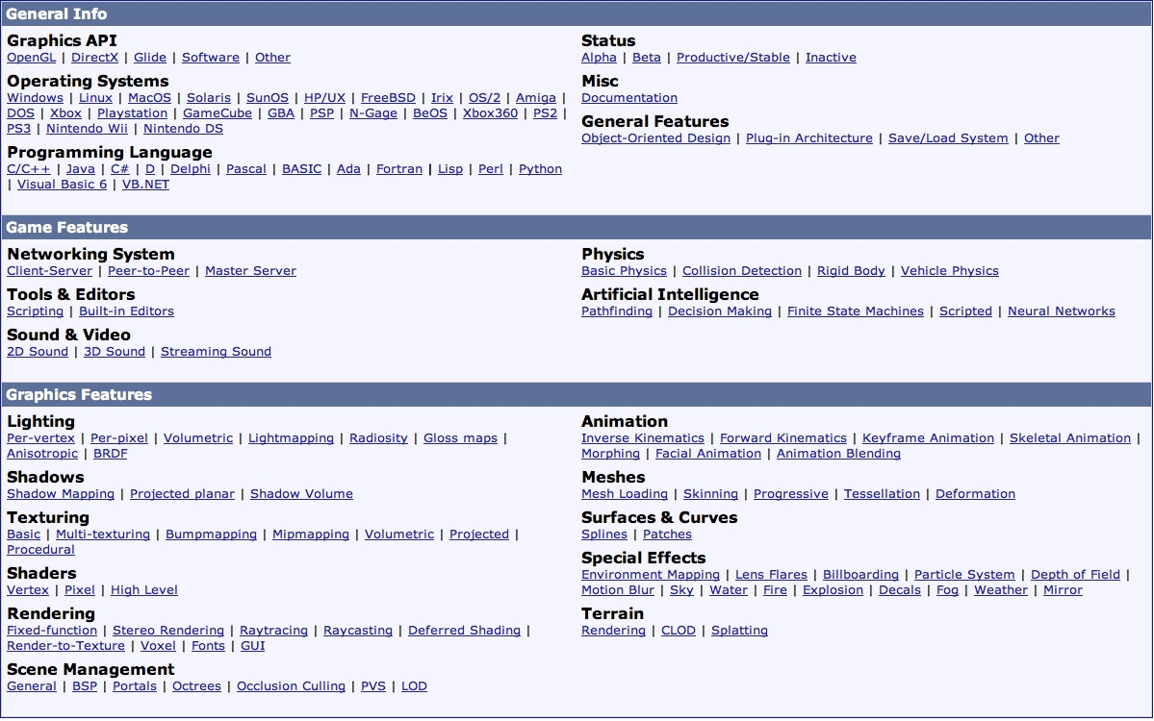
Many Evaluation Dimensions/Features
[ DevMaster.net ]
If there’s a feature term here you don’t know, you should look it up!

Slide 9
Evaluation by Size – Lines of Code
“Measuring software productivity by lines of code is like measuring progress on an airplane by how much it weighs.” - Bill Gates
Dragonfly (2015) 5k
id Tech 1 (1999) 79k
id Tech 2 (2001) 138k
id Tech 3 (2005) 329k
id Tech 4 (2011) 586k
UE4 v4.6 (2015) 1964k
Used cloc
Only counting C, C++ and header files.

Slide 10
Game Engine Architecture
GAME CODE
Saucer: hit()
Hero: kbd()
Star: eventHandler()
GameOver: step()
DRAGONFLY
DrawCharacter
InsertObject
LoadSprite
GetKey
MoveObject
SendEvent
COMPUTER PLATFORM
Allocate memory
Clear display
File open/close
Get keystroke
What are architecture choices for Game Engine layer?

Slide 11
Types of Engine Architectures (Broadly)
Monolithic (e.g., GameMaker)
Modular
Extensible IDE (e.g., Unity, UE4)
Open Class Library (e.g., C4, UE4,
or what Dragonfly would be
when it grows up ☺)

Slide 12
Monolithic Engines
“Old style”- typically grew out of specific game
e.g., ID Tech for first-person shooters
Tend to be genre-specific
e.g., GameMaker for arcade-style games
Difficult to go beyond extensions/modifications not anticipated in API (e.g., scripting)
Proven, comprehensive capabilities
Good for original purpose

Slide 13
Modular Engines
“Modern” – often developed by game engine company (relatively new category)
e.g., Unity
Use object-oriented techniques for greater modularity
Much easier to extend/replace components than for monolithic engines

Slide 14
Modular: Extensible IDE’s
GUI-oriented development process
More accessible for novice/casual programmers
More “art asset friendly”
Comprehensive asset management
Integrated with IDE
Limited (or controlled) exposure of internals
Prevents abuse
But also prevents some extensions

Slide 15
Modular: Open Class Library
Code-oriented development
Carefully layered
Allows maximum modifiability
Often open source
UE4 source available, but not freely distributable
Not as accessible for novices and “casual” programmers

Slide 16
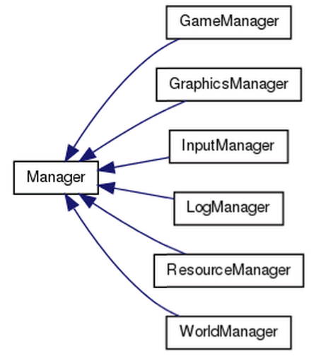
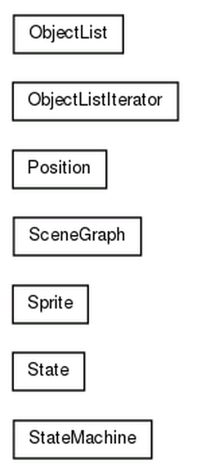
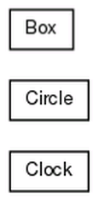
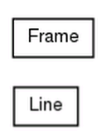
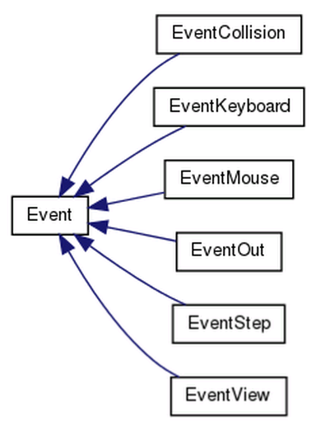
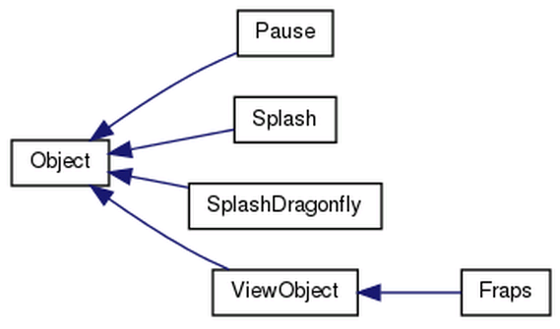
Game Engine Architecture Blocks

Slide 17
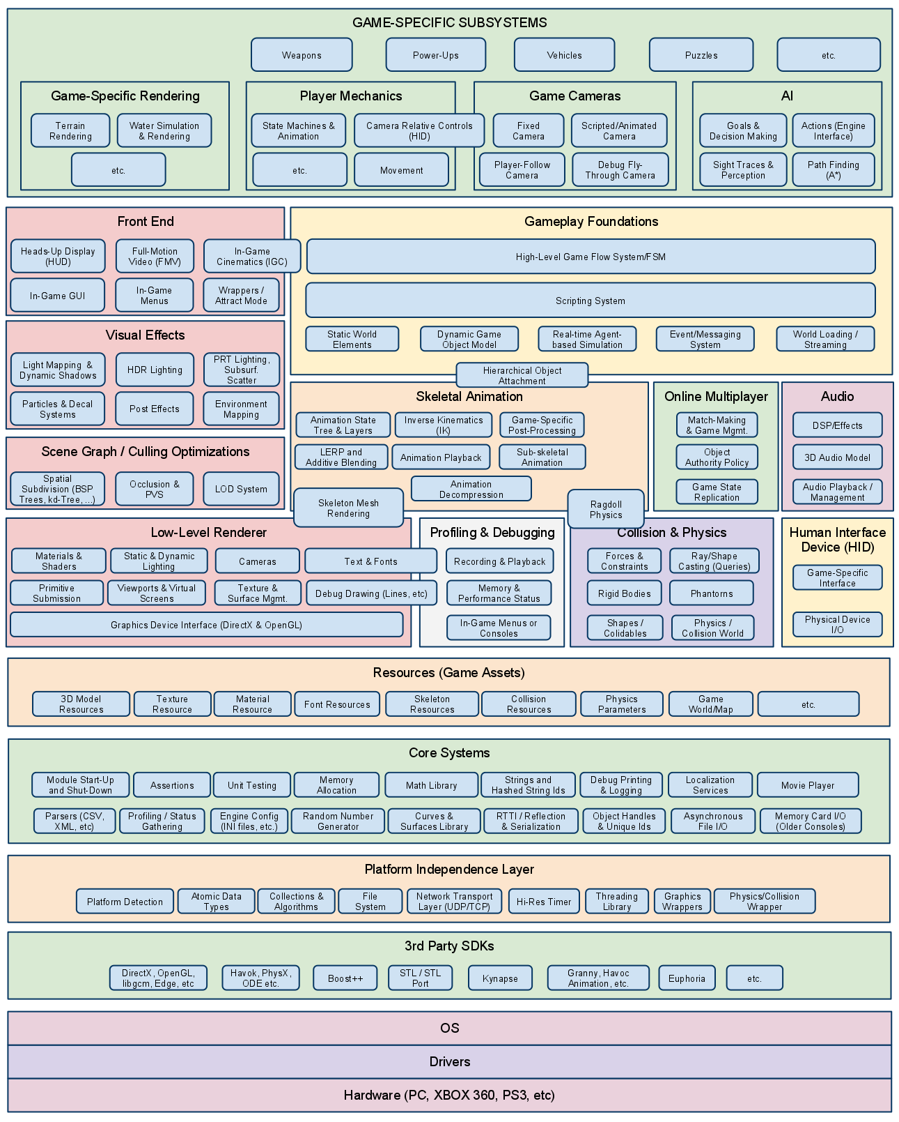
Game Engine Architecture Blocks (complete?)
Game Engine Architecture, by Jason Gregory, 2009, AK Peters, ISBN: 1-5688-1413-5.
Notes:
Game Engine Architecture, by Jason Gregory, 2009, AK Peters, ISBN: 1-5688-1413-5.

Slide 18
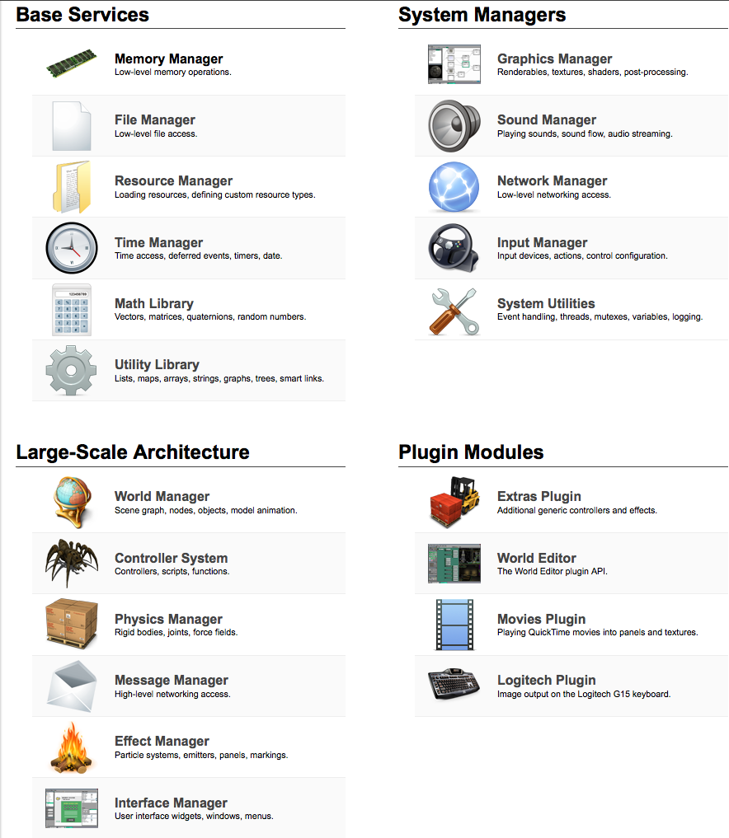
Game Engine Architecture Blocks

Slide 19
Best Engine Choice is Relative to Situation
Similar issues of needs, resources and constraints (as in buy vs. build)
Platform, programming language constraints
Cost constraints (commercial run $ to $$$)
Specific technical features required (e.g., MMO)
Previous experience of staff
Support from developers, user community (e.g., forums)
Pedagogical goals (e.g., this course, or even to teach yourself)

Slide 20
Choice of UE4 for IMGD 4000
Relatively easy (trivial) for artists
C4 tough art pipeline, Dragonfly limited
Comparable to Unity?
Programming in C++
Still “gold standard” for tech game development
Need for IMGD majors to do more, get better
Full support of mature IDE
Microsoft Visual Studio (Windows), Xcode (Mac)
Source code available
Aid in debugging interactions
Future offerings may delve into code

Slide 21
UE4 in Timeline of FPS Game Engines
(Click below to open browser to image for zooming)
http://commons.wikimedia.org/wiki/File:Fpsengine.svg

Slide 22
Feature Comparisons
vs
vs
C4 & Unity from DevMaster.net
UE4 from UE4 Features and other UE4 docs
Caveats:
Not complete - broad view of main features touched upon in IMGD 4000
Info is not audited (e.g., DevMaster.net from enthusiasts, UE4 from my knowledge and Epic docs)
Let’s not get bogged down in the details – the idea is to get overall sense of emphasis

Slide 23
General Features
Object-Oriented Design, Plug-in Architecture, Save/Load System
• Clean class hierarchy for scene graph nodes
• General state serialization support for saving worlds
• Separation between per-instance and shared data
• External scene graph referencing from within another scene graph
• Support for pack files and virtual directory hierarchy
• Skinable GUI's
Object-Oriented Design, Plug-in Architecture, Save/Load System
• Professional FPS controller ready to drop in (and tune)
• Streamed loading for the Unity Web Player
• Unity asset server / asset source code version control
• Cross-platform Web player
• Standalone executables for both Mac OS X and Windows
• Mac OS X Dashboard Widgets
• iPhone Publishing is available as add-on product
• Streaming Asset Bundles: the ability to stream in any asset (terrain, mesh, etc) into the game
Object-Oriented Design, Plug-in Architecture, Save/Load System
• Professional FPS controller ready to drop in (and tune)
• Multiplatform compilation – Windows, Mac, Linux Mobile
• Built-in content and community integration

Slide 24
Physics
Basic Physics, Collision Detection, Rigid Body
• Built-in character controller
• Built-in projectile controller
• Real-time fluid surface simulation
• Real-time cloth simulation
Basic Physics, Collision Detection, Rigid Body, Vehicle Physics
• Powered by the PhysX Engine, which also supports particle physics
• Cloth simulation
Basic Physics, Collision Detection, Rigid Body, Vehicle Physics
• Powered by the PhysX Engine, which also supports particle physics

Slide 25
Scripting
• Graphical script editor
• Scripts are edited graphically for easy artist/designer access
• Games can easily define custom script components, and these automatically appear in the editor
• Controllers can advertise custom function calls that can be accessed from scripts
• Scripts support variables, looping, and conditional execution, all shown in a concise graphical manner
• Uses the Mono and supports JavaScript, C# and Boo, interoperable (to a certain extent) and JIT'ted to native code
• Complete scripting documentation
• Source-level debugging
• Blueprints visual scripting, easier “programming” for artists and designers
• Live debugging of script code before trying out in game
• Extensible scripting → Objects can link with blueprints to be used in script code

Slide 26
Builtin-Editors
• Full-featured integrated cross-platform world editor
• Interface panel editor
• Complete built-in windowing system
• Powerful and intuitive interface design
• Advanced surface attribute manipulation and material management
• Editor provides asset pipeline: save a file and it updates automatically
• Editor Extensibility: Create custom editor windows, and new tools and workflows
• Asset Server that provides version control capabilities for Unity projects
• Optimized for use with large projects
• Updates, commits, and graphical version comparisons inside the Unity editor.
• World editor
• Version control integration – indicates objects that are checked in, out. Can do diffs, etc. within editor

Slide 27
Graphics
Lighting: Per-vertex, Per-pixel, Lightmapping, Radiosity, Gloss maps, Anisotropic:
Texturing: Basic, Multi-texturing, Bumpmapping, Mipmapping, Projected
Shaders: Vertex, Pixel, High Level:
Shadows: Shadow Mapping, Projected planar, Shadow Volume
…
Lighting: Per-vertex, Per-pixel, Lightmapping
Texturing: Basic, Bumpmapping, Procedural
Shaders: Vertex, Pixel, High Level
Shadows: Projected planar
…
Lighting: Lightmapping, Per-pixel,
Texturing: Basic, Bumpmapping
Shaders:
Shadows:
…

Slide 28
Networking
Client-Server:
• Fast, reliable network implementation using UDP/IP
• Solid fault tolerance and hacker resistance
• Advanced security measures, including packet encryption
• Automatic message distribution to entity controllers
• Cross-platform internet voice chat
Client-Server:
• Build on Raknet
• Supports .NET library and asynchronous WWW API
• Multiplayer networking (advanced NAT punch-through, delta compression, easy to set up)
(cf. guest lectures later in term)
Client-Server:
Communication via RPC
Reliable and unreliable
Built in voice support
Network simulation features (e.g., packet lag, packet loss)

Slide 29
AI
AI system?
AI system:
• Real-time navmesh (pathfinding)
AI system:
Behavior trees
Real-time navmesh (pathfinding)
Environment query tree

