Slide 1
Project 2
Dragonfly

Slide 2
Overview
Goal is to build your own Dragonfly
2D (text-based graphics) game engine
Objectives
Learn how game engine works from ground up
Provide in-depth understanding of your engine to enable development of your game (Project 3)
Become better programmer

Slide 3
Dragonfly Parts (1 of 2)
A: Dragonfly Egg: September 15th, 11:59pm
B: Dragonfly Naiad: September 22nd, 11:59pm
C: Dragonfly: September 30th (was 29th). 11:59pm
All build towards fully working, full-featured game engine
Part A is foundational
Part B is fully functional
Part C is full featured

Slide 4
Dragonfly Parts (2 of 2)
Completing through Part B will enable Project 3
Earn a “B” grade for Project 2
Completing through Part C will enable additional game engine features (e.g. animated sprites)
Potential for “A” grade for Project 2
Important! Tested, trusted robust code that implements A and B much better than buggy, unreliable code that attempts part C
Work alone (Project 3 in teams)
Can collaborate for debugging, discussion but all coding done separately (do not send/swap code!)

Slide 5
Part A – Dragonfly Egg
Start and stop gracefully
Log messages to file
Adding and removing of game objects
Objects have 2d game world positions
Running a game loop with:
A fixed rate (e.g., 30 Hz)
Updates sent to all objects each tick
Note! No visual depiction needed for Part A!
→ Output to screen or, better, logfile via LogManager

Slide 6
Part A Classes
LogManager
singleton
startup and shutdown
flexible means of data entry (integers, strings, ...)
Clock
milliseconds of resolution for timing
Position
(x,y) location
GameManger
singleton
startup and shutdown
game loop
Event
getting/setting type
Object
position
event handler
ObjectList
store 1+ Objects
add, remove Object
ObjectListIterator
iterate through ObjectList
WorldManager
singleton
store all game programmer game objects
add, remove game objects
can send an event to all game objects
(Note, not necessarily in order of implementation!)

Slide 7
Part A – Grading
LogManager 20%
Clock 10%
Position 5%
GameManager 10%
(Game) Object 10%
ObjectList 10%
Iterator 10%
Manager 5%
WorldManager 15%
Event 5%
Test code and documentation! Up to 20% off.

Slide 8
Part B – Dragonfly Naiad
Output
Support 2d (ascii) characters
Clean refresh each game loop
Support color
Support "velocity" for game objects with automatic updates
Input
Accept non-blocking keyboard and mouse input
Collisions
Detect between solid Objects (note, need "solid" attribute for game objects)
Send event to both Objects
Misc
Provide "altitude" attribute for game objects for layered drawing
Send "out of bounds" event when Objects off screen

Slide 9
Part B – Classes
Manager (base class)
Send events to all Objects (onEvent)
GameManager
Modify game loop
Get input (InputManager)
Have objects draw themselves (WorldManager)
Refresh screen (GraphicsManager)
GraphicsManager
Singleton
Startup and shutdown
Draw character at (x,y) with/without color
Detect and store horiz and vert screen size
SwapBuffers to refresh display to latest world
InputManager
Singleton
Startup and shutdown
Support keyboard and mouse input
EventKeyboard
Getting/setting type
Getting/setting key pressed
WorldManager
Support boundary limits (equal to screen limits)
Detect collisions (sending events to both)
Move objects
If out of bounds, provide event
If solid, provide collisions (detection and events)
Modify update to support velocities
Draw method, where all objects draw themselves
Altitude , where lowest objects drawn first
Object
Solidness
Altitude
Getting/setting x-velocity, y-velocity
EventOut
Getting/setting type
EventCollision
Getting/setting type
Getting/setting both objects in collision
Getting/setting collision position
EventMouse
Getting/setting type
Getting/setting mouse action (button)
Getting/setting (x,y) location on screen
(Note, not necessarily in order of implementation!)

Slide 10
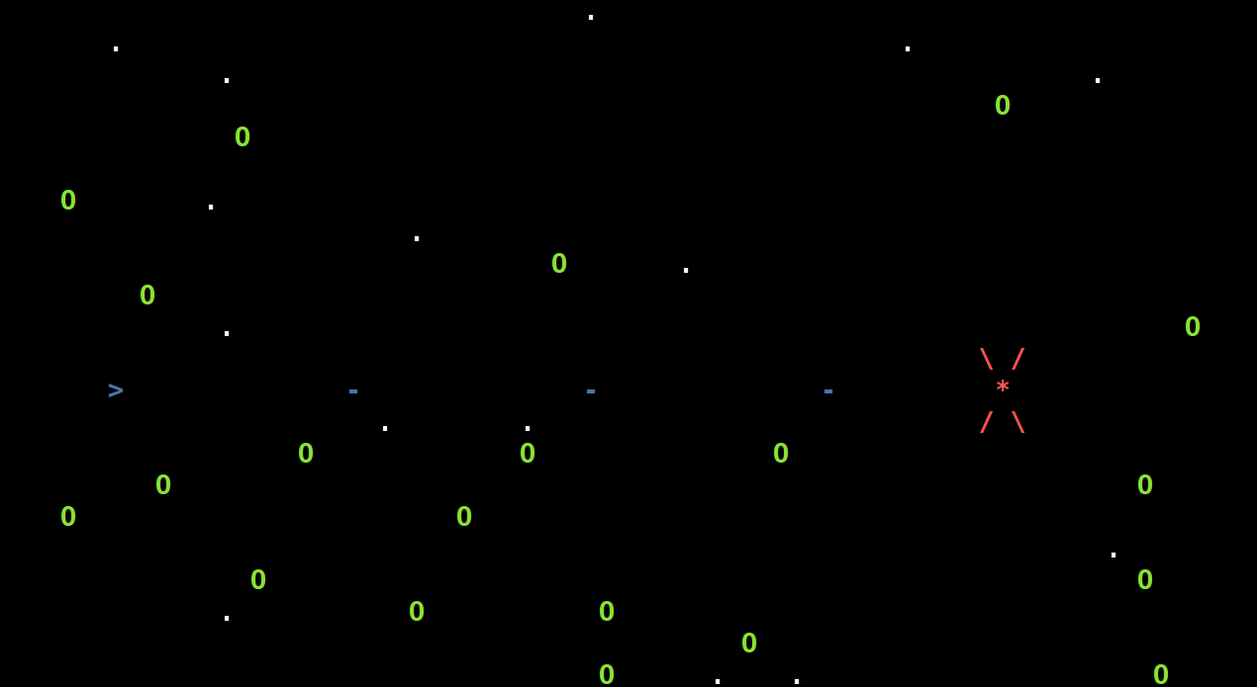
Test with Saucer Shoot Naiad!
No sprites → mostly single character only
No ViewObjects → no GameStart, No Points or Nuke Display
No registering for events (all objects get all events)
Available on Project 2b Web page

Slide 11
Part B – Grading
Manager 5%
GameManager 10%
GraphicsManager 20%
InputManager 20%
WorldManager 20%
Object and Events 10%
Testing and documentation 20%

Slide 12
Part C - Dragonfly
Sprites
Provide multi-character frame
Associate 1+ frames with Object
Play frames in sequence to achieve animation, with animation scene
Resource Management
Read sprite data from file
Bounding boxes
Game objects larger than single character (movement and collisions)
Bounding box associated with Sprite
Camera control
Game world larger than screen (viewport)
View port movement around game world
Event filtering
Objects indicate interest in events
Managers only accept registration for valid events
View Objects
Support “display” objects that don’t interact with game world objects
Misc
Random number seeding
No longer part of 2c!

Slide 13
Part C – Classes
No longer part of 2c!
ResourceManager
Singleton
Startup and shutdown
Load Sprites from file
Find Sprites with given labels
Sprite
Width, height
Label
Color
Frame count and frame
Frame
Width, height
Data
Box
Corner, position
EventView
Tag, value, delta
Manager
Register/unregister interest
Object
Support Sprites
Centered
Animation rate (slowdown)
Gettting/setting bounding box
Centered based on Sprite
Register/unregister interest
ViewObjects
Getting/setting location
Getting/setting border, color and display string
EventHandler
WorldManager
Modify collision detection for box intersection
Add camera (viewport) control
Get/set view
Translate world (x,y) to view (x,y)

Slide 14
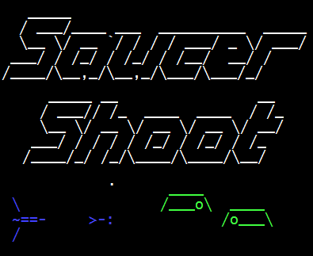
Test with Saucer Shoot (v9)!
Core gameplay (no “GameStart”)
Version 9 available on Dragonfly Web page → Tutorial

Slide 15
Part C - Grading
Sprite animation 25%
Box collisions 25%
Resource manager 20%
Interest management
View objects and events 20%
Random numbers 5%
Docs, ease of running, grading 5%
No longer part of 2c!
Test code and documentation! Up to 20% off.

Slide 16
Development Option
Rationale: a solid, working Dragonfly core better than buggy, unreliable (hence unusable) Dragonfly with some 2c features
Instead of Project 2c, can fix and re-submit 2a or 2b
Cannot resubmit and turnin Project 2c
New grade will replace old grade
If doing this option:
Use “proj2c” for turnin
Indicate in README that resubmission and for which project
For planning, Project 2a and Project 2b combined are 85% of your Project 2 grade

Slide 17
Development
Must be C++
Can be Linux, Windows (Cygwin), or Mac
Certain to support curses (project 2b, project 2c)
Consider Eclipse or Visual Studio if want IDE
Where?
FL222, FLA21 → Cygwin, 64-bit
CCC → login to ccc.wpi.edu, Linux 64-bit
Or, setup your own environment (e.g., Eclipse or Visual Studio)
Must have curses support
TA needs to grade
If in doubt about your platform, ask!

Slide 18
Resources
Book
Slides
Header files
Code listings
Question-answer forum
Documentation

Slide 19
Hand In (1 of 2)
Source code package
All code necessary to build your game (well-structured, commented)
Any other support files, including .h files.
A Makefile or project for building your utilities.
Test/game program(s)
“Use” game engine from game code, illustrating functionality
Should be accompanied by what to see in log files
README file explaining:
Platform
Files
Code structure
How to compile
Anything else needed to understand (and grade) your game

Slide 20
Hand In (2 of 2)
When ready, upload (WinSCP) to CCC machine
mkdir lastname-proj2a
cp * lastname-proj2a
tar czvf proj2a-lastname.tgz lastname-proj2a
Submit your assignment (proj2a-lastname.tgz):
/cs/bin/turnin submit imgd3000 proj2a proj2a-lastname.tgz
Verify
/cs/bin/turnin verify imgd3000 proj2a
Help at
http://www.cs.wpi.edu/Resources/turnin.html
Due at midnight (11:59pm)
(Modify for 2b, 2c)

