Slide 1
U-Pick Game Analytics
Project 4
IMGD 2905

Slide 2

Overview
Analytics on game of your choosing!
Pick game
Determine pipeline
Plan analysis (charts)
Propose
Do it!
Write it up
Present
Solo or group of two

Slide 3
Compnents
Part 1 - Proposal
Part 2 - Project
Hints
Writeup
Submission
Presentation
Grading

Slide 4




Proposal
Due Monday!
Written, turned in online
“Look before you leap” – investigate game, and game data, before using
Allow for feedback – adjust scope and content
http://www.multifacet-software.com/assets/images/projectproposal.jpg
?
http://bridgepartnersconsulting.com/_ui/img/insights/Look-Before-Leap_Hero-Image.jpg

Slide 5

Proposal – Heading
Project title (creativity welcome)
Student name(s)
  Solo
  Group of two, max
http://inspectorgrapes.com/uploads/3/4/9/8/34985878/2000897_orig.png

Slide 6








Proposal – Game Overview
Previous Game
New Game
(Note, must do all new analysis!)
Brief description of game and gameplay
  As relates to analysis

Slide 7

Proposal – Pipeline
Game
Raw Data
Extracted Data
Analysis
Brief description of pipeline
  New scripts/tools needed
    Note, do not have to use Python!
  Playtesting needed (as appropriate)
  Data available for analysis
    Details on exact fields (e.g., game duration)
    Details on format (e.g., json)

Slide 8
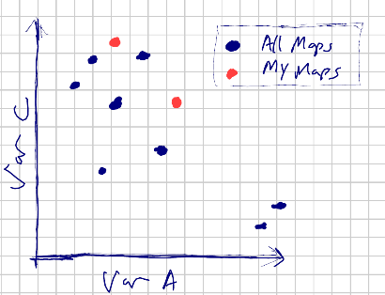
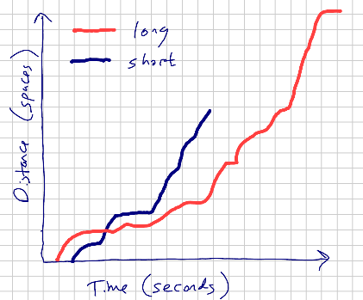
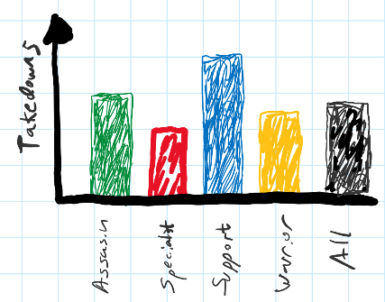
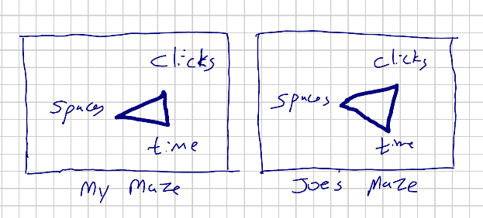
Proposal – Charts
Hand drawn
Show intended visual analysis
Labeled axes
  No numbers, units
Clearly depict trends/relationships
Examples
Minimum 3 charts
Minimum 3 different kinds
Tables where appropriate
Important for planning
Drives methodology, data wrangling

Slide 9
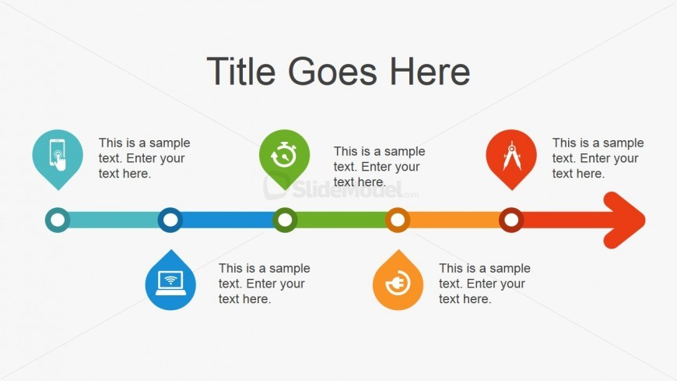
Proposal – Timeline
Major tasks
Team? → Particularly important to coordinate
Breakdown day by day
Timeline for Awesome Project
Wrangle Game Data
Analyze Score
Second Draft Done
Analyze Duration
First Draft Done

Slide 10

Proposal – Grading Guide
Points to be allocated
Based on amount of effort, relevance to class
  e.g., game setup, data pipeline, analysis of players
Emphasis must prioritize final analysis
  Some leeway
Note, entire contributions in final report
Submit final guide with report
  Revised to reflect actual
http://www.dentonisd.org/cms/lib/TX21000245/Centricity/Domain/8618/grades2.jpg
See examples:
Project 1
Project 2
Project 3

Slide 11

Proposal – Notes
“Size” about same as previous projects
  (i.e., plan on about 10-12 hours per person total, including proposal)
Unlike previous, you “figure out” analytics pipeline
  Suggests slightly less analysis (i.e., fewer charts)
  Unless LoL, Mazetool, Hearthstone or Pig, since known pipeline
Group project about 1/3rd “bigger” than solo project
Proposal text about 1-2 pages at most
  But doc longer with charts and screen shots
https://goo.gl/efReCu

Slide 12



Hints
Many possible suitable games
  Can run ideas by me (after class, office hours or via email) before
  Access to data is key
Remember, new game takes more time
  Data available (e.g., score? duration?)
  Format of data (e.g., json? log files?)
  Scripts needed?
Your own game ok
  But emphasis must be analytics
  Not developing game
  Not instrumenting game
Playing game to gather data cannot be a major task
http://blueclay.com.au/wp-content/uploads/2013/10/hints-and-tips-2.jpg

Slide 13

Writeup
Write report on analysis
Describe game (brief)
Describe methodology
Organize analysis results
Provide grading guide
Can re-use proposal, as appropriate
All guidelines for previous projects (writing, charts, statistics) hold!
http://ec.europa.eu/environment/waste/reporting/images/173649127.jpg

Slide 14


Presentation (in class)
(After report done)
Visual aids (slides)
  2-3 total
Intro
  High concept of game
  Describe where got data (brief)
One result
  Chart (maybe table)
  Describe axes, then data, then message
Rehearse!
  Script what to say (team)
Bring laptop/test on podium ahead of time!
  Don’t try out for first time with audience!
Total time 4 minutes
  Plan accordingly
Practice! Many times → content, timing and transitions down

Slide 15
Presentation Schedule
Tuesday
Wednesday
Daniel Blatner
Zack Pitts
Zaeli Goodman
Ethan Carter
Crow Zubrick
Patrick Hussey
Ethan Wright
Kris Ferreira
Morgan Acevedo
Casey Wohlers
Jack Sheeran
Jacob Major
Brenden Lee
Avi Pal
Jimmy Zhang

Slide 16
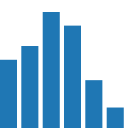
Grading
Part 1 – Proposal 20%
Part 2 – Report 70%
  Broken down by your grading guide
  Must have 3 charts minimum, 3 different types
    Can (and probably should) have more
  Appropriate statistics (e.g., measures of spread)
  Clear and concise textual descriptions
Part 3– Presentation 10%
  Chart + presentation

Slide 17
Rubric
100-90. The submission clearly exceeds requirements. All parts of the project have been thoroughly completed. The proposal and report are clearly organized and well-written, charts and tables are clearly labeled and described and messages provided about each part of the analysis.
89-80. The submission meets requirements. All parts of the project have been completed or nearly completed. The proposal and report are organized and well-written, charts and tables are clearly labeled and described and messages provided about each part of the analysis.
79-70. The submission barely meets requirements. Most parts of the project are completed or nearly completed, but some may be missing. The proposal and report are somewhat disorganized or not well-written. Charts and tables are clearly labeled, but there may be issues with the description and messages provided about each part of the analysis.
69-60. The project fails to meet requirements in some places. Not all parts of the project are completed. The proposal and report are disorganized and not well-written. Charts and tables are not clear nor up to standards described in class. Messages are not always provided for the analysis.
59-0. The project does not meet requirements. Many parts of the project are not completed. The proposal and report are disorganized and poorly written. Charts and tables are not clear nor up to standards described in class. Messages are generally not provided for the analysis.

