Slide 1
Hearthstone Analytics
Project 3
IMGD 2905

Slide 2
Overview
Use game analytics pipeline
Apply to Blizzard’s Hearthstone
Pipeline:
Unlike previous “prescriptive” projects, use your growing analytics skills for targeted exploration
Track-o-Bot

Slide 3
Hearthstone – Overview
Free-to-play, online card game
Two-players, turn-based
Select Hero (custom ability)
Standard deck of 30 cards
But can customize
Goal: reduce opponent health to 0
Winning earns gold, can buy new cards

Slide 4
Hearthstone – Trailer
https://www.youtube.com/watch?v=QdXl3QtutQI

Slide 5
Parts
Part 0 – Learn Hearthstone, Prepare Pipeline
Part 1 – The Coin
Part 2 – Heroes
Part 3 – Play rate
Part 4 – Choice
Hints
Writeup and Submission
Grading

Slide 6
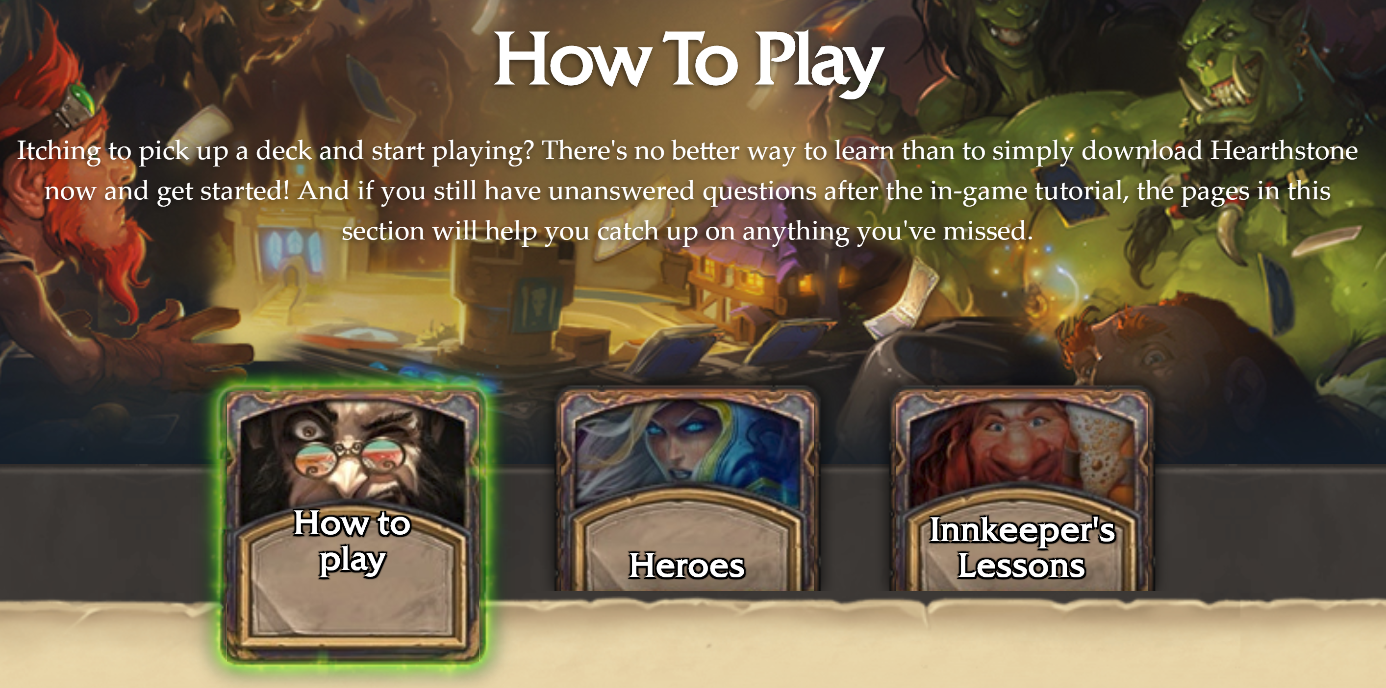
Hearthstone – Steps
Download and Install
Play and/or Read Guides
https://playhearthstone.com/en-us/game-guide

Slide 7
Hearthstone – Data
Track-o-Bot
Runs along with Hearthstone
Records data, uploads to site
Data privacy/transparency
Collect-o-Bot
Collection of Track-o-Bot games
One file per day, aggregated at end of month
One month files, from June 2016 – July 2017
Format is JSON (next slide)
Track-o-Bot

Slide 8
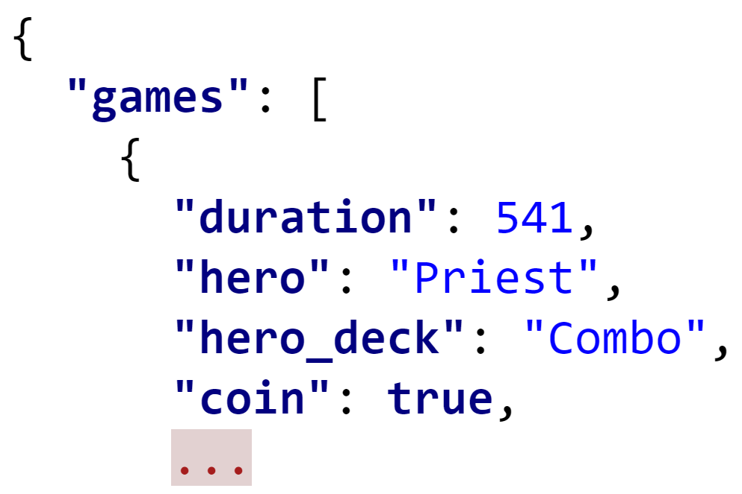
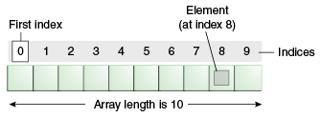
JavaScript Object Notation
Open-standard format
Encapsulate object (e.g., game, hand, player)
Human-readable text
Attribute-value pairs, built-in list
Outer is “games”
Array/List
game[0] is first game
https://www.javatpoint.com/images/core/array.gif

Slide 9
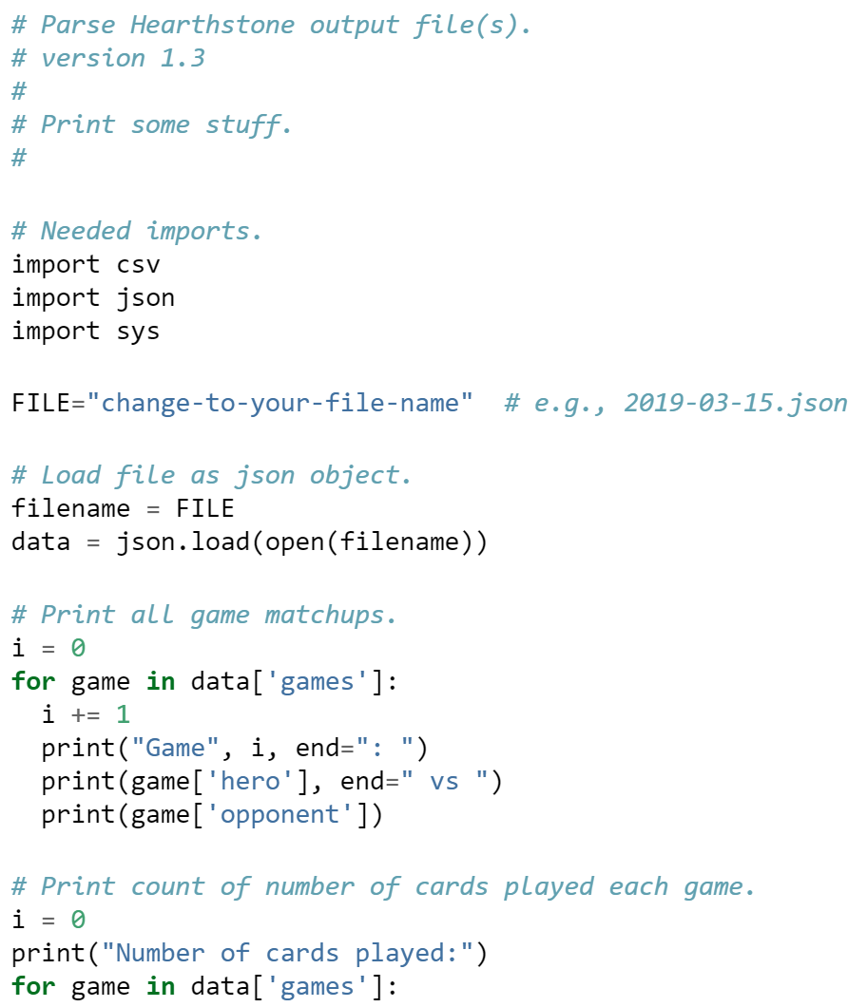
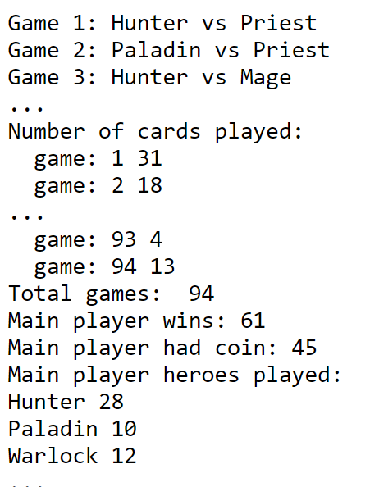
Parse
Script
Python script to show basics
Load “dictionary” from JSON
Key – Value pair

Slide 10
Analysis
Part 1 – The Coin
Part 2 – Heroes
Part 3 – Play rate
Part 4 – Choice

Slide 11
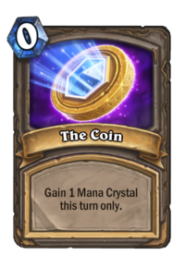
Part 1 – the Coin
Player that goes first may have advantage
e.g., White in Chess gets +5%
Player goes second gets “The Coin” – extra 1 mana for 1 turn only
Exploration:
Which player wins most often, first or second?

Slide 12
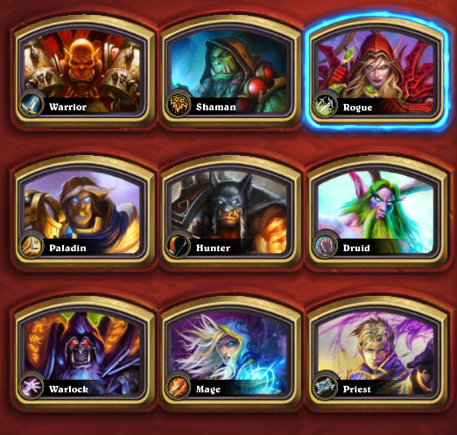
Part 2 – Heroes
Exploration:
How many different Heroes are used?
What is popularity of each Hero?
How often does each Hero win?
Methods (wrangling, analysis, charts, tables) up to you
Suggestion:
Think of Chart or Table to draw
Work backwards from there

Slide 13
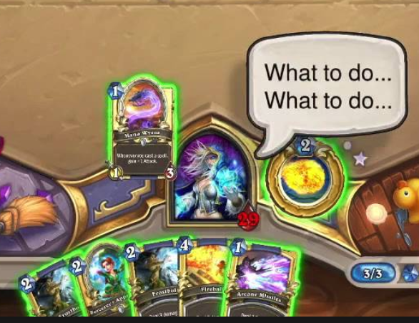
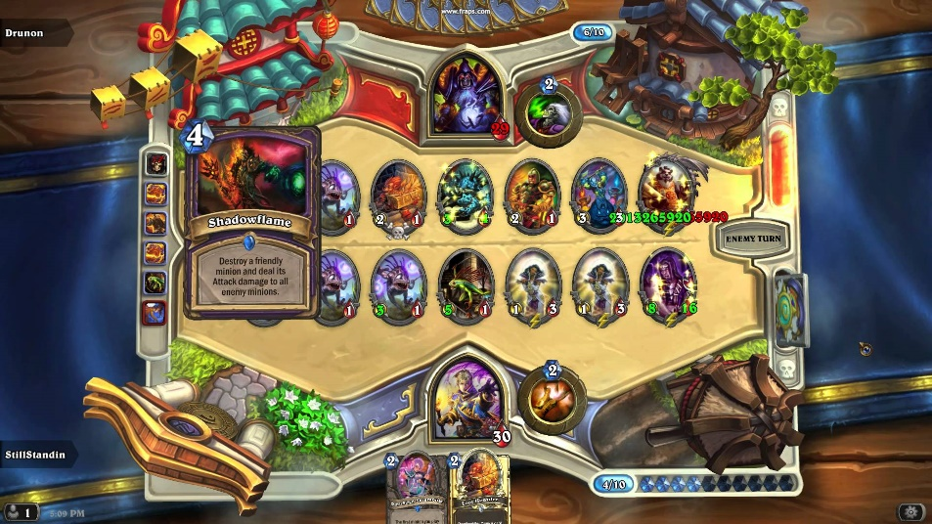
Part 3 – Play Rate
Exploration:
How long are Hearthstone games?
How many cards are played?
So, what is the rate of play?
Methods (wrangling, analysis, charts, tables) up to you
Hint:
Rate is cards / time
Some durations may be null (ignore but report)

Slide 14
Part 4 – Choice
Exploration:
Hearthstone exploration you would like to do
Consider gameplay itself, data, and possible use
Some options:
Changes to game statistics (e.g., Hero popularity) over time (e.g., more than one month).
In-depth analysis of cards (e.g., games with more than one Coin)
Analysis of rank in relation to win-rate, considering game mode
Data fields that may be of interest
hero_deck
opponent_deck
mode
rank
user_hash
Hint:
Not trivial
But also consider your abilities with Python

Slide 15
Hints
Copy parse.py to new notebook. Remove parts that are not needed.
Work with single game, then day of games (pending), then month
Web page has other sample python code
Parsing Hearthstone data file
“Pretty-print” JSON file (for exploration)
Some code snippets for Part 4
Remember to also use summary statistics
Measures of central tendency
Measures of spread
Pay attention to Project 1 (and 2) comments

Slide 16
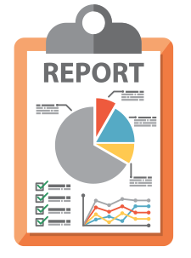
Writeup
Short report
Appropriate descriptions for your data set, pipeline and methodology
For each part, brief section on analysis
Charts, tables, summary statistics
All guidelines for presenting and describing charts should be adhered to!
https://cdn.donorperfect.com/images/archive/reporting-analytics_60.png

Slide 17
Grading
Part 1 (The Coin) 25%
Part 2 (Heroes) 25%
Part 3 (Play Rate) 25%
Part 4 (Choice) 25%
Not necessarily equal effort
All visible in report!

Slide 18
Rubric
100-90. The submission clearly exceeds requirements. All Parts of the project have been completed or nearly completed. The report is clearly organized and well-written, charts and tables are clearly labeled and described, measures of central tendency and spread properly computed and explained, and messages provided about each Part of the analysis.
89-80. The submission meets requirements. Parts 1-3 of the project have been completed or nearly completed, but perhaps not Part 4. The report is organized and well-written, charts and tables are labeled and described, measures of central tendency and spread computed and explained, and messages provided about most of the analysis.
79-70. The submission barely meets requirements. Parts 1-2 of the project have been completed or nearly completed, and some of Part 3, but not Part 4. The report is semi-organized and semi-well-written, charts and tables are somewhat labeled and described, but parts may be missing. Measures of central tendency and spread may not be always computed or explained. Messages are not always clearly provided for the analysis.
69-60. The project fails to meet requirements in some places. Part 1 of the project has been completed or nearly completed, and some of Part 2, but not Parts 3 or 4. The report is not well-organized nor well-written, charts and tables are not labeled or may be missing. Measures of central tendency and spread may not be always computed or explained or may even be misused. Messages are not always provided for the analysis.
59-0. The project does not meet requirements. Besides Part 0, and maybe Part 1, no other part of the project has been completed. The report is not well-organized nor well-written, charts and tables are not labeled and/or are missing. Measures of central tendency and spread are missing of, if in place, are misused. Messages are not consistently provided for the analysis.

