Slide 1
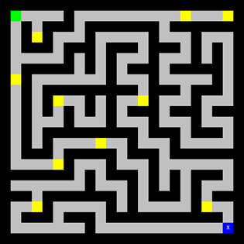
Mazetool
Analytics
Postmortem
Project 2
IMGD 2905

Slide 2
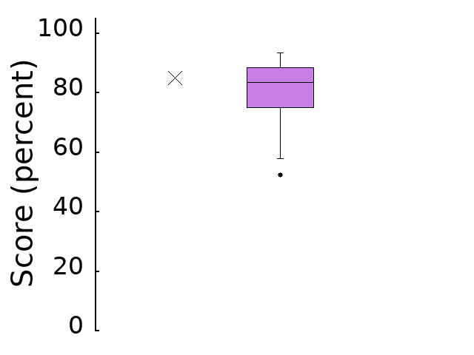
Scores
n: 15
min: 52.5
mean: 79.6
std dev: 12.1
max: 93.5

Slide 3
General Comments
Better!
Provide details on data
  Number of participants/runs for your maze, number of total runs, maybe even students in the class
  → context matters!
Double-down, make sure solid on fundamentals of drawing and presenting charts
  Minimize “ink”, maximize information
  Label axes, provide units, clear message
  Figure numbers and captions, refer to in text
  Describe axes + data before message

Slide 4
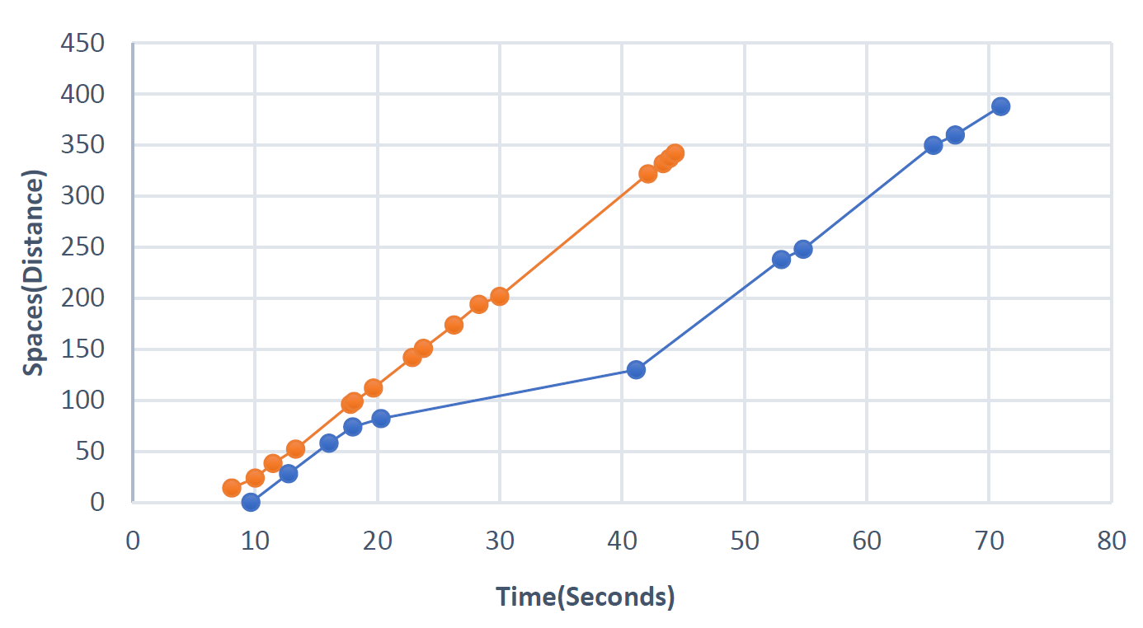
Part 1 – Maze Running
What is happening during these flat parts?
Time versus clicks?

Slide 5
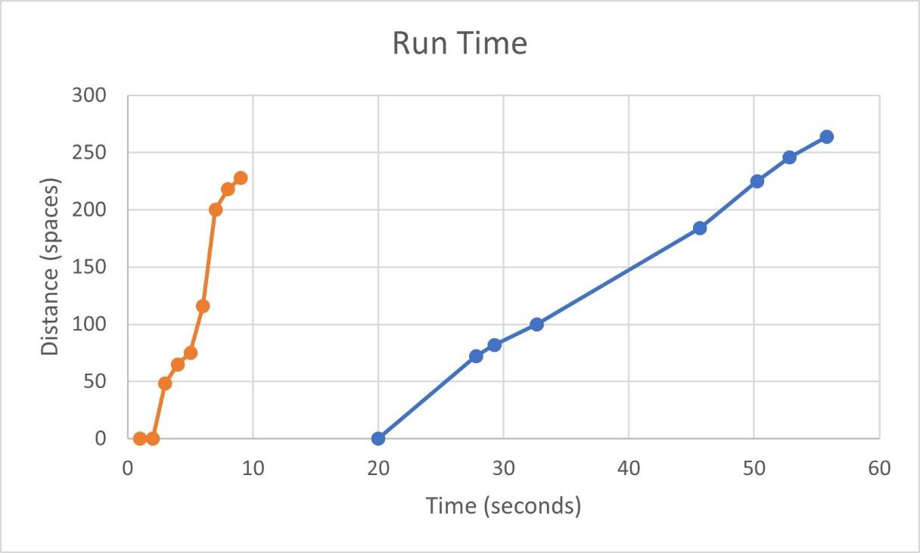
Part 1 – Maze Running
What about beginning?

Slide 6
Part 2 – Beware of Outliers!
What is this person doing?

Slide 7
Part 2 – Outlier Removed
Scale CDF to max (100)
Units not fraction?
“Cumulative Distribution (percent)”

Slide 8
Part 3 – Comparing Radar Charts
Remember to tell how axes are normalized in text!

Slide 9
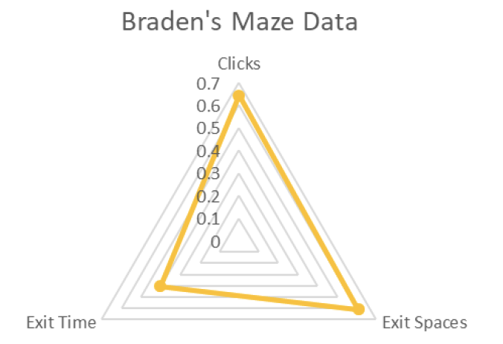
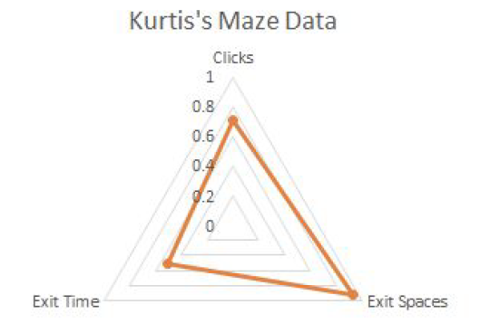
Part 3 – Comparing Radar Charts
Radar charts best when can compare one one page
Person B
Person A

Slide 10
Part 4 – Choice
Box-and-Whiskers to compare distributions
(compare to histograms)

Slide 11
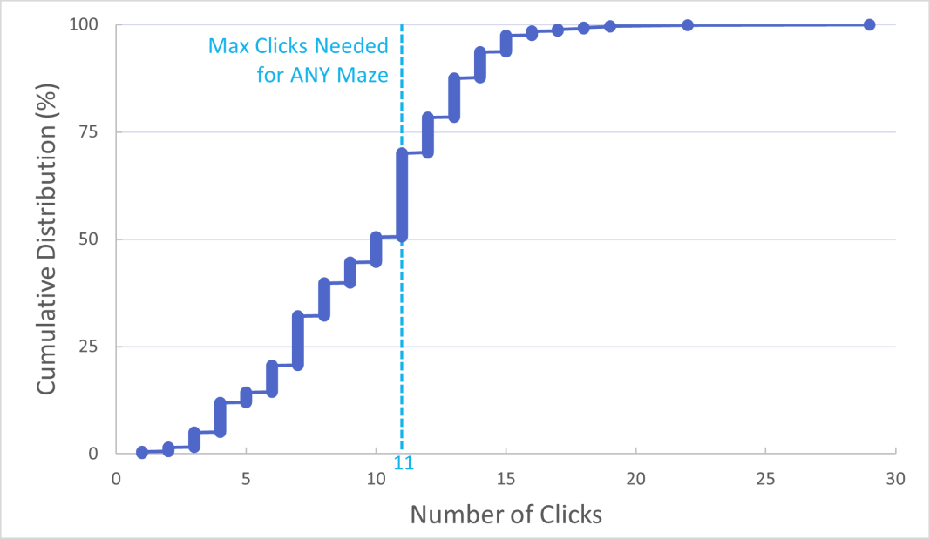
Part 4 – Choice

Slide 12
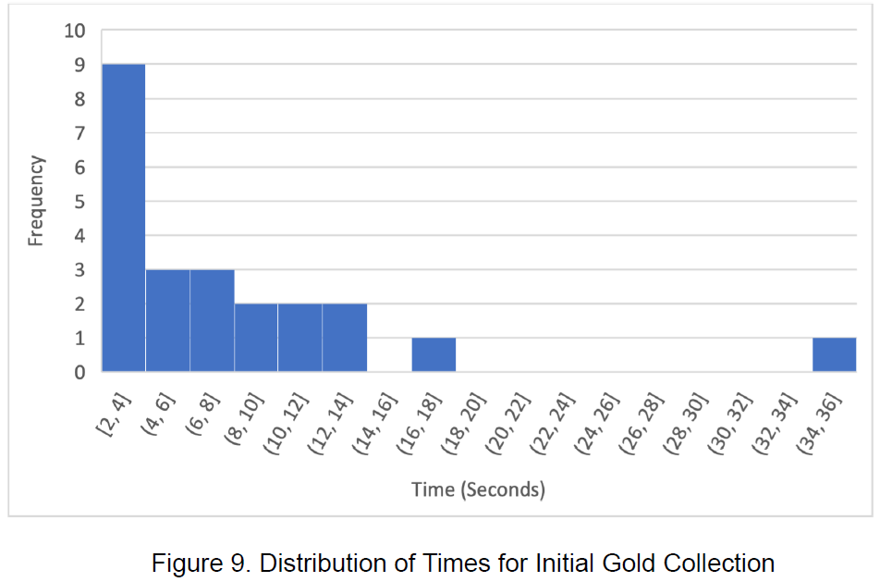
Part 4 – Choice

Slide 13

Next Steps
Read over comments on your report
  Ask if you have questions
Incorporate general and specific tips into next project!
  Re-review before turning in Project 3
Keep up the good work!
https://i0.wp.com/www.johnhardingestates.co.uk/wp-content/uploads/2018/02/John-Harding-Estates-Hints-and-Tips.png?fit=600%2C419

