Slide 1
PlayerUnknown’s Battlegrounds (PUBG) Analytics
Project 1
IMGD 2905

Slide 2
Overview
Set up tools for part of game analytics pipeline
Apply to PUBG
Pipeline:
Basic analysis this project, but repeat (reinforcement) and do more for later projects
E.g., front end involves some scripting in Python
Goal of this (and most) projects → time with tools

Slide 3
Parts
Part 0 - Learn PUBG, Prepare Analysis Setup
Part 1 - Fight or Flight Analysis
Part 2 - Game Time Analysis
Part 3 - Team Size
Part 4 - Your Choice Analysis
Writeup
(Submission and Grading)
https://animalcare.umich.edu/sites/default/files/acu-generic-checklist-icon.png

Slide 4
Part 0 – Learn PUBG, Prepare Setup
Named “part 0” since don’t write up → but foundational for rest of projects!
Learn PUBG
Install Spreadsheet
Download dataset
Analyze

Slide 5
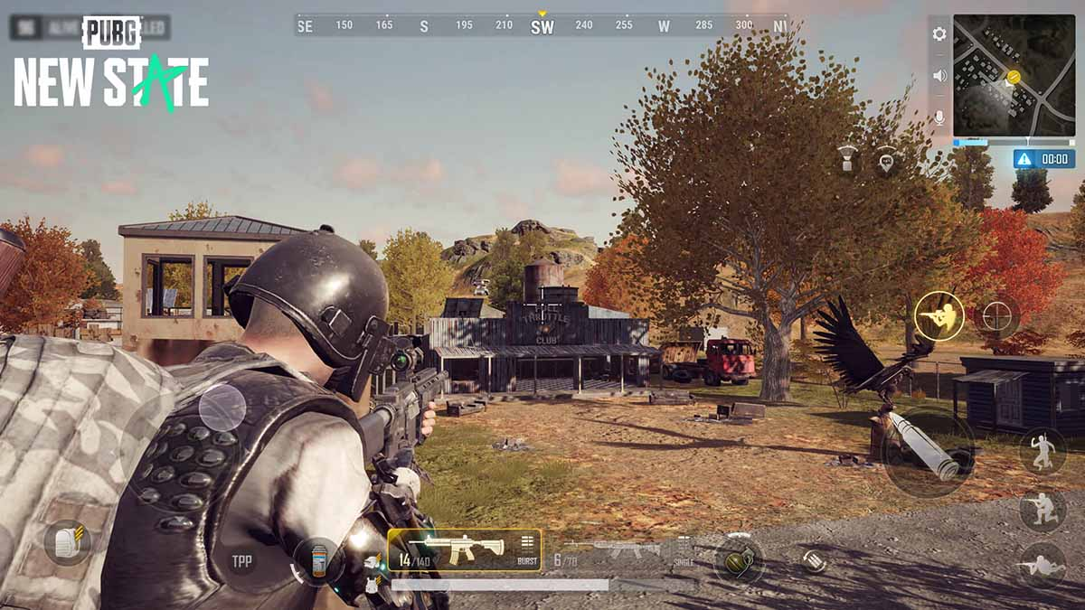
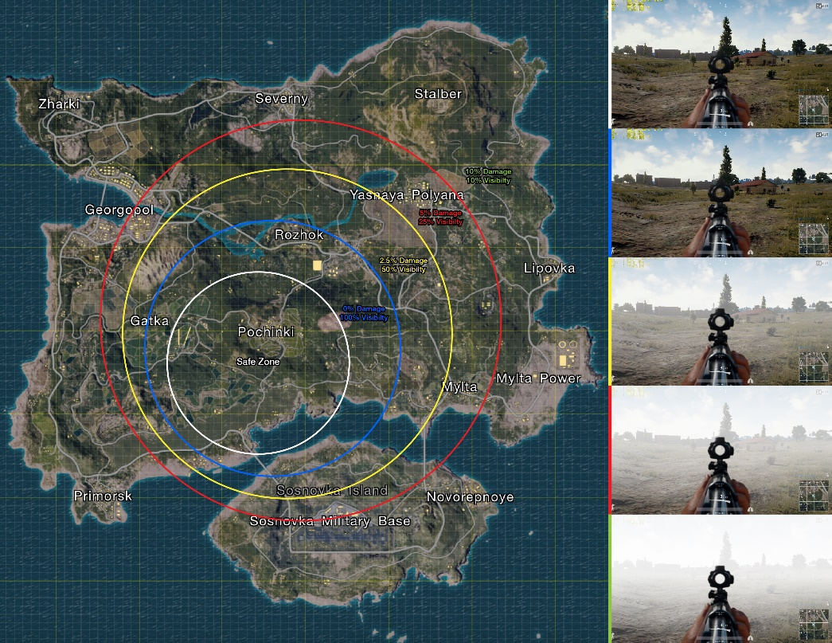
Part 0 – Learn PUBG
Battle Royale Shooter
Up to 100 players
Solo or teams of 2-4
Last one alive wins
Drop on island
Scavenge weapons, ammo, armor and first-aid kits
Hide and/or fight
Map shrinks!

Slide 6
Part 0 – Prepare Analysis Setup
Install spreadsheet
Download dataset
Condensed: 720k full → 500k partial → 1k partial
Try it out
https://web.cs.wpi.edu/~imgd2905/d24/projects/proj1/data.zip

Slide 7
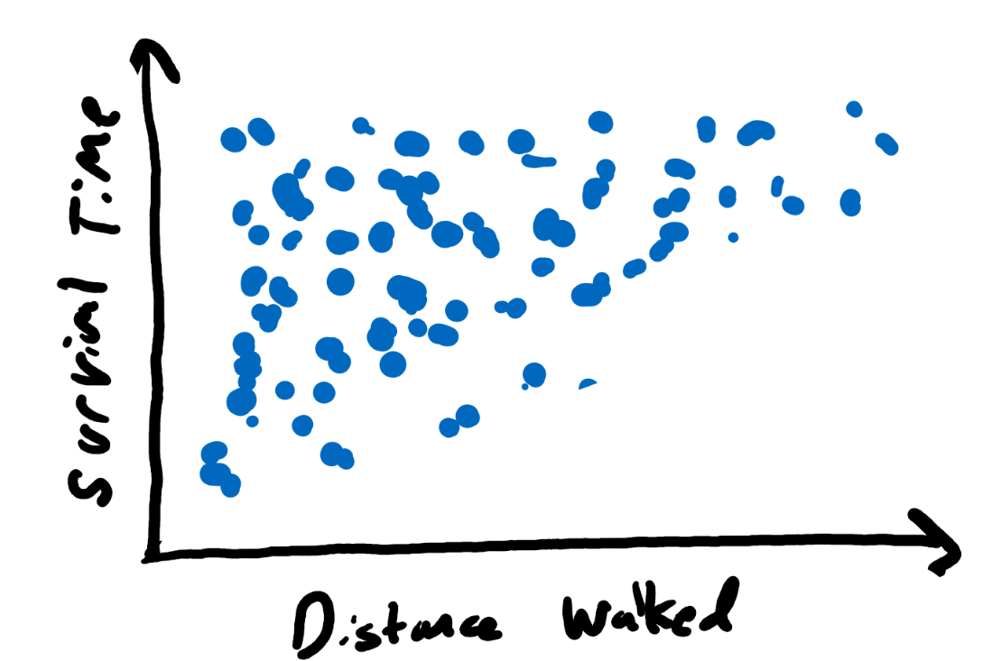
Part 1 – Fight or Flight
Basically, run or hide
Scatter plot
Comma Separated Values (csv)
Distance and Damage
Tips
Select some columns
Charts
Explore
Trends?
Outliers?
Distance versus damage?

Slide 8
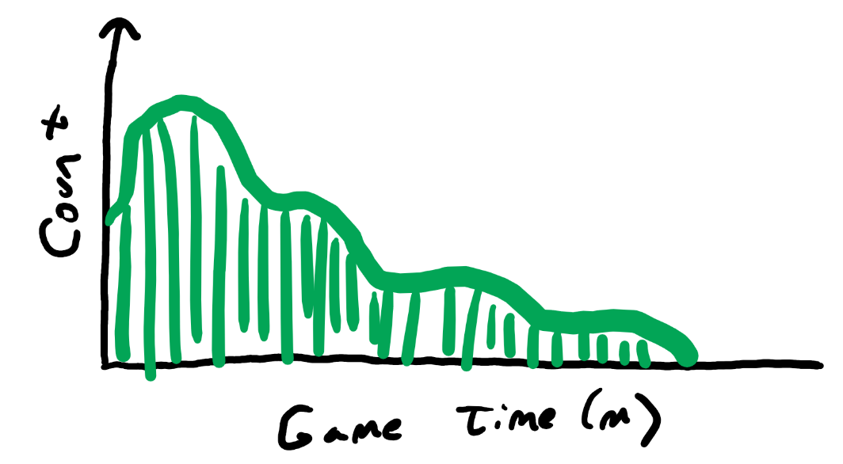
Part 2 – Game Time Analysis
Histogram
Compute summary statistics
Avg, stddev, min, max
Excel formula
Explore
What do they tell you about data?
Shape with bin size?
Ends?

Slide 9
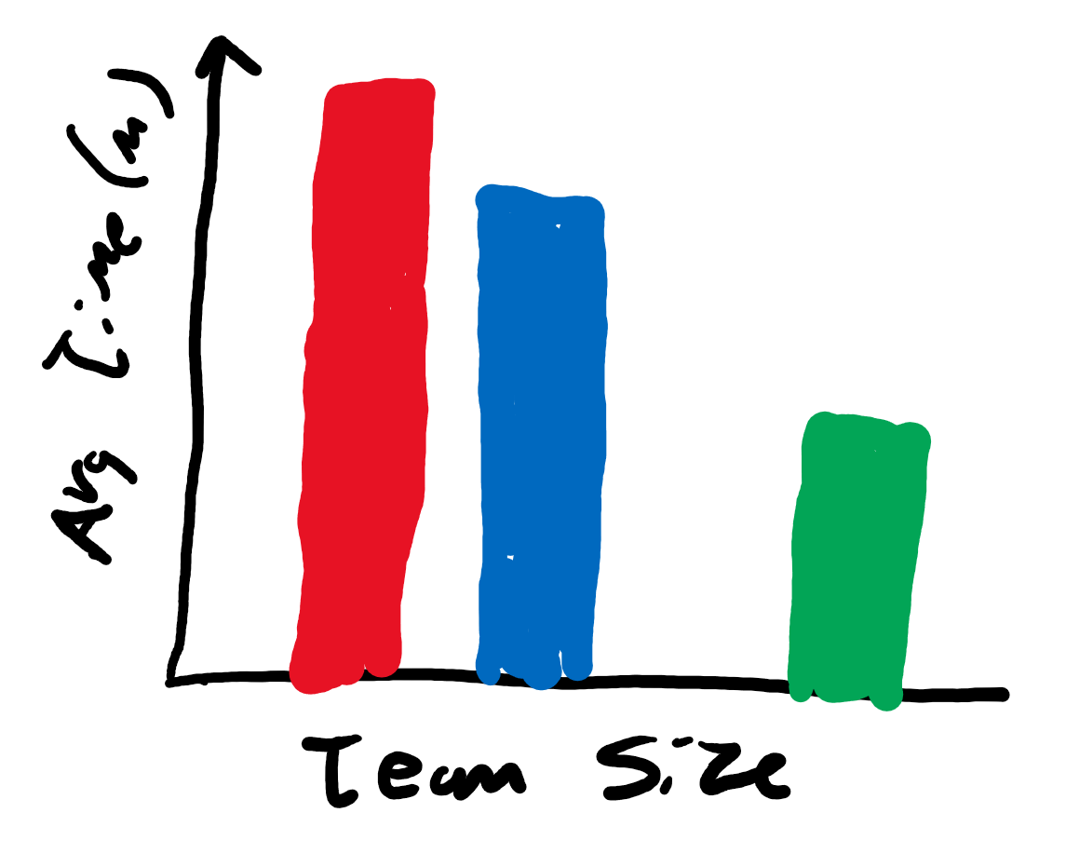
Part 3 – Team Size
Analyze Team Size and length
Select some data
Bar Chart
Explore:
Differences based on team size?
Features of game that explain?

Slide 10
Part 4 – Your Choice
Pick other data not yet analyzed
Analyze
Chart
Table
Summary stats
E.g., number of clicks, “thinking” time, “win” ratio
Feel free to be creative!
https://static1.squarespace.com/static/5947dbd14f14bc4eadcd0267/t/5a0d98c6ec212d61eecd0878/1510840528600/TOEFL+Question+analysis

Slide 11
Write Up
Short report
Content key, but structure and writing matter
Consider:
Ease of extracting information
Organization
Concise and precise
Clarity
Grammar/English
Graphs/tables:
Number and caption
Referred to by number
Labeled axes
Explained trend lines
Message
Whatever document tool you want (e.g., Word, sheets, markdown)
→ Generate PDF

Slide 12
Hints
Tips from previous years
https://web.cs.wpi.edu/~imgd2905/d24/projects/proj1/#hints
For most issues, will not be much penalty (yet)
Learning analytics pipeline is iterative
Will teach and reinforce
But start instilling good habits!
https://i0.wp.com/www.johnhardingestates.co.uk/wp-content/uploads/2018/02/John-Harding-Estates-Hints-and-Tips.png?fit=600%2C419

Slide 13
Grading
Part 1 (Fight or Flight) 30%
Part 2 (Game Time) 30%
Part 3 (Team Size) 20%
Part 4 (Choice) 10%
Misc 10%
All visible in report!
(Late – 10% per day if “significantly late”)

Slide 14
Rubric
100-90. The submission clearly exceeds requirements. All parts of the project have been completed or nearly completed. The report is clearly organized and well-written, charts and tables are clearly labeled and described, and messages provided about each part of the analysis.
89-80. The submission meets requirements. The first 3 parts of the project have been completed well, but not parts 4 or 5. The report is organized and well-written, charts and tables are labeled and described and messages provided about most of the analysis.
79-70. The submission barely meets requirements. The first 2 parts of the project have been completed or nearly completed, but not parts 3 or 4. The report is semi-organized and semi-well-written, charts and tables are somewhat labeled and described, but parts may be missing. Messages are not always clearly provided for the analysis.
69-60. The project fails to meet requirements in some places. The first part of the project has been completed or nearly completed, and maybe some of part 2, but not parts 3, 4 or 5. The report is not well-organized nor well-written, charts and tables are not labeled or may be missing. Messages are not always provided for the analysis.
59-0. The project does not meet requirements. No part of the project has been completed. The report is not well-organized nor well-written, charts and tables are not labeled and/or are missing. Messages are not consistently provided for the analysis..

