Slide 1
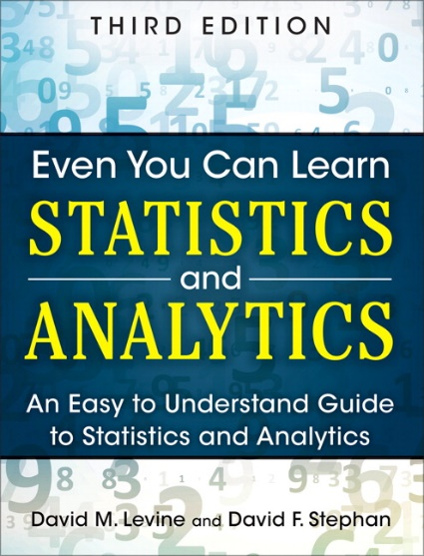
Probability
IMGD 2905
Chapters 4 & 5

Slide 2
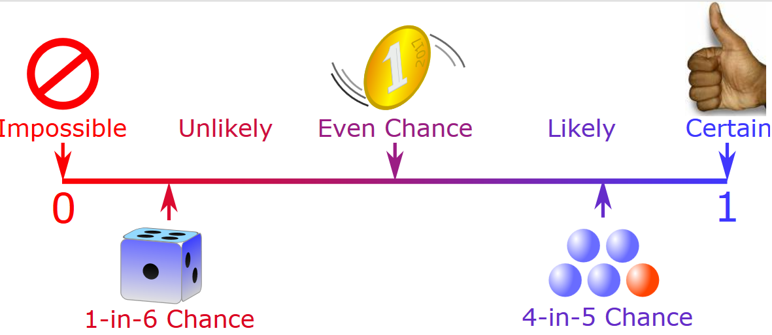
Overview
Statistics important for game analysis
Probability important for statistics
So, understand some basic probability
Also, probability useful for game development
https://www.mathsisfun.com/data/images/probability-line.svg

Slide 3

Groupwork
What are some examples of probabilities needed for game development?
Provide a specific example
Icebreaker, Groupwork, Questions
https://web.cs.wpi.edu/~imgd2905/d24/groupwork/5-probabilities/handout.html
https://www.mathsisfun.com/data/images/probability-line.svg

Slide 4

Overview
Statistics important for game analysis
Probability important for statistics
So, understand some basic probability
Also, probability itself useful for game development
Probabilities for game development?
Examples?

Slide 5
Overview
Statistics important for game analysis
Probability important for statistics
So, understand some basic probability
Also, probability itself useful for game development
Probabilities for game development?
Probability attack will succeed
Probability loot from enemy contains rare item
Probability enemy spawns at particular time
Probability action (e.g., building a castle) takes particular amount of time
Probability players at server

Slide 6
Outline
Introduction (done)
Probability (next)
Probability Distributions

Slide 7
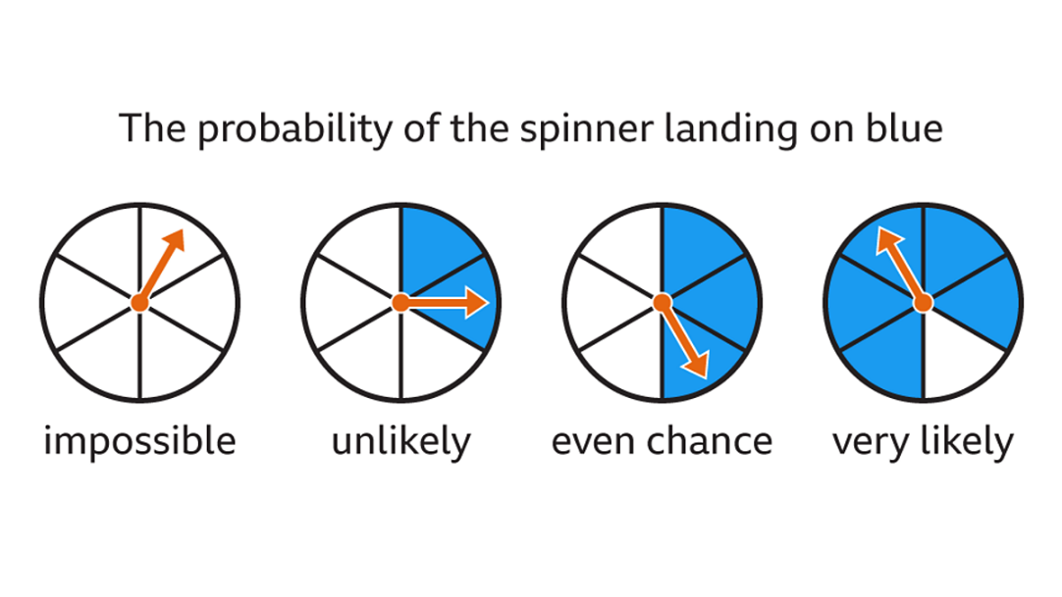
Probability Definitions (1 of 3)
Probability – way of assigning numbers to outcomes to express likelihood of event
Event – outcome of experiment or observation
  Elementary – simplest type for given experiment. independent
  Joint/Compound – more than one elementary
Roll die (d6) and get 6
  elementary event
Roll die (d6) and get even number
  compound event, consists of elementary events 2, 4, and 6
Pick card from standard deck and get queen of spades
  elementary event
Pick card from standard deck and get face card
  compound event
Observe players logging in to MMO server and see if two people log in less than 15 minutes apart
  compound event
We’ll treat/compute probabilities of elementary versus compound separately

Slide 8
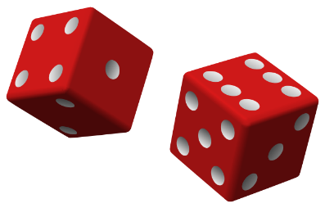
Probability – Definitions (2 of 3)
Exhaustive set of events – set of all possible outcomes of experiment/observation
Mutually exclusive sets of events – elementary events that do not overlap
Roll d6: Events: 1, 2
  not exhaustive, mutually exclusive
Roll d6: Events: 1, 2, 3, 4, 5, 6
  exhaustive, mutually exclusive
Roll d6: Events: get even number, get number divisible by 3, get a 1 or get a 5
  exhaustive, but overlap
Observe logins: time between arrivals <10 seconds, 10+ and <15 seconds inclusive, or 15+ seconds
  exhaustive, mutually exclusive
Observe logins: time between arrivals <10 seconds, 10+ and <15 seconds inclusive, or 10+ seconds
  exhaustive, but overlap

Slide 9
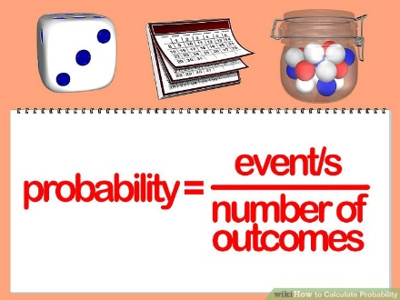
Probability – Definitions
(3 of 3)
Probability – likelihood of event to occur,
ratio of favorable cases to all cases
Set of rules that probabilities must follow
  Probabilities must be between 0 and 1 (but often written/said as percent)
  Probabilities of set of exhaustive, mutually exclusive events must add up to 1
e.g., d6: events 1, 2, 3, 4, 5, 6. Probability of 1/6th to each, sum of P(1) + P(2) + P(3) + P(4) + P(5) + P(6) = 1
  → legal set of probabilities
e.g., d6: events 1, 2, 3, 4, 5, 6. Probability of ½ to roll 1, ½ to roll 2, and 0 to all the others sum of P(1) + … + P(6) = 0.5 + 0.5 + 0 … + 0 = 1
  → Also legal set of probabilities
  Not how honest d6’s behave in real life!
https://goo.gl/iy3YGr
Q: how to assign probabilities?

Slide 10
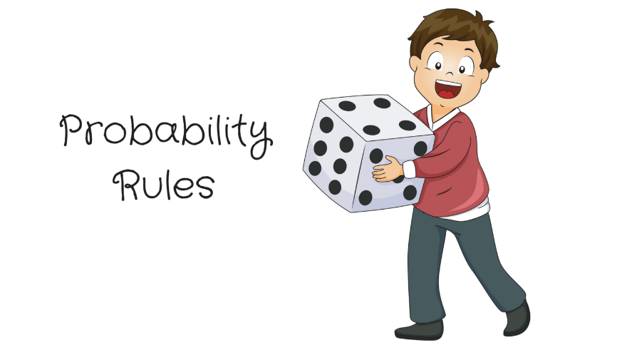


How to Assign Probabilities?
http://static1.squarespace.com/static/5a14961cf14aa1f245bc3942/5a1c5e8d8165f542d6db3b0e/5acecc7f03ce64b9a46d99c6/1529981982981/Michael+Jordan+%2833%29.png?format=1500w
https://newvitruvian.com/images/marbles-clipart-bag-marble-4.png
Q: how to assign probabilities?

Slide 11
Assigning Probabilities
Classical (by theory)
  In some cases, exhaustive, mutually exclusive outcomes equally likely → assign each outcome probability of 1/n
  e.g., d6: 1/6, Coin: prob heads ½, tails ½, Cards: pick Ace 4/52
Empirically (by observation)
  Obtain data through measuring/observing
  e.g., Watch how often people play PUBG in FL222 versus some other game. Say, 30% PUBG. Assign that as probability
Subjective (by hunch)
  Based on expert opinion or other subjective method
  e.g., eSports writer says probability Fnatic (European LoL team) will win World Championship is 25%

Slide 12
Rules About Probabilities (1 of 2)
Complement: A an event. Event “Probability A does not occur” called complement of A, denoted A’
  P(A’) = 1 - P(A) ← Why?
  e.g., d6: P(6) = 1/6, complement is P(6’) and probability of “not 6” is 1-1/6, or 5/6
  Note: Value often denoted p, complement is q
Mutually exclusive: Have no simple outcomes in common – can’t both occur in same experiment
  P(A or B) = P(A) + P(B)
  “Probability either occurs”
  e.g., d6: P(3 or 6) = P(3) + P(6) = 1/6 + 1/6 = 2/6

Slide 13
Rules About Probabilities (2 of 2)
Independent: Probability that one occurs doesn’t affect probability that other occurs
  e.g., 2d6: A= die 1 get 5, B= die 2 gets 6. Independent, since result of one roll doesn’t affect roll of other
  “Probability both occur” P(A and B) = P(A) x P(B)
  e.g., 2d6: prob of “snake eyes” is P(1) x P(1) = 1/6 x 1/6 = 1/36
Not independent: One occurs affects probability that other occurs
  Probability both occur P(A and B) = P(A) x P(B | A)
    Where P(B | A) means prob B given A happened
  e.g., PUBG chance of getting top 10 is 10%. Chance of using only stock gun 50%. You might think that:
    P(top 10) x P(stock) = 0.10 x 0.50 = 0.05
  But likely not independent. P(top | stock) < 5%. So, need non-independent formula
    P(top) x P(top | stock)
(Card example next slide)

Slide 14

Probability Example
Draw, put back. Draw. Not King either card?
  P(K’) x P(K’)
  = ¾ x ¾ = 9/16
Draw, don’t put back. Draw. Not King either card?
P(K’) x P(K’ | K’)
= ¾ x (1-1/3)
= ¾ x 2/3 = 6/12 = ½
Draw, don’t put back. Draw. King 2nd card?
P(K’) x P(K | K’)
= ¾ x ⅓
= 3/12 = ¼
Probability drawing King?
  P(K) = ¼
Draw, put back. Now?
  P(K) = ¼
Probability not King?
  P(K’) = 1-P(K)
  = 1 - ¼ = ¾
Draw, put back. 2 Kings?
  P(K) x P(K)
  = ¼ x ¼ = 1/16
Draw. King or Queen?
  P(K or Q) = P(K) + P(Q)
= ¼ + ¼ = ½

Slide 15
Outline
Intro (done)
Probability (done)
Probability Distributions (next)

Slide 16
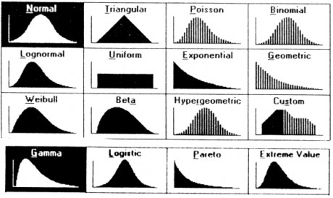
Probability Distributions
Probability distribution – values and likelihood (expected value) that random variable can take
Why? If can model mathematically, can use to predict occurrences
  e.g., probability slot machine pays out on given day
  e.g., probability game server can host player this hour
  e.g., probability certain game mode is chosen by player
  Also, some statistical techniques for some distributions only
https://goo.gl/jqomFI
Types discussed: Uniform (discrete)
  Binomial (discrete)
  Poisson (discrete)
  Normal (continuous)
Remember empirical rule?
What distribution did it apply to?

Slide 17

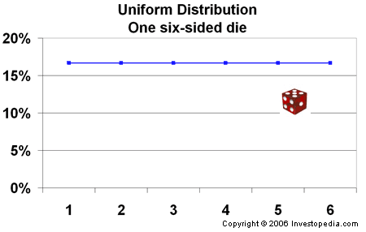
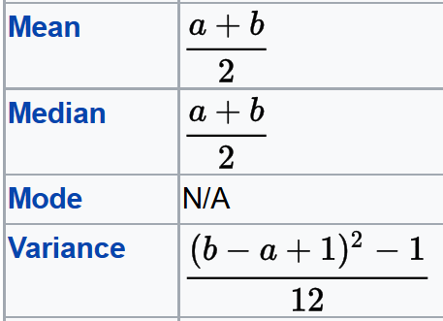
Uniform Distribution
“So what?”
Can use known formulas
Mean = (1 + 6) / 2 = 3.5
Variance = ((6 – 1 + 1)² – 1)/12
= 2.9
Std Dev = sqrt(Variance) = 1.7
Note – mean is also the expected value
(if you did a lot of trials, would be average result)

Slide 18

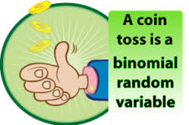
Binomial Distribution Example (1 of 3)
How to assign probabilities?
Suppose toss 3 coins
Random variable
X = number of heads
Want to know probability of exactly 2 heads
P(X=2) = ?

Slide 19
Binomial Distribution Example (1 of 3)
How to assign probabilities?
Could measure (empirical)
  Q: how?
Could use “hunch” (subjective)
  Q: what do you think?
Could use theory (classical)
  Math using our probability rules (not shown)
  Enumerate (next)
Suppose toss 3 coins
Random variable
X = number of heads
Want to know probability of exactly 2 heads
P(X=2) = ?

Slide 20
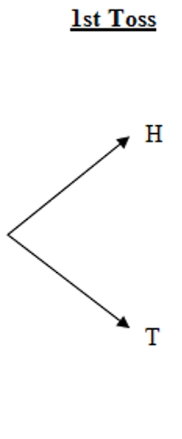
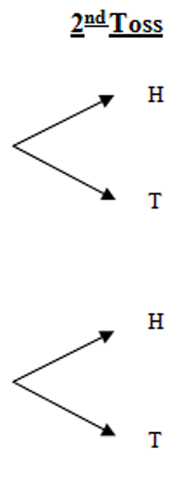
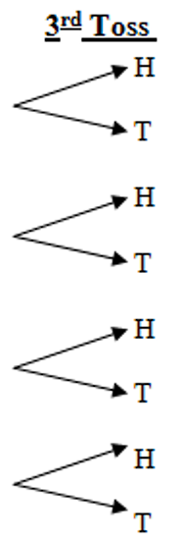
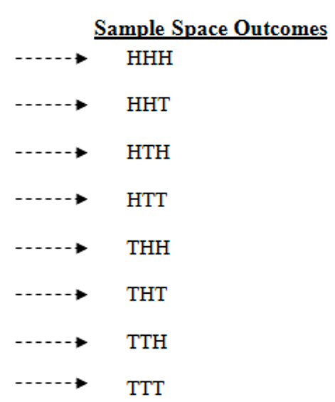
Binomial Distribution Example (2 of 3)
Toss?
http://web.mnstate.edu/peil/MDEV102/U3/S25/Cartesian3.PNG
All equally likely (p is 1/8 for each)
→ P(HHT) + P(HTH) + P(THH) = 3/8
Can draw histogram of number of heads

Slide 21
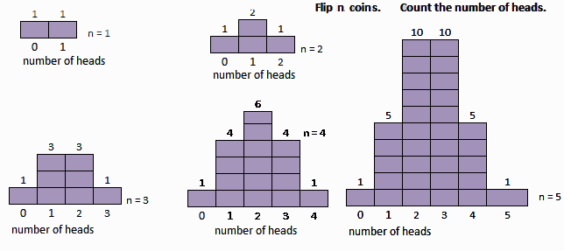
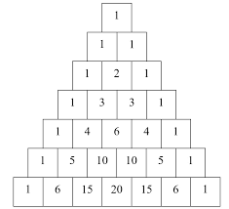
Binomial Distribution Example (3 of 3)
http://www.mathnstuff.com/math/spoken/here/2class/90/binom2.gif
These are all binomial distributions
(Pascal's Triangle)

Slide 22
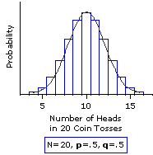
Binomial Distribution (1 of 2)
In general, any number of trials (n) & any probability of successful outcome (p) (e.g., coin heads p=0.5, d8 one p=0.125)
Characteristics of experiment that gives random number with binomial distribution:
  Experiment of n identical trials
  Trials are independent
  Each trial only two possible outcomes, Success or Fail
  Probability of Success each trial is same, denoted p
  Random variable of interest (X) is number of Successes in n trials
http://www.vassarstats.net/textbook/f0603.gif

Slide 23
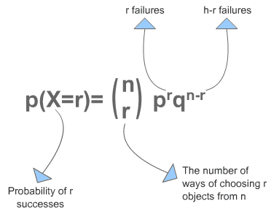
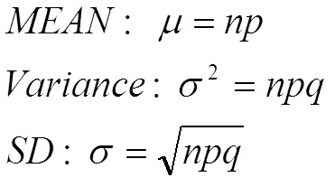
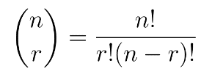
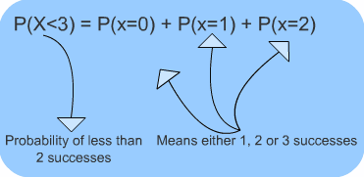

Binomial Distribution (2 of 2)
“So what?”
Can use known formulas
http://www.s-cool.co.uk/gifs/a-mat-sdisc-dia08.gif
Excel: binom.dist()
binom.dist(x,trials,prob,cumulative)
2 heads, 3 flips, coin, discrete
=binom.dist(2, 3, 0.5, FALSE)
=0.375 (i.e., 3/8)
If “true”?
http://www.s-cool.co.uk/gifs/a-mat-sdisc-dia12.gif

Slide 24
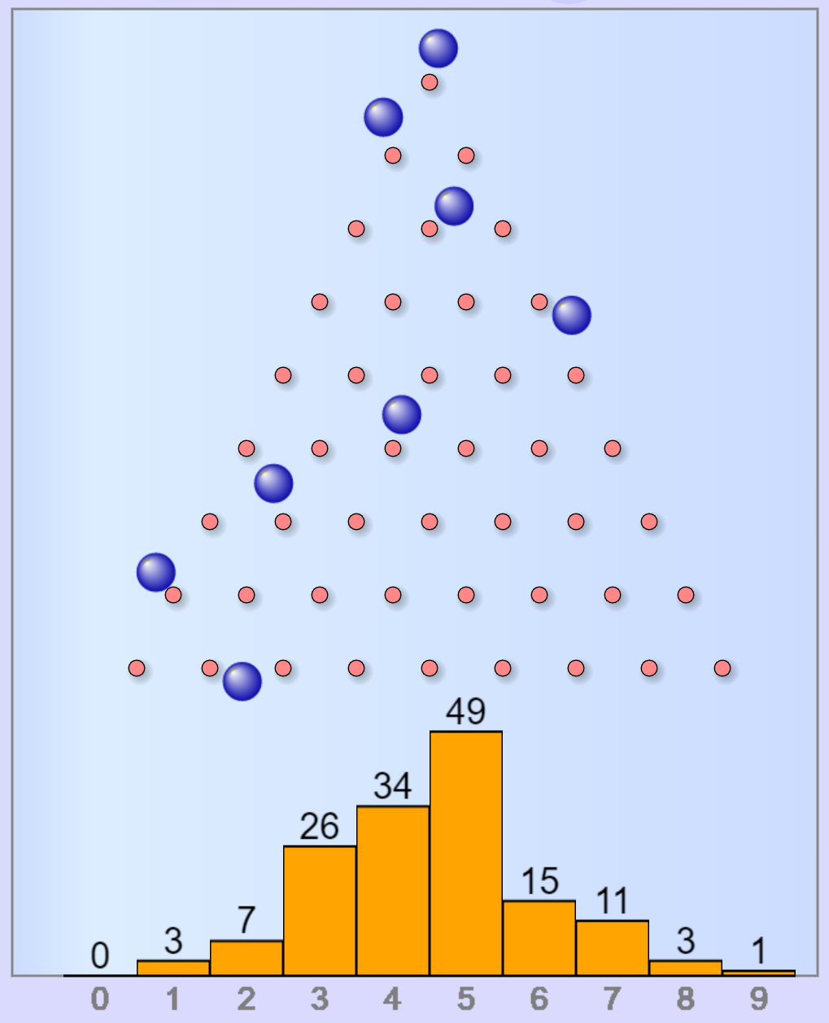
Binomial Distribution Example
“Galton Board” (Sir Francis Galton): Each row is like a coin flip
right = “heads”
left = “tails”
Bottom axis is number of heads
Gives an empirical way to estimate P(X)
  bin(X) ÷
  sum(bin(0) + bin(1) + …)
Try it!
https://www.mathsisfun.com/data/quincunx.html
Calculate it!

Slide 25

Poisson Distribution
Distribution of probability of x events occurring in certain interval (broken into units)
  Interval can be time, area, volume, distance
  e.g., number of players arriving at server lobby in 5-minute period between noon-1pm
Requires
  Probability of event same for all time units
  Number of events in one time unit independent of number of events in any other time unit
  Events occur singly (not simultaneously). In other words, as interval unit gets smaller, probability of two events occurring approaches 0

Slide 26

Poisson Distributions?
Could Be Poisson
Not Poisson
Number of groups arriving at restaurant during dinner hour
Number of logins to MMO during prime time
Number of defects (bugs) per 100 lines of code
People arriving at cash register (if they shop individually)
Number of people arriving at restaurant during dinner hour
  People frequently arrive in groups
Number of students registering for course in Workday per hour on first day of registration
  Prob not equal – most register in first few hours
  Not independent – if too many register early, system crashes
https://tinyurl.com/3xbaht9c
Phrase people use is random arrivals
Poisson?

Slide 27


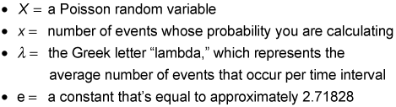
Poisson Distribution
Distribution of probability of x events occurring in certain interval
https://tinyurl.com/2ad6fewt
http://www.dummies.com/education/math/business-statistics/how-to-compute-poisson-probabilities/

Slide 28

Poisson Distribution Example (1 of 2)
Number of games student plays per day averages 1 per day
Number of games played per day independent of all other days
Can only play one game at a time
What’s probability of playing 2 games tomorrow?
In this case, the value of λ = 1, want P(X=2)

Slide 29
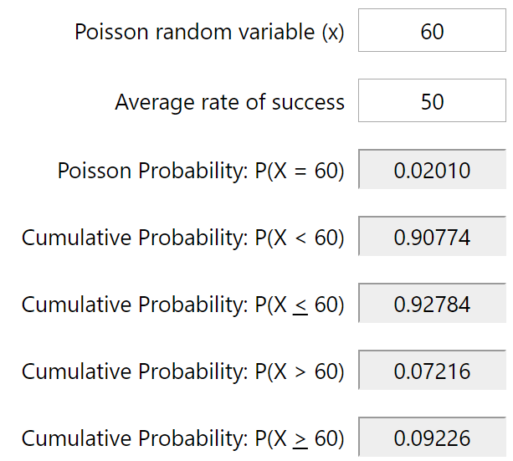
Poisson Distribution Example (2 of 2)
https://stattrek.com/online-calculator/poisson.aspx
New England city
Average new COVID-19 cases 50/day
Local hospital has 60 free beds
What is the probability more than 60 in one day?
Q: How do we get greater than 60?
= ???
P(0) + P(1) + … + P(60) → P(≤60)
P(>60) = 1 = P(≤ 60)

Slide 30
Poisson Distribution Example (2 of 2)
https://stattrek.com/online-calculator/poisson.aspx
New England city
Average new COVID-19 cases 50/day
Local hospital has 60 free beds
What is the probability more than 60 in one day?
60
Q: How do we get greater than 60?
= ???
P(0) + P(1) + … + P(60) → P(≤60)
P(>60) = 1 = P(≤ 60)
50
60

Slide 31
Poisson Distribution Example (2 of 2)
https://stattrek.com/online-calculator/poisson.aspx
https://stattrek.com/online-calculator/poisson.aspx
New England city
Average new COVID-19 cases 50/day
Local hospital has 60 free beds
What is the probability more than 60 in one day?
60
Q: How do we get greater than 60?
= ???
P(0) + P(1) + … + P(60) → P(≤60)
P(>60) = 1 = P(≤ 60)
50
60

Slide 32
Poisson Distribution Example (2 of 2)
https://stattrek.com/online-calculator/poisson.aspx
New England city
Average new COVID-19 cases 50/day
Local hospital has 60 free beds
What is the probability more than 60 in one day?
60
Q: How do we get greater than 60?
= 0.02
P(0) + P(1) + … + P(60) → P(≤60)
P(>60) = 1 = P(≤ 60)
50
60

Slide 33
Poisson Distribution Example (2 of 2)
https://stattrek.com/online-calculator/poisson.aspx
New England city
Average new COVID-19 cases 50/day
Local hospital has 60 free beds
What is the probability more than 60 in one day?
60
Q: How do we get greater than 60?
= 0.02
P(0) + P(1) + … + P(60) → P(≤60)
P(>60) = 1 - P(≤ 60)
50
60

Slide 34
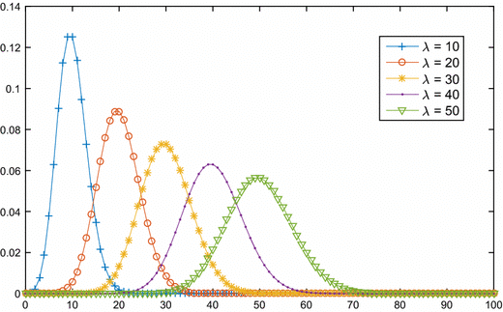
Poisson Distribution
“So what?” → Known formulas
Mean = λ
Variance = λ
Std Dev = sqrt (λ)
https://www.researchgate.net/publication/317746840/figure/fig1/AS:779409749471250@1562837173902/The-Poisson-distribution-probability-function.gif
Excel: poisson.dist()
poisson.dist(x,mean,cumulative)
mean 50 per day, 60 beds, chance > 60?
= 1 - POISSON.DIST(60, 50, TRUE)
= 0.07216
e.g., Games → may want to know likelihood of 1.5x average people arriving at server

Slide 35
Expected Value – Formulation
Expected value of discrete random variable is value you’d expect after many experimental trials. i.e., mean value of population
Value: x₁ x₂ x₃ … x_{n}
Probability: P(x₁) P(x₂) P(x₃) … P(x_{n})
Compute by multiplying each value by probability and summing
μ_{x} = E(X) = x₁P(x₁) + x₂P(x₂) + … + x_{n}P(x_{n})
= Σ x_{i}P(x_{i})

Slide 36

Expected Value Example –
Gambling Game
Pay $3 to enter
Roll 1d6 → 6? Get $7 1-5? Get $1
What is expected payoff? Expected net?
Outcome Payoff(x) P(x) xP(x)
1-5 $1 5/6 $5/6
6 $7 1/6 $7/6
E(x) = $5/6 + $7/6 = $12/6 = $2
E(net) = E(x) - $3 = $2 - $3 = 0

Slide 37
Expected Value Example –
Gambling Game
Pay $3 to enter
Roll 1d6 → 6? Get $7 1-5? Get $1
What is expected payoff? Expected net?
Outcome Payoff(x) P(x) xP(x)
1-5 $1 5/6 $5/6
6 $7 1/6 $7/6
E(X) = $5/6 + $7/6 = $12/6 = $2
E(net) = E(x) - $3 = $2 - $3 = 0

Slide 38
Expected Value Example –
Gambling Game
Pay $3 to enter
Roll 1d6 → 6? Get $7 1-5? Get $1
What is expected payoff? Expected net?
Outcome Payoff(x) P(x) xP(x)
1-5 $1 5/6 $5/6
6 $7 1/6 $7/6
E(X) = $5/6 + $7/6 = $12/6 = $2
E(net) = E(X) - $3 = $2 - $3 = $-1

Slide 39
Expected Value Example –
Gambling Game
Pay $3 to enter
Roll 1d6 → 6? Get $7 1-5? Get $1
What is expected payoff? Expected net?
Outcome Payoff(x) P(x) xP(x)
1-5 $1 5/6 $5/6
6 $7 1/6 $7/6
E(X) = $5/6 + $7/6 = $12/6 = $2
E(net) = E(X) - $3 = $2 - $3 = $-1

Slide 40
Outline
Intro (done)
Probability (done)
Probability Distributions
  Discrete (done)
So far random variable could take only discrete set of values
Q: What does that mean?
Q: What other distributions might we consider?

Slide 41
Outline
Intro (done)
Probability (done)
Probability Distributions
  Discrete (done)
  Continuous (next)

Slide 42
Continuous Distributions
Many random variables are continuous
  e.g., recording time (time to perform service) or measuring something (height, weight, strength)
For continuous, doesn’t make sense to talk about P(X=x) → continuum of possible values for X
  Mathematically, if all non-zero, total probability infinite (this violates our rule)
So, continuous distributions have probability density, f(x)
→ How to use to calculate probabilities?
Don’t care about specific values
  e.g., P(Height = 60.194672816”)
Instead, ask about range of values
  e.g., P(59.5” < X < 60.5”)
Uses calculus (integrate area under curve) (not shown here)
Q: What continuous distribution is especially important?
→ the Normal Distribution

Slide 43
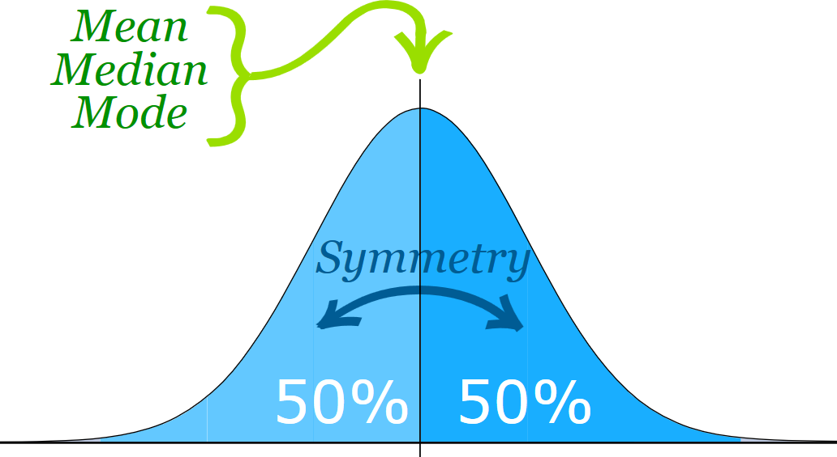

Normal Distribution (1 of 2)
“Bell-shaped” or “Bell-curve”
  Distribution from -∞ to +∞
Symmetric
Mean, median, mode all same
  Mean determines location, standard deviation determines “width”
Super important!
  Lots of distributions follow a normal curve
  Basis for inferential statistics (e.g., statistical tests)
  “Bridge” between probability and statistics
50% area to left
50% area to right
-∞
+∞
https://www.mathsisfun.com/data/images/normal-distribution-2.svg
Aka “Gaussian” distribution

Slide 44
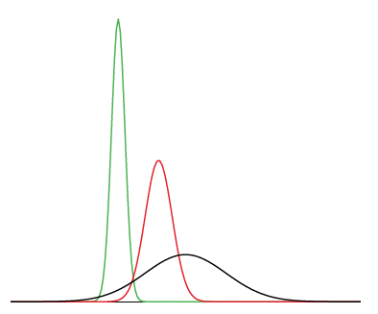
Normal Distribution (2 of 2)
Many normal distributions (see right)
However, “the” normal distribution refers to standard normal
  Mean (μ) = 0
  Standard deviation (σ) = 1
Can convert any normal to the standard normal
  Given sample mean (x̅)
  Sample standard dev. (s)
Many normal distributions
green - mean -3, std dev 0.5
red - mean 0, std dev 1
black - mean 2, std dev 3
???
???
???
(Next)

Slide 45
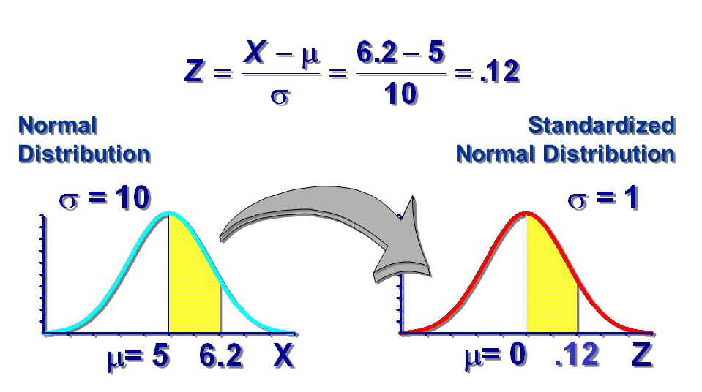
Standard Normal Distribution
Standardize
  Subtract sample mean (x̅)
  Divide by sample standard deviation (s)
Mean μ = 0
Standard Deviation σ = 1
Total area under curve = 1
  Sounds like probability!
Remember the
Z-score?
=norm.dist()
Use to predict how likely an observed sample is given population mean
(next)
http://images.slideplayer.com/10/2753952/slides/slide_2.jpg

Slide 46
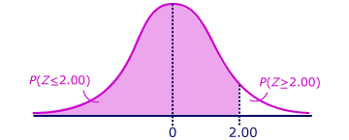
Using the Standard Normal
Z = (x - x̅) / s
= (30 - 24) / 3
= 2
Want to know P(Z > 2)
Suppose League of Legends Champion released once every 24 days on average, standard deviation of 3 days
What is the probability Champion released 30+ days?
x = 30, x̅ = 24, s = 3
http://ci.columbia.edu/ci/premba_test/c0331/s6/s6_4.html
Q: how? Hint: what rule might help?

Slide 47
Using the Standard Normal
Z = (x - x̅) / s
= (30 - 24) / 3
= 2
Want to know P(Z > 2)
Suppose League of Legends Champion released once every 24 days on average, standard deviation of 3 days
What is the probability Champion released 30+ days?
x = 30, x̅ = 24, s = 3
http://ci.columbia.edu/ci/premba_test/c0331/s6/s6_4.html
=norm.dist(x,mean,stddev,cumulative)
=1 - norm.dist(30,24,3,true)
Empirical Rule. Or use table (Z-table)
→ 5% / 2 = 2.5% likely

Slide 48
Test for Normality
Why?
  Can use Empirical Rule
  Use some inferential statistics (parametric tests)
How?
  Measure skewness (next)
  Looks normal
    Histogram
    Normal probability plot (QQ plot) – graphical technique to see if data set is approximately normally distributed
  Statistical test
    Kolmogorov-Smirnov test (K-S) or Shapiro-Wilk (S-W) that compare to normal (won’t do, but ideas in next slide deck)

Slide 49
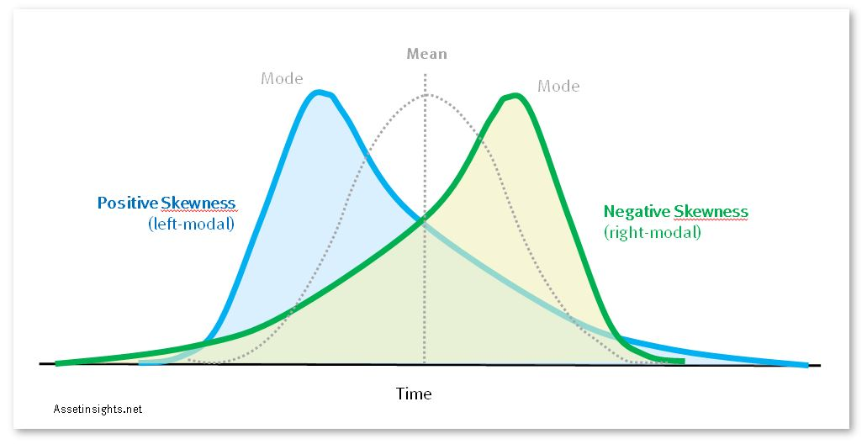
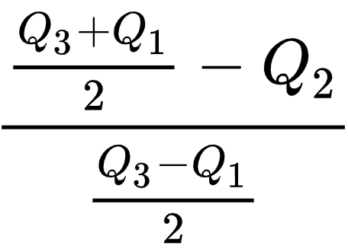
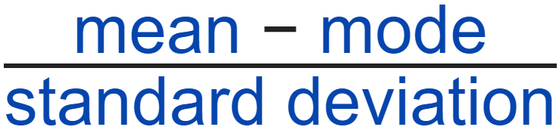

Measuring Skewness
https://assetinsights.net/Concepts/Curves_Modal_Left_and_Right.JPG
Measure of symmetry of distribution
  Normal distribution is perfectly symmetric, skewness 0
Easy equations:
“How much” is not symmetric?
  Somewhat arbitrary
  Less than -1 or greater than +1
    Highly skewed
  Between [-1, -0.5] or [0.5, +1]
    Moderately skewed
  Between -0.5 and 0.5
    Symmetric
=skew(A1:A10)
“Fisher–Pearson standardized moment”
[Note, related “Kurtosis” is how clumped]

Slide 50
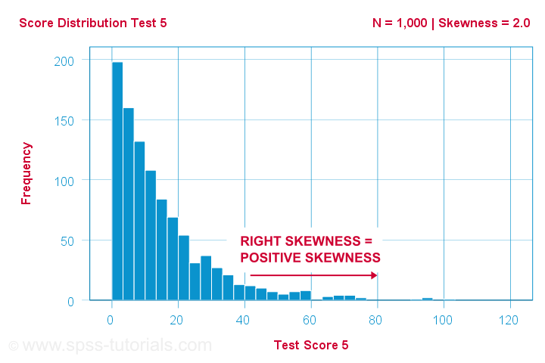
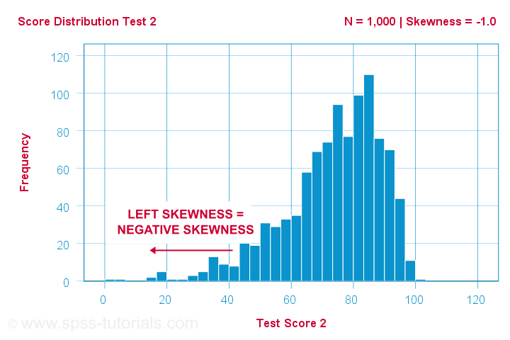
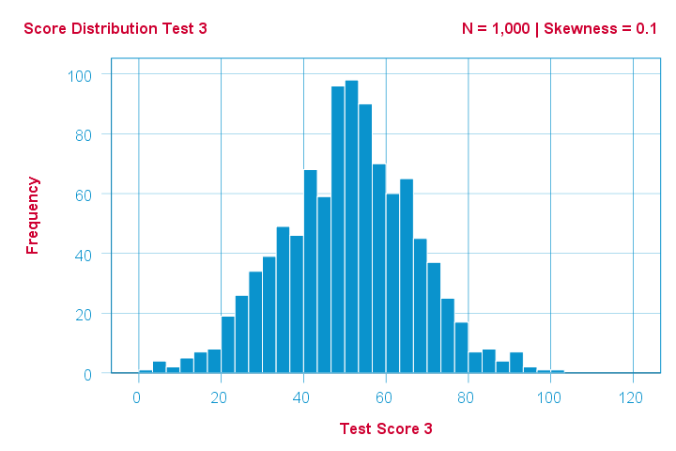
Skewness Examples
Skewness 2.0
Skewness-1.0
Skewness 0.1

Slide 51
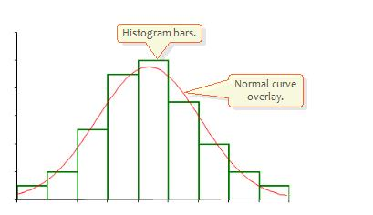
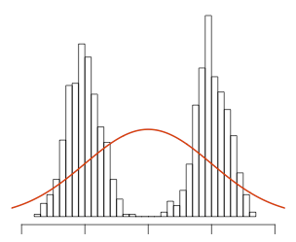
Normality Testing with a Histogram
Use histogram shape to look for “bell curve”
http://2.bp.blogspot.com/_g8gh7I4zSt4/TR85eGJlMfI/AAAAAAAAAQs/PaOHJsjonPM/s1600/histo.JPG
http://seankross.com/img/biqq.png
Yes
No

Slide 52
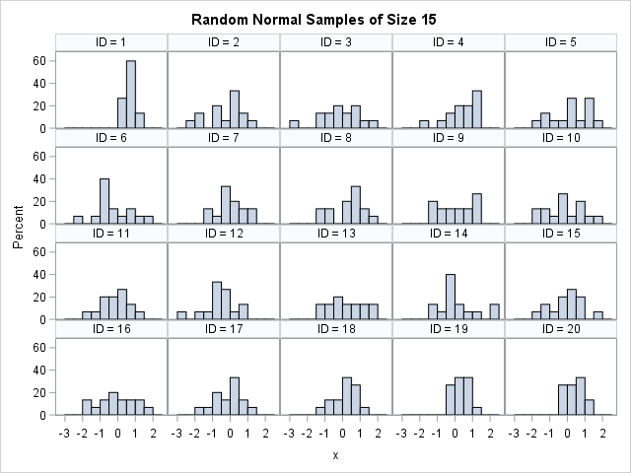
Normality Testing with a Histogram
http://www.sascommunity.org/planet/blog/category/statistical-thinking/
Q: What distributions are these from? Any normal?

Slide 53
Normality Testing with a Histogram
http://www.sascommunity.org/planet/blog/category/statistical-thinking/
They are all from normal distribution! Suffer from:
Binning (not continuous)
Few samples (15) – we’ll talk about sample size next slide deck

Slide 54
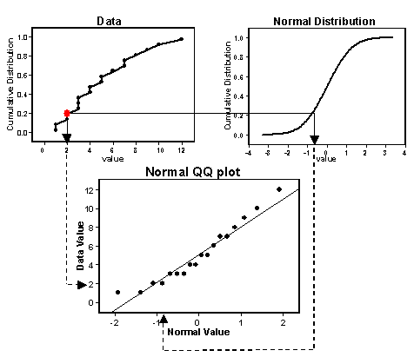
Normality Testing with a Quantile-Quantile Plot
Percentiles (quantiles) of one versus another
If line → same distribution
Order data
Compute Z scores (normal)
Plot data (y-axis) versus Z (x-axis)
Normal? → line
https://goo.gl/rLLSIQ

Slide 55
Quantile-Quantile Plot Example
Do the following values come from a normal distribution?
7.19, 6.31, 5.89, 4.5, 3.77, 4.25, 5.19, 5.79, 6.79
Order data
Compute Z scores
Plot data versus Z
Show each step, next
http://www.statisticshowto.com/q-q-plots/

Slide 56
Quantile-Quantile Plot Example – Order Data
Unordered
Ordered (low to high)
7.19
6.31
5.89
4.50
3.77
4.25
5.19
5.79
6.79
3.77
4.25
4.50
5.19
5.89
5.79
6.31
6.79
7.19
N = 9 data points
http://www.statisticshowto.com/q-q-plots/

Slide 57
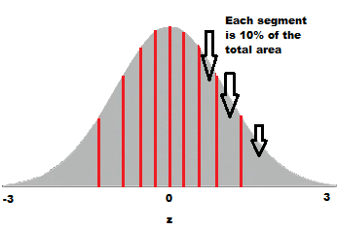
Quantile-Quantile Plot Example – Compute Z scores
10% = ?
20% = ?
30% = ?
40% = ?
50% = 0
60% = ?
70% = ?
80% = ?
90% = ?
Divide into
N+1 = 10
http://www.statisticshowto.com/q-q-plots/
=NORMSINV(area) – provide Z for area under standard normal curve
=NORMSINV(.80)
=0.841621
Want Z-score for that segment

Slide 58
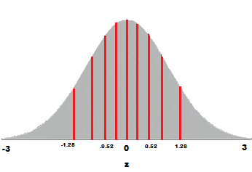
Quantile-Quantile Plot Example – Compute Z scores
Example:
=NORMSINV(.80)
=0.841621
10% = -1.28
20% = -0.84
30% = -0.52
40% = -0.25
50% = 0
60% = 0.25
70% = 0.52
80% = 0.84
90% = 1.28
(Only some points shown)

Slide 59
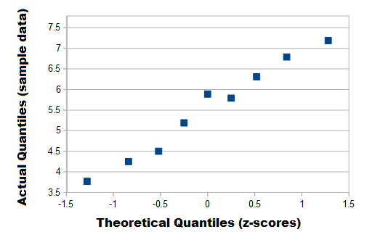
Quantile-Quantile Plot Example – Plot
http://www.statisticshowto.com/q-q-plots/
Linear? → Normal

Slide 60
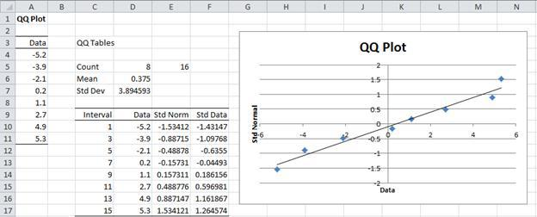
Quantile-Quantile Plots in Excel
Mostly, a manual process. Do as per above.
Example of step by step process (with spreadsheet):
http://facweb.cs.depaul.edu/cmiller/it223/normQuant.html
https://i2.wp.com/www.real-statistics.com/wp-content/uploads/2012/12/qq-plot-normality.jpg

Slide 61
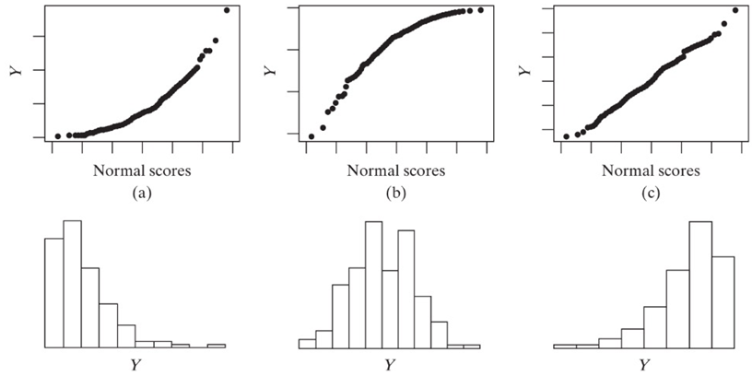
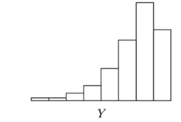
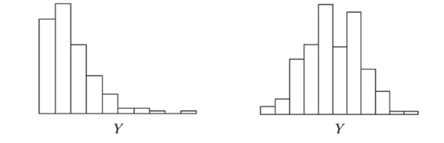
Examples of Normality Testing with a Quantile-Quantile Plot
http://d2vlcm61l7u1fs.cloudfront.net/media%2Fb95%2Fb953e7cd-31c3-45b0-a8ec-03b0e81c95d1%2Fphp2Y86od.png

