Slide 1
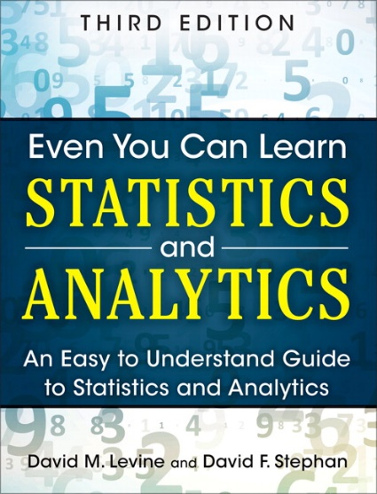
Presenting Data
IMGD 2905
Chapter 2

Slide 2
Outline
Types of Charts (next)
Game Analytics Examples
Guidelines for Charts

Slide 3
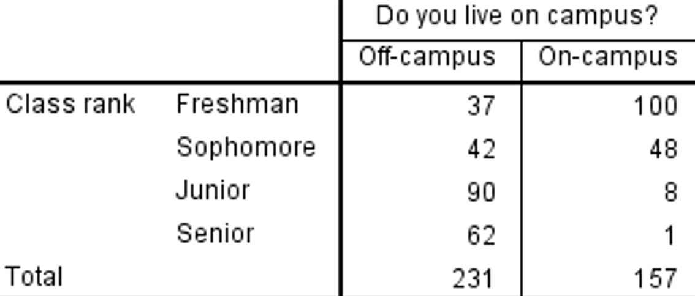
Tables
Generally, independent variable in left column and dependent variables next
Table 1. Number of student on campus and off by year
Checklist
Number and caption
Units labeled (as appropriate)
Minimal vertical lines (or none)
Lines only to break apart areas (or use Bold)
Make sure to consider message. Often much clearer in chart!

Slide 4
“Right” Chart Depends on Variable Type
Qualitative (Categorical) variables
  Can have states or subclasses
    e.g., position: [striker, goalie, midfield]
  Can be ordered or unordered
    e.g., bronze, silver, gold → ordered
    e.g., support, warrior, specialist → unordered
Quantitative (Numeric) variables
  Numeric levels
  Discrete or continuous
    e.g., goals in season, speed in meters
    e.g., takedowns, win percentage
Variables
Qualitative
Quantitative
Ordered
Unordered
Discrete
Continuous

Slide 5
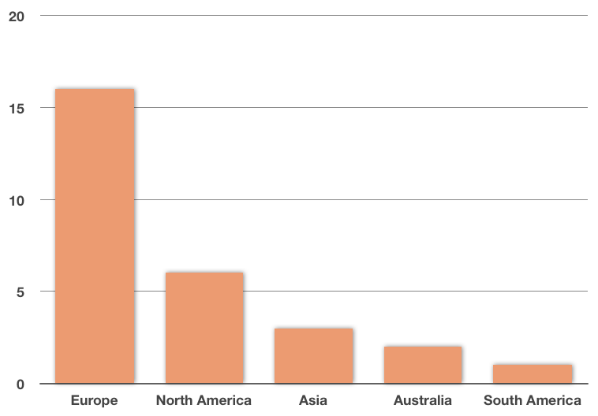
Categorical: Bar Chart (1 of 2)
Chart containing rectangles (“bars”) where length represents count, amount, or percent (aka “column chart”)
Usually better than table for comparing numbers
https://www.kristakingmath.com/blog/bar-graphs-and-pie-charts
https://www.kristakingmath.com/blog/bar-graphs-and-pie-charts
Olympic Games Hosted
Continent

Slide 6
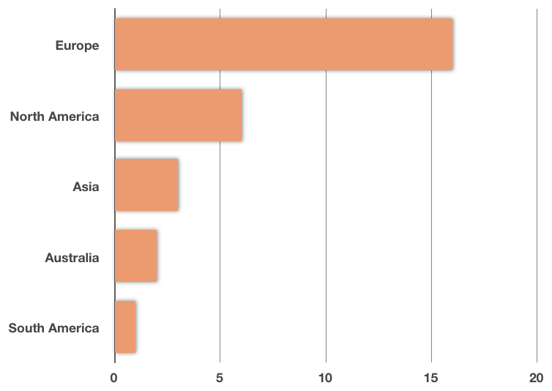
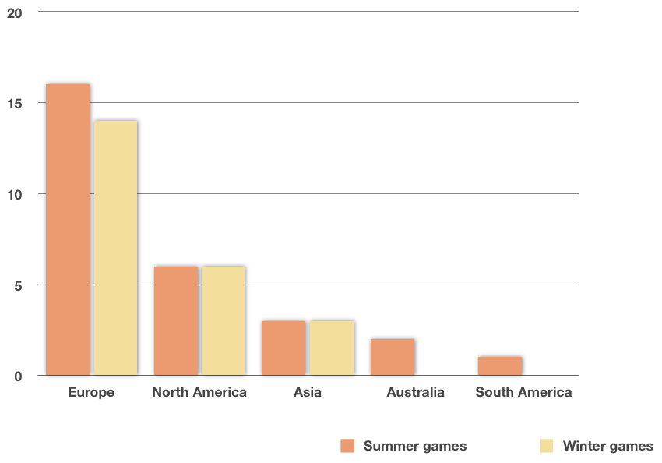
Categorical: Bar Chart (2 of 2)
Chart containing rectangles (“bars”) where length represents count, amount, or percent
https://www.kristakingmath.com/blog/bar-graphs-and-pie-charts
https://www.kristakingmath.com/blog/bar-graphs-and-pie-charts

Slide 7
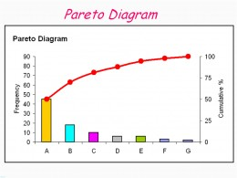
Categorical: Pareto Chart
Bar chart, arranged most to least frequent
Line showing cumulative percent
Helps identify most common
https://usercontent2.hubstatic.com/3767965_f520.jpg
Sort by column D (Data -> Sort high to low)
New column E for percent [=D2/SUM(D$2:D$11)]
Note: $ “locks” value in (e.g., D$2 versus D2)
New column F for running [=SUM(E$2:E2)]
Select B, D and F. Insert “combo chart”

Slide 8
Categorical: Pie Chart
Wedge-shaped areas (“pie slices”) – represent count, amount or percent of each category from whole
Compare relative amounts at a glance
Best if few slices since quantifying “size” of pie difficult
Comparing pies also difficult
http://www.cs.wpi.edu/~claypool/iqp/tf2/
Reflex: don’t use a pie chart
Notes:
Joseph Blackman, Stephen Lafortune, and Adam Myers. The Effects of Latency and Jitter on a First Person Shooter: Team Fortress 2, Interactive Qualifying Project IQP-MLC-LJ15, Worcester Polytechnic Institute, Spring 2016. (Advisor Mark Claypool) Online at: http://www.cs.wpi.edu/~claypool/iqp/tf2/
Figure 5.1: Age and Experience Distributions of Participants

Slide 9
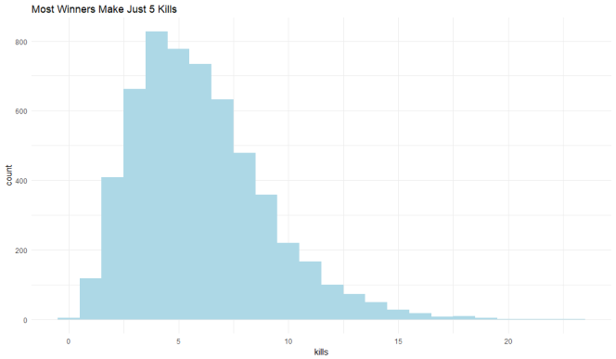
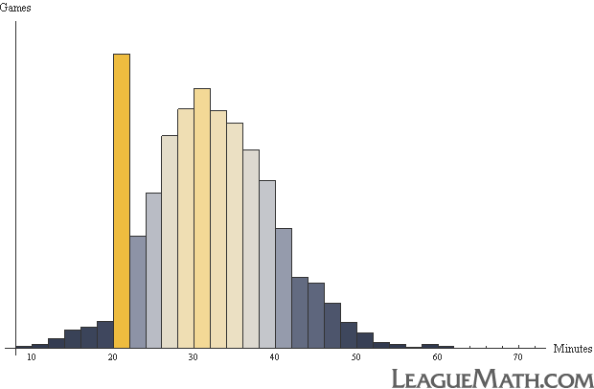
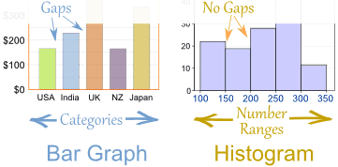
Histogram
Bar chart for grouped numerical data
- No gaps btwn adjacent bars
#kills winners make in PUBG
Select GPA data
Insert → Statistics Chart → Histogram
Can adjust bins, overflow/underflow
https://theparttimeanalyst.com/2018/12/10/pubg-eda/
0 5 10 15 20
http://www.leaguemath.com/early-vs-late-game-champions/
Kills
https://www.mathsisfun.com/data/images/bar-chart-vs-histogram.gif

Slide 10
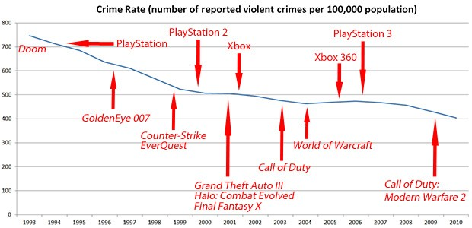
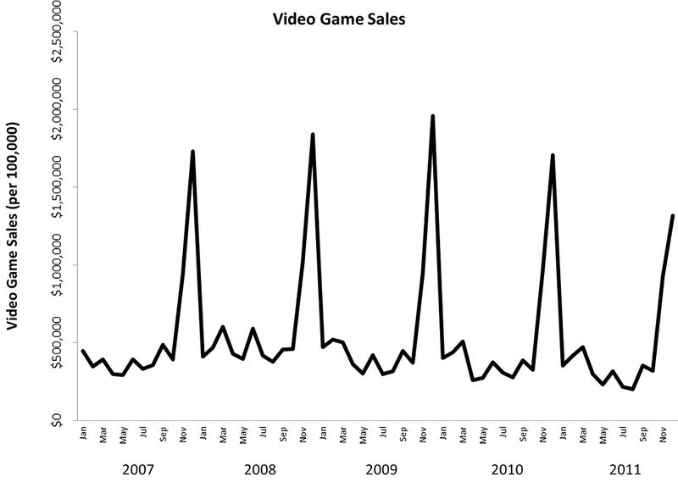
Time Series Plot
Associate data with date
Line graph with dates (proportionally spaced!)
http://www.soundandvision.com/content/violence-and-video-games
http://www.polygon.com/2014/9/12/6141515/do-violent-video-games-actually-reduce-real-world-crime
Sel. year and majors
Insert → Line Chart
→ More Line Charts

Slide 11
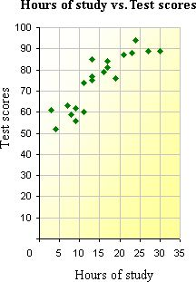
Two Variables –
Scatter Plot
Two numerical variables, one on each axis
Reveal patterns in relationship
Setup “right” models (later)
“Intelligent Simulation of Worldwide Application Distribution for OnLive's Server Network”
http://www.cs.wpi.edu/~claypool/mqp/onlive/
Select two of {win, pick, ban}
Insert → scatter plot
Notes:
Samuel Jaffe, Brendan Stephen, and Thinh Nguyen. Intelligent Simulation of Worldwide Application Distribution for OnLive's Server Network, Major Qualifying Project E-project-033014-145824, Computer Science, Spring 2014. (Advisors Mark Claypool and David Finkel) Online at: http://www.cs.wpi.edu/~claypool/mqp/onlive/
Figure 25: Failure Rate vs. Number of AppHosts with 1000 second average session length

Slide 12
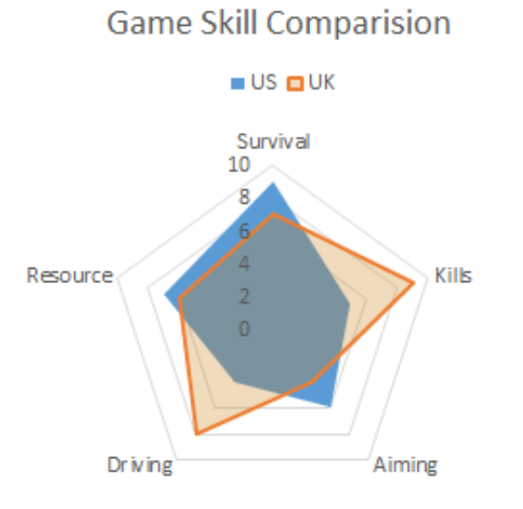
Radar Chart (1 of 2)
Also called “star”, “spider”, “web” or “kiviat” charts
Good for quick visual comparison, especially when axes unequal
PUBG game comparison
Select top line {win, pick, ban} + 3 row s (Ctrl-select)
Insert → Other → Radar scatter plot
https://www.exceltip.com/wp-content/uploads/2019/11/00213.png
Note: need to normalize data to scale Axes
Insert column E (“B Norm”)
=E2/MAX(E$2:E42)
Copy and paste down

Slide 13
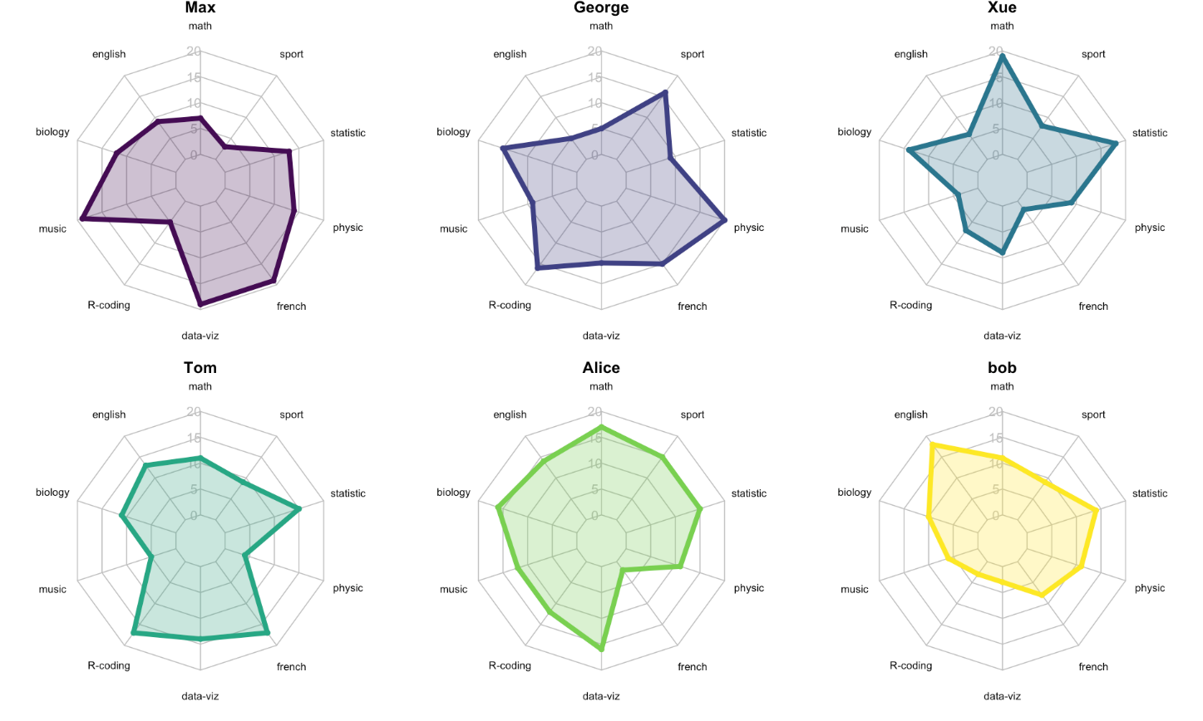
Radar Charts (2 of 2)
Note, axes themselves hard to read values
Value is to compare shapes
https://www.data-to-viz.com/caveat/spider.html

Slide 14
Many More Charts!
https://en.wikipedia.org/wiki/Chart
Bubble
Waterfall
Tree
Gap
Polar
Violin
Candlestick
Kagi
Gantt
Nolan
Pert
Smith
Skyline
Vowel
Nomogram
Natal
If common chart effective for message, use
Otherwise, learn/use other charts as needed
But remember – may need to explain how to read

Slide 15
Outline
Types of Charts (done)
Game Analytics Examples (next)
Guidelines for Charts

Slide 16
Game Analytics Visual Analysis
Gunter Wallner and Simone Kriglstein. “An Introduction to Gameplay Data Visualization”, Game Research Methods, pages 231-250, ETC Press, ISBN: 978-1-312-88473-1, 2015. http://dl.acm.org/citation.cfm?id=2812792
Player choices (e.g., build units)
Density of activities (e.g., where spend time on map)
Movement through levels

Slide 17
Player Choices – Pie-Chart
(Custom game, comparative study)

Slide 18
Player Location – Heat Map (1 of 2)

Slide 19
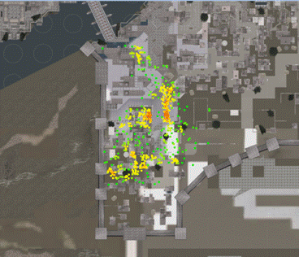
Player Location – Heat Map (2 of 2)
Assassin’s Creed
Where play testers failed
Result: Make red areas easier
http://www.gamasutra.com/blogs/JonathanDankoff/20140320/213624/Game_Telemetry_with_DNA_Tracking_on_Assassins_Creed.php

Slide 20
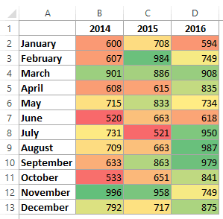
Note, Heat Map for Tables, Too!
Red means sales are low
Excel tutorial at: https://trumpexcel.com/heat-map-excel/

Slide 21
Movement (1 of 2)
(game: Infinite Mario, clone of Super Mario Bros.)

Slide 22
Movement (2 of 2)

Slide 23
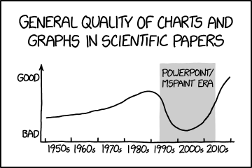
Outline
Types of Charts (done)
Game Analytics Examples (done)
Guidelines for Charts (next)
https://xkcd.com/1945/

Slide 24
Guidelines for Good Charts (1 of 7)
Require minimum effort from reader
  Perhaps most important metric
  Given two, can pick one that takes less reader effort
a
a
b
c
b
e.g.,
c
Direct Labeling
Legend Box

Slide 25
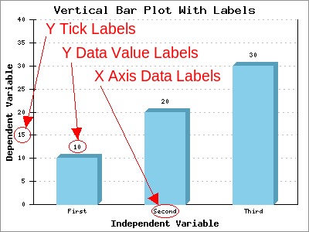
Guidelines for Good Charts (2 of 7)
Maximize information
  Make self-sufficient
  Key words in place of symbols
    e.g., “Gold IV” not “Player A”
    e.g., “Daily Games Played” not “Games Played”
  Axis labels as informative as possible
    e.g., “Game Time (seconds)” not “Game Time”
  Help by using captions (or title, if stand-alone)
    e.g., “Game time in seconds versus player skill in total hours played”
http://www.phplot.com/phplotdocs/conc-labels.html

Slide 26
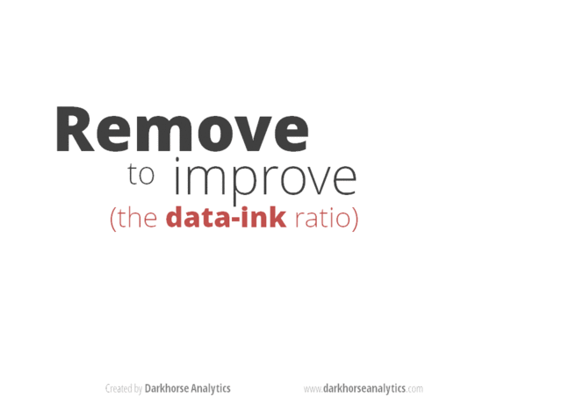
Guidelines for Good Charts (3 of 7)
Minimize ink
https://www.slideshare.net/NicoleMarinsek/darkhorse-line-chart

Slide 27
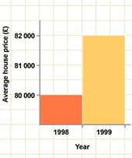
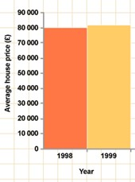
Guidelines for Good Charts (4 of 7)
Use commonly accepted practices
  Present what people expect
  e.g., origin at (0,0)
  e.g., independent (cause) on x-axis, dependent (effect) on y-axis
  e.g., x-axis scale is linear
  e.g., increase left to right, bottom to top
  e.g., scale divisions equal, proportional
Departures are permitted but require extra effort from reader → so use sparingly!
vs.

Slide 28
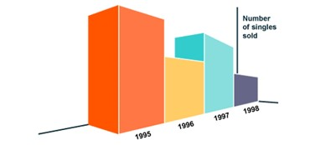
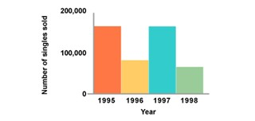
Guidelines for Good Charts (5 of 7)
Avoid ambiguity
  Show coordinate axes
    at right angles
  Show origin
    usually at (0,0)
  Identify individual curves and bars
    With key/legend or label
  Do not plot multiple variables on same chart
    Single y-axis
vs.
http://www.carltonassociatesinc.com/images/confusion-new.jpg

Slide 29
Guidelines for Good Charts (6 of 7)
Don’t connect categorical data with lines
  Lines joining successive points signify that they can be approximately interpolated
  If don’t have meaning, should not use line chart
- No linear relationship between champion types
Don’t connect with lines
Instead, use column chart
Assists
jungle
top
mid
support

Slide 30
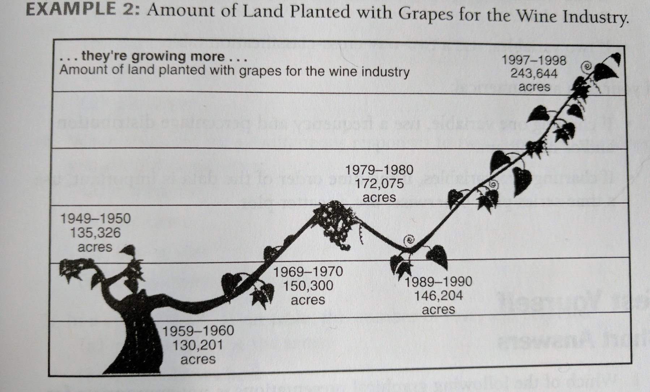
Guidelines for Good Charts (7 of 7)
Avoid pictorial charts and focus on meaning
Missing x-axis (1997 too far over)
Missing y-axis hard to compare (1950 height > 1970)
Data points unclear

Slide 31

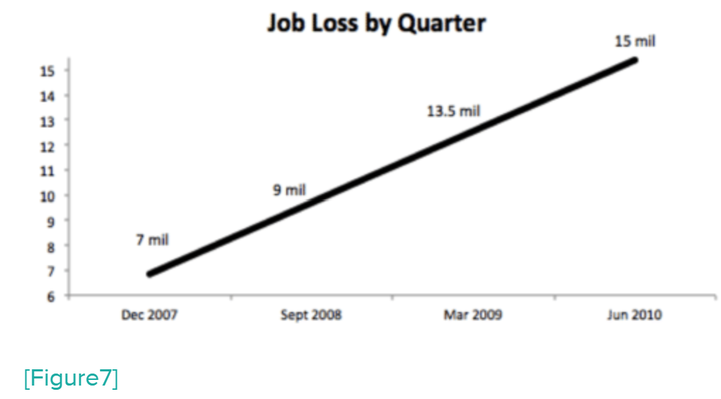
Groupwork
Improving Bad Charts
Work Solo: Study chart. Identify improvements. Write down.
Work as a Team: Compare lists. Discuss.
Write down combined.
https://web.cs.wpi.edu/~imgd2905/d24/groupwork/2-bad-charts/handout.html

Slide 32
Checklist for Good Charts
Axes
  Are both axes labeled?
  Are the axis labels self-explanatory and concise?
  Are the scale and divisions shown on both axes?
  Are the min and max ranges appropriate?
  Are the units indicated?
Lines/Curves/Points
  Is the number of lines/curves reasonably small?
  Are curves labeled?
  Are all symbols clearly distinguishable?
  Is a concise, clear legend provided?
  Does the legend obscure any data?
Information
  If the y-axis is variable, is an indication of spread (error bars) shown?
  Are grid lines required to read data (if not, then remove)?
Scale
  Are units increasing left to right (x-axis) and bottom to top (y-axis)?
  Do all charts use the same scale?
  Are the scales contiguous?
  Is bar chart order systematic?
  Are bars appropriate width, spacing?
Overall
  Does the whole chart add information to reader?
  Are there no curves/symbols/text that can be removed and still have the same information?
  Does the chart have a title or caption (not both)?
  Is the chart self-explanatory and concise?
  Do the variables plotted give more information than alternatives?
  Is chart referenced and discussed in any accompanying report?
Notes:
Based on Raj Jain, The Art of Computer Systems Performance Analysis, Box 10.1

Slide 33
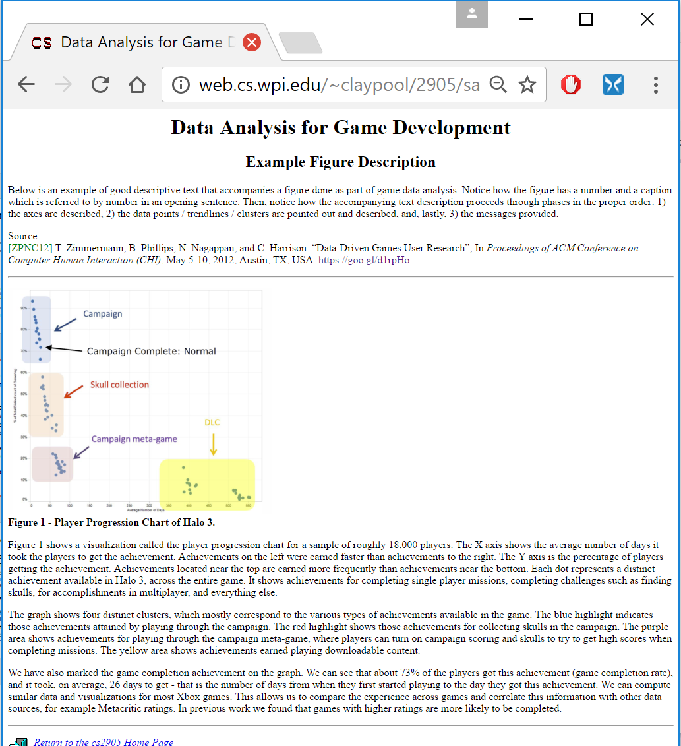
Describing Chart in Report & Presentation
“Formula”
  Describe all axes
    E.g., “The x-axis is time since game began, in seconds”
  Describe data sets/trendlines
    E.g., “The blue dots are the average maze completion time”
  Then provide message
    E.g., “Notice how the red bar is higher than the blue, indicating that …”
Example on Web page
http://web.cs.wpi.edu/~imgd2905/d24/samples/analysis-example.html

Slide 34

Guidelines for Good Charts (Summary)
For each chart, go over “checklist”
The more “yes” answers, the better
  Remember, while guidelines, art and not science
  So, may consciously decide not to follow these guidelines if better without them → but have good reason!
In practice, takes several trials before arriving at “best” chart
Want to present message the most: accurately, simply, concisely, logically
Accompany with description! Text or verbal
  Remember, audience/reader has not seen! – Make sure to introduce

