Slide 1
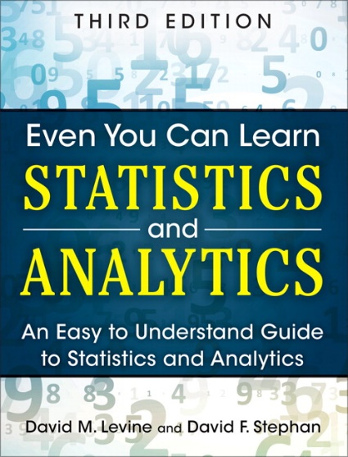
Inferential Statistics
IMGD 2905
Chapter 6 & 7

Slide 2
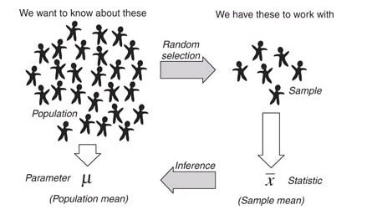
Overview
Use statistics to infer population parameters
http://3.bp.blogspot.com/_94E2PdKwaXE/S-xQRuoiKAI/AAAAAAAAABY/xvDRcG_Mcj0/s1600/120909_0159_1.png
Inferential statistics

Slide 3
Outline
Overview (done)
Foundation (next)
Inferring Population Parameters
Hypothesis Testing

Slide 4

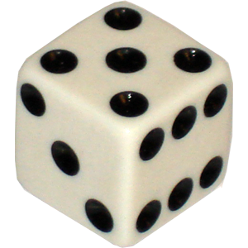
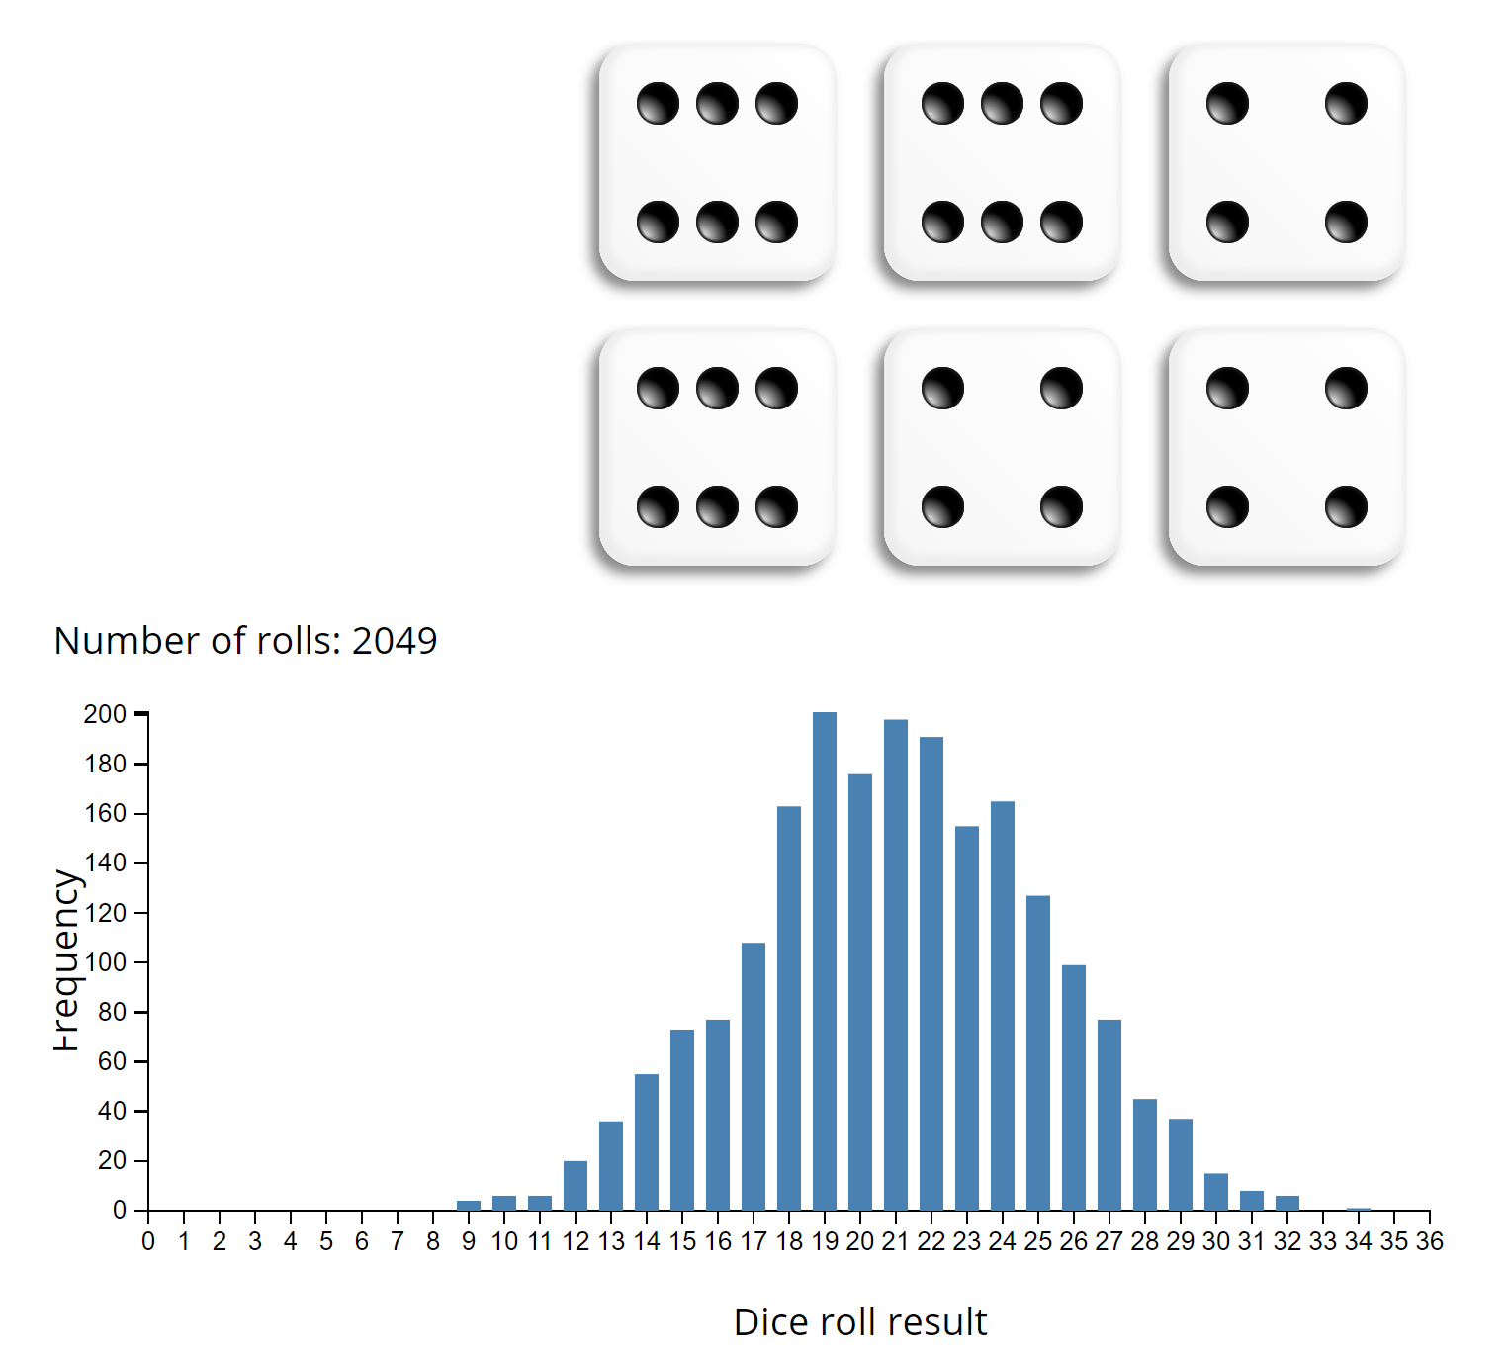
Groupwork
Remember, probability distribution shows possible outcomes on x-axis and probability of each on y-axis.
Describe the probability distribution of 1 d6?
Describe the probability distribution of 2 d6?
Describe the probability distribution of 3 d6?
Icebreaker, Groupwork, Questions
https://web.cs.wpi.edu/~imgd2905/d24/groupwork/6-prob-dist/handout.html
https://academo.org/demos/dice-roll-statistics/

Slide 5
Dice Rolling (1 of 4)
Have 1d6, sample (i.e., roll 1 die)
What is probability distribution of values?

Slide 6
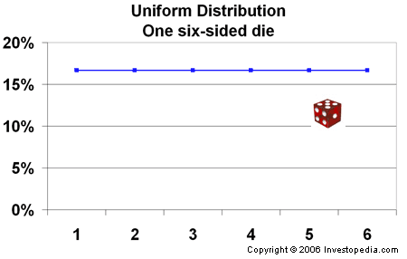
Dice Rolling (1 of 4)
Have 1d6, sample (i.e., roll 1 die)
What is probability distribution of values?
“Square“ distribution
http://www.investopedia.com/articles/06/probabilitydistribution.asp

Slide 7
Dice Rolling (2 of 4)
Have 1d6, sample twice and sum (i.e., roll 2 dice)
What is probability distribution of values?

Slide 8
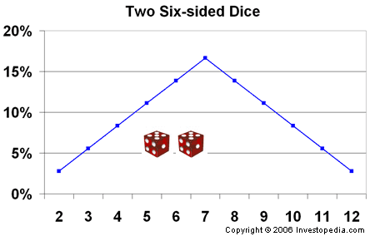
Dice Rolling (2 of 4)
Have 1d6, sample twice and sum (i.e., roll 2 dice)
What is probability distribution of values?
“Triangle“ distribution
http://www.investopedia.com/articles/06/probabilitydistribution.asp

Slide 9
Dice Rolling (3 of 4)
Have 1d6, sample thrice and sum (i.e., roll 3 dice)
What is probability distribution of values?

Slide 10
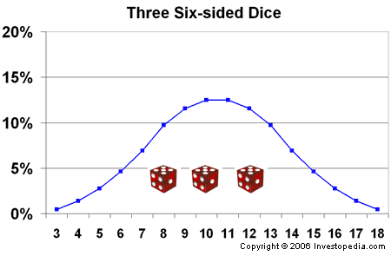
Dice Rolling (3 of 4)
Have 1d6, sample thrice and sum (i.e., roll 3 dice)
What is probability distribution of values?
What’s happening to the shape?
http://www.investopedia.com/articles/06/probabilitydistribution.asp

Slide 11
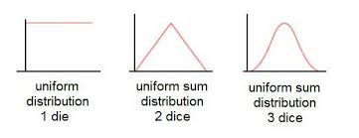
Dice Rolling (3 of 4)
Have 1d6, sample thrice and sum (i.e., roll 3 dice)
What is probability distribution of values?
What’s happening to the shape?

Slide 12
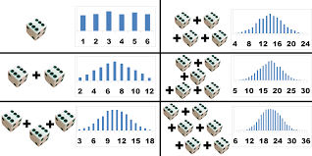
Dice Rolling (4 of 4)
Same holds for general experiments with dice (i.e., observing sample sum and mean of dice rolls)
Resulting sum/mean follows a normal distribution
→ Even though base distribution is uniform!
http://www.muelaner.com/uncertainty-of-measurement/
Ok, neat – for “square” distributions (e.g., d6).
But what about experiments with other distributions?

Slide 13
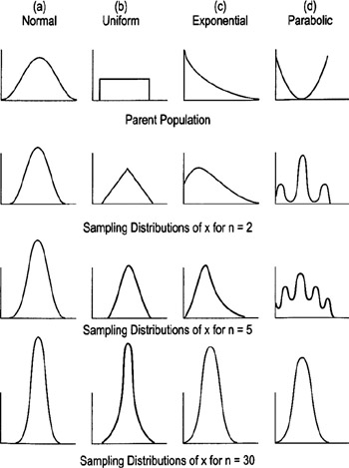
Sampling Distributions
http://flylib.com/books/2/528/1/html/2/images/figu115_1.jpg

Slide 14
Sampling Distributions
With “large enough” sample size, sum/mean looks “bell-shaped” → Normal!
How many is large enough?
  30 (15 if symmetric distribution)
Central Limit Theorem
  Sum of independent variables tends towards Normal distribution
http://flylib.com/books/2/528/1/html/2/images/figu115_1.jpg

Slide 15
Sampling Distributions
With “large enough” sample size, sum/mean looks “bell-shaped” → Normal!
How many is large enough?
  30 (15 if symmetric distribution)
Central Limit Theorem
  Sum of independent variables tends towards Normal distribution
http://flylib.com/books/2/528/1/html/2/images/figu115_1.jpg

Slide 16
Sampling Distributions
With “large enough” sample size, sum/mean looks “bell-shaped” → Normal!
How many is large enough?
  30 (15 if symmetric distribution)
Central Limit Theorem
  Sum of independent variables tends towards Normal distribution
http://flylib.com/books/2/528/1/html/2/images/figu115_1.jpg

Slide 17
Sampling Distributions
With “large enough” sample size, sum/mean looks “bell-shaped” → Normal!
How many is large enough?
  30 (15 if symmetric distribution)
Central Limit Theorem
  Sum of independent variables tends towards Normal distribution
http://flylib.com/books/2/528/1/html/2/images/figu115_1.jpg

Slide 18
Sampling Distributions
With “large enough” sample size, sum/mean looks “bell-shaped” → Normal!
How many is large enough?
  30 (15 if symmetric distribution)
Central Limit Theorem
  Sum of independent variables tends towards Normal distribution
http://flylib.com/books/2/528/1/html/2/images/figu115_1.jpg

Slide 19
Sampling Distributions
With “large enough” sample size, sum/mean looks “bell-shaped” → Normal!
How many is large enough?
  30 (15 if symmetric distribution)
Central Limit Theorem
  Sum of independent variables tends towards Normal distribution
http://flylib.com/books/2/528/1/html/2/images/figu115_1.jpg

Slide 20
Sampling Distributions
With “large enough” sample size, sum/mean looks “bell-shaped” → Normal!
How many is large enough?
  30 (15 if symmetric distribution)
Central Limit Theorem
  Sum of independent variables tends towards Normal distribution
http://flylib.com/books/2/528/1/html/2/images/figu115_1.jpg

Slide 21
Sampling Distributions
With “large enough” sample size, sum/mean looks “bell-shaped” → Normal!
How many is large enough?
  30 (15 if symmetric distribution)
Central Limit Theorem
  Sum/mean of independent variables tends towards Normal distribution
http://flylib.com/books/2/528/1/html/2/images/figu115_1.jpg

Slide 22
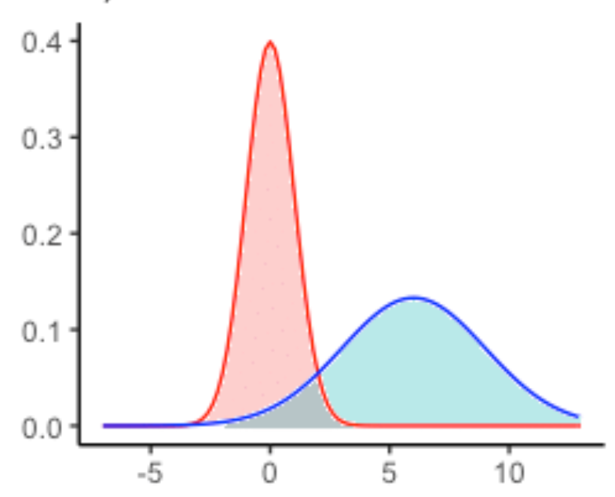
Why do we care about sample means following Normal distribution?
What if we had only a sample mean and no measure of spread
  e.g., mean score is 3
What can we say about population mean?
  Not a whole lot!
  Yes, population mean could be 6. But could be 0. How likely are each?
  → No idea!
A
A
B
B
Sample mean
Population mean?

Slide 23
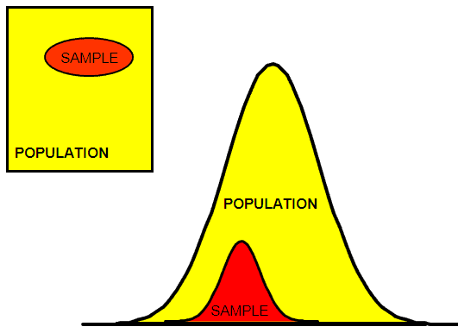
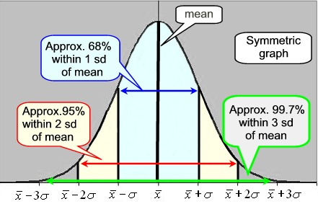
Why do we care about sample means following Normal distribution?
Remember this?
http://www.six-sigma-material.com/images/PopSamples.GIF
With mean and standard deviation
Allows us to predict range to bound population mean
(see next slide)

Slide 24
Why do we care about sample means following Normal distribution?
Sample mean
Actual population mean (probably) in this range!
Probable range of population mean

Slide 25
Outline
Overview (done)
Foundation (done)
Inferring Population Parameters (next)
Hypothesis Testing

Slide 26
Estimating Population Mean
Underlying data follows uniform probability distribution (d6)
  But assume population mean unknown
(Example)
Sample Sample Mean
1 d6 4.0
2 d6 (4 + 2) / 2 = 3.0
3 d6 (1 + 6 + 2) / 3 = 2.3
4 d6 (4 + 4 + 2 + 3) / 4 = 3.3
Q: How do we estimate the population mean?

Slide 27
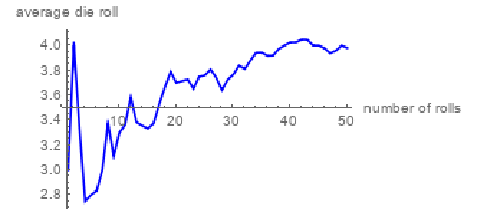
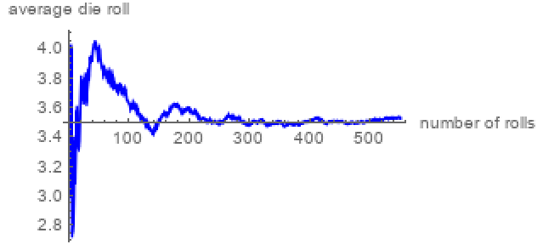
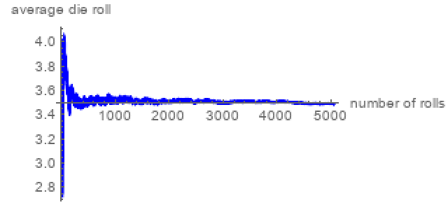
Estimating Population Mean
Sample size 50
Q: What happens as sample size increases?
Q: How big a sample do we need?
  Depends upon how much varies
Values that are not the mean contribute to “error” → sampling error
Sample size 500
Sample size 5000
https://demonstrations.wolfram.com/LawOfLargeNumbersDiceRollingExample/

Slide 28
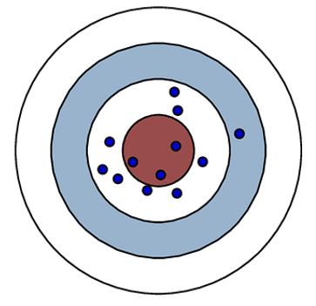
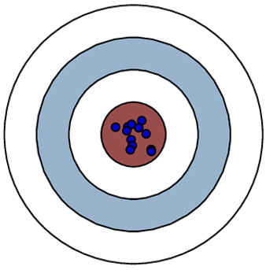
Sampling Error
Error from estimating population parameters from sample statistics is sampling error
Exact error often cannot be known (do not know population parameters)
But size of error based on:
  Variation in population (σ) itself – more variation, more sample statistic variation (s)
  Sample size (N) – larger sample, lower error
    Q: Why can’t we just make sample size super large?
How much does it vary? → Standard error
high variance
low variance

Slide 29
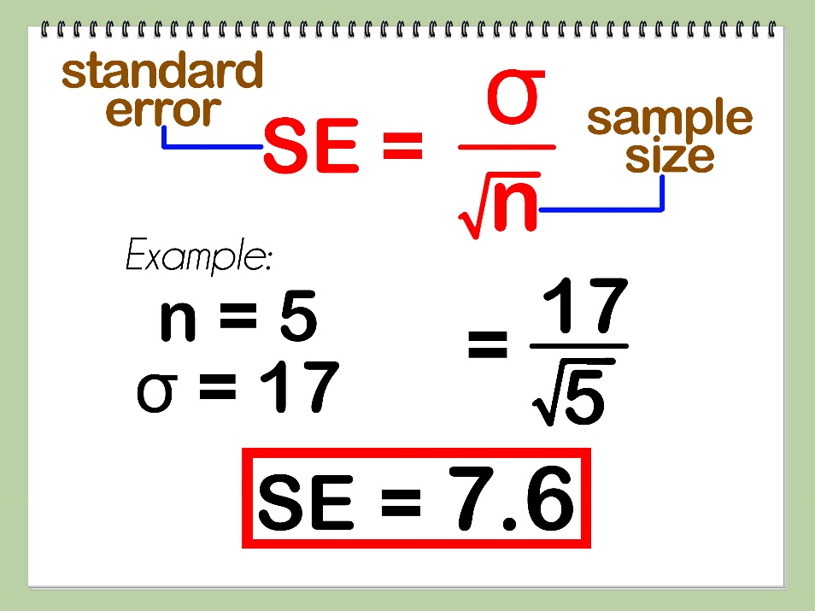
Standard Error
Amount sample means will vary from experiment to experiment of same size
  Standard deviation of the sample means
Also, likelihood that sample statistic is near population parameter
s
What does the size of the standard error depend upon? (Hint: see formula above)
So what? Reason about population mean
e.g., 95% confident that sample mean is within ~ 2 SE’s
(where does this come from?)

Slide 30
Standard Error
Amount sample means will vary from experiment to experiment of same size
  Standard deviation of the sample means
Also, likelihood that sample statistic is near population parameter
s
Depends upon sample size (N)
Depends upon standard deviation (s)
So what? Reason about population mean
e.g., 95% confident that sample mean is within ~ 2 SE’s
(where does this come from?)
(Example next)

Slide 31
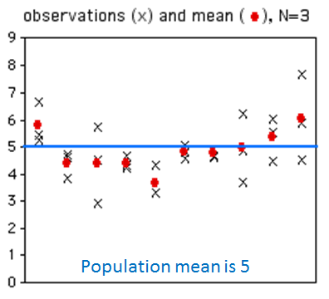
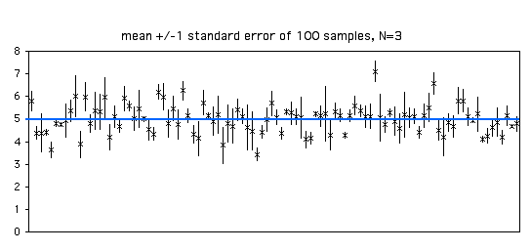
Standard Error (2 of 2)
standard error, 100 experiments, N=3
If N = 20:
What will happen to x’s?
What will happen to dots?
If N=20:
What will happen to means?
What will happen to bars?
How many will cross the blue line?
Groupwork!
http://www.biostathandbook.com/standarderror.html

Slide 32
Groupwork
How many of the bars intersect the blue?
What do graphs look like N = 20?
Now, how many bars intersect?
Standard Error
https://web.cs.wpi.edu/~imgd2905/d24/groupwork/7-std-error/handout.html
standard error, 100 experiments, N=3

Slide 33
Standard Error (2 of 2)
standard error, 100 experiments, N=3
If N = 20:
What will happen to x’s?
What will happen to dots?
If N=20:
What will happen to means?
What will happen to bars?
How many will cross the blue line?
http://www.biostathandbook.com/standarderror.html

Slide 34
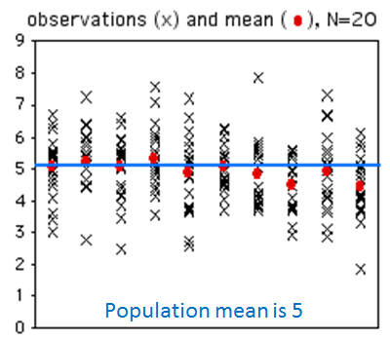
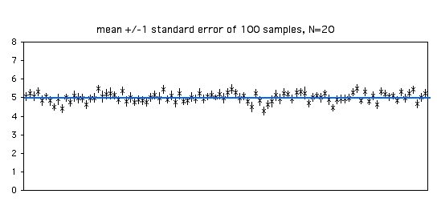
Standard Error (2 of 2)
standard error, 100 experiments, N=3
standard error, 100 experiments, N=20
How many cross the blue line?
Estimate population parameter → confidence interval
http://www.biostathandbook.com/standarderror.html

Slide 35
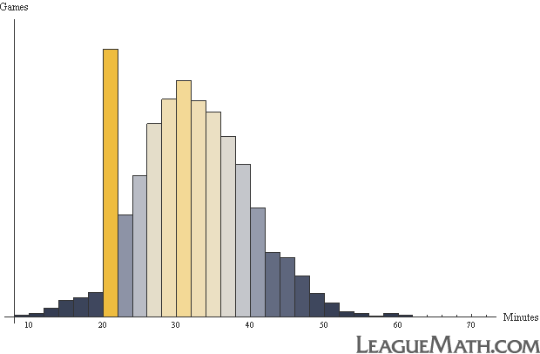
Confidence Interval
Range of values with specific certainty that population parameter is within
  e.g., 90% confidence interval for mean League of Legends match duration: [28.5 minutes, 32.5 minutes]
Have sample of durations
Compute interval containing mean population duration (μ)
  (with 90% confidence)
Mean:
30.5
In general:
probability of μ in interval [c₁,c₂] with A confidence
28.5
32.5

Slide 36
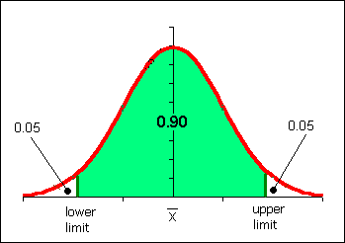
Confidence Interval for Mean
Probability of μ in interval [c₁,c₂]
  P(c₁ < μ < c₂) = 1-α
  [c1, c2] is confidence interval
  α is significance level
  100(1-α) is confidence level
Typically want α small so confidence level 90%, 95% or 99% (more on effect later)
Say, α = 0.1. Could do k experiments (size n), find sample means, sort
  Graph distribution
Interval from distribution:
  Lower bound: 5%
  Upper bound: 95%
  → 90% confidence interval
So, do we have to do k experiments, each of size n?!
http://www.comfsm.fm/~dleeling/statistics/notes009_normalcurve90.png

Slide 37
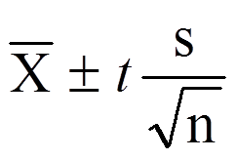
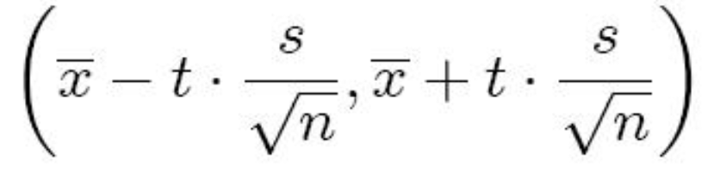
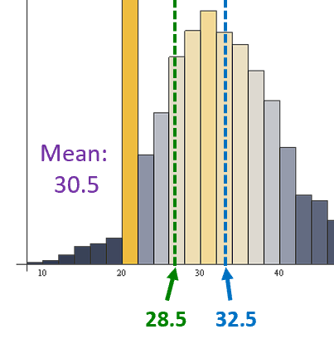
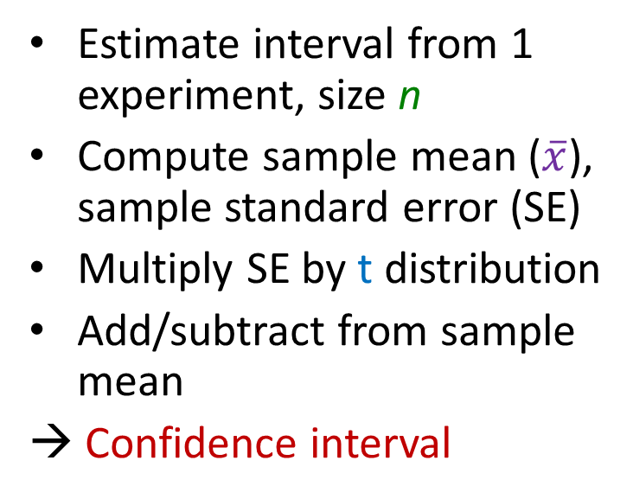
Confidence Interval Estimate
Estimate interval from 1 experiment, size n
Compute sample mean ($\overline{x}\text{)}$, sample standard error (SE)
Multiply SE by t distribution
Add/subtract from sample mean
→ Confidence interval
e.g., mean 30.5
t x SE = 2
30.5 - 2 = 28.5
30.5 + 2 = 32.5
[28.5, 32.5]
Ok, what is t distribution?
  Function, parameterized by α and n

Slide 38
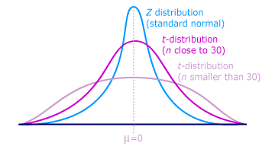
t distribution
Looks like standard normal, but bit “squashed”
Gets more less squashed as n gets larger
Note, can use standard normal (z distribution) when large enough sample size (n = 30+)
aka student’s t distribution (“student” was anonymous name used when published by William Gosset)
http://ci.columbia.edu/ci/premba_test/c0331/images/s7/6317178747.gif

Slide 39
Computing a Confidence Interval – Example
(Unsorted)
Game Time
Suppose gathered game times in a user study (e.g., for your MQP)
Can compute sample mean, yes
But really want to know where population mean is
→ Bound with confidence interval
4.4
3.8
2.8
4.2
2.8
2.9
1.9
5.9
3.9
3.2
4.1
5.3
3.6
5.1
2.7
3.9
3.9
3.2
4.1
3.3
2.8
4.2
3.1
4.5
4.5
4.8
4.9
5.1
3.7
3.4
5.6
3.1

Slide 40

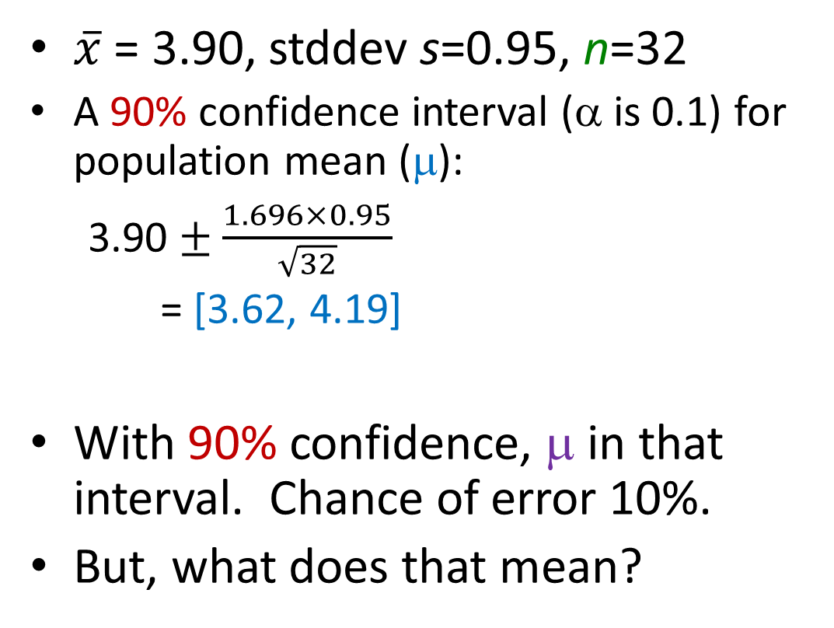
Computing a Confidence Interval – Example
(Sorted)
Game Time
$\overline{x}$ = 3.90, stddev s=0.95, n=32
  A 90% confidence interval (α is 0.1) for population mean (μ):
  3.90 $±$ $\frac{1.696×0.95}{\sqrt{32}}$
  = [3.62, 4.19]
With 90% confidence, μ in that interval. Chance of error 10%.
But, what does that mean?
1.9
2.7
2.8
2.8
2.8
2.9
3.1
3.1
3.2
3.2
3.3
3.4
3.6
3.7
3.8
3.9
3.9
3.9
4.1
4.1
4.2
4.2
4.4
4.5
4.5
4.8
4.9
5.1
5.1
5.3
5.6
5.9
Need t
=TINV(0.1,31)
→ 1.696
(See next slide for depiction of meaning)

Slide 41
Meaning of Confidence Interval (α)
μ
  If 100 experiments and confidence level is 90%:
  90 cases interval includes μ, in 10 cases not include μ
f(x)
Experiment/Sample Includes μ?
1 yes
2 yes
3 no
… e.g.,
100 yes α =0.1
Total yes > 100 (1-α) 90
Total no < 100 α 10

Slide 42
How does Confidence Interval Size Change?
With sample size (N)
With confidence level (1-α)
Look at each separately next

Slide 43
How does Confidence Interval Change (1 of 2)?
What happens to confidence interval when sample size (N) increases?
  Hint: think about Standard Error

Slide 44
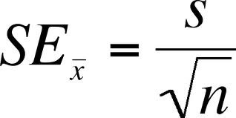
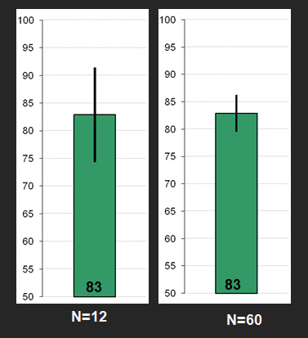
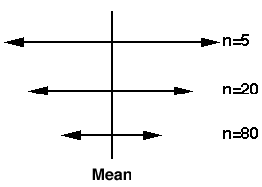
How does Confidence Interval Change (1 of 2)?
What happens to confidence interval when sample size (N) increases?
  Hint: think about Standard Error

Slide 45
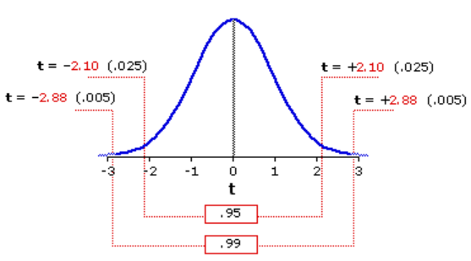
How does Confidence Interval Change (2 of 2)?
What happens to confidence interval when confidence level (1-α) increases?
90% CI = [6.5, 9.4]
  90% chance population value is between 6.5, 9.4
95% CI = [6.1, 9.8]
  95% chance population value is between 6.1, 9.8
Why is interval wider when we are “more” confident?
http://vassarstats.net/textbook/f1002.gif

Slide 46
How does Confidence Interval Change (2 of 2)?
What happens to confidence interval when confidence level (1-α) increases?
90% CI = [6.5, 9.4]
  90% chance population value is between 6.5, 9.4
95% CI = [6.1, 9.8]
  95% chance population value is between 6.1, 9.8
Why is interval wider when we are “more” confident? See distribution on the right
http://vassarstats.net/textbook/f1002.gif

Slide 47
Groupwork –
Interpreting a Confidence Interval
Stay tuned! Example coming

Slide 48
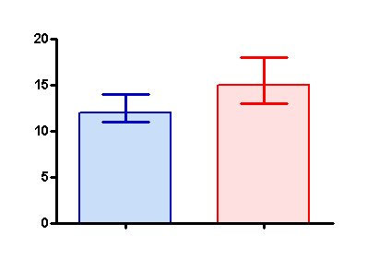
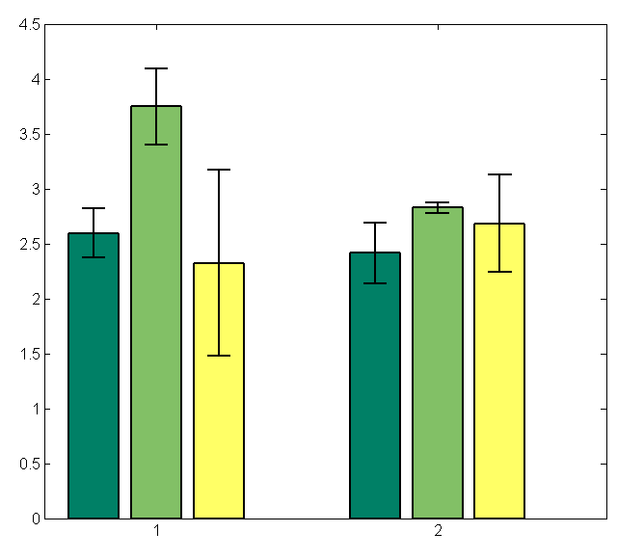
Using Confidence Interval (1 of 3)
For charts, depict with error bars
CI different than standard deviation
  Standard deviation show spread
  CI bounds population parameter (decreases with N)
→ CI indicates range of population parameter
Make sure sample size N=30+ (N=15+ if somewhat normal.
Any N if know distro is normal)

Slide 49
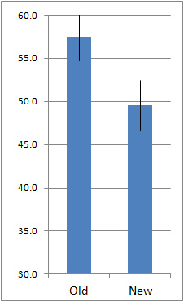
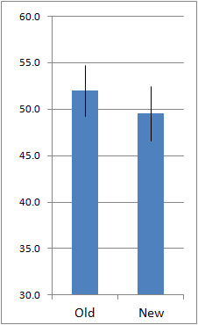
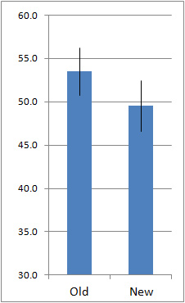
Using Confidence Interval (2 of 3)
https://measuringu.com/ci-10things/
No overlap
Large overlap
Some overlap
Compare two alternatives, quick check for statistical significance
No overlap? → 90% confident difference (at α = 0.10 level)
Large overlap (50%+)? → No statistically significant diff (at α = 0.10 level)
Some overlap? → more tests required

Slide 50
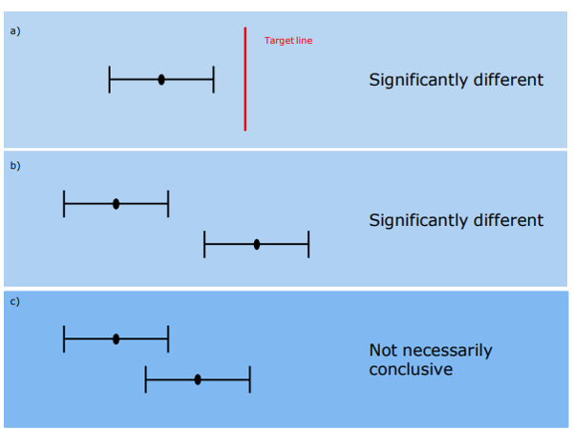
Interpreting Confidence Intervals
Assume bars are conference intervals
Interpret difference in old versus new
Large overlap
No statistically significant difference (at given α)
https://emedia1.nhs.wales/PublicHealthWales/cache/file/DF7D68CA-6C7F-42BA-87FFCBD9FF0668BB.png
Helpful hint: ignore sample means. Think about population means for Old and New

Slide 51
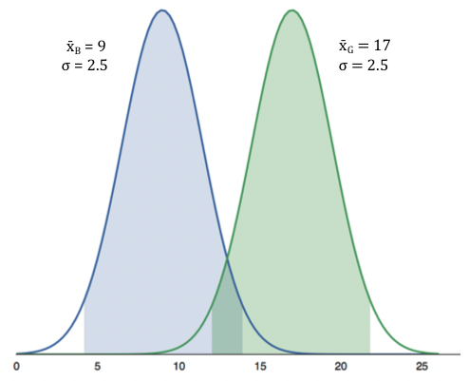
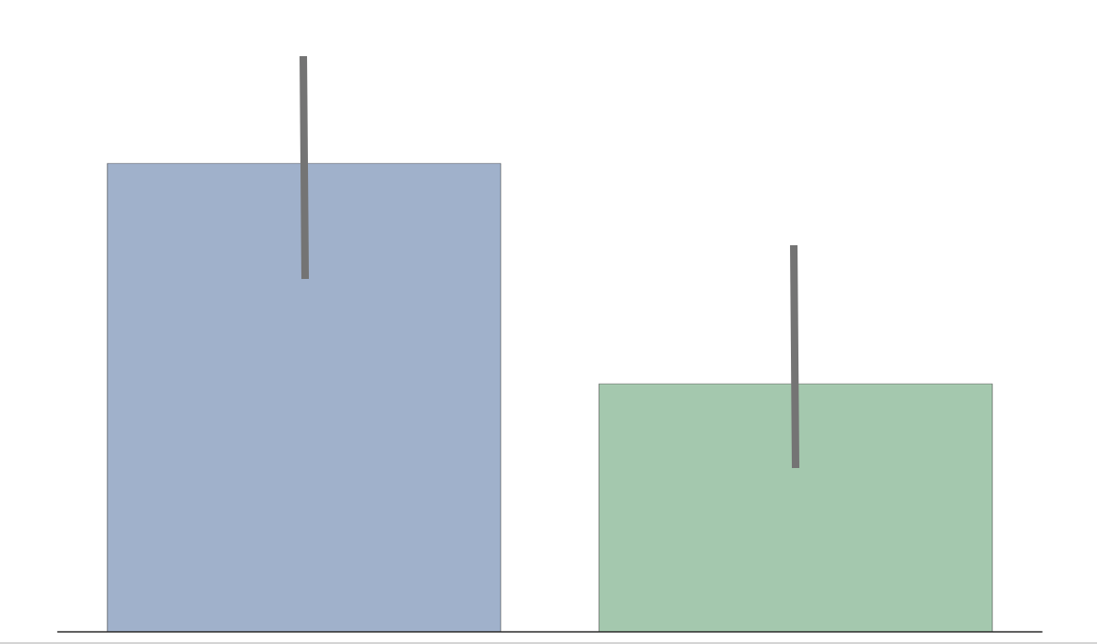
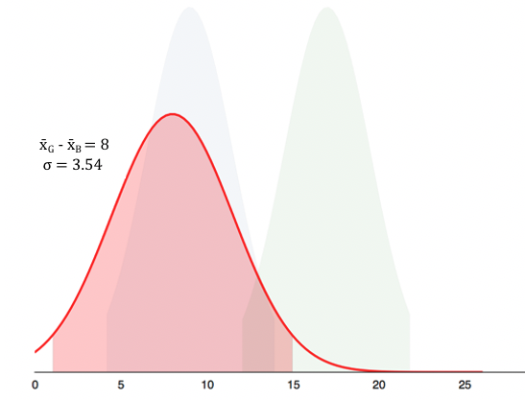
Using Confidence Interval (3 of 3)
[Some Overlap]
(Some overlap)
(Here is the overlap)
But if compute difference, and then confidence interval does not cross 0!
(Caused by error propagation)

Slide 52
How Not to Use Confidence Intervals
(1 of 2)
“The confidence intervals of the two groups overlap, hence the difference is not statistically significant” — A lot of People
Overlap – careful not to say no statistically significant difference (see previous slide)
But not significant
Overlap!

Slide 53
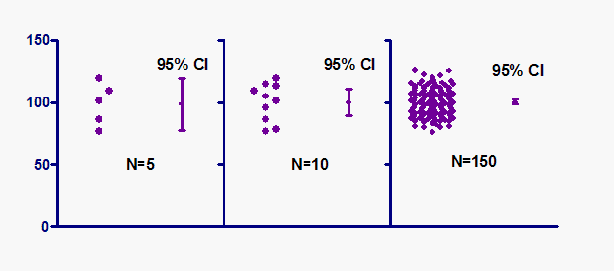
How Not to Use Confidence Intervals (2 of 2)
“The 95% confidence interval goes from C1 to C2, so 95% of all observations are between C1 and C2. — A lot of People
Do not quantify variability (e.g., 95% of values in interval)
https://www.graphpad.com/guides/prism/7/statistics/images/hmfile_hash_f71959f8.gif

Slide 54
Statistical Significance versus Practical Significance
Warning: may find statistically significant difference.
That doesn’t mean it is important.
It’s a Honey of an O
Latency can Kill?
Boxes of Cheerios, Tastee-O’s both target 12 oz.
Measure weight of 18,000 boxes (large N!)
Using statistics:
  Cheerio’s heavier by 0.002 oz.
  And statistically significant (α=0.99)!
But … 0.0002 is only ½ O. Customer doesn’t care!
Lag in League of Legends
Pay $$ to upgrade Internet from 100 Mb/s to 1000 Mb/s
Measure ping to LoL server for 20,000 samples (large N!)
Using statistics
  Ping times improve 0.4 ms
  And statistically significant (α=0.99)!
But … below perception!

Slide 55
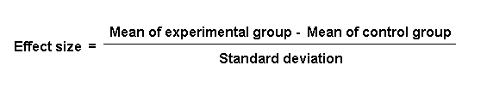
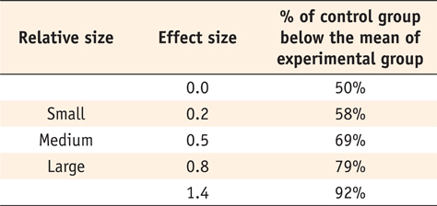
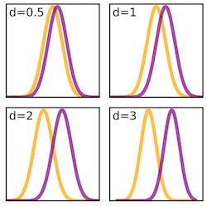
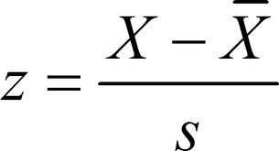
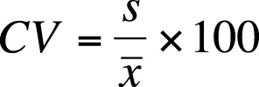
Effect Size
Quantitative measure of strength of finding
  Measures practical significance
Emphasizes size of difference of relationship
(Cohen’s d)
https://www.simplypsychology.org/cohen-d.jpg
Similar to Z-score
And Coefficient of Variation

Slide 56
What Confidence Level to Use (1 of 2)?
Often see 90% or 95% (or even 99%) used
Choice based on loss if wrong (population parameter is outside), gain if right (parameter inside)
  If loss is high compared to gain, use higher confidence
  If loss is low compared to gain, use lower confidence
  If loss is negligible, lower is fine
Example (loss high compared to gain):
  Hairspray, makes hair straight, but has chemicals
  Want to be 99.9% confident it doesn’t cause cancer
Example (loss low compared to gain):
  Hairspray, makes hair straight, mainly water
  Ok to be 75% confident it straightens hair

Slide 57
What Confidence Level to Use (2 of 2)?
Often see 90% or 95% (or even 99%) used
Choice based on loss if wrong (population parameter is outside), gain if right (parameter inside)
  If loss is high compared to gain, use higher confidence
  If loss is low compared to gain, use lower confidence
  If loss is negligible, lower is fine
Example (loss negligible compared to gain):
  Lottery ticket costs $1, pays $5 million
  Chance of winning is 10⁻⁷ (50% payout, so 1 in 10 million)
  To win with 90% confidence, need 9 million tickets
    No one would buy that many tickets ($9 mil to win $5 mil)!
  So, most people happy with 0.0001% confidence

Slide 58
Outline
Overview (done)
Foundation (done)
Inferring Population Parameters (done)
Hypothesis Testing (next)

Slide 59

Hypothesis Testing
Term arises from science
  State tentative explanation → hypothesis
  Devise experiments to gather data
  Data supports or rejects hypothesis
Statisticians have adopted to test using inferential statistics
→ Hypothesis testing
Science
Just brief overview here → Conversant
Chapters 8 & 9 in book have more
http://s1.hubimg.com/u/4205792_f520.jpg

Slide 60

Hypothesis Testing Terminology
Null Hypothesis (H₀) – hypothesis that no significance difference between measured value and population parameter (any observed difference due to error)
  e.g., population mean time for Riot to bring up NA servers is 4 hours
Alternative Hypothesis – hypothesis contrary to null hypothesis
  e.g., population mean time for Riot to bring up NA servers is not 4 hours
Care about Alternate, but test Null
  If data supports, Alternate may not be true
  If data rejects, Alternate may be true
Why Null and Alternate?
  Remember, data doesn’t “prove” hypothesis
  Can only reject it at certain significance (e.g., there is probably a difference)
  So, reject Null
P value – smallest level that can reject H₀
“If p value is low, then H₀ must go”
How “low” based on “risk” of being wrong (like confidence interval)
http://www.buzzle.com/img/articleImages/605910-49223-57.jpg

Slide 61
Example – Smelling Salts and Athletes
Smelling salts helps e-sports?
Alternative hypothesis - Smelling salts improves performance
Null hypothesis - Salts no effect on performance
Significance level - significance 0.10 (90%)
Experiment - One group with salts and another with placebo, compute difference in game score
P-value - p-value is 0.004
Conclusion - difference is statistically significant (below 0.1). Reject Null, so support for alternative hypothesis that smelling salts help performance

Slide 62
Example – Vitamin C and Colds
Vitamin C prevents common cold?
Alternative hypothesis - Take vitamin C less likely to become ill
Null hypothesis - Take vitamin C no less likely to become ill
Significance level - significance 0.05 (95%)
Experiment - one group vitamin C, other placebo, and record whether or not participants got cold
P-value - p-value is 0.20
Conclusion - difference is not significant (0.20 ≰ 0.5). Fail to reject Null hypothesis. No support for alternative hypothesis that vitamin C can prevent colds

Slide 63
Hypothesis Testing Steps
State hypothesis (H) and null hypothesis (H₀)
Evaluate risks of being wrong (based on loss and gain), choosing significance (α) and sample size (N)
Collect data (sample), compute statistics
Calculate p value based on test statistic and compare to α
Make inference
  Reject H₀ if p value less than α
    So, H may be right
  Do not reject H₀ if p value greater than α
    So, H may not be right

Slide 64
Hypothesis Testing Steps (Example)
State hypothesis (H) and null hypothesis (H₀)
  H: Mario level takes more than 5 minutes to complete
  H₀: Mario level takes 5 minutes to complete (H₀ always has =)
Evaluate risks of being wrong (based on loss and gain), choosing significance (α) and sample size (N)
  Player may get frustrated, quit game, so α = 0.1
  Without distribution analysis, 30 (Central Limit Theorem)
Collect data (sample), compute statistics
  30 people play level, compute average minutes, compare to 5
  E.g., mean of 6.1 minutes
Calculate p value based on test statistic and compare to α
  P value = 0.02, α = 0.1
  “How likely is it that the true mean is 5 when measure 6.1?”
Make inference
  Here: p value less than α → REJECT H₀, so H may be right
  Note, would not have rejected H₀ if p value greater than α

Slide 65

Depiction of P Value
Probability density of each outcome, computed under Null hypothesis
p value is area under curve past observed data point (e.g., sample mean)
E.g., Mario mean of 5, so is 6.1. in the “unlikely” region?
Hypo. mean 5
https://en.wikipedia.org/wiki/P-value
Observed
mean 6.1

