Slide 1


Homework 2
IMGD 2905
*A group of older pigs is a “sounder,, a group of young pigs is a “drift”

Slide 2





Overview
Analyze simple games of chance
  Using theoretical and empirical methods (basic simulation)
Coin flip
Single die
Analyze elementary and compound probability
Modify basic Python game script
Run games with different strategies
  Record data
  Analyze results
https://wp-media.patheos.com/blogs/sites/96/2013/03/Coin-Toss1.jpg
https://michiganross.umich.edu/sites/default/files/images/articles/handondie.jpg

Slide 3

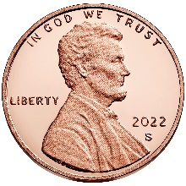

Piglet – Rules
Each turn, the pot starts empty
  Player choice: go or stay
  If stay, player adds pot to points and turn ends
  If go, player flips coin:
    Tails busts and pot empties and turn ends
    Heads add 2 to pot and go back to choice
Get to 10 points to win
Lower number of turns is better
→ Get coin and play Piglet (with friend) to get feel for game!

Slide 4

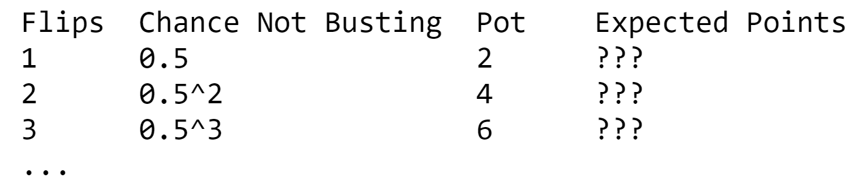
Piglet – Questions
What is probability player wins on their first turn?
What is expected number of points for first flip?
  Hint: consider number of points if successful (heads), number of points if bust (tails) and likelihood of each.
Complete following table for 10 rows, also filling in all "Expected Points" columns.
If flip coin only once and then pass, after 20 turns what is probability has 4 or fewer points?
  Hint: think of kind of distribution and try out formula

Slide 5


Piglet – Experiments
Copy and paste piglet.py Python script (file or Jupyter notebook)
Run it
Study what it does
Run it some more
Repeat until you mostly understand it

Slide 6
Piglet – Experiments
There are two different bots that can be played (TIMID_BOT or BRAVE_BOT)
Which bot is better?
  Run experiments that gather data needed to answer query
  Analyze results: compute statistics, draw charts, and describe analysis
  Provide conclusion from data

Slide 7
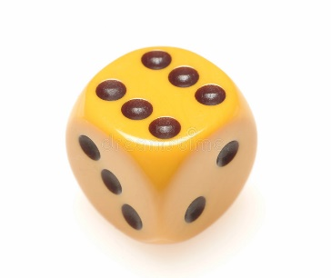
Pig – Rules
Like Piglet, but roll one d6
Each turn, pot starts empty
  Player choice: go or stay
  If stay, player adds pot to points and turn ends
  If go, player rolls die:
    1 busts and pot empties and turn ends
    2-6 add number of pips to pot and go back to choice
Get to 50 points to win
Lower number of turns is better
→ Find die and play Pig (with friend) to get feel for game!

Slide 8
Pig – Questions
What is probability of not busting on single roll?
What is average pot if player does not bust on single roll?
What is expected number of points player gets for single roll?
What is probability of getting exactly 4 points on one turn? (Optional - what is the probability of doing so?)
Draw chart depicting expected number of points versus number of consecutive rolls. Hint: see #3.

Slide 9
Pig – Experiments
Modify Piglet Python script from Part 1 to play Pig
Which bot is better, TIMID_BOT or BRAVE_BOT?
  Run experiments that gather data needed to answer this question
  Analyze results: compute statistics, draw charts, and describe analysis
  Provide conclusion from data
Bonus: BETTER_BOT that wins in fewer rolls than TIMID_BOT or BRAVE_BOT
  Once developed, describe logic behind your bot
  Run experiments that gather data needed to evaluate your BETTER_BOT compared to other two bots
  Draw charts, provide statistics and analyze data to support your comparison

