Slide 1
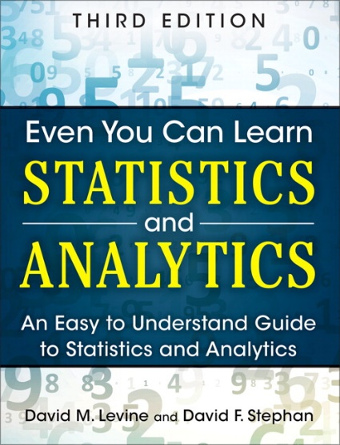
Fundamentals of Statistics
IMGD 2905
Chapter 1

Slide 2
Why Do We Need Statistics?
Game
445 446 397 226
388 3445 188 1002
47762 432 54 12
98 345 2245 8839
77492 472 565 999
1 34 882 545 4022
827 572 597 364
Aggregate data into meaningful information.
Ok, but what are statistics?
→ First, some key words

Slide 3
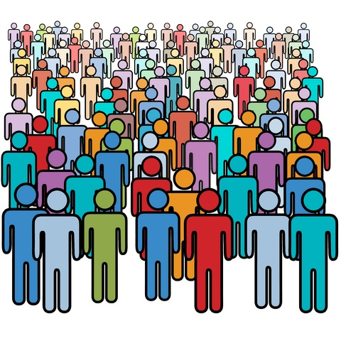
Key Words
Population – all members of group pertaining to a study
Q: examples?
http://www.mycariboonow.com/wp-content/uploads/2016/02/Population.jpg

Slide 4
Key Words
Population – all members of group pertaining to a study
  e.g., every person in IMGD 2905 in D-term
  e.g., every League of Legends player in North America
In many cases, impossible to survey a population!
  Typical for game analytics → want to understand/improve game for all
http://www.mycariboonow.com/wp-content/uploads/2016/02/Population.jpg
Q: So … what to do?

Slide 5
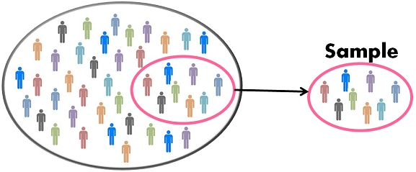
Key Words
Sample – part of population selected for analysis
  e.g., all League of Legends players at WPI
  e.g., students at one table in IMGD 2905
Population
Q: Is sample same as population?
Is it representative?
http://keydifferences.com/wp-content/uploads/2016/04/census-vs-sample.jpg
Often want sample to be representative of population. …
  (e.g., poll: “did you finish chart for Project 1, Part 4?”)
But Is it? → method to obtain sample is important! (We won’t talk much about this right now, however.)

Slide 6
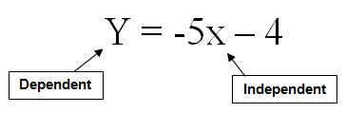
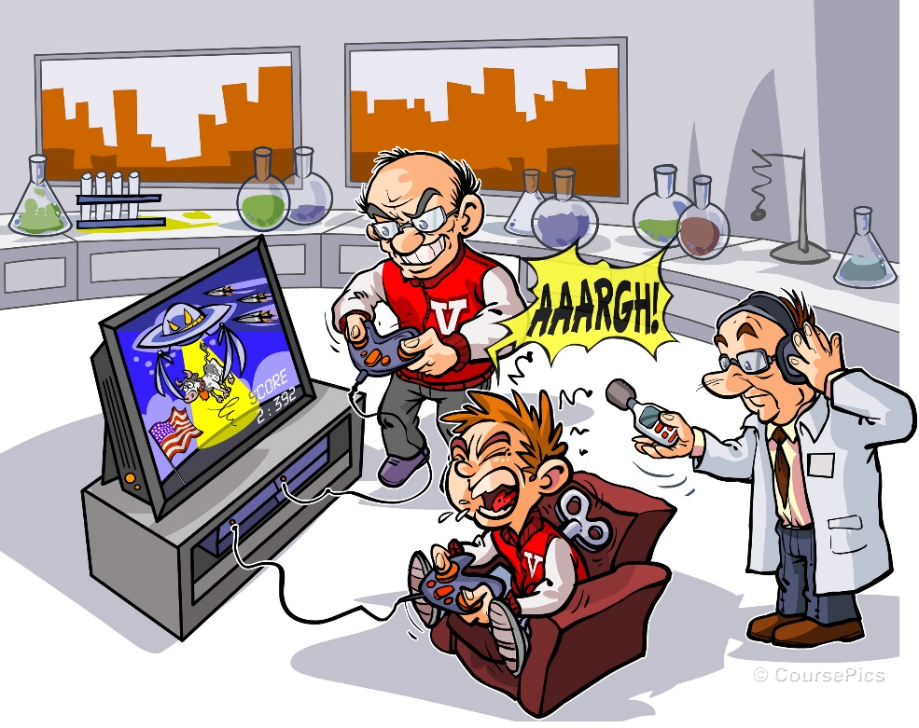
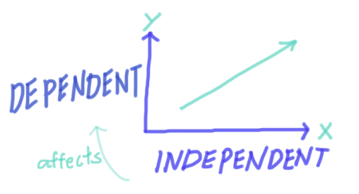
More Key Words
Variable – characteristic of individuals in population analyzing
  e.g., time spent playing competitive mode in Starcraft 2
  e.g., vehicle choice in Grand Theft Auto (GTA)
Independent variable is inherent in population, versus dependent variable that want to assess
http://tinyurl.com/y4b3hj7k
https://www.coursepics.com/wp-content/uploads/2016/11/Independent-and-Dependent-Variable.jpg
https://dqm1v390v3ac1.cloudfront.net/screen_shot_2017-10-31_at_3.54.16_pm_2.png

Slide 7


More Key Words
Observation – all variable values for sample
  e.g., PUBG hours/week and Best Rank (that week). Two observations could be:
    “Player A: Rank #2, 2 hours”
    “Player B: Rank #30, 7.5 hours”
  Can be continuous (time) or discrete (rank)
Often, data in grid
  Observation in rows
  Variables in columns
  Format works well for spreadsheet
  Consider our project 1 → PUBG data!
Player Hours Rank
A 2 #2
B 7.5 #30

Slide 8


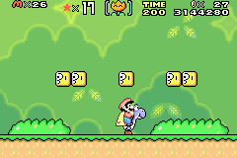
Putting It Together
Designing Super Mario World levels
What are some dependent variables?
What are some independent variables?
Other variables of interest?
What are some observations?
https://tinyurl.com/trb4h7v
https://tinyurl.com/s8tcprt

Slide 9
Putting It Together
Time, Deaths/fails, Fun …
Koopas, power ups, gap lengths …
Time spent getting coins, Number of jumps …
A, 10s, 12 jumps
Designing Super Mario World levels
What are some dependent variables?
What are some independent variables?
Other variables of interest?
What are some observations?
https://tinyurl.com/s8tcprt
https://tinyurl.com/trb4h7v

Slide 10
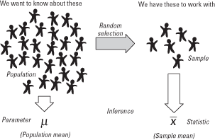
Even More Key Words
Parameter – measure of dependent variable for population
  e.g., average crashes in Mario Cart level for every player
  Usually what we want to know, but can’t get easily
Statistic – measure of dependent variable in sample
  e.g., average crashes in Mario Cart level for IMGD 2905 class
Statistics – set of numerical methods for getting information about population based on data from sample, usually to get information about population parameters
“Statistics - a branch of mathematics dealing with the collection, analysis, interpretation, and presentation of masses of numerical data.”
-Merriam-Webster dictionary
https://qph.ec.quoracdn.net/main-qimg-058791361f10bc9a0339823e1e01d3ec

Slide 11



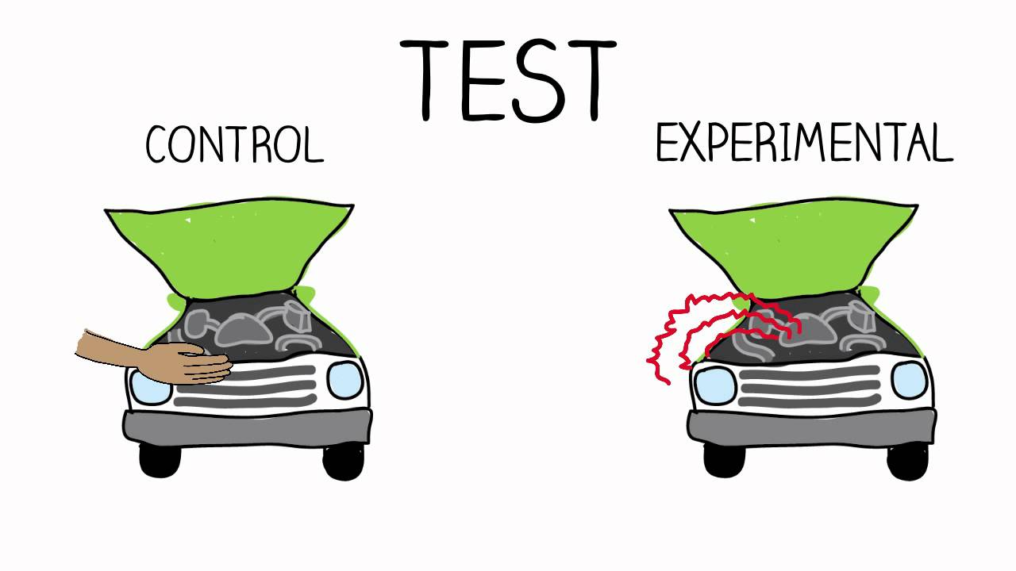

Sources of Data
Published – generally made available from those that collected it
  e.g., PUBG Developer API data
  e.g., Metacritic’s reviews and ratings
  e.g., HOTS Logs dataset on Heroes of the Storm
Experiments – multiple trials to collect data from sample
  Can be in laboratory or “real world” setting
  e.g., play shooter, add lag and play again
Survey – ask people to answer questions
  e.g., self-rating as gamer, difficulty with level, …
  Ethical issues with stress and use of data
  → Institute Review Board (IRB) for approval with human subjects
https://i.ytimg.com/vi/qtLnBz6lbRQ/maxresdefault.jpg
http://www.mayersmemorial.com/pictures/content/122253.jpg

Slide 12

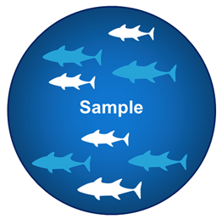

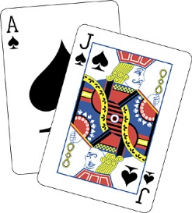
Sampling Concepts
https://tinyurl.com/y4nu9ckf
https://tinyurl.com/y4nu9ckf
Sampling – process by which members of population selected for sample
  e.g., choose ½ class based on seat, or choose ½ class based on alphabet
Probability sampling – sampling considering likelihood of selection
  e.g., survey for intended Champ, ask ½ class, but when tournament starts, result different. Why? → sample didn’t consider League players! (e.g., often similar analogy for voter polls)
  e.g., voluntary polls/surveys
  Use probability sampling whenever possible, but sometimes it is not (cost) or not known
Sampling with replacement – once sample, put back in pool
  e.g., die roll to see which attack boss makes
Sampling without replacement – once sample, won’t sample again
  e.g., user survey – don’t allow to submit twice
  e.g., deck of 52 cards for blackjack
https://openclipart.org/image/800px/94489
https://tinyurl.com/y3ndyrom

Slide 13
Using Sample Data
Word “sample” comes from same root word as “example”
  So, one sample does not prove a theory, but rather is an example
Basically, in general, definite statement cannot be made about characteristics of all systems
Instead, make probabilistic statement about range of most systems
→ That’s where statistics come in!
Statistics – set of numerical methods for getting information about population based on data from sample, usually to get information about population parameters

