Slide 1
Data Analysis for Game Development
Administrative
IMGD 2905

Slide 2
Outline
Background
Admin Stuff
Motivation
Objectives

Slide 3



Professor Background
(Who am I?)
Mark Claypool (professor, “Mark”)
  Professor, Computer Science and Interactive Media and Game Development
Research interests
  Multimedia performance
  Congestion control (protocols, AQM)
  Wireless networking
  Network games
Currently playing

Slide 4

Student Assistant
Audrey Gross
Year?
Major?
Background?
Playing?

Slide 5
Student Background
(Who are you?)
Year?
Major?
  IMGD Art or Tech
  Other
Background?
  Statistics
  Probability
Tools?
  Python
  Excel
Platform of Choice?
  Windows
  Linux
  Mac

Slide 6

Classes
In-person (yay!)
  No online options
  Miss?
    Slides are available
    See classmates for notes
Lectures, Q&A, Intro to projects
Group work …
Let’s be flexible!

Slide 7





Syllabus Stuff
http://www.cs.wpi.edu/~imgd2905/d24
  Linked from Canvas Web page
Class: M, T, Th, F 10-10:50am
SA: Audrey Gross
Office hours (Zoom): T, W, F 12-1pm
  Discord, Zoom or in-person
  Or by appointment
Email: claypool@cs.wpi.edu (me)
Discord server
  Invite code on Canvas page

Slide 8
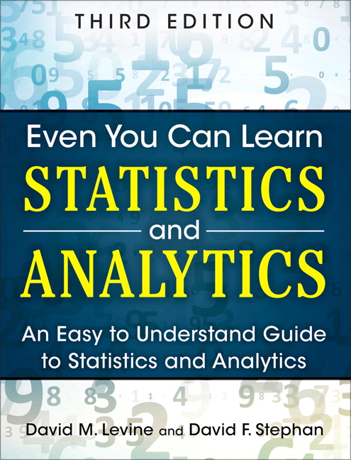
Text Book
D.M. Levine and D.F. Stephan
“Even You Can Learn Statistics and Analytics”
3rd ed. Pearson, 2015
Unfortunate name, but good content → depth to provide foundation for analytics
Good examples, but not game-centric

Slide 9




Class Topics
Data analysis tools and pipeline
Statistics
Visualizing and presenting data
Probability
Hypothesis testing
Regression
Apply topics to game data!
  Commercial and custom
  New and old

Slide 10

Course Structure
Prerequisites
  College algebra
  No {programming, stats, probability} expected
  No game analytics experience required
Grading
  Projects (60%)
  Homework (30%)
  Participation (10%)
Turnin on the Canvas Website:
  https://canvas.wpi.edu/courses/58182
  Authenticate with WPI login and password
http://idwbi.com/wp-content/uploads/2017/01/database-Schema.png

Slide 11

Projects
4 projects, 60% of grade total
  Last project slightly larger
Do game analysis on actual game data!
Use game analytics pipeline
  Typical flow for game (and other) analytics
  Common tools used for analytics
Multiple instances of analysis
  Apply, become skilled with methods of synthesis, interpretation, dissemination
Project 1 – today!
https://www.shareicon.net/download/2015/12/06/683311_board.svg

Slide 12

Homework
3 homework sets, 30% of grade total
Written problem set
From the book, Web, made up
Solve with pencil and paper
Or calculators
Or Excel

Slide 13

Participation
Showing up to class matters
  Come to class!
Being engaged in class matters
  Don’t multi-task!
Ask questions, answer questions
8% of your grade
  But much bigger indirect effect!

Slide 14


Playtesting
Engage with WPI IMGD community
  Playing and testing each other’s games
Useful for development, research
  Focus groups
  Interviews
  User studies
Two (10-30 min.) sessions
2% of your grade

Slide 15

Slides
Download from class page
PowerPoint and PDF
Caution! Don’t rely upon slides alone! Use them as supplementary material
  (come to class)
https://cdn4.iconfinder.com/data/icons/documents-letters-and-stationery/400/doc-18-512.png

Slide 16

Timeline
Tentative timeline for dates for exams and projects
  In order to help you plan
http://www.cs.wpi.edu/~imgd2905/d24/timeline.html
Will notify if update

Slide 17
Why This Class?

Slide 18
Why This Class?
Goals
Objectives
Gain proficiency using modern tools for data acquisition and analysis
Understand basic probability and statistics as it applies to data analysis
Develop skills for presenting game data analysis both orally and in written form
Use spreadsheet to analyze and visualize game data
Use scripting language to extract and clean data recorded from game
Apply summary statistics to game data
Compute probability distributions for game data
Write reports with graphs and tables illustrating analysis of game data
Present game dataset report using appropriate visual aids

Slide 19
Why This Class? – Other
WPI IMGD requirements
  Gotta take Math/Quantitative Science
Statistics and Probability useful for game design and development
Game Analytics similar to other forms of analytics (e.g., Data Science)
Game analysis increasingly important (jobs!)
https://www.google.com/search?q=data+analytics+jobs+for+games

Slide 20

Jobs
Game Play Data Analyst, Sony Interactive Entertainment
Duties
  Advise, define implement gameplay data to ensure understanding of player experience
  Provide insights that impact game design and improve quality
  Create and maintain player segmentation that allows understanding of engagement and spending
  Mine data sets and develop dashboard for live service teams, game developers
  Devise and implement A/B experiments to test acquisition, engagement
  Present findings and provide recommendations
Requirements
  BS/BA degree Stats, Math, Econ, CS or related
  Experience with SQL
  Experience with data visualization packages
  Experience with statistical software
  Experience with Amazon cloud services
  Have created and presented visualizations and insights to various business groups
  Passion for video games preferred

Slide 21

Jobs
Analyst, Riot Games
Duties
  Aggregate and analyze petabytes of game data from various sources
  Prep data for deeper analysis and/or reporting
  Organize collected data into reliable intel that informs Rioters to improve player experience
  Work with decision-makers to understand goals, identify opportunities, and inform decisions across company
  Create awesome
Requirements
  BS/BA degree Stats, Math, Econ, CS or related
    Graduate degree preferred
  Business savvy
  Technically adept
    SQL, Python
    Excel, PowerPoint
  Communicator
    Reports clear, and concise
    Presentations to variety of audiences

Slide 22


Why This Class?
Fun!

