Slide 1
U-Pick Game Analytics
Highlights
Project 4
IMGD 2905
http://web.cs.wpi.edu/~imgd2905/d24/projects/proj4/index.html

Slide 2
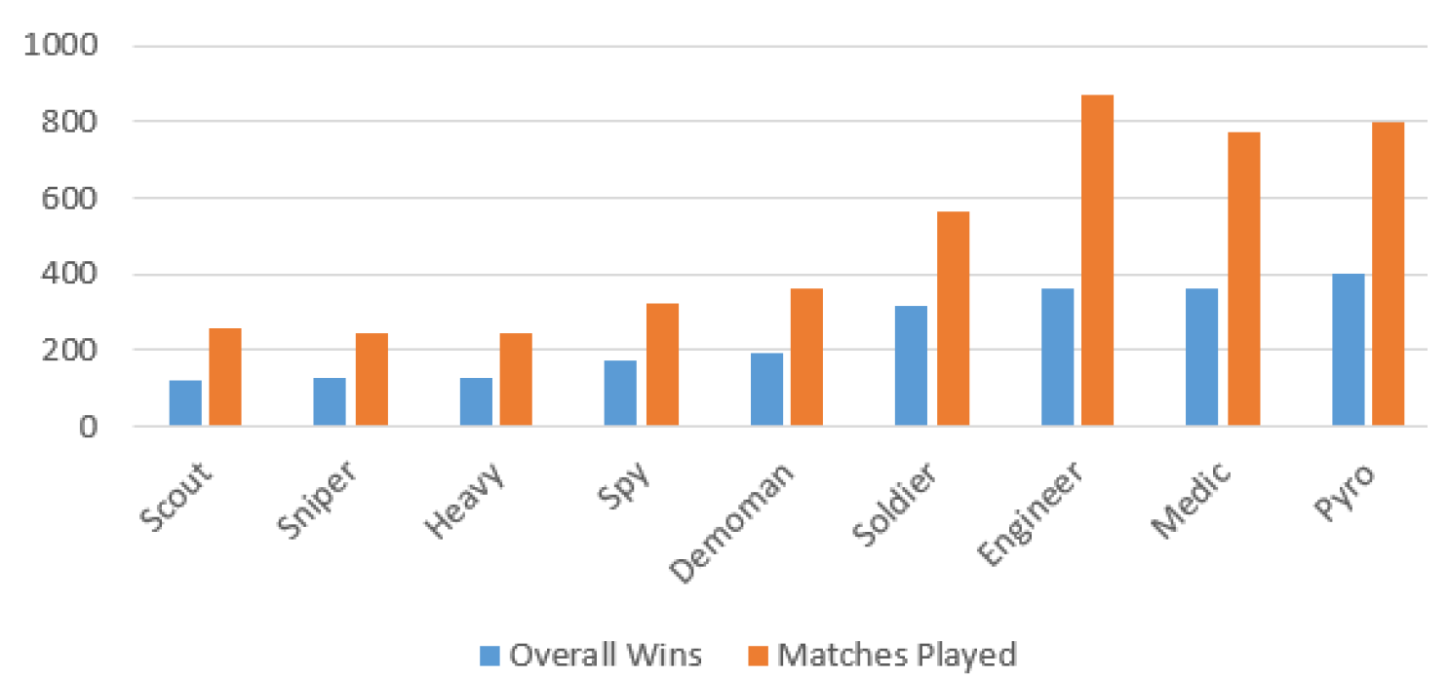
Matches Played and Won
Team Fortress 2 – Highlander – By Kris Ferreira
Column chart comparing matches played and won by class

Slide 3
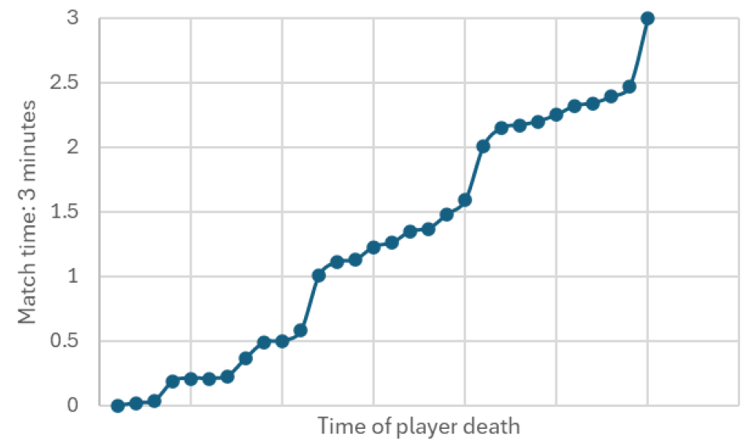
Death Splatters
Splatoon – By Mackenzie Appleyard
Time series of player deaths

Slide 4
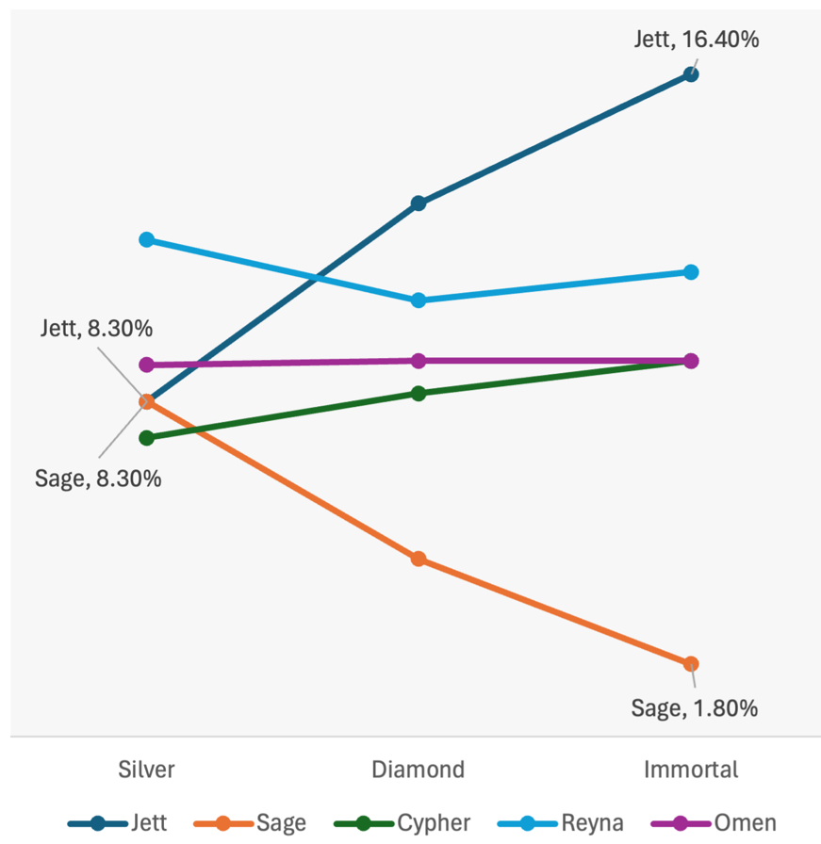
Choosing Carefully
Valorant – By Daniel Blatner
Agent pick rates by rank

Slide 5
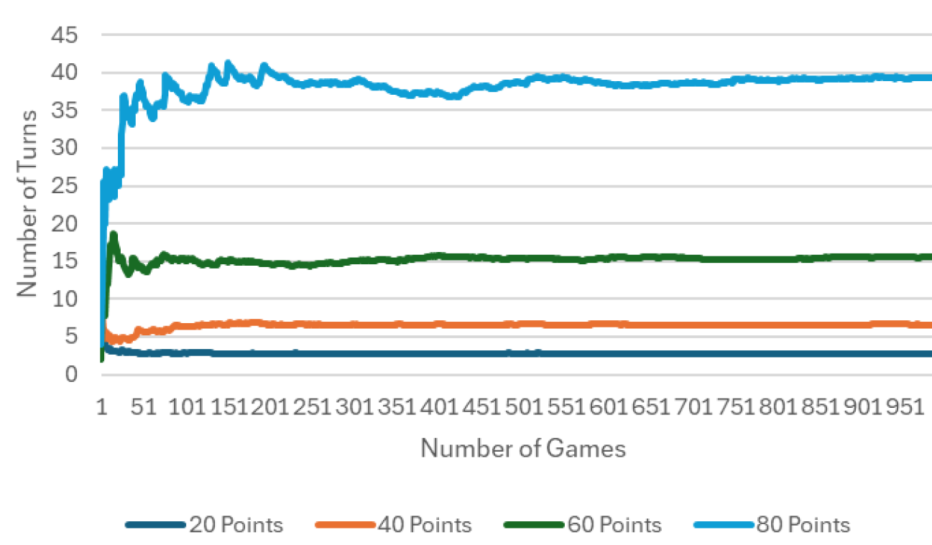
Pig Out! Brave Bot Turns to Win
Pig – By Ethan Carter
Line chart showing running average of number of turns Bot requires to win Pig games with different point totals

Slide 6
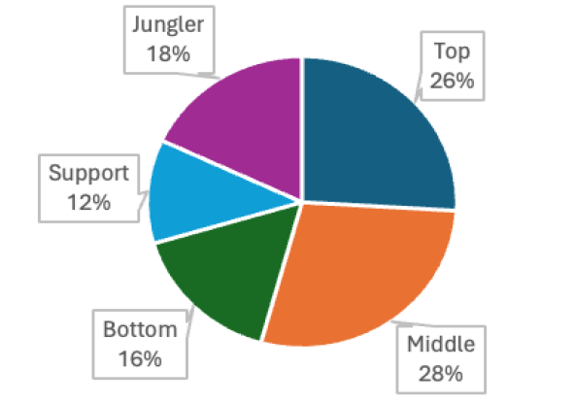
The Golden Rule
League of Legends – By Morgan Acevedo
Pie chart of gold distribution

Slide 7
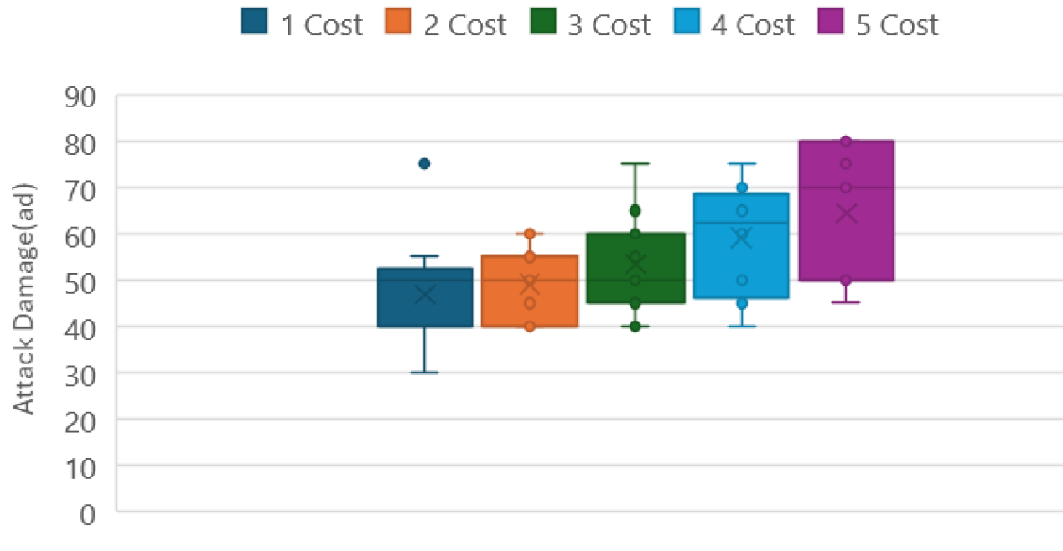
At What Cost?
Team Fight Tactics – By Zaeli Goodman
Boxplots showing distribution of attack damage based on unit cost

Slide 8
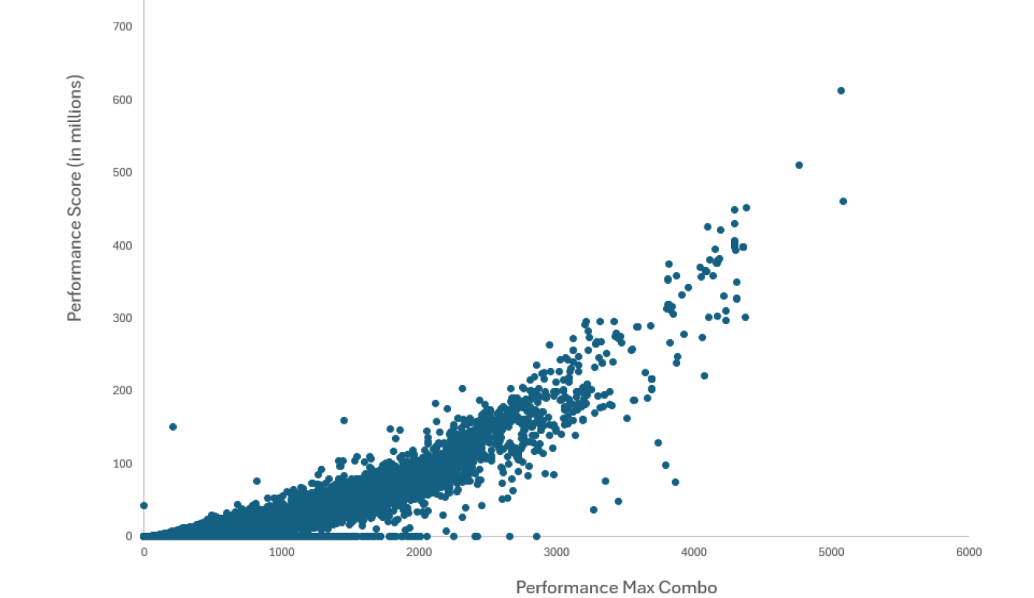
Feel the Beat
Osu! – By Patrick Hussey
Scatterplot of performance versus combos

Slide 9
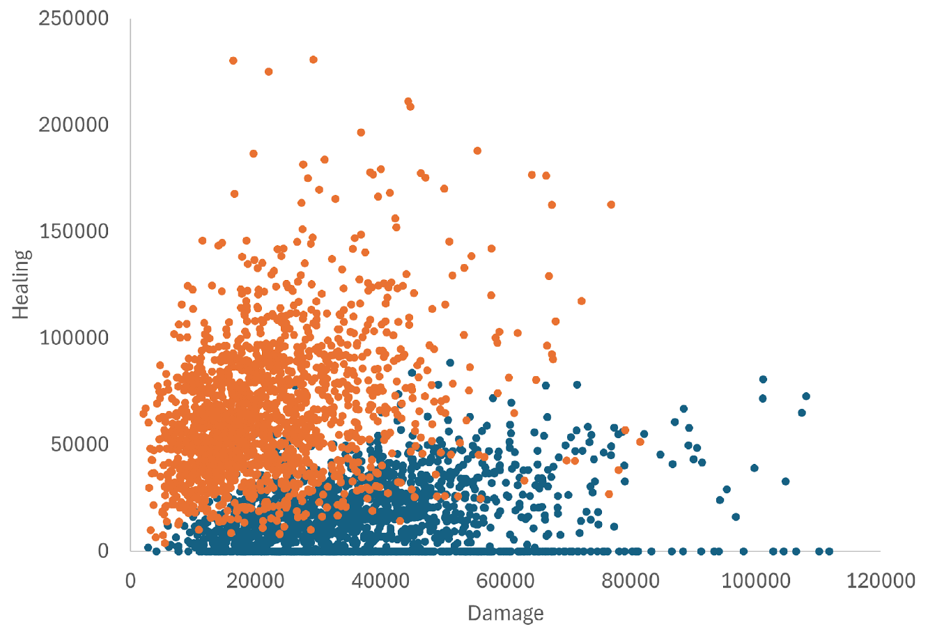
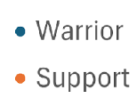
You are my Hero
Heroes of the Storm – By Jacob Major
Scatterplot showing healing versus damage for two classes

Slide 10
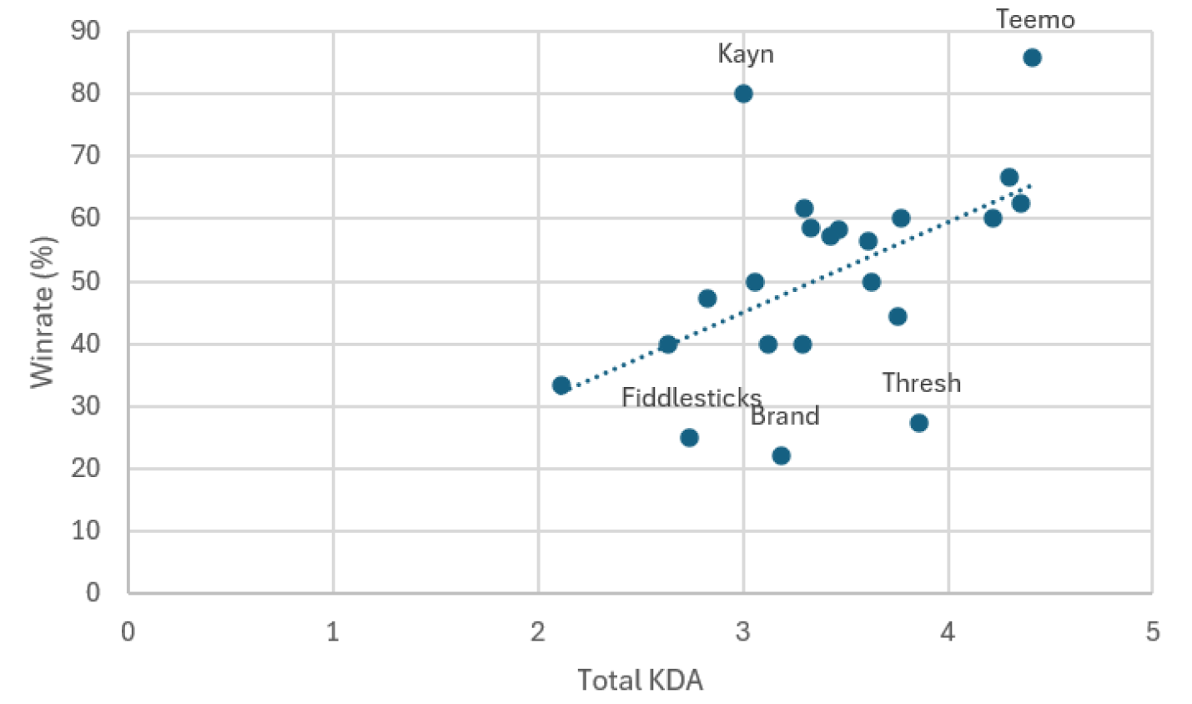
Kill to Win
League of Legends – By Avikshit Pal
Scatterplot showing winrate versus KDA with a linear regression

Slide 11
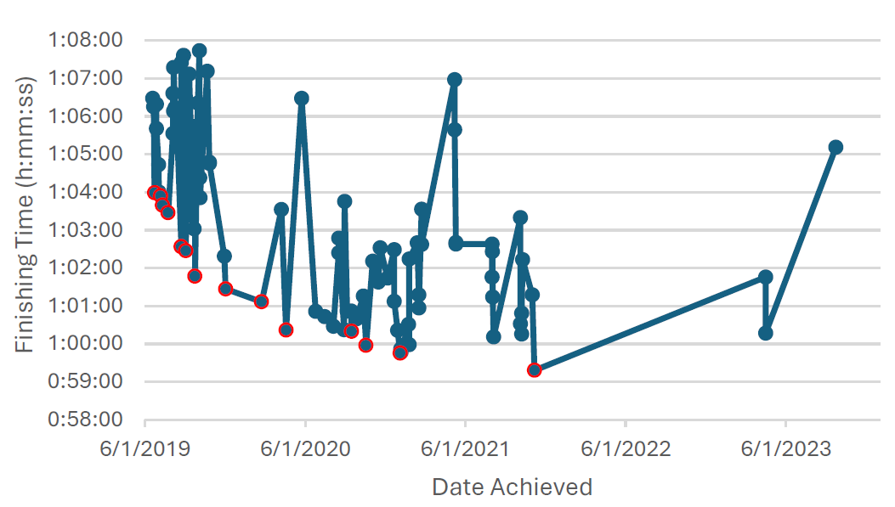
Speed Running Mario
Super Mario Odyssey – By Zachary Pitts
Time series showing speedrun times for Mario Odyssey, with new personal bests highlighted in red

Slide 12
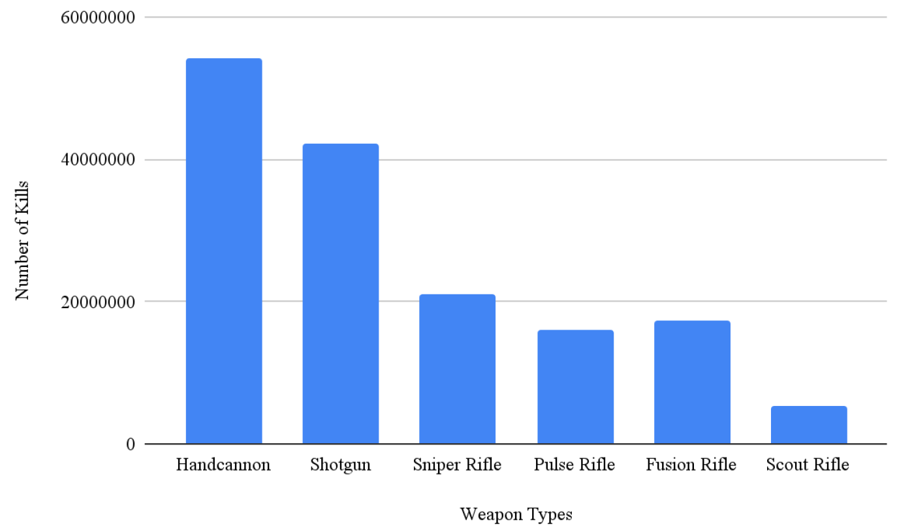
It is Your Destiny
Destiny 2 – By Jack Sheeran and Crow Zubrick
Column chart showing kills based on weapon type

Slide 13
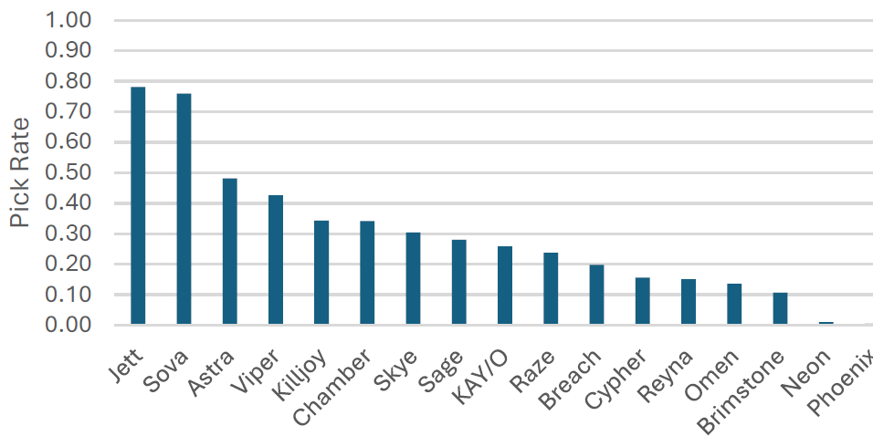
Take Your Pick
Valorant – By Ethan Wright
Column chart showing agent pick rate

Slide 14
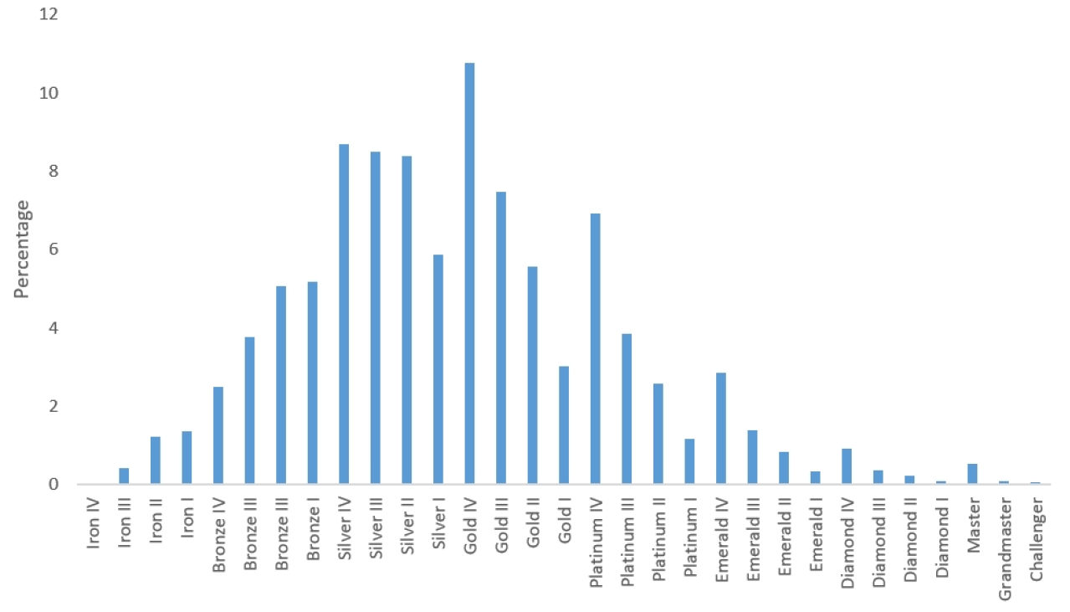
Pulling Rank
Team Fight Tactics – By Junmin Zhang
Histogram of player ranks

Slide 15
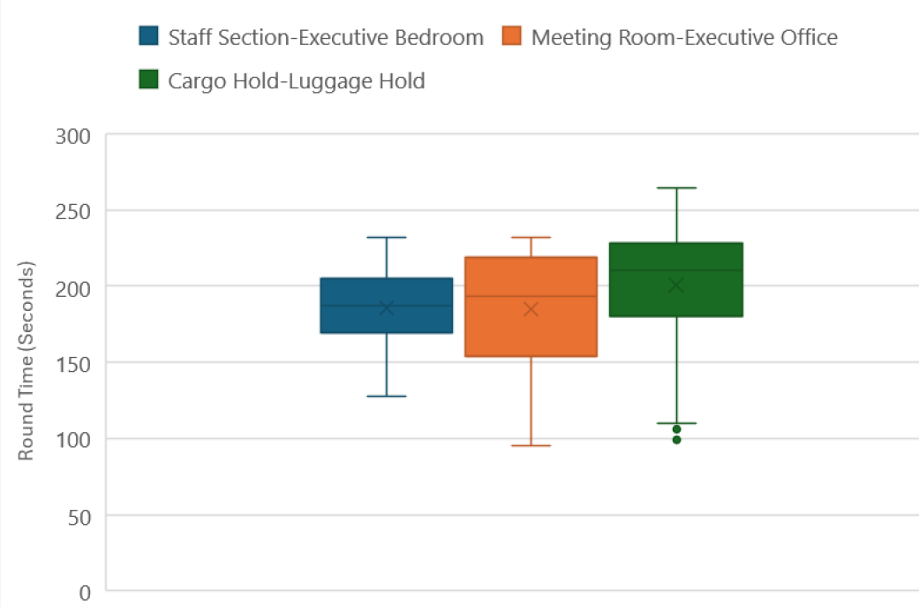
I Just Want to Fly
Rainbow 6 Siege – By Brenden Lee
Boxplots round time versus starting location on Plane map

