Slide 1
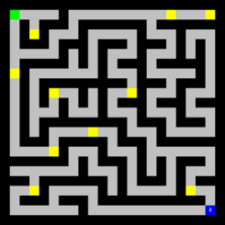
Mazetool Analytics
Project 2
IMGD 2905

Slide 2




Overview
Use complete game analytics pipeline
  Get your “arms around” full pipeline: simple game and level to how it went (adding game and scripting!)
  New skills
Apply to Mazetool (Perlenspiel game)
Pipeline:
Here, have control over game level, access and understanding to “full” game
Reinforce analytics skills (scripts, data, tools) → preparing for own exploration

Slide 3
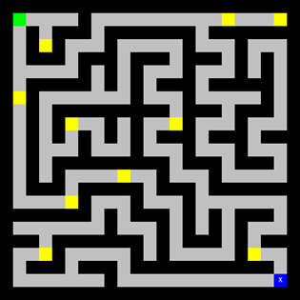
Mazetool
Simple maze game
  Get 10 gold pieces
  Get to exit
Can create own level!
  Re-generate maze
  Move gold
  Move start and exit
Provides events:
  Clicks
  Gold
  Exit
Data:
  Time
  Spaces
https://ps3.perlenspiel.net/examples/mazetool3/mazetool3.html

Slide 4
Parts
Part 0 – Design, Play, Tools
Part 1 – Maze Running
Part 2 – Win Tally
Part 3 – Maze Time
Part 4 – Maze Analysis
Hints
Writeup and Submission
Grading

Slide 5
Part 0 – Design
Read Mazetool documentation
Play to understand game
  3 to 5 random levels
  2 to 4 custom levels
  Look at data (email) → understand content related to player experience
Design one maze for user study
  When tested (by you)
  → “Save”
Take screenshot
Decide time to “win”
Determine shortest path in spaces
Determine fewest clicks
Determine shortest time either:
  Measuring by running
  Estimate based on spaces and speed
Unlike for Project 1, you do write up Part 0!

Slide 6
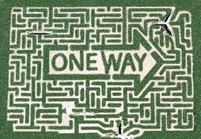
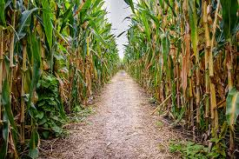
Part 0 – Play
Visit (note URL different!)
  https://tinyurl.com/playmazes
Use list of usernames
  Shuffled
Enter first name
Play once!
Refresh browser
Repeat for all

Slide 7

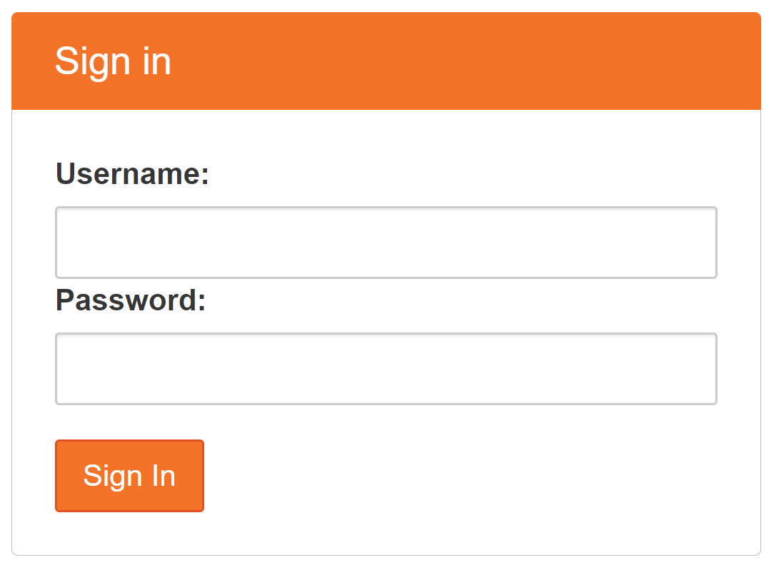
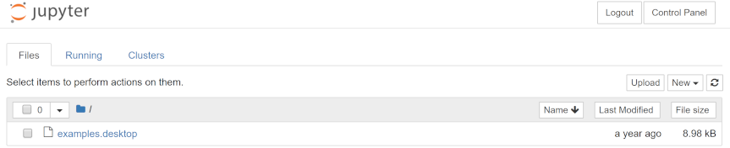
Part 0 – Analysis Tools
Python
  Scripting language
  Easy for beginners
  Powerful for expert users
  Good data analytics tool
  Good for some in-game behaviors, too
Jupyter Notebooks
  Environment for data analysis with Python
[JupyterHub]

Slide 8
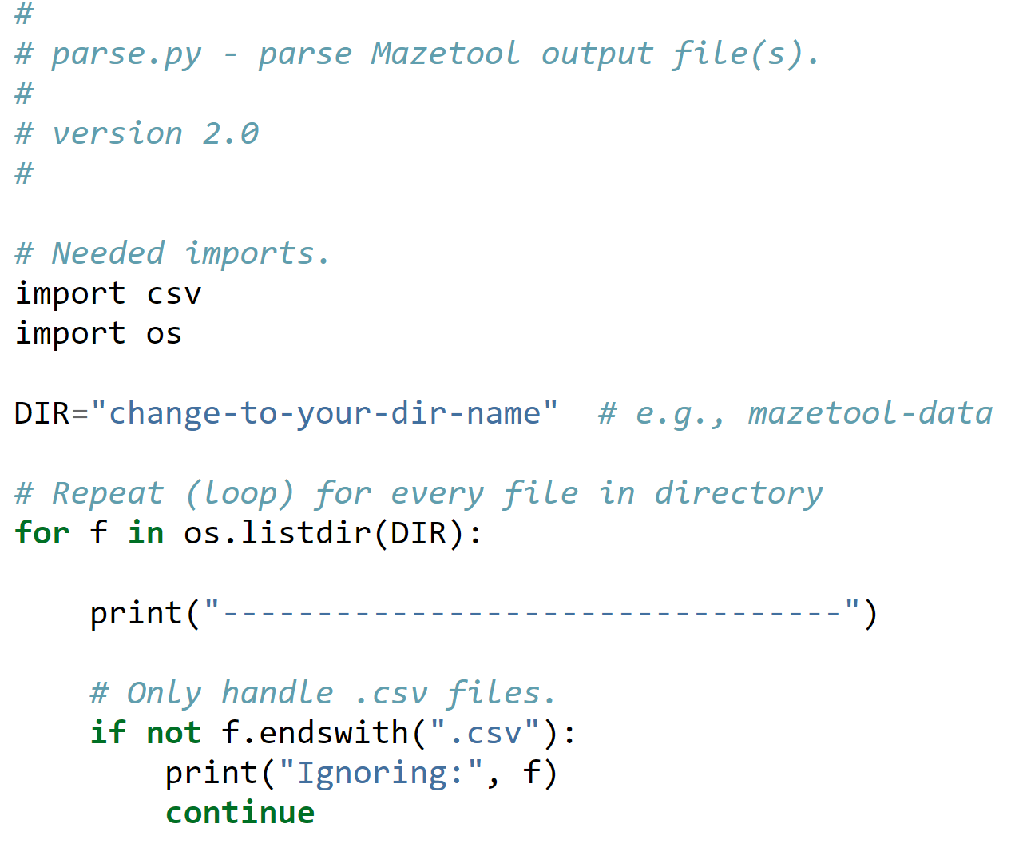
Part 0 – Tools
Upload “sample.csv”
Apply “parse.py”
Make sure it works
Understand each line!
Extract maze data (email)
  Multiple files this time
→ Will modify for your analysis (see next slide)
Gold (time number):
01.586 1
01.786 2
…
38.518 10
-----------
Clicks (time spaces):
00.800 0
2.653 10
…
1:10.071 188
-----------
Exit (time spaces):
1:15.022 238

Slide 9
Part 0 – Useful Extensions
Write to file
http://web.cs.wpi.edu/~imgd2905/d20/projects/proj2/#write
Convert time to single number
http://web.cs.wpi.edu/~imgd2905/d20/projects/proj2/#time
Zip/Unzip
https://web.cs.wpi.edu/~imgd2905/d20/projects/proj2/setup-python.html#tips
Python Help? → Office Hours, ARC

Slide 10
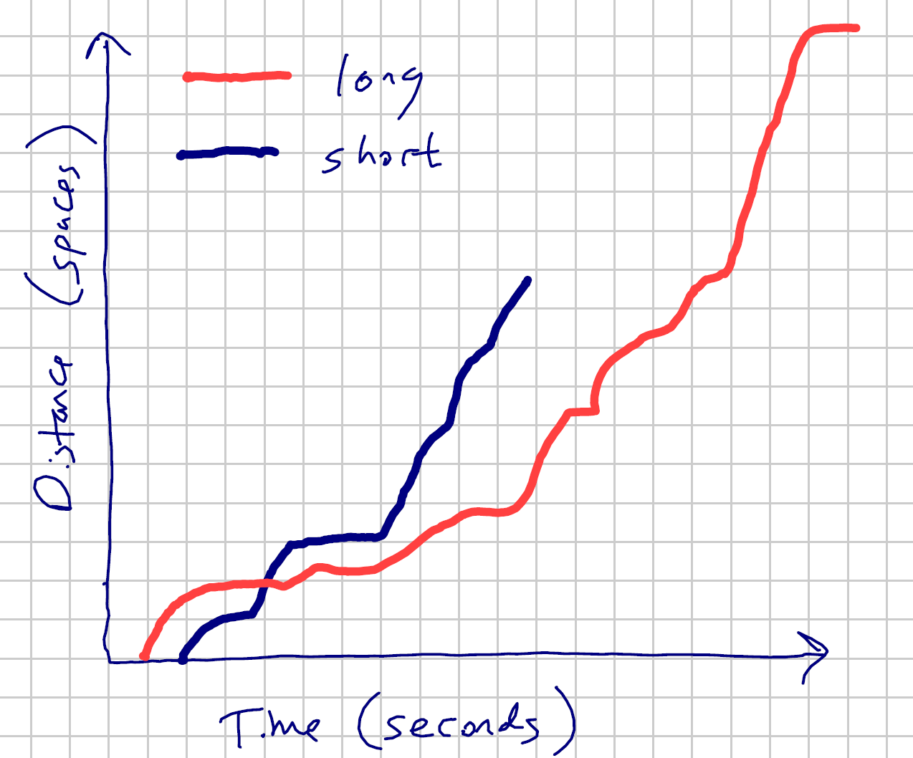
Part 1 - Maze Running
Select “short” and “long” runs
Draw time series chart
(Note Web page tip on “additional trend line”)

Slide 11
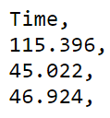
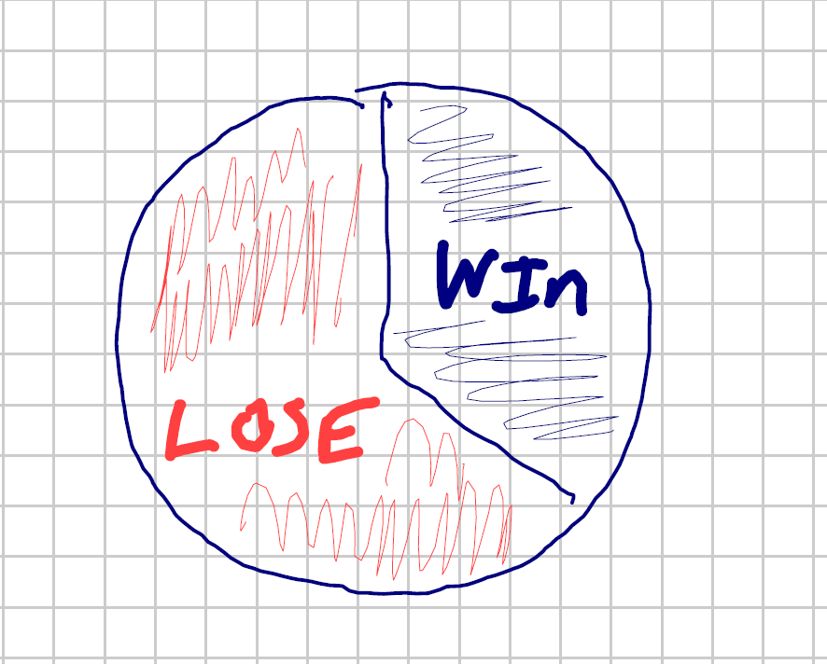

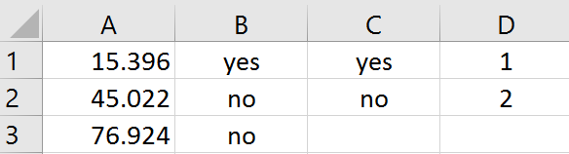
Part 2 – Win Tally
Based on your “win” time, compute tally
Draw pie chart
Need formulas:
=IF(A1 < 30, "yes", "no")

Slide 12
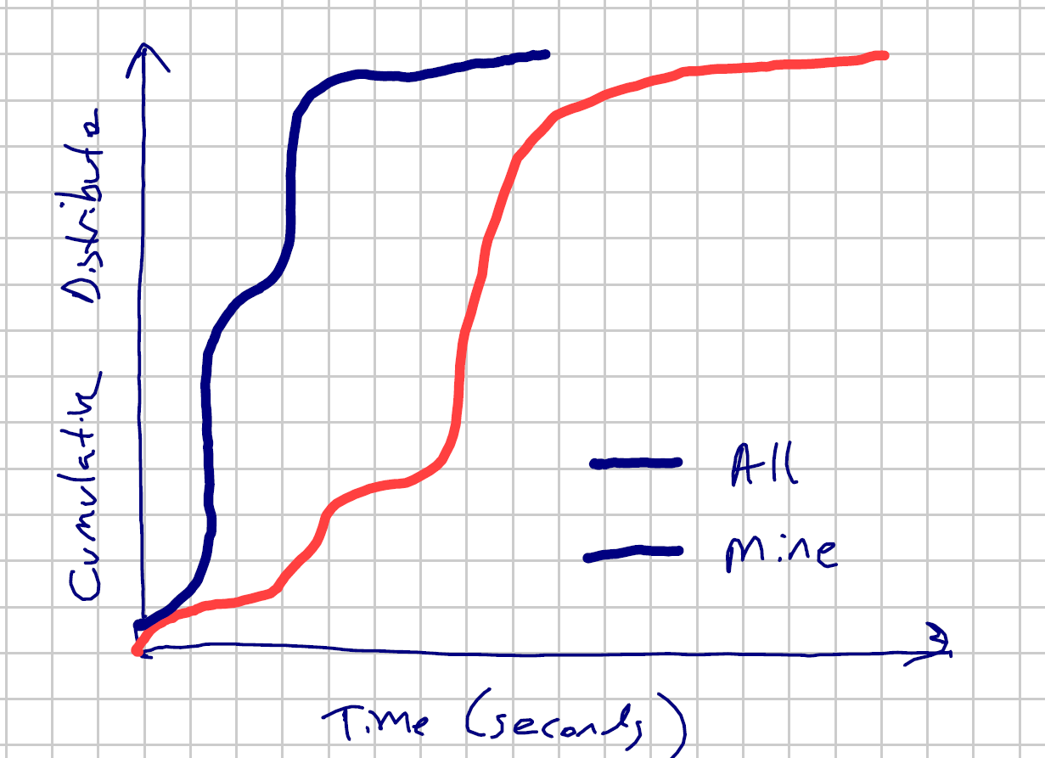
Part 2 – Maze Time
Analyze completion times
  Your maze compared to all (minus your) maze
Draw cumulative
distribution chart
Sort low to high
Compute percent

Slide 13
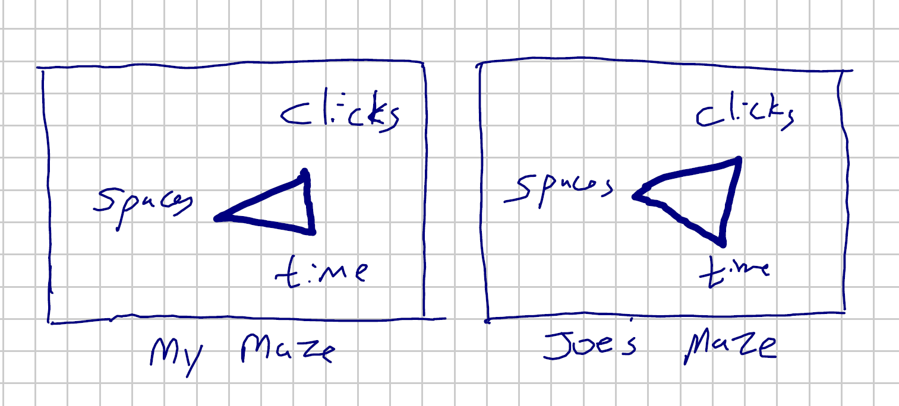

Part 3 – Maze Analysis
Compare your maze, with all mazes, and three other mazes
Maximum: clicks, time, spaces
  Report in table
Draw radar chart
Clicks, Spaces, Time,
7, 128, 72,
Normalize

Slide 14
Part 4 – Your Choice
Pick other data not yet analyzed
Analyze
  Chart
  Table
  Summary stats
As always, provide a figure number with caption and your interpretation.

Slide 15

Hints
All Mazetool data will be available online
  Note download time!
Keep organized!
  One script, one task
  Name script, output, excel same (e.g., exit-times)
  README.txt with notes
Watch font sizes → readable! Chart checklist
Python functions (totally optional)
  seconds = getSeconds(row[“time”])
Pay attention to Project 1 comments!
https://www.maloneri.com/wp-content/uploads/2015/05/tips-300x296.jpg

Slide 16
Write Up
Short report
Content key, but structure and writing matter
Consider:
  Ease of extracting information
  Organization
  Concise and precise
  Clarity
  Grammar/English
Part 0 – Level design, too
Sections
  Brief method, chart, message
Charts/tables:
  Number and caption
  Referred to by number
  Labeled axes
  Explained trend lines
  Chart checklist
  Message
Submit online via Canvas (PDF)

Slide 17
Grading
Intro (game, pipeline) 3%
Part 0 (Level Design) 7%
Part 1 (Maze Runs) 35%
Part 2 (Win Tally) 25%
Part 3 (Maze Times) 20%
Part 4 (Maze Compare) 10%
All visible in report!

Slide 18
Rubric
100-90. The submission clearly exceeds requirements. All Parts of the project have been completed or nearly completed. The report is clearly organized and well-written, charts and tables are clearly labeled and described and messages provided about each Part of the analysis.
89-80. The submission meets requirements. Parts 0-3 of the project have been completed or nearly completed, but perhaps not Part 4. The report is organized and well-written, charts and tables are labeled and described and messages provided about most of the analysis.
79-70. The submission barely meets requirements. Parts 0-2 parts of the project have been completed or nearly completed, and some of Part 3, but not Part 4. The report is semi-organized and semi-well-written, charts and tables are somewhat labeled and described, but parts may be missing. Messages are not always clearly provided for the analysis.
69-60. The project fails to meet requirements in some places. Parts 0-1 of the project has been completed or nearly completed, and some of Part 2, but not Parts 3 or 4. The report is not well-organized nor well-written, charts and tables are not labeled or may be missing. Messages are not always provided for the analysis.
59-0. The project does not meet requirements. Besides Part 0, and maybe Part 1, no other part of the project has been completed. The report is not well-organized nor well-written, charts and tables are not labeled and/or are missing. Messages are not consistently provided for the analysis.

