Slide 1
PlayerUnknown’s Battlegrounds (PUBG) Analytics
Postmortem
Project 1
IMGD 2905

Slide 2
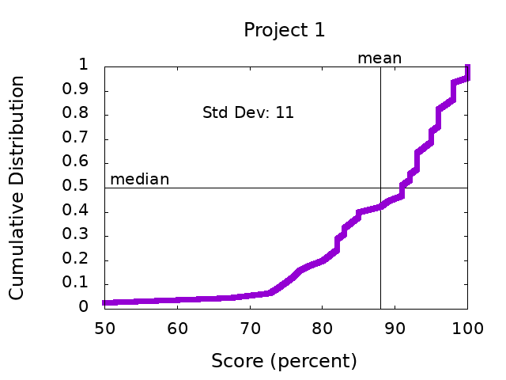
Scores

Slide 3
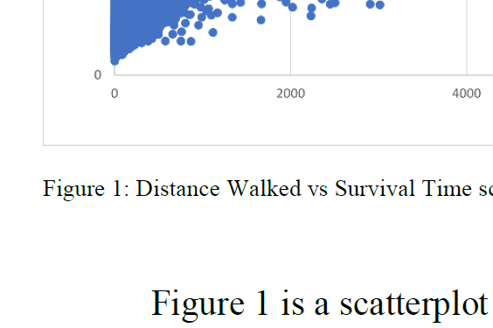
General Comments
Structure – Headings per section, Title
Avoid “you”, casual writing
All figures need numbers and captions (no title)
“Figure 1. Distance Walked versus Time”
Refer to figure by number
“Figure 1 shows the relationship between…”
Describe axes and data BEFORE messages
Make figure fonts similar size to text font

Slide 4
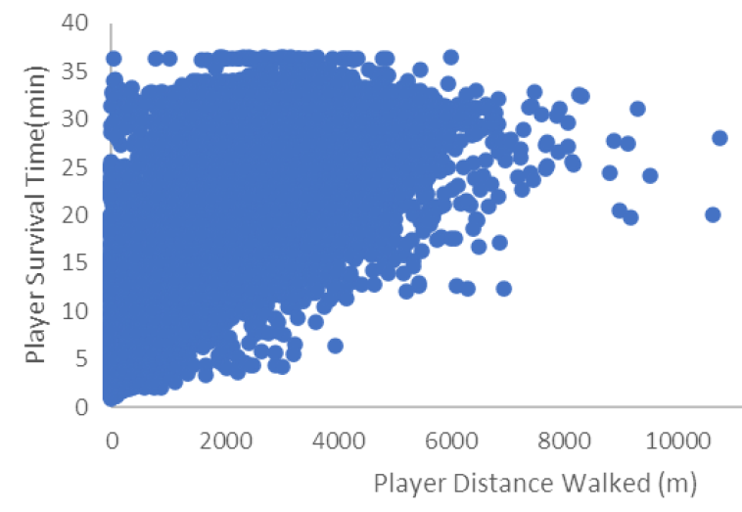
Part 1 – Fight or Flight
Y-axis versus X-axis
Dependent versus Independent
Time versus Distance
Need both versus distance and versus damage

Slide 5
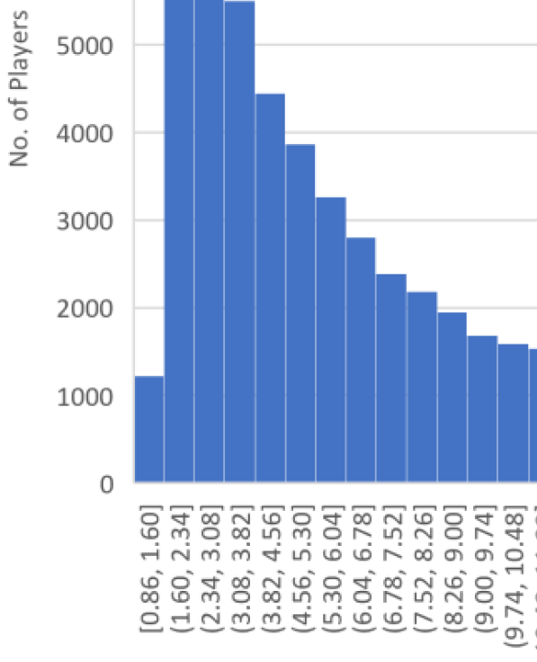
Part 2 – Game Time Analysis
Histogram bins
Boundary and frequency
(underflow bin)
Give your tables some love, too!
Watch spacing
Limit horizontal lines

Slide 6
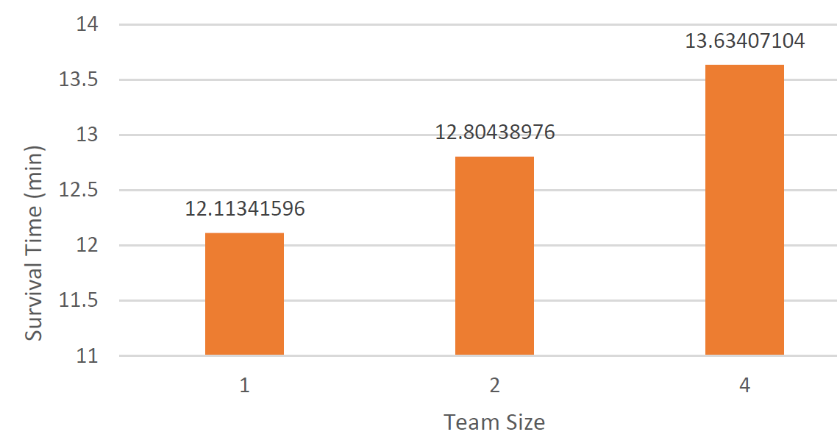
Part 3 – Champion Winrate
(0,0) origin
Digits of precision
Mind the
gap!

Slide 7
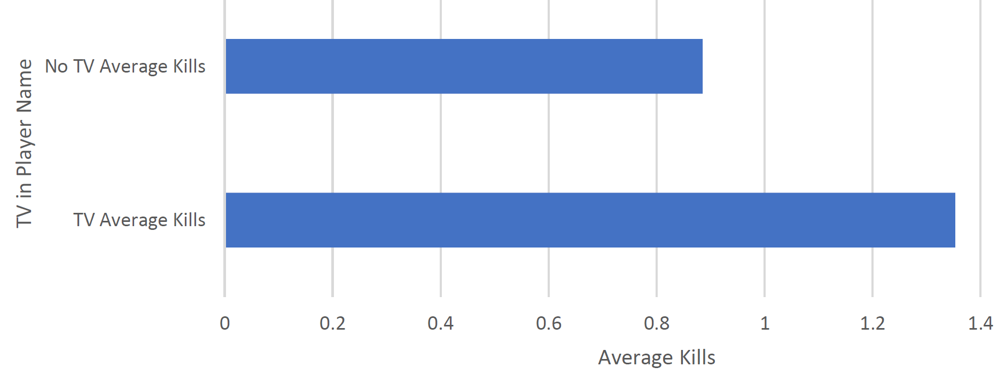
Part 4 – Your Choice
Time vs. distance vehicles (4x)
Kills vs. distance vehicles
Kills vs team (3x)
Kills vs rank (3x)
Kills vs damage
Kills vs time
Damage vs rank (2x)
Damage vs kills (2x)
Distance vs team (3x)
Time vs kills (2x)
https://tinyurl.com/ymz5jtpk
Time vs placement (3x)
Rank vs distance
Rank vs kills
Rank vs revivals
Winner kill distro (3x)
Revive vs kills
Assists vs party
Winner time distro (2x)

Slide 8
Next Steps
Read over comments on your report
Ask if you have questions
Incorporate general and specific tips into next project!
Re-review before turning in Project 2
https://i0.wp.com/www.johnhardingestates.co.uk/wp-content/uploads/2018/02/John-Harding-Estates-Hints-and-Tips.png?fit=600%2C419

