Slide 1


The Impact of Latency on Target Selection in First-Person Shooter Games
Shengmei Liu, and Mark Claypool

Slide 2
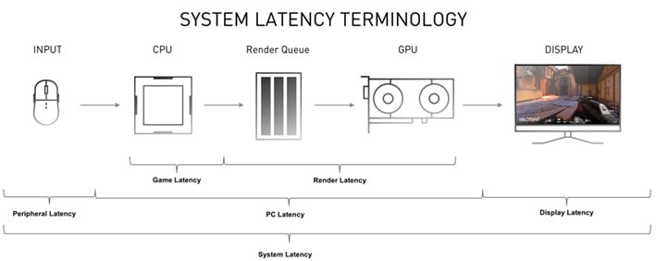
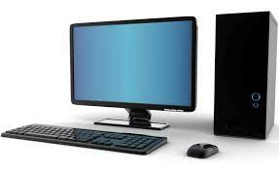
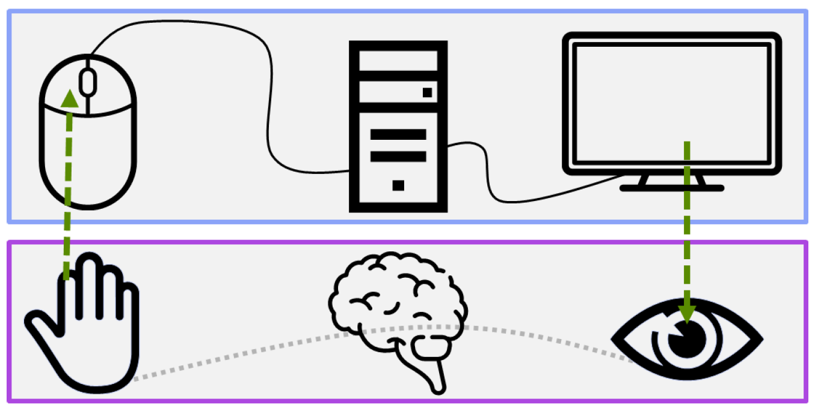
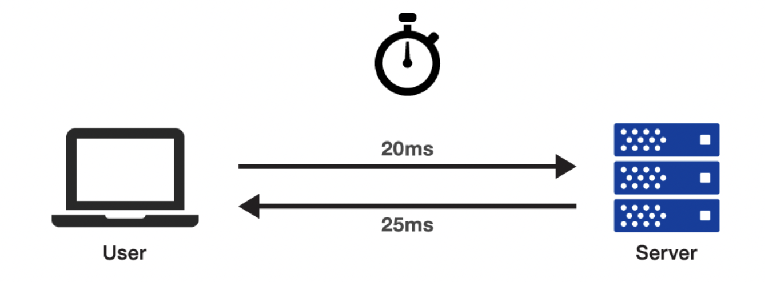
Types of Latency
Local latency
Computer – Hardware and Software
Physics
(speed of light)
Network latency
Human Physiology – Sense, Think, Act
Notes:
In computer games, players give input and the game gives response. Latency is anything delays the input and makes the game less responsive. There are mainly two types of latency, local latency and network latency.
Local latency denotes the system latency, which is mainly from the input devices, like the mouse and keyboard, and also the software and display.
It's the time between mouse clicking and the rendering on the screen.
Network latency is the RTT between the client and server. For example, the uplink time is 20ms and the downlink time is 25ms.
The network latency would be 20+25 = 45 ms.
Both types of latency can affect player performance and player performance can affect player’s rank in the games.

Slide 3
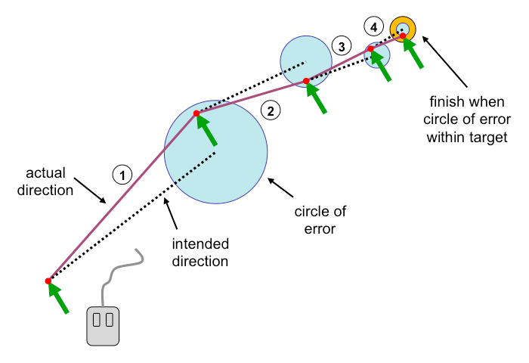
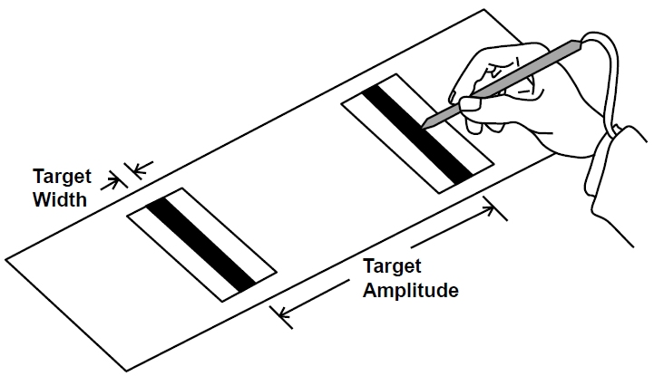
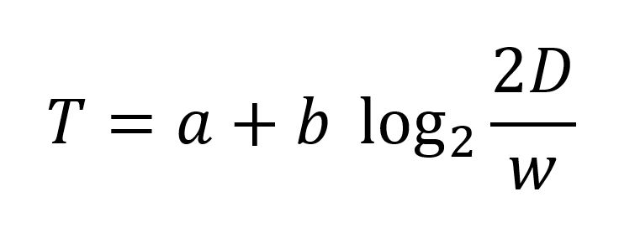
Latency and Users
Fitt’s Law (1954)

Slide 4
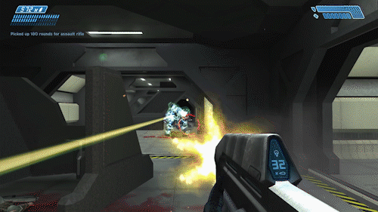
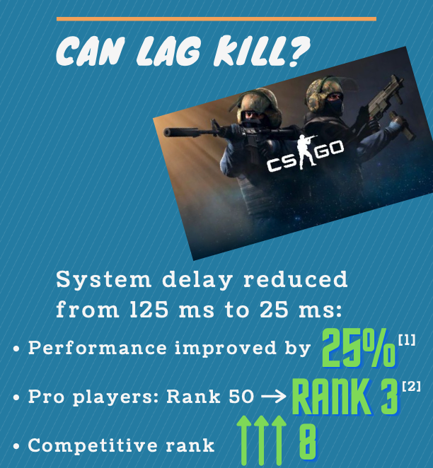
Latency and Gamers
[Liu et al., 2021]
Notes:
Computer games are one of the world’s most popular forms of entertainment.
Among the different game genres, first-person shooter games, also known as fps games, are some of the most popular. In FPS games, players take on the first-person perspective of an avatar, and move and shoot targets to accomplish tasks. Over 20% of sales of computer games were FPS games and about one-third of all gamers like to play FPS games.
First-person shooter is considered the most sensitive to latency. The picture on the right is the results from our previous study on CSGO. It shows 100 ms reduce in latency can improve player performance by 25%, pro players rank from 50 to top 3, and competitive rank by 8.
The research revealed that latency has high impact on fps players but it’s for one game with specific map and configurations. The study takes about one year and it only studied a deathmatch where 1 player play against 20 bots on map Mirage with AK47. The results may not generalize to other FPS games.

Slide 5
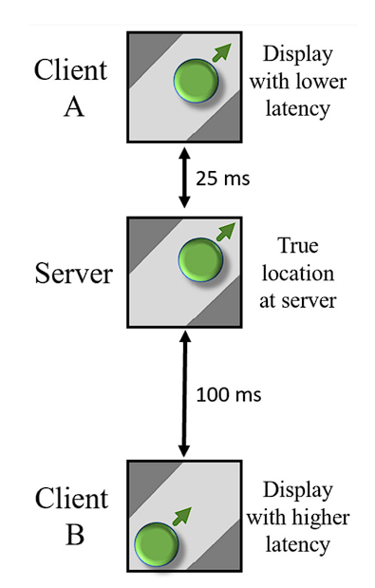
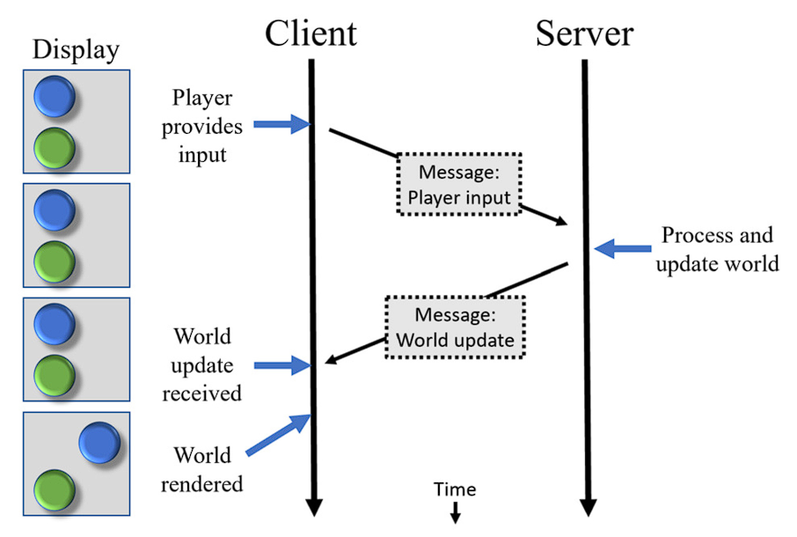
Latency and Gamers
Responsiveness
Consistency and Fairness

Slide 6

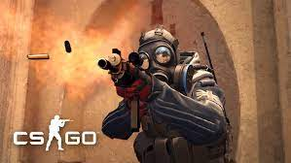


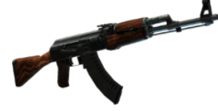
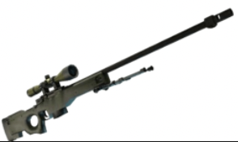
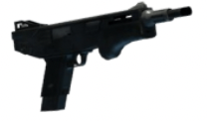
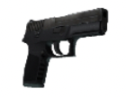
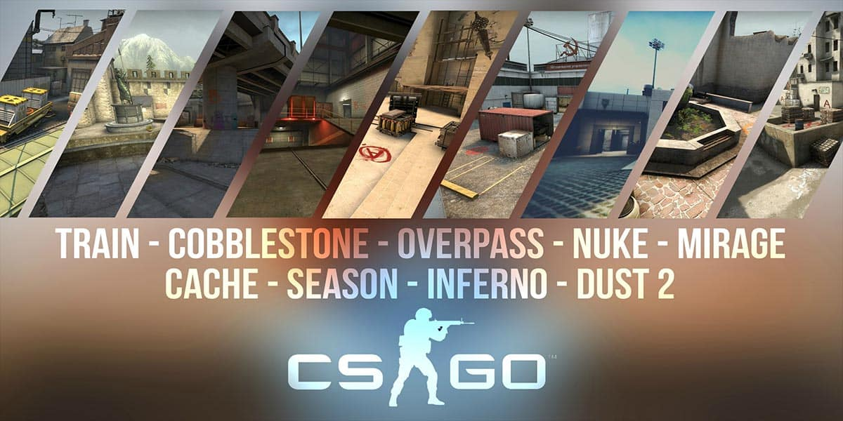
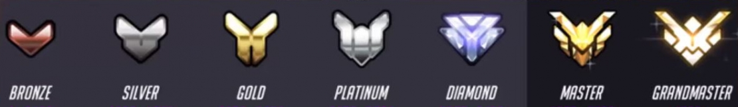
First-Person Shooter Variety
Games
…..
Weapons
…..
Maps
…..
Skills
…..
Notes:
We want to study the impact of latency on general fps games, but there are tons of different games, like Overwatch, CSGO and valorant and so much more.
The games may have different play mode and configurations. Different games may have different subset of weapons. In CSGO alone, there are 34 different weapons. The games may have different target size and speed too.
For example, in game Overwatch, each character may have different size and speed and there are 36 playable hero in the game.
The game maps can be very different too. The maps may of different size, and they may have different terrains. The distributions and shapes of obstacles can be different too.
The players may also come from different skill groups.
Given the number of the parameter values, the number of combinations is numerous. The number will only get larger and larger with future games. It’s not possible to study all the combinations. Is there a way to study the impact of latency on FPS gamers without the need of running user studies for each condition?

Slide 7
Approach
Navigation
Selection
Gather data
Repeat for
each action
Build models
Simulate scenarios using models
Validate simulations
Explore game scenarios
Notes:
And here comes our approach. Our approach is to look at the building blocks for first-person shooter games, assemble the building blocks together and explore the space.
The first step is to define the actions, which are the main player interactions in first-person shooter games.
We want to gather data on the gaming actions with user studies, and build mathematical models for them,
repeat this for each action,
and then integrate the models and simulate senarios in fps games.
We then validate the simulations with empirical first-person shooter game data.
Finally we will be able to explore more fps game scenarios with the validated simulations without the need of running a whole user study for every single condition.

Slide 8
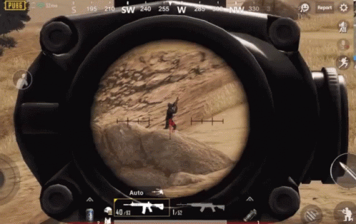
Gaming Actions - Selection
Notes:
As I mentioned the first step is to define the game actions, and we find that there are two of them in first-person shooting games – aiming and moving. The first one is aiming and we call it selection.
Selection in first-person shooter games means clicking or pressing the moving target on the screen with a pointing device. In FPS games, you got to put cursor on the enemies and click on the enemies, like what the person is trying to do in this clip.

Slide 9
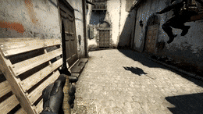
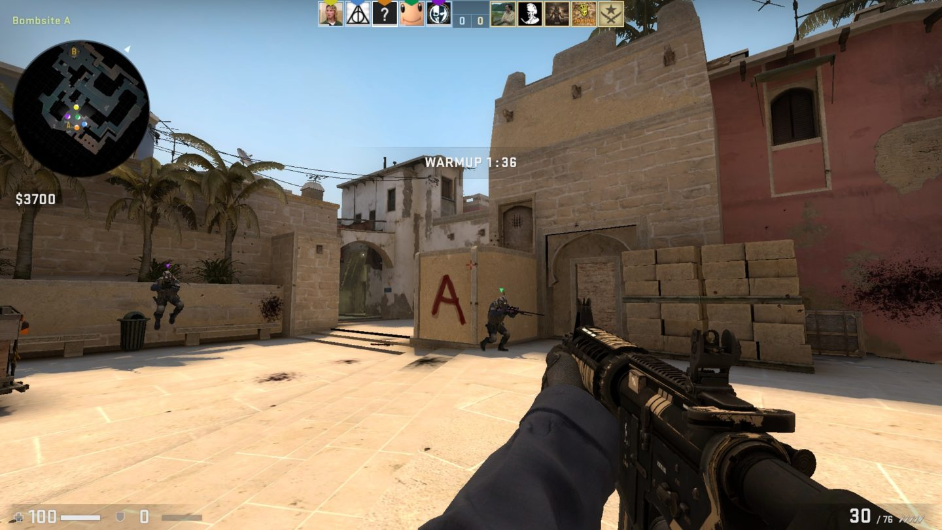
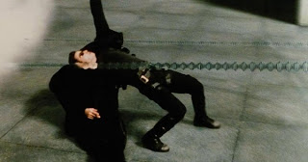
Gaming Actions - First-person Navigation
Move into position to shoot
Move to avoid being shot
Notes:
Talking about navigation in games, normally it means controlling an avatar to move from one position in a virtual
world to another position in constrainted paths, as in the racing car games.
It manifests differently in FPS games, where navigation refers to
move and get into position,
to shoot opponents,
or avoid been shot.

Slide 10
Approach
Navigation
Selection
Gather data
Repeat for
each action
Build models
Simulate scenarios using models
Validate simulations
Explore game scenarios
Notes:
And here comes our approach. Our approach is to look at the building blocks for first-person shooter games, assemble the building blocks together and explore the space.
The first step is to define the actions, which are the main player interactions in first-person shooter games.
We want to gather data on the gaming actions with user studies, and build mathematical models for them,
repeat this for each action,
and then integrate the models and simulate senarios in fps games.
We then validate the simulations with empirical first-person shooter game data.
Finally we will be able to explore more fps game scenarios with the validated simulations without the need of running a whole user study for every single condition.

Slide 11
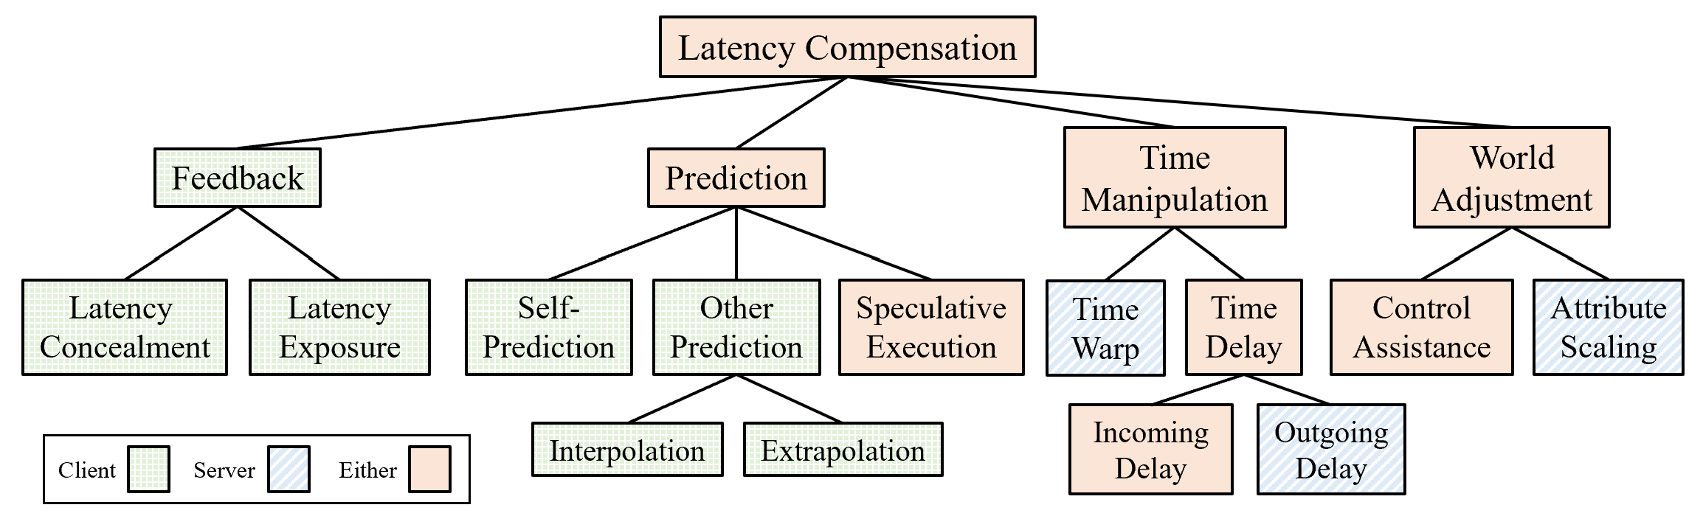
Latency Compensation Techniques
Shengmei Liu, Xiaokun Xu and Mark Claypool
“A Survey and Taxonomy of Latency Compensation Techniques for Network Computer Games”, ACM Computing Surveys, Article 243, Volume 54, Issue 11S, January 2022 https://doi.org/10.1145/3519023

Slide 12
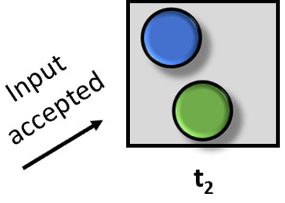
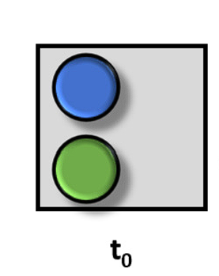
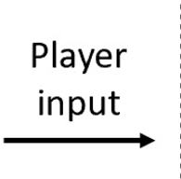
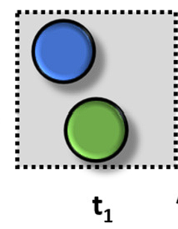
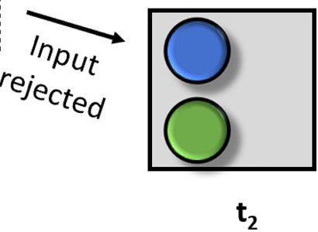

Latency Compensation – Self-prediction
Self-prediction

Slide 13
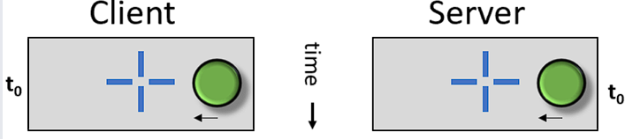
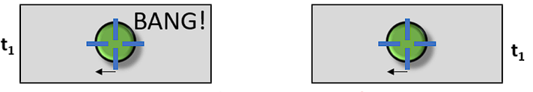
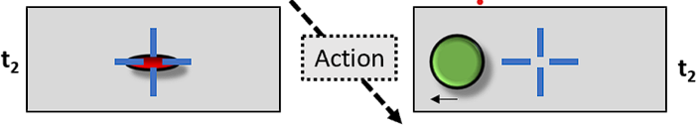
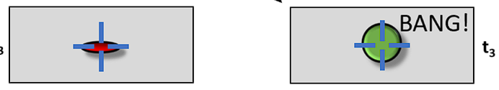
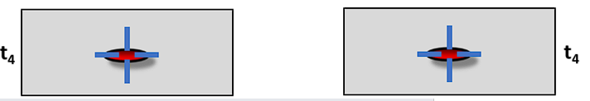
Latency Compensation – Time Warp

Slide 14

Group Work –
Latency and First-Person Target Selection
https://web.cs.wpi.edu/~imgd2905/d23/groupwork/13-lag-design/handout.html

Slide 15
Group Work –
Latency and First-Person Target Selection
Build a model for predicting performance of target selection for first-person shooter games with latency.
Design experiments. Independent variables? Dependent variables? How and where do you gather data? Control conditions?
Gather data. How do you get users?
Analyze data. Analysis? Models?

Slide 16
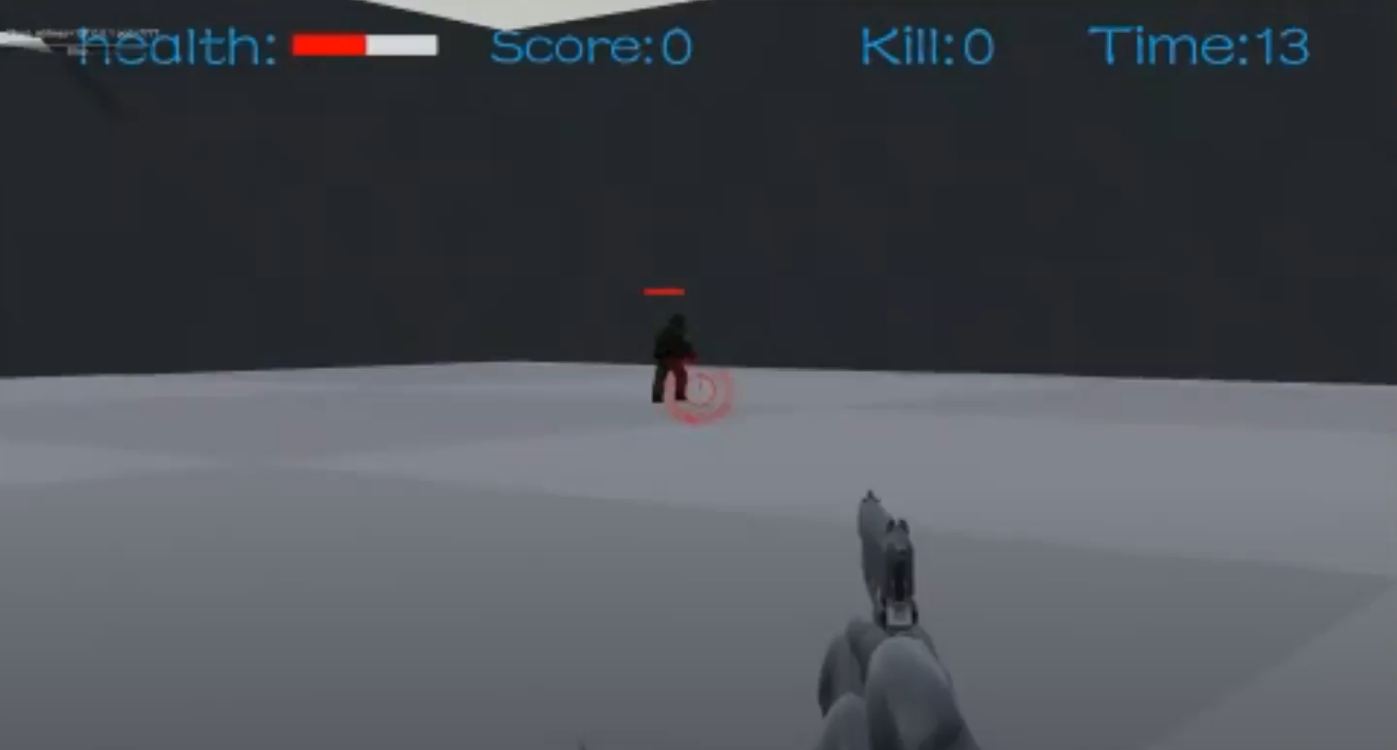

User Study
Custom FPS game
  Client-server architecture
  Latency compensation: time warp, self-prediction
Notes:
To compare the impact of latency on first-person navigation, we designed a user study.
We first built a custom game with Unity that isolated the action of navigation in a first-person shooter-type setting. The game is a two-player game called “hide and seek”. The map is as the picture on the left which is a single room with many obstacles.
Here is a short video of the game. At any given time, one player is the hider and the other player is the seeker. In a frame, if the seeker can see any part of the hider, the seeker earns a point; otherwise, the hider earns a point. The roles switch frequently and randomly. Each player seeks for half of the time and hides for half of time. When the timer runs out, the player with more points wins.
Our user study was conducted in a dedicated, on-campus computer lab using a client-server architecture. The server hosts the game and is connected via high-speed LAN to the client. The client is equipped with a gaming mouse and high-refresh rate monitor so as to minimize local system latency. All the PCs are with the latest Linux system. The participants play on the client with controlled amount of local latency and network latency as indicated by the left gray box.
We have a player play as control without any extra latency, which is me.
The testing flow is automated and self-contained, players click on the start button once and the flow will keep going.

Slide 17
Latency Values
Local latency
Network latency
25
50
75
100
22
0
100
200
300
(ms)
Gaming system
Normal PCs
Console, TV, etc.
0
50
100
150
<1
100
200
300
0
(ms)
Good
Internet Connection
Moderate
Internet connection
Other
Notes:
Different types of system would cause different local latencies. The latency for gaming system are mainly in a range of 0 -100 ms. Normal PCs are like 100-200 ms. Consoles and TVs would have latencies even higher.
The base local latency of the gaming system was measured at 22 ms. It’s captured by a high speed camera with 1000 f/s. We have 3 shuffled total local latency values and they are 25 100 and 175 ms.
Normally speaking, network latency from 0 to 100 indicates a good internet connection, moderate internet connection may have latency between 100 and 200 ms. And bad internet connections would cause even higher network latency.
The base round trip time for the LAN in the study was less than 1 ms.
There are 3 shuffled total network values for the rounds, and they are 0 100 and 200ms.
For each combo of latency, we have 3 trials. With 27 rounds in total and 40 seconds per round, the testing procedure lasts about 30 min for each player.

Slide 18
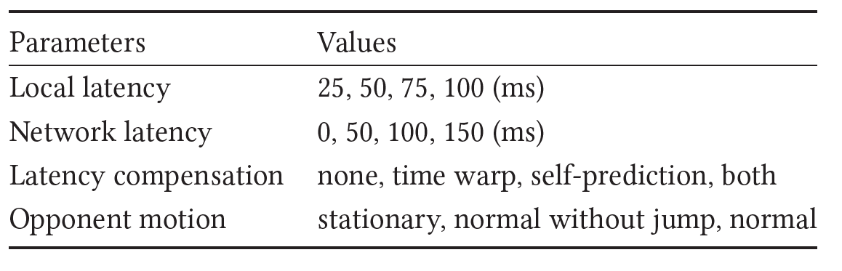
Experimental Parameters
3 trials for each, 30 seconds/trial

Slide 19
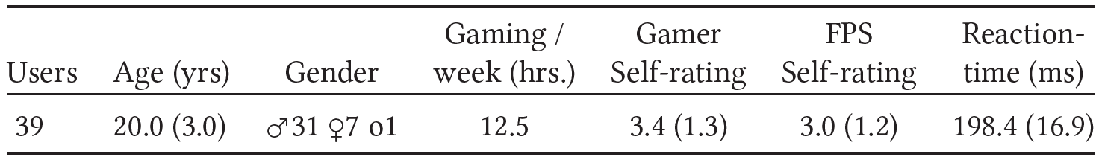
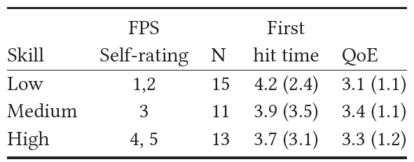
Demographics
Notes:
30 users were recruited from our university email list. They are of typical college age and we end up having a lot more males than females. On average they spent over 10 hours a week on video games. The values in the parathesis are standard deviations. The self-rated score in video games and fps lean towards to high skill, with both on a 5-point scale. The mean reaction time of the players is about 227 ms which is of typical gamers’ reaction time.

Slide 20
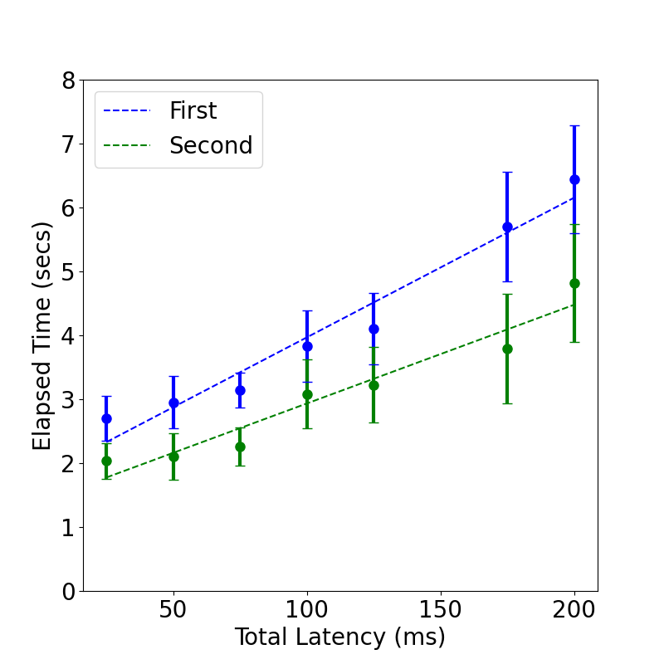
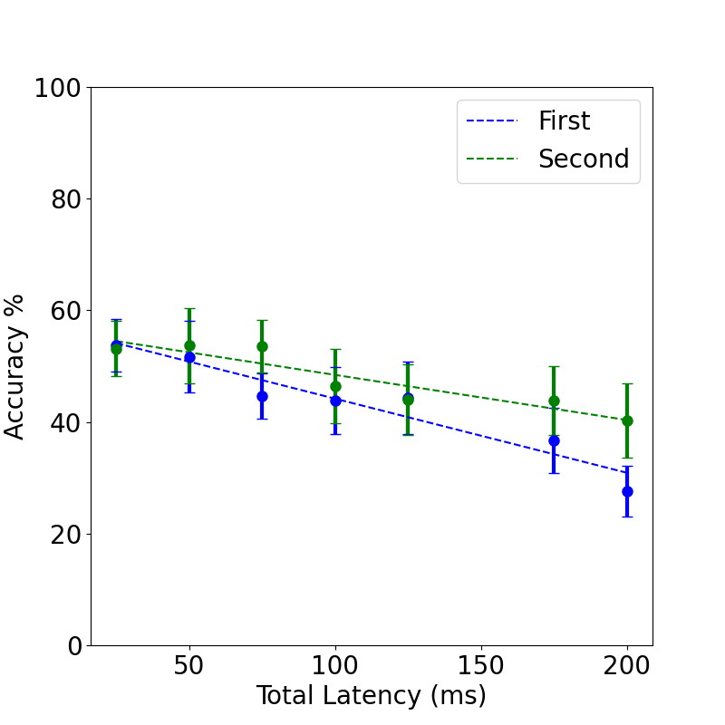
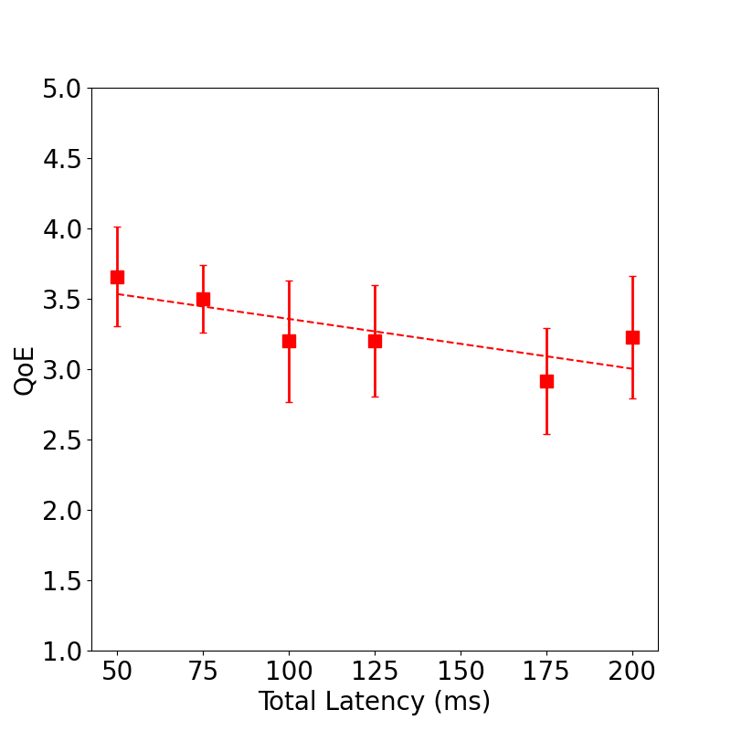
Versus network latency without Latency Compensation

Slide 21
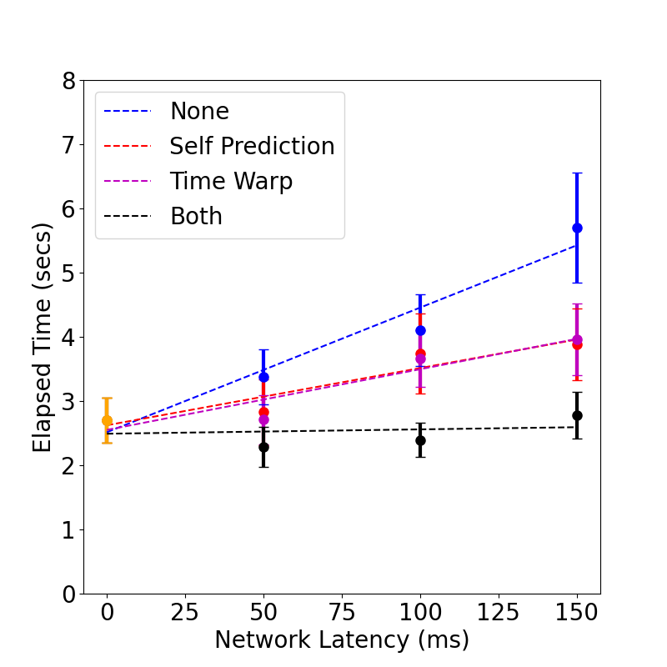
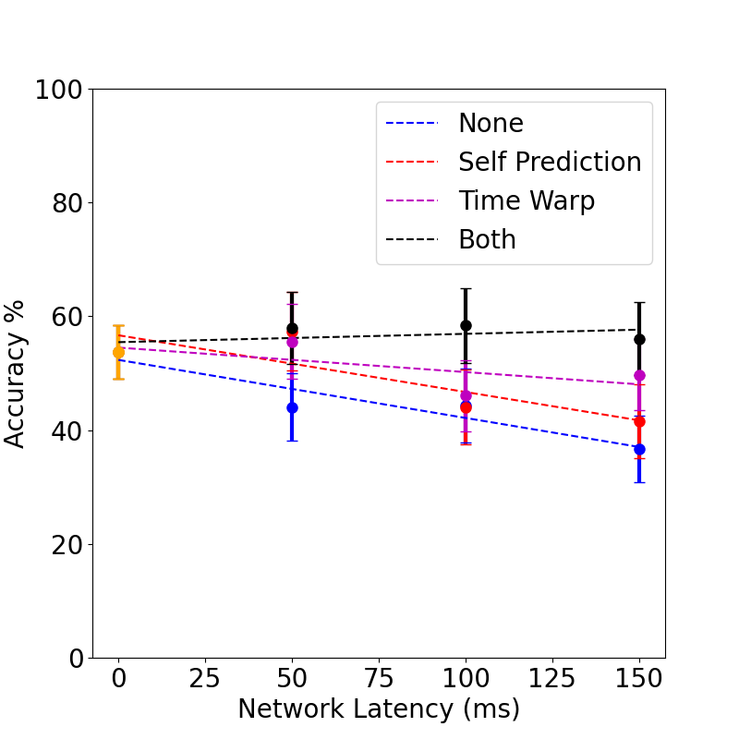
Versus Network Latency with Latency Compensation

Slide 22
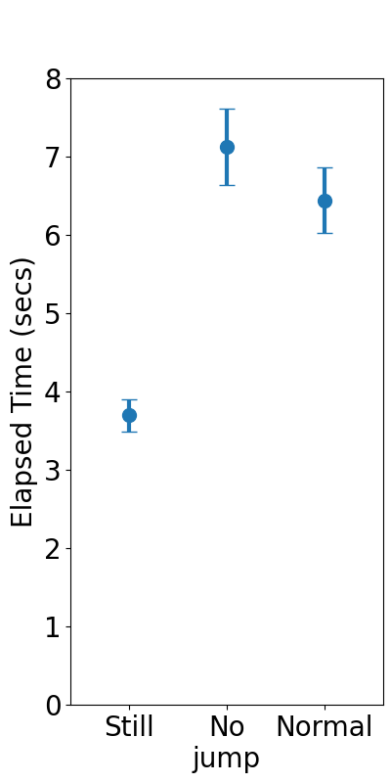
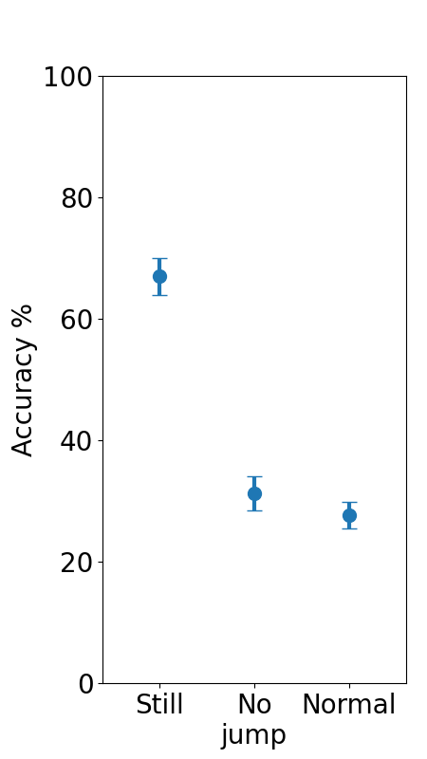
Versus Target Motion

Slide 23
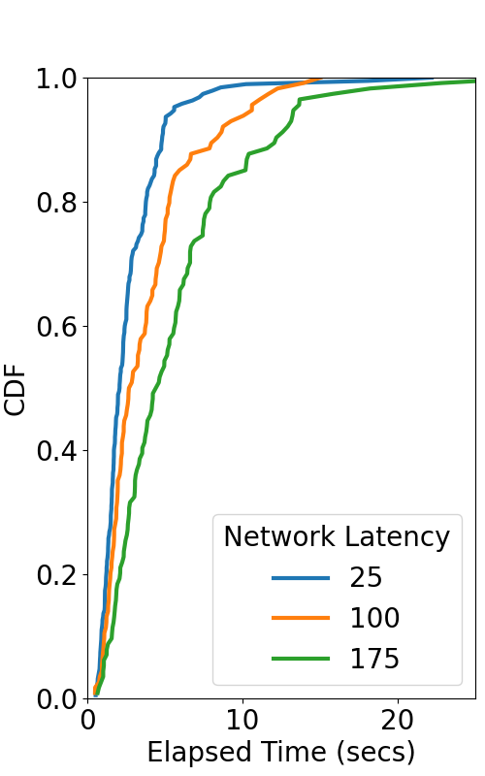
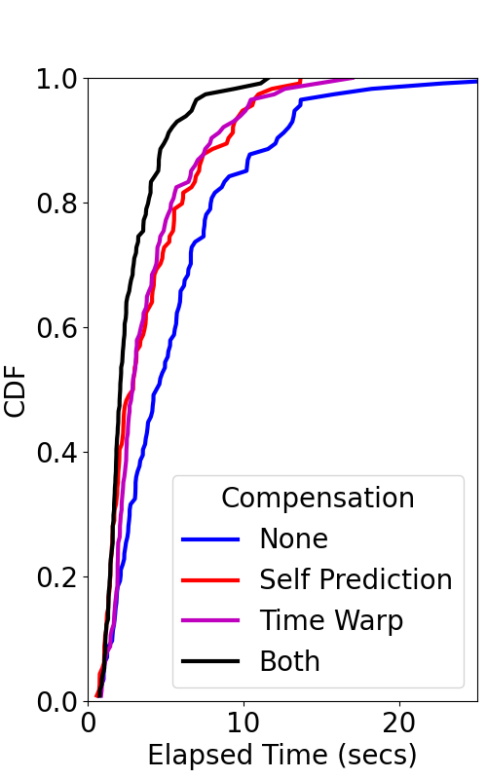
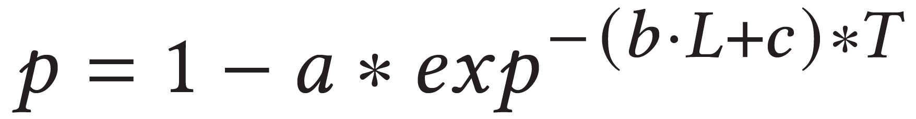
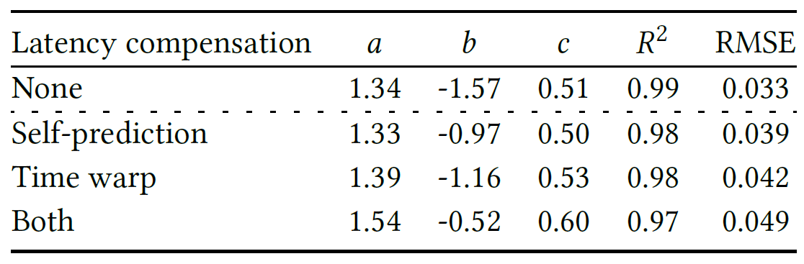
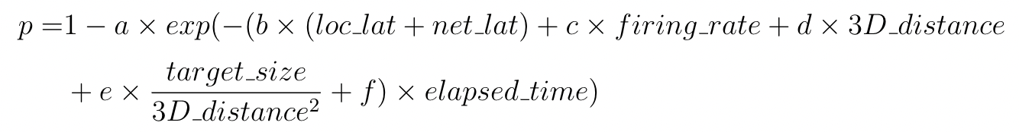
Selection Models
R² = 0.98
Notes:
This figure depicts the cumulative distribution functions (CDF) of elapsed time. The x-axis is length of elapsed time in seconds and the y-axis is the cumulative distribution. The data is grouped for three different total latency conditions. From the graph, there is some visual separation of the lines based on latency, with lower latencies having shorter elapsed times (the lines are shifted up and to the left).
We tried different mathematical distribution to fit the data and exponential turns out to be the most parsimonious one. Below we have the equations, with local latency, network latency, firing rate, distance, target size and elapsed time as parameters. The model fits the data well with R2 at 0.98.

Slide 24
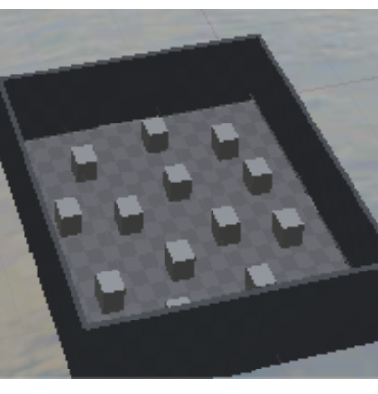




Next Steps
Combine model with Navigation model
Simulate FPS games
Validate simulations
Explore!
Spoilers →

Slide 25
The Impact of Latency on Target Selection in First-Person Shooter Games
Thank-you! Questions?
Shengmei Liu, and Mark Claypool

