Slide 1
U-Pick Game Analytics
Highlights
Project 4
IMGD 2905
http://web.cs.wpi.edu/~imgd2905/d23/projects/proj4/index.html

Slide 2

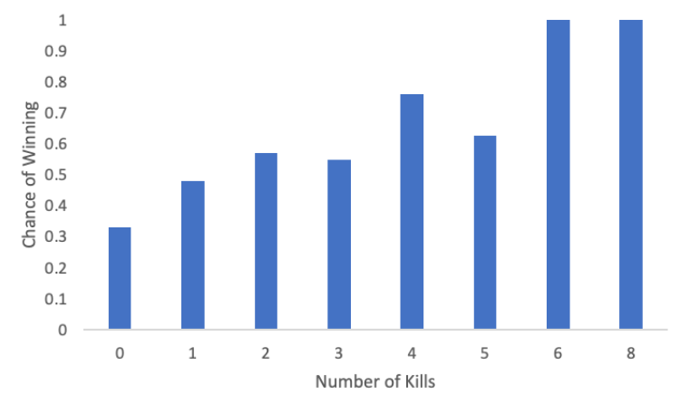
The Killer Among Us
Among Us – Abigail Albuquerque
Column chart of win percentage for different numbers of kills

Slide 3

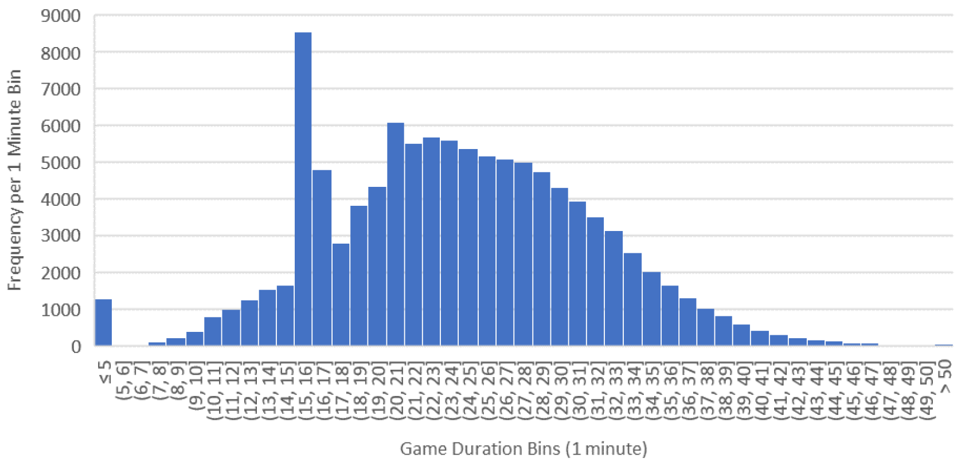
Surrender at 15?
League of Legends – By Andrew Hariyanto
Histogram of game duration

Slide 4

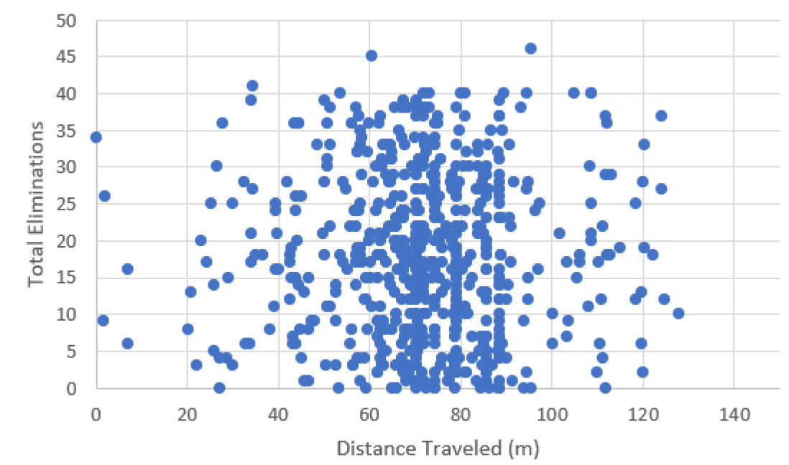
Eliminations vs. Traveled
Overwatch – By Caleb Powell
Scatter plot showing eliminations versus the distance an objective traveled

Slide 5

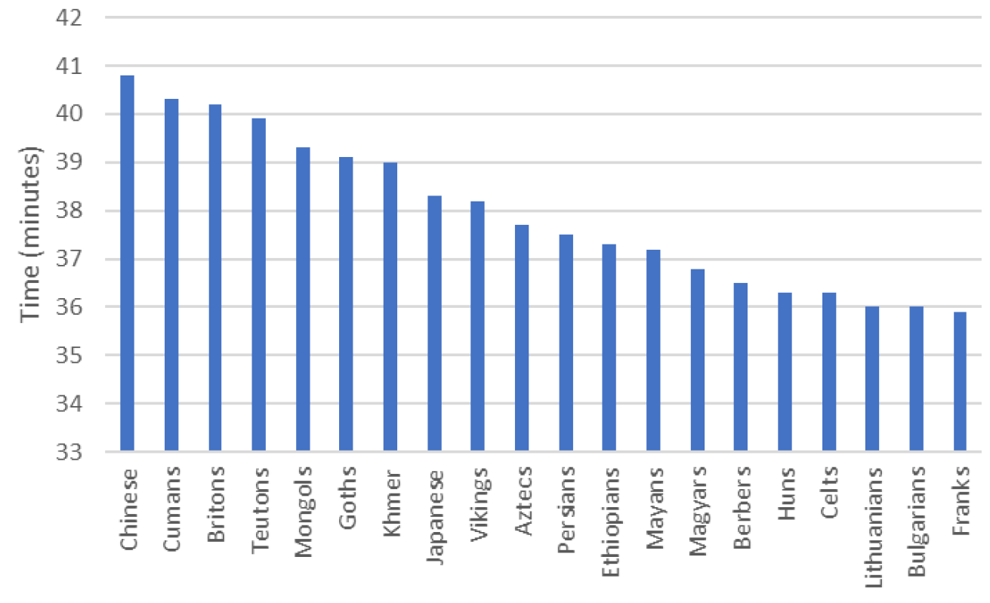
Time to Win!
Age of Empires II – By Carson Byrnes
Column chart of time to win for different civilizations

Slide 6

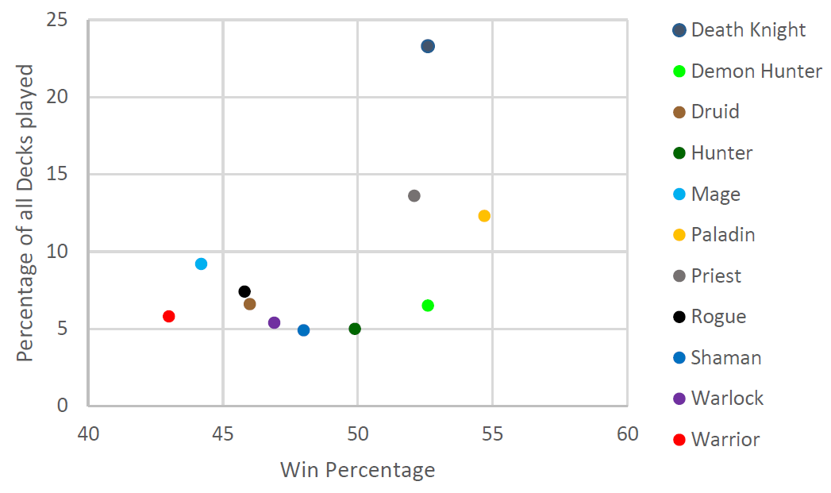
Popularity vs. Win Rate
Hearthstone – By Charlie Doud
Scatter plot showing relationship between card deck popularity and win rate

Slide 7

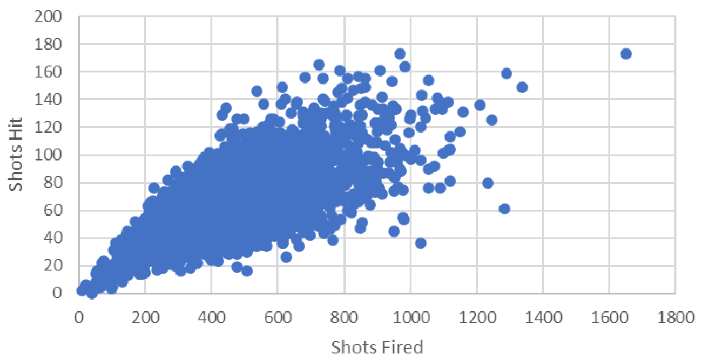
Spray and Pray
CS:GO – By Colin Masucci
Scatter plot showing shots hit versus shots fired

Slide 8
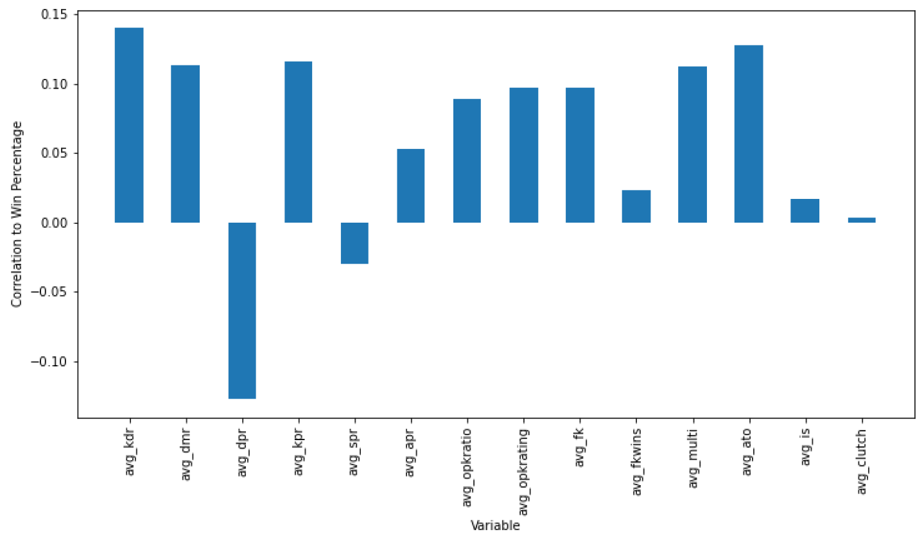
Spray and Pray
CS:GO – By Duncan Farquharson
Correlation of various CS:GO statistics to winning

Slide 9

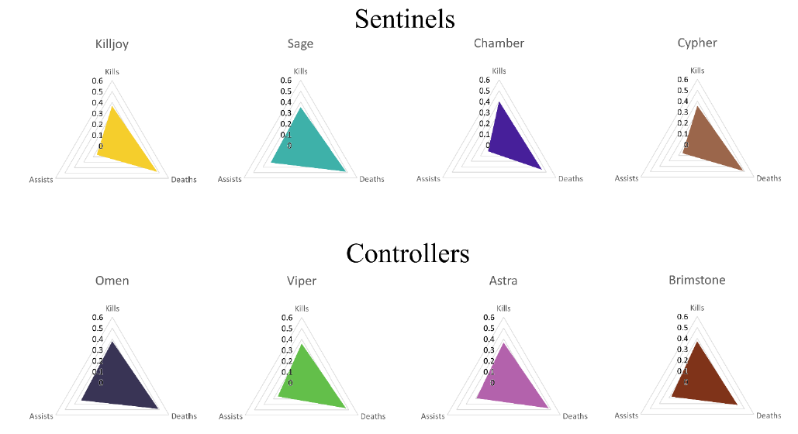
KDA by Character
Valorant – By Eric Maher
Jacob Antepli & Chris Ryan
Radar charts showing Kills, Deaths and Assists for Sentinels and Controllers

Slide 10

Player Ratings by Country
FIFA 23 – By Federico Perez
Boxplots of player ratings broken up by country

Slide 11

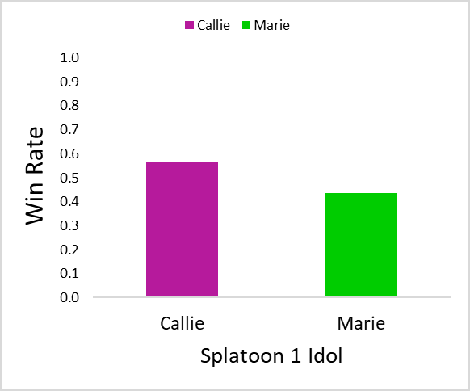
Splatfest
Splatoon– By Isaac Hernandez
Column charts showing win rate for different idols in Splatoon Splatfests

Slide 12


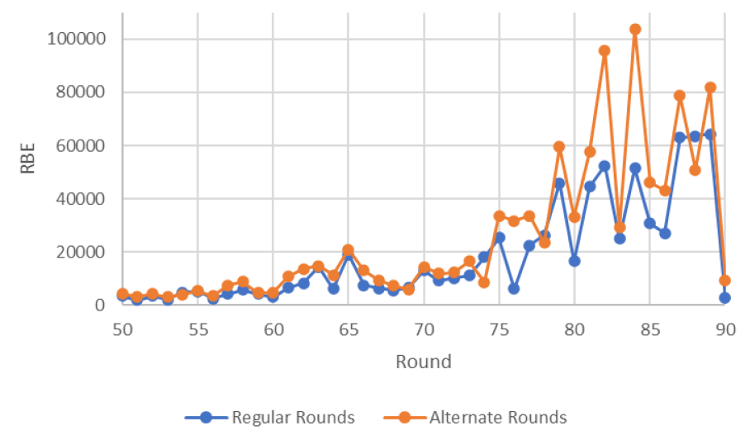
99 Red Balloons
Bloons TD 6 – By Jason Kardon
Time series chart showing Red Bloon Equivalents (RBE) for rounds 50 to 90

Slide 13

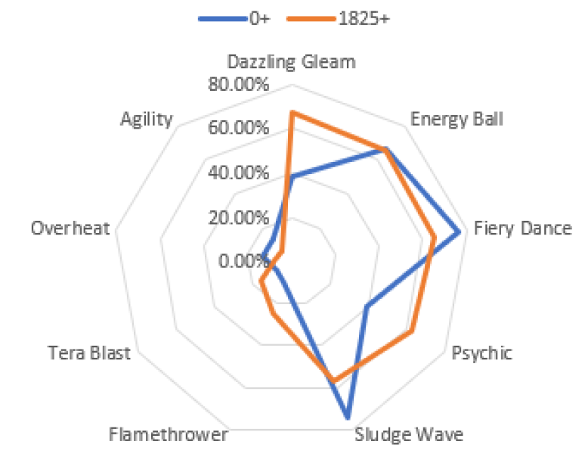
L33t vs. N00b Moves
Pokémon Showdown Gen 9 OU – By John Burke
Radar chart showing move uses for Iron Moth for low rated players (blue) and high rated players (orange)

Slide 14

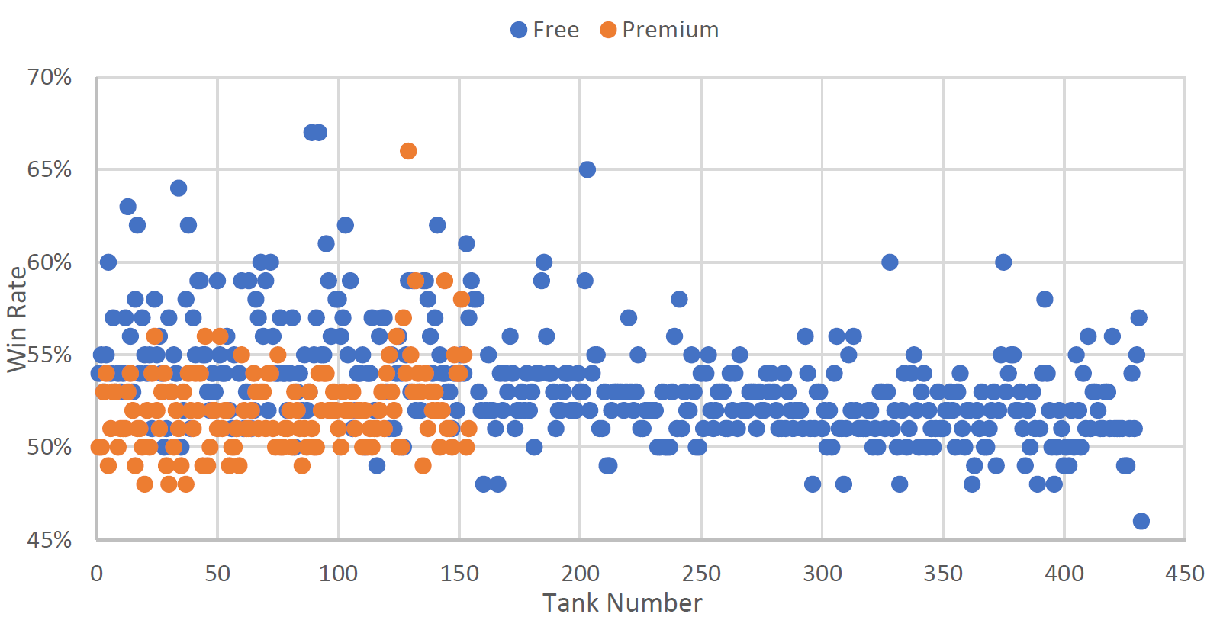
Pay to Win?
World of Tanks – By Josh Cohen
Scatter plot of win rate for each tank, clustered by free versus premium (not-free) tanks

Slide 15

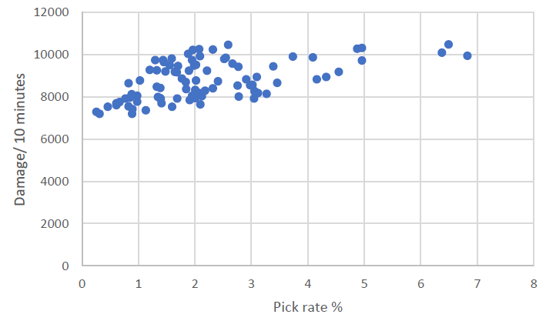
Picking High Damage Champions
Overwatch 2 – By Juliet Morin
Scatter plot of damage rate versus pick rate

Slide 16

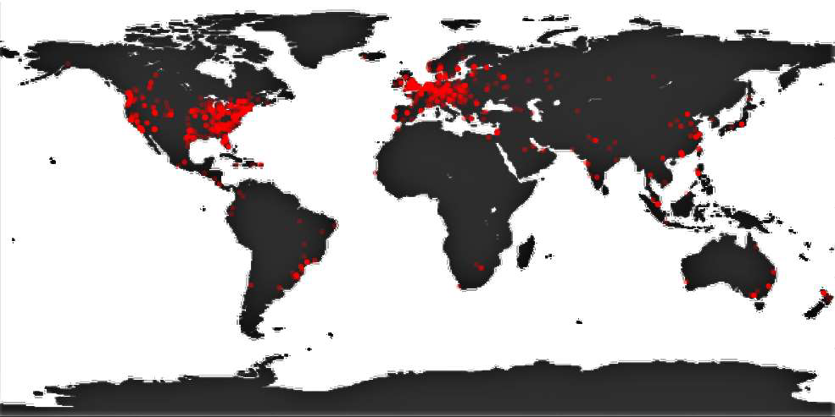
Where in the World?
Project Nodenium – Minecraft – By Matt Hagger
Heatmap of incoming traffic to website

Slide 17
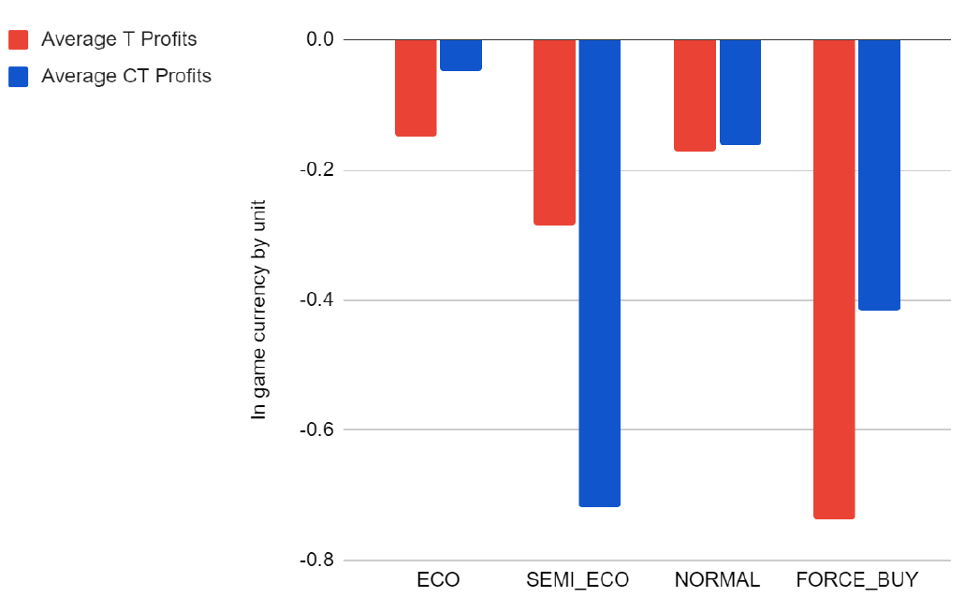
Buy, Buy, Buy
CS:GO – By Mauricio Mergal
Column chart showing average profit for each buy phase strategy

Slide 18
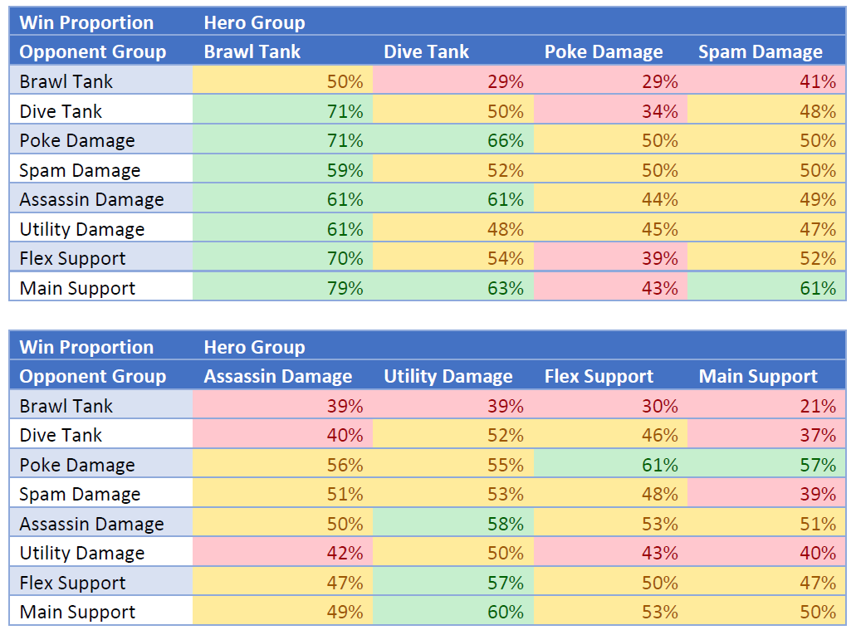
1v1 Me!
Overwatch 2 – By Max Allen
Heat map showing 1v1 win rates clustered by hero type

Slide 19
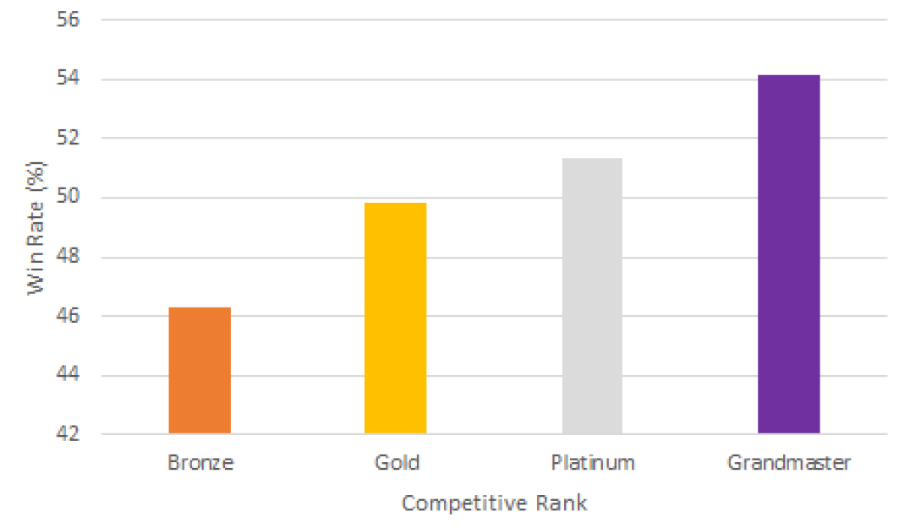
Winning by Rank
Overwatch 2 – By Owen Pugh
Column chart showing win rate based on player rank

Slide 20
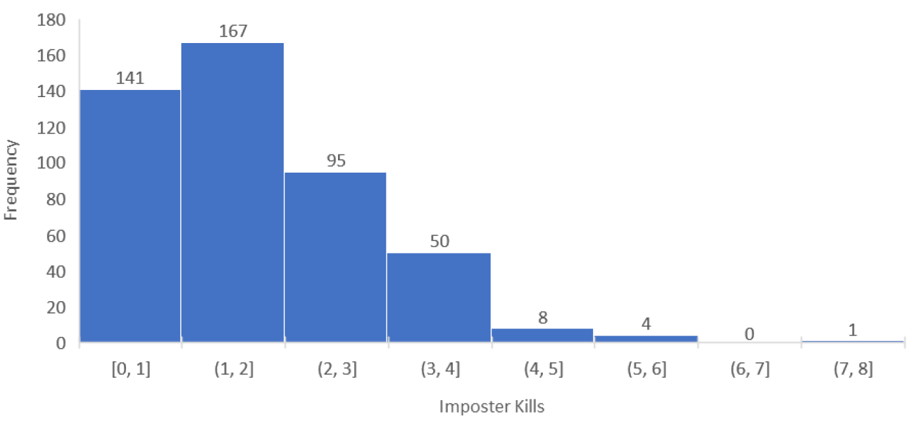
The Killer is Still Among Us?
Among Us – By Perla Walling-Sotolongo
Histogram of imposter kills

Slide 21

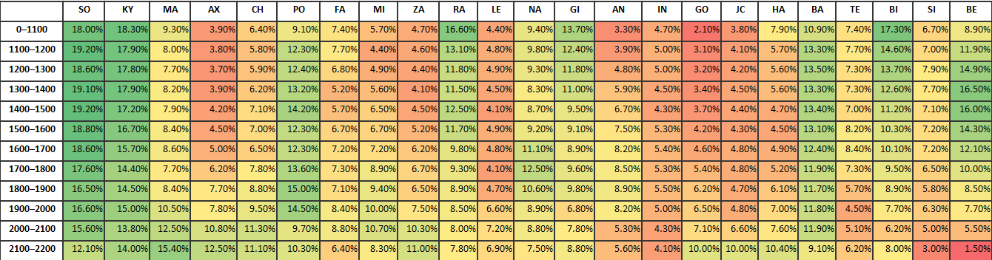
Popularity Context
Guilty Gear Strive – By Connor Chartier and Charles West
Heat map of character popularity based on player rank

Slide 22
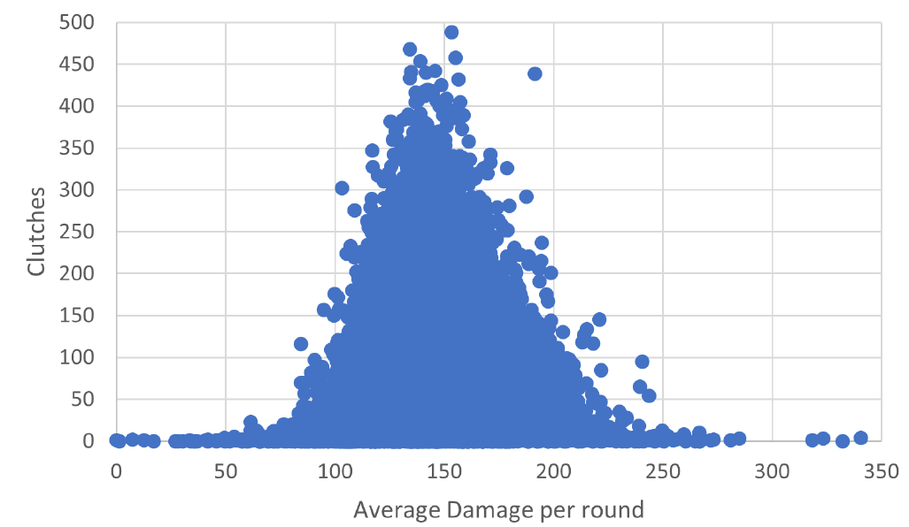
Clutch Player
Valorant – By Jacob Antepli and Chris Ryan
Scatter plot (almost as a distribution ) of clutches (last teammate standing) versus average damage per round

Slide 23
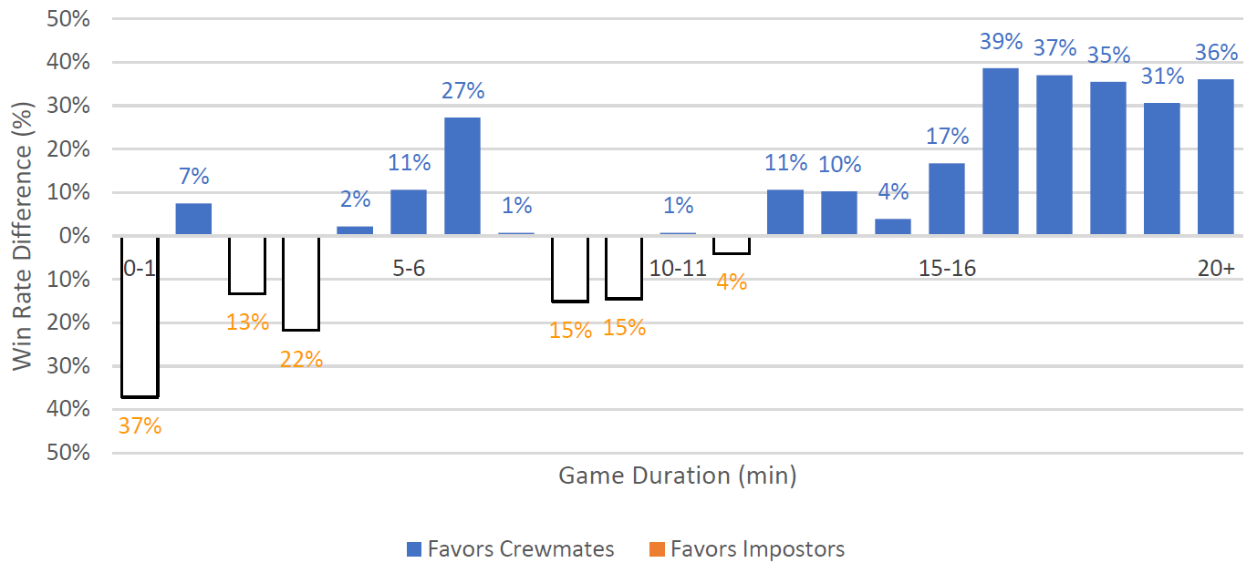
Living Longer Among Us
Among Us – By Skye Vinson
Column chart showing chance of winning versus game duration

Slide 24

First Player Advantage?
Yu-Gi-Oh – By Spencer Dill
Column chart showing number of wins for going first versus going second

Slide 25
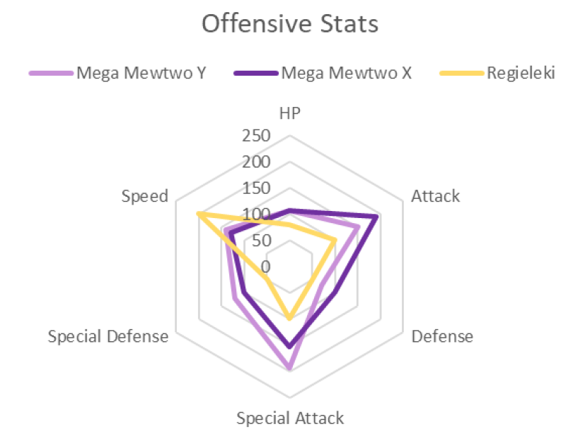
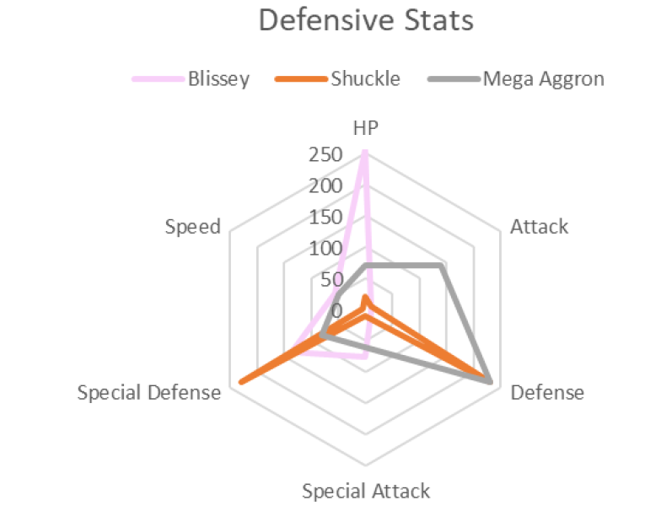
Top Offense and Defense
Pokémon – By Trey Bowen
Radar charts showing Pokémon with highest offense (left) and defense (right), broken down by type

Slide 26
Agent Popularity
Valorant – By Vijay Mistry
Column chart showing agent popularity

Slide 27

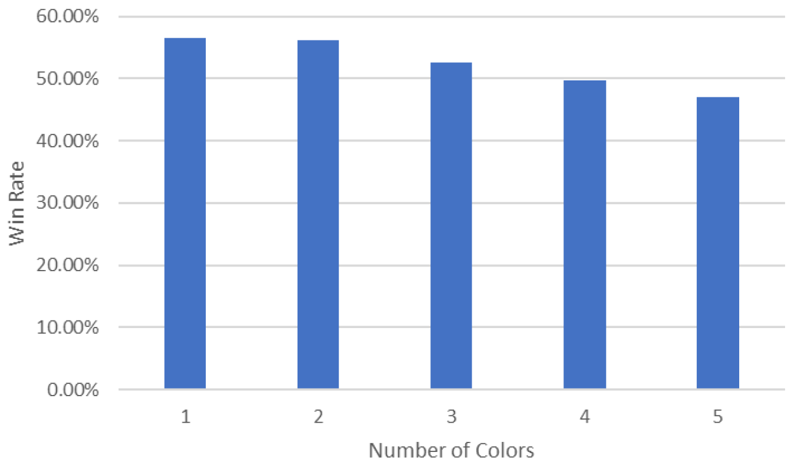
All the Colors of the Rainbow
Magic the Gathering – By Zachary Robinson
Column chart showing number of colors used in a deck versus the win rate

Slide 28
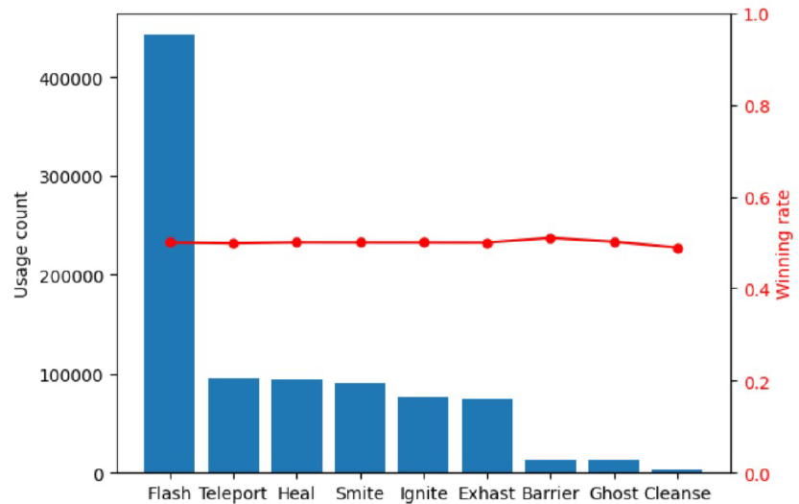
Flash FTW?
League of Legends – By Zihang Chen
Two-axis chart showing summoner spell usage (left y-axis) and corresponding winning rate (right y-axis)

