Slide 1
Mazetool Analytics
Postmortem
Project 2
IMGD 2905

Slide 2
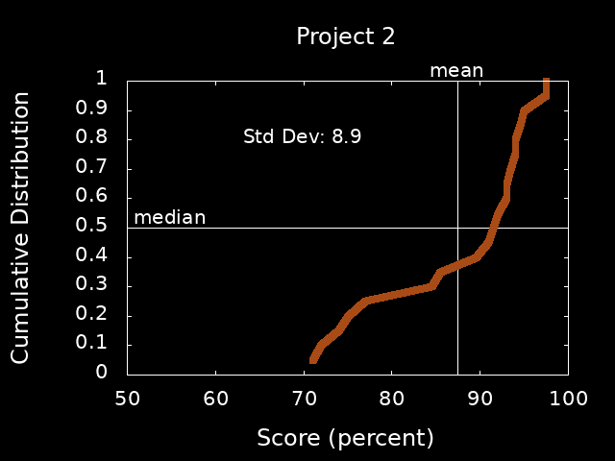
Scores

Slide 3
General Comments
Quite good!
Provide details on data
Number of participants, number of total runs, maybe even students in the class
→ context matters!
Double-down, make sure solid on fundamentals of drawing and presenting charts
Minimize “ink”, maximize information
Label axes, provide units, clear message
Figure numbers and captions, refer to in text
Describe axes + data before message

Slide 4
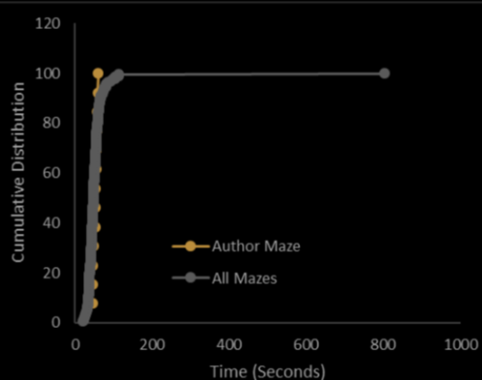
Be Aware of Outliers

Slide 5
Be Aware of Outliers
What was the user doing? Can you know?

Slide 6
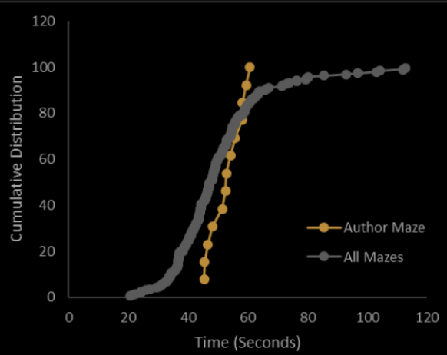
Outlier Removed
BTW, scale CDF to max

Slide 7
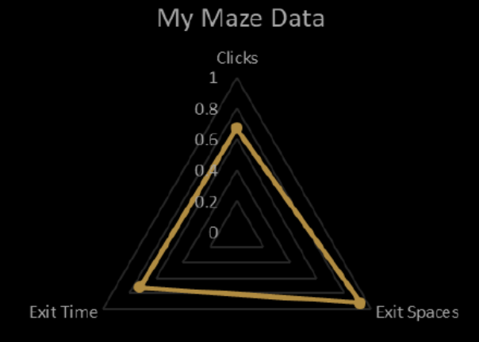
Comparing Radar Charts
1. Remember to say how axes are normalized in text!

Slide 8
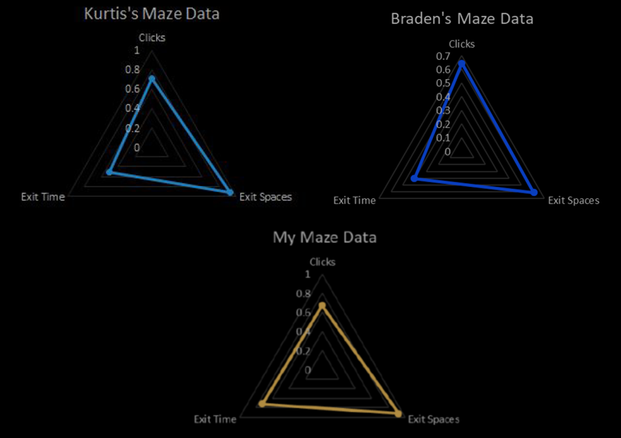
Comparing Radar Charts
Better if same scale on y axis!

Slide 9
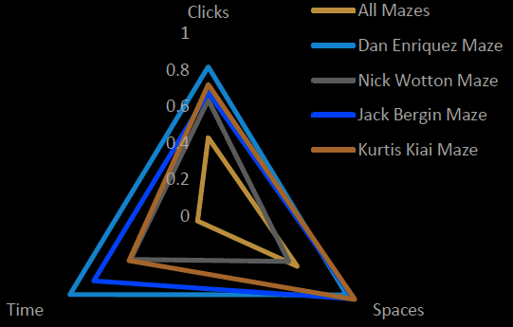
Comparing Radar Charts

Slide 10
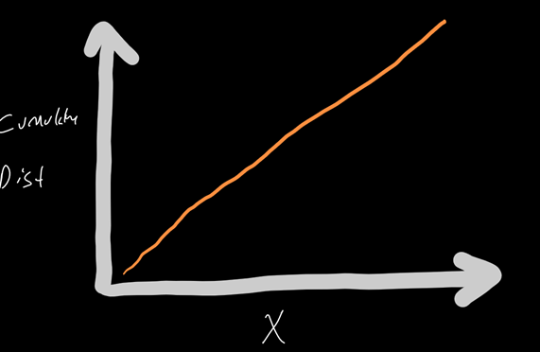
Linear Trendlines for CDFs
Not usually done …
What distribution is this?
Cumulative
Distribution

Slide 11
Linear Trendlines for CDFs
What would a normal distribution look like?
Cumulative
Distribution

Slide 12
Next Steps
Read over comments on your report
Ask if you have questions
Incorporate general and specific tips into next project!
Re-review before turning in Project 3
Keep up the good work!
https://i0.wp.com/www.johnhardingestates.co.uk/wp-content/uploads/2018/02/John-Harding-Estates-Hints-and-Tips.png?fit=600%2C419

