Slide 1
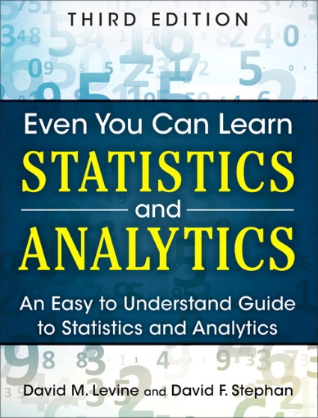
Probability
IMGD 2905
Chapters 4 & 5

Slide 2
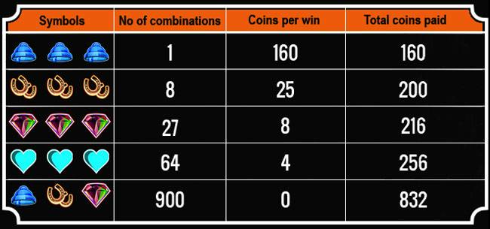
Overview
Statistics important for game analysis
Probability important for statistics
So, understand some basic probability
Also, probability useful for game development

Slide 3
Breakout 4
What are some examples of probabilities needed for game development?
Provide a specific example
Icebreaker, Groupwork, Questions
https://web.cs.wpi.edu/~imgd2905/d21/breakout/breakout-4.html

Slide 4
Some examples of probabilities for game development?

Slide 5
Some examples of probabilities for game development?
Probability attack will succeed
Probability loot from enemy contains rare item
Probability enemy spawns at particular time
Probability action (e.g., building a castle) takes particular amount of time
Probability players at server

Slide 6
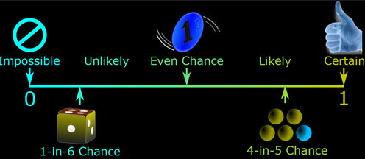
Probability Introduction
Probability – way of assigning numbers to outcomes to express likelihood of event

Slide 7
Outline
Introduction (done)
Probability (next)
Probability Distributions

Slide 8
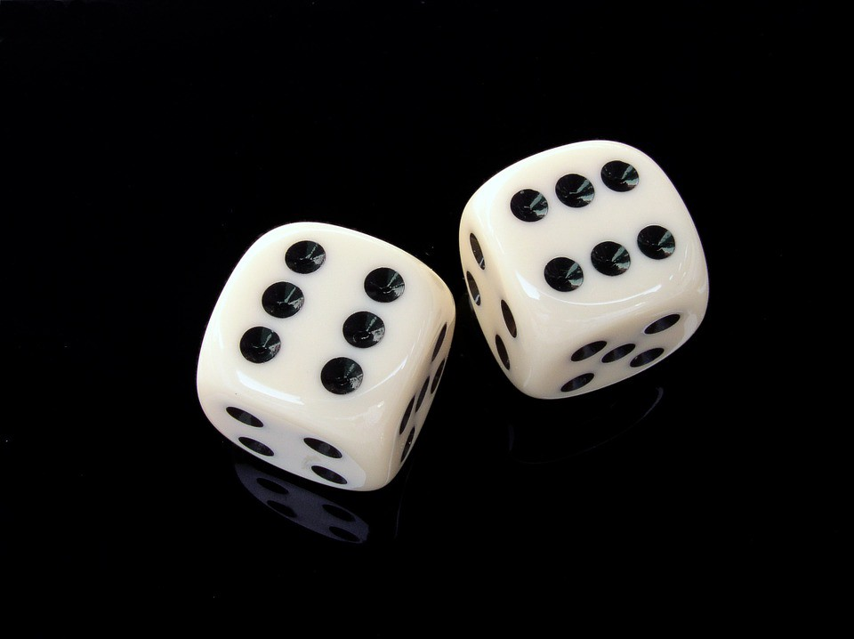
Probability – Definitions
Probability – way of assigning numbers to outcomes to express likelihood of event
Event – outcome of experiment or observation
Elementary – simplest type for given experiment. independent
Joint/Compound – more than one elementary

Slide 9
Probability – Definitions
Roll die (d6) and get 6
elementary event
Roll die (d6) and get even number
compound event, consists of elementary events 2, 4, and 6
Pick card from standard deck and get queen of spades
elementary event
Pick card from standard deck and get face card
compound event
Observe players logging in to MMO server, see if two people log in less than 15 minutes apart
compound event
We’ll treat/compute probabilities of elementary versus compound separately

Slide 10
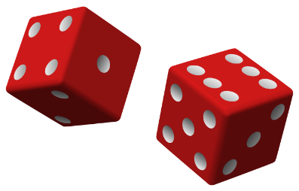
Probability – Definitions
Exhaustive set of events – set of all possible outcomes of experiment/observation
Mutually exclusive sets of events – elementary events that do not overlap
Roll d6: Events: 1, 2
not exhaustive, mutually exclusive

Slide 11
Probability – Definitions
Roll d6: Events: 1, 2, 3, 4, 5, 6
exhaustive, mutually exclusive
Roll d6: Events: get even number, get number divisible by 3, get a 1 or get a 5
exhaustive, but not mutually exclusive
Observe logins: time between arrivals <10 seconds, 10+ and <15 seconds inclusive, or 15+ seconds
exhaustive, mutually exclusive
Observe logins: time between arrivals <10 seconds, 10+ and <15 seconds inclusive, or 10+ seconds
exhaustive, but overlap

Slide 12
Probability – Definition
Probability – likelihood of event to occur, ratio of favorable cases to all cases
Set of rules that probabilities must follow
Probabilities must be between 0 and 1 (but often written/said as percent)
Probabilities of set of exhaustive, mutually exclusive events must add up to 1

Slide 13
Probability – Definition
e.g., d6: events 1, 2, 3, 4, 5, 6. Probability of 1/6th to each, sum of P(1) + P(2) + P(3) + P(4) + P(5) + P(6) = 1
→ legal set of probabilities
e.g., d6: events 1, 2, 3, 4, 5, 6. Probability of ½ to roll 1, ½ to roll 2, and 0 to all the others sum of P(1) + … + P(6) = 0.5 + 0.5 + 0 … + 0 = 1
→ Also legal set of probabilities
Not how honest d6’s behave in real life!

Slide 14
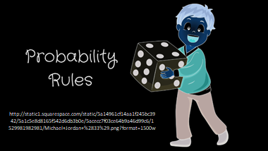
How to Assign Probabilities?
https://newvitruvian.com/images/marbles-clipart-bag-marble-4.png

Slide 15
Assigning Probabilities
Classical (by theory)
In many cases, exhaustive, mutually exclusive outcomes equally likely → assign each outcome probability of 1/n
e.g., d6: 1/6, Coin: prob heads ½, tails ½, Cards: pick Ace 1/13
Empirically (by observation)
Obtain data through measuring/observing
e.g., Watch how often people play FIFA 20 in FL222 versus some other game. Say, 30% FIFA. Assign that as probability
Subjective (by hunch)
Based on expert opinion or other subjective method
e.g., eSports writer says probability Fnatic (European LoL team) will win World Championship is 25%

Slide 16
Rules About Probabilities (1 of 4)
Complement: A an event. Event “Probability A does not occur” called complement of A, denoted A’
P(A’) = 1 - P(A)
e.g., d6: P(6) = 1/6, complement is P(6’) and probability of “not 6” is 1-1/6, or 5/6.
Note: Value often denoted p, complement is q
Q: why?

Slide 17
Rules About Probabilities (2 of 4)
Mutually exclusive: Have no simple outcomes in common – can’t both occur in same experiment
P(A or B) = P(A) + P(B)
“Probability either occurs”
e.g., d6: P(3 or 6) = P(3) + P(6) = 1/6 + 1/6 = 2/6

Slide 18
Rules About Probabilities (3 of 4)
Independent: Probability that one occurs doesn’t affect probability that other occurs
e.g., 2d6: A= die 1 get 5, B= die 2 gets 6. Independent, since result of one roll doesn’t affect roll of other
“Probability both occur”
P(A and B) = P(A) x P(B)
e.g., 2d6: prob of “snake eyes” is P(1) x P(1) = 1/6 x 1/6 = 1/36

Slide 19
Rules About Probabilities (4 of 4)
Not independent: One occurs affects probability that other occurs
Probability both occur
P(A and B) = P(A) x P(B | A)
Where P(B | A) means the prob B given A happened
e.g., LoL chance of getting most kills 20%. Chance of being support is 20%. You might think that:
P(kills) x P(support) = 0.2 x 0.2 = 0.04
But likely not independent. P(kills | support) < 20%. So, need non-independent formula
P(kills) * P(kills | support)
(example next)

Slide 20
Probability Example
Probability drawing King?
P(K) = ¼
Draw, put back. Now?
P(K) = ¼
Probability not King?
P(K’) = 1-P(K) = ¾
Draw, put back. 2 Kings?
P(K) x P(K) = ¼ x ¼ = 1/16

Slide 21
Probability Example
Probability drawing King?
P(K) = ¼
Draw, put back. Draw. Now?
P(K) = ¼
Probability not King?
P(K’) = 1-P(K) = ¾
Draw, put back. 2 Kings?
P(K) x P(K) = ¼ x ¼ = 1/16

Slide 22
Probability Example
Probability drawing King?
P(K) = ¼
Draw, put back. Draw. Now?
P(K) = ¼
Draw. Probability not King?
P(K’) = 1-P(K) = ¾
Draw, put back. 2 Kings?
P(K) x P(K) = ¼ x ¼ = 1/16

Slide 23
Probability Example
Probability drawing King?
P(K) = ¼
Draw, put back. Draw. Now?
P(K) = ¼
Draw. Probability not King?
P(K’) = 1-P(K) = ¾
Draw, put back. Draw. 2 Kings?
P(K) x P(K) = ¼ x ¼ = 1/16

Slide 24
Probability Example
Probability drawing King?
P(K) = ¼
Draw, put back. Draw. Now?
P(K) = ¼
Draw. Probability not King?
P(K’) = 1-P(K) = ¾
Draw, put back. Draw. 2 Kings?
P(K) x P(K) = ¼ x ¼ = 1/16

Slide 25
Probability Example
Draw. King or Queen?
P(K or Q) = P(K) + P(Q)
= ¼ + ¼ = ½
Draw, put back. Draw. Not King either card?
P(K’) x P(K’) = ¾ x ¾ = 9/16
Draw, don’t put back. Draw. Not King either card?
P(K’) x P(K’ | K’) = ¾ x (1-1/3)
= ¾ x 2/3
= 6/12 = ½
Draw, don’t put back. Draw. King 2nd card?
P(K’) x P(K | K’) = ¾ x ⅓ = 3/12 = ¼

Slide 26
Probability Example
Draw. King or Queen?
P(K or Q) = P(K) + P(Q)
= ¼ + ¼ = ½
Draw, put back. Draw. Not King either card?
P(K’) x P(K’) = ¾ x ¾ = 9/16
Draw, don’t put back. Draw. Not King either card?
P(K’) x P(K’ | K’) = ¾ x (1-1/3)
= ¾ x 2/3
= 6/12 = ½
Draw, don’t put back. Draw. King 2nd card?
P(K’) x P(K | K’) = ¾ x ⅓ = 3/12 = ¼

Slide 27
Probability Example
Draw. King or Queen?
P(K or Q) = P(K) + P(Q)
= ¼ + ¼ = ½
Draw, put back. Draw. Not King either card?
P(K’) x P(K’) = ¾ x ¾ = 9/16
Draw, don’t put back. Draw. Not King either card?
P(K’) x P(K’ | K’) = ¾ x (1-1/3)
= ¾ x 2/3
= 6/12 = ½
Draw, don’t put back. Draw. King 2nd card?
P(K’) x P(K | K’) = ¾ x ⅓ = 3/12 = ¼

Slide 28
Probability Example
Draw. King or Queen?
P(K or Q) = P(K) + P(Q)
= ¼ + ¼ = ½
Draw, put back. Draw. Not King either card?
P(K’) x P(K’) = ¾ x ¾ = 9/16
Draw, don’t put back. Draw. Not King either card?
P(K’) x P(K’ | K’) = ¾ x (1-1/3)
= ¾ x 2/3
= 6/12 = ½
Draw, don’t put back. Draw. King 2nd card?
P(K’) x P(K | K’) = ¾ x ⅓ = 3/12 = ¼

Slide 29
Probability Example
Draw. King or Queen?
P(K or Q) = P(K) + P(Q)
= ¼ + ¼ = ½
Draw, put back. Draw. Not King either card?
P(K’) x P(K’) = ¾ x ¾ = 9/16
Draw, don’t put back. Draw. Not King either card?
P(K’) x P(K’ | K’) = ¾ x (1-1/3)
= ¾ x 2/3
= 6/12 = ½
Draw, don’t put back. Draw. King 2nd card?
P(K’) x P(K | K’) = ¾ x ⅓ = 3/12 = ¼

Slide 30
Outline
Introduction (done)
Probability (done)
Probability Distributions (next)

Slide 31
Probability Distributions
Probability distribution – values and likelihood (expected value) that random variable can take
Why? If can model mathematically, can use to predict occurrences
e.g., probability slot machine pays out on given day
e.g., probability game server hosts player today
e.g., probability certain game mode is chosen by player
Also, some statistical techniques for some distributions only

Slide 32
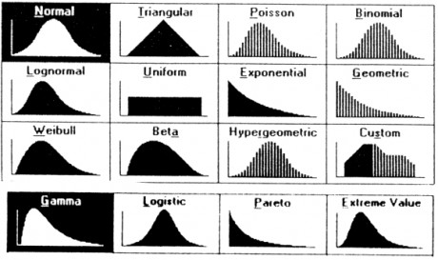
Probability Distributions
https://goo.gl/jqomFI
Types discussed:
Uniform (discrete)
Binomial (discrete)
Poisson (discrete)
Normal (continuous)

Slide 33
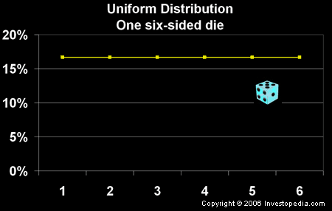
Uniform Distribution
“So what?”
Can use known formulas

Slide 34
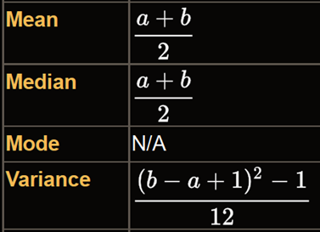
Uniform Distribution
“So what?”
Can use known formulas
Mean = (1 + 6) / 2 = 3.5
Variance = ((6 – 1 + 1)² – 1)/12
= 2.9
Std Dev = sqrt(Variance) = 1.7
Note – mean is also the expected value
(if you did a lot of trials, would be average result)

Slide 35
Binomial Distribution Example (1 of 3)
Suppose toss 3 coins
Random variable
X = number of heads
Want to know probability of exactly 2 heads
P(X=2) = ?
How to assign probabilities?

Slide 36
Binomial Distribution Example (1 of 3)
Suppose toss 3 coins
Random variable
X = number of heads
Want to know probability of exactly 2 heads
P(X=2) = ?
Could measure (empirical)
Could use “hunch” (subjective)
Could use theory (classical)
Math using our probability rules (not shown)
Enumerate (next)

Slide 37
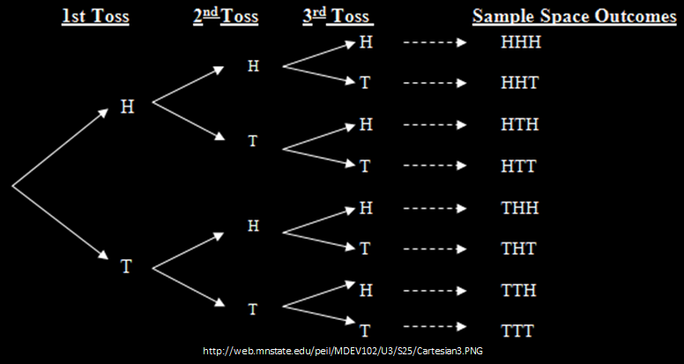
Binomial Distribution Example (2 of 3)
All equally likely (p is 1/8 for each)
→ P(HHT) + P(HTH) + P(THH) = 3/8
Can draw histogram of number of heads

Slide 38
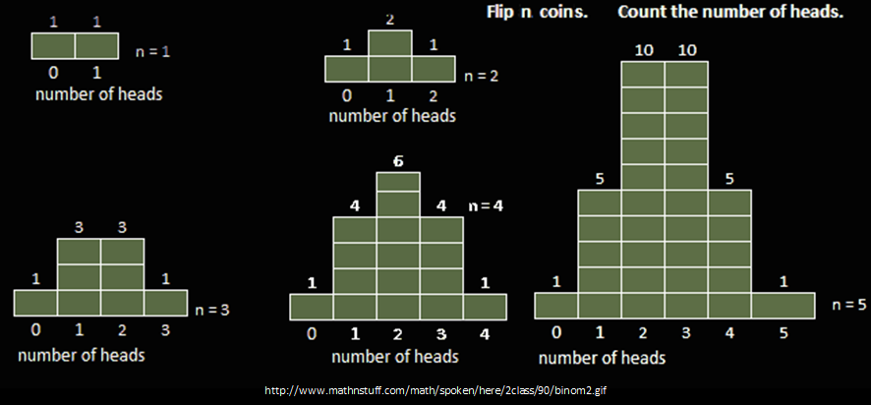
Binomial Distribution Example (3 of 3)
These are all binomial distributions
Note, again expected value -
average amount you’d get if you did many trials

Slide 39
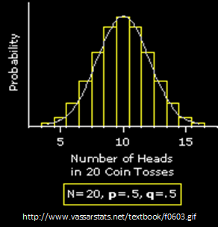
Binomial Distribution (1 of 3)
In general, any number of trials (n) & any probability of successful outcome (p) (e.g., heads)

Slide 40
Binomial Distribution (2 of 3)
Characteristics of experiment that gives random number with binomial distribution:
Experiment consists of n identical trials.
Trials are independent
Each trial results in only two possible outcomes, S or F
Probability of S each trial is same, denoted p
Random variable of interest (X) is number of S’s in n trials

Slide 41
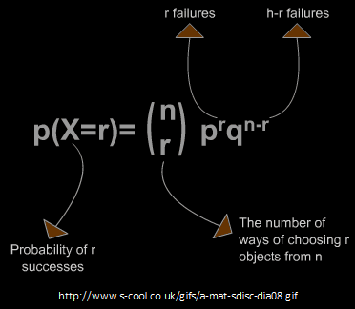
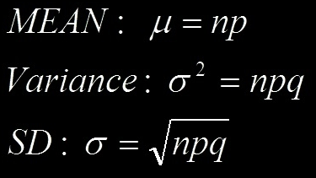
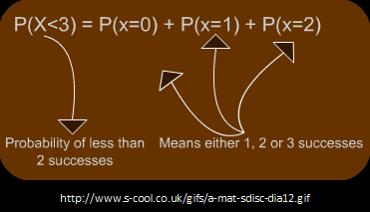
Binomial Distribution (3 of 3)
“So what?”
Can use known formulas
Excel: binom.dist()
binom.dist(x,trials,prob,cumulative)
– 2 heads, 3 flips, coin, discrete
=binom.dist(2,3,0.5,FALSE)
=0.375 (i.e., 3/8)

Slide 42
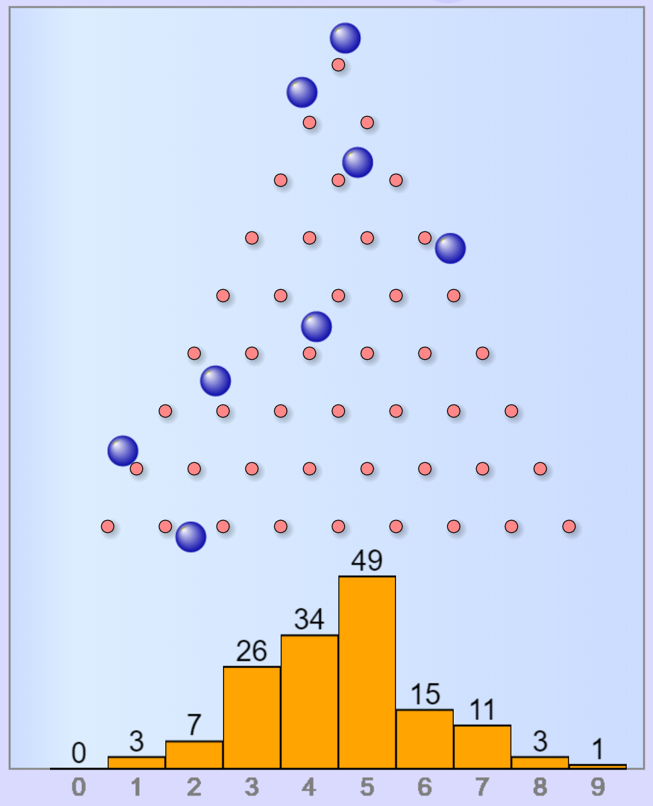
Binomial Distribution Example
Each row is like a coin flip
right = “heads”
left = “tails”
Bottom axis is number of heads
Proves and “empirical” way to estimate P(X)
bin(X) / sum(bin(0) + bin(1) + …)
https://www.mathsisfun.com/data/quincunx.html

Slide 43
Poisson Distribution
Distribution of probability of x events occurring in certain interval (into units)
Interval can be time, area, volume, distance
e.g., number of players arriving at server lobby in 5-minute period between noon-1pm
Requires
Probability of event same for all time units
Number of events in one time unit independent of number of events in any other time unit
Events occur singly (not simultaneously). i.e., as interval unit gets smaller, probability two events occurring → 0

Slide 44
Poisson Distributions?
Not Poisson
Could Be Poisson
Number of people arriving at restaurant during dinner hour
People frequently arrive in groups
Number of students registering for course in BannerWeb per hour on first day of registration
Prob not equal – most register in first few hours
Not independent – if too many register early, system crashes
Number of groups arriving at restaurant during dinner hour
Number of logins to MMO during prime time
Number of defects (bugs) per 100 lines of code
People arriving at cash register (if they shop individually)
Phrase people use is random arrivals

Slide 45
Poisson Distribution
Distribution of probability of x events occurring in certain interval
“So what?”
Can use known formulas
http://www.dummies.com/education/math/business-statistics/how-to-compute-poisson-probabilities/

Slide 46
Poisson Distribution Example
Number of games student plays per day averages 1 per day
Number of games played per day independent of all other days
Can only play one game at a time
What’s probability of playing 2 games tomorrow?
In this case, the value of λ = 1, want P(X=2)

Slide 47
Current Poisson Distribution Example
New England city
Average new COVID-19 cases 50/day
Local hospital has 60 free beds
What is the probability more than 60 in one day?

Slide 48
Current Poisson Distribution Example
New England city
Average new COVID-19 cases 50/day
Local hospital has 60 free beds
What is the probability more than 60 in one day?
60
= ???
50
60

Slide 49
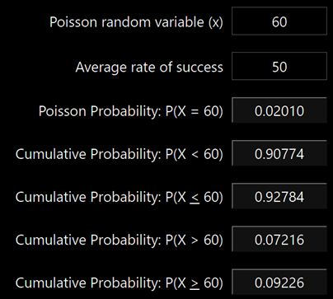
Current Poisson Distribution Example
https://stattrek.com/online-calculator/poisson.aspx
New England city
Average new COVID-19 cases 50/day
Local hospital has 60 free beds
What is the probability more than 60 in one day?
60
Q: How do we get greater than 60?
= 0.02
50
60

Slide 50
Current Poisson Distribution Example
https://stattrek.com/online-calculator/poisson.aspx
New England city
Average new COVID-19 cases 50/day
Local hospital has 60 free beds
What is the probability more than 60 in one day?
60
Q: How do we get greater than 60?
= 0.02
P(0) + P(1) + … + P(60) → P(≤60)
P(>60) = 1 - P(≤ 60)
50
60

Slide 51
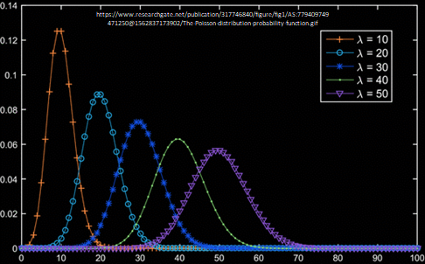
Poisson Distribution
“So what?” → Known formulas
Mean = λ
Variance = λ
Std Dev = sqrt (λ)
Excel: poisson.dist()
poisson.dist(x,mean,cumulative)
mean 50 per day, 60 beds, chance > 60?
= 1 - POISSON.DIST(60,50,TRUE)
= 0.07216
e.g., Games → may want to know likelihood of 1.5x average people arriving at server

Slide 52
Expected Value – Formulation
Expected value of discrete random variable is value you’d expect after many experimental trials. i.e., mean value of population
Value: x₁ x₂ x₃ … x_{n}
Probability: P(x₁) P(x₂) P(x₃) … P(x_{n})
Compute by multiplying each value by probability and summing
μ_{x} = E(X) = x₁ P(x₁) + x₂ P(x₂) + … + x_{n} P(x_{n})
= Σ x_{i} P(x_{i})

Slide 53
Expected Value Example – Gambling Game
Pay $3 to enter
Roll 1d6 → 6? Get $7 1-5? Get $1
What is expected payoff? Expected net?
Outcome Payoff P(x) xP(x)
1-5 $1
6 $7
???

Slide 54
Expected Value Example – Gambling Game
Pay $3 to enter
Roll 1d6 → 6? Get $7 1-5? Get $1
What is expected payoff? Expected net?
Outcome Payoff P(x) xP(x)
1-5 $1 5/6 $5/6
6 $7 1/6 $7/6
E(X) =

Slide 55
Expected Value Example – Gambling Game
Pay $3 to enter
Roll 1d6 → 6? Get $7 1-5? Get $1
What is expected payoff? Expected net?
Outcome Payoff P(x) xP(x)
1-5 $1 5/6 $5/6
6 $7 1/6 $7/6
E(X) = $5/6 + $7/6 = $12/6 = $2
E(net) =

Slide 56
Expected Value Example – Gambling Game
Pay $3 to enter
Roll 1d6 → 6? Get $7 1-5? Get $1
What is expected payoff? Expected net?
Outcome Payoff P(x) xP(x)
1-5 $1 5/6 $5/6
6 $7 1/6 $7/6
E(X) = $5/6 + $7/6 = $12/6 = $2
E(net) = E(X) - $3 = $2 - $3 = $-1

Slide 57
Outline
Introduction (done)
Probability (done)
Probability Distributions
Discrete (done)
So far random variable could take only discrete set of values
Q: What does that mean?
Q: What other distributions consider?

Slide 58
Outline
Introduction (done)
Probability (done)
Probability Distributions
Discrete (done)
Continuous (next)

Slide 59
Continuous Distributions
Many random variables are continuous
e.g., recording time (time to perform service) or measuring something (height, weight, strength)
For continuous, doesn’t make sense to talk about P(X=x) → continuum of possible values for X
Mathematically, if all non-zero, total probability infinite (this violates our rule)
So, continuous distributions have probability density, f(x)
→ How to use to calculate probabilities?
Don’t care about specific values
e.g., P(Height = 60.1946728163 inches)
Instead, ask about range of values
e.g., P(59.5” < X < 60.5”)
Uses calculus (integrate area under curve) (not shown here)
Q: What continuous distribution is especially important?

Slide 60
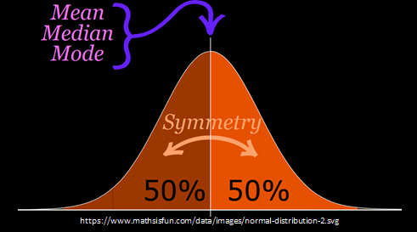
Normal Distribution (1 of 2)
“Bell-shaped” or “Bell-curve”
Distribution from -∞ to +∞
Symmetric
Mean, median, mode all same
Mean determines location, standard deviation determines “width”
50% area to left
50% area to right
-∞
+∞
Super important!
Lots of distributions follow a normal curve
Basis for inferential statistics (e.g., statistical tests)
“Bridge” between probability and statistics
Aka “Gaussian” distribution

Slide 61
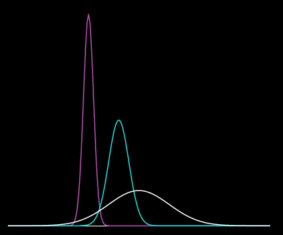
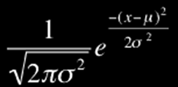
Normal Distribution (2 of 2)
Many normal distributions (see right)
However, “the” normal distribution refers to standard normal
Mean (μ) = 0
Standard deviation (σ) = 1
Can convert any normal to the standard normal
Given sample mean (x̅)
Sample standard dev. (s)
pink - mean -3, std dev 0.5
turqoise - mean 0, std dev 1
white - mean 2, std dev 3
(Next)
=norm.dist()

Slide 62
Standard Normal Distribution
Standardize
Subtract sample mean (x̅)
Divide by sample standard deviation (s)
Mean μ = 0
Standard Deviation σ = 1
Total area under curve = 1
Sounds like probability!
Remember the
Z-score?
Use to predict how likely an observed sample is given population mean
(next)

Slide 63
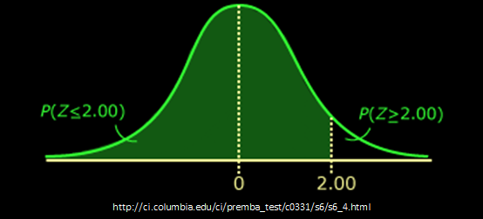
Using the Standard Normal
Suppose League of Legends Champion released once every 24 days on average, standard deviation of 3 days
What is the probability Champion released 30+ days?
x = 30, x̅ = 24, s = 3
Z = (x - x̅) / s
= (30 - 24) / 3
= 2
Want to know P(Z > 2)
Q: how? Hint: what rule might help?

Slide 64
Using the Standard Normal
Suppose League of Legends Champion released once every 24 days on average, standard deviation of 3 days
What is the probability Champion released 30+ days?
x = 30, x̅ = 24, s = 3
Z = (x - x̅) / s
= (30 - 24) / 3
= 2
Want to know P(Z > 2)
=norm.dist(x,mean,stddev,cumulative)
= 1 - norm.dist( 30, 24, 3, true )
Empirical Rule. Or use table (Z-table)
→ 5% / 2 = 2.5% likely (Z-table is 2.28%)

Slide 65
Test for Normality
Why?
Can use Empirical Rule
Use some inferential statistics (parametric tests)
How?
Measure skewness (next)
Looks normal
Histogram
Normal probability plot (QQ plot) – graphical technique to see if data set is approximately normally distributed
Statistical test
Kolmogorov-Smirnov test (K-S) or Shapiro-Wilk (S-W) that compare to normal (won’t do, but ideas in next slide deck)

Slide 66
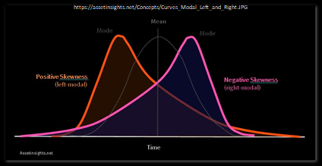
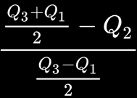
Measuring Skewness
Measure of symmetry of distribution
Normal is perfectly symmetric, skewness 0
=skew(A1:A10)
“Fisher–Pearson standardized moment”

Slide 67
Measuring Skewness
“How much” is non-normal?
Somewhat arbitrary
Less than -1 or greater than +1
Highly skewed
Between [-1, -0.5] or [0.5, +1]
Moderately skewed
Between -0.5 and 0.5
Symmetric
[Note, related “Kurtosis” is how clumped]

Slide 68
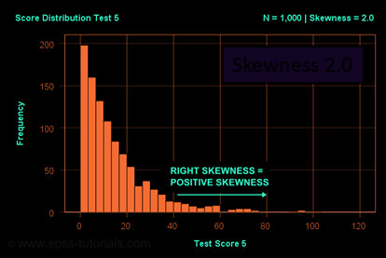
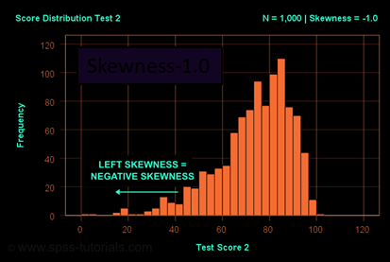
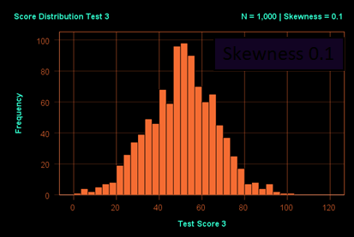
Skewness Examples
Skewness 2.0
Skewness -1.0
Skewness 0.1

Slide 69
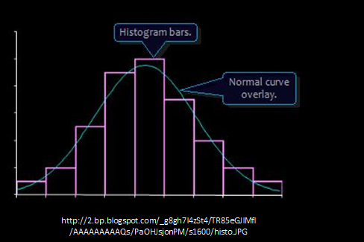
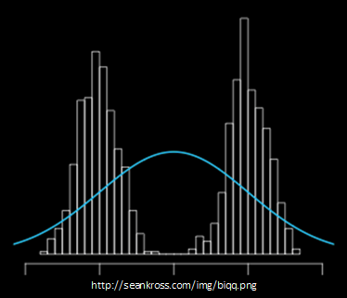
Normality Testing with a Histogram
Use histogram shape to look for “bell curve”
Yes
No

Slide 70
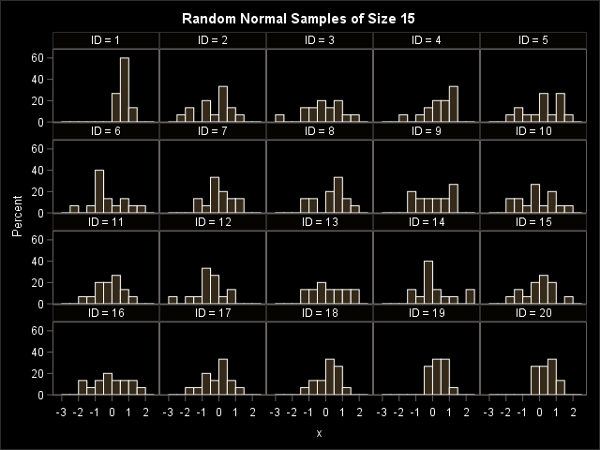
Normality Testing with a Histogram
Q: What distributions are these from? Any normal?

Slide 71
Normality Testing with a Histogram
Suffer from:
Binning (not continuous)
Few samples (15)
They are all from normal distribution!

Slide 72
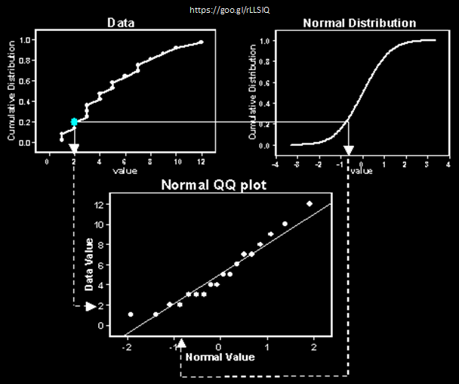
Normality Testing with a Quantile-Quantile Plot
Percentiles (quantiles) of one versus another
If line → same distribution
Order data
Compute Z scores (normal)
Plot data (y-axis) versus Z (x-axis)
Normal? → line

Slide 73
Quantile-Quantile Plot Example
Do the following values come from a normal distribution?
7.19, 6.31, 5.89, 4.5, 3.77, 4.25, 5.19, 5.79, 6.79
Order data
Compute Z scores
Plot data versus Z
Show each step, next
http://www.statisticshowto.com/q-q-plots/

Slide 74
Quantile-Quantile Plot Example – Order Data
Ordered
Unordered
7.19
6.31
5.89
4.50
3.77
4.25
5.19
5.79
6.79
3.77
4.25
4.50
5.19
5.89
5.79
6.31
6.79
7.19
N = 9 data points
http://www.statisticshowto.com/q-q-plots/

Slide 75
Quantile-Quantile Plot Example – Compute Z scores
10% = ?
20% = ?
30% = ?
40% = ?
50% = 0
60% = ?
70% = ?
80% = ?
90% = ?
Divide into
N+1 = 10
Want Z-score for that segment
http://www.statisticshowto.com/q-q-plots/

Slide 76
Quantile-Quantile Plot Example – Compute Z scores
10% = -1.28
20% = -0.84
30% = -0.52
40% = -0.25
50% = 0
60% = 0.25
70% = 0.52
80% = 0.84
90% = 1.28
=NORMSINV(area) – provide Z for area under standard normal curve
=NORMSINV(.80)
=0.841621

Slide 77
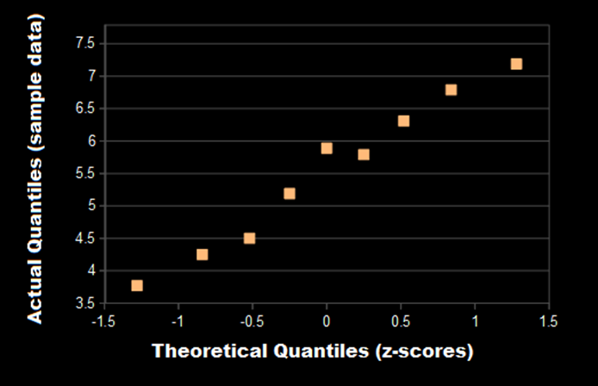
Quantile-Quantile Plot Example – Plot
http://www.statisticshowto.com/q-q-plots/
Linear? → Normal

Slide 78
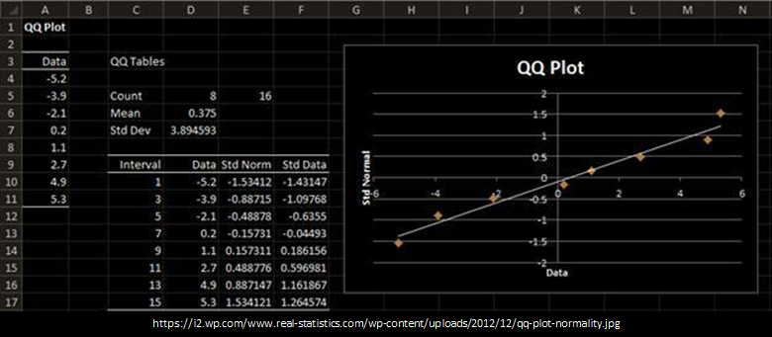
Quantile-Quantile Plots in Excel
Mostly, a manual process. Do as per above.
Example of step by step process (with spreadsheet):
http://facweb.cs.depaul.edu/cmiller/it223/normQuant.html

Slide 79
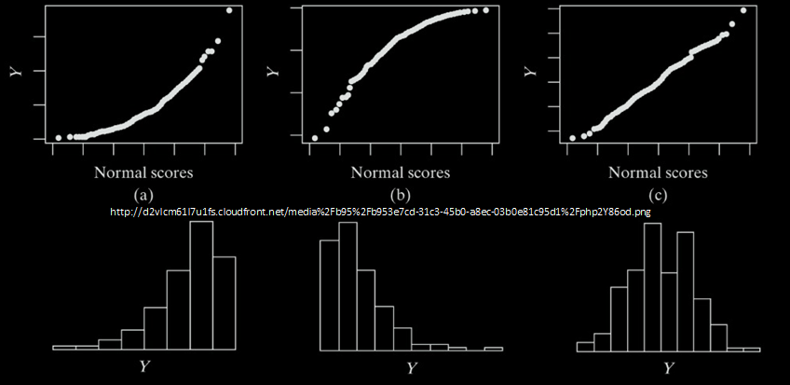
Examples of Normality Testing with a Quantile-Quantile Plot

