Slide 1
League of Legends Analytics
Postmortem
Project 1
IMGD 2905

Slide 2
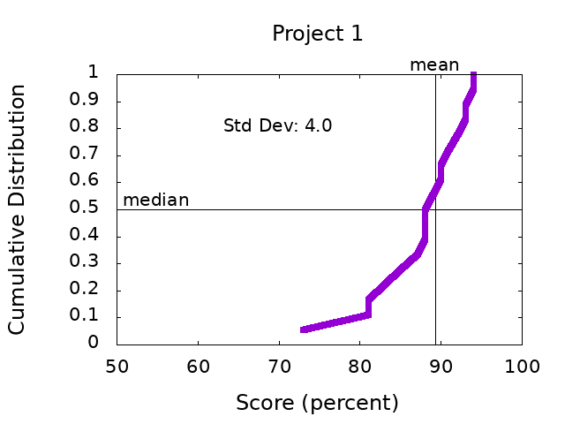
Scores

Slide 3
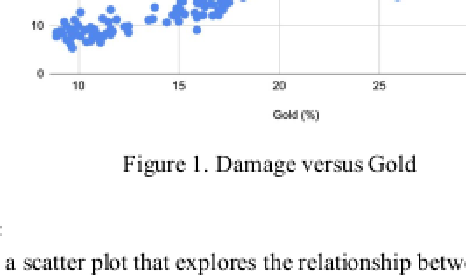
General Comments
Structure – Headings per section, Title
Avoid “you”
Spell out contractions
All figures need numbers and captions (no title)
“Figure 1. Damage versus Gold”
Refer to figure by number
“Figure 1 shows the relationship between…”
Describe axes and data BEFORE messages
Make figure fonts similar size to text font

Slide 4
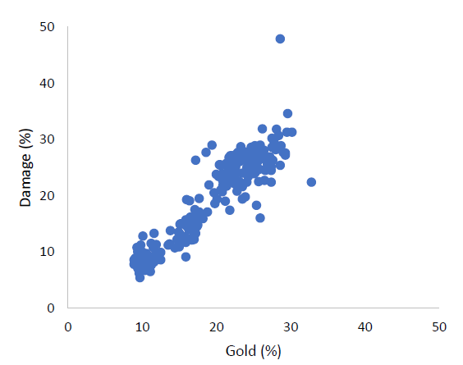
Part 1 – Damage versus Gold
Y-axis versus X-axis
Dependent versus Independent
Damage versus Gold
NOT Gold versus Damage

Slide 5
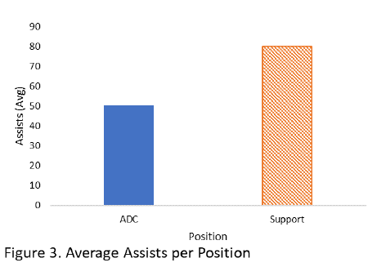
Part 2 – Kills and Assists by Role
Direct label of columns
Table inline
Watch Table spacing

Slide 6
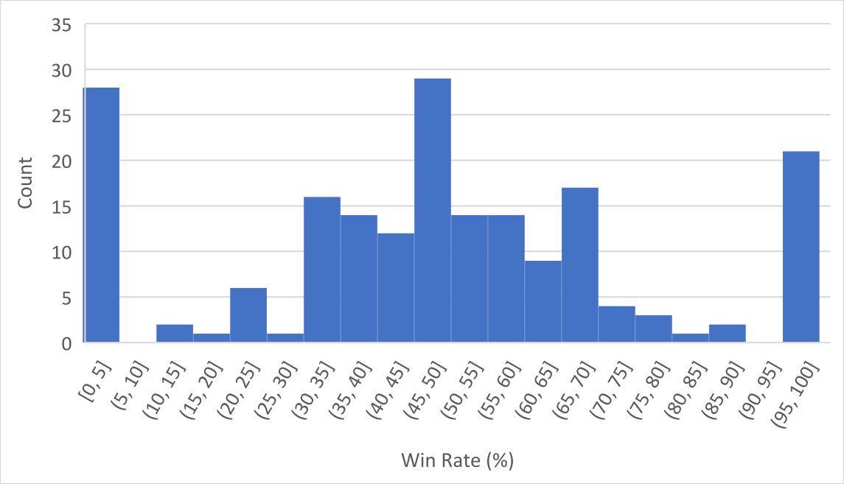
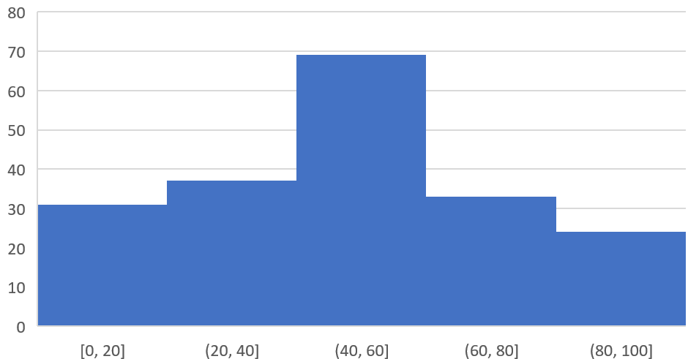
Part 3 – Champion Winrate
Histogram
10% bin size base
Explain what happens as bin size increase/descrease
What about ends?
Infrequently played!
5%
10%
20%
15%

Slide 7
Part 4 – Your Choice
Death rate by role (versus Kills)
Blue versus Red by Champion
Distribution of Champions played
CS by team
Deaths XP
Damage versus Gold by Role
Wins versus Deaths
Wards cleared by Role
https://static1.squarespace.com/static/5947dbd14f14bc4eadcd0267/t/5a0d98c6ec212d61eecd0878/1510840528600/TOEFL+Question+analysis

Slide 8
Next Steps
Read over comments on your report
Ask if you have questions
Incorporate general and specific tips into next project!
Re-review before turning in Project 2
https://i0.wp.com/www.johnhardingestates.co.uk/wp-content/uploads/2018/02/John-Harding-Estates-Hints-and-Tips.png?fit=600%2C419

