Slide 1
U-Pick Game Analytics
Highlights
Project 4
IMGD 2905
http://web.cs.wpi.edu/~imgd2905/d20/projects/proj4/index.html

Slide 2

Attempts versus Tags
Mario Maker – Owen Aguirre
Column chart of average attempts for different descriptive tags for a map

Slide 3

Gold and XP
Dota 2 – Braden Arnold
Column chart comparing gold and experience for two teammates (different roles)

Slide 4

Hit Points
Pokémon – Emily Austin
Hit point distribution for Pokémon

Slide 5

Troop Cards
Clash Royale – Jack Bergin
Histogram of troop cards played in Clash Royale matches

Slide 6

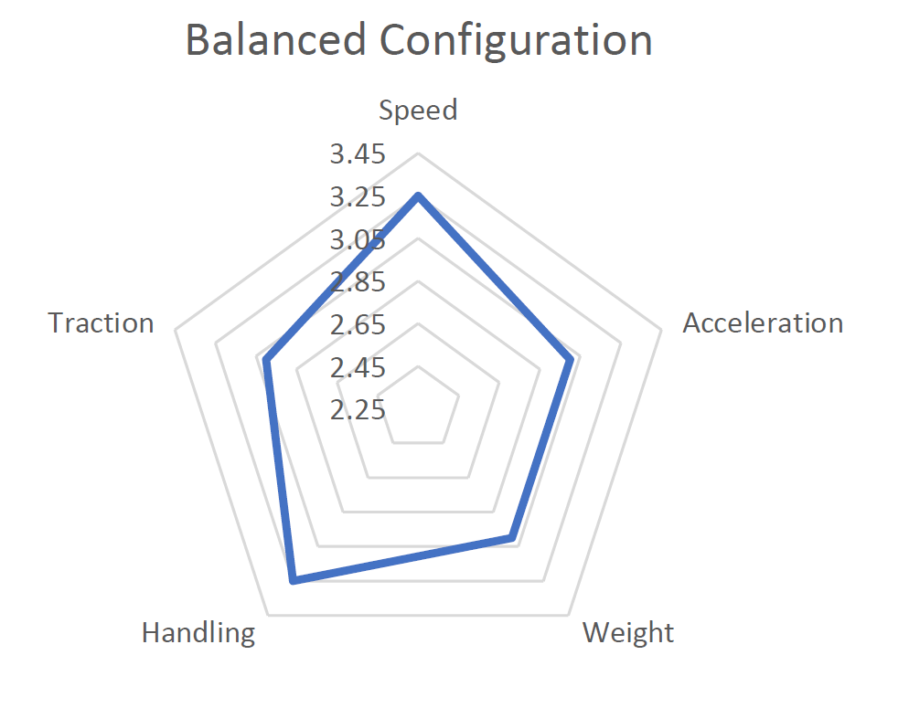
Cart Attributes
Mario Cart – Victoria Buyck
Radar chart of most balanced cart (in terms of attributes)

Slide 7

Dungeon Success Rate
World of Warcraft – Jonathan Chang
Success rate for parties attempting mythic+ dungeons

Slide 8
Base Statistics
Pokémon – Daniel Enriquez
Average of base stat totals by Pokémon generation

Slide 9

KDA by Position
League of Legends – Nadiyah Garris
Kills-Deaths-Assists by champion position

Slide 10

Win Rate versus Pick Rate
Rainbow 6 Siege – Tucker Grim
Win rate versus operator pick rate

Slide 11

Win Rate by Rank
Overwatch – Matthew Hurlbut-Coke
Win rate for different ranks for specific champions

Slide 12

Map Popularity
CS:GO – Kurtis Kiai
Number of games played for different maps

Slide 13
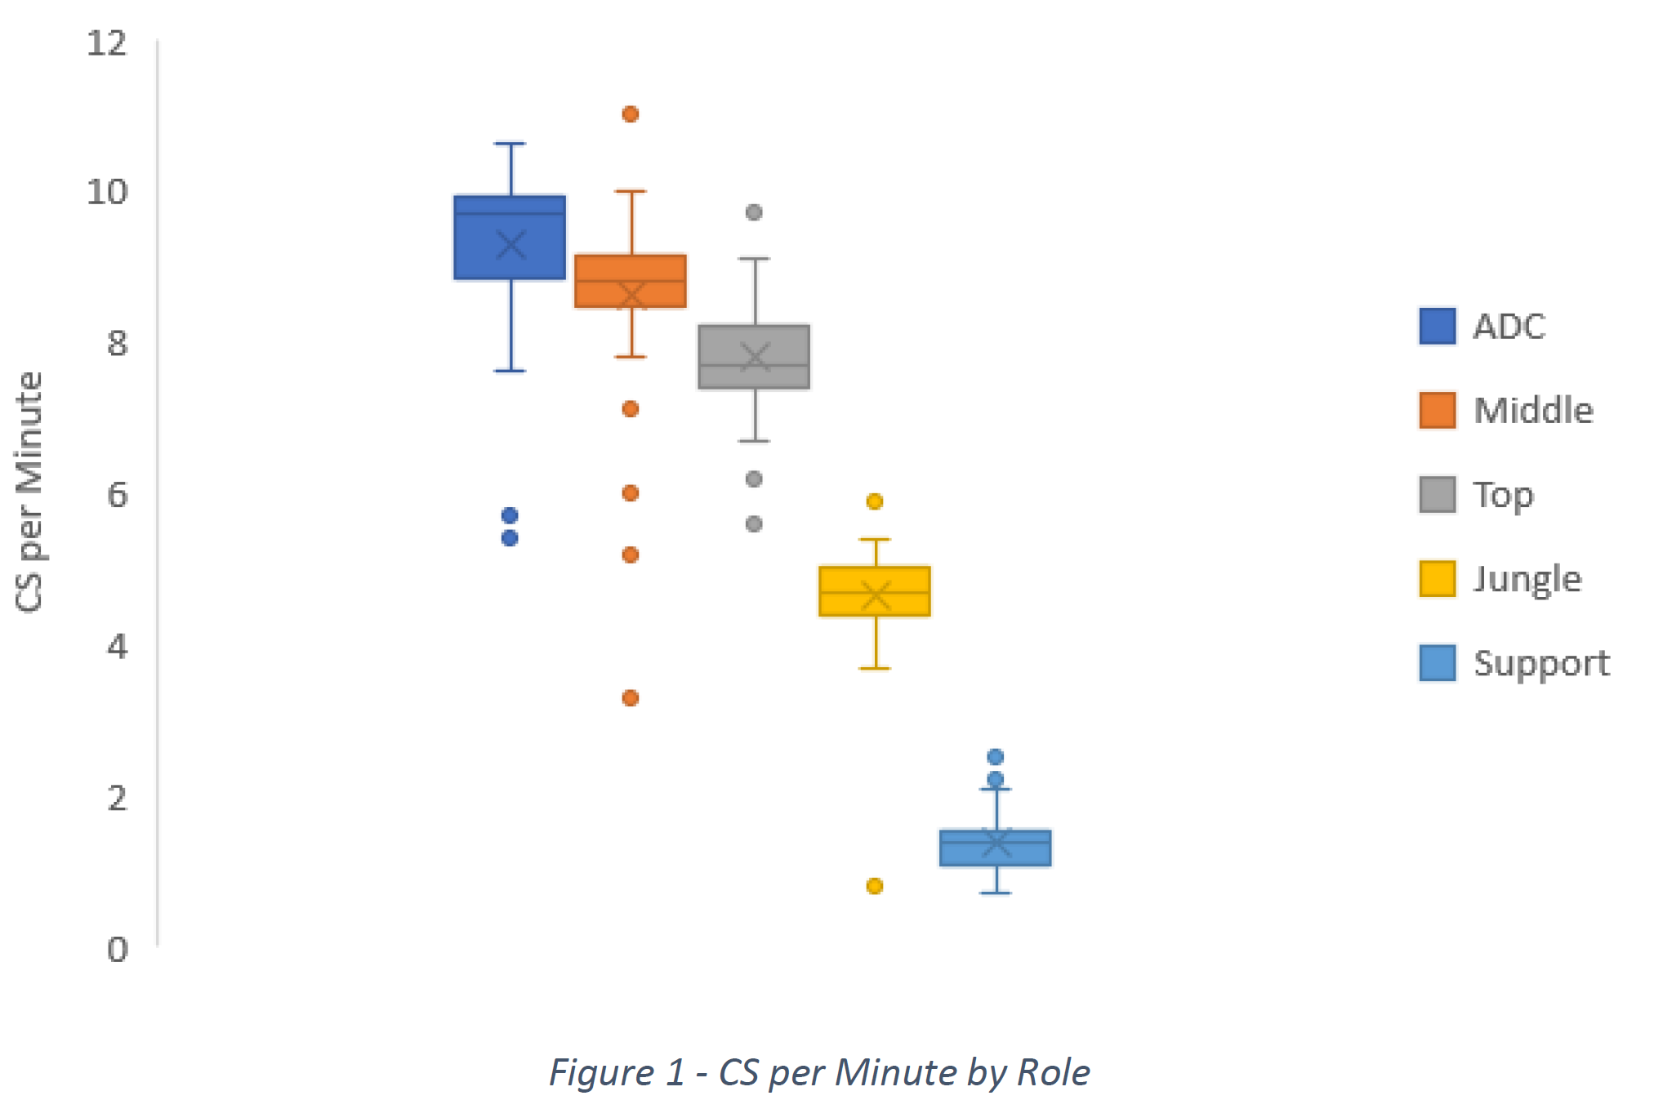
Creep Scores
League of Legends – Yaseen Nagib
Creep score by role (CS – a source of gold)

Slide 14

Soccer Player Wages
FIFA 20 – Luna Nguyen
Soccer player wages broken down by position

Slide 15

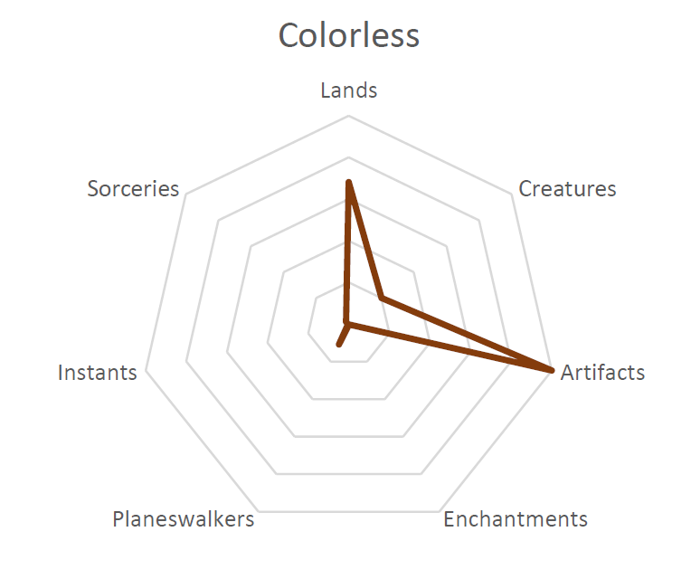
Card Distributions
Magic the Gathering – Nicolas Pingal
Distribution of card types by color

Slide 16
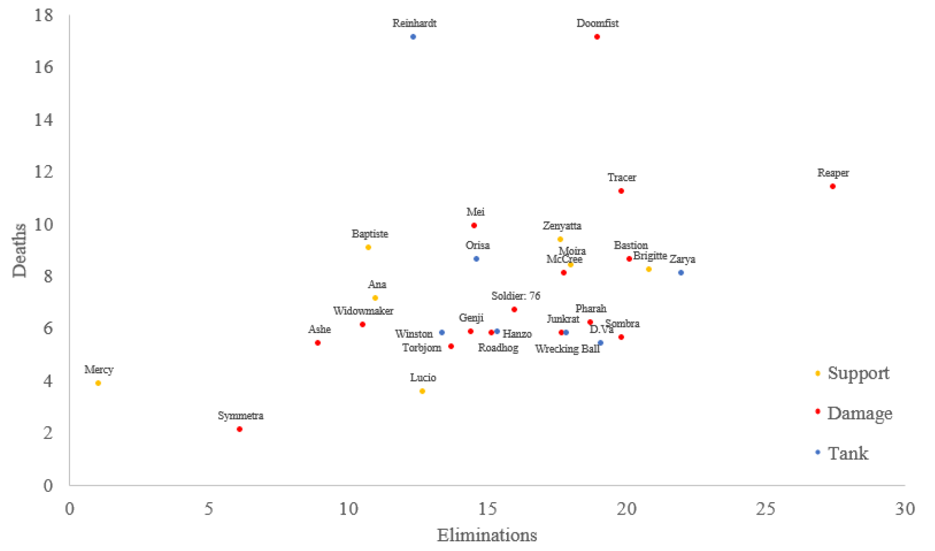
Soccer Player Wages
Overwatch – Kyle Trottier
Deaths versus eliminations by Hero position

Slide 17
Feeling Blue or Seeing Red?
League of Legends – Nick Wotton
Cumulative distribution of towers destroyed for Red team versus Blue team

