Slide 1
Heroes of the Storm Analytics
Project 1
IMGD 2905

Slide 2
Overview
Set up tools for part of game analytics pipeline
Apply to Blizzard’s Heroes of the Storm
Pipeline:
Basic analysis this project, but repeat (reinforcement) and do more for later projects
E.g., front end involves some scripting in Python
Goal of this (and most) projects → time with tools

Slide 3
Parts
Part 0 - Learn HOTS, Prepare Analysis Setup
Part 1 - Takedowns versus Hero Damage
Part 2 - Healing versus Damage
Part 3 - Takedown Distribution
Part 4 - Takedowns by Group
Part 5 - Your Choice Analysis
Writeup
(Submission and Grading)
https://animalcare.umich.edu/sites/default/files/acu-generic-checklist-icon.png

Slide 4
Part 0 – Learn HOTS, Prepare Setup
Named “part 0” since don’t write up → but foundational for rest of projects!
Learn HOTS
Install Spreadsheet
Download dataset
Analyze

Slide 5
Part 0 – Learn Heroes of the Storm
Multiplayer online battle arena PC game
5v5 match
Each player controls 1 Hero (can pick from 85)
Four roles: Assassin, Warrior, Support, Specialist
Heroes upgraded when team gains XP (takedowns)
New Hero ability
Augment existing ability
15 maps, w/different objectives
Tutorial:
https://heroesofthestorm.com/en-us/game/

Slide 6
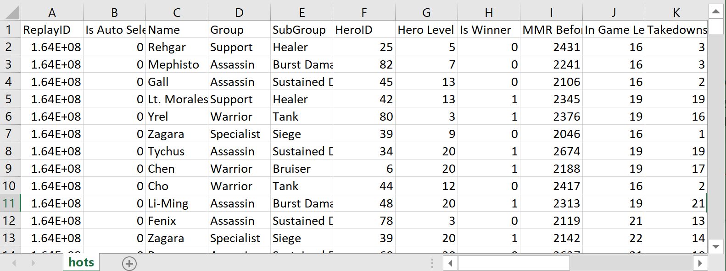
Part 0 – Prepare Analysis Setup
Install spreadsheet
Download dataset
Try it out
http://web.cs.wpi.edu/~imgd2905/d19/projects/proj1/hots.csv
https://www.hotslogs.com/Info/API

Slide 7
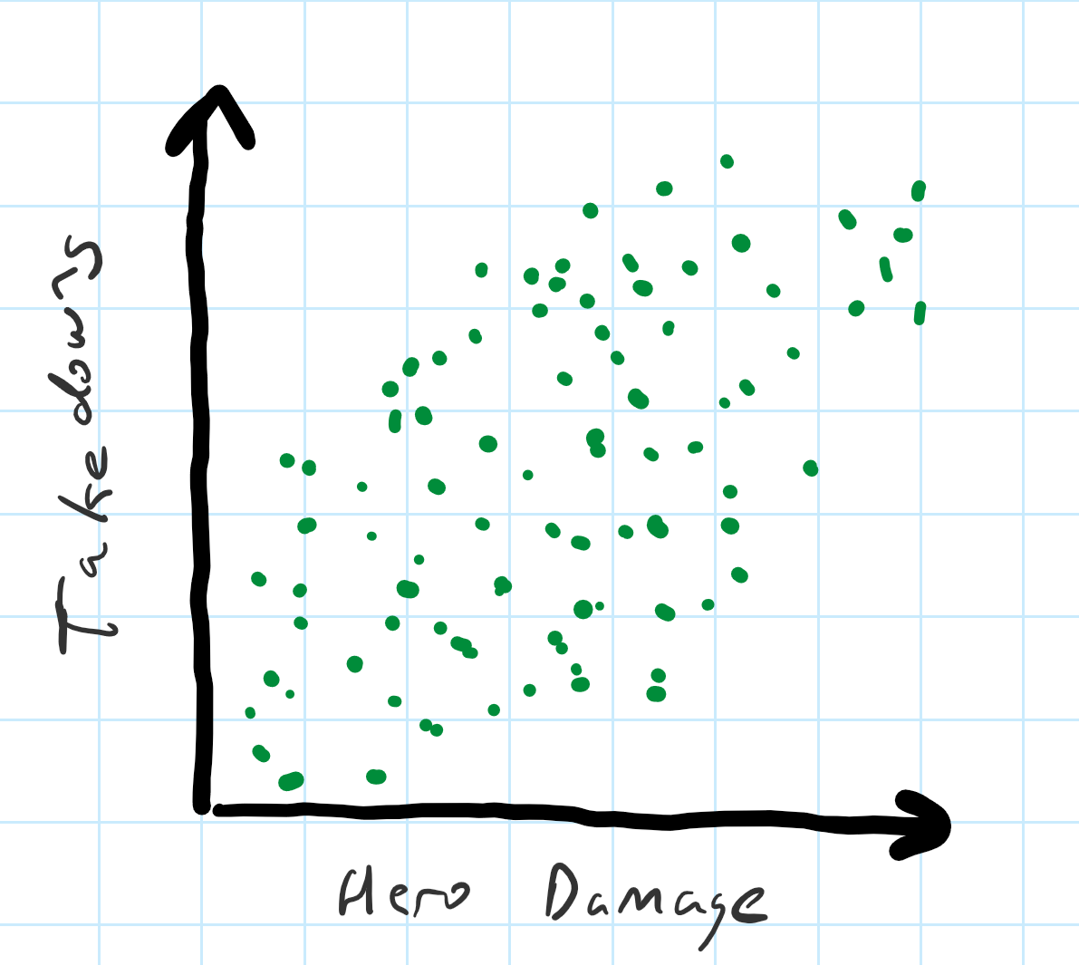
Part 1 – Takedown versus Hero Damage
Takedown – Hero kill or assist
Scatter plot
Comma Separated Values (csv)
Tips
Select some columns
Charts
Hero Damage, Takedowns,
14123, 3,
42082, 25,
23145, 12,

Slide 8
Part 2 – Healing versus Damage
Another scatter plot
But only 2 groups
Warrior
Support
Compute averages
Team, Overall
Tips:
Sort by column
Select some rows (e.g., Warrior)
Compute summary stats
Can make separate “sheets”

Slide 9
Part 3 – Takedown Distribution
Analyze Takedowns for all
Histogram
Tips:
Drawing histogram
F1 help, too
“How to make a histogram”

Slide 10
Part 4 – Takedowns by Group
Takedowns clustered for each group
Assassin, Specialist, Support, Warrior
All
Note, again computing averages
Bar chart
Tips
Filtering data
Again, can make separate “sheets”

Slide 11
Part 5 – Your Choice
Pick other data not yet analyzed
Analyze
Chart
Table
Summary stats
E.g., other game stats (Killing Blows), sub-groups (Bruiser versus Healer)
https://static1.squarespace.com/static/5947dbd14f14bc4eadcd0267/t/5a0d98c6ec212d61eecd0878/1510840528600/TOEFL+Question+analysis

Slide 12
Write Up
Short report
Content key, but structure and writing matter
Consider:
Ease of extracting information
Organization
Concise and precise
Clarity
Grammar/English
Graphs/tables:
Number and caption
Referred to by number
Labeled axes
Explained trend lines
Message
Whatever document tool you want (e.g., Word, markdown)
→ Generate PDF

Slide 13
Hints
Tips from previous years
http://web.cs.wpi.edu/~imgd2905/d19/projects/proj1/#hints
For most issues, will not be much penalty (yet)
Learning analytics pipeline is iterative
Will teach and reinforce
But start instilling good habits!
https://i0.wp.com/www.johnhardingestates.co.uk/wp-content/uploads/2018/02/John-Harding-Estates-Hints-and-Tips.png?fit=600%2C419

Slide 14
Grading
Part 1 (Td v Hero) 30%
Part 2 (Hl v Dam) 25%
Part 3 (Td HG) 20%
Part 4 (Td by Gp) 15%
Part 5 (Choice) 10%
All visible in report!
(Late – 10% per day)

Slide 15
Rubric
100-90. The submission clearly exceeds requirements. All parts of the project have been completed or nearly completed. The report is clearly organized and well-written, charts and tables are clearly labeled and described and messages provided about each part of the analysis.
89-80. The submission meets requirements. The first 3 parts of the project have been completed well, but not parts 4 or 5. The report is organized and well-written, charts and tables are labeled and described and messages provided about most of the analysis.
79-70. The submission barely meets requirements. The first 2 parts of the project have been completed or nearly completed, but not parts 3 or 4. The report is semi-organized and semi-well-written, charts and tables are somewhat labeled and described, but parts may be missing. Messages are not always clearly provided for the analysis.
69-60. The project fails to meet requirements in some places. The first part of the project has been completed or nearly completed, and maybe some of part 2, but not parts 3, 4 or 5. The report is not well-organized nor well-written, charts and tables are not labeled or may be missing. Messages are not always provided for the analysis.
59-0. The project does not meet requirements. No part of the project has been completed. The report is not well-organized nor well-written, charts and tables are not labeled and/or are missing. Messages are not consistently provided for the analysis..

