Slide 1
Project 3, Part 3
Possible Exploration

Slide 2
Part 3
How long are Hearthstone games?
How many cards are played?
How does the number of cards vary by Hero?
Data – Duration in seconds
→ Needs to be cleaned!
Data – Number of cards per game
Where to start? Distributions!

Slide 3
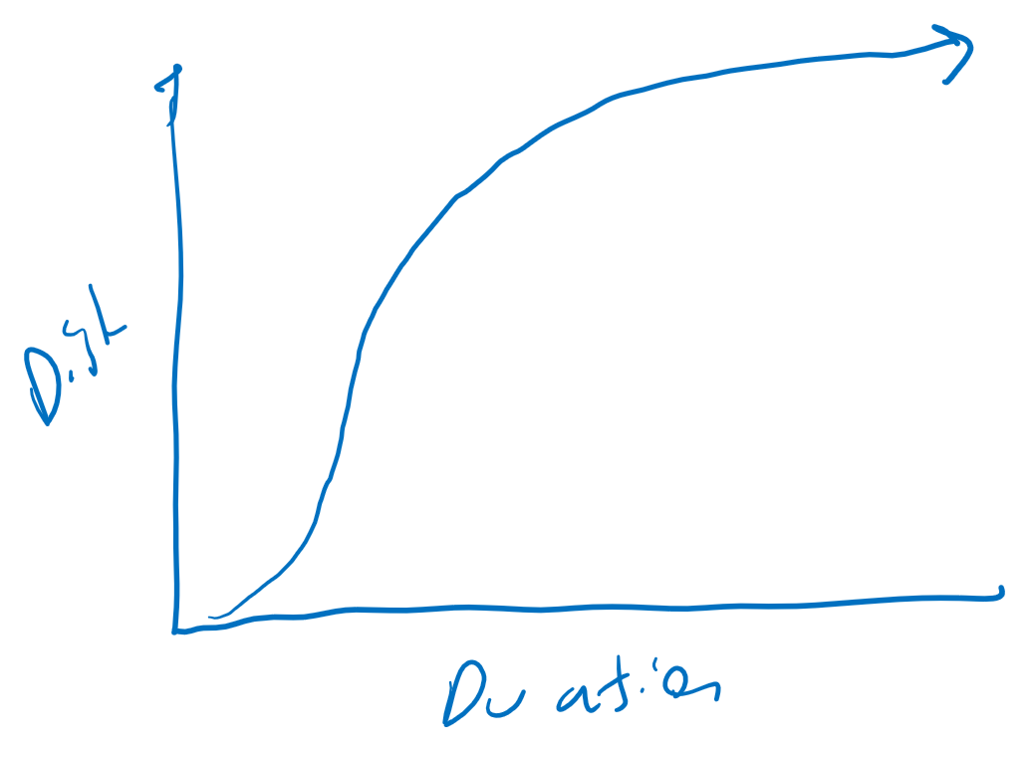
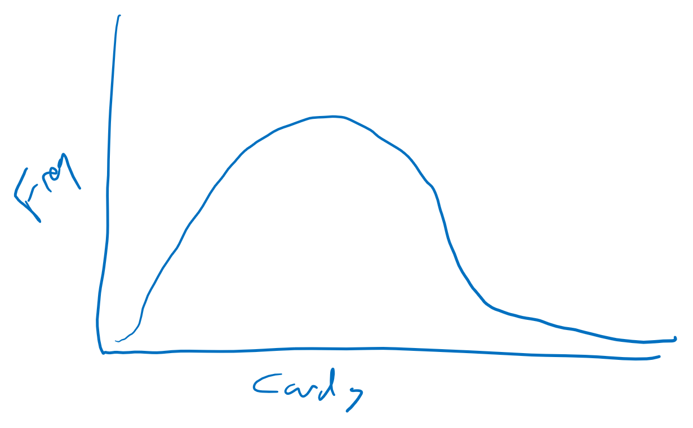
Distribution Analysis
Distributions help characterize the data, look for interesting spots
Often, report measures of central tendency with them

Slide 4
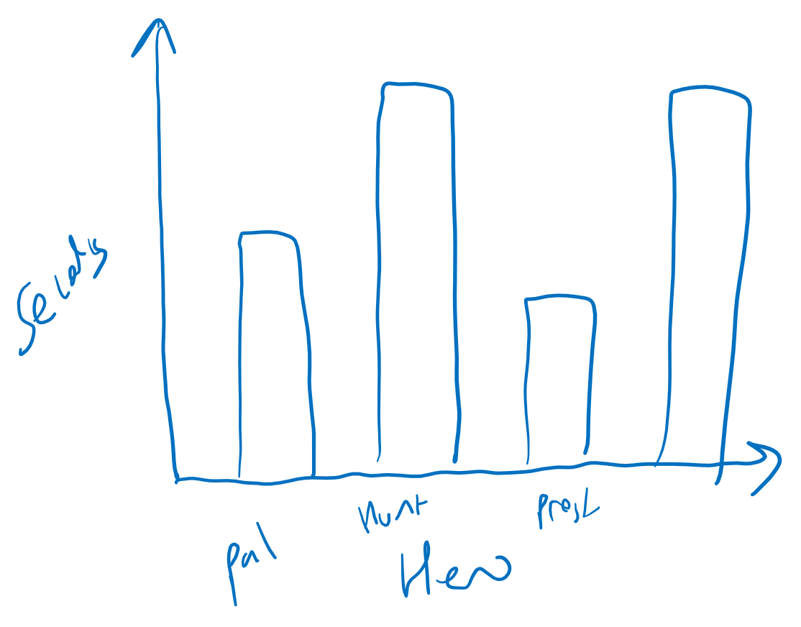
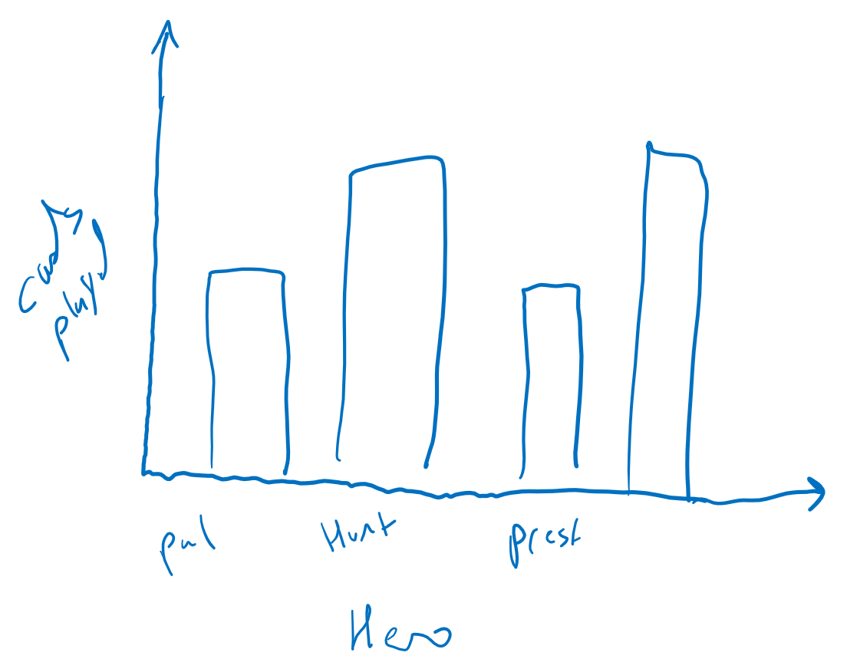
Duration and Cards Played
Order of x-axis?
Seconds? → Try minutes!
Cards depends upon Hero popularity!
→ Try cards per game
Yes, a challenge is to get the raw data to CSV
But then, don’t just make first bar chart and call it done!

Slide 5
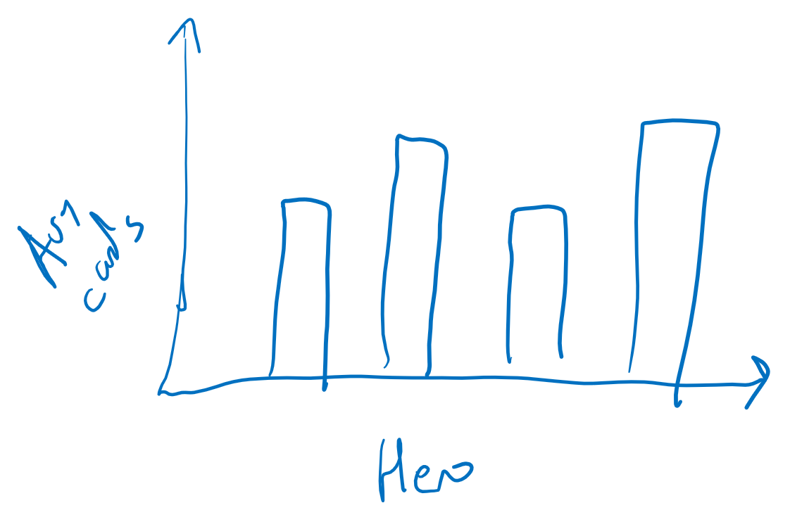
Average Cards per Game
Reporting measure of central tendency… what’s missing?

Slide 6
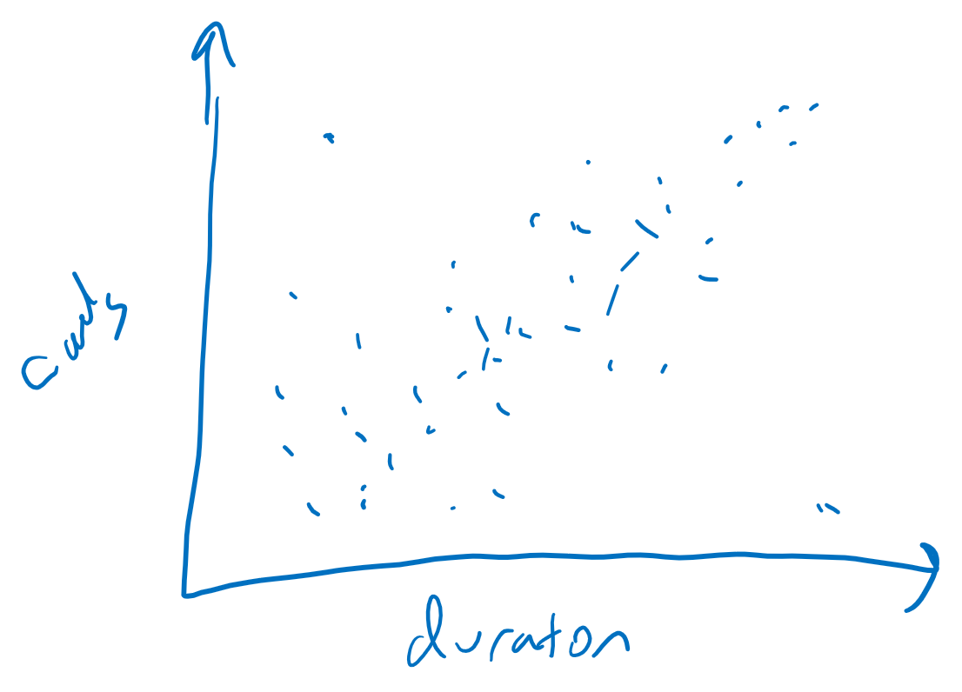
Combined Analysis – Scatter Plots for Exploration

Slide 7
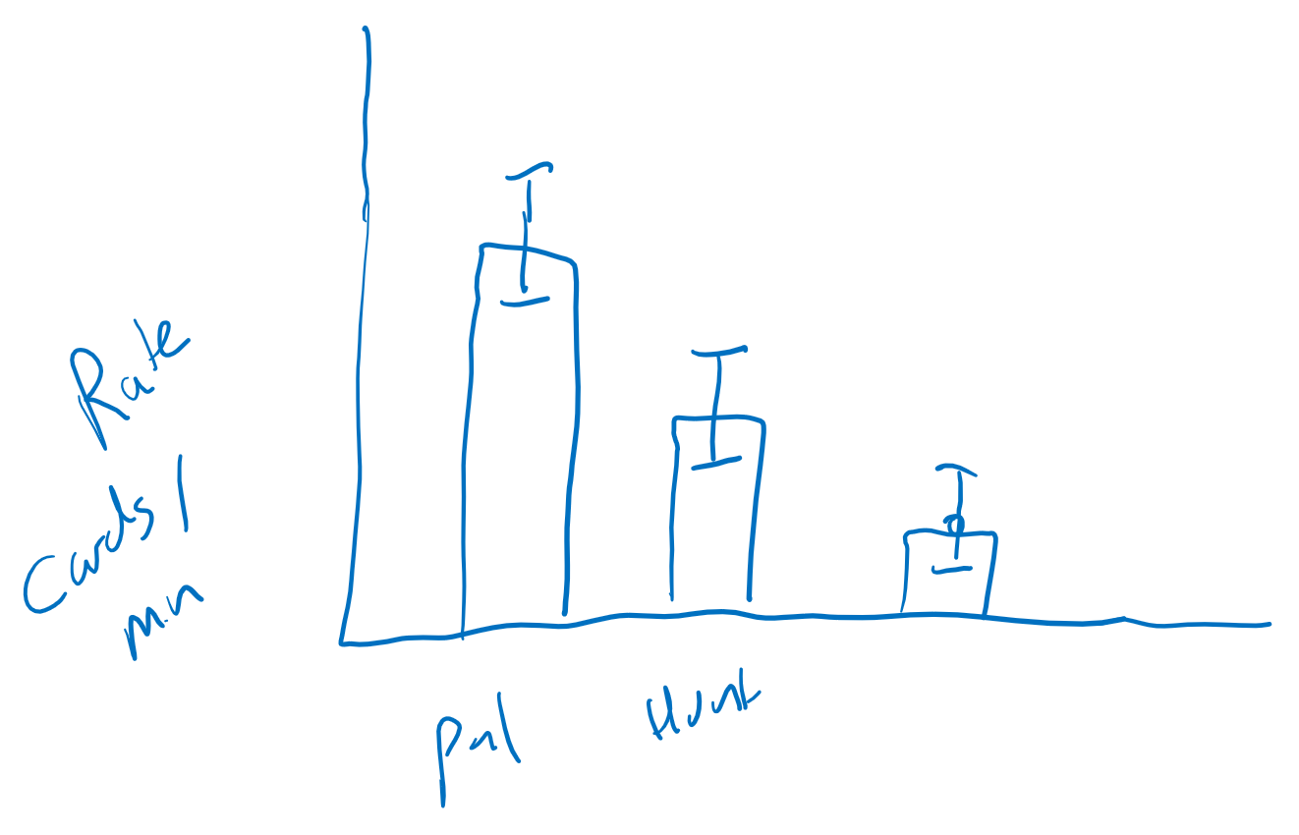
Combined Analysis – Cards/Minute (Play Rate)
Could also consider:
Play rate versus win rate
Play rate versus popularity
Play rate versus rank

