Slide 1
League of Legends Player Analytics
Project 4
IMGD 2905

Slide 2
Overview
Set up tools for game analytics pipeline
Apply to Riot's League of Legends
Pipeline:

Slide 3
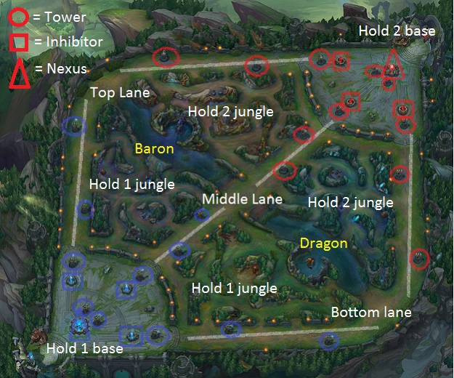
League of Legends
Most popular game in world [1]
Played by more than 27 million people each day
Professional leagues (e-Sports)
32 million viewers 2014 at World Championships
8.5 million simultaneous (compare to 16 million for soccer World Cup)
Team versus team game (5v5)
Teams based on player ranking (~25 ranks)
Players each choose 1 Champion
Over 130 choices
10 unique per game
Champions have abilities and level up in game
Player can buy items to enhance Champion
[1] Raptr - The Offical Blog (2015). Most Played Games: November 2015. http: //goo.gl/bVytCX

Slide 4
Parts
Part 0 – Learn and Setup
Part 1 – Matches
Part 2 – Gold
Part 3 – Puck Hunt

Slide 5
Part 0 - Setup
Learn League
New Player Guide
League of Legends - Getting Started Guide
Download the Game
Get Riot API Key
Install RiotWatcher
Test It Out (hello.py) ← Fix before proceeding!

Slide 6
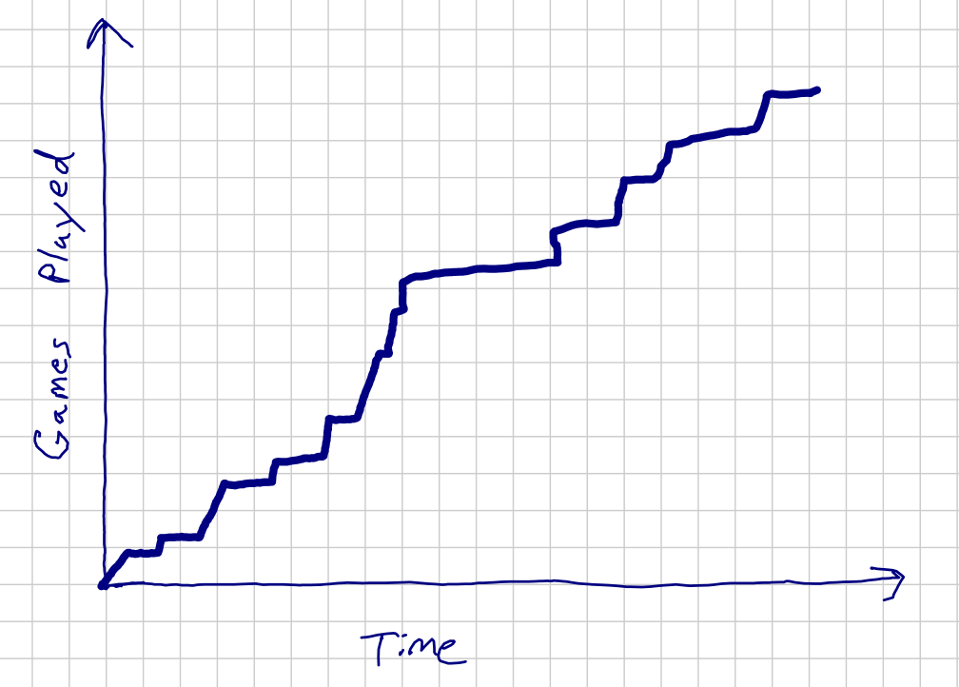
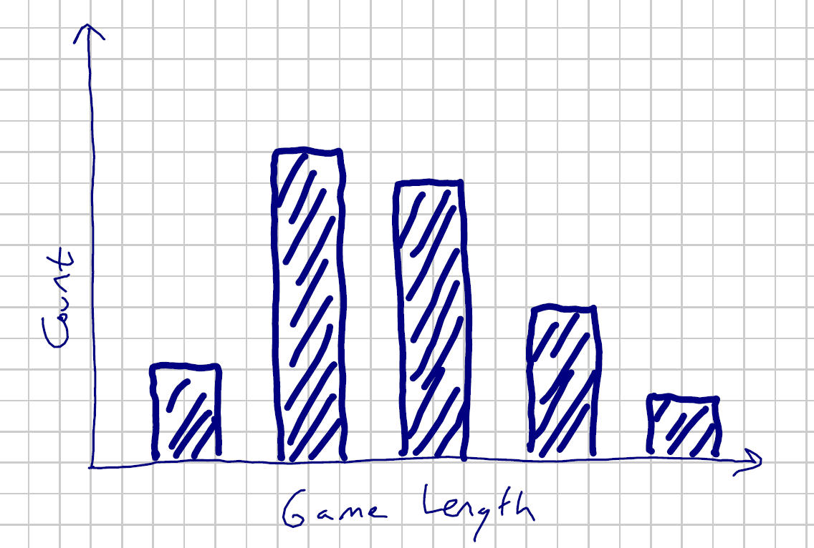
Part 1 – Matches and Champions
Competitive/professional League of Legends player (summoner) of choice, analyze:
number of (ranked) LoL matches played over time
duration of matches
summoner's most played Champions.

Slide 7
Part 2 – The Golden Rule
Gold earned over time, and for killing monsters and opposing Champions
Gold important → buy items (e.g., weapons or armor) → makes Champions tougher
Do gold analysis
total gold
total gold per match versus the match duration
difference between total gold earned by winning team minus the losing team

Slide 8
Part 3 – PuckHunt
Participate in study
http://www.tinyurl.com/lagstudy
Takes about 30 minutes
By next Tuesday!
Analyze data
(Pending)

