Slide 1
Get More Insight! First Year Student Academic Advising Day
Interactive Media & Game Development
Prof. David Finkel
IMGD Web page at: http://imgd.wpi.edu/

Slide 2
Outcomes
Learn about the IMGD major
Get advice for C and D term course selection
Registration December 2!
Have your questions answered

Slide 3
Agenda
10 minutes Review of IMGD major
10 minutes Course selection C, D terms
2 minutes More IMGD
10 minutes Q&A

Slide 4
Interactive Media and Game Development
All aspects of creating computer-based interactive media and games
Game design
Content creation
Programming
Testing
Project management

Slide 5
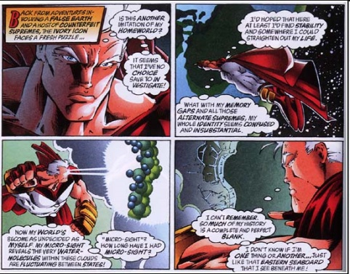
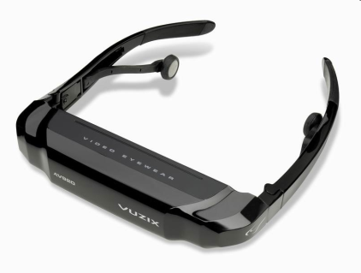
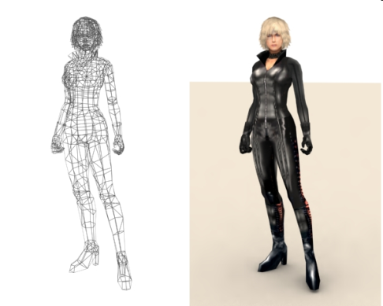
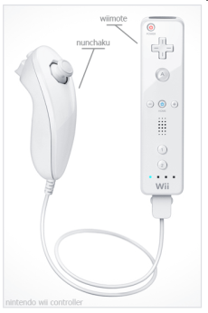
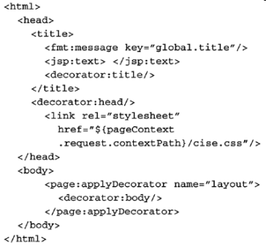
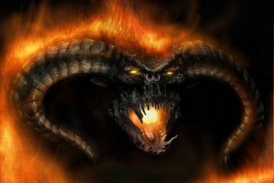
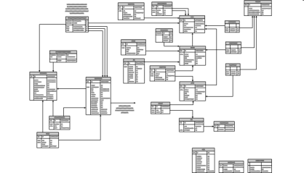
Art + Tech = Games
Design
Art
Tech
IMGD

Slide 6
IMGD Course Flow
IMGD 1000
Critical Studies
IMGD 1001
Game Dev Process
IMGD 1002
Storytelling
AR 1100
Essentials of Art
AR 1101
Digital Art
AR 2202
Figure Drawing
IMGD 2000
Social Issues
IMGD 2001
Philosophy
IMGD 2030
Game Audio
IMGD 2900
Game Design I
IMGD 2500
Tabletop Strategy
IMGD 2005
Machinima
IMGD 2201
Animation I
IMGD 2101
Model I
IMGD 2700
Digital Painting
CS 2303
System Program
IMGD 3000
Technical Game Dev I
IMGD 3100
Novel Interfaces
IMGD 3030
Game Audio II
IMGD 302x
Game Design II
IMGD 3201
Animation II
IMGD 3500
Artistic Game Dev I
IMGD 3101
Model II
IMGD 3700
Concept Art
EN 2211
Elements of Writing
MU 3613
Digital Sound
IMGD 4100
AI and Games
IMGD 4000
Technical Game Dev II
IMGD 4600
Serious Games
IMGD 4200
History and Future
IMGD 4700
Advanced Storytelling
IMGD 4500
Artistic Game Dev II
HCI
IMGD 5100
Immersive HCI
IMGD 5200
History and Future II
IMGD 5300
Design Int Experience
IMGD 5400
Production Mng of IM

Slide 7
Core Courses
IMGD 1000
Critical Studies
IMGD 1001
Game Dev Process
IMGD 1002
Storytelling
AR 1100
Essentials of Art
AR 1101
Digital Art
AR 2202
Figure Drawing
IMGD 2000
Social Issues
IMGD 2001
Philosophy
IMGD 2030
Game Audio
IMGD 2900
Game Design I
IMGD 2500
Tabletop Strategy
IMGD 2005
Machinima
IMGD 2201
Animation I
IMGD 2101
Model I
IMGD 2700
Digital Painting
CS 2303
System Program
IMGD 3000
Technical Game Dev I
IMGD 3100
Novel Interfaces
IMGD 3030
Game Audio II
IMGD 302x
Game Design II
IMGD 3201
Animation II
IMGD 3500
Artistic Game Dev I
IMGD 3101
Model II
IMGD 3700
Concept Art
EN 2211
Elements of Writing
MU 3613
Digital Sound
IMGD 4100
AI and Games
IMGD 4000
Technical Game Dev II
IMGD 4600
Serious Games
IMGD 4200
History and Future
IMGD 4700
Advanced Storytelling
IMGD 4500
Artistic Game Dev II
HCI
IMGD 5100
Immersive HCI
IMGD 5200
History and Future II
IMGD 5300
Design Int Experience
IMGD 5400
Production Mng of IM

Slide 8
Visual Arts
IMGD 1000
Critical Studies
IMGD 1001
Game Dev Process
IMGD 1002
Storytelling
AR 1100
Essentials of Art
AR 1101
Digital Art
AR 2202
Figure Drawing
IMGD 2000
Social Issues
IMGD 2001
Philosophy
IMGD 2030
Game Audio
IMGD 2900
Game Design I
IMGD 2500
Tabletop Strategy
IMGD 2005
Machinima
IMGD 2201
Animation I
IMGD 2101
Model I
IMGD 2700
Digital Painting
CS 2303
System Program
IMGD 3000
Technical Game Dev I
IMGD 3100
Novel Interfaces
IMGD 3030
Game Audio II
IMGD 302x
Game Design II
IMGD 3201
Animation II
IMGD 3500
Artistic Game Dev I
IMGD 3101
Model II
IMGD 3700
Concept Art
EN 2211
Elements of Writing
MU 3613
Digital Sound
IMGD 4100
AI and Games
IMGD 4000
Technical Game Dev II
IMGD 4600
Serious Games
IMGD 4200
History and Future
IMGD 4700
Advanced Storytelling
IMGD 4500
Artistic Game Dev II
HCI
IMGD 5100
Immersive HCI
IMGD 5200
History and Future II
IMGD 5300
Design Int Experience
IMGD 5400
Production Mng of IM

Slide 9
Design Courses
IMGD 1000
Critical Studies
IMGD 1001
Game Dev Process
IMGD 1002
Storytelling
AR 1100
Essentials of Art
AR 1101
Digital Art
AR 2202
Figure Drawing
IMGD 2000
Social Issues
IMGD 2001
Philosophy
IMGD 2030
Game Audio
IMGD 2900
Game Design I
IMGD 2500
Tabletop Strategy
IMGD 2005
Machinima
IMGD 2201
Animation I
IMGD 2101
Model I
IMGD 2700
Digital Painting
CS 2303
System Program
IMGD 3000
Technical Game Dev I
IMGD 3100
Novel Interfaces
IMGD 3030
Game Audio II
IMGD 302x
Game Design II
IMGD 3201
Animation II
IMGD 3500
Artistic Game Dev I
IMGD 3101
Model II
IMGD 3700
Concept Art
EN 2211
Elements of Writing
MU 3613
Digital Sound
IMGD 4100
AI and Games
IMGD 4000
Technical Game Dev II
IMGD 4600
Serious Games
IMGD 4200
History and Future
IMGD 4700
Advanced Storytelling
IMGD 4500
Artistic Game Dev II
HCI
IMGD 5100
Immersive HCI
IMGD 5200
History and Future II
IMGD 5300
Design Int Experience
IMGD 5400
Production Mng of IM

Slide 10
Advanced IMGD Courses
IMGD 1000
Critical Studies
IMGD 1001
Game Dev Process
IMGD 1002
Storytelling
AR 1100
Essentials of Art
AR 1101
Digital Art
AR 2202
Figure Drawing
IMGD 2000
Social Issues
IMGD 2001
Philosophy
IMGD 2030
Game Audio
IMGD 2900
Game Design I
IMGD 2500
Tabletop Strategy
IMGD 2005
Machinima
IMGD 2201
Animation I
IMGD 2101
Model I
IMGD 2700
Digital Painting
CS 2303
System Program
IMGD 3000
Technical Game Dev I
IMGD 3100
Novel Interfaces
IMGD 3030
Game Audio II
IMGD 302x
Game Design II
IMGD 3201
Animation II
IMGD 3500
Artistic Game Dev I
IMGD 3101
Model II
IMGD 3700
Concept Art
EN 2211
Elements of Wrting
MU 3613
Digital Sound
IMGD 4100
AI and Games
IMGD 4000
Technical Game Dev II
IMGD 4600
Serious Games
IMGD 4200
History and Future
IMGD 4700
Advanced Storytelling
IMGD 4500
Artistic Game Dev II
HCI
IMGD 5100
Immersive HCI
IMGD 5200
History and Future II
IMGD 5300
Design Int Experience
IMGD 5400
Production Mng of IM

Slide 11
Other IMGD
IMGD 1000
Critical Studies
IMGD 1001
Game Dev Process
IMGD 1002
Storytelling
AR 1100
Essentials of Art
AR 1101
Digital Art
AR 2202
Figure Drawing
IMGD 2000
Social Issues
IMGD 2001
Philosophy
IMGD 2030
Game Audio
IMGD 2900
Game Design I
IMGD 2500
Tabletop Strategy
IMGD 2005
Machinima
IMGD 2201
Animation I
IMGD 2101
Model I
IMGD 2700
Digital Painting
CS 2303
System Program
IMGD 3000
Technical Game Dev I
IMGD 3100
Novel Interfaces
IMGD 3030
Game Audio II
IMGD 302x
Game Design II
IMGD 3201
Animation II
IMGD 3500
Artistic Game Dev I
IMGD 3101
Model II
IMGD 3700
Concept Art
EN 2211
Elements of Writing
MU 3613
Digital Sound
IMGD 4100
AI and Games
IMGD 4000
Technical Game Dev II
IMGD 4600
Serious Games
IMGD 4200
History and Future
IMGD 4700
Advanced Storytelling
IMGD 4500
Artistic Game Dev II
HCI
IMGD 5100
Immersive HCI
IMGD 5200
History and Future II
IMGD 5300
Design Int Experience
IMGD 5400
Production Mng of IM

Slide 12
Graduate Courses
IMGD 1000
Critical Studies
IMGD 1001
Game Dev Process
IMGD 1002
Storytelling
AR 1100
Essentials of Art
AR 1101
Digital Art
AR 2202
Figure Drawing
IMGD 2000
Social Issues
IMGD 2001
Philosophy
IMGD 2030
Game Audio
IMGD 2900
Game Design I
IMGD 2500
Tabletop Strategy
IMGD 2005
Machinima
IMGD 2201
Animation I
IMGD 2101
Model I
IMGD 2700
Digital Painting
CS 2303
System Program
IMGD 3000
Technical Game Dev I
IMGD 3100
Novel Interfaces
IMGD 3030
Game Audio II
IMGD 302x
Game Design II
IMGD 3201
Animation II
IMGD 3500
Artistic Game Dev I
IMGD 3101
Model II
IMGD 3700
Concept Art
EN 2211
Elements of Writing
MU 3613
Digital Sound
IMGD 4100
AI and Games
IMGD 4000
Technical Game Dev II
IMGD 4600
Serious Games
IMGD 4200
History and Future
IMGD 4700
Advanced Storytelling
IMGD 4500
Artistic Game Dev II
HCI
IMGD 5100
Immersive HCI
IMGD 5200
History and Future II
IMGD 5300
Design Int Experience
IMGD 5400
Production Mng of IM

Slide 13
Year 1
2 IMGD core courses (IMGD 1000, IMGD 1001 or IMGD 1002)
Art course (AR 1100)
Computer Science course (CS 1101, CS 1102, or CS1004)
English, Writing or Rhetoric course
If IMGD-Tech:
CS courses (CS 2102, CS 2303, and CS 2223)
HUA courses (for HUA requirement)
If IMGD-Art:
AR courses (AR 1101 and AR 2101)
CS, Math or Science course
Major question … are you going to a project center for your IQP (Junior year)? Apply in time your Sophomore year!
http://www.wpi.edu/Academics/Projects/available.html
(Note: PE courses anytime)

Slide 14
Agenda
5 minutes Review of IMGD major
10 minutes Course selection C, D terms
5 minutes More IMGD
10 minutes Q&A

Slide 15
IMGD Tech Track
C-term
D-term
IMGD 1002, IMGD 2001, IMGD 2030
CS 1101, CS 2303 or CS 2022
Math or Science
HUA Requirement - Depth or breadth
IMGD 1002, IMGD 2000, IMGD 2500
CS 2022, CS 2102, or CS 2223
Math or Science
HUA Requirement - Depth or breadth

Slide 16
IMGD Art Track
C-term
D-term
AR 1100, AR 1101, AR/IMGD 2101, AR 2202
CS 1004
Math or Science
HUA Requirement - Depth or breadth
IMGD 1002, IMGD 2030
IMGD 1002, IMGD 2000, IMGD 2500
AR 1101 (if not yet)
AR/IMGD 2201
CS 220x
Math or Science
HUA Requirement - Depth or breadth
*Depending on what you took in A and B terms*

Slide 17
2014-2015 Term Offerings
A-Term B-Term C-Term D-Term
1001 MBJ 1000 DMO 1002 DMO 1002 DMO
1001 MBJ 1000 DCF 1002 DMO
1000 DCF
2030 KZ 2000 DXF 2101 RS9 2000 KZ
2101 RS9 2201 RS9 2101 SBR 2500 GDP
2101 RS9 2201 RS9 2201 JHF
2700 SBR 204X RS9 2030 KZ
2900 DXF 2900 MBJ
3000 MLC 3101 SBR 3201 RS9
3500 JR1 3200 JR1 3700 SBR
3030 KZ
4700 DMO 4100 CR1 4600 CR1 4000 RL1
4900 MBJ 4500 JHF
Fall Spring
5100 RL1 5400 JW3
Course Schedules at: http://www.wpi.edu/offices/registrar/schedules.html

Slide 18
Agenda
10 minutes Review of IMGD major
5 minutes Course selection C, D terms
5 minutes More IMGD
10 minutes Q&A

Slide 19
Year 2
Rest of IMGD core (IMGD 1000, IMGD 1001 or IMGD 1002)
Social and/or Philo Issues course (IMGD 2000 or IMGD 2001)
If IMGD-Tech:
CS courses (including CS 3733 and CS 3041)
Final HUA courses plus Inquiry or Practicum
If IMGD-Art:
HUA courses plus Inquiry or Practicum
CS, Math or Science course (for Technical requirement)
Math or Science course
Audio course (IMGD 2030 possibly MU 3613)
Social Science course
Finish Humanities Requirement
http://www.wpi.edu/academics/Depts/HUA/Requirements/index.html
D-Term: arrange IQP for Year 3
Major question … are you going to Japan or Silicon Valley project center for your MQP (Senior year)? Apply in B-term Junior year!

Slide 20
Year 3
IQP (if on-campus, preferably in A, B and C terms)
Social and/or Philo Issues course (IMGD 2000 or IMGD 2001)
If IMGD-Tech:
IMGD 3000 and IMGD 4000
Additional IMGD (need 5 total)
Finish most CS courses
If IMGD-Art:
IMGD 3500 and IMGD 4500
Additional IMGD (need 5 total)
Finish most HUA courses
Electives: IMGD, Science/Engineering, Math, Management, etc.
Social Science course
Math or Science course (if not done already)
Consider BS/MS (see later slides)
C-Term: arrange MQP for Year 3
Project Pitch day!

Slide 21
Year 4
MQP (if on-campus, preferably in A, B and C terms)
If IMGD-Tech:
Finish remaining CS courses
Finish any remaining IMGD
If IMGD-Art:
Finish remaining HUA courses
Finish any remaining IMGD
If BS/MS, take 4k-level courses:
IMGD 4100 (AI in Games), IMGD 4200 (History), IMGD 4600 (Serious Games), IMGD 4700 (Quests)
Electives: IMGD, Science/Engineering, Math, Management, etc.
Social Science course (if needed)
Job hunting or grad school applications !

Slide 22
HUA Requirement
All WPI students (IMGD Art and Tech)
6 courses total; double counting is okay!
Depth and Breadth
4 in one area (including practicum/seminar)
1 in one other area
1 additional HUA course in any area
Practicum/Seminar (counts as 1 course)
Offerings at: http://www.wpi.edu/academics/Depts/HUA/Requirements/inquiry.html

Slide 23
A Word About Your Courses
IMGD has carefully designed your curricula
IMGD Core + Track Core + IMGD Depth
You need to treat all of these courses as IMGD courses
You will need them to be successful!
Advanced courses, your MQP, and your future CAREER assume you are well versed in them!

Slide 24
Portfolios
Everyone should have one (not just IMGD Art)!
Samples:
http://www.wpi.edu/academics/imgd/our-students.html

Slide 25
BS/MS
Master of Science in IMGD
Core Courses - Choose 3 of 4 (9 credits)
BS and MS in 5 years
Double-count ugrad courses
Maximum of 12 credits
Who?
Those that want “big picture” and extra experience
Jobs:
producers, designers, academics (professors), project leaders (tech, art, or design)
IMGD 5100. Immersive Human-Computer Interaction (3)
IMGD 5200. History and Future of Immersive and Interactive Media (3)
IMGD 5300. Design of Interactive Experiences (3)
IMGD 5400. Production Management for Interactive Media (3)
Focus Courses (6 credits)
Technical Focus (6) or
Serious Games Focus (6) or
Management Focus (6)
Elective Courses (6 credits)
Selected from courses in the Core and Focus Areas.
Thesis/Project (9 credits)
IMGD 5900. Master’s Thesis or
IMGD 5910. Master’s Project
Component | Credits
Core Courses | 9
Focus Courses | 6
Elective Courses | 6
Thesis/Project | 9
Total | 30

Slide 26
Resources
IMGD Advisor! (C-term … or sooner)
Resources
http://www.wpi.edu/academics/imgd/student-resources.html
Advising aids
http://www.wpi.edu/academics/imgd/advising-aids.html
Tracking sheets
Tech
Art
Tech+CS
Four-Year Plan
Undergraduate catalog
http://www.wpi.edu/academics/catalogs/ugrad.html
Course schedule
http://www.wpi.edu/Admin/Registrar/schedules.html
Time Management and Academic Coaching
http://www.wpi.edu/Admin/ARC/services.html

Slide 27
Agenda
10 minutes Review of IMGD major
5 minutes Course selection C, D terms
5 minutes More IMGD
10 minutes Q&A

Slide 28
Questions?
Take home message;
Read the catalog
Use the IMGD tracking sheet
Consult with your academic advisor
Meet with an IMGD faculty member

