Slide 1
Introduction to Machine Learning

Slide 2
$1,000,000

Slide 3
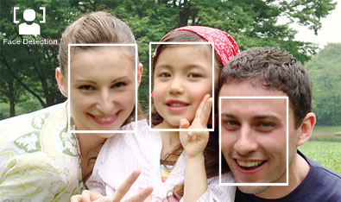
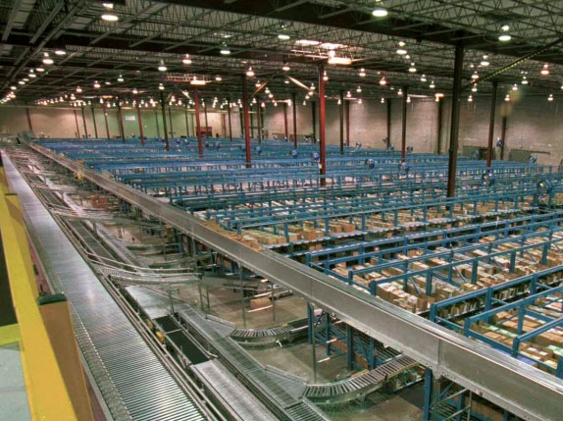
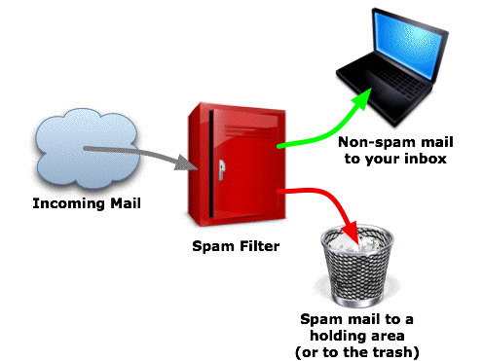

Slide 4
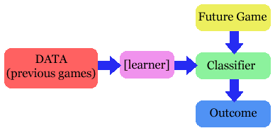
Machine Learning
Learn models from data
Three main types of learning:
Supervised learning
Unsupervised learning
Reinforcement learning

Slide 5
Variants of Machine Learning Problems
What is being learned?
Parameters, problem structure, hidden concepts,…
What information do we learn from?
Labeled data, unlabeled data, rewards
What is the goal of learning?
Prediction, diagnostics, summarization,…
How do we learn?
Passive/active, online/offline
Outputs
Binary, discrete, continuous

Slide 6
Supervised Learning
Given a set of data points with an outcome, create a model to describe them
Classification
outcome is a discrete variable (typically <10 outcomes)
Linear regression
outcome is continuous

Slide 7
Training Data
$$x_{11}x_{12}x_{13} y_{1}$$
$$x_{21}x_{22}x_{23} y_{2}$$
$$…$$
$$x_{m1}x_{m2}x_{m3} y_{m}$$
Training set.
Data set.
Training data.
Observations.
Input
Output
Each $y_{i}$ was generated by equation $f\left(x_{i}\right)=y_{i}$, and more generally $f\left(x\right)=y$.
Machine learning aims to discover a function $h\left(x\right)$ that approximates $f(x)$. $h$ is called a hypothesis. (sometimes it’s also just called $f$ even though we know it’s just an estimate)

Slide 8
What else do we have?
In real life, we usually don’t have just a set of data
Also have background knowledge, theory about the underlying processes, etc.
We will assume just the data (this is called inductive learning)
Cleaner and a good base case
More complex mechanisms needed to reason with prior knowledge

Slide 9
Inductive Learning
Given a set of observations come up with a model, $h$, that describes them
What does “describes” mean?
$h$ is the same as the function $f$ that generated them

Slide 10
How can we pick the right function?
There could be multiple models to generate the data
Examples do not completely describe the function
Search space is large
Would we know if we got the right answer?
Not the right way of thinking about the problem.

Slide 11
Inductive Learning
Given a set of observations come up with a model, $h$, that describes them
What does “describes” mean?
$h$ is the same as the function $f$ that generated them
$h$ models the observations well, and is likely to predict future observations well

Slide 12
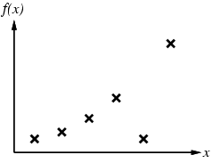
Inductive Learning
Construct/adjust $h$ to agree with $f$ on training data
E.g., curve fitting:

Slide 13
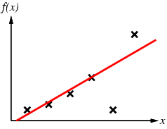
Inductive Learning
Construct/adjust $h$ to agree with $f$ on training data
E.g., curve fitting:

Slide 14
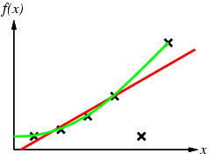
Inductive Learning
Construct/adjust $h$ to agree with $f$ on training data
E.g., curve fitting:

Slide 15
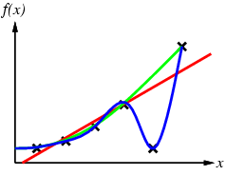
Inductive Learning
Construct/adjust $h$ to agree with $f$ on training data
E.g., curve fitting:

Slide 16
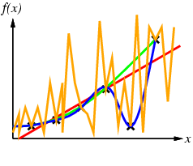
Inductive Learning
Construct/adjust $h$ to agree with $f$ on training data
E.g., curve fitting:

Slide 17
Inductive Learning
Construct/adjust $h$ to agree with $f$ on training data
E.g., curve fitting:
Ockham’s razor: prefer the simplest hypothesis consistent with data

Slide 18
Avoiding Overfitting the Model
Divide the data that you have into a distinct training set and test set.
Use only the training set to train your model.
Verify performance using the test set.
Measure error rate
Drawback of this method: the data withheld for the test set is not used for training
50-50 split of data means we didn’t train on half the data
90-10 split means we might not get a good idea of the accuracy

Slide 19
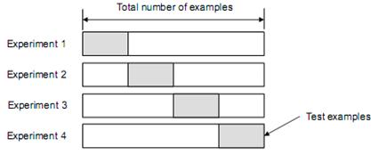
K-fold Cross-Validation
Divide the data into $k$ equal subsets.
Run learning $k$ times, each time leave out $\frac{1}{k}$ of the data (1 set) for testing and use the rest for training
The average error rate of all k rounds is a better estimate of the model accuracy.
$k$ is usually 5 or 10.
$k=n$(number of samples) is
“leave-one-out cross-validation”

Slide 20
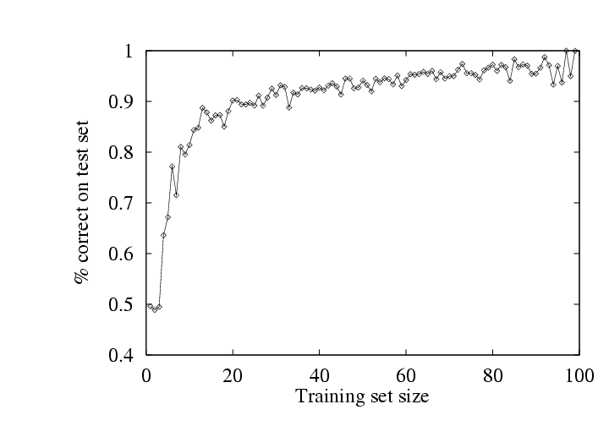
More Data Is Usually Better

Slide 21
Classification Algorithms
Decision trees
Neural networks
Logistic regression
Naïve Bayes
…

Slide 22
Decision Trees
…similar to a game of 20 questions
Decision trees are powerful and popular tools for classification and prediction.
Decision trees represent rules, which can be understood by humans and used in knowledge system such as database.

Slide 23
Learning decision trees
Problem: decide whether to wait for a table at a restaurant, based on the following attributes:
Alternate: is there an alternative restaurant nearby?
Bar: is there a comfortable bar area to wait in?
Fri/Sat: is today Friday or Saturday?
Hungry: are we hungry?
Patrons: number of people in the restaurant (None, Some, Full)
Price: price range ($, $$, $$$)
Raining: is it raining outside?
Reservation: have we made a reservation?
Type: kind of restaurant (French, Italian, Thai, Burger)
WaitEstimate: estimated waiting time (0-10, 10-30, 30-60, >60)

Slide 24
Attribute-based representations
Examples described by attribute values (Boolean, discrete, continuous)
E.g., situations where I will/won't wait for a table:
Classification of examples is positive (T) or negative (F)

Slide 25
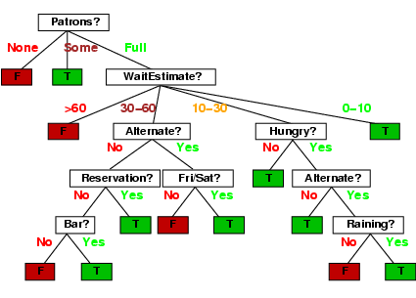
Decision trees
One possible representation for hypotheses

Slide 26
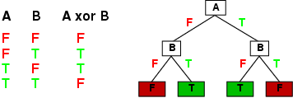
Expressiveness
Decision trees can express any function of the input attributes.
E.g., for Boolean functions, truth table row → path to leaf:
Trivially, there is a consistent decision tree for any training set with one path to leaf for each example (unless f nondeterministic in x) but it probably won't generalize to new examples
Prefer to find more compact decision trees

Slide 27
Decision tree learning
Aim: find a small tree consistent with the training examples
Idea: (recursively) choose "most significant" attribute as root of (sub)tree

Slide 28
Decision trees
One possible representation for hypotheses

Slide 29
Choosing an attribute
Idea: a good attribute splits the examples into subsets that are (ideally) "all positive" or "all negative"
Which is a better choice?
Patrons

