Slide 1
logic

Slide 2
Logic in general
Logics are formal languages for representing information such that conclusions can be drawn
Syntax defines the sentences in the language
Semantics define the "meaning" of sentences;
i.e., define truth of a sentence in a world
E.g., the language of arithmetic
x+2 ≥ y is a sentence;
x2+y > {} is not a sentence
x+2 ≥ y is true iff the number x+2 is no less than the number y

Slide 3
Propositional logic: Syntax
Propositional logic is the simplest logic – illustrates basic ideas
The proposition symbols P₁, P₂ etc are sentences
If S is a sentence, ¬S is a sentence (negation)
If S₁ and S₂ are sentences, S₁ ∧ S₂ is a sentence (conjunction)
If S₁ and S₂ are sentences, S₁ ∨ S₂ is a sentence (disjunction)
If S₁ and S₂ are sentences, S₁ ⇒ S₂ is a sentence (implication)
If S₁ and S₂ are sentences, S₁ ⇔ S₂ is a sentence (biconditional)

Slide 4
Propositional logic: Semantics
Each model specifies true/false for each proposition symbol
E.g. A B C
false true false
Rules for evaluating truth with respect to a model m:
¬S is true iff S is false
S₁ ∧ S₂ is true iff S₁ is true and S₂ is true
S₁ ∨ S₂ is true iff S₁is true or S₂ is true
S₁ ⇒ S₂ is true iff S₁ is false or S₂ is true
S₁ ⇔ S₂ is true iff S₁⇒S₂ is true and S₂⇒S₁ is true

Slide 5
Benefits
Easy to evaluate arbitrary sentence
¬P₁ ∧ (P₂ ∨ P₃)
= true ∧ (true ∨ false)
= true ∧ true = true

Slide 6
Truth tables for connectives

Slide 7
Example Problem
 | True | False | Unknown
A
B
E
J
M
$$(E\text{∨}\text{B}\text{) }\underset{⇒}{ }A$$
$$A\underset{⇒}{ }(J\text{∧}\text{M}\text{)}$$
$$B$$

Slide 8
Propositional logic
Can only talk about true/false
Can not model probability
Can not model objects
No shortcuts,

Slide 9
Syntax of FOL: Basic elements
Constants KingJohn, 2, NUS,...
Predicates Brother, >,...
Functions Sqrt, LeftLegOf,...
Variables x, y, a, b,...
Connectives ¬, ⇒, ∧, ∨, ⇔
Equality =
Quantifiers ∀, ∃

Slide 10
First Order Logic
First-order logic (like natural language) assumes the world contains
Objects
people, houses, numbers, colors, wars,…
Properties of objects
red, round, prime
Functions (or Relations between objects)
father of, best friend, one more than, plus, brother of, bigger than, part of, comes between
Each of the above can be true, false or unknown

Slide 11
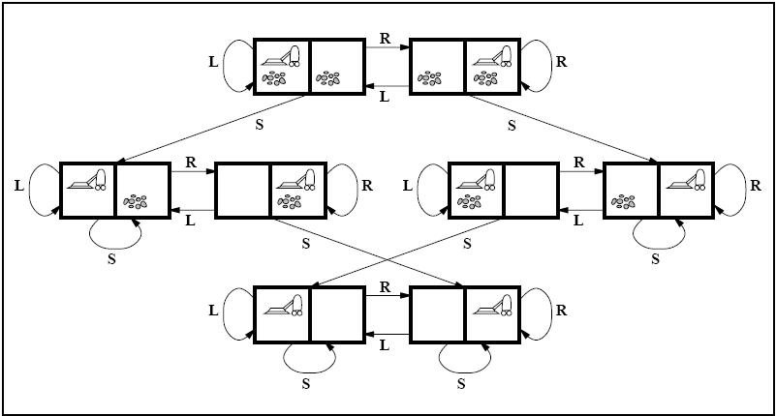

Slide 12
Example Problem
Valid | Satisfiable | Unsatisfiable
 |  |  | $$∃x,y x=y$$
 |  |  | $$(∃x x=x)\overset{⇒}{ }(∀y ∃z y=z)$$
 |  |  | $$∀x p\left(x\right) \text{∨} ¬p(x)$$
 |  |  | $$∃x p(x)$$

Slide 13
Questions?

