Slide 1
Constraint Satisfaction problems (CSP)

Slide 2
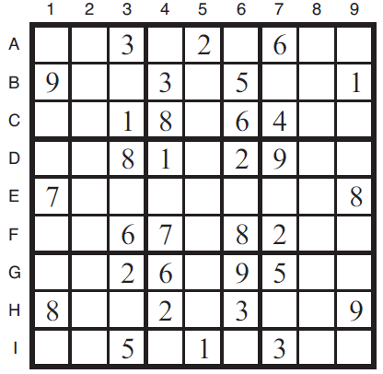
Sudoku

Slide 3
Problem Formulation
What is the state space?
What is the initial state?
What is the successor function?
What is the goal test?
What is the path cost?

Slide 4
CSP as a Search Problem
Initial state: empty assignment
Successor function: a value is assigned to any unassigned variable, which does not conflict with the currently assigned variables
Goal test: the assignment is complete
Path cost: irrelevant
In a domain with n variables and domain size d:
Branching factor b at the top level is equal to nd.
b=(n-l)d at depth l, hence n!d^{n} leaves (only d^{n} complete assignments).
We can do better…….

Slide 5
What else is needed?
Not just a successor function and goal test
But also a means to propagate the constraints imposed by one move on the others and an early failure test
Need an explicit representation of constraints and constraint manipulation algorithms

Slide 6
Constraint Satisfaction Problem
Set of variables {X₁, X₂, …, X_{n}}
Each variable Xi has a domain D_{i} of possible values
Usually D_{i} is discrete and finite
Set of constraints {C₁, C₂, …, C_{p}}
Each constraint C_{k} involves a subset of variables and specifies the allowable combinations of values of these variables
Goal: Assign a value to every variable such that all constraints are satisfied

Slide 7
Example: Sudoku CSP
variables:
domains:
constraints:
Goal: Assign a value to every variable such that all constraints are satisfied

Slide 8
Example: Sudoku CSP
variables: X_{A1}, …, X_{I9}
domains: {1,…,9}
constraints:
row constraint: X_{A1} ≠ X_{A2}, …, X_{A1} ≠ X_{A9}
col constraint: X_{A1} ≠ X_{B1}, …, X_{A1} ≠ X_{I1}
block constraint: X_{A1} ≠ X_{A2}, …, X_{A1} ≠ X_{C3}
…
Goal: Assign a value to every variable such that all constraints are satisfied

Slide 9
Example: Map Coloring
NT
NT
Q
Q
WA
WA
SA
SA
NSW
NSW
V
V
T
T
7 variables {WA,NT,SA,Q,NSW,V,T}
Each variable has the same domain {red, green, blue}
No two adjacent variables have the same value:
WA≠NT, WA≠SA, NT≠SA, NT≠Q, SA≠Q, SA≠NSW, SA≠V,Q≠NSW, NSW≠V

Slide 10
Example: Task Scheduling
T1
T2
T4
T3
T1 must be done during T3
T2 must be achieved before T1 starts
T2 must overlap with T3
T4 must start after T1 is complete

Slide 11
Varieties of constraints
Unary constraints involve a single variable.
e.g. SA ≠ green
Binary constraints involve pairs of variables.
e.g. SA ≠ WA
Higher-order constraints involve 3 or more variables.
e.g. cryptarithmetic puzzles (see book)
Preference (soft constraints)
e.g. red is better than green
Typically representable by a cost for each variable assignment
When preferences are involved, often called a constraint optimization problem (COP).

Slide 12
Constraint Graph
Binary constraints
NT
What is the constraint graph for sudoku?
Q
WA
SA
NSW
V
T
Two variables are adjacent if they
are connected by an edge (arc)

Slide 13
Commutativity of CSP
The order in which values are assigned to variables is irrelevant to the final assignment
Therefore, we can:
Generate successors of a node by considering assignments for only one variable
E.g. at the root consider only the possible values for SA and not for all variables
Not store the path to node

Slide 14
Backtracking Algorithm
CSP-BACKTRACKING(assignment)
If assignment is complete then return assignment
X ← select unassigned variable
D ← select an ordering for the domain of X
For each value v in D do
If v is consistent with assignment then
Add (X = v) to assignment
inferences ← perform inference on X and v given constraints
if inferences ≠ failure then
Add inference to assignment
result ← CSP-BACKTRACKING(assignment)
if result ≠ failure then return result
remove X=v and inferences from assignment
returnfailure
This algorithm will backtrack when a variable has no legal values left to assign.

Slide 15
Backtracking example

Slide 16
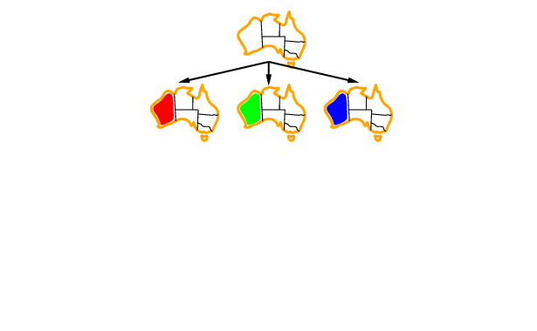
Backtracking example

Slide 17
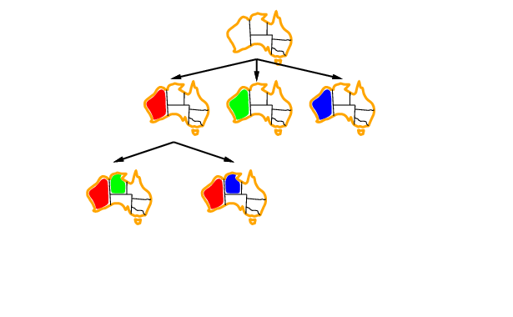
Backtracking example

Slide 18
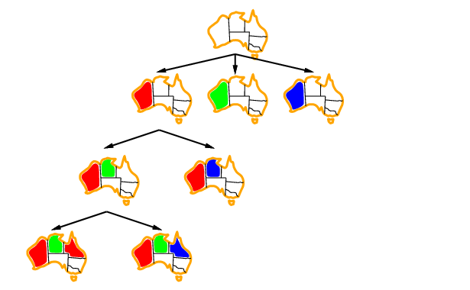
Backtracking example

Slide 19
→ Backtracking Search
empty assignment
1st variable
2nd variable
3rd variable
Assignment = {}

Slide 20
→ Backtracking Search
empty assignment
1st variable
2nd variable
3rd variable
Assignment = {(var1=v11)}

Slide 21
→ Backtracking Search
empty assignment
1st variable
2nd variable
3rd variable
Assignment = {(var1=v11),(var2=v21)}

Slide 22
→ Backtracking Search
empty assignment
1st variable
2nd variable
3rd variable
Assignment = {(var1=v11),(var2=v21),(var3=v31)}

Slide 23
→ Backtracking Search
empty assignment
1st variable
2nd variable
3rd variable
Assignment = {(var1=v11),(var2=v21),(var3=v32)}

Slide 24
→ Backtracking Search
empty assignment
1st variable
2nd variable
3rd variable
Assignment = {(var1=v11),(var2=v22)}

Slide 25
→ Backtracking Search
empty assignment
1st variable
2nd variable
3rd variable
Assignment = {(var1=v11),(var2=v22),(var3=v31)}

Slide 26
Questions
Which variable X should be assigned a value next?
In which order should its domain D be sorted?
What are the implications of a partial assignment for yet unassigned variables? (→ Constraint Propagation)

Slide 27
Backtracking Algorithm
CSP-BACKTRACKING(assignment)
If assignment is complete then return assignment
X ← select unassigned variable
D ← select an ordering for the domain of X
For each value v in D do
If v is consistent with assignment then
Add (X = v) to assignment
inferences ← perform inference on X and v given constraints
if inferences ≠ failure then
Add inference to assignment
result ← CSP-BACKTRACKING(assignment)
if result ≠ failure then return result
remove X=v and inferences from assignment
returnfailure
Areas in red are where we can improve performance.

Slide 28
Choice of Variable
Map coloring
NT
NT
Q
WA
WA
SA
SA
NSW
V
T

Slide 29
Choice of Variable
X ← select unassigned variable
Minimum remaining values heuristic (a.k.a. Fail First):
Select a variable with the fewest remaining values

Slide 30
Choice of Variable
NT
Q
WA
SA
SA
NSW
V
T

Slide 31
Choice of Variable
X ← select unassigned variable
Minimum remaining values heuristic (a.k.a. Fail First):
Select a variable with the fewest remaining values
Degree Heuristic
Select the variable that is involved in the largest number of constraints on other unassigned variables

Slide 32
Choice of Value
D ← select an ordering for the domain of X
NT
NT
NT
NT
Q
Q
WA
WA
WA
WA
SA
NSW
SA
NSW
V
V
{}
{blue}
T
T

Slide 33
Choice of Value
D ← select an ordering for the domain of X
3) Least-constraining-value heuristic:
Prefer the value that leaves the largest subset of legal values for other unassigned variables
(preferred)

Slide 34
Summary so far…
We’ve found a new way to define problems in terms of variables, their domains and their constraints
We’ve found a way to do search more effectively by checking each time we make an assignment and using heuristics to select the order of variables and values.
Variable Selection:
Minimum Remaining Values
Degree
Value Selection:
Least constraining value

Slide 35
Constraint Propagation …
… is the process of determining how the possible values of one variable affect the possible values of other variables

Slide 36
Forward Checking
After a variable X is assigned a value v, look at each unassigned variable Y that is connected to X by a constraint and deletes from Y’s domain any value that is inconsistent with v

Slide 37
Map Coloring: Forward Checking
NT
Q
WA
NSW
T
SA
V
WA | NT | Q | NSW | V | SA | T
RGB | RGB | RGB | RGB | RGB | RGB | RGB

Slide 38
Map Coloring: Forward Checking
NT
Q
WA
NSW
T
SA
V
WA | NT | Q | NSW | V | SA | T
RGB | RGB | RGB | RGB | RGB | RGB | RGB
1: R | RGB | RGB | RGB | RGB | RGB | RGB

Slide 39
Map Coloring: Forward Checking
NT
Q
WA
NSW
T
SA
V
WA | NT | Q | NSW | V | SA | T
RGB | RGB | RGB | RGB | RGB | RGB | RGB
1: R | RGB | RGB | RGB | RGB | RGB | RGB

Slide 40
Map Coloring: Forward Checking
NT
Q
WA
NSW
T
SA
V
WA | NT | Q | NSW | V | SA | T
RGB | RGB | RGB | RGB | RGB | RGB | RGB
R | RGB | RGB | RGB | RGB | RGB | RGB
R | RGB | 2: G | RGB | RGB | RGB | RGB

Slide 41
Map Coloring: Forward Checking
NT
Q
WA
NSW
T
SA
V
WA | NT | Q | NSW | V | SA | T
RGB | RGB | RGB | RGB | RGB | RGB | RGB
R | RGB | RGB | RGB | RGB | RGB | RGB
R | RGB | 2: G | RGB | RGB | RGB | RGB

Slide 42
Map Coloring: Forward Checking
NT
Q
WA
NSW
T
SA
V
WA | NT | Q | NSW | V | SA | T
RGB | RGB | RGB | RGB | RGB | RGB | RGB
R | RGB | RGB | RGB | RGB | RGB | RGB
R | RGB | G | RGB | RGB | RGB | RGB
R | RGB | G | RGB | 3:B | RGB | RGB

Slide 43
Map Coloring: Forward Checking
NT
Q
WA
NSW
T
SA
V
WA | NT | Q | NSW | V | SA | T
RGB | RGB | RGB | RGB | RGB | RGB | RGB
R | RGB | RGB | RGB | RGB | RGB | RGB
R | RGB | G | RGB | RGB | RGB | RGB
R | RGB | G | RGB | 3:B | RGB | RGB

Slide 44
Other inconsistencies?
NT
Q
WA
NSW
T
SA
V
Impossible assignments that forward
checking do not detect
WA | NT | Q | NSW | V | SA | T
RGB | RGB | RGB | RGB | RGB | RGB | RGB
R | RGB | RGB | RGB | RGB | RGB | RGB
R | RGB | G | RGB | RGB | RGB | RGB
R | RGB | G | RGB | 3:B | RGB | RGB

Slide 45
Map Coloring: Forward Checking
NT
Q
WA
NSW
T
SA
V
Should have applied the minimum remaining values heuristic and gone to SA or NT in step 2.
WA | NT | Q | NSW | V | SA | T
RGB | RGB | RGB | RGB | RGB | RGB | RGB
R | RGB | RGB | RGB | RGB | RGB | RGB
R | RGB | G | RGB | RGB | RGB | RGB
R | RGB | G | RGB | 3:B | RGB | RGB

Slide 46
Constraint propagation
Forward checking propagates information from assigned to unassigned variables but does not look ahead far enough…

Slide 47
Arc consistency
NT
Q
WA
NSW
T
SA
V
X → Y is consistent iff
for every value x of X there is some allowed y in Y
SA → NSW is consistent iff
SA=blue and NSW=red

Slide 48
Arc consistency
NT
Q
WA
NSW
T
SA
V
X → Y is consistent iff
for every value x of X there is some allowed y
NSW → SA is consistent iff
NSW=red and SA=blue
Arc can be made consistent by removing blue from NSW

Slide 49
Arc consistency
NT
Q
WA
NSW
T
SA
V
Arc can be made consistent by removing blue from NSW
RECHECK neighbors of NSW!!
Remove red from V

Slide 50
Arc consistency
NT
Q
WA
NSW
T
SA
V
Arc consistency detects failure earlier than FC
Can be run as a preprocessor or after each assignment.
Repeated until no inconsistency remains

Slide 51
Arc consistency algorithm
function AC-3(csp) return the CSP, possibly with reduced domains
inputs: csp, a binary csp with variables {X₁, X₂, …, X_{n}}
local variables: queue, a queue of arcs initially the arcs in csp
while queue is not empty do
(X_{i}, X_{j}) ← REMOVE-FIRST(queue)
if REMOVE-INCONSISTENT-VALUES(X_{i}, X_{j}) then
for each X_{k} in NEIGHBORS[X_{i} ] - X_{j} do
add (X_{k}, X_{i}) to queue
function REMOVE-INCONSISTENT-VALUES(X_{i}, X_{j}) return true iff we remove a value
removed ← false
for each x in DOMAIN[X_{i}] do
if no value y in DOMAIN[X_{i}] does (x, y) satisfy constraints between X_{i} and X_{j}
then delete x from DOMAIN[X_{i}];
removed ← true
return removed

Slide 52
K-consistency
Arc consistency does not detect all inconsistencies:
Partial assignment {WA=red, NSW=red} is inconsistent.
Stronger forms of propagation can be defined using the notion of k-consistency.
A CSP is k-consistent if for any set of k-1 variables and for any consistent assignment to those variables, a consistent value can always be assigned to any kth variable.
E.g. 1-consistency or node-consistency (unary constraint)
E.g. 2-consistency or arc-consistency (binary constraint)
E.g. 3-consistency or path-consistency

Slide 53
Local search for CSP
Remember that local search uses complete-state representation that assigns a value for every variable
For CSPs
allow states with unsatisfied constraints
operators reassign variable values
Variable selection: randomly select any conflicted variable
Value selection: min-conflicts heuristic
Select new value that results in a minimum number of conflicts with the other variables

Slide 54
Local Search for CSP
A two-step solution for an 8-queens problem using min-conflicts.
At each stage, a queen is chosen for reassignment in its column.
The number of conflicts (in this case, the number of attacking queens) is shown in each square.
The algorithm moves the queen to the min-conflict square, breaking ties randomly.

Slide 55
Remark
Local search with min-conflict heuristic works extremely well for million-queen problems
The reason: Solutions are densely distributed in the O(n^{n}) space, which means that on the average a solution is a few steps away from a randomly picked assignment

Slide 56
Solving CSP through problem structure
How can the problem structure help to find a solution quickly?
Subproblem identification is important:
Coloring Tasmania and mainland are independent subproblems
Identifiable as connected components of constrained graph.
Improves performance

Slide 57
Problem structure
Suppose each problem has c variables out of a total of n.
Worst case solution cost is O(n/c d^{c}), i.e. linear in n
Instead of O(d ^{n}), exponential in n
E.g. n= 80, c= 20, d=2
2⁸⁰ = 4 billion years at 1 million nodes/sec.
4 * 2²⁰= .4 second at 1 million nodes/sec

Slide 58
Tree-structured CSPs
Theorem: if the constraint graph has no loops then CSP can be solved in O(nd ²) time
Compare difference with general CSP, where worst case is O(d ^{n})

Slide 59
Tree-structured CSPs
In most cases subproblems of a CSP are connected as a tree
Any tree-structured CSP can be solved in time linear in the number of variables.
Choose a variable as root, order variables from root to leaves such that every node’s parent precedes it in the ordering. (label var from X₁ to X_{n})
For j from n down to 2, apply REMOVE-INCONSISTENT-VALUES(Parent(X_{j}),X_{j})
For j from 1 to n assign X_{j} consistently with Parent(X_{j} )

Slide 60
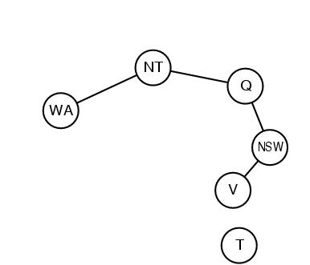
Nearly tree-structured CSPs
Can more general constraint graphs be reduced to trees?
Two approaches:
Remove certain nodes (cycle cutset)
Collapse certain nodes

Slide 61
Nearly tree-structured CSPs
Idea: assign values to some variables so that the remaining variables form a tree.
Assume that we assign {SA=x} ← cycle cutset
And remove any values from the other variables that are inconsistent.
The selected value for SA could be the wrong one so we have to try all of them

Slide 62
Nearly tree-structured CSPs
This approach is worthwhile if cycle cutset is small.
Finding the smallest cycle cutset is NP-hard
Approximation algorithms exist
This approach is called cutset conditioning.

Slide 63
Summary of CSP Techniques
Backtracking Search
DFS that assigns one variable per layer of the tree and backtracks when constraints are violated
Heuristics used to decide the order of variables/values
Constraint Propagation
Forward checking prevents assignments that guarantee single-step failure
Arc consistency, AC-3 algorithm (multiple steps)
Local Search
Start with a random assignment and minimize constraints
Problem Structure solutions
Turn graph into a tree by removing cycle cutset, then solve the remaining nodes in linear time

Slide 64
When to Use CSP Techniques?
When the problem can be expressed by a set of variables with constraints on their values
When constraints are relatively simple (e.g., binary)
When constraints propagate well (AC3 eliminates many values)
Local Search: when the solutions are “densely” distributed in the space of possible assignments

Slide 65
Applications
CSP techniques allow solving very complex problems
Numerous applications, e.g.:
Crew assignments to flights
Management of transportation fleet
Flight/rail schedules
Task scheduling in port operations
Design
Brain surgery

Slide 66
Constraint Programming
“Constraint programming represents one of the closest approaches computer science has yet made to the Holy Grail of programming: the user states the problem, the computer solves it.”
Eugene C. Freuder, Constraints, April 1997

Slide 67
Glossary of Terms
A constraint satisfaction problem is a problem in which the goal is to choose a value for each of a set of variables, in such a way that the values all obey a set of constraints.
A constraint is a restriction on the possible values of two or more variables. For example, a constraint might say that A=a is not allowed in conjunction with B=b.
Backtracking search is a form of DFS in which there is a single representation of the state that gets updated for each successor, and then must be restored when a dead end is reached.
A directed arc from variable A to variable B in a CSP is arc consistent if, for every value in the current domain of A, there is some consistent value of B.
Backjumping is a way of making backtracking search more efficient by jumping back more than one level when a dead end is reached.
Min-conflicts is a heuristic for use with local search on CSP problems. The heuristic says that, when given a variable to modify, choose the value that conflicts with the fewest number of other variables.

Slide 68
Questions?

