Slide 1
HaLoop: Efficient Iterative Data Processing On Large Scale Clusters by Yingyi Bu, Bill Howe, Magdalena Balazinska, & Michael D. Ernst
Slides contributed by Sumitha Wunnava and Saber Jahanpour
Presentation by
Xi Liu
Ye Wang

Slide 2
Citations
Many of the slides in this presentation were taken from the author’s website, which can be found here: http://www.ics.uci.edu/~yingyib/

Slide 3
OutLine
Motivation
Example Algorithms Used
Architecture of HaLoop
Task Scheduling
Caching and Indexing
Experiments & Results
Conclusion / Discussion

Slide 4
Review: K-means
Input: Data points and centroids
Mapper: Assign points to nearest centroids
Mapper output: <Centroids, points>
Reducer: Compute new centroids
Reducer output: New centroids

Slide 5
Motivation
Lots of interesting programs need loops
graph algorithms
clustering
machine learning
recursive queries
MapReduce lack recursion/iteration
Solution: Use a driver program outside of MapReduce
Disadvantages of manually orchestrating an iterative program in Map Reduce
Data may be unchanged from iteration to iteration
Detecting whether fix point has been reached

Slide 6
Example 1: PageRank
Rank Table R₀
Linkage Table L
url | rank
www.a.com | 1.0
www.b.com | 1.0
www.c.com | 1.0
www.d.com | 1.0
www.e.com | 1.0
url_src | url_dest
www.a.com | www.b.com
www.a.com | www.c.com
www.c.com | www.a.com
www.e.com | www.d.com
www.d.com | www.b.com
www.c.com | www.e.com
www.e.com | www.c.om
www.a.com | www.d.com
R_{i+1}
π(url_dest, γ_{url_dest}SUM(rank))
R_{i}.rank = R_{i}.rank/γ_{url}COUNT(url_dest)
Rank Table R₃
R_{i}.url = L.url_src
url | rank
www.a.com | 2.13
www.b.com | 3.89
www.c.com | 2.60
www.d.com | 2.60
www.e.com | 2.13
R_{i}
L

Slide 7
PageRank in MapReduce
Join & compute rank
Aggregate
fixpoint evaluation
R_{i}
M
r
M
r
M
r
L-split0
M
r
M
r
M
r
L-split1
M
i=i+1
Converged?
Client
done

Slide 8
PageRank in MapReduce
What’s the Problem?
R_{i}
m
r
M
r
M
r
L-split0
m
r
M
r
M
r
L-split1
3.
m
2.
1.
L is loop invariant, but
L is loaded on each iteration
L is shuffled on each iteration
Fixpoint evaluated as a separate MapReduce job per iteration

Slide 9
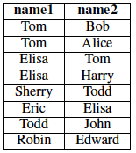
Example 2: Descendant Query
Friend
Find all friends within two hops of Eric
S₀
{Eric, Eric}
s₁
{Eric, Elisa}
S₂
{Eric, Tom
Eric, Harry}
S₃
{}
Notes:
The goal of descendant query
How to: 1. find Eric’ direct friends; 2. find all the friends of these friends;

Slide 10
Descendant Query in MapReduce
(compute next generation of friends)
(remove the ones we’ve already seen)
Join
Dupe-elim
S_{i}
M
r
M
r
Friend0
M
r
M
r
Friend1
M
Anything new?
i=i+1
Client
done
Notes:
find friends within n hops --- repeat the iteration until fixpoint or specific num of iterations

Slide 11
Descendant Query in MapReduce
What’s the Problem?
(compute next generation of friends)
(remove the ones we’ve already seen)
Join
Dupe-elim
S_{i}
M
r
M
r
Friend0
M
r
M
r
Friend1
M
2.
1.
Friend is loop invariant, but
Friend is loaded on each iteration
Friend is shuffled on each iteration

Slide 12
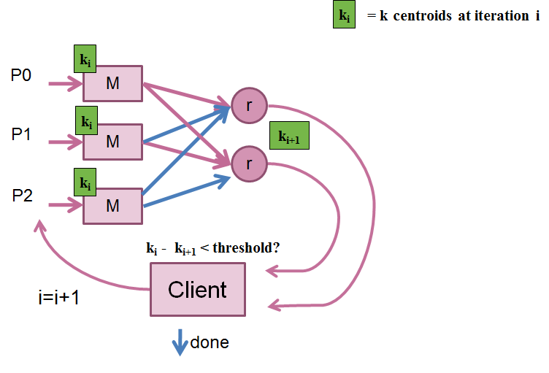
Example 3: K-Means

Slide 13
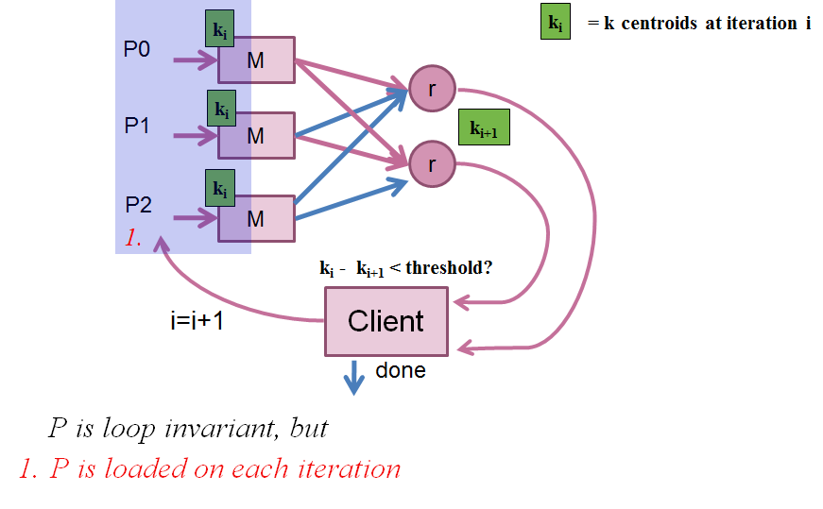
Example 3: K-Means
What’s the Problem?
Notes:
20

Slide 14
HaLoop – The Solution
HaLoop offers the following solutions to these problems:
A New Programming Model & Architecture for Iterative Programs
Loop-Aware Task Scheduling
Caching for Loop Invariant Data
Caching for Fixpoint Evaluation

Slide 15
OutLine
Motivation
Example Algorithms Used
Architecture of HaLoop
Task Scheduling
Caching and Indexing
Experiments & Results
Conclusion / Discussion

Slide 16
HaLoop Architecture

Slide 17
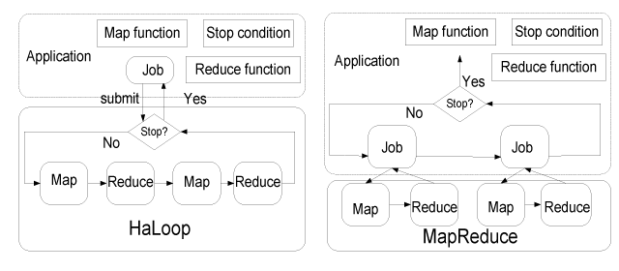
HaLoop Architecture
Note: The loop control (i.e. determining when execution has finished) is pushed from the application into the infrastructure.

Slide 18
HaLoop Architecture
HaLoop will work given the following is true:
In other words, the next result is a join of the previous result and loop-invariant data L.

Slide 19
HaLoop Programming Model
AddMap and AddReduce
Used to add a Map Reduce loop
SetFixedPointThreshold
Set a bound on the distance between iterations
ResultDistance
A function that returns the distance between iterations
SetMaxNumOfIterations
Set the maximum number of iterations the loop can take.

Slide 20
SetIterationInput
A function which returns the input for a certain iteration
AddStepInput
A function will allows injection of additional data in between the Map and Reduce
AddInvariantTable
Add a table which is loop invariant
Notes:
30

Slide 21
PageRank In HaLoop
R₀
Map
Rank
Reduce
Rank
Map
Aggregate
Reduce
Aggregate
L

Slide 22
PageRank In HaLoop
R₀ U L
R₀
Map
Rank
Reduce
Rank
Map
Aggregate
Reduce
Aggregate
L
Source URL | Dest/Rank | Source File
a.com | 1.0 | #2
a.com | b.com,c.com, d.com | #1
b.com | 1.0 | #2
b.com |  | #1
c.com | 1.0 | #2
c.com | a.com, e.com | #1
d.com | 1.0 | #2
d.com | b.com | #1
e.com | 1.0 | #2
e.com | d.com,c.com | #1
Only these values
are given to reducer

Slide 23
PageRank In HaLoop
R₀ U L
Calculate New Rank
R₀
Map
Rank
Reduce
Rank
Map
Aggregate
Reduce
Aggregate
L
Destination | New Rank
b.com | 1.5
c.com | 1.5
d.com | 1.5
a.com | 1.5
e.com | 1.5
b.com | 1.5
d.com | 1.5
c.com | 1.5

Slide 24
PageRank In HaLoop
Calculate New Rank
Identity
R₀ U L
R₀
Map
Rank
Reduce
Rank
Map
Aggregate
Reduce
Aggregate
L
Destination | New Rank
b.com | 1.5
c.com | 1.5
d.com | 1.5
a.com | 1.5
e.com | 1.5
b.com | 1.5
d.com | 1.5
c.com | 1.5

Slide 25
PageRank In HaLoop
Calculate New Rank
Identity
Aggregate
R₀ U L
R₀
Map
Rank
Reduce
Rank
Map
Aggregate
Reduce
Aggregate
L
R₁
Destination | New Rank
a.com | 1.5
b.com | 3.0
c.com | 3.0
d.com | 3.0
e.com | 1.5

Slide 26
PageRank In HaLoop
Calculate New Rank
Identity
Aggregate
R₀ U L
R₀
Map
Rank
Reduce
Rank
Map
Aggregate
Reduce
Aggregate
L
R₁
Destination | New Rank
a.com | 1.0
b.com | 1.0
c.com | 1.0
d.com | 1.0
e.com | 1.0
Destination | New Rank
a.com | 1.5
b.com | 3.0
c.com | 3.0
d.com | 3.0
e.com | 1.5
Compare R0 and R1. If not under threshold, repeat.

Slide 28
API’s in Action – Descendant Query

Slide 29
Descendant Query in HaLoop
∆S₀
Map
Join
Reduce
Join
Map
Distinct
Reduce
Distinct
F

Slide 30
Descendant Query in HaLoop
∆S₀
Map
Join
Reduce
Join
Map
Distinct
Reduce
Distinct
F
Eric | Eric | #2
Eric | Elisa | #1
Elisa | Tom | #1
Elisa | Harry | #1

Slide 31
Descendant Query in HaLoop
∆S₀
Map
Join
Reduce
Join
Map
Distinct
Reduce
Distinct
F
Eric | Eric | 1
Eric | Elisa | 1
Elisa | Tom | 1
Elisa | Harry | 1
Eric | Tom | 1
Eric | Harry | 1
Elisa | Eric | 1

Slide 32
Descendant Query in HaLoop
∆S₀
Map
Join
Reduce
Join
Map
Distinct
Reduce
Distinct
F
Eric | Eric
Eric | Elisa
Elisa | Tom
Elisa | Harry
Eric | Tom
Eric | Harry
Elisa | Eric
∆S₁

Slide 33
Descendant Query in HaLoop
∆S₁
Map
Join
Reduce
Join
Map
Distinct
Reduce
Distinct
F
Eric | Eric | #2
Elisa | Eric | #2
Tom | Eric | #2
Harry | Eric | #2
Tom | Elisa | #2
Harry | Elisa | #2

Slide 34
Descendant Query in HaLoop
∆S₁
Map
Join
Reduce
Join
Map
Distinct
Reduce
Distinct
F
Eric | Eric | 2
Elisa | Eric | 2
Tom | Eric | 2
Harry | Eric | 2
Tom | Elisa | 2
Harry | Elisa | 2

Slide 35
Descendant Query in HaLoop
Step Input
Step Input allows the union of all iterations to be input
∆S₁
Map
Join
Reduce
Join
Map
Distinct
Reduce
Distinct
F
Eric | Eric | 2
Elisa | Eric | 2
Tom | Eric | 2
Harry | Eric | 2
Tom | Elisa | 2
Harry | Elisa | 2
Eric | Eric | 1
Eric | Elisa | 1
Elisa | Tom | 1
Elisa | Harry | 1
Eric | Tom | 1
Eric | Harry | 1
Elisa | Eric | 1
Eric | Eric
Tom | Eric
Harry | Eric
Tom | Elisa
Harry | Elisa
Eric | Elisa
Eric | Tom
Eric | Harry
Elisa | Tom
Elisa | Harry
Eric | Eric | 0
Notes:
40

Slide 36
OutLine
Motivation
Example Algorithms Used
Architecture of HaLoop
Task Scheduling
Caching and Indexing
Experiments & Results
Conclusion / Discussion

Slide 37
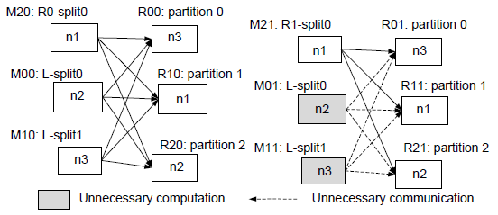
HaLoop Inter-Iteration Locality
One goal of HaLoop is to schedule map/reduce tasks on the same machine as the data.
Scheduling the first iteration is no different than Hadoop.
Subsequent iterations put tasks that access the same data on the same physical node.

Slide 38
HaLoop Scheduling
The master node keeps a map of
node ID → Filesystem Partition
When a node becomes free, the master tries to assign a task related to data contained on that node.
If a task is required on a node with a full load, it will utilize a nearby node.
Notes:
50

Slide 39
OutLine
Motivation
Example Algorithms Used
Architecture of HaLoop
Task Scheduling
Caching and Indexing
Experiments & Results
Conclusion / Discussion

Slide 40
Caching and Indexing
Thanks to the inter-iteration locality, access to a particular loop-invariant data partition is usually only needed by one physical node.
Cach data partitions on physical node (reduce I/O cost) and index them.

Slide 41
Caching And Indexing
Mapper Input Cache
Reducer Input Cache
Reducer Output Cache
Haloop Indexes Cached Data
Keys and values stored in separate local files
Reduces I/O seek time
Notes:
Cache implies storage on local disk, not HDFS

Slide 42
Approach: Inter-iteration caching
Loop body
M
…
r
M
r
M
Reducer output cache (RO)
Reducer input cache (RI)
Mapper input cache (MI)
Notes:
No need to cache mapper output (MO) because data will always be different; MI, RI, RO makes sense; we’ll look at these in detail

Slide 43
RI: Reducer Input Cache
Provides:
Access to loop invariant data without map/shuffle
Used By:
Reducer function
Requirements:
Deterministic
L must be same across iteration
3. Same input
PageRank
Avoid shuffling the network at every step
Descendant Query
Avoid shuffling the graph at every step
K-means
No help
…
Notes:
This is useful when data doesn’t change; list of names, list of pages, etc. “loop invariant” means that the data that determines the conditional control for the loop is static—not the case with K-means because it is likely re-clustering data with each iteration.

Slide 44
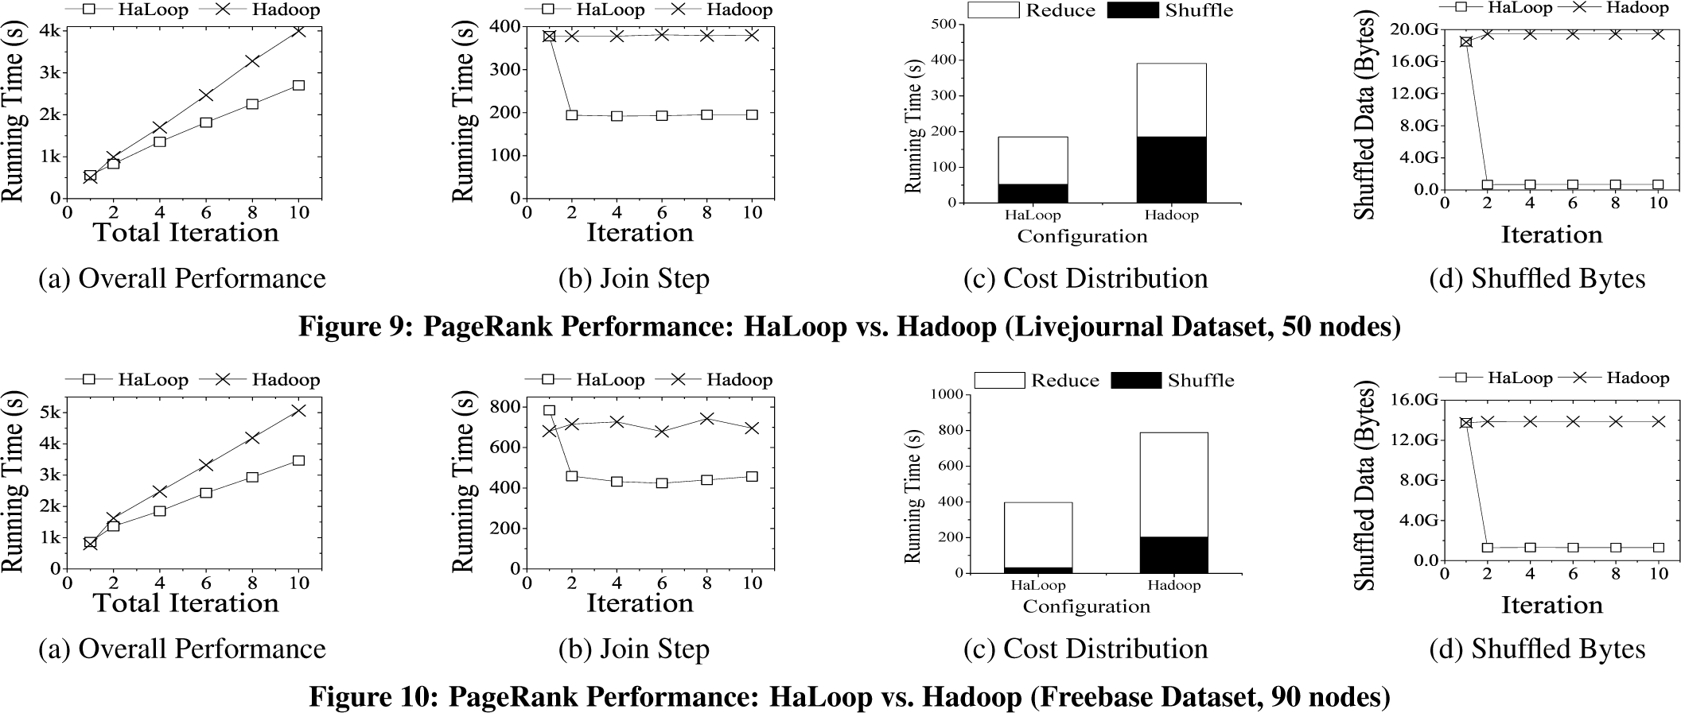
Results: Page Rank
Run only for 10 iterations
Join and aggregate in every iteration
Overhead in first step for caching input
Catches up soon and outperforms Hadoop.
Low shuffling time: time between RPC invocation by reducer and sorting of keys.
Notes:
Key Point: Performance improves with each iteration (compared to traditional Hadoop)
Cost Distribution is for iteration 3
Join step = shuffle time + reduce time
Figure 9: LiveJournal (Descendant Query)
Figure 10: Freebase (Page Rank)

Slide 45
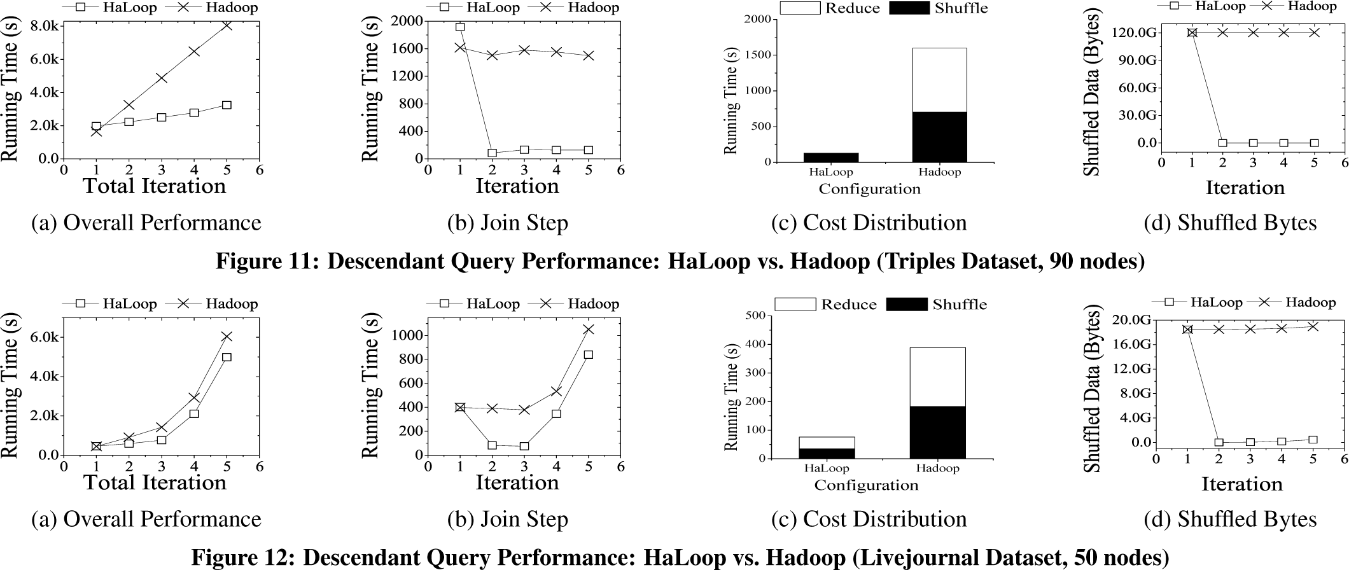
Results: Descendant Query
Join and duplicate elimination in every iteration.
Less striking Performance on LiveJournal: social network, high fan out, excessive duplicate generation which dominates the join cost and reducer input caching is less useful.
Notes:
Figure 10c: Reduce cost is not 0, but very low
Shuffled data is low with Haloop

Slide 46
RO: Reducer Output Cache
Provides:
Test the convergence condition by comparing consecutive iterations
Used By:
Fixpoint evaluation
Assumes:
Reducer output key functionally determines Reducer input key
PageRank
Allows distributed fixpoint evaluation
Obviates extra MapReduce job
Descendant Query
No help
K-means
No help
…
Notes:
Key for Fixpoint algorithms (using previous values in current step)– seek backup slide for example

Slide 47
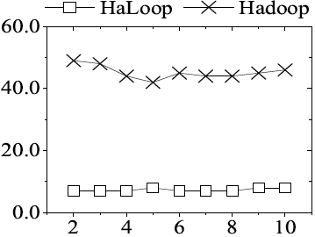
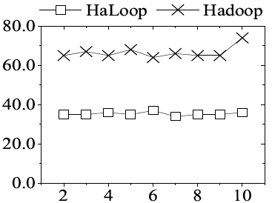
Reducer Output Cache Benefit
Fixpoint Evaluation Overhead in PageRank: HaLoop vs. Hadoop
Fixpoint evaluation (s)
Iteration #
Iteration #
Livejournal dataset
50 EC2 small instances
Freebase dataset
90 EC2 small instances
Notes:
Should help with K-means algorithm (signifantly)
Number of EC2 instances differ

Slide 48
MI: Mapper Input Cache
Aims to avoid non-local data reads in mappers
Used:
During scheduling of map tasks
Assumes:
Mapper input does not change
PageRank
use of Reducer Input Cache
Descendant Query
use of Reducer Input Cache
K-means
Avoids non-local data reads on iterations > 0
…
Notes:
Co-locate map tasks with their input data; avoids network i/o; “penalty” on first iteration, but gains on subsequent iterations

Slide 49
Mapper Input Cache Benefit
Performance of K-Means: HaLoop vs. Hadoop
5% non-local data reads; ~5% improvement
Cosmo-gas, 8 nodes
Cosmo-dark, 8 nodes
Notes:
Hadoop mapper locality is at 95%, so only 5% gain due to local cache

Slide 50
Cache Rebuilding
Cache Must be Reconstructed:
Hosting Node Fails
Hosting Node has Full Node (M/R Job Needs to be Scheduled on a Different Substitution Node)
Process is Transparent
Notes:
60

Slide 51
OutLine
Motivation
Example Algorithms Used
Architecture of HaLoop
Task Scheduling
Caching and Indexing
Experiments & Results
Conclusion / Discussion

Slide 52
Conclusions
Relatively simple changes to MapReduce/Hadoop can support arbitrary recursive programs
TaskTracker (Cache management)
Scheduler (Cache awareness)
Programming model (multi-step loop bodies, cache control)
Optimizations
Caching loop invariant data realizes largest gain
Good to eliminate extra MapReduce step for termination checks
Mapper input cache benefit inconclusive; need a busier cluster

Slide 53
The Good …
Haloop extends MapReduce:
Easier programming of iterative algorithms
Efficiency improvement due to loop awareness and caching
Lets users reuse major building blocks from existing application implementations in Hadoop.
Fully backward compatible with Hadoop.
Notes:
65

