Slide 1
CS585/DS503. Big Data Management
Team Presentation (1)
Yousef Fadila
Yousef@Fadila.net
Abdulaziz Alajaji asalajaji@wpi.edu
Slides source:
Prof. Mohamed Eltabakh & IBM Almaden Research Center.

Slide 2
CoHadoop: Flexible Data Placement and Its Exploitation in Hadoop
Mohamed Eltabakh
Worcester Polytechnic Institute
Joint work with: Yuanyuan Tian, Fatma Ozcan, Rainer Gemulla, Aljoscha Krettek, and John McPherson
IBM Almaden Research Center

Slide 3
What is CoHadoop
CoHadoop is an extension of Hadoop infrastructure, where:
  HDFS accepts hints from the application layer to specify related files
  Based on these hints, HDFS tries to store these files on the same set of data nodes
  Example
    Files A and B are related
    Files C and D are related
File A
File B
File C
File D
Hadoop
CoHadoop
Files are distributed blindly over the nodes
Files A & B are colocated
Files C & D are colocated
Notes:
What is coHadoop.
Cohadoop is an extension to hadoop that allows the application to specify related file.
Based of that, Hadoop will try it is best effort to put these file at the same set of nodes.

Slide 4
Motivation
Colocating related files improves the performance of several distributed operations
  Fast access of the data and avoids network congestion
Examples of these operations are:
  Join of two large files.
  Use of indexes on large data files
  Processing of log-data, especially aggregations
Notes:
Having the related file on the same set of node gives better performance for operations require reading both files. Like joining. Because when all files are local that save network time

Slide 5
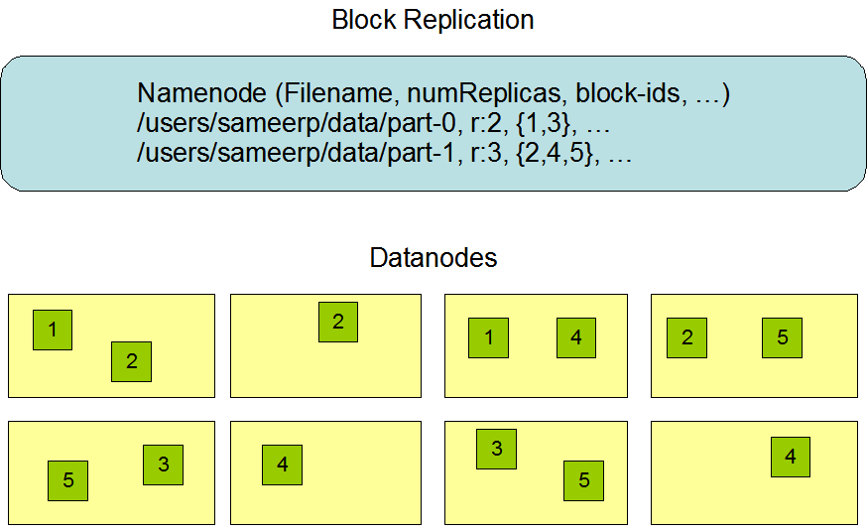
Background on HDFS
Single namenode and many datanodes
Namenode maintains the file system metadata
Files are split into fixed sized blocks and stored on data nodes
Data blocks are replicated for fault tolerance and fast access (Default is 3)
Default data placement policy
  First copy is written to the node creating the file (write affinity)
  Second copy is written to a data node within the same rack
  Third copy is written to a data node in a different rack
  Objective: load balancing & fault tolerance

Slide 6
Data Colocation in CoHadoop
Introduce the concept of a locator as an additional file attribute
Files with the same locator will be colocated on the same set of data nodes
Example
    Files A and B are related
    Files C and D are related
1
File A
1
File B
5
File C
5
File D
1
5
1
5
1
5
1
5
Storing Files A, B, C, and D in CoHadoop
Notes:
In coHadoop. When adding file , the application can specify another parameter called locator.
Files with the same locator will be saved of the same set of data nodes.

Slide 7
Data Placement Policy in CoHadoop
Change the block placement policy in HDFS to colocate the blocks of files with the same locator
Best-effort approach, not enforced
Locator table stores the mapping of locators and files
  Main-memory structure
  Built when the namenode starts
While creating a new file:
    Get the list of files with the same locator
    Get the list of data nodes that store those files
    Choose the set of data nodes which stores the highest number of files
Notes:
The implementation of this extension based on changing the default data placement
Best effort approach, in case for any reason Hadoop can’t do the co-location, for example there is no enough space in specific node. Then it won’t fail the operation but will use the default placement policy and the operation will success.
While creating a new file:
Get the list of files with the same locator
Get the list of data nodes that store those files
Choose the set of data nodes which stores the highest number of files

Slide 8
Example of Data Colocation
An HDFS cluster of 5 Nodes, with 3-way replication
A₁
A₂
A₁
A₂
File A (1)
File B (5)
Block 1
Block 1
C₁
C₂
C₃
C₁
C₂
C₃
Block 2
Block 2
B₁
B₂
D₁
D₂
File C (1)
File D
B₁
B₂
A₁
A₂
B₁
B₂
Block 1
Block 1
C₁
C₂
C₃
D₁
D₂
D₁
D₂
Block 2
Block 2
Block 3
Locator Table
1
file A, file C
5
file B
These files are usually post-processed files, e.g., each file is a partition

Slide 9
Target Scenario: Log Processing
Data arrives incrementally and continuously in separate files
Analytics queries require accessing many files
Study two operations:
  Join: Joining N transaction files with a reference file
  Sessionazition: Grouping N transaction files by user id, sort by timestamp, and divide into sessions
In Hadoop, these operations require a map-reduce job to perform
Notes:
In industry Hadoop is used a lot in log processing.
In this presentation we will study how co-Hadoop perform in Join operation and Sessionazition.

Slide 10
Joining Un-Partitioned Data (Map-Reduce Job)
Dataset A
Dataset B
Different join keys
Reducers perform the actual join
Reducer 1
Reducer 2
Reducer N
Shuffling and sorting over the network
Shuffling and Sorting Phase
- Each mapper processes one block (split)
- Each mapper produces the join key and the record pairs
Mapper 1
Mapper 2
Mapper 3
Mapper M
HDFS stores data blocks
(Replicas are not shown)
Notes:
As we learned in lecture 2 or 3 and from the project 1
Joining operation could be implemented using is a map-reduce job or map only job.
This is a reminder from the class how to implement join using map-reduce

Slide 11
Joining Partitioned Data (Map-Only Job)
Dataset A
Dataset B
Different join keys
- Each mapper processes an entire partition from both A & B
- Special input format to read the corresponding partitions
- Most blocks are read remotely over the network
- Each mapper performs the join
Mapper 1
Mapper 2
Mapper 3
remote
remote
remote
remote
remote
local
remote
remote
local
local
- Partitions (files) are divided into HDFS blocks
(Replicas are not shown)
- Blocks of the same partition are scattered over the nodes
Notes:
And This is a reminder how to implement join using map only job/
In map only job, each mapper read all related files and perform the join.
Notice that related files are likely on other nodes. Therefore the mapper should request them from the network

Slide 12
CoHadoop: Joining Partitioned/Colocated Data (Map-Only Job)
Dataset A
Dataset B
Different join keys
- Each mapper processes an entire partition from both A & B
- Special input format to read the corresponding partitions
- Most blocks are read locally (Avoid network overhead)
- Each mapper performs the join
Mapper 1
Mapper 2
Mapper 3
All blocks
are local
All blocks
are local
All blocks
are local
- Partitions (files) are divided into HDFS blocks
(Replicas are not shown)
- Blocks of the related partitions are colocated
Notes:
On co-Hadoop. The mapper will have all files on the local node which would save the network overhead.

Slide 13
CoHadoop Key Properties
Simple: Applications only need to assign the locator file property to the related files
Flexible: The mechanism can be used by many applications and scenarios
  Colocating joined or grouped files
  Colocating data files and their indexes
  Colocating a related columns (column family) in columnar store DB
Dynamic: New files can be colocated with existing files without any re-loading or re-processing

Slide 14
Outline
What is CoHadoop & Motivation
Data Colocation in CoHadoop
Target Scenario: Log Processing
Related Work
Experimental Analysis
Summary

Slide 15
Related Work
Hadoop++ (Jens Dittrich et al., PVLDB, Vol. 3, No. 1, 2010)
  Creates Trojan join and Trojan index to enhance the performance
  Cogroups two input files into a special “Trojan” file
  Changes data layout by augmenting these Trojan files
  No Hadoop code changes, but static solution, not flexible
HadoopDB (Azza Abouzeid et al., VLDB 2009)
  Heavyweight changes to Hadoop framework: data stored in local DBMS
  Enjoys the benefits of DBMS, e.g., query optimization, use of indexes
  Disrupts the dynamic scheduling and fault tolerance of Hadoop
    Data no longer in the control of HDFS but is in the DB
HDFS 0.21: provides a new API to plug-in different data placement policies
Notes:
Hadoop++ changes the internal layout of a split
and/or feeds Hadoop with appropriate UDFs . However,
Hadoop++ does not change anything in the Hadoop framework.
User Defined Functions block, split, itemize, mem, map, sh, cmp, grp, combine, and reduce are injected at predetermined places
A Trojan Index enriches logical input splits by bulkloaded read-optimized indexes. Trojan Indexes are created at data load time and thus have no penalty at query time
Trojan join allows us to copartition the data at data load time
Trojan Index and Trojan Join may be combined to create arbitrarily indexed and co-partitioned data inside the same split
. Co-locate file that are created by the same job only and Require re-organize the data when new files are ingested into the system.

Slide 16
Experimental Setup
Data Set: Financial transactions data generator, augmented with accounts table as reference data
  Accounts records are 50 bytes, 10GB fixed size
  Transactions records are 500 bytes
Cluster Setup: 41-node IBM SystemX iDataPlex
  Each server with two quad-cores, 32GB RAM, 4 SATA disks
  IBM Java 1.6, Hadoop 0.20.2
  1GB Ethernet
Hadoop configuration:
  Each worker node runs up to 6 mappers and 2 reducers
  Following parameters are overwritten
    Sort buffer size: 512MB
    JVM’s reused
    6GB JVM heap space per task

Slide 17
Query Types
Two queries:
  Join 7 transactions files with a reference accounts file
  Sessionize 7 transactions file
Three Hadoop data layouts:
  RawHadoop: Data is not partitioned
  ParHadoop: Data is partitioned, but not colocated
  CoHadoop: Data is both partitioned and colocated
Notes:
We will compare three data layouts
RawHadoop: Data is not partitioned
ParHadoop: Data is partitioned, but not colocated
CoHadoop: Data is both partitioned and colocated

Slide 18
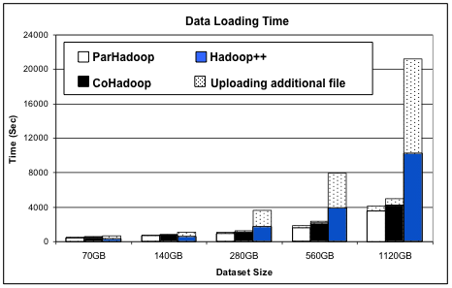
Data Preprocessing and Loading Time
CoHadoop and ParHadoop are almost the same and around 40% of Hadoop++
CoHadoop incrementally loads an additional file
Hadoop++ has to re-partition and load the entire dataset when new files arrive
Notes:
Cohadoop is slightly slower due to increased network utilization
Because parhadoop always put the 1st copy locally. While co-hadoop might puit in remote node to satisfy the locator hints.

Slide 19
Hadoop++ Comparison: Query Response Time
Hadoop++ has additional overhead processing the metadata associated with each block
Notes:
Here they test the response time of the join query as a function of dataset size, of both cohadoop and hadoop++
Cohadoop outperforms hadoop++ by 20-25%

Slide 20
Join Query: Response Time
Savings from ParHadoop and CoHadoop are around 40% and 60%, respectively
Notes:
We see parHadoop is way better Rawhadoop.
Which indictates that Data partition can significantly improve the performance.
And the performance is better when the data is also co-located as co-hadoop achieve the lowest response time.

Slide 21
Fault Tolerance
After 50% of the job time, a datanode is killed
CoHadoop retains the fault tolerance properties of Hadoop
Failures in map-reduce jobs are more expensive than in map-only jobs
Failures under larger block sizes are more expensive than under smaller block sizes
Notes:
In order to test that; After 50% of the work down, randomly kill a node and measure how this slow down processing.
Raw hadoop has the highest because it produce map-reduce job and not map only job
We see that coHadoop and Par hadoop have almost the same slow down percentage. Which indicate that colocation doesn’t effect the fault tolenance in hadoop.

Slide 22
Summary
CoHadoop is an extension to Hadoop system to enable colocating related files
CoHadoop is flexible, dynamic, light-weight, and retains the fault tolerance of Hadoop
Data colocation is orthogonal to the applications
  Joins, indexes, aggregations, column-store files, etc…
Co-partitioning related files is not sufficient, colocation further improves the performance

Slide 23
Next Paper

Slide 24
Eagle-Eyed Elephant (E3): Split-Oriented Indexing in Hadoop
Mohamed Eltabakh
Worcester Polytechnic Institute, MA, USA
Joint work with IBM Almaden, CA, USA
F. Özcan, Y. Sismanis, H. Pirahesh, P. Haas, J. Vondrak
E3 System EDBT 2013 Mohamed Eltabakh,WPI IBM Research
Notes:
The second paper we are going to present is called Eagle Eyes Elephant (E3) system . Which is basically an indexing system for hadoop.

Slide 25
Talk Outline
Background and Motivation
E3 System Features
  Indexing and Domain Segmentation
  Materialized Views
  Adaptive Caching
Performance and Evaluation
Related Work & Differences
Summary
E3 System EDBT 2013 Mohamed Eltabakh,WPI IBM Research
Notes:
Here is the outline for the slides..

Slide 26
E3 Motivation & Objectives
Typical Scenarios: Analytical query workloads on Hadoop with selection predicates
  Multiple (possibly repeated) queries over the same data set
No Smart Skipping: No indexing (or split elimination) embedded into Hadoop
  Queries scan all the data splits (relevant or not)
Little Users’ Knowledge: Workloads and data may change
  Users may not know the query workload in advance or the data schema
E3 System EDBT 2013 Mohamed Eltabakh,WPI IBM Research
Notes:
A typical scenario that E3 addresses is when you have a large dataset, and perform multiple (possibly repeated) queries over the data. And hadoop doesn’t have indexing and can’t skip irrelevant splits, which is the main objective of this system. Also, the user may not know the query workload in advance or even how the data is structured.

Slide 27
E3 Objectives
Discovery-based elimination of irrelevant splits
No dependency on physical design, No data movement or DDL
Adapt to workload and data changes
E3 System EDBT 2013 Mohamed Eltabakh,WPI IBM Research
Notes:
So the goal of E3 is to have
Discovery-based elimination of irrelevant splits
And it shouldn’t need any change on the design
And it should adapt to work load and data changes .

Slide 28
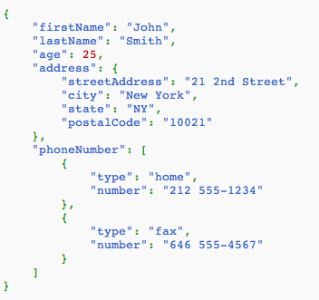
E3: Highlights
JSON-Based Data Model
  Works on all data types/sources that provide a mapping to JSON (JSON view of the data)
Split elimination at I/O layer (InputFormat) before creating map tasks
  Can be integrated into Jaql
  Can be used in hand-coded map-reduce jobs
E3 System EDBT 2013 Mohamed Eltabakh,WPI IBM Research
Notes:
One thing to mention here about E3 is that The Dataset has to be mapped into a JSON Format, and the split elimination happens at the I/O layer before creating map tasks. So it could integrated into high-level applications or native hadoop applications

Slide 29
Talk Outline
Background and Motivation
E3 System Features
  Indexing and Domain Segmentation
  Materialized Views
  Adaptive Caching
Performance and Evaluation
Related Work & Differences
Summary
E3 System EDBT 2013 Mohamed Eltabakh,WPI IBM Research
Notes:
We start talking about the first component

Slide 30
1) Split-Level Domain Segmentation
Applied for all numeric and date attributes
  One-dimensional clustering to produce multiple ranges (Reduces false-negative hits)
x
a₁
a₂
a₃
a₄
a₅
a₆
a₇
a₈
a₉
a₁₀
Query Q(x): [a₁, a₁₀] contains x
[a₁,a₂], [a₃,a₄], [a₅,a₆], [a₇,a₈], [a₉,a₁₀] do not contain x
E3 System EDBT 2013 Mohamed Eltabakh,WPI IBM Research
Notes:
The first component is creating what is called the Range index. This part applied only on numeric and date attribute.
What you see here in the graph represents multiples values of an attribute within a single split.
The purpose of this is to eliminate
One approach is to store the minimum & maximum values of a, and use them when we want to query the variable a.
But the problem is the range might be huge and sometimes there will be a gap between these values.. and so it might give false-negative hits. The proposed solution is to store multiple ranges, and make sure the cluster of ranges as tight as possible.

Slide 31
2) Coarse-Grained Inverted Index
Split-level as opposed to record-level
Inverted index implemented using bitmaps
Run-Length Encoding for effective compression
E3 System EDBT 2013 Mohamed Eltabakh,WPI IBM Research
Notes:
The second part is applied on string attributes.
It is basically an index used for equality predicates
The index is stored as bitmap of size= the number of splits in the input file
And it sets the bit if the corresponding split contains that value.

Slide 32
Inverted Index Limitations
Inverted Index is of no use for infrequent-scattered values
  Values appearing in many splits, but few times per split
Split-Level
Inverted Index
(V,{1,2,3, …, i, …, N})
v is infrequent-
scattered value
File A
{v, …}
{v, …}
{v, …}
{v, …}
{v, …}
{v, …}
{v, …}
Split 1
Split 2
Split 3
Split i
Split N
Query Q(v): Must read all splits containing value v !
E3 System EDBT 2013 Mohamed Eltabakh,WPI IBM Research
Notes:
But the problem with the index is when we have values that are appearing in many splits , then the index is not useful.
And if these values appear few times, we can handle them by moving them to a materialized view.

Slide 33
3) Materialized Views
File A
Build a materialized view A_{MV} for each file A
Copy the data records containing v to A_{MV}
|A_{MV}| << |A| (in splits)
At query time, E3 re-directs Q(v) from A to A_{MV}
{v, …}
{v, …}
{v, …}
{v, …}
{v, …}
{v, …}
{v, …}
Split 1
Split 2
Split 3
Split i
Split N
A_{MV}
{v, …}
{v, …}
M << N
{v, …}
{v, …}
{v, …}
Split 1
Split M
Query Q(v): read only M splits (M << N)
E3 System EDBT 2013 Mohamed Eltabakh,WPI IBM Research
Notes:
Which is explained here.
The basic idea.. Create a new materialized view .. Which a new file stored on HDFS.. Copy all records containing these infrequent-scatter values. The view can be useful at query time.

Slide 34
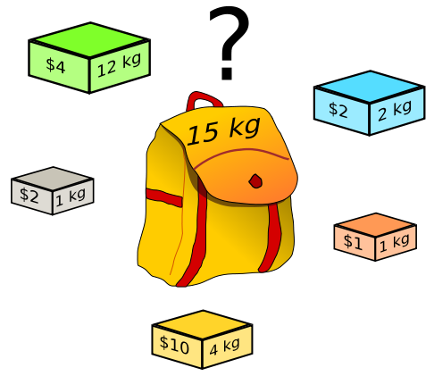
Building the Materialized View
MV is relatively very small ➔ |A_{MV}| ≈ (1%-2%) |A|
Infrequent-scattered values can be too many ➔ which v’s to select?
Modeling as optimization problem:
0-1 Knapsack problem
  Space constraint: A_{MV} can hold M splits (R records)
  Each value v has a profit and a cost
    Profit(v) = |Splits(v)| – M
    Cost(v) = |Records(v)|
Select subset of values v to:
Maximize Σ profit(v) | Σcost(v) <= R
E3 System EDBT 2013 Mohamed Eltabakh,WPI IBM Research
Notes:
The size of the materialized view is very small, and it’s around 1 or 2% of the whole file.
Choosing the infrequent-scattered values is a challenge, because there will be too many of them and at the same time we have limited space.
So in there analysis of this problem, they come up with the ides of profit and cost for each value V. And the objective to store values that have high values, but at the same time does not exceed our budget.
The profit for each value is the amount of eliminated splits if v is added
And the cost is the number of records containing v
And this problem is called the knapsack problem, and it’s very expensive to compute.

Slide 35
Building the Materialized View: More Challenges
Submodular 0-1 Knapsack problem because
  Selecting v and copying its records to A_{MV} changes the cost of all other values v’ contained in v’s records
Naïve greedy algorithm
  Very expensive to do sorting (profit/cost)
E3 avoids sorting and ignore cost(v) overlapping
  Estimates an upper bound K values needed to fill in A_{MV} (over estimate)
  Maintain the top K in max-heap (profit/cost for each v).
  One scan over all dataset ➔ Copy records containing top K values v until A_{MV} is full.
E3 System EDBT 2013 Mohamed Eltabakh,WPI IBM Research
Notes:
It’s also a sub modular case, because selecting a v will effect the cost of the other values, because there will be an overlapping across the records containing different v’s
The naïve way to do an approximation solution is to sort all values (by their profit / cost ) ratio but this is so expensive.
E3 solution is to estimate an upper bound K of needed values to be filled Amv
And do one scan over all vales to maintain the top K in max-heap
Then select from the top K in order until Amv is full.

Slide 36
Talk Outline
Background and Motivation
E3 System Features
  Indexing and Domain Segmentation
  Materialized Views
  Adaptive Caching
Performance and Evaluation
Related Work & Differences
Summary
E3 System EDBT 2013 Mohamed Eltabakh,WPI IBM Research

Slide 37
Optimizing Conjunctive Predicates
Conjunctive predicates can be together very selective
  But also harder to optimize (each predicate by itself may not be selective)
File A
{v, …}
{v, …}
{v, …}
{v, …}
{w, …}
{v, w, …}
{w, …}
{w, …}
{w, …}
{v, …}
{v, …}
Split 1
Split 2
Split 3
Split 4
Split N
Query Q(v,w) ➔ read split 3 only
Index cannot help: splits(v) ∩ splits(w) = {1, 2, 3, …, N}
Materialized Views cannot help: domain is too large to enumerate
E3 System EDBT 2013 Mohamed Eltabakh,WPI IBM Research
Notes:
The third component is the adaptive cache
It addresses the problem of conjunctive predicates
If we use only one condition, we might not be selective. But if we add another condition on the query, it becomes very selective.
The challenges are:
The index is not helpful
And we cannot do this offline with the materialized view because it’s very expensive to do for pairs of values.

Slide 38
Handling “nasty” Value-Pairs
Too expensive to identify all such value pairs (v, w)
E3’s Solution: Adaptive cache
  Only “cache” pairs that are:
    Very nasty (high savings in splits if cached)
    Referenced frequently
    Referenced recently
E3 System EDBT 2013 Mohamed Eltabakh,WPI IBM Research
Notes:
So the authors mentioned what is called the nasty value-pairs.
Essentially, these pairs are identified if they are referenced frequently and recently , and would results in high savings in splits if cached.

Slide 39
4) Adaptive Caching for “nasty” Value-Pairs
Select the value-pairs based on the observed query workload
Given (Q = P1 and P2) over values v and w
  Compute (splits(v) ∩ splits(w)) from the inverted index
  Monitor which map tasks return output records → splits(v, w)
  If |splits(v) ∩ splits(w)| >> |splits(v, w)|, then
    Add (v, w, splits(v, w)) to the cache
E3 System EDBT 2013 Mohamed Eltabakh,WPI IBM Research
Notes:
In order to decided if we want to store the pairs v, w to cache or not
We have to test a condition based on the observed work load..
So the system will decide to add them to cache if it sees that they are used in the output of map tasks a lot.
Now : the cache is limited so there has to be a replacement policy.

Slide 40
E3’s Cache Replacement Policy
LRU may perform poorly
  It does not take savings into account
SFR (Savings-Frequency-Recency) Replacement Policy
  Compute a weight for candidate (v,w):
    Savings in splits: the bigger the saving, the higher the weight
    Frequency: the more frequently queried, the higher the weight
    Recency: the more recently queried, the higher the weight
E3 System EDBT 2013 Mohamed Eltabakh,WPI IBM Research

Slide 41
E3 Computation Flow
Need two jobs to pre-process the data
Materialized view
Final output
Map-Phase
(split-level)
Map-only job
Selected subset of nasty values
Data split
Map-Phase
(split-level)
(v, SplitId,
RecordCount, …)
Reduce-Phase
(dataset-level)
Map-reduce job
Final output
Final output
Range statistics
Inverted Index
E3 System EDBT 2013 Mohamed Eltabakh,WPI IBM Research
Notes:
Here it shows the computation flow of the whole system.
Without going into much detail, one thing to mention here is the computations of mappers and reducers are share whenever is possible.. and there are options to disable any component by the user .

Slide 42
E3 Computation Flow
Building the Materialized View
1) Map-reduce job:
  Reports v and splits ID, and number of records in that split containing v;
  Calculate |splits(v)| and |records(v)| In reduce phase to execute E3 greedy algorithm > output: list of v to be stored.
2) Map-only job:
  Scans the data, copy records that contain selected v’s to A_{mv}.
Notes:
It’s also a sub modular case, because selecting a v will effect the cost of the other values, because there will be an overlapping across the records containing different v’s
The naïve way to do an approximation solution is to sort all values (by their profit / cost ) ratio but this is so expensive.
E3 solution is to estimate an upper bound K of needed values to be filled Amv
And do one scan over all vales to maintain the top K in max-heap
Then select from the top K in order until Amv is full.

Slide 43
E3 Query Evaluation
(Putting It All Together)
1) Read file A & set of predicates P
E3 Wrapper
E3 Metadata
2) Consult E3’s metadata (A, P)
4) Read A, list of splits
4) Read A_{MV}
OR
3) Return list of relevant splits
Or A_{MV}
Input Format
5) Input splits to query evaluation (map-reduce engine)
>> Ranges & inverted index in light-weight DB
>> Materialized views are in HDFS
E3 System EDBT 2013 Mohamed Eltabakh,WPI IBM Research
Notes:
And here how querying works with E3..
It consults the metadata, which is stored in a light weight database and materialized views in HDFS
It returns a list of relevant splits or a materialized view.
Then it passes them to the map-reduce engine.

Slide 44
Talk Outline
Background and Motivation
E3 System Features
  Indexing and Domain Segmentation
  Materialized Views
  Adaptive Caching
Performance and Evaluation
Related Work & Differences
Summary
E3 System EDBT 2013 Mohamed Eltabakh,WPI IBM Research
Notes:
Now we want to show some expirements

Slide 45
Experimental Setup
Datasets (800GB)
  Transaction Processing over XML (TPoX) – Orders
    4 levels of nesting, 181 distinct fields
  Transaction Processing Council (TPCH) – LineItems
    1 level (no nesting),16 distinct fields
Cluster
  41 nodes cluster: 1 master, and 40 data nodes, 8 cores
  160 Mappers and 160 Reducers
  Block size = 64MB, Replication factor = 2
Performance
  Wall clock savings at query time
  Computation cost of (1) Ranges, (2) Indexes, (3) Materialized view
  Storage overhead of (1) Ranges, (2) Indexes, (3) Materialized view
E3 System EDBT 2013 Mohamed Eltabakh,WPI IBM Research
Notes:
They have tested on two datasets generated from benchmarking datasets. TPOX and TPCH
with 800GB for both datasets.
And here are there technical settings.

Slide 46
Query Response Time Savings
Query: read(hdfs(‘input’)) → filter (P1 ^ P2) → count();
  Equality predicates
Savings depend on selectivity ➔ up to 20x with E3 optimizations
E3 System EDBT 2013 Mohamed Eltabakh,WPI IBM Research
Notes:
In this slide it shows how much time saved in query response time
Whenever we increase the selectivity.
One thing to mention here is the idea of waves, its described in full details in the paper but the basic idea is the number of waives you need to make a full scan of the data is measured by how many map tasks can run on your cluster in parallel. And in this case an 800GB of data needed a 83 waives.

Slide 47
Computation Cost (TPoX)
Costs are shared whenever possible
Requires ~12 selective queries to redeem the cost
E3 System EDBT 2013 Mohamed Eltabakh,WPI IBM Research
Notes:
Here it shows how much time you need to construct different kinds of indexing componenets.
Notice the range index needed the least time, and when want to construct multiple components it wont need as much time as if we were to do them one by one.

Slide 48
Computation Cost (TPCH)
Requires ~8 selective queries to redeem the cost
E3 System EDBT 2013 Mohamed Eltabakh,WPI IBM Research
Notes:
And here the index didn’t need as much tim because the number of attributes are less.

Slide 49
Summary & Lessons Learned
Eagle-Eyed Elephant (E3) integrates various indexing and elimination techniques to effectively eliminate splits (I/O)
Up to 20x savings can be achieved using E3 optimizations
Discovery-based, No DDL or data movement
Partitioning alone is not enough. Also indexing alone is not enough
More complex data ➔ More preprocessing cost ➔ more queries to redeem the cost
E3 System EDBT 2013 Mohamed Eltabakh,WPI IBM Research
Notes:
To sum up,
E3 integrated various indexing and elimination approaches at the I/O layer of hadoop.
Up to 20 times more savings can get from E3 optimization
its discovery based so no need to adds schema or change design of the data.

Slide 50

Thank You
E3 System EDBT 2013 Mohamed Eltabakh,WPI IBM Research

