Slide 1
A Study of Main Memory Database System - General Ideas and Applications
Kevin Heath
Zhenyu Hu

Slide 2
Agenda
Memory Hierarchy
Background of MMDBs
General idea of MMDB
- Mechanisms and details
Application demonstration
- SAP HANA

Slide 3
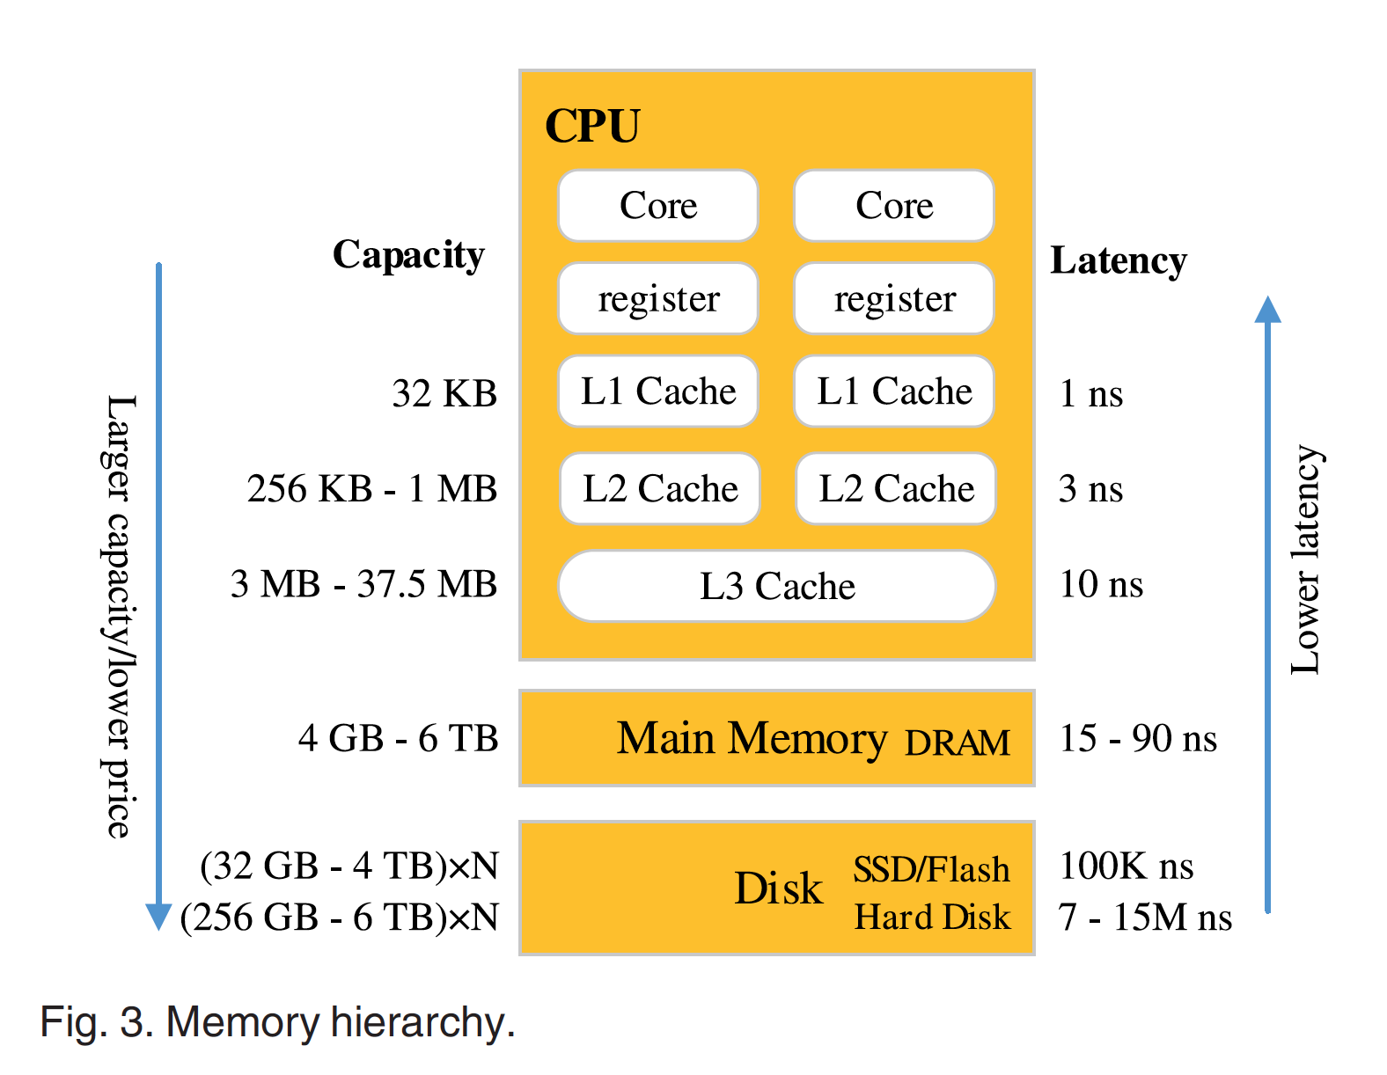
Memory Hierarchy

Slide 4
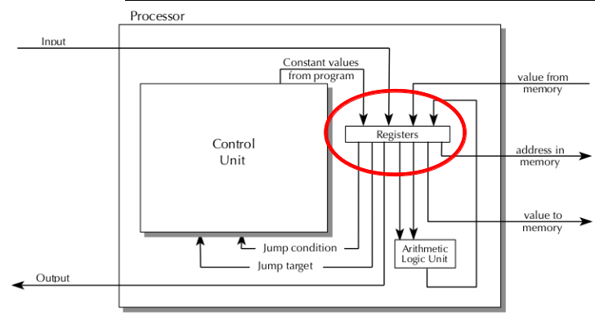
Registers
Stored on the CPU
Fastest access
Can be optimized to improve data locality
https://www.d.umn.edu/~tcolburn/cs1581/lectures/chapter11/images/11.3-regs.png

Slide 5
Caches
Three levels: L1, L2, and L3
Made of SRAM (high-speed static RAM)
Most latency comes from loading memory into a cache
Optimize with column store
Optimize with cache-sensitive indexes (T-tree)

Slide 6
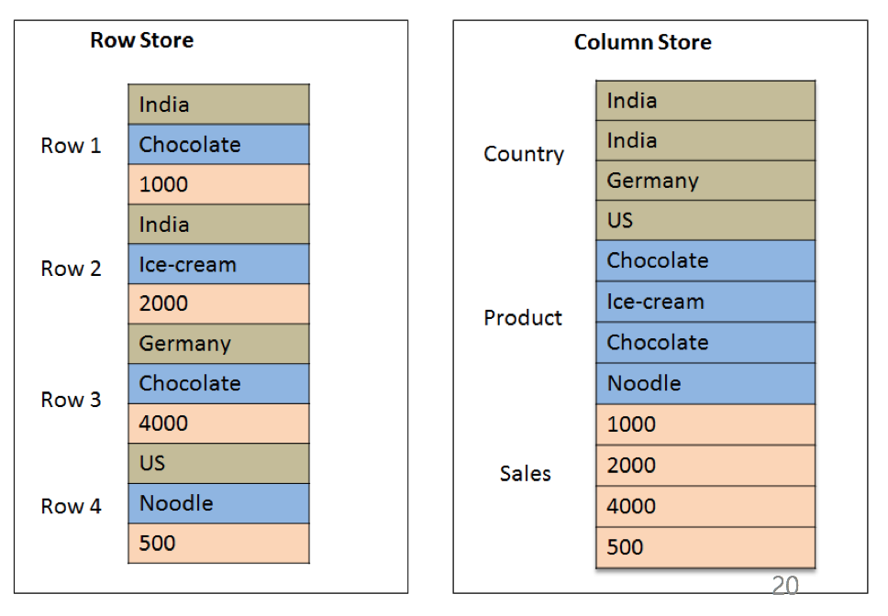
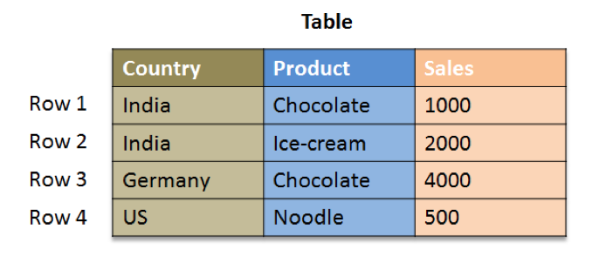
Column Store
stores data tables as columns of data rather than as rows of data

Slide 7
Benefits of Column Store
Column stores are more suitable in MMDB than row stores
Better parallelism
Better compression
Faster data access
Using parallel processing.
Especially for aggregations.

Slide 8
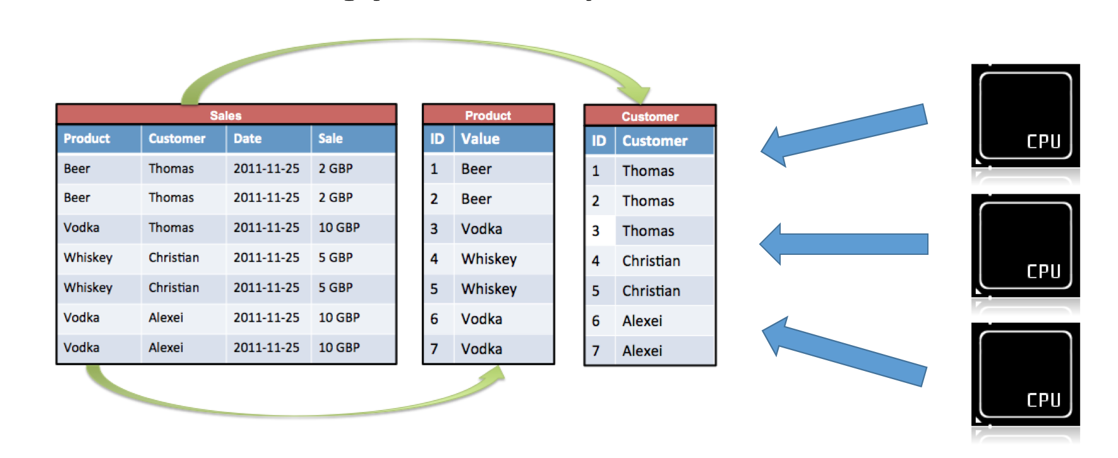
Parallelism
Highly parallelized scan operations using column stores are faster than using just ordinary indexes.

Slide 9
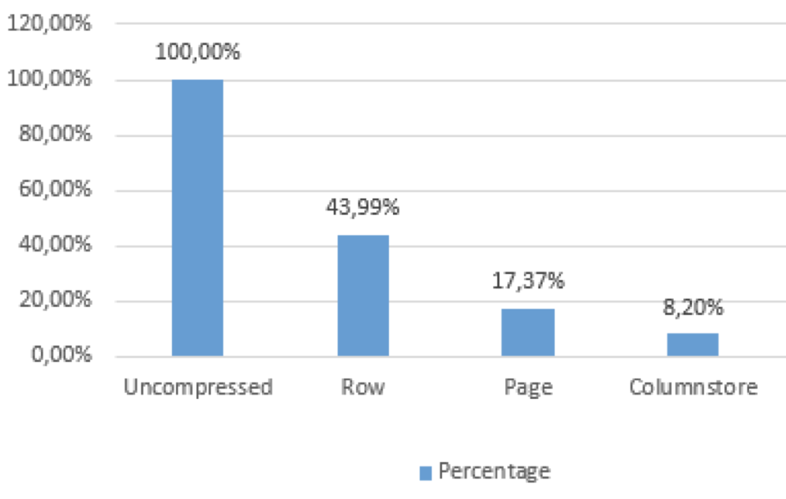
Compression
Column store allows highly efficient compression because the columns contain only few distinct values.

Slide 10
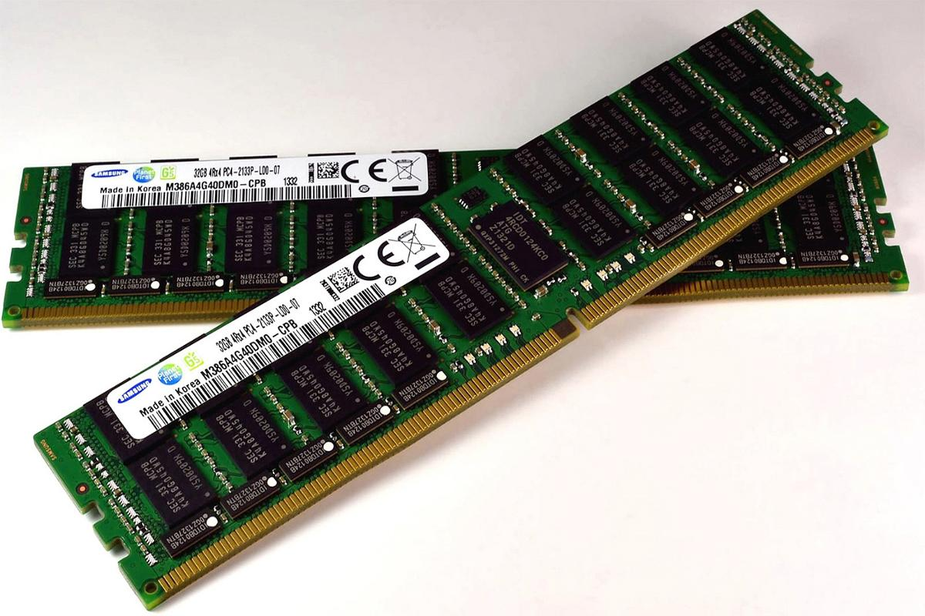
Main Memory
Much faster to access than disk memory
Loses data when turned off
Consists of DRAM or NVRAM
http://www.linuxnix.com/wp-content/uploads/2016/11/RAM-1.jpg

Slide 11
Main Memory Hardware
DRAM – Dynamic Access Ram
Most commonly used for Main Memory
Lose information without power
NVRAM – Non-Volatile Ram
Retains information without power
Limited rewrites
Large granularity of blocks

Slide 12
Key Features
All data permanently store in main memory
Pro
Better response time
Con
Unstable store media

Slide 13
Comparison of MMDB and Disk DB with large cache
MMDB
Disk DB
Large Cache
in memory
Main memory
Data
Data
Disk
Data

Slide 14
Comparison of MMDB and Disk DB with large cache
1.Disk DB does not take full advantage of memory.
Even if all data fits in memory, the structures and algorithms are designed for disk access.
B- tree is designed to access the disk data.
Algorithms
1 must compute the disk address
2 buffer manager check whether this page is in memory or not

Slide 15
Properties of Main Memory DBs
Commit processing
Recovery
Concurrency control
Index
Data Clustering and Migration
Performance

Slide 16
Commit Processing
Protect against media failures
Use log, log must reside in stable storage (Disk)
Improvements
Pre-commit
Group commit
Small amount of stable memory

Slide 17
Stable memory
Special Purpose Hardware
Battery-backed up memory
Uninterruptable power
Error detecting and correcting memory

Slide 18
An Example of Backup Battery

Slide 19
Uninterruptable Power Supply

Slide 20
Error-Correcting Memory (ECCM)
Uses an extra chip to detect and correct internal data corruption
http://en.wikipedia.org/wiki/ECC_memory

Slide 21
Recovery
Checking-point bring a copy of main memory to Disk
Store in big blocks, big blocks are efficient to write.
Improvement on Failure Recovery
Recover on demand
Use a disk array to recover in parallel.

Slide 22
Concurrency Control
Disk DB locking
Using hash table
Mechanism of MMDB locking
“2 bits locking”
Pay a little more space per records
Disk
Record
Lock table

Slide 23
Locking
Structure:
0
0
Record
Is anyone in waiting list? “1” means yes, “0” means no.
Is any one locking this record? “1” means yes, “0” means no.

Slide 24
Example of the locking mechanism
t1
Waiting List
0
0
Record
t2
t1
Waiting List
1
0
Record
t1
Waiting List
1
1
Record
t2
0
1
Record
1
0
Record
t2
Waiting List
0
0
Record

Slide 25
Index
A wide variety of index structures have been
proposed and evaluated for MMDB
Random access is much faster than disk access
Hashing (for random access) is faster
T-tree for sorted data
Save access time
Using pointer
Save some space

Slide 26
T-tree
Indexes in MMDBs are focused on reduced memory consumption and CPU cycles
In the early 90's, Lehman and Carey proposed the T-tree as an index structure for main memory database
The T-tree indexes are more efficient than B-trees in that they require less memory space and fewer CPU cycles

Slide 27
T-tree
The T-tree evolved from AVL Trees and B-Trees.

Slide 28
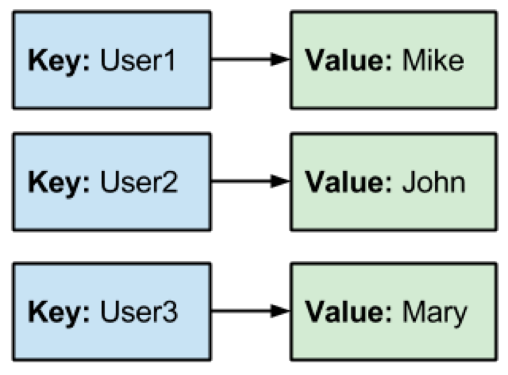
Hash index
Hash indexes are used for key-value based in-memory databases (cache servers)

Slide 29
Using Pointer
Key1
www.wikipidia.org/......./.......................
Key2
Pointer
Key3
Pointer
Random access is fast in main memory, pointer can be followed quickly. Therefore the index structure can store pointers to the indexed data, rather than the data itself.
Pointer is not suitable for Disk DB, because theoretically, using pointer will increase one I/O for each access. Since nothing can assure pointer and value will be on same block.

Slide 30
Data Clustering and Migration
Not eager to cluster objects, since random access is much faster than Disk DB
In Disk DB
Serial Access N block
Accessing time = seeking time + rotating time + N * transfer time
Radom Access N block
Accessing time= N*(seeking time + rotating time + transfer time)

Slide 31
Performance
Metric
Processing time (CPU time)
Backup and checking points algorithms is critical,
since it need to access Disk.
Metric of Disk DB
- I/O cost

Slide 32
Applications of Main-memory DB
Demand vary fast data access, storage
Applications do not have a disk
Sophisticated data manipulation
ACID properties still apply

Slide 33
SAP HANA An In-memory Database System

Slide 34
SAP HANA
An in-memory database and application platform
10 – 1000x faster than a regular database
Column and row store
Sums, indexes, materialized views and aggregates are not required
SAP HANA can scale up to 6 TB for a single system, up to 112 TB in a cluster
Used by large companies
Written in C++

Slide 35
What SAP HANA can provide?

Slide 36
Architecture of SAP HANA
Distributed HANA System:
One cluster
Multiple servers
N active servers & M standby servers
Shared-nothing approach
Shared file system: General Parallel File System(HDD:data storage, Flash: log storage)

Slide 37
ACID Properties
HANA writes savepoints to disk at frequent intervals
HANA saves a log of each database change to a flash disk
If power goes out, HANA loads the last savepoint and plays the logs back

Slide 38
Key features
Always store data in memory if there is space
If not enough space, saves data on disk and loads parts of database tables on demand
All queries have real-time access to data as a relational database system

Slide 39
Reference
Garcia-Molina, H., and K. Salem. "Main Memory Database Systems: An Overview."IEEE Transactions on Knowledge and Data Engineering 4.6 (1992): 509-16. Web.
http://itgility.com/solutions/converged-infrastructure/ci-for-business-analytics/
http://bi-insider.com/portfolio/sap-hana-platform-technical-overview/
Zhang, Hao, Gang Chen, Beng Chin Ooi, Kian-Lee Tan, and Meihui Zhang. "In-Memory Big Data Management and Processing: A Survey." IEEE Transactions on Knowledge and Data Engineering 27.7 (2015): 1920-948. Web.

