Slide 1
Simba
Team 12: Jiaoyan Chen, Xiaozhou Zou
Special Thanks to: Prof. Eltabakh

Slide 2
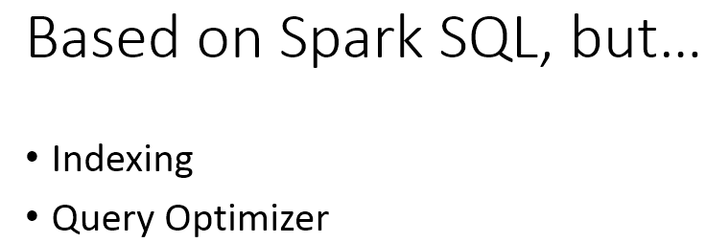
What is Simba?
An analytical system that is said to be:
Scalable
Efficient
In-memory
Customized for spatial query processing and analytics
Target: low latency and high throughput

Slide 3
Why Simba?
Disk oriented systems such as Spatial Hadoop
Problem:
Optimized for IO efficiency, so they
are not scalable to large spatial data
In-memory systems such as Spark
Problem:
1. Not customized for Spatial analytics
2. Need user defined functions to do the query
3. No underlying customized optimization
Spatial In-Memory Big data Analytics system (Simba)
Property:
1. Scalable, efficient and in-memory.
2. Customized indexing and query optimizer.

Slide 4
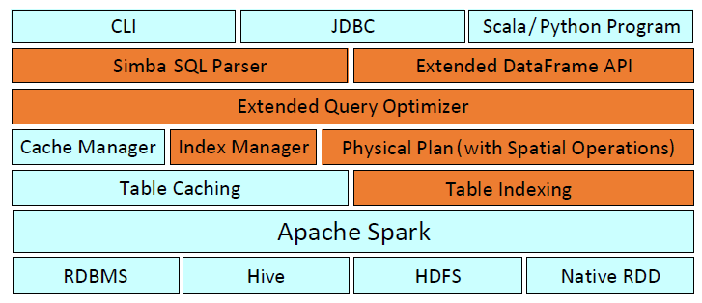
Simba Architecture
Many types of storage systems
can be connected as the input source
Idea: Integrate into SparkSQL the key optimization techniques used in Relational Database System

Slide 5
Simba Workflow
Based on existing indexes and statistics collected in Cache manager and index manager
Rule-based optimizations such as selection pulled down

Slide 6
Spatial operations

Slide 7
Programming interface support for these operations
Keywords added:
Sample queries:

Slide 8
Input Format transformation
RDD[Row]

Slide 9
Indexing Strategy
Core component in Simba
Global index helps prune irrelevant partitions
Local index helps accelerate task execution within a partition
Three phases to construct the index:
1. Partitioning
2. Constructing local index
3. Constructing global index

Slide 10
Partition
Three main concerns:
1. Partition size: Avoid memory overflow
2. Data Locality: Records that locate close to each other with respect to the indexing attributes should be assigned to the same partition
3. Load Balancing: Partitions should be roughly of the same size
The default partitioner is STRPartitioner which stands for Sort-Tile-Recursive Partitioner.

Slide 11
Local index
Pack all records within an RDD partition into an array to make random access inside that RDD partition an efficient operation with O(1) cost.
One possible solution: hash-indexing

Slide 12
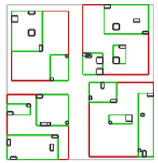
R-tree:
a popular hierarchical indexing strategy for local index
Root
R_1
R_2
R_3
R_4
G_11
G_12
G_21
G_22
G_23
……
B_111
B_112
B_113
……

Slide 13
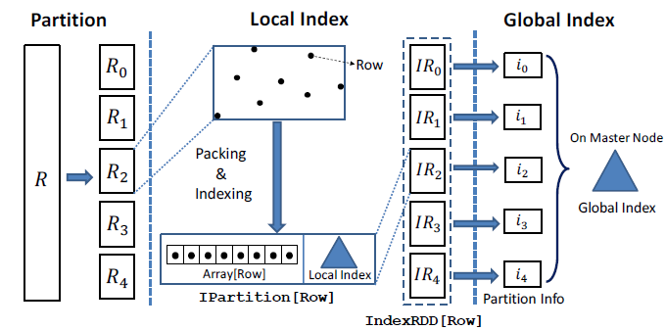
Global Index:
Partition boundaries are generated by the partitioner and other statistics collected in the local index phase are sent to the master node
Eg: In R-tree, the minimum bound rectangle for a partition is returned

Slide 14
Example operations 1: KNN Query
In SparkSQL:
Step 1: Calculate distances from all points in the table to the query point
Step 2: Take k records with minimum distances.
Cost:
Distance computation for every record
Shuffling of large intermediate results
3. A top k selection on each RDD partition

Slide 15
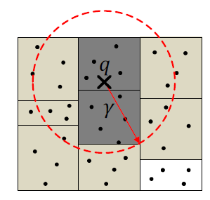
KNN query in Simba (1)
Step 1: Get a loose pruning bound using the global index
Simba finds the nearest partitions to the query point q, which are sufficient to cover at least
k data points. The distance between q and a partition Ri is defined as maxdist(q, mbr(Ri))
Assume the following MBRs are returned: {mbr(R1), . . . , mbr(Rm)}.
Then = max{maxdist(q;mbr(R1)), … , maxdist(q, Rm)} is a safe pruning bound.
All s partitions that have intersection with the circle which centers at q and has radius will be returned
to be further processed.

Slide 16
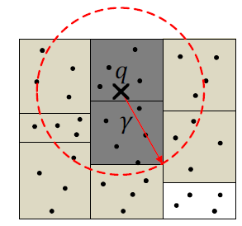
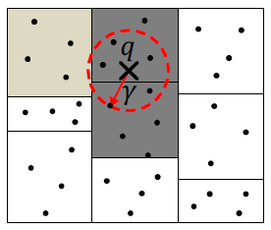
KNN query in Simba (2)
Step 2: Tighten the loose pruning bound using the global index
Simba issues a kNN query on the s partitions selected from the first step and
takes the k-th minimum distance from q to the ks candidates returned from
these partitions as new
In this process, local KNN is performed and local index is used to accelerate this process

Slide 17
Example operation 2: Distance Join
In SparkSQL:
Step 1: Perform Cartesian product of the two input tables
Step 2: Filter from the Cartesian product based on the join conditions
Cost:
O(n^2) when each table has n partitions

Slide 18
Distance Join in Simba: DJSpark
Input : {S1, . . ., Sm} are m partitions of S, {R1, . . ., Rn} are n partitions of R
Step1: Global join
For each partition Si in S, Si matches with some records in Rj only if mindist(Si, Rj)
is not greater than the threshold . So Simba produces combined partition P = {Si, Rj}
that satisfy the above condition for each pair (i, j)
Step2: Local join
Given a combined partition P = {Si, Rj} from the global join. Local index is used to
accelerate the local join.

Slide 19
kNN Join on Index
BKJSpark-N(block nested loop KNN join in Spark)
Voronoi kNN Join
z-Value kNN Join
R-Tree kNN Join

Slide 20
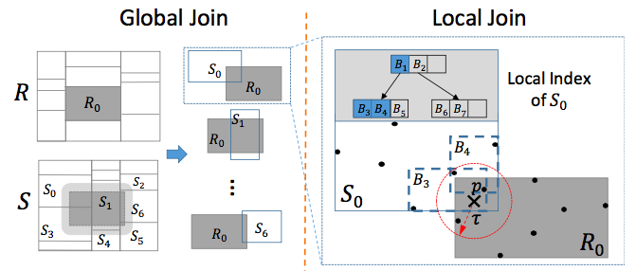
BKJSpark-N

Slide 21
BKJSpark-N cont’d

Slide 22
BKJSpark-N cont’d

Slide 23
Voronoi kNN Join
Leveraging a Voronoi diagram based partitioning strategy
The baseline methods need to check roughly n2 buckets (when O(n1) = O(n2) = O(n))
It executes only n local joins by partitioning both R and S into n partitions respectively, where the partition strategy is based on the Voronoi diagram for a set of pivot points selected from R.

Slide 24
z-Value kNN Join

Slide 25
R-Tree kNN Join

Slide 26
R-Tree kNN Join

Slide 27
R-Tree kNN Join

Slide 28
Query Optimization
Simba tunes system configuration and optimizes complex spatial queries
First, determine a proper number of partitions in different query plans

Slide 29
Query Optimization
Simba builds a cost model to estimate the partition size
(It is difficult to estimate the size of partition given tables with variable-length records)
simba uses a sampling based approach, the sampling probability of a record is proportional to its length

Slide 30
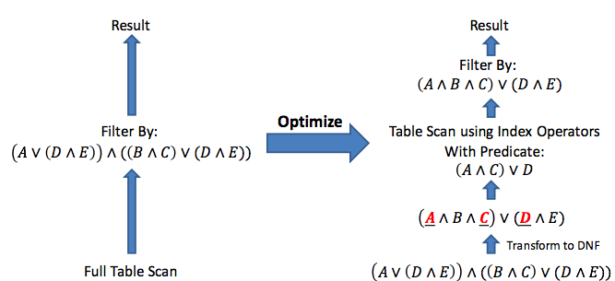
Query Optimization cont’d
Select those predicates which can be optimized by indexes

Slide 31
Query Optimization

Slide 32
Fault tolerance
Simba’s fault tolerance mechanism extends that of Spark and Spark SQL
User can also choose to persist IndexRDD and global indexes to the file system, and have the option of loading them back from the disk.

Slide 33
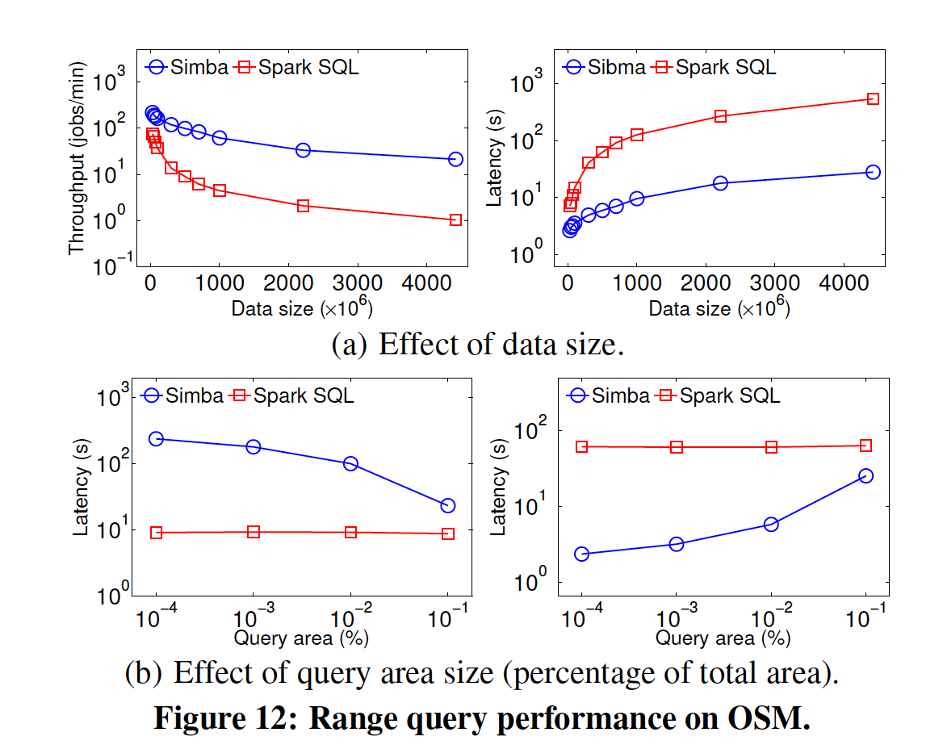
Experiment
Comparison against SparkSQL
Range queries

Slide 34
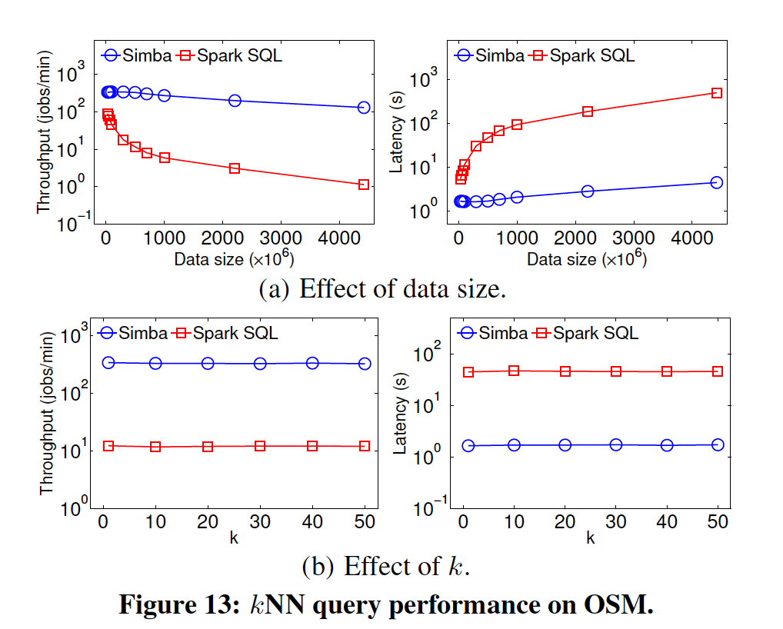
Experiment
Comparison against SparkSQL
KNN queries

Slide 35
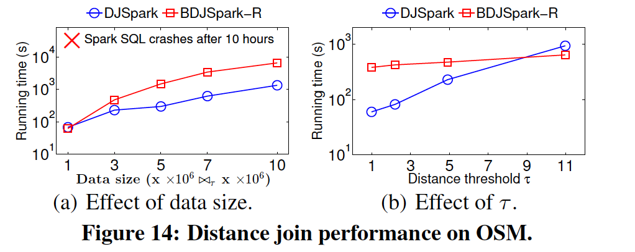
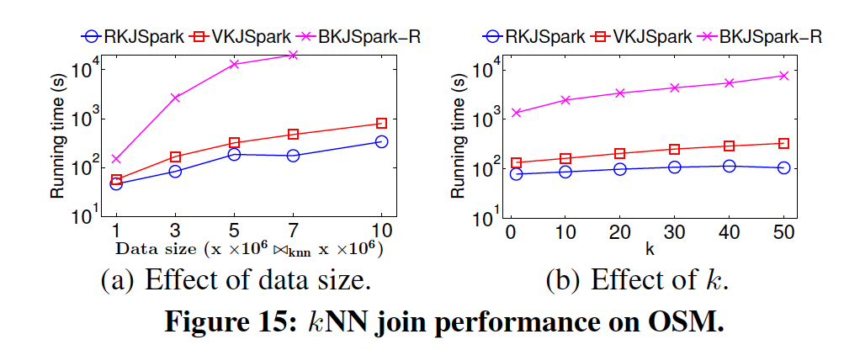
Experiment
Comparison against SparkSQL
Distance join
KNN join

Slide 36
Conclusion
Simba offers simple and expressive query language in both SQL and DataFrame API.
Simba extends Spark SQL with native support to spatial operations, introduces indexes on RDDs, and adds spatial-aware (logical and cost based) optimizations to select good query plans.

