Slide 1
ReStore: Reusing Results of MapReduce Jobs
Xinyu Dai
Aniket Kadam

Slide 2
Problem and Solution
Statistics and Analysis: Map-Reduce is used for analysis tasks. High level languages like Hive, Pig or Jaql are used
Current Practice: Delete the intermediate results
Optimization Opportunity: Keep the intermediate results and reuse them in the future workflows
Potential: it is common for enterprises to have large data sets on which many data analysis and other queries are executed
E.g. Facebook stores the result of any query in its MapReduce cluster for seven days so that it can be shared among users

Slide 3
Introduction to ReStore
Manages the storage and reuse of the intermediate results
Creates additional reuse opportunities
Extension to Pig dataflow system on top of Hadoop. But it can be easily extended over any other High level query dataflow system like Hive etc.

Slide 4
Basic Mechanism of ReStore
High level query language processors translate queries into workflows of MapReduce jobs
ReStore performs the following on these workflows of MapReduce jobs:
Rewrites the MapReduce jobs to reuse job outputs previously stored in the system
Stores the outputs of the executed jobs for future use
Creates more reuse opportunities by storing the outputs of the sub-jobs in addition to the outputs from the whole MapReduce jobs
Selects the outputs of the jobs to keep in the distributed file-system and those to delete
Submits the re-written MapReduce jobs to the MapReduce system for execution

Slide 5
Similarity with any Relational DB Concept?
Hint: a type of View?
Answer: It is analogous to the steps of building and using Materialized Views
Materialized views are disk based and are updated periodically based upon the query definition - can be set to refresh manually, on a set schedule, or based on the database detecting a change in data from one of the underlying tables
Views are virtual only and run the query definition each time they are accessed

Slide 6
Opportunity to Reuse Outputs
Query Q1: Join Only
Query Q2: Join, Group and Aggregate
A = load ’page_views’ as (user, timestamp,
est_revenue, page_info, page_links);
B = foreach A generate user, est_revenue;
alpha = load ’users’ using (name, phone,
address, city);
beta = foreach alpha generate name;
C = join beta by name, A by user;
store C into ’L2_out’;
A = load ’page_views’ as (user, timestamp,
est_revenue, page_info, page_links);
B = foreach A generate user, est_revenue;
alpha = load ’users’ using (name, phone,
address, city);
beta = foreach alpha generate name;
C = join beta by name, A by user;
D = group C by $0;
E = foreach D generate group, SUM(C.est_revenue);
store E into ’L3_out’;

Slide 7
Physical Query Execution Plan

Slide 8
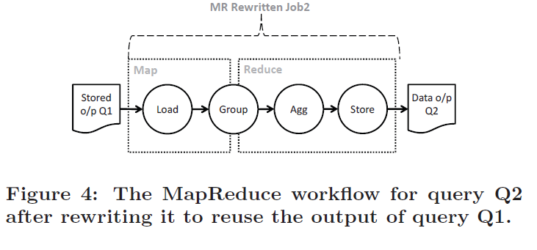
Basic Idea behind ReStore
Keeping the output of any job, J_{A}, in the distributed file system and reusing it in future workflows that have J_{A} reoccurring in them is expected to reduce the execution time of these workflows

Slide 9
Architecture
Repository of ReStore:
The physical query execution plan of the MR job produced this output
The filename in HDFS
Statistics about the MR job (input/output size, the avg. execution time of mappers/reducers) and the usage frequency

Slide 10
Architecture(Cont’d)
Main Components:
Plan Matcher and Rewriter:
search for reuse opportunities
rewrite the input job
Sub-job Enumerator:
enumerate candidate operators
Enumerated Sub-job Selector
examine based on statistics(keep/discard)

Slide 11
Plan Matcher and Rewriter
Logical plan: created for each line, only syntax and semantics checks
Physical plans: represent the query in series of MR jobs
Goal: find physical plans in the repository that can be used to rewrite the MR jobs
Why physical plans? Not logical plans?
Direct Correspondence: the stored outputs are computed by past MR jobs that are generated by the dataflow language compiler from a physical plan
Adaptive: ReStore to any dataflow system (regardless of the input language, the logical query translation, optimization techniques)

Slide 12
Plan Matcher and Rewriter(Cont’d)
Process Flow:
Scan sequentially through the physical plans in the repository
As soon as a match is found, rewrite the matched part with a Load operator
A new sequential scan through the repository
If a scan does not find any match, ReStore proceeds to matching the next MR job in the workflow
Matching and rewriting processes one MR job at a time!!

Slide 13
Plan Matcher and Rewriter(Cont’d)
Physical plan matching algorithm:
Operator equivalence:
The two operators’ input are pipelined from equivalent operators or from the same datasets
The two operates perform functions that produce the same output data
Both plans are traversed simultaneously from the Load operators until mismatching or all are matched

Slide 14
Physical Plan Matching Algorithm
For every operator in the input plan of ReStore, try to find an equivalent operator of the plan in the repository.
If not found, then the next operator.
If found, continue to match the successors of the operators
If the successors match, remove the equivalent operator from the plan in the repository
Until the plan in the repository becomes empty

Slide 15
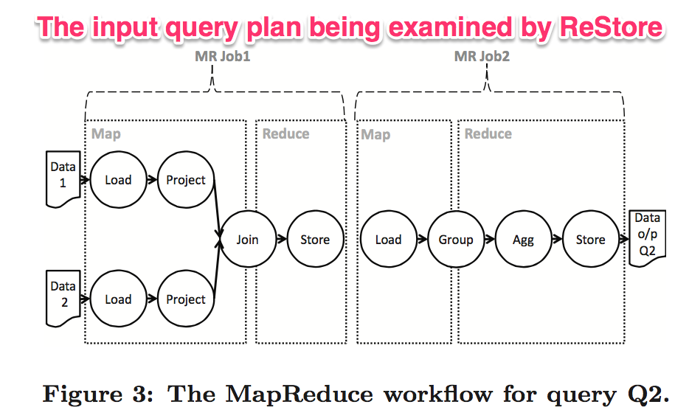
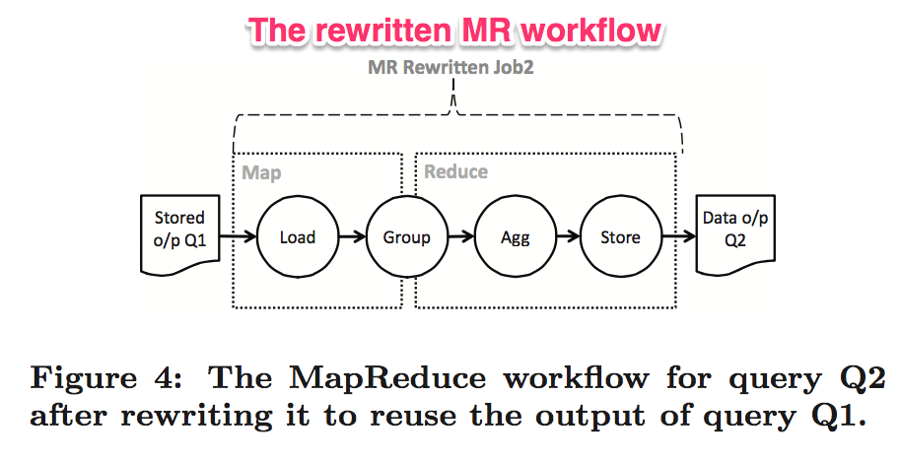

Slide 16
Plan Matcher and Rewriter(Cont’d)
What if more than one match?
ReStore would use the first match that it finds to rewrite.
Order the physical plans in the repository:
Plan A is preferred to plan B if plan A includes plan B
Order based on statistics(the ratio input/output; the execution time), the higher the better

Slide 17
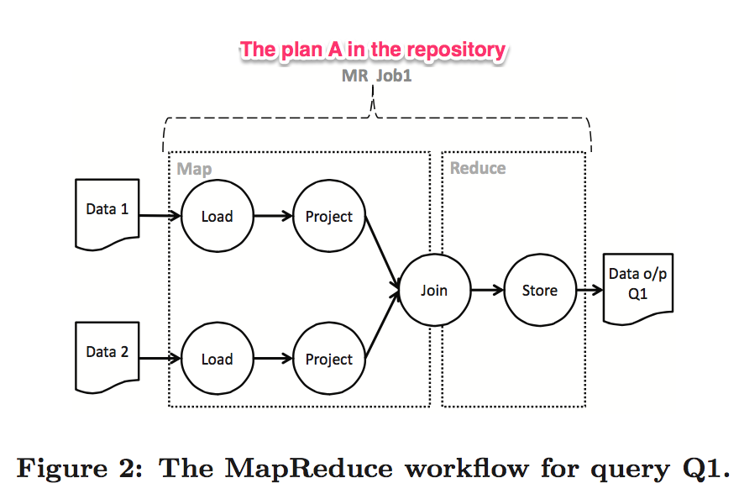
Plan A contains plan B and plan C.
Plan A is more preferred.

Slide 18
Execution Time for Each Job
T_{total} (Job_{n}) = ET(Job_{n}) + max_{i}$∈$_{Y} {T_{total}(Job_{i})}
Where,
Y: set of jobs on which Job_{n} depends
max_{i}$∈$_{Y} {T_{total}(Job_{i})}: time needed for the slowest of these jobs to finish (Max(Time for all jobs)

Slide 19
Interpretations
If all dependent jobs of Job_{n} were previously executed and are stored in the system, the total time to execute Job_{n} can now be reduced to: T_{total} (Job_{n}) = ET(Job_{n})
What if any of the dependent job’s output is not previously stored?
If the execution time of that job is less than the Max time of all the dependent jobs – then the overall execution time is reduced
If not then there may be any profit in terms of reducing the execution time but resource utilization would definitely be optimized

Slide 20
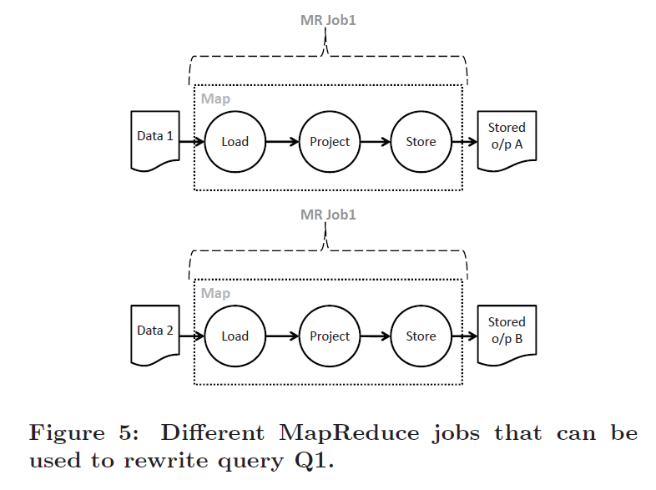
Two Types of Reuse Opportunities
Whole jobs, which reduces max_{i}$∈$_{Y} {T_{total} (Job_{i})} in future workflows
Operators in jobs (sub-jobs), which reduces ET(Job_{n}) in future workflows

Slide 21
Can we really cache everything? Would it be a good idea?
Substantial amount of storage in the distributed file system
Overhead of storing all this intermediate data would considerably slow down the execution of the input MapReduce job
All sub-jobs may not be useful for future workflows

Slide 22
Two Heuristics for Choosing Candidate Sub-jobs for Storage
Conservative Heuristic: Use the outputs of operators that are known to reduce their input size as candidate sub-jobs. These operators are Project and Filter
Aggressive Heuristic: Use the outputs of operators that are known to reduce their input size and also the outputs of operators that are known to be expensive as candidate sub-jobs. These operators are Project, Filter, Join, Group, and CoGroup

Slide 23
Selecting Sub-jobs and Storing Outputs
The physical plan of the input MapReduce job is parsed starting from its load operation
For each operation, heuristics are checked to determine if sub-job needs to be generated for the operation
The sub-job generation step is performed for every MapReduce job in the input workflow
After this, ReStore submits the workflow of jobs to the MapReduce system for execution
All the outputs, from MapReduce jobs and injected store operators, are stored in distributed file system

Slide 24
Store Operator
If the selected / generated sub-job has a store as its last command its output would already be on distributed file system
However, to inject a store operator, an operator similar UNIX tee command is used
For e.g. Split operator in Pig
One branch of the output of the Split operator is pipelined into successor operators in the MapReduce job, and the other branch is pipelined into the new Store operator

Slide 25
Split Example

Slide 26
Managing Repository
Properties required to store job output in repository:
Job, when reused, should reduce the execution times
There are indeed future workflows / jobs that can reuse the output of this job

Slide 27
Rules based on Required Properties
The first 2 rules satisfy the first required property:
The size of the output data is the job is smaller than the size of its input data. This reduces the T_{load}, i.e. the time required to load the input data, and thus reduces the total execution time, ET(Job)
There should be reduction in execution time on reusing the job. This depends on the max_{i}$∈Y$(T_{total}(job_{i})), i.e. the maximum execution time considering all the dependent job. i.e. the job’s output is selected to be stored in the repository only if its execution time less than the max time

Slide 28
Rules contd..
Rules 3 and 4 are satisfy the second required property: Reusability of the job:
Evict a job from the repository if it has not been reused within a window of time
Evict a job from the repository if one or more of its inputs have been deleted of modified

Slide 29
Storing and Selecting from Repository
While matching and rewriting, ReStore uses the first matching plan from the repository
Physical plans are stored in the repository using the following rules:
Plan A is preferred to plan B if plan A subsumes plan B
If neither plan A subsumes plan B, then the ordering is based on following metrics:
The ratio of the size of the input data and the output data
The execution time of the MapReduce job [may be given more weightage as group etc. has better potential of reuse]
These metrics are collected during job execution after plan rewriting and sub-job generation

Slide 30
ReStore Implementation
Implement ReStore as an extension to the JobControlCompiler of Pig
Pig:
A parser syntactically checks and transforms the input query to a logical plan
A logical optimizer applies optimization
A MR compiler transforms the logical plan into a physical plan and then into a series of MR jobs
A MR optimizer applies optimization
A Hadoop job manager(JobControlCompiler) submits the jobs to Hadoop for execution

Slide 31
ReStore Implementation(Cont’d)
JobControlCompiler: iterates through the workflow and intermediate outputs are deleted by default
ReStore:
jobs selected and rewrite
Matching with plans in the repository
Generate candidate sub-jobs
statistics stored in the repository(execution, physical plans)

Slide 32
Experiments
The evaluated workflow:
Unmodified workflows as generated by Pig
Workflows after injecting extra Store operators by ReStore
Workflows after being rewritten by ReStore to reuse job outputs
Performance metric:
speedup: T(original query)/T(rewritten query)
overhead: T(query injecting extra Store operators)/T(original query)

Slide 33
Experiments—Reuse the output of Whole Jobs
Average speedup=9.8
No overhead
Highly beneficial

Slide 34
Experiments—Reuse the output of Sub-Jobs
Average speedup=24.4
Average overhead=1.6
Overhead for L6:
Store after group
Nature of Aggressive Heuristic: high speedup and high overhead

Slide 35
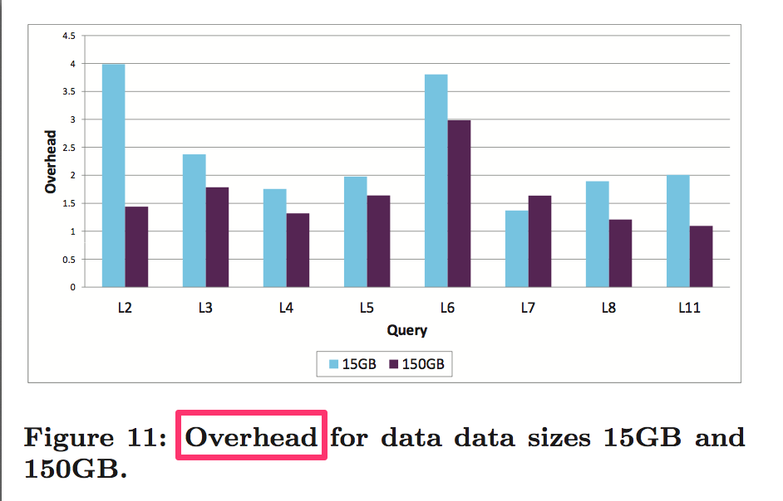
Experiments—ReStore among diff. size of datasets

Slide 36
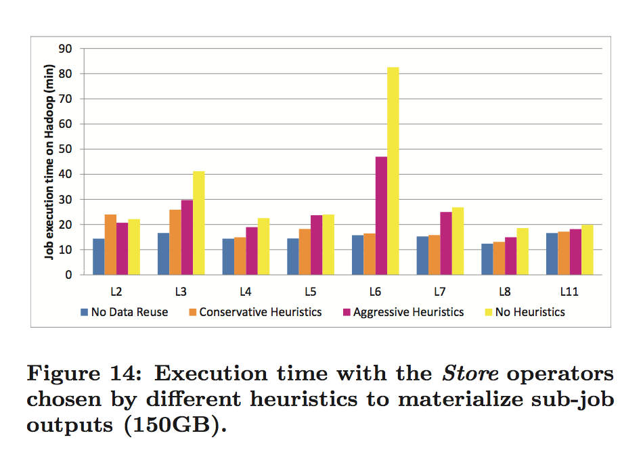
Experiment-Comparing the heuristics
Extra overhead and storage requirements results in more reuse opportunities ?
NH better performance?
NH: no heuristics, inject a Store operator each physical operator
Storage: NH>>HA$≈$HC
Overhead: NH>>HA$≈$HC

Slide 37
Experiment—Comparing the heuristics
HA provides more reuse opportunities than Hc
HA has similar performance as NH
HA is better overall
( trade-off between overhead and speedup)

Slide 38
Conclusion
ReStore reusing intermediate outputs of MapReduce jobs in a workflow to speed up future workflows are beneficial.
Maximum benefit is obtained when reusing whole jobs or sub-jobs chosen by Aggressive Heuristics.

Slide 39
Portability
Sub-job enumeration and Enumerated sub-job selection are based on physical plans
This makes ReStore portable across different dataflow systems: only requires making ReStore aware of the specific physical operators of the system and all algorithms would work with the new physical operators with little or no change.

Slide 40
Comparison with HaLoop
HaLoop | ReStore
Map Input Cache | Storage of entire MR job’s output to minimize the input load
Reducer Output/Input Cache: Used to preserve output for next iterations | Storage of the sub-job’s output to reduce the overall job execution time
Both store the outputs / data on distributed file system
Optimization for 1 iterative job only based on configuration | Optimization for overall execution of all the jobs

Slide 41
Questions?
Thank You

