Slide 1
MapReduce Online
Zhiyan LIU Jiaqi LIU

Slide 2
Introduction
Hadoop
The entire output of each map and reduce task is materialized to a local file before it can be consumed by the next stage
Advantage: allows for a simple and elegant checkpoint/restart fault tolerance ( If any task fails, JobTracker simply schedule a new task.)
Preserve fault tolerance
Disadvantage: high probability of slowdowns or failures at worker nodes
Faster: reduce completion times

Slide 3
Objective
Pipleline intermediate data between operators
Keep fault tolerance
Notes:
First the author uses pipeline to transfer internmdeiate data between operators. For example, before, Hadoop need write key-value pairs into an output file, and reducers cannot gat the file until the mapper is complete. But now reducer can get the record one by one instead of the entire file, as each record is produced. This is the main idea of this paper.

Slide 4
Objective
Pipleline intermediate data between operators
On-line aggregation: Estimate final result during execution
Continuous queries: continuously, accept and analyze new data
Keep fault tolerance

Slide 5
Guideline
Hadoop
Hadoop installation
Map & Reduce
Pipelined MapReduce ( Faster )
Online Aggregation( Extension & Application)
Continuous Queries ( Application )
Performance Evaluation

Slide 6
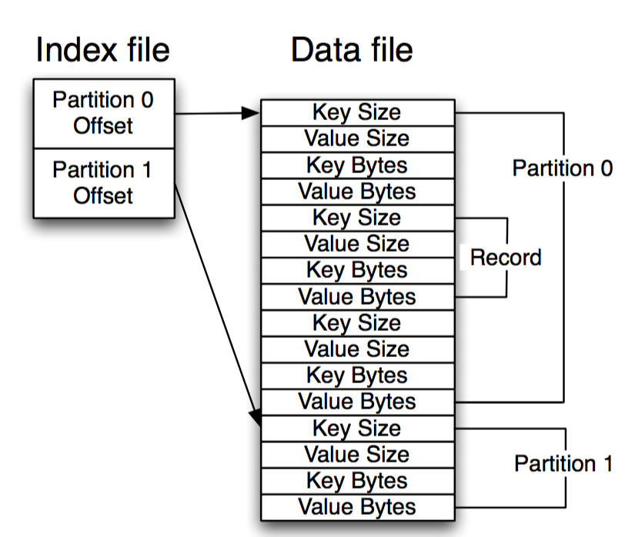
Hadoop Architecture
OutputCollector
Notes:
Spill files
Register these final files with task tracker.

Slide 7
Hadoop Architecture
Notes:
After receiving its partition from all map outputs, the reduce task enters the sort phase
The output of the reduce function is written to a temporary location on HDFS

Slide 8
Hadoop
In this design, the output of both map and reduce tasks is written to disk before it can be consumed.
Pipelining

Slide 9
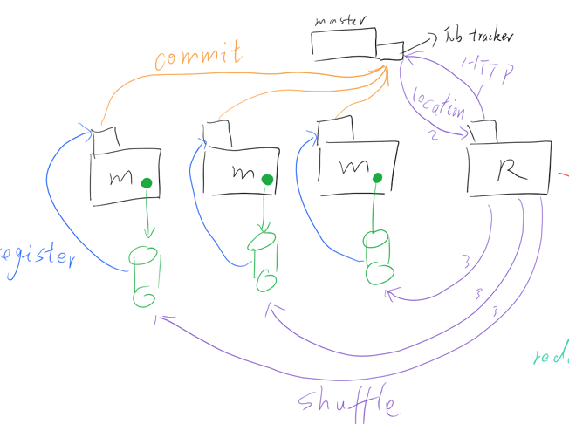
Pipelining
Key point: map task push data to reducers as it is produced
Pull

Slide 10
Pipelining
Key point: map task can push data to reducers as it is produced
each reduce task contacts every map task upon initiation of the job, and opens a TCP socket which will be used to pipeline the output of the map function.

Slide 11
Refinement
Not enough slots?
If a reduce task has not yet been scheduled, any map tasks that produce records for that partition simply write them to disk.
Once the reduce task is assigned a slot, it can then pull the records from the map task, as in regular Hadoop

Slide 12
Refinement
Too many TCP connection?
each reducer can be configured to pipeline data from a bounded number of mappers at once
the reducer will pull data from the remaining map tasks in the traditional Hadoop manner

Slide 13
Refinement
Server map function or socket?
the map function was invoked by the same thread that writes output records to the pipeline sockets (blocked by network………😥map function)
running the map function in a separate thread that stores its output in an in-memory buffer
another thread periodically send the contents of the buffer to the connected reducers
Benefit: it frees a TaskTracker slot to be used for other purposes

Slide 14
Granularity of Map Output
Pipelining each record as soon as it is produced
Reduce network traffic
Instead of sending the buffer contents to reducers directly, we wait for the buffer to grow to a threshold size.
The mapper then applies the combiner function, sorts the output by partition and reduce key, and writes the buffer to disk using the spill file format

Slide 15
Combiner
If the reducers are able to keep up with the production of combiner outputs and the network is not a bottleneck, a spill file will be sent to a reducer soon after it has been produced
If not, the mapper will accumulate multiple spill files
Once the queue of unsent spill files falls below a threshold, the map task merges and combines the accumulated spill files into a single file, and then re- sumes registering its output with the TaskTracker.

Slide 16
Fault Tolerance for map
To recover from map task failures, we added bookkeeping to the reduce task to record which map task produced each pipelined spill file.
reducer treats the output of a pipelined map task as “tentative” until map task has committed successfully
The reducer can only merge together spill files generated by the same uncommitted mapper
If a map task fails, each reduce task can ignore any tentative spill files produced by the failed map attempt.

Slide 17
Merge more split files
“The reducer can only merge together spill files generated by the same uncommitted mapper”
Checkpoint
As a map task runs, it will periodically notify the JobTracker that it has reached offset x in its input split
The JobTracker will notify any connected reducers; map task output that was produced before offset x can then be merged by reducers with other map task output as normal.
Recovery: resumes reading its input at offset x

Slide 18
Fault Tolerance for reduce
If a reduce task fails and a new copy of the task is started, the new reduce instance must be sent all the input data that was sent to the failed reduce attempt.
Map tasks retain their output data on the local disk for the complete job duration

Slide 19
Task Scheduling
pipelining between jobs
we modified the Hadoop job submission interface to accept a list of jobs, where each job in the list depends on the job before it.
The JobTracker looks for this annotation and coschedules jobs with their dependencies.
Notes:
reduce tasks of one job can optionally pipeline their output directly to the map tasks of the next job,

Slide 20
Take away
TCP socket connect map and reduce
Keep output of map in buffer to apply combiner
Fault tolerance
Map fail:
Tentative, reduce ignore what have received;
Using checkpint to merge more split files
Reduce fail: need be sent all previous data from maps
Based on the dependency, schedule mulitple tasks

Slide 21
Three potential benefits:
Online Aggregation:
initial estimates of results
Continuous Queries:
event monitoring and stream processing
Increase Opportunities for Parallelism:
evaluation part

Slide 22
Guideline
Hadoop
Hadoop installation
Map & Reduce
Pipelined MapReduce
Online Aggregation
Continuous Queries
Performance Evaluation

Slide 23
Online Aggregation
What is online aggregation?
Traditional MapReduce: batch mode
Online Aggregation: interactive data analysis

Slide 24
Online Aggregation
Single-Job Online Aggregation
Snapshot
Multi-Job Online Aggregation
Fault Tolerance

Slide 25
Online Aggregation
Single-Job Online Aggregation
the reduce function cannot be invoked until the entire output of every map task has been produced
applying the reduce function to the data that a reduce task has received so far. We call the output of such an intermediate reduce operation a snapshot

Slide 26
Online Aggregation
Snapshot
Report job progress
Snapshots computed periodically. Eg: when 50%, and 75% of the input has been seen
Each snapshot is stored in a direction of HDFS. Atomical name includes progress value.
if there are not enough free slots, snapshots will not be available for reduce tasks that are still waiting to be executed. In the current prototype, we manually configured the cluster to avoid this scenario

Slide 27
Online Aggregation
Job Progress
Hadoop provides support for monitoring the progress of task executions. As each map task executes, it is assigned a progress score in the range [0,1]. We reuse this feature
To compute the progress score for a snapshot, we take the average of the progress scores associated with each spill file used to produce the snapshot.
A map task may have not been pipelined output to reducer (not scheduled or most k map concurrently). Scale the progress metric. Eg: connect 1/n total map, then divided by n

Slide 28
Online Aggregation
Multi-Job Online Aggregation
Suppose that j1 and j2 are two MapReduce jobs, and j2 consumes the output of j1. When j1’s reducers compute a snapshot to perform online aggregation, that snapshot is written to HDFS, and also sent directly to the map tasks of j2. The map and reduce steps for j2 are then computed as normal, to produce a snapshot of j2’s output.
Fault Tolerance

Slide 29
Online Aggregation
Fault tolerance
j1 fails. Recover traditionally.
j2 fails. Simply restarts the failed task. To handle failures in j1, tasks in j2 cache the most recent snapshot received by j1, and replace it when they receive a new snapshot with a higher progress metric
both jobs fail, a new task in j2 recovers the most recent snapshot from j1 that was stored in HDFS and then wait for snapshots with a higher progress score

Slide 30
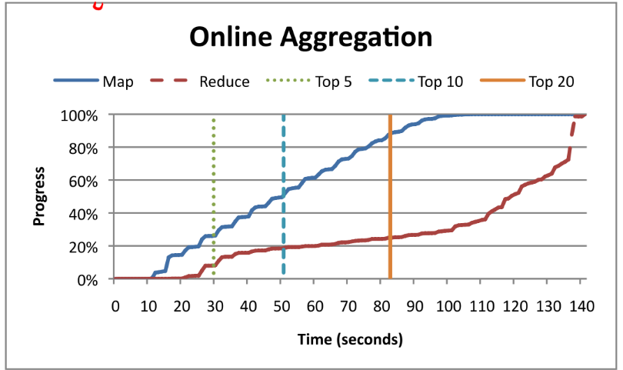
Online Aggregation
Top-k example

Slide 31
Guideline
Hadoop
Hadoop installation
Map & Reduce
Pipelined MapReduce
Online Aggregation
Continuous Queries
Performance Evaluation

Slide 32
Continuous Queries
MapReduce is often used to analyze streams of constantly-arriving data, such as URL access logs and system console logs. Because of traditional constraints on MapReduce, this is done in large batches that can only provide periodic views of activity.
pipelined version of Hadoop allows an alternative architecture: MapReduce jobs that run continuously, accepting new data as it becomes available and analyzing it immediately.

Slide 33
Continuous Queries
Continuous MapReduce Job
map output is already delivered to the appropriate reduce task shortly after it is generated. Added an optional “flush” API that allows map functions to force their current output to reduce tasks
When a reduce task is unable to accept such data, the mapper framework stores it locally and sends it at a later time.
To support continuous reduce tasks, the user-defined reduce function must be periodically invoked on the map output available at that reducer.

Slide 34
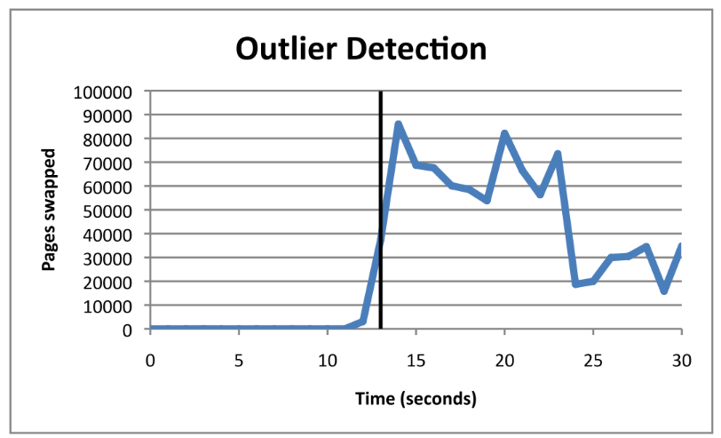
Continuous Queries
The output of the reduce function can be written to HDFS. Or prototype system monitoring application, sends alert via email.
In current implementation, the number of map and reduce tasks is fixed

Slide 35
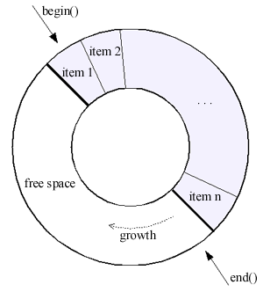
Continuous Queries
Fault Tolerance
extending the JobTracker interface to capture a rolling notion of reducer consumption. Map-side spill files are maintained in a ring buffer with unique IDs for spill files over time.
When a reducer commits an output to HDFS, it informs JobTask. Tells mappers garbage collect

Slide 36
Guideline
Hadoop
Hadoop installation
Map & Reduce
Pipelined MapReduce
Online Aggregation
Continuous Queries
Performance Evaluation

Slide 37
Performance Evaluation
demonstrate that pipelining can reduce job completion times in some configurations
By pushing work from map tasks to reduce tasks more aggressively, pipelining can enable better overlapping of map and reduce computation
When pipelining is enabled, the sort phase is avoided since map tasks have already sent some fraction of the spill files to concurrently running reduce tasks. Therefore, pipelining increases the merging workload placed on the reducer

Slide 38
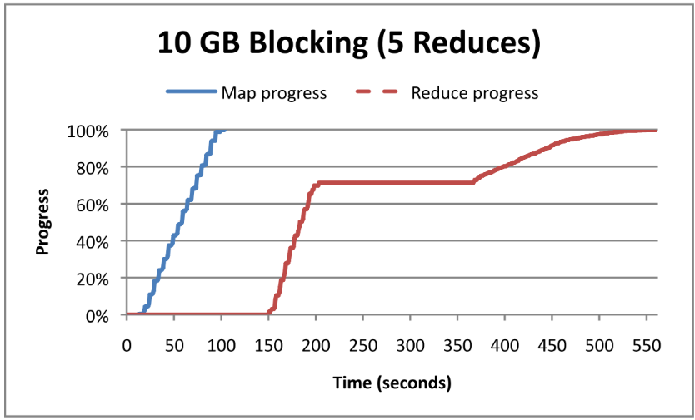
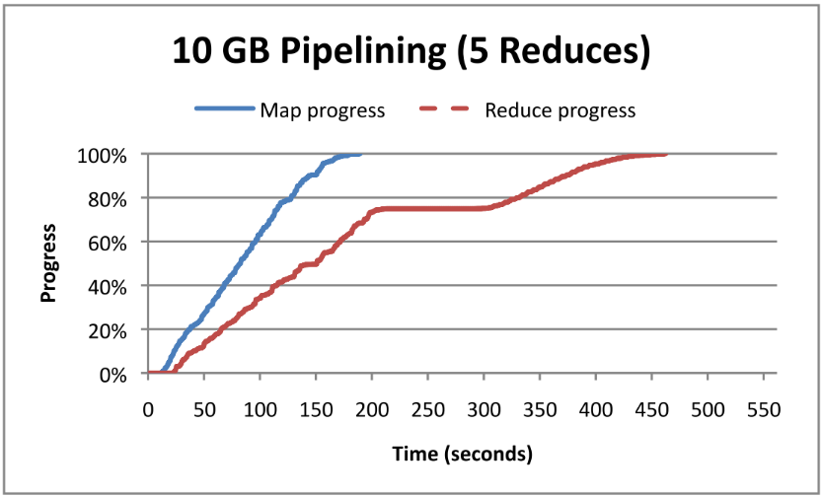
Performance Evaluation
Small Job Results
A plateau can be seen at 75% progress for both blocking and pipelining, caused by the time taken to perform a final merge of all map output before entering the reduce phase
the plateau for the pipelining case is shorter. With pipelining, reduce tasks receive map outputs earlier and can begin sorting earlier

Slide 39
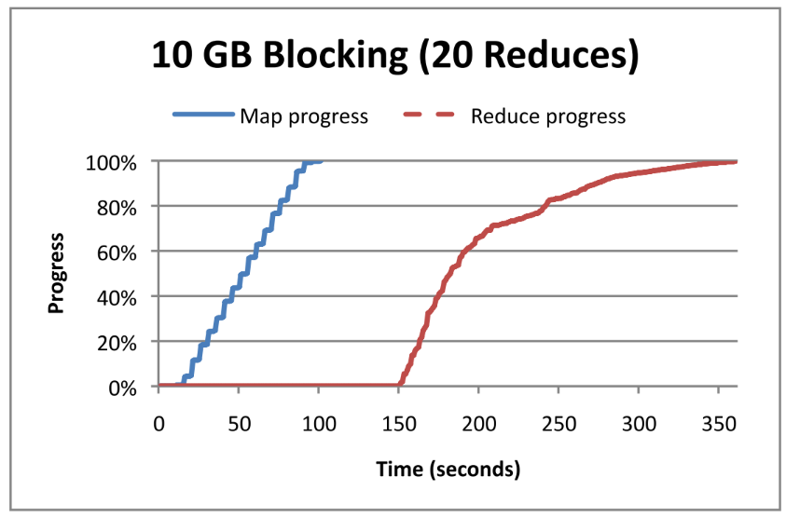
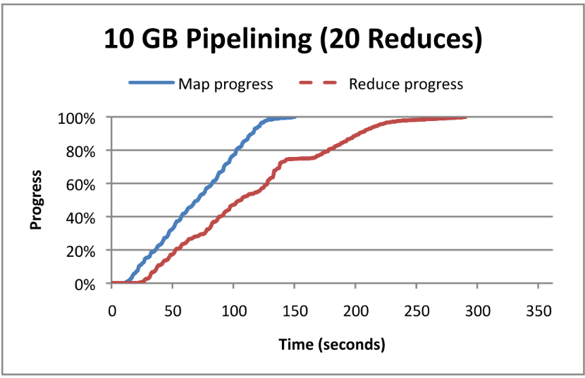
Performance Evaluation
Small Job Results
Using more reduce tasks decreases the amount of merging that any one reduce task must perform, which reduces the duration of the plateau at 75% progress. In the blocking case, the plateau is practically gone.
map phase finishes faster with blocking than with pipelining. Because pipelining allows reduce tasks to begin executing more quickly hence, the reduce tasks compete for resources with the map tasks

Slide 40
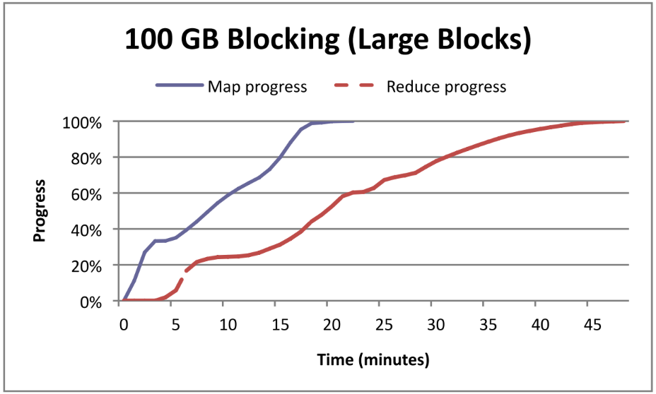
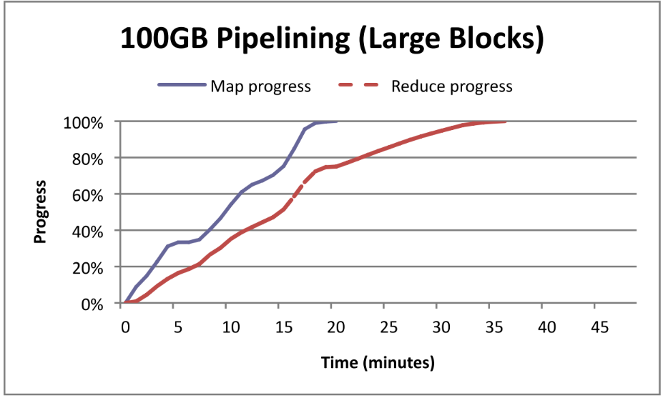
Performance Evaluation
Large Job Results
100GB word-count job with 512MB blocks, which resulted in 240 map tasks, scheduled in three waves of 80 tasks each. The 60 reduce tasks were coscheduled with the first wave of map tasks
the blocking case, the reduce tasks began working as soon as they received the output of the first wave. Pipelining was able to achieve significantly better cluster utilization, and hence reduced job completion time by ~25%

Slide 41
Conclusion
Pipeline
Three Benefits
Online Aggregation
Continuous Queries
Parallelism
Fault Tolerance Is a Big Issue

