Slide 1
Advanced Analytics
on Hadoop
WPI, Mohamed Eltabakh

Slide 2



Data Analytics
Include machine learning and data mining tools
  Analyze/mine/summarize large datasets
  Extract knowledge from past data
  Predict trends in future data

Slide 3
Data Mining & Machine Learning
Subset of Artificial Intelligence (AI)
Lots of related fields and applications
  Information Retrieval
  Stats
  Biology
  Linear algebra
  Marketing and Sales

Slide 4
Tools & Algorithms
Collaborative Filtering
Clustering Techniques
Classification Algorithms
Association Rules
Frequent Pattern Mining
Statistical libraries (Regression, SVM, …)
Others…

Slide 5
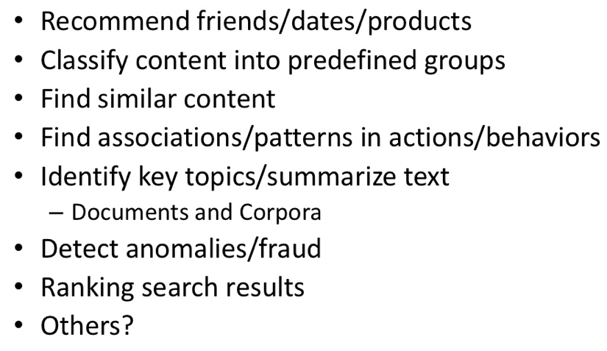
Common Use Cases

Slide 6


In Our Context…
--Efficient in analyzing/mining data
--Do not scale
--Efficient in managing big data
--Does not analyze or mine the data
How to integrate these two worlds together

Slide 7
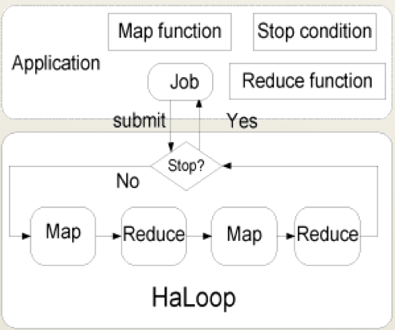
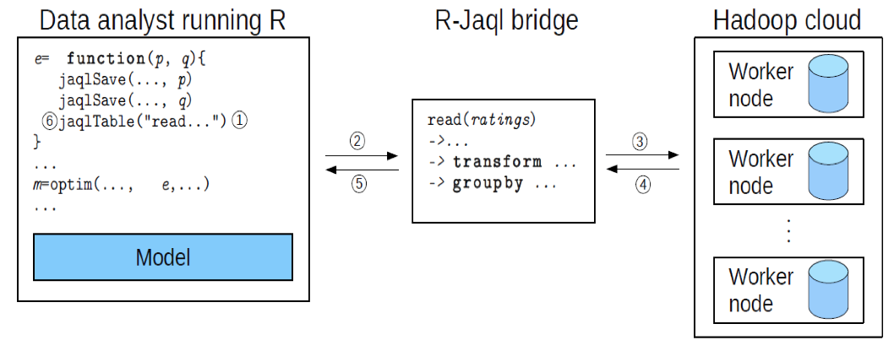
On Going Research Effort
  Ricardo (VLDB’10): Integrating Hadoop and R using Jaql
  Haloop (SIGMOD’10): Supporting iterative processing in Hadoop

Slide 8


Other Projects
Apache Mahout
  Open-source package on Hadoop for data mining and machine learning
Revolution R (R-Hadoop)
  Extensions to R package to run on Hadoop

Slide 9

Apache Mahout

Slide 10

Apache Mahout
Apache Software Foundation project
Create scalable machine learning libraries
Why Mahout? Many Open Source ML libraries either:
  Lack Community
  Lack Documentation and Examples
  Lack Scalability
  Or are research-oriented

Slide 11
Goal 1: Machine Learning

Slide 12
Goal 2: Scalability
Be as fast and efficient as the possible given the intrinsic design of the algorithm
Most Mahout implementations are Map Reduce enabled
Work in Progress

Slide 13
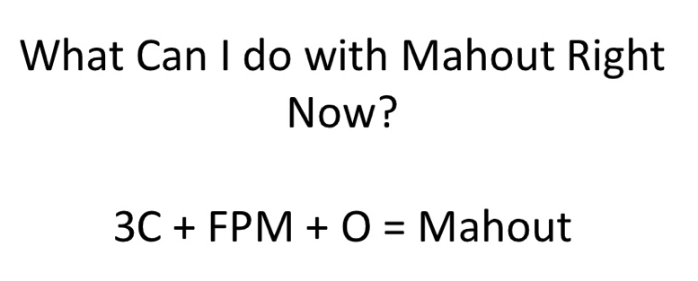
Mahout Package

Slide 14
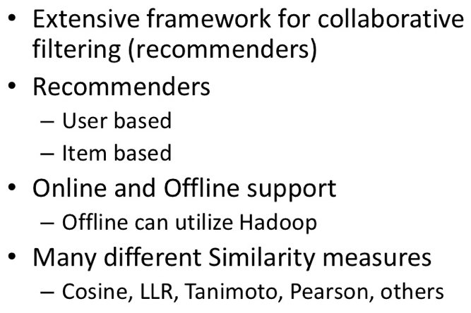
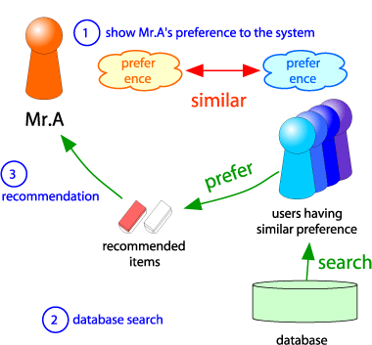
C1: Collaborative Filtering

Slide 15
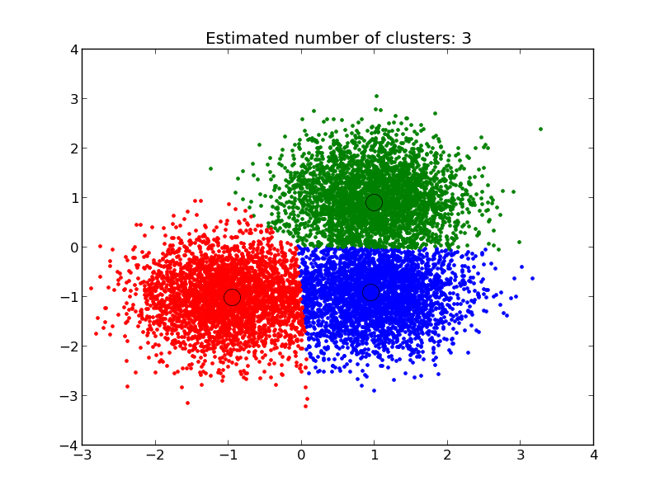
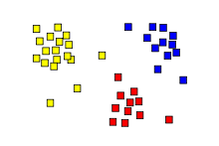
C2: Clustering
Group similar objects together
K-Means, Fuzzy K-Means, Density-Based,…
Different distance measures
  Manhattan, Euclidean, …

Slide 16
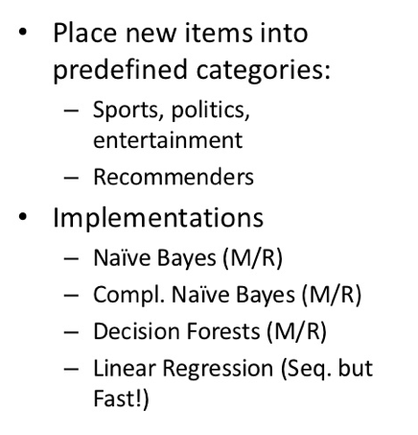
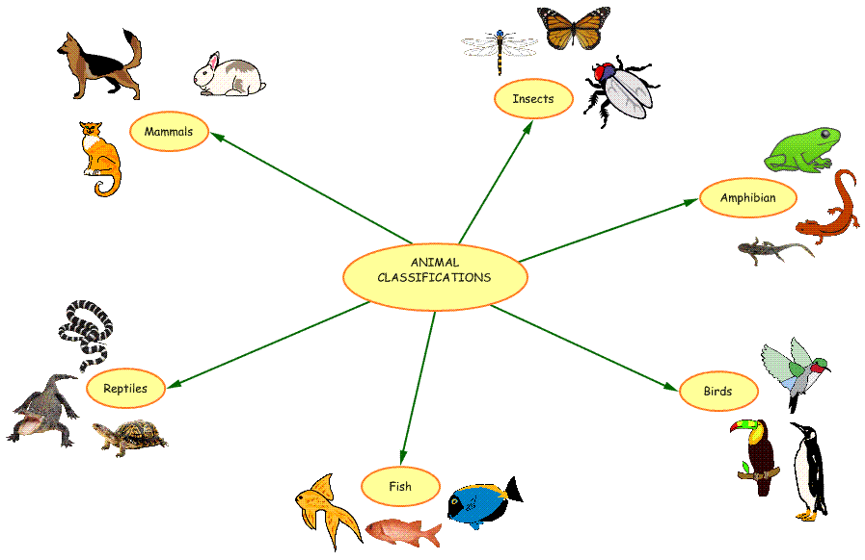
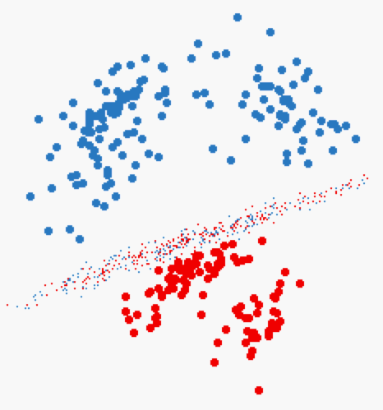
C3: Classification

Slide 17
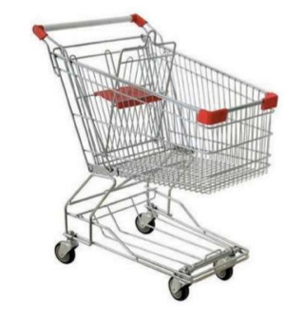
FPM: Frequent Pattern Mining
Find the frequent itemsets
  <milk, bread, cheese> are sold frequently together
Very common in market analysis, access pattern analysis, etc…

Slide 18
O: Others
Outlier detection
Math libirary
  Vectors, matrices, etc.
Noise reduction

Slide 19
We Focus On…
Clustering ➔ K-Means
Classification ➔ Naïve Bayes
Frequent Pattern Mining ➔ Apriori
-- Technique logic
-- How to implement in Hadoop

Slide 20
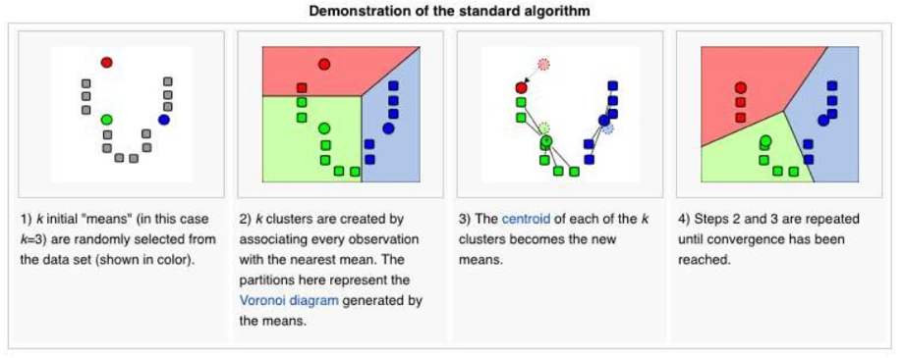
K-Means Algorithm
Iterative algorithm until converges

Slide 21
K-Means Algorithm
Step 1: Select K points at random (Centers)
Step 2: For each data point, assign it to the closest center
  Now we formed K clusters
Step 3: For each cluster, re-compute the centers
  E.g., in the case of 2D points ➔
    X: average over all x-axis points in the cluster
    Y: average over all y-axis points in the cluster
Step 4: If the new centers are different from the old centers (previous iteration) ➔ Go to Step 2

Slide 22
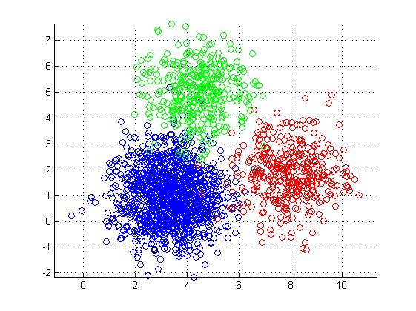
K-Means in MapReduce
Input
  Dataset (set of points in 2D) --Large
  Initial centroids (K points) --Small
Map Side
  Each map reads the K-centroids + one block from dataset
  Assign each point to the closest centroid
  Output <centroid, point>

Slide 23
K-Means in MapReduce (Cont’d)
Reduce Side
  Gets all points for a given centroid
  Re-compute a new centroid for this cluster
  Output: <new centroid>
Iteration Control
  Compare the old and new set of K-centroids
    If similar ➔ Stop
    Else
      If max iterations has reached ➔ Stop
      Else ➔ Start another Map-Reduce Iteration

Slide 24
K-Means Optimizations
Use of Combiners
  Similar to the reducer
  Computes for each centroid the local sums (and counts) of the assigned points
  Sends to the reducer <centroid, <partial sums>>
Use of Single Reducer
  Amount of data to reducers is very small
  Single reducer can tell whether any of the centers has changed or not
  Creates a single output file

Slide 25
Naïve Bayes Classifier
Given a dataset (training data), we learn (build) a statistical model
  This model is called “Classifier”
Each point in the training data is in the form of:
  <label, feature 1, feature 2, ….feature N>
  Label ➔ is the class label
  Features 1..N ➔ the features (dimensions of the point)
Then, given a point without a label <??, feature 1, ….feature N>
  Use the model to decide on its label

Slide 26
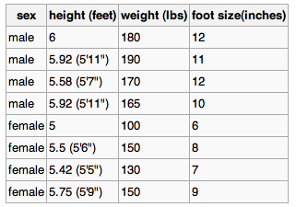
Naïve Bayes Classifier: Example
Best described through an example
Three features
Class label (male or female)
Training dataset

Slide 27

Naïve Bayes Classifier (Cont’d)
For each feature in each label
  Compute the mean and variance
That is the model (classifier)

Slide 28

Naïve Bayes: Classify New Object
Male or female?
For each label ➔ Compute posterior value
The label with the largest posterior is the suggested label

Slide 29

Naïve Bayes: Classify New Object (Cont’d)
Male or female?
>> evidence: Can be ignored since it is the same constant for all labels
>> P(label): % of training points with this label
>> p(feature|label) = , f is feature value in sample
f

Slide 30


Naïve Bayes: Classify New Object (Cont’d)
Male or female?

Slide 31
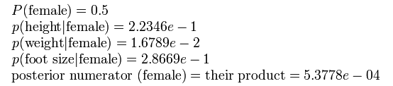
Naïve Bayes: Classify New Object (Cont’d)
Male or female?
The sample is predicted to be female

Slide 32

Naïve Bayes in Hadoop
How to implement Naïve Bayes as a map-reduce job?

Slide 33
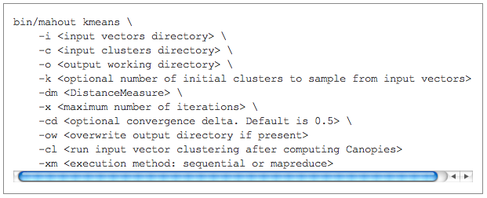
Apache Mahout
http://mahout.apache.org/

