Slide 1
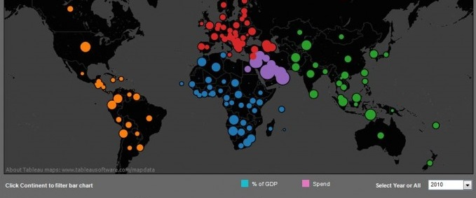

Mohammed Ayub Rakesh Biradar
Notes:
Image References:
http://visualoop.com/blog/3199/25-great-data-visualizations-made-with-tableau-public

Slide 2
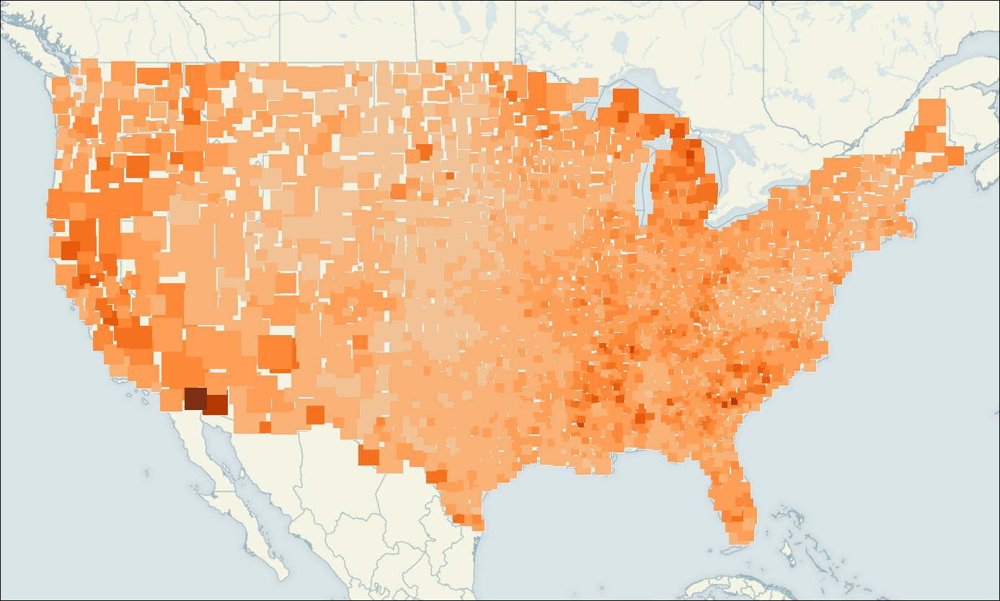
Topics
Introduction to Tableau and Products
Architecture and Technology
Charts and Dashboards in Tableau
Basic Tableau Features Demo
Tableau with R Demo
Notes:
Image References:
http://www.clearlyandsimply.com/clearly_and_simply/2009/10/choropleth-maps-with-tableau.html

Slide 3



Tableau Roots
Christian Chabot
CEO & co-founder
Pat Hanrahan
Chief Scientist & co-founder
Chris Stolte
CDO & co-founder
Headquarters in Seattle, Washington(2003)
Revenue more than 400M and growing.
Notes:
Image References:
1) http://www.tableau.com/about/leadership

Slide 4
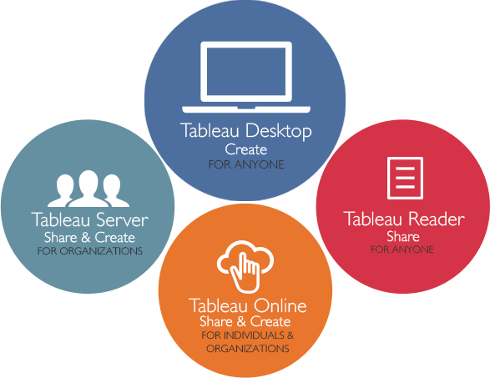
Tableau Products
Tableau Desktop
Tableau Server
Tableau Online
Tableau Reader
Tableau Public
Notes:
Image Reference: http://www.tableau.com/fr-fr/products

Slide 5
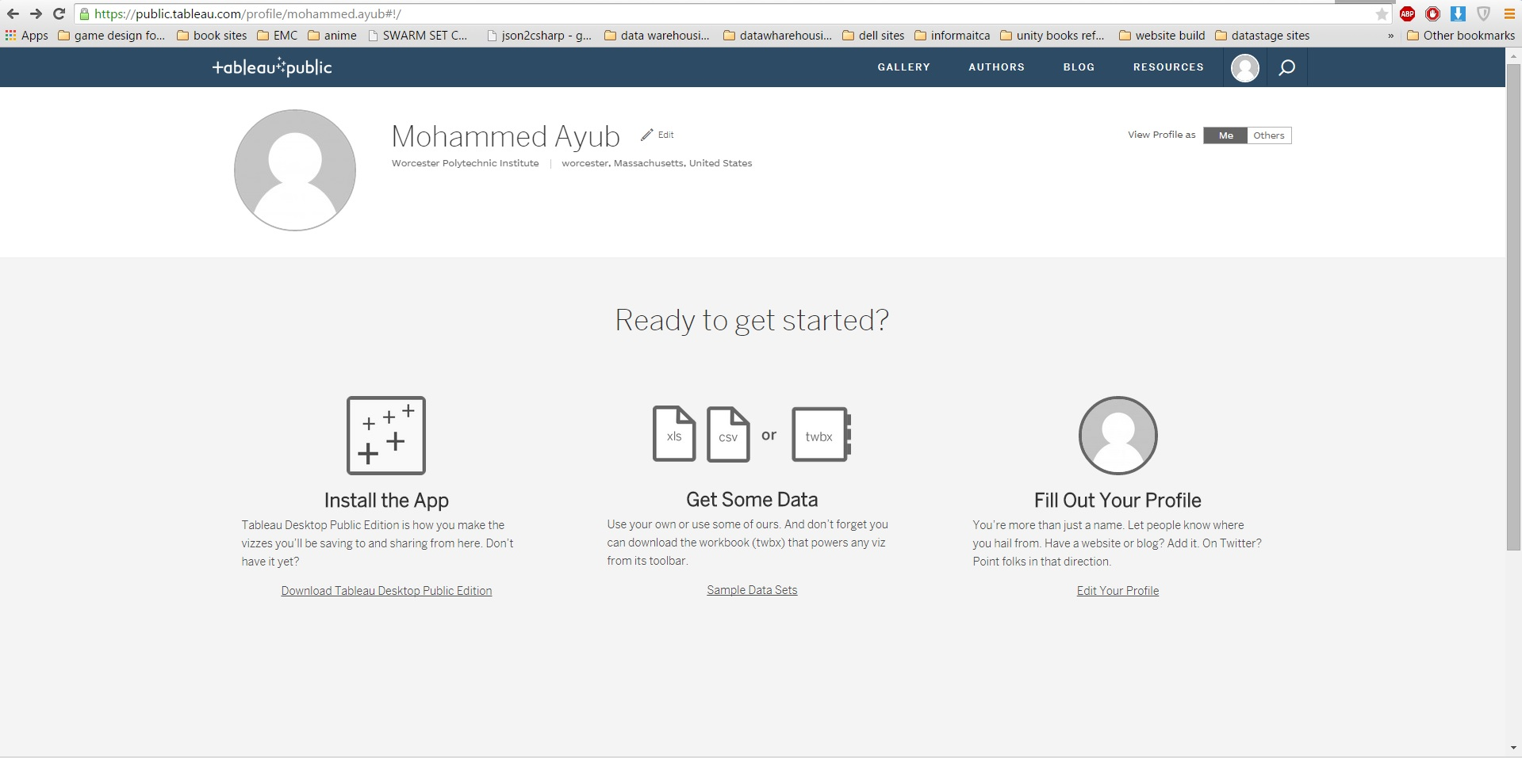
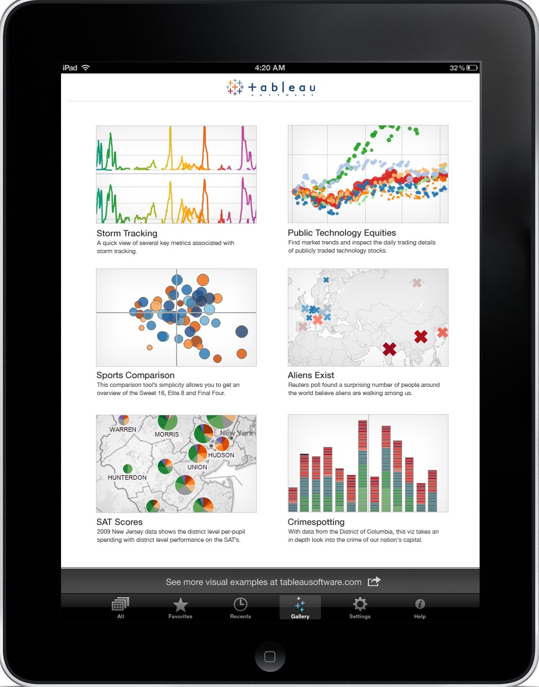
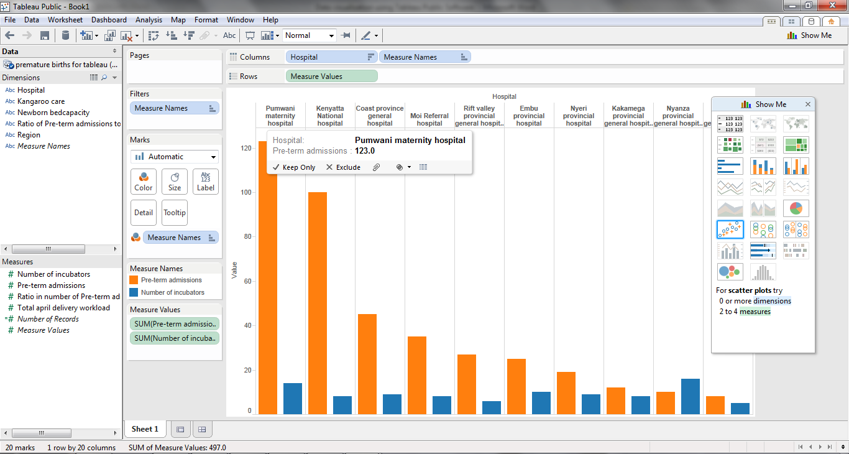
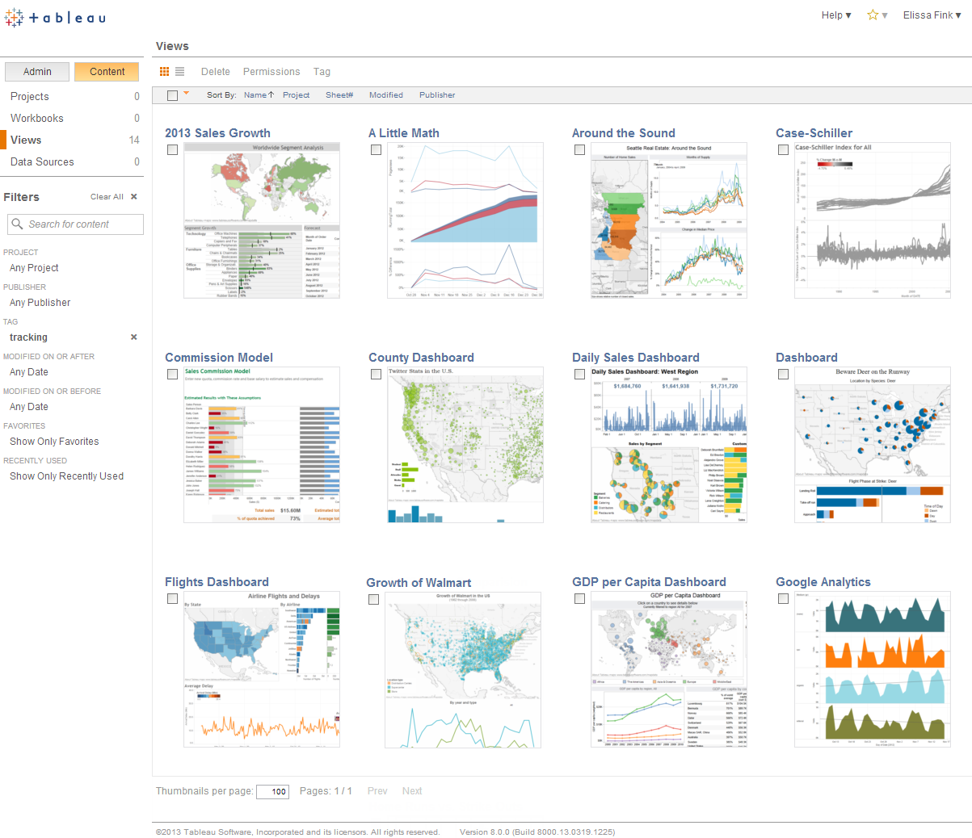
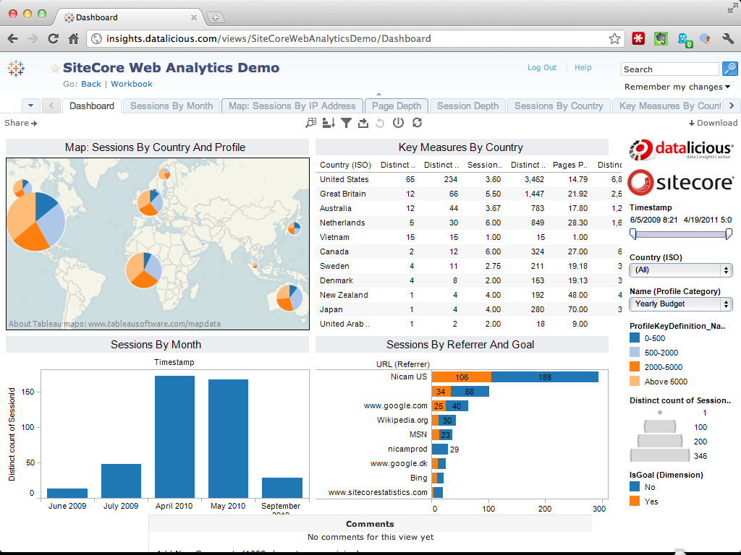
Notes:
Image References:
1) http://internewskenya.org/fellowshipblog/data-visualization-using-tableau-public/
2) http://docs.treasuredata.com/articles/tableau-server
3) http://blog.datalicious.com/sitecore-raw-data-analysis-tableau/
4)
5)

Slide 6
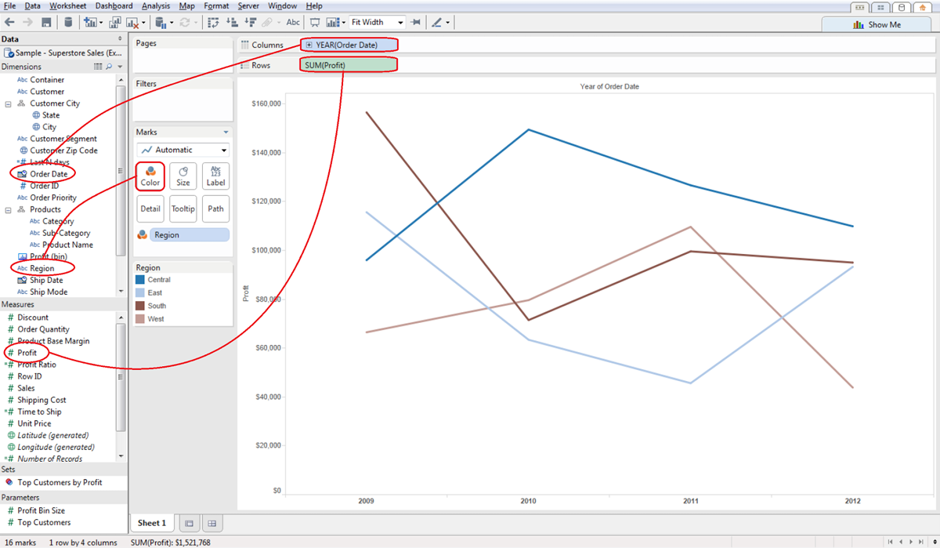
Why Use Tableau ?
1) Easy of Use- “You Don’t need a Data Genius to Operate it.”
Notes:
Image References: http://interworks.co.uk/business-intelligence/tableau-desktop/

Slide 7
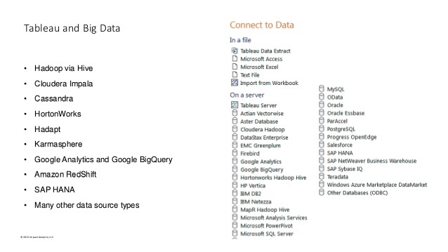
2) Connect to any Data Source including Big Data
Notes:
Image Reference:
http://www.tableau.com/solutions/data-sources

Slide 8
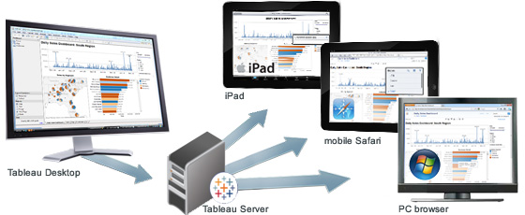
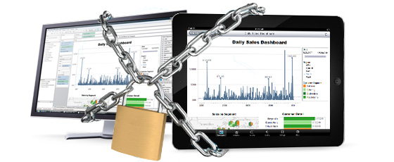
3) Compatible across Multiple Platforms
Security Protocols with ActiveDirectory via Tableau Server - Truly Mobile BI
Notes:
Image Reference:
1) http://www.tableau.com/solutions/mobile-business-intelligence

Slide 9
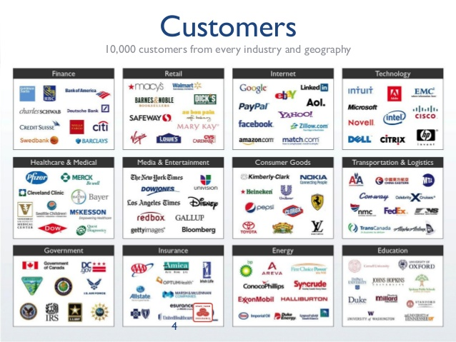
4) Large Customer Base

Slide 10
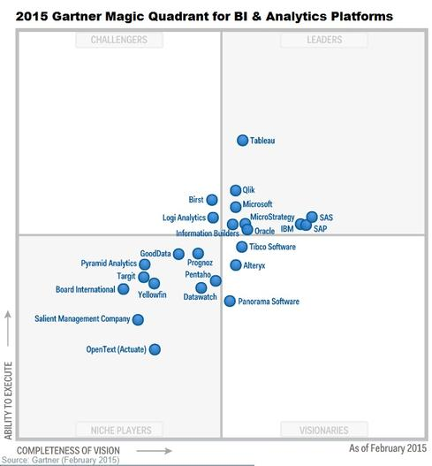
4) Industry Leader for the third consecutive time
in the magic quadrant
“Tableau is the “sweetheart” of the BI Magic Quadrant”
— Gartner
“Tableau Software continues to set the standards…”
— Forrester
“Tableau had the highest score in the area of in-house implementation by a very wide margin, skewing the entire chart. No other product came close”
— BARC
Notes:
Image References:
1) http://www.tableau.com/gartner-magic-quadrant-2015

Slide 11
Tableau Architecture

Slide 12
Clients
Tableau has a highly scalable, n-tier client-server architecture that serves mobile clients, web clients and desktop-installed software.

Slide 13
Customer Data
Excel
Oracle
Cloudera
CSV
SQL DB
HIVE
Tera Data
Many more….

Slide 14
Gateway / Balance Loader
Security
Task Manager

Slide 15
Main Components
Tableau Server Components
  Application Server
  VizQL Server
  Data Server

Slide 16
Data Connectors
Data Layers
  Fast Data Engine (In-memory connection)
  SQL Connector
  MDX Connector

Slide 17
Core Technology
VizQL - Unifies computer graphics and databases.
  A new language for data that translates your actions into a database query and then expresses the response graphically.
In Memory Data Engine -
  Architecture aware - Column store with novel techniques to extensively use L1 and L2 caches with near optimal throughput.
  True Ad-hoc Queries- “On the fly” query support.
  Flexible Data model
  Instant load and connection Time

Slide 18
Demo Time

Slide 19
Drawbacks of Tableau
Need IT expertise to prepare initial dataset
Cost Prohibitive- Desktop License - $1000-$2000/yr. Online hosting $500/yr.
Change management issues – Deployment versioning
Risky Security – ”Row Level” security.
No Scheduling/Notification of Reports

Slide 20




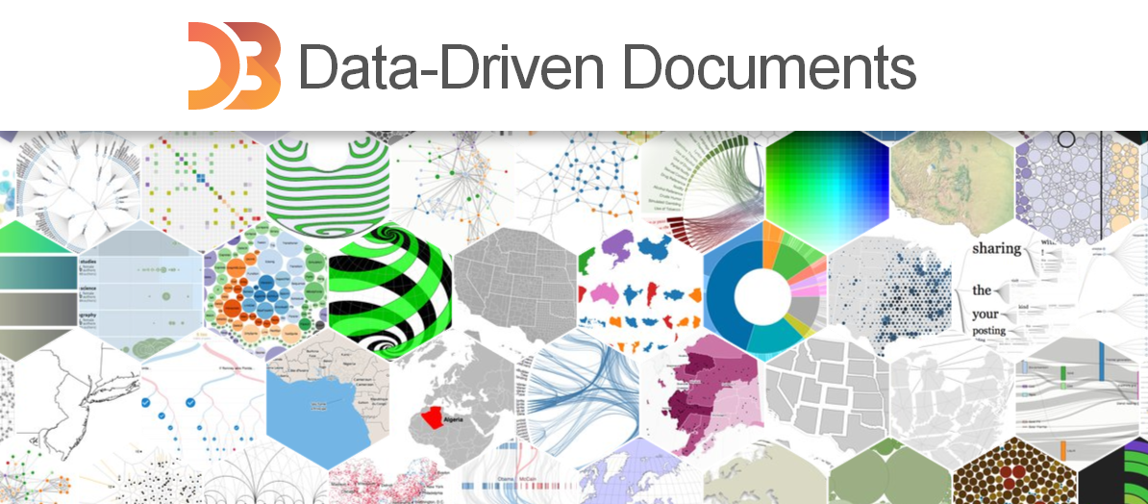

Other tools out in market

Slide 21
References
Books -
Learning Tableau – Joshua Milligan, April 2015
Communicating Data with Tableau – Ben Jones, July 2014
Tutorial Links -
http://www.tableau.com/learn/training
http://kb.tableau.com/
Community - http://community.tableau.com/welcome
Conferences - http://www.tableau.com/learn/events
Blogs - http://www.tableau.com/about/blog
http://www.jenunderwood.com/category/predictve-analytics/
White Papers - http://www.tableau.com/learn/whitepapers

Slide 22
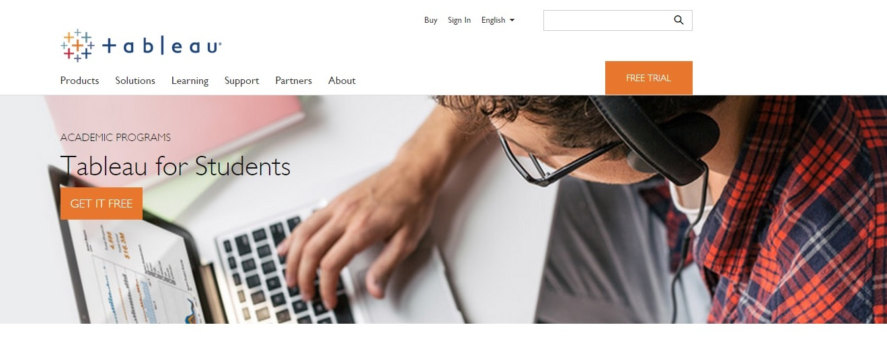
Thank you & Questions ???
Notes:
Image Reference:
1) http://bevisualmag.ru/?p=2245

