Slide 1
A Study of
Main Memory Database System
- General Idea and Applications
Hongnan Li
Yanpu Li
Chong Zhou
Notes:
This PowerPoint Template includes a series of slide masters with predefined layouts and color schemes for formatting slides
Slide Masters are displayed when you right click on a slide and select Layout from menu

Slide 2
Agenda
General idea of MMDB
- Mechanisms and details
Application demonstration
- SAP HANA

Slide 3
Key Features
All data permanently store in main memory
Pros
  Better response time
Cons
  Unstable store media

Slide 4
Comparison of MMDB and Disk DB with large cache
MMDB
Disk DB
Large Cache
in memory
Main memory
Data
Data
Disk
Data

Slide 5
Comparison of MMDB and Disk DB with large cache
1.Disk DB does not take full advantage of memory.
  Even if all data fits in memory, the structures and algorithms are designed for disk access.
B+ tree is designed to access the disk data.
  Algorithms
  1 must compute the disk address
  2 buffer manager check whether this page is in memory or not

Slide 6
Properties differences
  Commit processing
  Recovery
  Concurrency control
  Index
  Data representation
  Performance

Slide 7
Atomicity, Consistency and Durability
How can MMDB hold these?
  Commit processing
  Recovery

Slide 8
Commit Processing
Protect against media failures
Use log, log must reside in stable storage (Disk)
Improvement
  Pre-commit
  Group commit
    Small amount of stable memory

Slide 9
Stable memory
Special Purpose Hardware
  Battery-backed up memory
  Uninterruptable power
  Error detecting and correcting memory

Slide 10
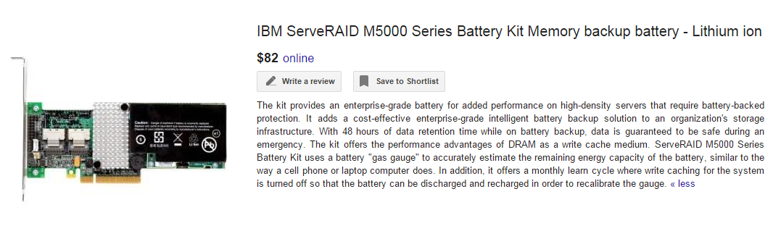
An Example of Backup Battery

Slide 11
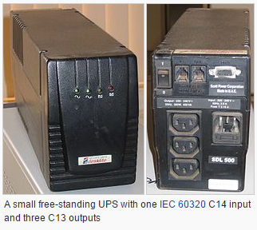
  Uninterruptable power Supply

Slide 12
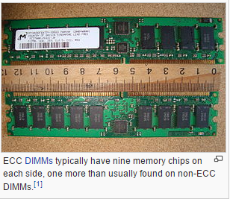
Error-Correcting Memory
(ECCM)
http://en.wikipedia.org/wiki/ECC_memory

Slide 13
Recovery
Checking-point bring a copy of main memory to Disk
  Store in big blocks, big block is efficient in written.
Improvement on Failure Recovery
  Recover on demand
  Using disk array to parallel recover.

Slide 14
Concurrency Control
Disk DB locking
  Using hash table
Mechanism of MMDB locking
  “2 bits locking”
    Pay a little more space per records
Disk
Record
Lock table

Slide 15
Locking
Structure:
0
0
Record
Is any one in waiting list? “1” means yes, “0”means no.
Is any one locking this record? “1” means yes, “0”means no.

Slide 16
How this locking mechanism work?
t1
Waiting List
0
0
Record
t2
t1
Waiting List
1
0
Record
t1
Waiting List
1
1
Record
t2
0
1
Record
1
0
Record
t2
Waiting List
0
0
Record

Slide 17
Index
Random access is much faster than disk access
  Hashing (for random access) is faster
T-tree for sorted data
  Save access time
Using pointer
  Save some space

Slide 18
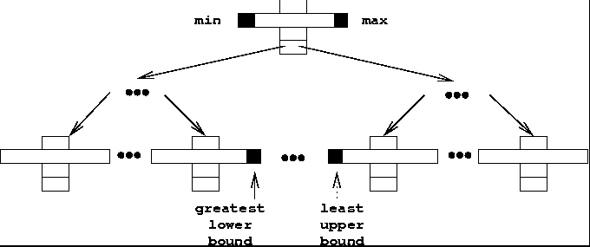
T-tree
http://en.wikipedia.org/wiki/T-tree#/media/File:T-tree-2.png

Slide 19
T-tree node
Draw a picture

Slide 20
Using Pointer
Key1
www.wikipidia.org/......./.......................
Key2
Pointer
Key3
Pointer
Pointer is not suitable for Disk DB, because theoretically, using pointer will increase one I/O for each access. Since nothing can guarantee pointer and value will be on same block.

Slide 21
Data Clustering and Migration
Not eager to cluster objects, since random access is much faster than Disk DB
In Disk DB
  Serial Access N block
    Accessing time = seeking time + rotating time + N * transfer time
  Radom Access N block
    Accessing time= N*(seeking time + rotating time + transfer time)

Slide 22
Performance
Metric
  Processing time (CPU time)
  Backup and checking points algorithms is critical,
  since it need to access Disk.
  Metric of Disk DB
  - I/O cost

Slide 23
Applications of Main-memory DB
Demand vary fast data access, storage
Applications do not have a disk
Sophisticated data manipulation
ACID properties still apply

Slide 24

SAP HANA
An In-memory Database System

Slide 25
SAP HANA
An in-memory database and application platform
10 – 1000x faster than a regular database
Column and row store
Sums, indexes, materialized views and aggregates are not required
SAP HANA can scale up to 6 TB for a single system, up to 112 TB in a cluster
Used by large companies
Written in C++

Slide 26
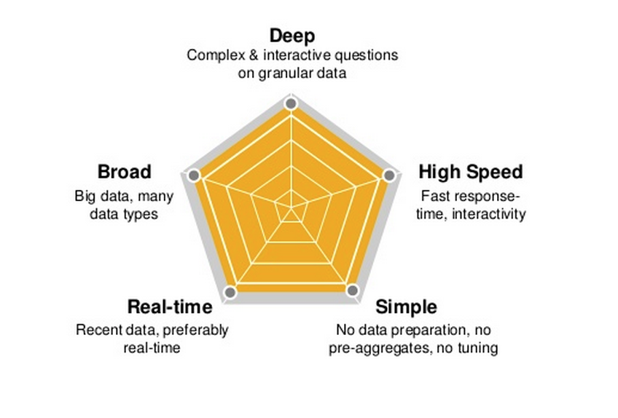
What SAP HANA can provide?

Slide 27
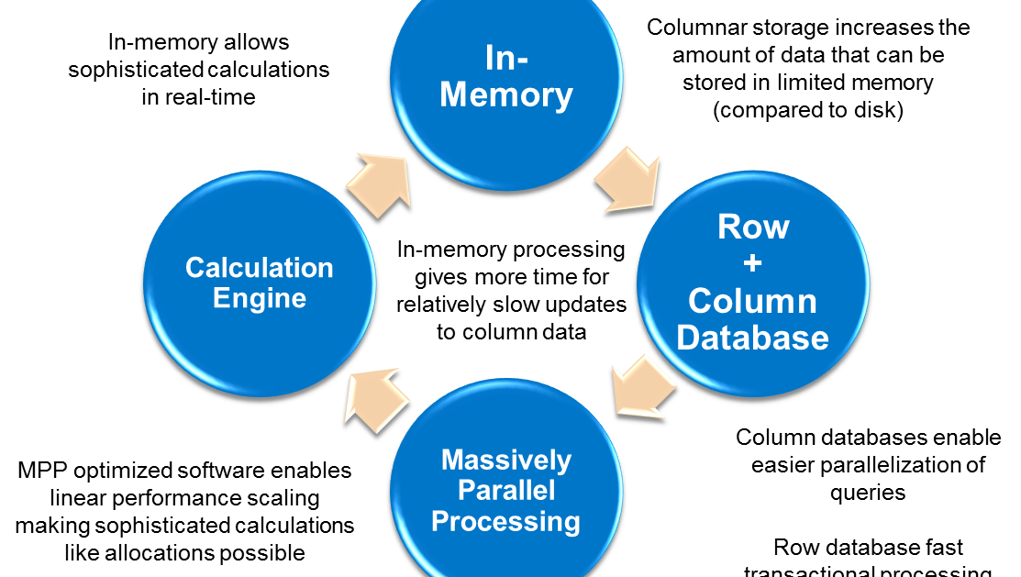
SAP HANA Data Processing
Notes:
http://bi-insider.com/portfolio/sap-hana-platform-technical-overview/

Slide 28
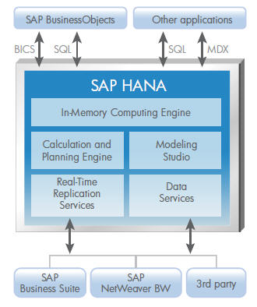
SAP HANA Architecture

Slide 29
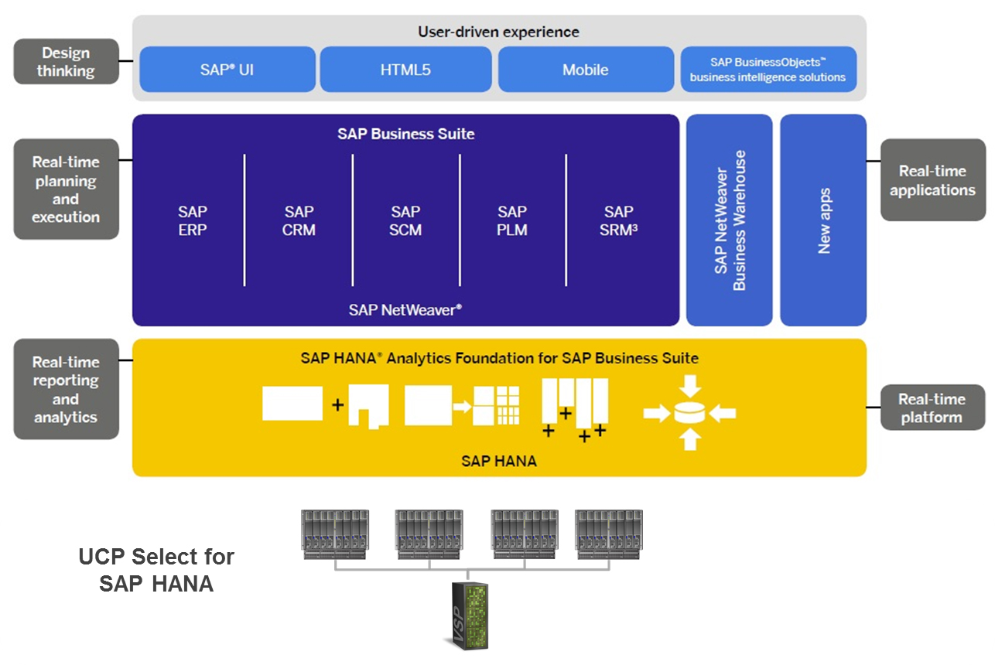
SAP HANA Platform
Notes:
http://itgility.com/solutions/converged-infrastructure/ci-for-business-analytics/

Slide 30
ACID Properties
HANA writes savepoints to disk at frequent intervals
HANA saves a log of each database change to a flash disk
If power goes out, HANA loads the last savepoint and play the logs back

Slide 31
Key features
Always store data on disk and loads parts of database tables on demand
All queries have real-time access to data, relational database system

Slide 32
SAP HANA Installation on Eclipse
Open Eclipse, choose in the menu bar Help > Install New Software...
For Eclipse Luna (4.4), add the URL https://tools.hana.ondemand.com/luna.
Press Enter to display the available features.
Select the desired features and choose Next.
On the next wizard page, you get an overview of the features to be installed. Choose Next.
Confirm the license agreements and choose Finish to start the installation.

Slide 33
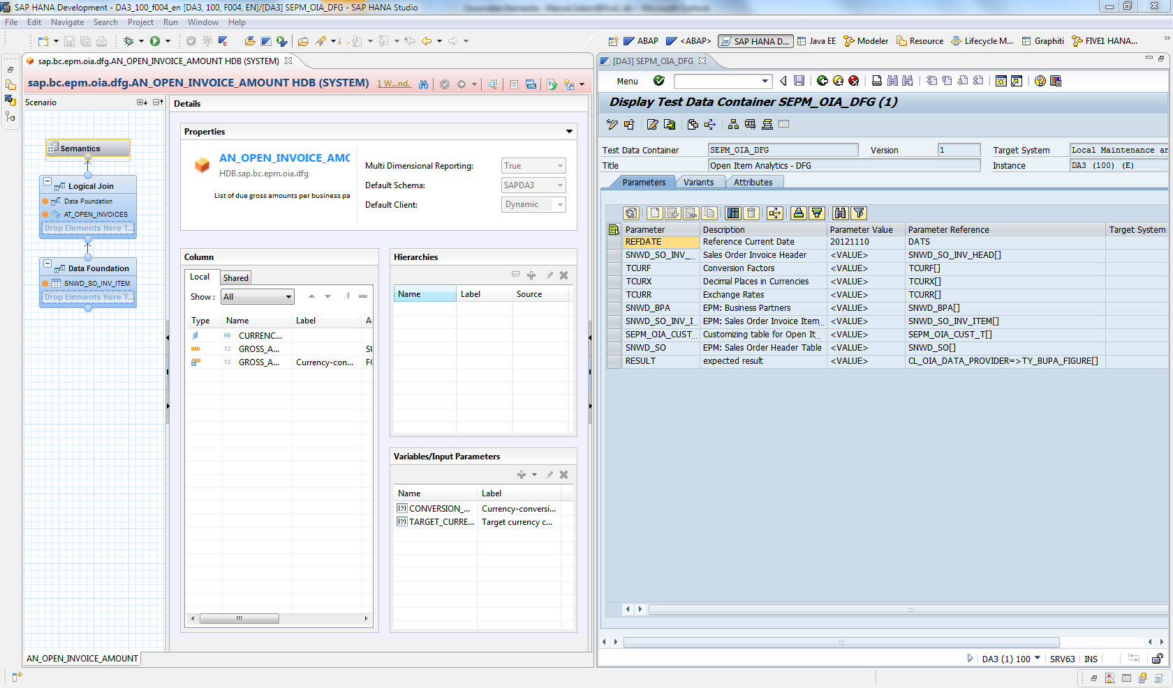
HANA Eclipse Studio

Slide 34
Architecture of SAP HANA
Distributed HANA System:
-One cluster
-Multiple servers
-N active servers & M standby servers
-Shared-nothing approach
-Shared file system: General Parallel File System(HDD:data storage, Flash: log storage)

Slide 35
Role of the Server
Name Server
-topology, data location
-type: (master, slave)
Index Server
-the actual data stores, the engines processing the data
-type: (worker, standby);(master, slave)
Statistics Server
-status, performance, resource consumption

Slide 36
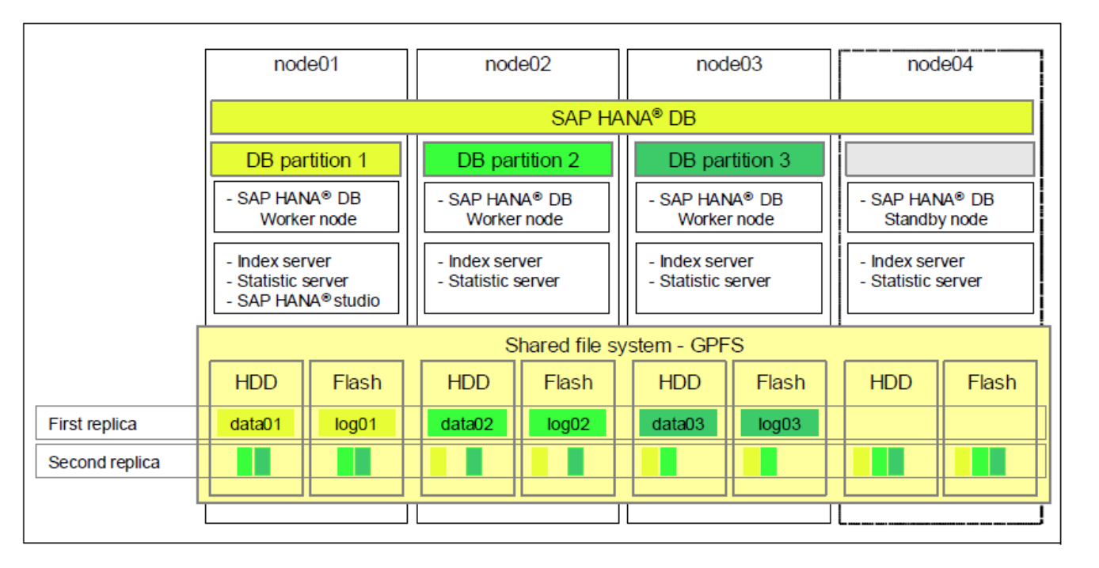
Storage Layout Example:

Slide 37
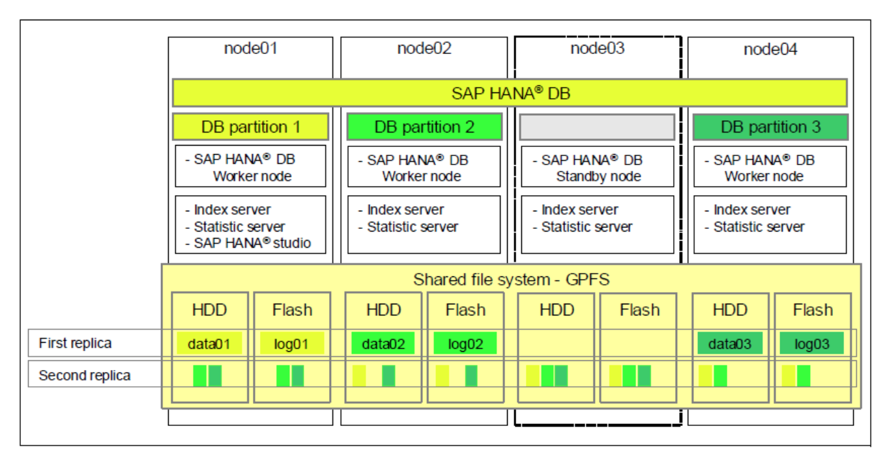
Example of Failure

Slide 38
Drawbacks
Complexity:
-multiple configuration and actual roles for each node(master, slave, worker, standby).
Not Active-Active:
-resemble cold cluster technology
(N+1 topology->N+M)
Time-consuming for Recovery
Downtime during Scale-out

Slide 39
Reference
Hector Garcia-Molina, Member, IEEE, and Kenneth Salem, Member, IEEE “Main Memory Database Systems: An Overview”
http://itgility.com/solutions/converged-infrastructure/ci-for-business-analytics/
http://bi-insider.com/portfolio/sap-hana-platform-technical-overview/

Slide 40


