Slide 1
ReStore: Reusing Results of MapReduce Jobs
Yang Zheng

Slide 2
Outline
Introduction to MapReduce
Overview of ReStore
Implementation Details
Experiments
Notes:
1. MapReduce final result, intermediate result
2. MapReduce job, sub-job

Slide 3
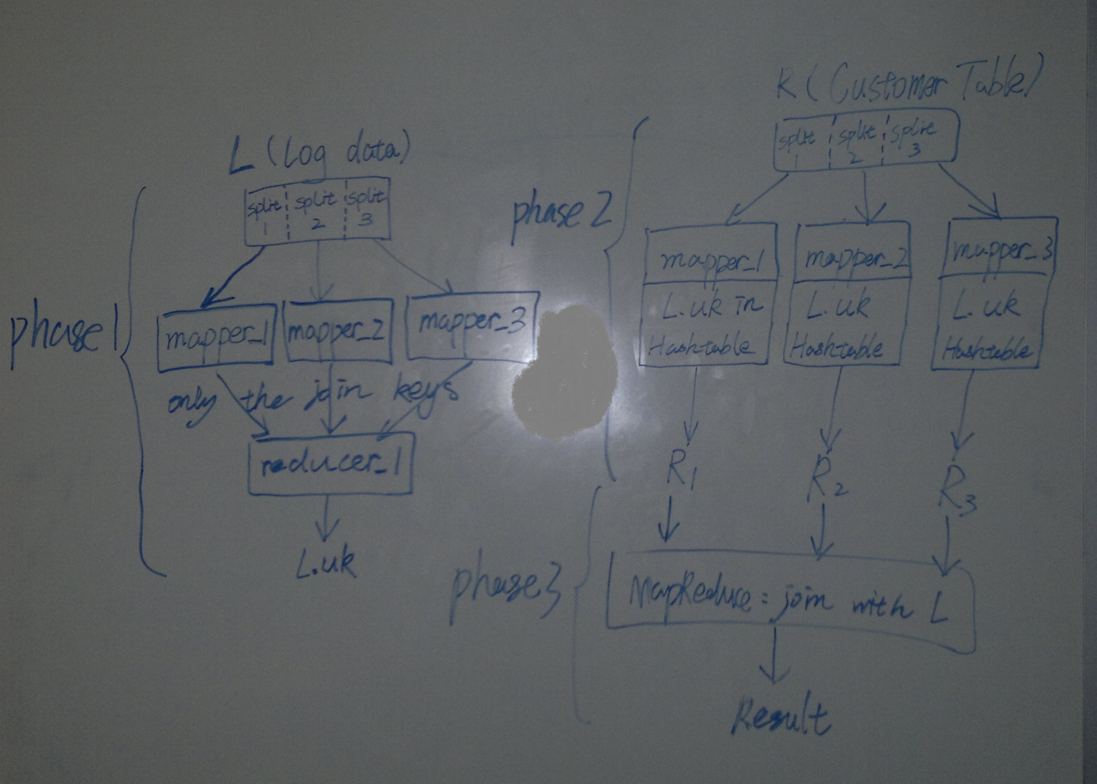
Introduction to MapReduce
Notes:
This is the workflow I drew for the semi-join algorithm of the paper A Comparison of Join Algorithms for Log Processing in
MapReduce which is presented by Devin before. I think this figure well illustrate what are MapReduce job, intermediate result and final result. The query behind this workflow is to join a log table and a customer table on CustomerID, under the situation that only a small fraction of customers are referenced by the log table.

Slide 4
Introduction to MapReduce
What comes to your mind?
Keep these intermediate results and final results and reuse them for future workflows submitted to the system.
An example
Facebook stores the result of any query in its MapReduce cluster for seven days so that it can be shared among users.
Notes:
The basic idea behind the Restore is to use these intermediate results and final results and reuse them for future workflows submitted to the system.
A good example is Facebook stores the result of any query in its MapReduce cluster for seven days so that it can be shared among users.

Slide 5
Overview of ReStore
Rewrites the MapReduce jobs in a submitted workflow to reuse job outputs previously stored in the system
Stores the outputs of executed jobs for future reuse
Creates more reuse opportunities by storing the outputs of sub-jobs in addition to whole MapReduce jobs
Selects the outputs of jobs to keep in the distributed file system and those to delete

Slide 6
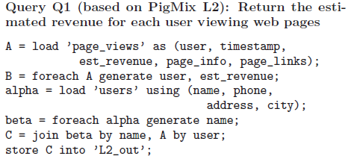
Overview of ReStore
The name of the file or directory
Identifiers
schemas
project
Output directory
join field
Notes:
To illustrate the various result reuse opportunities, they use an example of two queries Q1 and Q2, written in PigMix.
Identifiers are the names of relations (aliases), fields, variables, and so on.

Slide 7
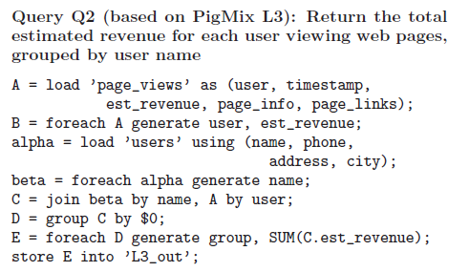
Overview of ReStore
Positional notation

Slide 8
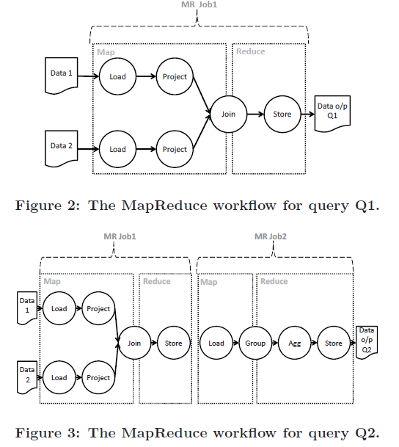
Overview of ReStore
t1
t01
Job_01
t02
Job_02
Notes:
Let’s go back to this slide, and I will give you an example of formula one.
Let’s first assume Data 1 and Data 2 are obtained by executing Job_01 and Job_02.

Slide 9
Overview of ReStore
The time needed to finish executing jobn
the time needed to finish all jobs on which Jobn depends
The total time needed to execute jobn
Notes:
For a certain jobn in the work flow, this paper divides the total time needed to execute jobn, into two parts. The time needed to finish executing jobn, and the time needed to finish all jobs on which Jobn depends, which is the time needed for the slowest of these jobs to finish. Because every job in the mapreduce architecture can not start until all the jobs on which it depends finish.

Slide 10
Overview of ReStore
ReStore generates two types of reuse opportunities by
materializing the output of:
(1) whole jobs, which reduces
maxi$∈$Y{Ttotal (Jobi)} in future workflows,
(2) operators in jobs (sub-jobs), which reduces ET(Jobn) in future workflows.

Slide 11
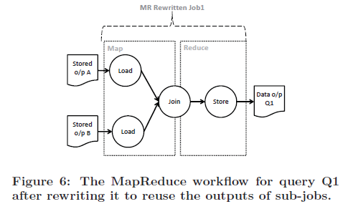
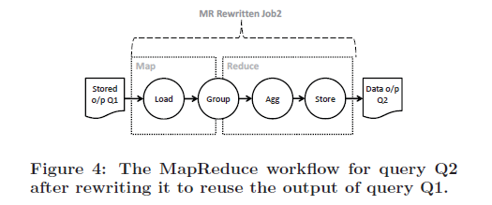
Overview of ReStore

Slide 12
Overview of ReStore
ReStore Sysem Archiecture
Input
Workflow of MapReduce jobs generated by a dataflow system for an input query
Output
a modified MapReduce workflow that exploits prior jobs executed in the MapReduce system and stored by ReStore
a new set of job outputs to store in the distributed file system

Slide 13
Overview of ReStore
Repository
the physical query execution plan of the MapReduce job that was executed to produce this output
the filename of the output in the distributed file system
statistics about the MapReduce job that produced the output and the frequency of use of this output by different workflows

Slide 14
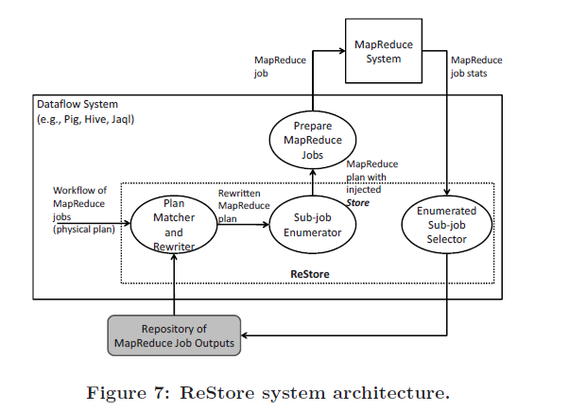
Overview of ReStore

Slide 15
Implementation Details
Plan Matcher and Rewriter
Scans sequentially through the physical plans in the repository and tests whether each plan matches the input MapReduce job.
As soon as a match is found, the input MapReduce job is rewritten to use the matched physical plan in the repository.
After rewriting, a new sequential scan through the repository is started to look for more matches to the rewritten MapReduce job.
If a scan through the repository does not find any matches, ReStore proceeds to matching the next MapReduce job in the workflow.

Slide 16
Implementation Details
Sub-job Enumerator & Enumerated Sub-job Selector
Two types of reuse opportunaties
Store the output of whole MapReduce jobs
Store the output of subjobs
Which subjob should also be considered as candidates?
Some physical operators such as Project and Filter are known to reduce the size of their input
Other physical operators such as Join and Group are known to be expensive, so their outputs are also good sub-job candidates because replacing them with stored output reduces the time to execute these operators

Slide 17
Implementation Details
Manage the Restore Repository
Keep a candidate job in the repository only if the size of its output data is smaller than the size of its input data.
Keep a candidate job in the repository only if Equation 1 tells us that there will be a reduction in execution time for workflows reusing this job.
Evict a job from the repository if it has not been reused within a window of time.
Evict a job from the repository if one or more of its inputs is deleted or modified.

Slide 18
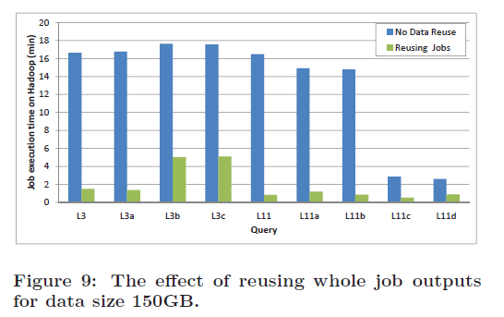
Experiments

Slide 19
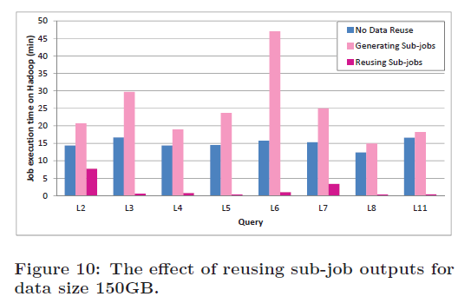
Experiments

Slide 20
Conclusion
MapReduce mode has become widely accepted for analyzing large data sets
In many cases, users express complex analysis tasks not directly with MapReduce but rather with higher-level SQL-like query languages
Important to make full use of the intermediate outputs of jobs to gain performance improvement

Slide 21
Any Questions?

