Slide 1
Managing Scientific Data From Data Integration to Scientific Workflow
Annies Ductan

Slide 2
Discussion Outline
Introduction to Scientific Data Management
Integration Challenges
Integration Examples
Data-centric: Geologic-Map Data Integration
Process-centric: Mineral Classification Workflow
Data Integration
Mediator Approach
Semantic Mediation
Semantic Data Registration
Scientific Workflows
Scientific Workflows In Kepler
Gravity Modeling Workflow
Semantic Workflow Extensions

Slide 3
Introduction
Why is there a need for managing scientific data:
There are a number of integration challenges that need to be overcome:
Enabling more data-driven “e-science”
Providing scientist with the right tools so that they spend less time on labor-intensive, error-prone manual data management.
This paper is an overview of the different kinds of data integration and interoperability challenges in scientific data management

Slide 4
Introduction
Importance of Interoperability:
Reduces operational cost and complexity:
Customers will continue to have mixed environments
Enabling systems to work together reduces the cost of building and supporting a heterogeneous infrastructure
Enables “best-of-breed” deployments:
Customers may have business requirements that can only be delivered with specific applications or platforms
Leverages existing investments:
Customers have a large and diverse range of systems installed in their environments. Moving to new platforms needs to be gradual

Slide 5
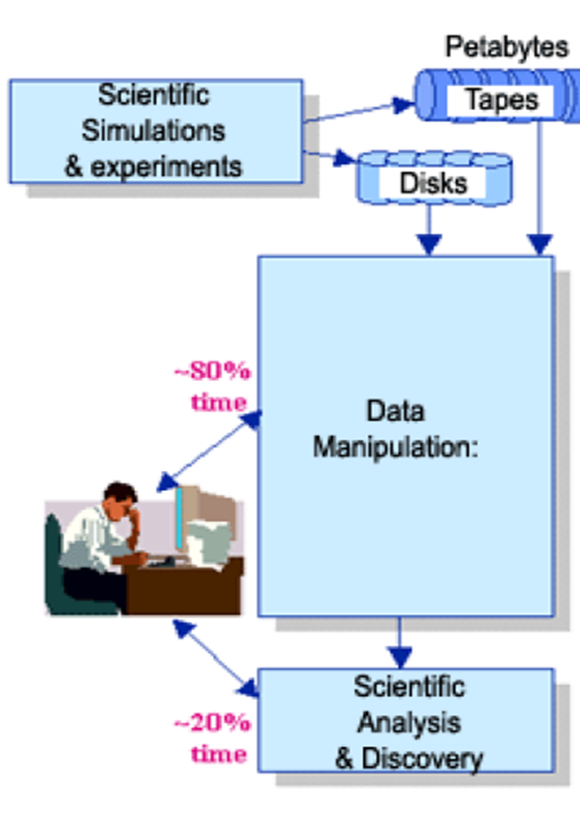
Introduction
Current integration strategies:
Scientist often repeat tasks and data management steps:
Select appropriate analysis methods to address a question
Search relevant data and create new data
Determine whether existing data can be used for the desired analyses
Pre-processing and integrating data as needed

Slide 6
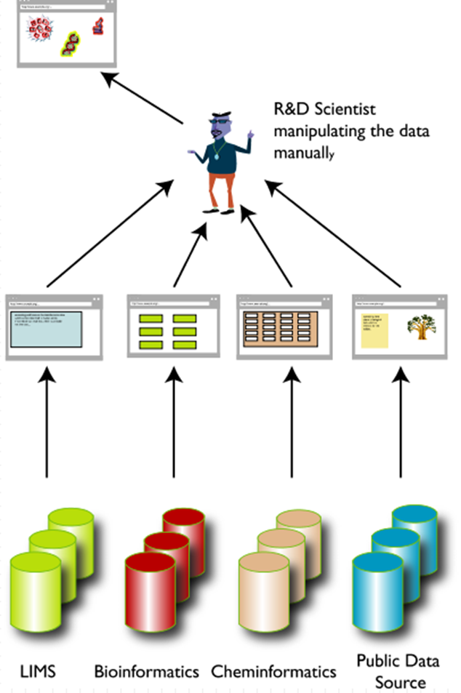
Integration Challenges
Scientist need to access data and information provided via:
Community databases
Analytical tools developed by community members
Easy way to make use of the increasing number of databases, analytical tools, and computational services
Creating techniques to leverage these resources for data integration

Slide 7
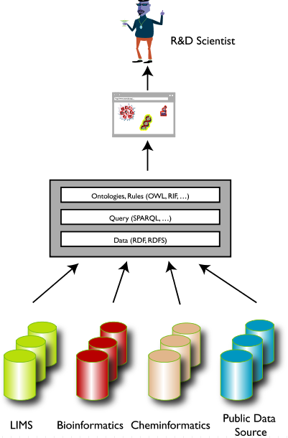
Integration Challenges
The goal:
Provide a framework that can be utilized by scientist and engineers for creating data transformation steps between semantically compatible, but structurally incompatible analytical steps
Benefits:
System aware of connections between workflow components
System aware of connections between data sources and workflow components

Slide 8
Integration Challenges
Issues arise due to heterogeneities that occur across systems, data sources and services that make up the scientific data management infrastructure
Traditional Heterogeneity:
Syntax
Structure
Semantics
Scientific data analysis and information-integration involve two additional levels:
System integration
Synthesis

Slide 9
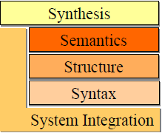
Integration Challenges
Refers to low level issues such as:
Network protocol
HTTP
FTP
Platforms
Operating system
Remote execution Methods
Web services
Authorization & Authentication mechanisms
Kerbros (network authentication protocol)

Slide 10
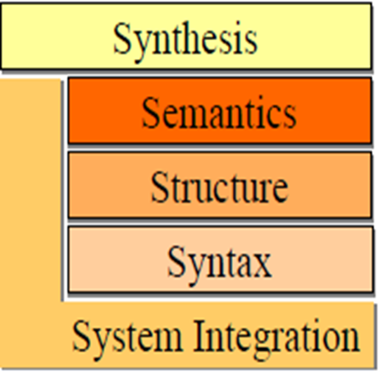
Integration Challenges
Data not stored in a database or data that is exchanged between applications:
Raster or vector
File formats:
netCDF (Weather forecast & climate)
HDF (Scientific data format)
ESRI Shapfiles (Environmental System Research Institute)

Slide 11
Integration Challenges
Similar data represented using different schemas
Structured entities requiring management:
database schemas & queries

Slide 12
Integration Challenges
Storing scientific data in a database system to provide solutions to a number of technical challenges

Slide 13
Integration Challenges
Encompasses all the challenges
Refers to the issue of putting together databases:
Semantic expressions
Queries & Transformations
Other computational services

Slide 14
Integration Challenges
Synthesis example:
If scientist want to put together two process steps in a simple analysis pipeline:
Syntactic and structural heterogeneities:
Does output d of A directly fit format B or is data transformation necessary
System and semantic:
What mechanisms should be used to invoke processes and how should data be shipped from A to B
Is it meaningful and valid to connect A and B in this way

Slide 15
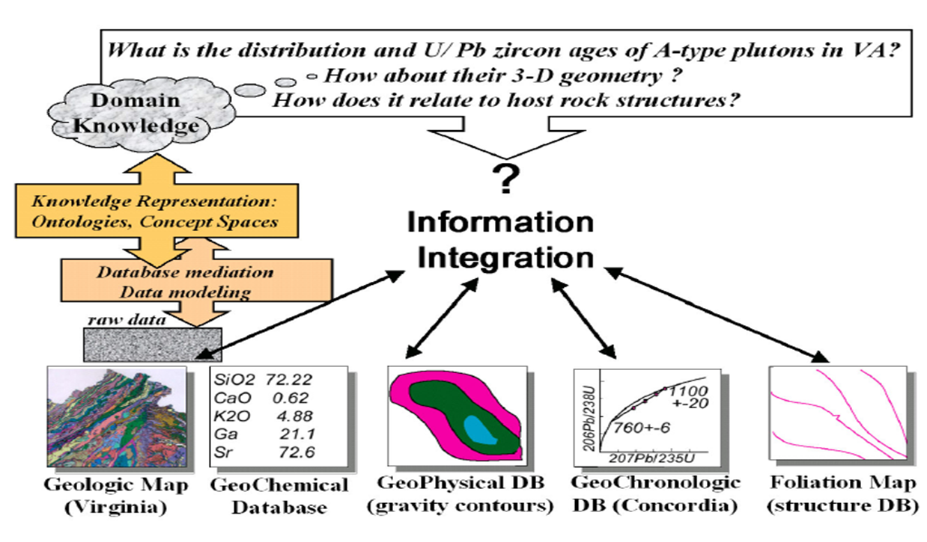
Integration Challenges Multi-world integration
Distribution of a certain rock type
Specific regions
3D geometry of the regions and relation to the host rock structures
Through databases and analytical tools, scientist can gather valuable information to answer scientific questions

Slide 16
Integration Examples
Ontology:
Intended for modeling knowledge about objects, their attributes, and their relationships to other objects
A set of representational primitives used to model a domain of knowledge
Primitives are:
Classes (or sets)
Attributes (or properties)
Relationships (or relations among class members)

Slide 17
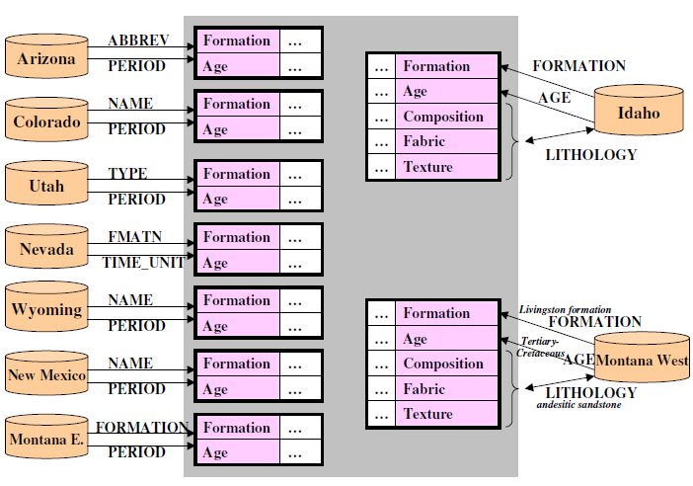
Integration Examples
Data-centric: Geologic-Map Data Integration:
Using an ontology to answer a conceptual-level query
The system provides a uniform interface to query the integrated information.
Information is integrated from:
Geologic maps
State geological surveys
Source Schemas
Integration Schema

Slide 18
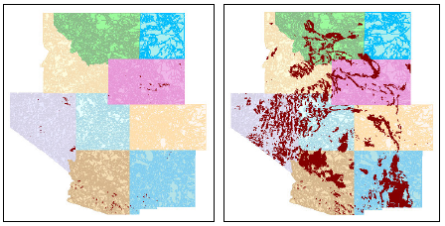
Integration Examples
Data-centric: Geologic-Map Data Integration:
Results of a query for regions with Paleozoic age:
Without ontology:
Few results return because missing domain knowledge of other geologic ages:
Paleozoic
Cambrium and Devon
With ontology:
A more complete set of regions returned
The system re-writes the user query to look for Paleozoic and all its sub-ages
Preliminaries:
Requires semantic data registration
Data objects(Polygons) must be associated with concepts from previously registered ontologies

Slide 19
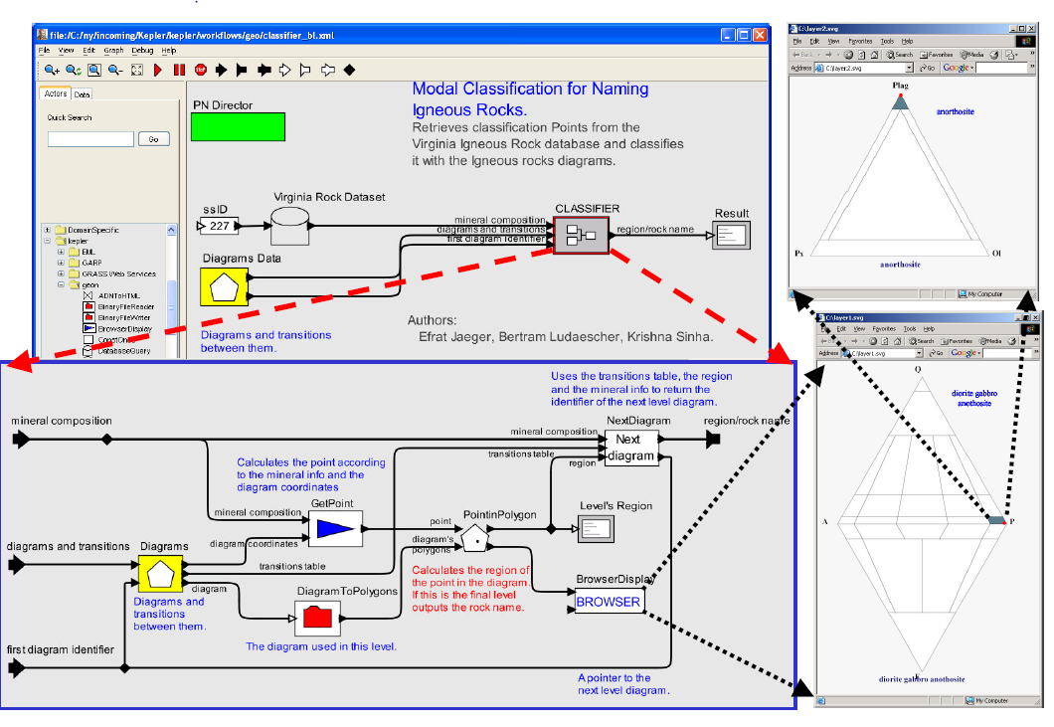
Integration Examples
Process-centric: Mineral classification & Interactive display
Classification Results:
Anorthosite
Database
Classification Diagram
Classifier Workflow
Scientific workflow system for automating manual data-analysis procedure, or reengineering an existing data-analysis tool in more generic and extensible environment.

Slide 20
Integration Examples
Kepler Workflow System:
Develops generic solutions to process and application-integration challenges of scientific workflows
An extension of the PTOLEMY II System
An open-source software framework supporting experimentation with actor-oriented design.
Actors are software components that execute concurrently and communicate through messages sent via interconnected ports.
A model is a hierarchy of interconnections of actors
In Ptolemy II semantics is determined by a software component in the model called a director which implements a model of computation

Slide 21
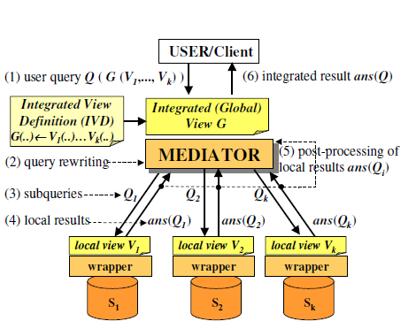
Data Integration
Traditional Mediator Approach:
User or application programmer defines a query (Q) against integrated view G
The mediator takes Q and the integrated view definition G(…)←…Vi and rewrites them into a query plan with a number subqueries Q1……Qk For the different sources
Subqueries Qi are sent to the local source for evaluation
The local ans(Qi) are sent back to the mediator
Further processing occurs
The integrated result ans(Q) is returned to the user

Slide 22
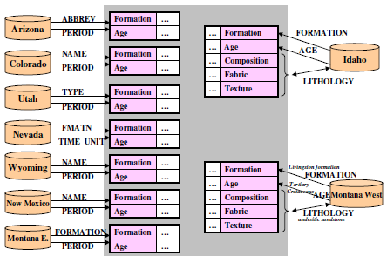
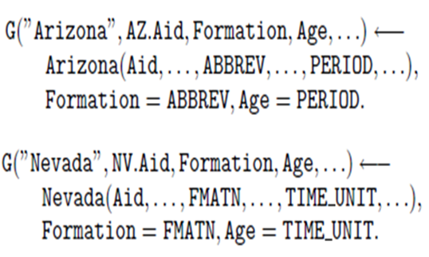
Data Integration
From the Geological-Map Integration example:
Nine sources integrated into a single global view
Allowing query expressions:
Shows the global-as-view approach
Global view G is filled with information from Arizona source by mapping the local
(ABBREV and PERIOD attributes) to the global (Formation and Age attributes)
Spatial regions from the AREA column are identified by the Aid key attribute
A unique prefix is used for each source to make the Aid attribute values unique across all sources. i.e ( )

Slide 23
Data Integration
Semantic Mediation:
Based on Concept
Knowledge-base extension:
Facilitate hard-to-relate data sources by going through shared ontologies and new types of concept-based queries against the data
Ability to view the geologic-age ontology as a set of concepts
One for each geologic age organized as a hierarchy
Example:
A tree in which children concepts (Devon, Cambrium) are considered to be a subset of restricted set of ages described by the parent concept ( Paleozoic).
Ontology-enabled mediator:
Uses the information from the geologic age ontology to retrieve data that directly matches the search concept Paleozoic, and all data that matches any subconcept of Paleozoic, such as Devon or Cambrium

Slide 24
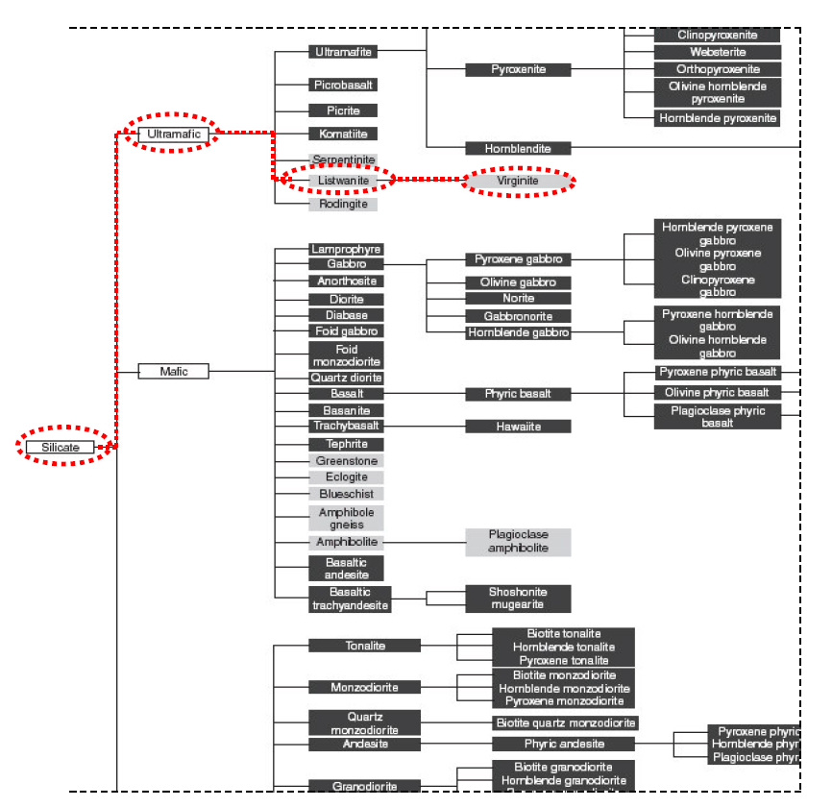
Data Integration
Canadian system for classification hierarchy of rock types
Semantic Mediation Results:
Concept-base query
Using this rock-type ontology
New semantic queries can be formulated and executed with the prototype.
Subconcept compositions are displayed as children to the right of the parent concept

Slide 25
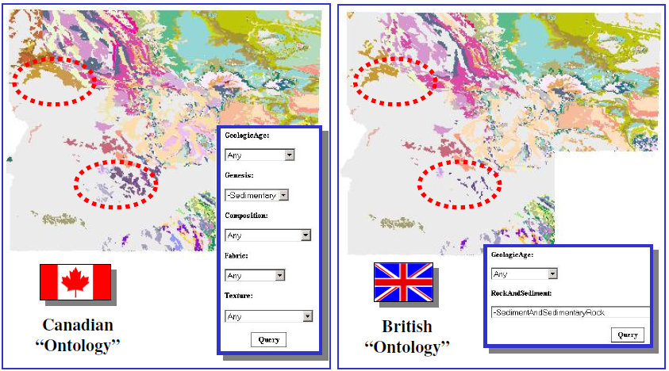
Data Integration
Semantic Mediation Results:
Achieved by semantically registering existing data sources to one or more ontologies
Extends the mediator approach to include expert knowledge for linking hard-to-relate sources
Semantic Query Results:
Left:
Lithology information provided by two of the nine state geologic maps (Idaho and Montana West) linked to concepts in the composition, fabric, and texture hierarchies
Right:
Result of a semantic query for Sedimentary rocks is displayed. Queries can be executed for
Composition (Silicate)
Fabric (Planar)
Texture (Crystalline)

Slide 26
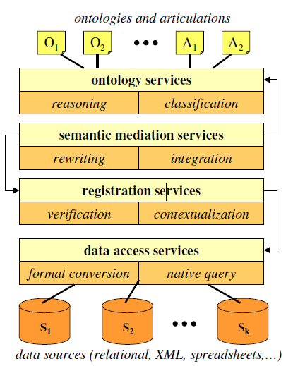
Data Integration
Associating data objects in the sources with concepts defined in a previously registered ontology
Semantic Data Registration:
Needed to facilitate data integration
Proposed Framework
Register the associations between data objects in a database D and a target ontology O
Example:
Let k = id(Dk) and j = id(Oj) be unique recourses identifiers of Dk and Oj respectively
The semantic data registration of Dk to Oj is given by constraints where each is a constraint formula over
Semantic mediation formula:
Shows ontology O’s concept D and its role R can be populated using certain tuples P(x,y,z) from D
When you combined the constraint and articulation
Allows data object from Dk to link to concepts like in ontology Oi

Slide 27
Data Integration
Results of Semantic Data Registration
Key Point:
Application of articulation axioms is that Oj and Oi can be used to query and view data from Dk through the conceptual view provided by Oi
Geological Map Example:
Enables the ability to query the geological maps using British rock classification view despite the fact that the geologic map database was originally registered to the Canadian System

Slide 28
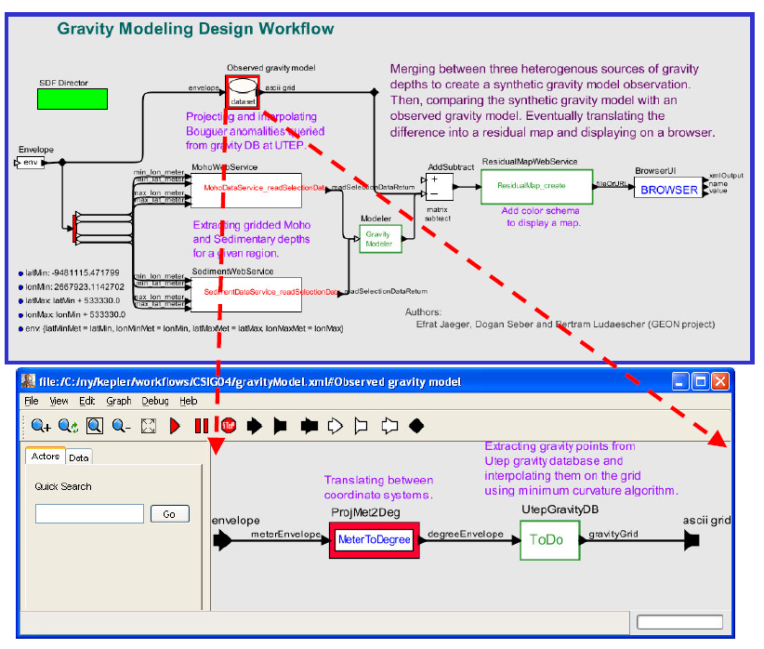
Scientific Workflows
Involves components that has not yet been implemented
Advantage:
Allow the user to go from a conceptual design workflow to an executable version by replacing the design components with implemented ones as they become available

Slide 29
Scientific Workflows
Semantic Workflow Extensions
Ontology-Driven Data Transformation
Implementation of Semantic Type ensures that the data is connected meaningfully:
Structural type check guarantees the actors connections have compatible data types
There is no means to check whether the connections are potentially meaningful
For example:
A connection between an actor outputting a velocity vector and one that takes as input a force vector may be structurally valid, but not semantically

Slide 30
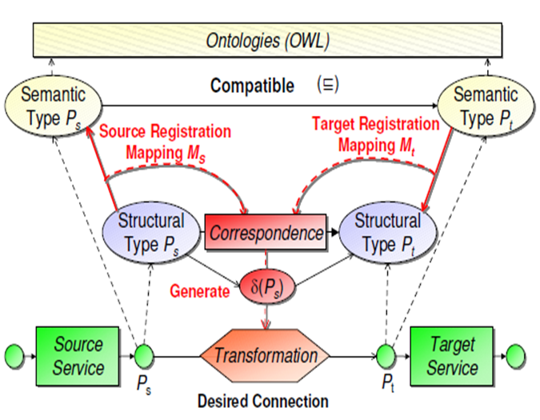
Scientific Workflows
Semantic Workflow Extensions
Ps is not compatible with Pt
Needs source registration to assist:
Source registration mapping Ms = by the rule
Target registration mapping Mt = by the rule
Correspondence mapping Mst = by the rule

Slide 31
Questions

