Slide 1
Building a Database on S3
[Ref: http://www.systems.ethz.ch/education/past-courses/fs09/HotDMS/pdf/dbons3.pdf]

Slide 2
Flow of the presentation
Background
Brief intro to S3, SQS, EC2.
Discuss details of implementation.
Discuss Costs, Performance and Results

Slide 3
Background
Running a service becomes particularly challenging and expensive if the service is ‘successful’.
Need to address cost to operate a service on the Web, ideally with 24-7 availability and acceptable latency.
Required: Hosted server and a database which both need to be administrated; this paper focuses on the means to implement database component.
Utility Computing provides cost effective answer for Storage, CPU, Network Bandwidth [User unaware of details] ; Infinitely Scalable, available. Consistent Response Time.

Slide 4
Components used for DB implementation.
AWS – Amazon Web Service
S3 [Simple Storage System]
SQS [Simple Queuing System]
EC2 [Elastic Computing Cloud]
SimpleDB

Slide 5
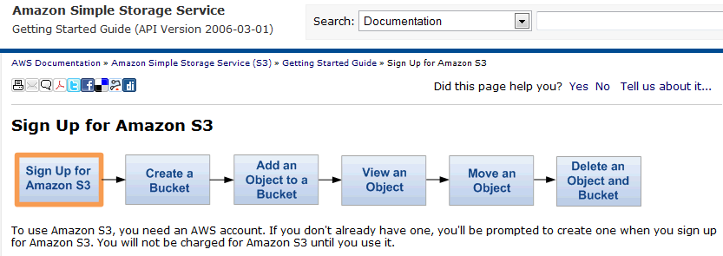
Accessing these Resources: Easy Setup in few steps at Amazon.com

Slide 6
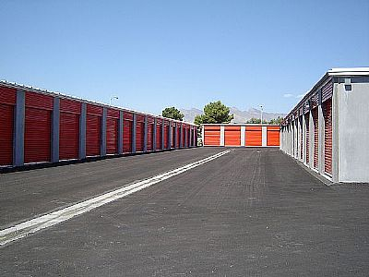
Analogy
S3 [Simple Storage System]
SQS [Simple Queuing System]

Slide 7
What is S3
Infinite store for objects of variable size ranging 1 Byte to 5 GB.
Access via URI using SOAP/REST based interface.
Methods e.g. get-if-modified-since enable caching based on a TTL protocol
User defined metadata up to 4KB can be associated to an object and can be read and updated independently of the rest of the object.
Object are associated to a bucket. Selective querying possible.
Users can grant read and write authorization to other users for entire buckets.
Alternatively, access privileges can be given on individual objects.

Slide 8
What is SQS
SQS allows users to manage a infinite number of queues with infinite capacity.
Each queue is referenced by a URI and supports sending and receiving messages via a HTTP or REST-based interface.
The max. message size 256 KB for REST based interface
And 8 KB for the HTTP interface.
Any bytestream can be put into a message.
Supported Methods: createQueue, send, receive, delete, addGrant.

Slide 9
COSTS
S3: $0.15 to store 1 GB of data for one month.
Seagate HDD 160 GB = $70 [In 2012 1.5TB costs $100]
r/w $0.01 per 10,000 get & $0.01 per 1,000 put requests
$.10-0.18/GB network bandwidth consumption - depending upon the total monthly volume therefore smugmug uses S3 as a persistent store.
SQS: $0.01 to send 1,000 messages.
network bandwidth $0.10 /GB of data Xferred.
$0.10 per GB is the minimum for heavy users

Slide 10
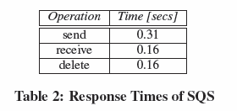
Performance
S3
SQS

Slide 11
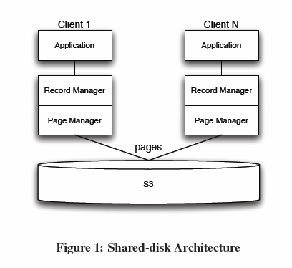
Putting the Pieces together: Implementing the Database
Using S3 as a Disk
Client Server Architecture
Record Manager
Page Manager
B-tree Indexes
Logging
Security

Slide 12
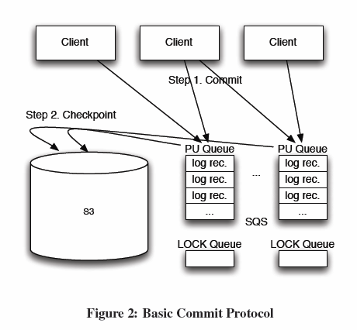
Basic Commit Protocol
Overview
PU Queues
Checkpoint Protocol for Data Pages
Checkpoint Protocol for B-trees
Checkpoint Strategies

Slide 13
TRANSACTIONAL PROPERTIES
Atomicity
Consistency Levels
Isolation: The Limits

Slide 14
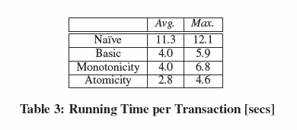
EXPERIMENTS
Software and Hardware Used
TPCW Benchmark
Experiment 1: Running Time [secs]

Slide 15
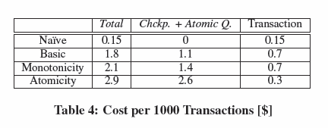
EXPERIMENTS (cont…)
Experiment 2: Cost [$]

Slide 16
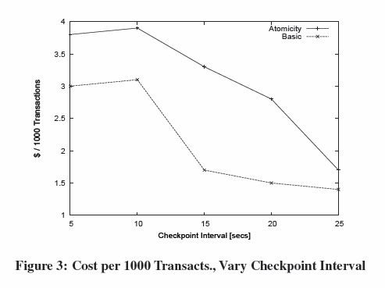
EXPERIMENTS (cont…)
Experiment 3: Vary Checkpoint Interval

Slide 17
CONCLUSION
Web-based applications need high scalability and availability at low and predictable cost.
No client must ever be blocked by other clients accessing the same data or due to hardware failures at the service provider.
Instead, clients expect constant and predictable response times when interacting with a Web-based service.
Utility computing has the potential to meet all these requirements.
Utility computing was initially designed for specific workloads.
This paper showed the opportunities and limitations to apply utility computing to general-purpose workloads, using AWS and in particular S3 for storage as an example.
As of today, utility computing is not attractive for high-performance transaction processing; such application scenarios are best supported by conventional database systems.
Utility computing, however, is a viable candidate for many Web 2.0 and interactive applications

