Slide 1
Data Management in the Cloud: Limitations and Opportunities
Annies Ductan

Slide 2
Discussion Outline:
Introduction
Overview
Vision of Cloud Computing
Managing Data in The Cloud
Cloud Characteristics
Data Management Applications
Transactional
Analytical
Analyzing Data in The Cloud
Ideal Properties and Features
MapReduce-like Software
Shared-Nothing Parallel Databases
Hybrid Solution
Summary

Slide 3
Overview:
There is a need for research and engineering work to be done in creating a hybrid MapReduce/Parallel Database System
Three Main Topics Discussed:
Features a DBMS should implement for large scale data analysis
Available options through open source and commercial database
The need for new DBMS
Design specifically for cloud environments

Slide 4
Vision:
Present:
Moving computer processing, storage, and software delivery away from the desktop and local servers
Future:
Into next generation data centers hosted by large infrastructure companies such as:
Amazon
Google
Yahoo
Microsoft
Sun
Benefits:
Corporations are free from large IT capital investments
Enables corporations with extremely powerful computing resources over the network

Slide 5
Vision:
Advantages:
Ability for elastic computing
Resources are available for growth spikes
Low cost
Pay only for what is use:
Example: Amazon's EC2 has computing resources for virtual private server instances:
Small
Large
Extra-large
Disadvantages:
Privacy violation possible
Hosting company has ability to access customers data without permission

Slide 6
Managing Data In the Cloud:
Amazon EC2 Instance Types
Available Instance Types
Small Instance – default
1.7 GB memory 1 EC2 Compute Unit (1 virtual core with 1 EC2 Compute Unit) 160 GB instance storage 32-bit or 64-bit platform I/O Performance: Moderate API name: m1.small
Medium Instance
3.75 GB memory 2 EC2 Compute Unit (1 virtual core with 2 EC2 Compute Unit) 410 GB instance storage 32-bit or 64-bit platform I/O Performance: Moderate API name: m1.medium
Large Instance
7.5 GB memory 4 EC2 Compute Units (2 virtual cores with 2 EC2 Compute Units each) 850 GB instance storage 64-bit platform I/O Performance: High API name: m1.large
Extra Large Instance
15 GB memory 8 EC2 Compute Units (4 virtual cores with 2 EC2 Compute Units each) 1,690 GB instance storage 64-bit platform I/O Performance: High API name: m1.xlarge

Slide 7
Managing Data In the Cloud:
Three characteristics of cloud:
Computing power is elastic if the workload is parallelizable:
Obtaining additional resources by allocating additional server instances to a task
Suitable for applications designed to run on shared-nothing architecture
Only useful if the application is able to take advantage of the additional server instance by offloading some of its required work to the new instances running in parallel with the old instances
Data is stored at an untrusted host:
US Patriot Act allows the government to demand access to the data stored on any computer
Most cloud computing vendors give the customer little control over where data is stored
Example:
Amazon S3 only allows a customer to choose between US and EU data storage
Customer have little choice unless the data is encrypted using a key not located at the host
Data is replicated across large geographic distances:
Allows cloud computing providers have to provide high levels of fault tolerance by replicating data across large geographic distances

Slide 8
Managing Data In the Cloud:
Data Management Market :
Composed of two large components:
Transactional Data Management
Databases that back:
Banking
Airline Reservation
Online e-commerce
Supply chain management
Analytical Data Management
Applications querying a data store for:
Business planning
Problem Solving
Decision Support

Slide 9
Managing Data In the Cloud:
Transactional vs. Analytical
Characteristics of Transactional Data Management:
Shared-nothing architecture
Typically not used
ACID guarantees
Hard to maintain
Security
Risk involved with untrusted host
Characteristics of Analytical Data Management:
Shared-nothing architecture
Good Match
ACID guarantees
Typically not needed
Security
Sensitive data not used in analysis

Slide 10
Managing Data In the Cloud:
Characteristics of Transactional Data Management:
Rely on ACID guarantees of databases
Tend to be write-intensive
Not likely to be stored in the cloud:
Do not typically use a shared-nothing architecture
Difficulties in maintain ACID guarantees replicating data over large geographic distances
Risks storing transactional data in an untrusted host

Slide 11
Managing Data In the Cloud:
Transactional Data Management:
Shared-nothing Architecture know for scalability:
Not relevant to Transactional Data Management:
Majority of deployments are less than 1TB in size
Data is partitioned across sites
Transactions can not be restricted to accessing data from a single site
What this means for cloud computing:
Complex distributed locking and commit protocols, and in shipping data over a network
Increased latency and potential network bandwidth bottlenecks
Transactional Database Providers:
Oracle
Implemented the Oracle Database Machine, uses a shared-nothing architecture at the storage layer designed only to be used for data warehouses
IBM DB2
Created an add-on feature Database Partitioning Feature(DPF) to Flagship product designed to scale analytical application running on data warehouses
Microsoft SQL Server (No shared-nothing architecture)
Sybase (No shared-nothing architecture)

Slide 12
Managing Data In the Cloud:
Transactional Data Management:
Maintain ACID guarantees
Distributed computer systems must choose between:
Consistency
Availability
Partition tolerance
When replicating data over a wide area it leaves consistency and availability to choose from compromising part of the ACID to yield a reasonable system availability
Consistency
Availability

Slide 13
Managing Data In the Cloud:
Transactional Data Management:
Security
Type of information gathered from TDMS
Operational data needed to power mission-critical business processes such as:
Customer data
Credit card numbers
Because of this they conclude that TDM applications are not well suited for cloud deployment
Companies attempt to implement TDM products for running in Amazon’s cloud:
EnterpriseDB’s
Postgres Plus Advanced Server
Oracle

Slide 14
Managing Data In the Cloud:
Characteristics of Analytical Data Management:
Shared-nothing architecture is a good match for analytical data management
ACID guarantees are typically not needed
Sensitive data can often be left out of the analysis

Slide 15
Managing Data In the Cloud:
Analytical Data Management:
Shared-nothing architecture
Primary driver is the increasing amount of data involved in data analysis workloads consisting of:
Large scans
Multidimensional aggregations
Star schema joins
Making it easy to parallelize across nodes in a shared-nothing network
Infrequent writes eliminates the need for complex distributed locking and commit protocols.

Slide 16
Managing Data In the Cloud:
Analytical Data Management:
ACID guarantees
Makes atomicity, consistency, and isolation of ACID easy to obtain due to:
Infrequent writes in the analytical database workloads
The fact that data can be performed on a recent snapshot of the data and not the most recent data.

Slide 17
Managing Data In the Cloud:
Analytical Data Management:
Security
Sensitive data can be left out of the analysis
Less granular data can be analyzed instead of the lowest level of data
Three options for highly sensitive data:
Leave it out of the analytical data store
Include it after anonymization function
Include after encrypting

Slide 18
Data Analysis in the Cloud:
Ideal Properties and Features in cloud DBMS:
Efficiency
Fault Tolerance
Ability to run in a heterogeneous environment
Ability to operate on encrypted data
Ability to interface with business intelligence products

Slide 19
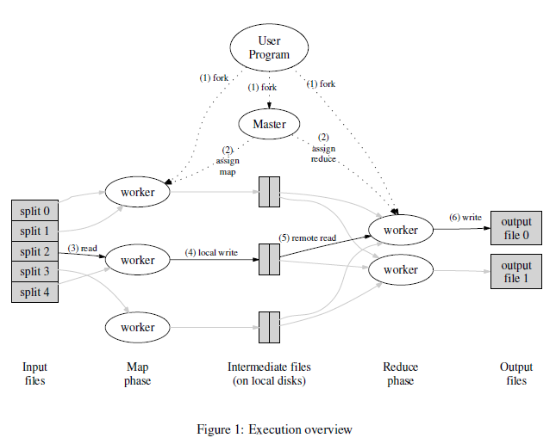
Data Analysis in the Cloud:
Available options for open source and commercial database:
MapReduce-like software
Fault Tolerance:
Designed with fault tolerance as a high priority.
Data analysis job is divided into many small tasks
Tasks assigned to a failed machine are transparently reassigned to another machine.
MapReduce experiment:
Killing 200 out of 1746 worker processes involved in a MapReduce job resulted in only a 5% degradation in query performance

Slide 20
Data Analysis in the Cloud:
Available options for open source and commercial database:
MapReduce-like software
Ability to run in a heterogeneous environment
Towards the end of a MapReduce job tasks that are still in progress get redundantly executed on other machines
Task are marked as completed as soon as the primary or the backup execution has completed:
Limits the effect “straggler” machines can have on total query time
Backup executions assigned to these machines will complete first
MapReduce Experiment:
It was shown that backup task execution improves query performance by 44% by alleviating the affects caused by slower machines

Slide 21
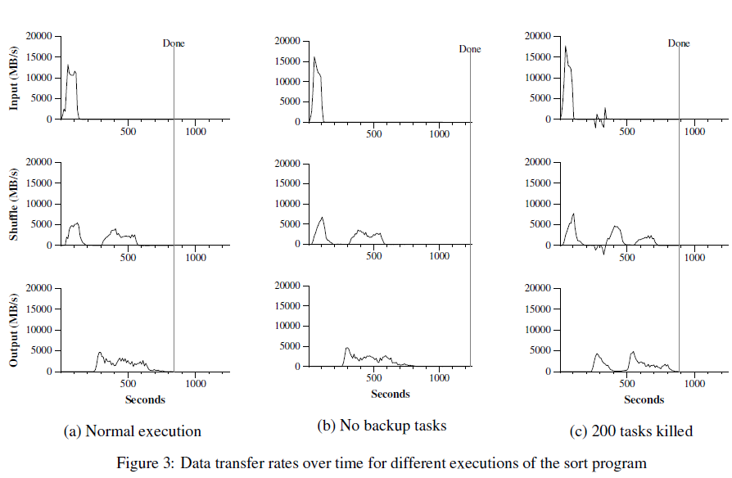
Data Analysis in the Cloud:
Available options for open source and commercial database:
MapReduce-like software
Figure(b) Show an execution of the sort program with backup tasks disabled.
Results: Execution flow is similar Figure (a) except that there is a very long tail where write activity barely occurs.
After 960 seconds, all except 5 of the reduce tasks are completed.
The last few stragglers don’t finish until 300 seconds later
The entire computation takes 1283 seconds, an increase of 44% in elapsed time

Slide 22
Data Analysis in the Cloud:
Available options for open source and commercial database:
MapReduce-like software
Ability to operate on encrypted data
No ability to operate on encrypted data
Needs to be provided by user-defined code
Ability to interface with business intelligence products
Does not easily interface with existing business intelligence products
MapReduce was not intended to be a database system
Not SQL compliant

Slide 23
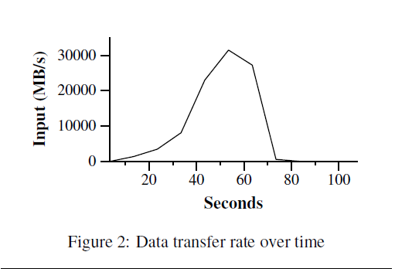
Data Analysis in the Cloud:
Available options for open source and commercial database:
MapReduce-like software
The Grep program:
Scans through 100-byte records searching for rare three-character patterns
Patterns occur in 92,337 records
The input is split into 64MB pieces (M = 15000)
The entire output is placed in one file (R = 1)

Slide 24
Data Analysis in the Cloud:
Efficiency
MapReduce experiment:
A rare string is searched for inside a 1TB dataset
1TB of data is read off 3600 disks in the cluster (in parallel) where a pattern search is performed
The entire Grep query took 150 seconds to complete
Dividing 1TB of data by the 3600 disks and 150 seconds to run the query:
Resulted in an average throughput of less than 2 MB/s/disk
At peak performance MapReduce was reading data at 32GB/s which is less than 10MB/s/disk.
Conclusion:
There is a need for improvement:
Given the long start-up time to get to peak performance, and that peak performance is four to six times slower than how fast disks in the cluster could actually be read
Available options for open source and commercial database: MapReduce-like software

Slide 25
Data Analysis in the Cloud:
Available options for open source and commercial database:
Shared-Nothing Parallel Databases
Ability to interface with business intelligence products
Not designed to work on top of databases
Efficiency
Improve query performance by implementing:
Indexes
Materialized views
Compressions
Fault Tolerance
Most parallel database systems restart a query upon a failure
Designed for environments where queries take no more than a few hours and run on a few hundred machines
Failures are rare so an occasional query restart is not problematic
Cloud environment offer:
Machines are cheaper
Less reliable
Less powerful
Failures more common

Slide 26
Data Analysis in the Cloud:
Available options for open source and commercial database:
Shared-Nothing Parallel Databases
Ability to run in a heterogeneous environment
Designed to run on homogeneous equipment
Susceptible to degraded performance:
If a small subset of nodes in the parallel cluster are performing poorly
Ability to operate on encrypted data
Not implement
Encryption needs to be hand-code to support user defined functions

Slide 27
Data Analysis in the Cloud:
A Call For A Hybrid Solution:
Map-Reduce-like soft and Parallel databases are ideal solutions for data analysis in the cloud
Each provide certain features that meets the five recommendation solution for impacting cloud market:
Hybrid solution combining:
Fault tolerance
Heterogeneous cluster
Ease of use capabilities
MapReduce + Parallel Database Systems = efficiency, performance, tool plugability

Slide 28
Data Analysis in the Cloud:
A Call For A Hybrid Solution:
Current Solutions :
Aim to integrate declarative queries from the database community into MapReduce-like software
Provideds greater data independence, code reusability, and automatic query optimization
Pig project (Yahoo)
SCOPE project (Microsoft)
Greenplum and Aster Data
Added the ability to write MapReduce functions over data stored in their parallel database products

Slide 29
Data Analysis in the Cloud:
A Call For A Hybrid Solution:
There remains a need for a hybrid solution at the systems level in addition to at the language level:
Future research:
How to combine the advantages of MapReduce-like software with the efficiency and shared-work advantages that come with loading data and creating performance enhancing data structures?
Proposal:
Incremental algorithms
Allows data to be initially read directly off the file system
Each time data is accessed progress is made towards the many activities surrounding a DBMS load
Compression
Index
Materialized view creation

Slide 30
Data Analysis in the Cloud:
A Call For A Hybrid Solution:
There remains a need for a hybrid solution at the systems level in addition to at the language level:
Future research:
How to balance the tradeoffs between fault tolerance and performance?
Through fault tolerance maximization by carefully check pointing intermediate results at the cost of performance
Providing a system that can adjust its levels of fault tolerance on the fly given an observed failure rate.

Slide 31
Summary:
The advantages and disadvantages of deploying database systems in the cloud
Read-mostly analytical database management applications are best suited for cloud deployment, than transactional data management applications
Large scale data analysis is not suited for cloud deployment and there is a need for a new design of DBMS to handle this type of analysis
The need for hybrid solutions at the systems level that combines the features of MapReduce and Parallel Database Systems

Slide 32
Questions?

