Slide 1
Hadoop: A Framework for Data-Intensive Distributed Computing
CS561-Spring 2012
WPI, Mohamed Y. Eltabakh

Slide 2
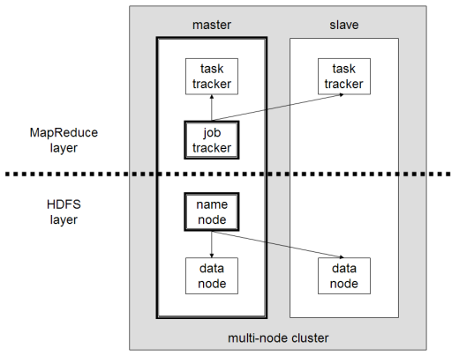
What is Hadoop?
Hadoop is a software framework for distributed processing of large datasets across large clusters of computers
Hadoop is open-source implementation for Google MapReduce
Hadoop is based on a simple programming model called MapReduce
Hadoop is based on a simple data model, any data will fit
Hadoop framework consists on two main layers
  Distributed file system (HDFS)
  Execution engine (MapReduce)

Slide 3
Hadoop Infrastructure
Hadoop is a distributed system like distributed databases
However, there are several key differences between the two infrastructures
  Data model
  Computing model
  Cost model
  Design objectives

Slide 4
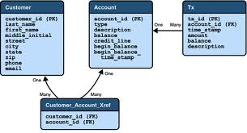
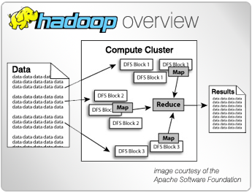
How Data Model is Different?
Distributed Databases
Hadoop
Deal with tables and relations
Must have a schema for data
Data fragmentation & partitioning
Deal with flat files in any format
No schema for data
Files are divide automatically into blocks

Slide 5
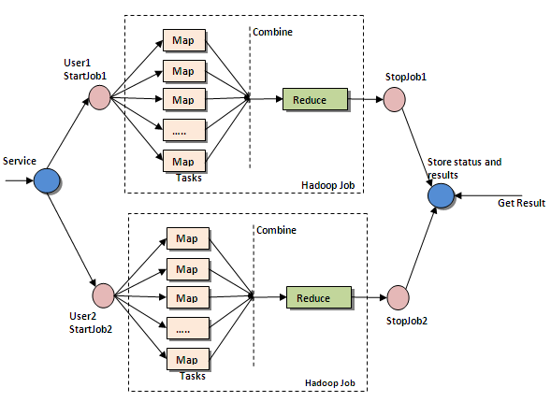
How Computing Model is Different?
Distributed Databases
Hadoop
Notion of a transaction
Transaction properties ACID
Distributed transaction
Notion of a job divided into tasks
Map-Reduce computing model
Every task is either a map or reduce

Slide 6
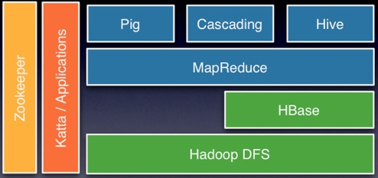
Hadoop: Big Picture
High-level languages
Execution engine
Distributed light-weight DB
Centralized tool for coordination
Distributed File system
HDFS + MapReduce are enough to have things working

Slide 7
What is Next?
Hadoop Distributed File System (HDFS)
MapReduce Layer
Examples
  Word Count
  Join
Fault Tolerance in Hadoop

Slide 8
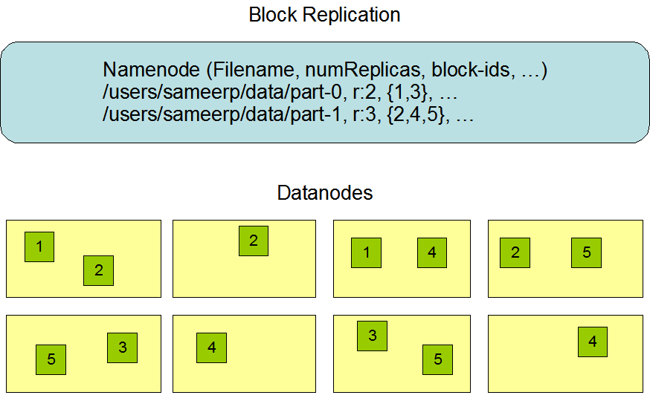
HDFS: Hadoop Distributed File System
Single namenode and many datanodes
Namenode maintains the file system metadata
Files are split into fixed sized blocks and stored on data nodes (Default 64MB)
Data blocks are replicated for fault tolerance and fast access (Default is 3)
Datanodes periodically send heartbeats to namenode
HDFS is a master-slave architecture
  Master: namenode
  Slaves: datanodes (100s or 1000s of nodes)

Slide 9
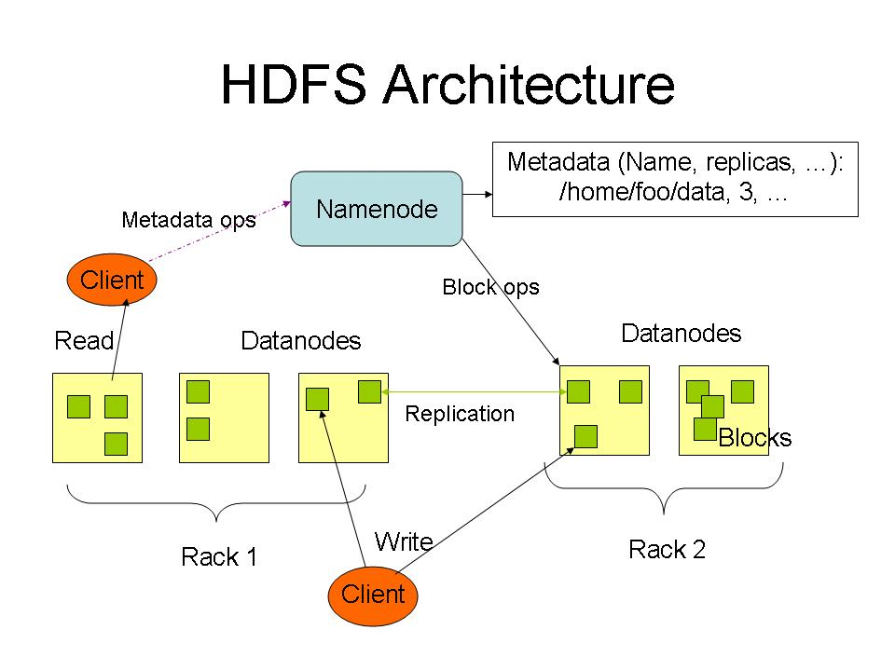
HDFS: Data Placement and Replication
Datanodes can be organized into racks
Default placement policy: Where to put a given block?
  First copy is written to the node creating the file (write affinity)
  Second copy is written to a data node within the same rack
  Third copy is written to a data node in a different rack
  Objectives: load balancing, fast access, fault tolerance

Slide 10
What is Next?
Hadoop Distributed File System (HDFS)
MapReduce Layer
Examples
  Word Count
  Join
Fault Tolerance in Hadoop

Slide 11
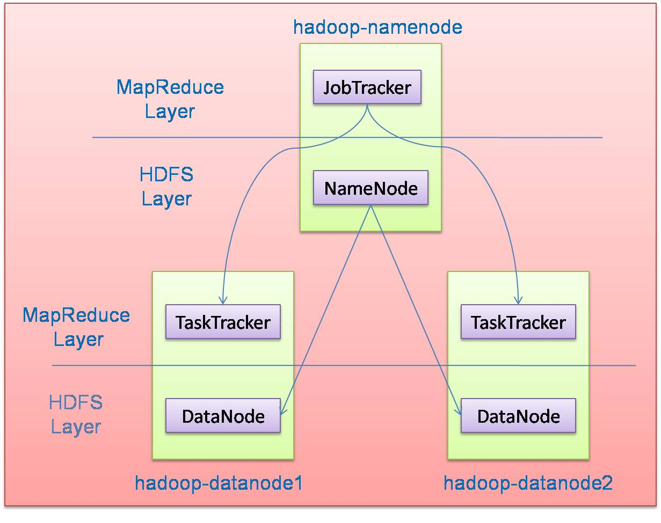
MapReduce: Hadoop Execution Layer
Jobtracker knows everything about submitted jobs
Divides jobs into tasks and decides where to run each task
Continuously communicating with tasktrackers
Tasktrackers execute tasks (multiple per node)
Monitors the execution of each task
Continuously sending feedback to Jobtracker
MapReduce is a master-slave architecture
  Master: JobTracker
  Slaves: TaskTrackers (100s or 1000s of tasktrackers)
Every datanode is running a tasktracker

Slide 12
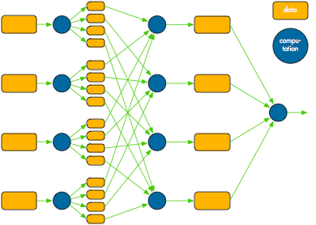
Hadoop Computing Model
Two main phases: Map and Reduce
Any job is converted into map and reduce tasks
Developers need ONLY to implement the Map and Reduce classes
Data Flow
Shuffling and Sorting
Blocks of the input file in HDFS
Output is written to HDFS
Map tasks (one for each block)
Reduce tasks

Slide 13
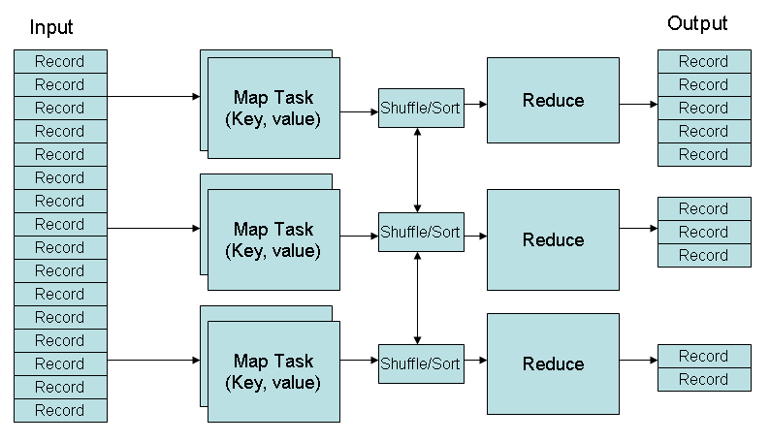
Hadoop Computing Model (Cont’d)
Mapper and Reducers consume and produce (Key, Value) pairs
Users define the data type of the Key and Value
Shuffling & Sorting phase:
  Map output is shuffled such that all same-key records go to the same reducer
  Each reducer may receive multiple key sets
  Each reducer sorts its records to group similar keys, then process each group

Slide 14
What is Next?
Hadoop Distributed File System (HDFS)
MapReduce Layer
Examples
  Word Count
  Join
Fault Tolerance in Hadoop

Slide 15
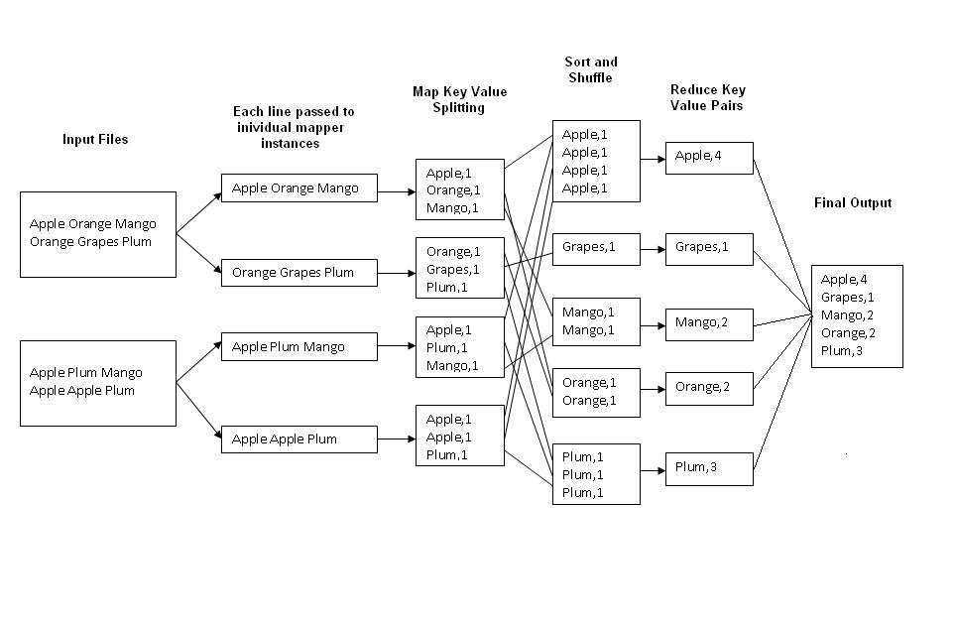
Word Count
Job: Count the occurrences of each word in a data set
Map
Tasks
Reduce
Tasks
Reduce phase is optional: Jobs can be MapOnly

Slide 16
Joining Two Large Datasets
Dataset A
Dataset B
Different join keys
Reducers perform the actual join
Reducer 1
Reducer 2
Reducer N
Shuffling and sorting over the network
Shuffling and Sorting Phase
- Each mapper processes one block (split)
- Each mapper produces the join key and the record pairs
Mapper 1
Mapper 2
Mapper 3
Mapper M+N
HDFS stores data blocks
(Replicas are not shown)

Slide 17
Joining Large Dataset (A) with Small Dataset (B)
Dataset A
Dataset B
Different join keys
Every map task processes one block from A and the entire B
Every map task performs the join (MapOnly job)
Avoid the shuffling and reduce expensive phases
Mapper 1
Mapper 2
Mapper N
HDFS stores data blocks
(Replicas are not shown)

Slide 18
What is Next?
Hadoop Distributed File System (HDFS)
MapReduce Layer
Examples
  Word Count
  Join
Fault Tolerance in Hadoop

Slide 19
Hadoop Fault Tolerance
Intermediate data between mappers and reducers are materialized to simple & straightforward fault tolerance
What if a task fails (map or reduce)?
  Tasktracker detects the failure
  Sends message to the jobtracker
  Jobtracker re-schedules the task
What if a datanode fails?
  Both namenode and jobtracker detect the failure
  All tasks on the failed node are re-scheduled
  Namenode replicates the users’ data to another node
What if a namenode or jobtracker fails?
  The entire cluster is down
Intermediate data
(materialized)

Slide 20
Reading/Writing Files
Recall: Any data will fit in Hadoop, so how does Hadoop understand/read the data?
User-pluggable class “Input Format”
  Input formats know how to parse and read the data (convert byte stream to records)
  Each record is then passed to the mapper for processing
Hadoop provides built-in Input Formats for reading text & sequence files
Input Formats can do a lot of magic to change the job behavior
Map code
Input Format
The same for writing →
“Output Formats”

Slide 21
Back to Joining Large & Small Datasets
Dataset A
Dataset B
Different join keys
Every map task processes one block from A and the entire B
How does a single mapper reads multiple splits (from different datasets)?
  Customized input formats
Mapper 1
Mapper 2
Mapper N
HDFS stores data blocks
(Replicas are not shown)

Slide 22
Using Hadoop
Java language
High-Level Languages
  Hive (Facebook)
  Pig (Yahoo)
  Jaql (IBM)

Slide 23
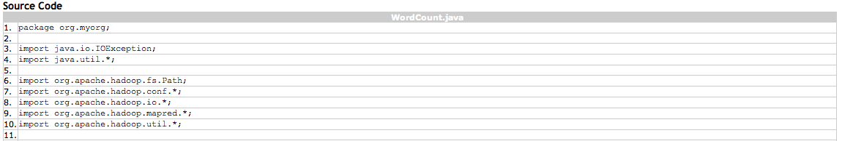
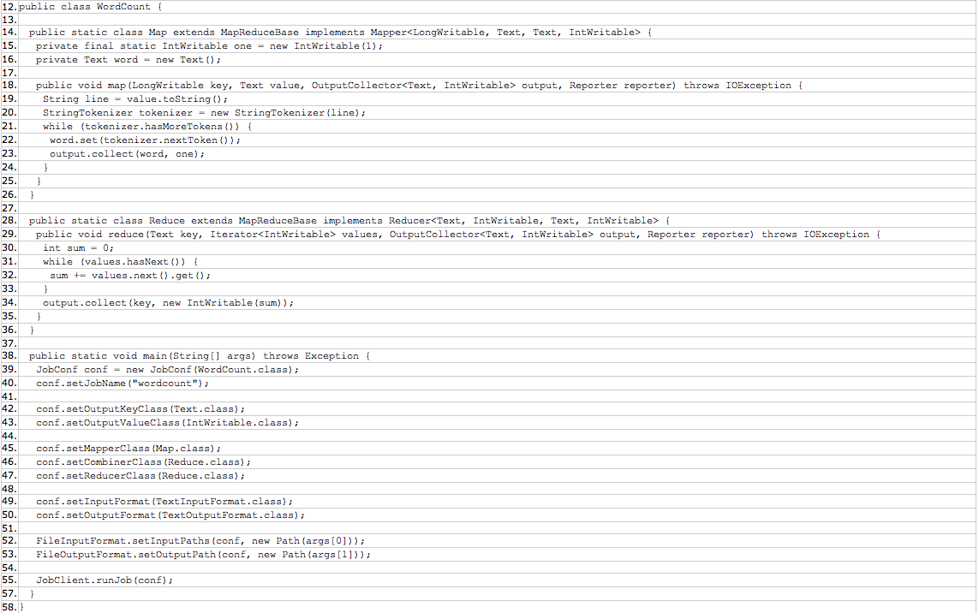
Java Code Example
Import Hadoop libs
Map class
Reduce class
Job configuration

Slide 24
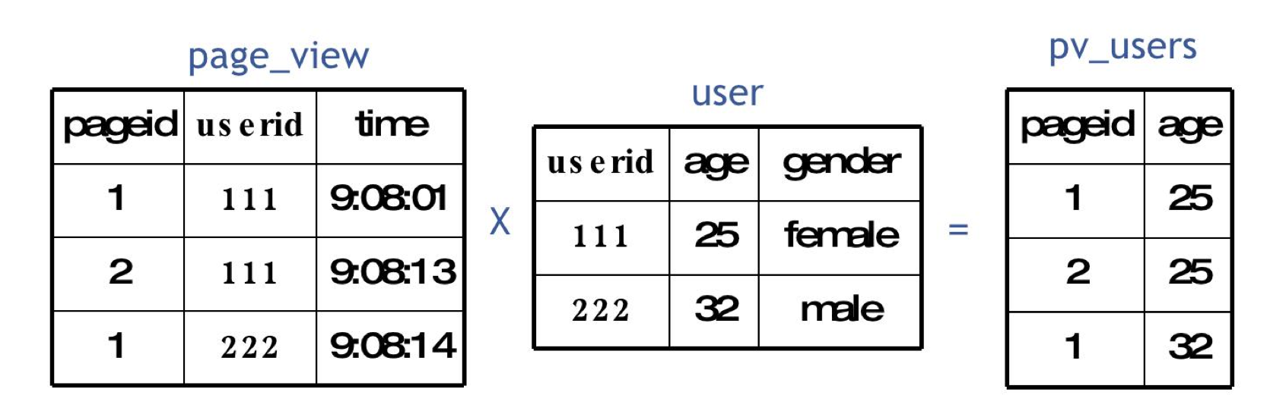
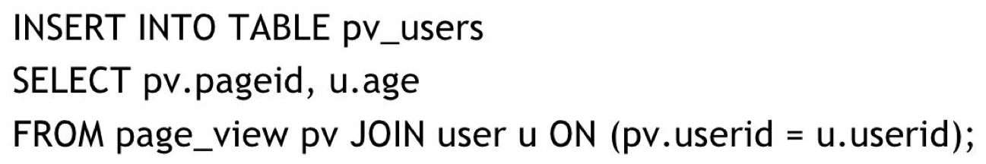
Hive Language
High-level language on top of Hadoop
  Like SQL on top of DBMSs
Support structured data, e.g., creating tables, as well as extensibility for un-structured data
Create Table user (userID int,
age int,
gender char)
Row Format Delimited Fields;
Load Data Local Inpath ‘/user/local/users.txt’ into Table user;

Slide 25
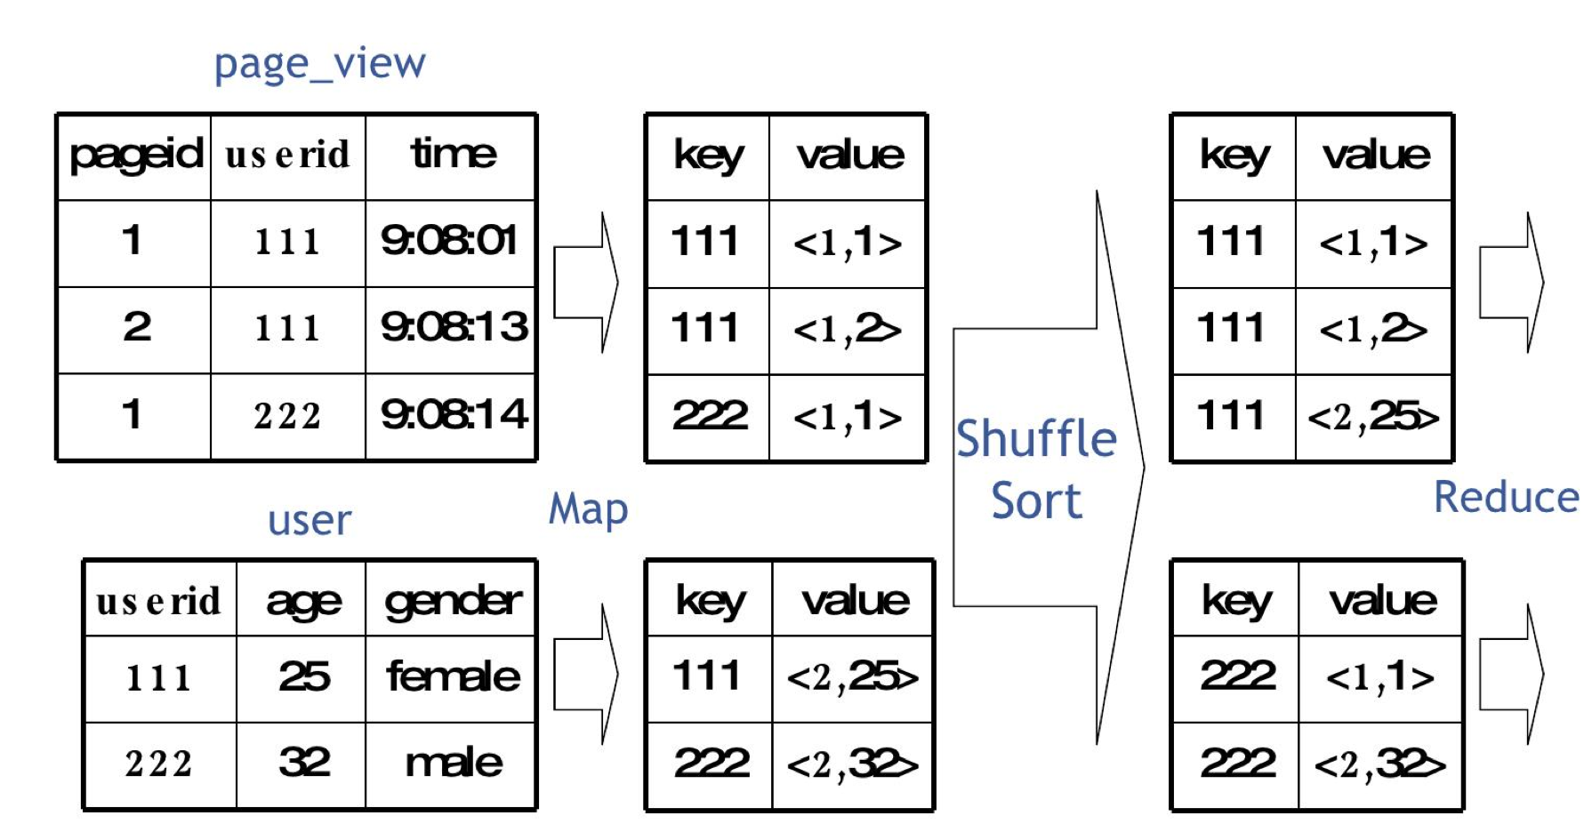
From Hive To MapReduce

Slide 26
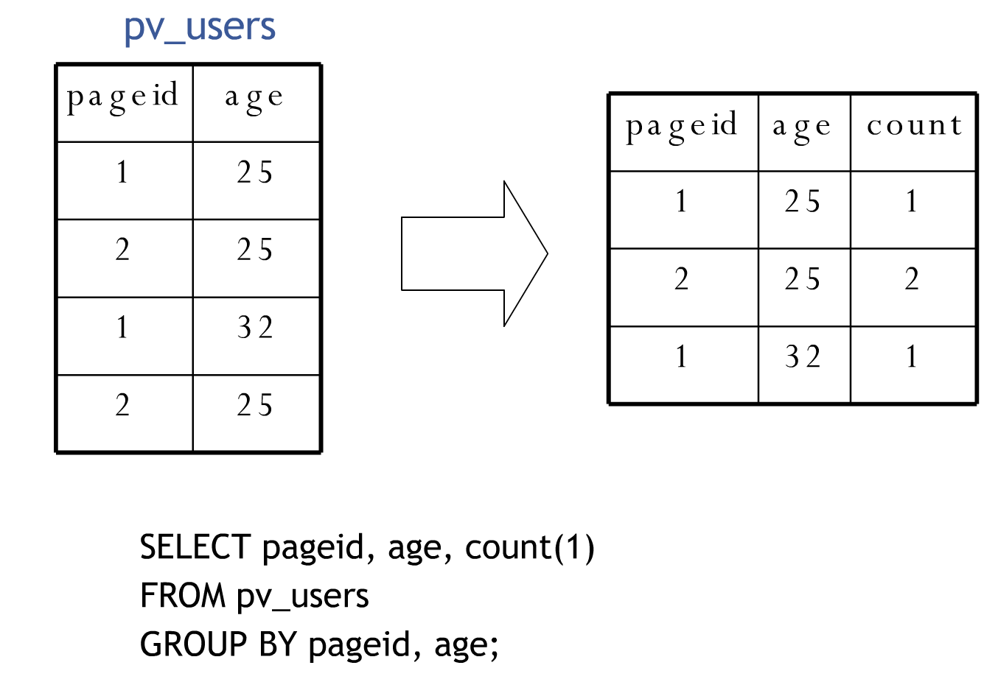
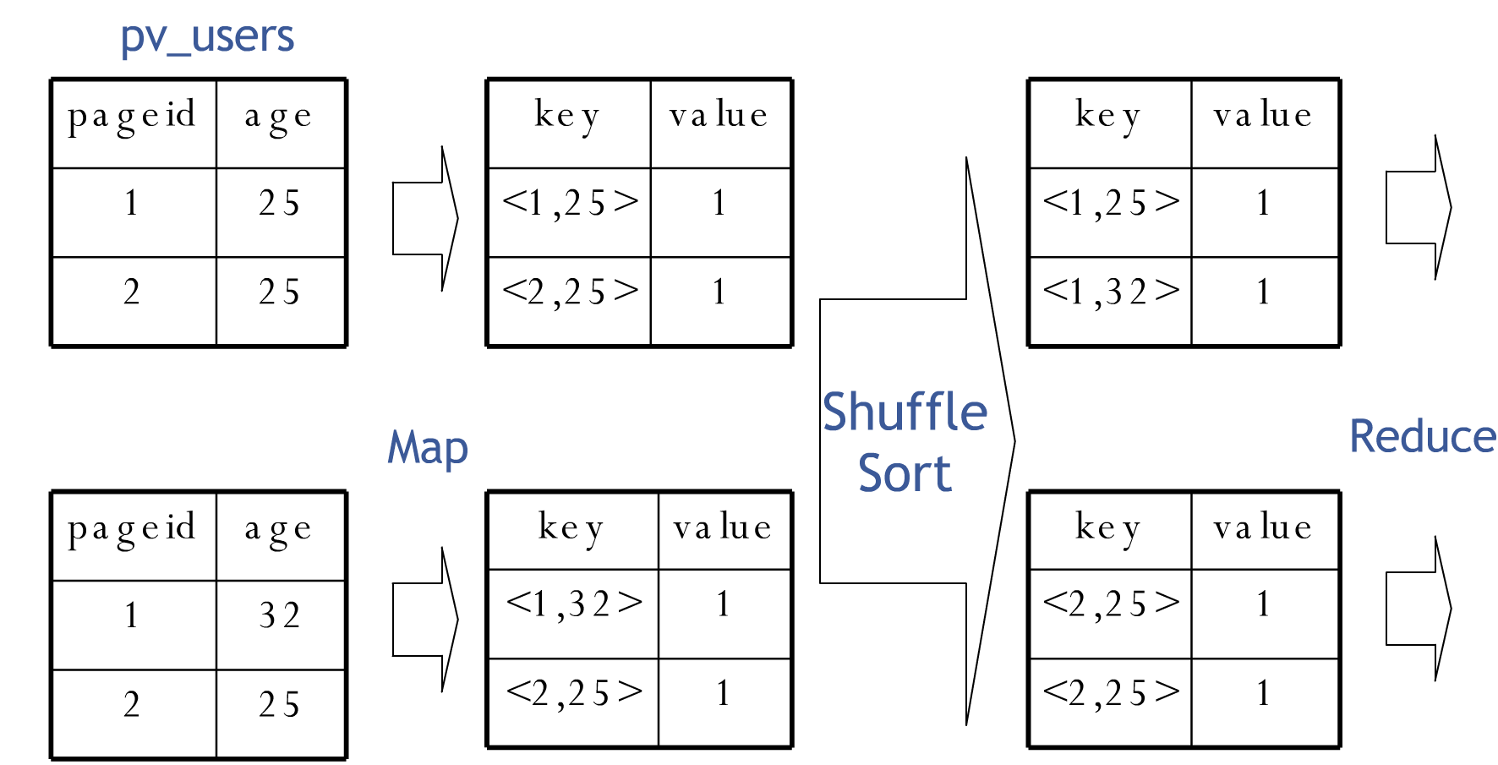
Hive: Group By

Slide 27
Summary
Hadoop is a distributed systems for processing large-scale datasets
  Scales to thousands of nodes and petabytes of data
Two main layers
  HDFS: Distributed file system(NameNode is centralized)
  MapReduce: Execution engine (JobTracker is centralized)
Simple data model, any format will fit
  At query time, specify how to read (write) the data using input (output) formats
Simple computation model based on Map-Reduce phases
  Very efficient in aggregation and joins
Higher-level Languages on top of Hadoop
  Hive, Jaql, Pig

Slide 28
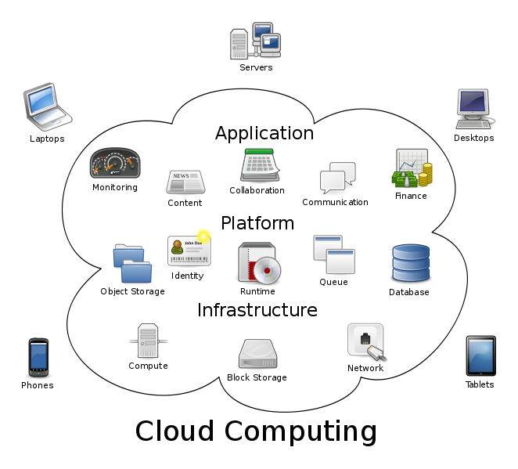
Summary: Hadoop vs. Other Systems
 | Distributed Databases | Hadoop
Computing Model | Notion of transactions Transaction is the unit of work ACID properties, Concurrency control | Notion of jobs Job is the unit of work No concurrency control
Data Model | Structured data with known schema Read/Write mode | Any data will fit in any format (un)(semi)structured ReadOnly mode
Cost Model | Expensive servers | Cheap commodity machines
Fault Tolerance | Failures are rare Recovery mechanisms | Failures are common over thousands of machines Simple yet efficient fault tolerance
Key Characteristics | - Efficiency, optimizations, fine-tuning | - Scalability, flexibility, fault tolerance
Cloud Computing
  A computing model where any computing infrastructure can run on the cloud
  Hardware & Software are provided as remote services
  Elastic: grows and shrinks based on the user’s demand
  Example: Amazon EC2

