Slide 1
CS548 Spring 2016 Web Mining Showcase
Cansu Sen, Nichole Etienne & Cut Famelia
Showcasing work by Sunmoo Yoon, Noémie Elhadad, Suzanne Bakken on
“A Practical Approach for Content Mining of Tweets”

Slide 2
References
Yoon, Sunmoo, Noémie Elhadad, and Suzanne Bakken. "A practical approach for content mining of Tweets." American journal of preventive medicine 45.1 (2013): 122-129.
"Social Network Importer for NodeXL", 2016. [Online]. Available: https://socialnetimporter.codeplex.com. [Accessed: 22- Apr- 2016].
[E1996] O. Etzioni, “The World Wide Web: Quagmire or Gold Mine”, in Communications of the ACM, 39(11):65-68, 1996.
[CMS1997] R. Cooley, B. Mobasher, J. Srivastava, “Web Mining: Information and Pattern Discovery on the World Wide Web”, in Proceedings of the 9th IEEE International Conference on Tools With Artificial Intelligence (ICTAI ’97), Newport Beach, CA, 1997.

Slide 3
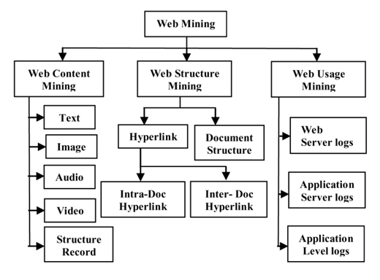
Web Mining
First used in [E1996], defined in a ‘task oriented’ manner
Alternate ‘data oriented’ definition given in [CMS1997]
Web mining refer to the application of data mining techniques to extract knowledge from Web data.

Slide 4
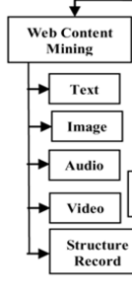
Web Content Mining
Web Content Mining is the process of extracting useful information from the contents of Web documents.
Content data corresponds to the collection of facts a Web page was designed to convey to the users.
Techniques from other disciplines such as Information Retrieval (IR) and natural language processing (NLP) are usually applied to the content mining.

Slide 5
Web Content Mining : Typical Preprocessing
Content Preparation:
Extract text from HTML
Perform Stemming
Remove Stop Words
Calculate Collection Wide Word Frequencies (DF)
Calculate per Document Term Frequencies (TF)
Vector Creation:
Information Retrieval Techniques
Each document is represented by a sparse vector of term weights
TFIDF weighting is most common

Slide 6
Context Mining, Twitter and Health
“Tweets may represent more-naturalistic content and have the additional advantage of being available in large volume”
Real-time, real-world data
Example: Health behaviors, ecologic momentary assessment
Capture a behavior, current activity, location, and social surroundings at any particular moment
Tweet contents are not dependent on a specific intermittent stimulus to
The intended respondent

Slide 7
Research Questions
What is the content of Tweets that mention specific physical activities?
Does Tweet content vary by specific physical activity?
Does Tweet content change over time?
What proportion of Tweets that mention specific physical activities express positive as compared to negative sentiments?
How is context expressed in Tweets that mention specific physical activities?

Slide 8
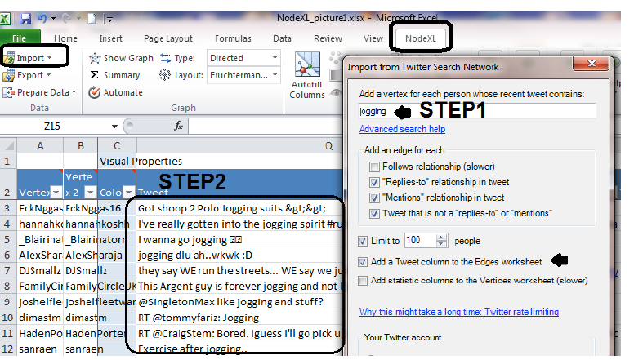
Step 1 and 2
Selecting tweets: Identify appropriate key terms and phrases (e.g.,synonyms/morphologic variants) for extraction of Tweets to create the analytic corpus.
Importing: Tweets are imported by searching the selected terms and phrases via Tweet import tools.
NodeXL
Notes:
Open-source Microsoft Excel template for creating a Tweet data corpus
Convenient data manipulation for users without programming skills by facilitating searching Twitter for public Tweets and importing the Tweets as an Excel file.
Visualizations

Slide 9
Step 3: Preparing Tweets
Text cleaning
Text transformation
Dimensionality reduction (attribute selection)

Slide 10
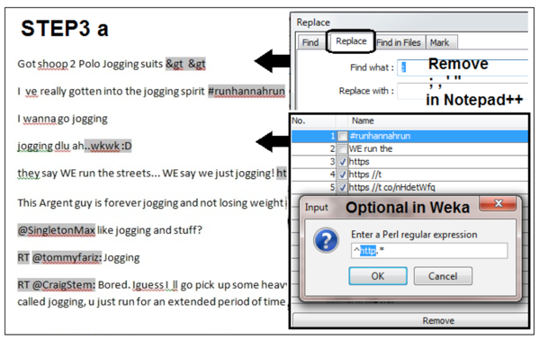
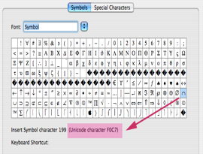
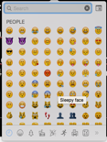
Text Cleaning

Slide 11
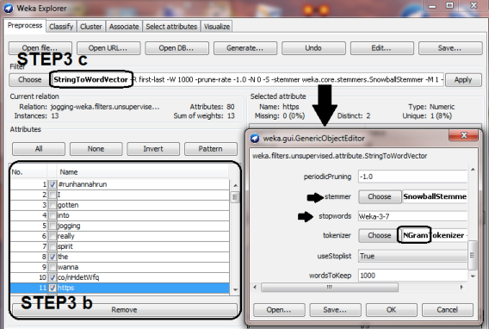
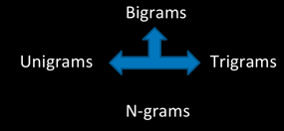
Text Transformation

Slide 12
Dimensionality Reduction

Slide 13
Step 4: Analyzing Data
(a) Topic Detection
(b) Sentiment Analysis
(c) Categorization of Ecologic Momentary Context

Slide 14
Topic Detection

Slide 15
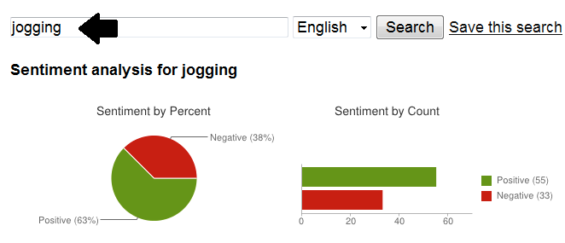
Sentiment Analysis & Categorization of Ecologic Momentary Context
Extract subjective information on a topic/document by computational analytic techniques
Sentiment analysis tool categorizes Tweets as positive or negative
Tweets qualitatively examined based on context typically assessed in ecologic momentary assessment: time, purpose, environment, social context, feeling.

Slide 16
Step 5: Interpreting Data
Domain experts play a critical role/make decisions.
Domain experts terminated the process because the study scope was to investigate the spring season.
Alternative decision:
return to Step 2 to import Tweets in a different season to
increase generalizability

Slide 17
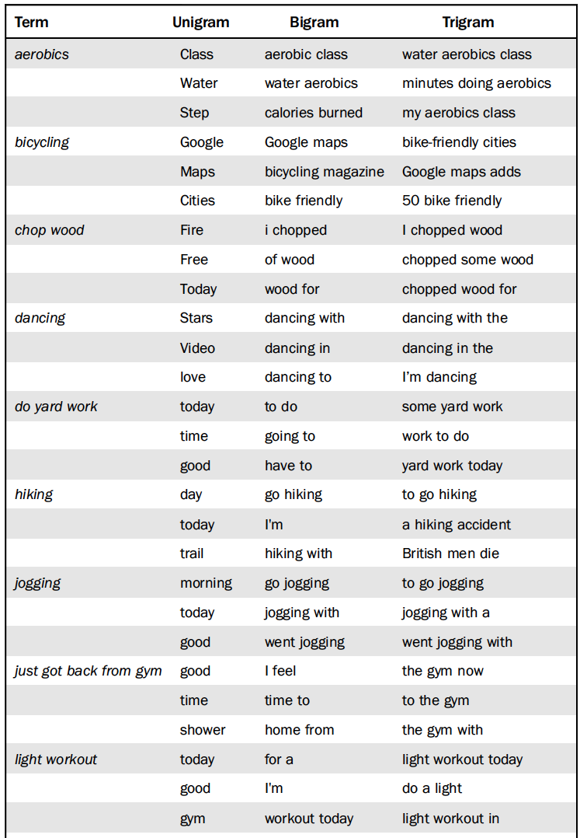
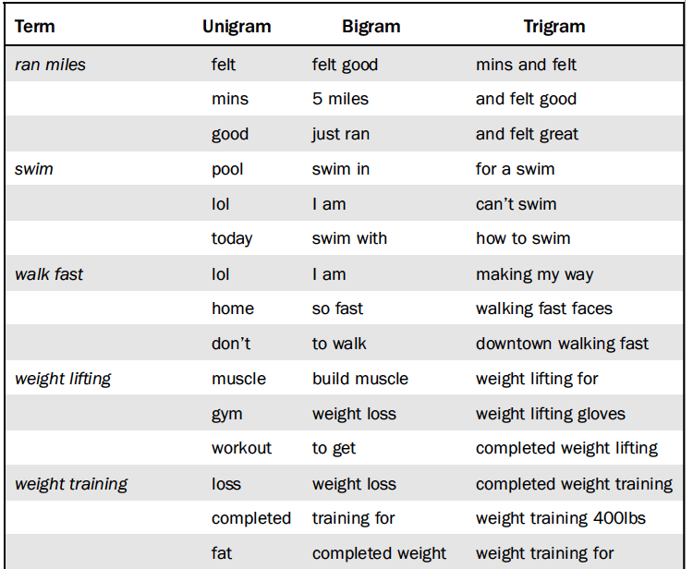
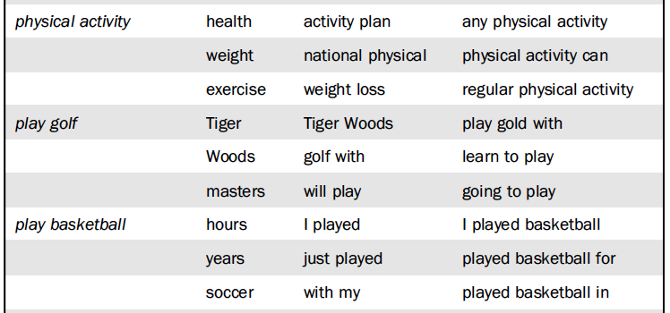
1) What is the content of Tweets that mention specific physical activities?
The most frequently occurring unigram, bigram, and trigram for each physical activity

Slide 18
2) Does Tweet content vary by specific physical activity?
The term “good” appeared across all activities
“obesity” occurred only for a few activities
“but should” (light workout); “mountain” (hiking); and “the basics” (bicycling) were the most distinct terms calculated by chi-square test.
Selected distinct terms that frequently appeared in Tweets that mention physical activity: “student, women, unintentional physical activity, breast cancer prognosis, arthritis walk season, cell phone, improve symptoms gerd, everyone benefits, CDC”

Slide 19
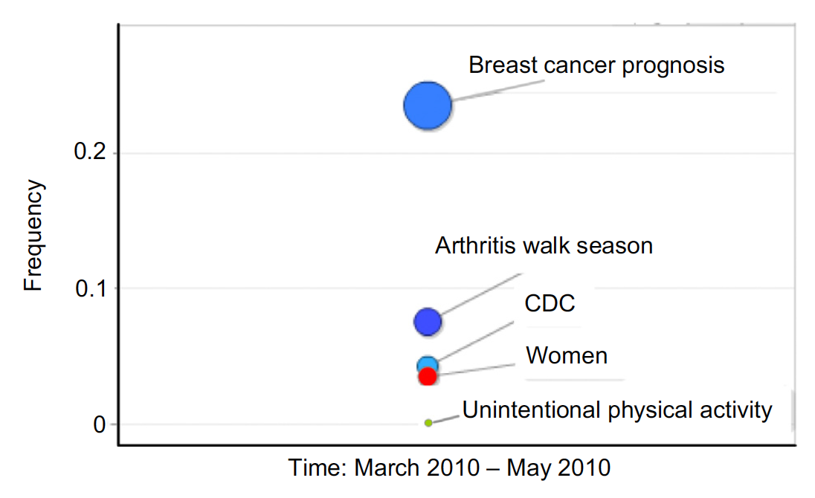
3) Does Tweet content change over time?
The change of distinctive terms of bicycling over the course of 12 weeks.
The change of distinctive terms of physical activity over the course of 12 weeks.

Slide 20
3) Does Tweet content change over time?

Slide 21
4) What proportion of Tweets that mention specific physical activities express positive as compared to negative sentiments?
For the physical activity most Tweets reflected positive attitudes, with bicycling (77%) as the top-ranked category.
Tweet categories that reflected more than 40% negative sentiments were as follows: walking fast, running, weight-lifting, physical activity, basketball, yard work, weight training, and jogging.
Tweets mentioning hiking, golf, dancing, and swimming showed consistent positive sentiments, whereas others varied over time.
Dancing-related Tweets were overwhelmingly positive.

Slide 22
5) How is context expressed in Tweets that mention specific physical activities?
Tweets that mention outdoor activities contained information about physical contexts such as weather condition, trails, seasonal condition, and time of day.
Tweets that mention running provided detailed information about the activity (e.g., miles run, duration—hours/minutes/seconds, intensity—fast/slow).
Emotional context (e.g., emotional obligation, feelings) was also prevalent in some Tweets. Tweets revealed social context (e.g. with my dad, friend, sister).

Slide 23
Conclusion & Discussion
Results:
Results support the applicability of Twitter as an assessment tool by demonstrating the relevance of Tweet contents as a source of health behavior data.
Approach may overcome the limitations of self-reports of health behavior.
Help health behavior researchers utilize the detected topics for health behavior intervention design.
Motivation for changing health behaviors.
Contributions:
Introduced a simple method for mining Tweet contents
Illustrated application of the content-mining pipeline to gain insights for health behavior research
3D motion chart as a visualization strategy
Challenges:
Assessment of complex health behaviors
Health promoting behavior intervention design
Motivation for health-promoting behaviors
Notes:
Intervention strategies example: the basics, traffic, and safety were frequently occurring distinct terms in bicycle related Tweets.
Researchers, government officials and health providers can harness such distinct terms for designing interventions that promote bicycling.

Slide 24
Questions
Comments

