Slide 1
CS 548 Spring 2016 Model and Regression Trees Showcase
by
Yanran Ma, Thanaporn Patikorn, Boya Zhou
Showcasing work by
Gabriele Fanelli, Juergen Gall, and Luc Van Gool
on
Real Time Head Pose Estimation with Random Regression Forests

Slide 2
References
[1] Fanelli, G.; Gall, J.; Van Gool, L., "Real time head pose estimation with random regression forests," in IEEE Conference on Computer Vision and Pattern Recognition (CVPR), 2011, vol., no., pp.617-624, 20-25 June 2011. doi: 10.1109/CVPR.2011.5995458 URL: http://ieeexplore.ieee.org/stamp/stamp.jsp?tp=&arnumber=5995458&isnumber=5995307 [2] Hastie, Trevor; Tibshirani, Robert; Friedman, Jerome (2008). The Elements of Statistical Learning (2nd ed.). Springer. ISBN 0-387-95284-5. Page 587-588

Slide 3
Outline
Application: Real Time Head Pose Estimation with Random Regression Forests
Background & Importance
Formulate the Problem
Input & Labels
Training Set & Test Set
Algorithm: Random Regression Forest
Results

Slide 4
Short Description
This paper introduces a system that can detect head pose in real-time. The detection algorithm uses random regression forests, which utilize several regression trees to make predictions. Since images do not have typical features for tree construction, the trees were trained from sets of randomly generated rules that maximize information gain.

Slide 5
Background & Importance
Problem: want to detect head pose in real time
Importance: allows for higher-level face analysis tasks e.g. emotion detection
Image taken from [1]

Slide 6
Input
What is the input?
extracted visual feature “channels” from patches:
depth values
X, Y, Z of geometric normal vectors
What is the resolution?
image in 640x480 range(fixed)
patches in 120x80 pixels (fixed)
What are patches?
randomly selected regions of pixels from an image

Slide 7
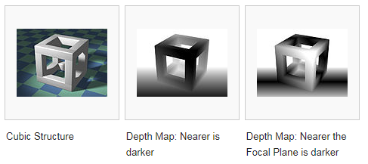
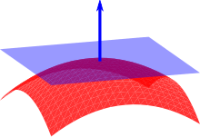
Image Channels
Depth
Normal Vector
geometric
normal vector
source: https://en.wikipedia.org/wiki/Normal_(geometry)
source: https://en.wikipedia.org/wiki/Depth_map

Slide 8
Each Image Will Look Like This
3 | 5 | 9 | 7 | 11 | 13 | 25 | 35
7 | 22 | 30 | 35 | 35 | 40 | 30 | 32
11 | 22 | 33 | 44 | 55 | 66 | 77 | 88
15 | 30 | 45 | 30 | 32 | 64 | 23 | 12
12 | 12 | 12 | 13 | 15 | 15 | 12 | 13
35 | 45 | 43 | 23 | 95 | 65 | 43 | 21
23 | 56 | 75 | 93 | 65 | 32 | 21 | 43
56 | 58 | 43 | 21 | 65 | 47 | 95 | 23
3 | 5 | 9 | 7 | 11 | 13 | 25 | 35
7 | 22 | 30 | 35 | 35 | 40 | 30 | 32
11 | 22 | 33 | 44 | 55 | 66 | 77 | 88
15 | 30 | 45 | 30 | 32 | 64 | 23 | 12
12 | 12 | 12 | 13 | 15 | 15 | 12 | 13
35 | 45 | 43 | 23 | 95 | 65 | 43 | 21
23 | 56 | 75 | 93 | 65 | 32 | 21 | 43
56 | 58 | 43 | 21 | 65 | 47 | 95 | 23

Slide 9
Input
What is the input?
extracted visual feature “channels” from patches:
depth values
X, Y, Z of geometric normal vectors
What is the resolution?
image in 640x480 range(fixed)
patches in 120x80 pixels (fixed)
What are patches?
randomly selected regions of pixels from an image

Slide 10
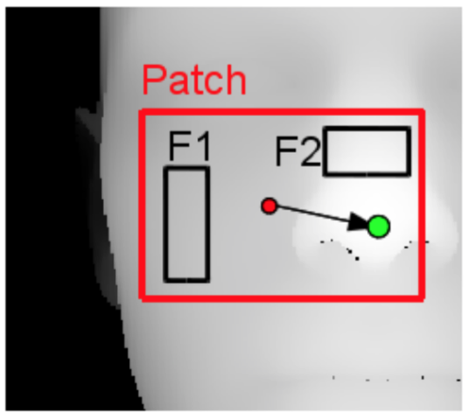
Patches
What are patches?
randomly selected regions of pixels from an image
patches in 120x80 pixels (fixed)
Patches will be samples
Image taken from [1]

Slide 11
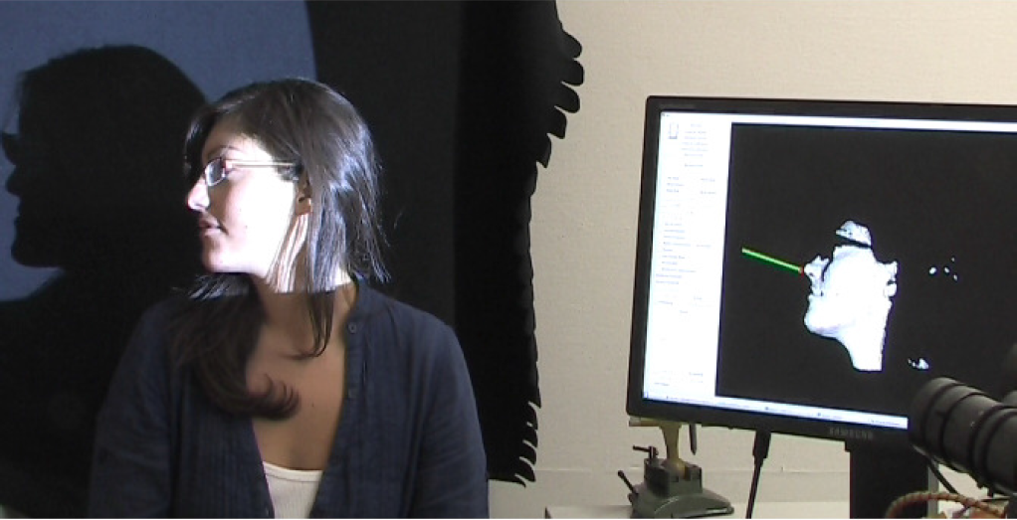
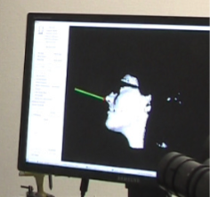
What Are They Trying to Predict
Want: the direction the head is facing (the green line)
The green line can be obtained if we know:
The location of the nose
The rotation of the head
Images taken from [1]

Slide 12
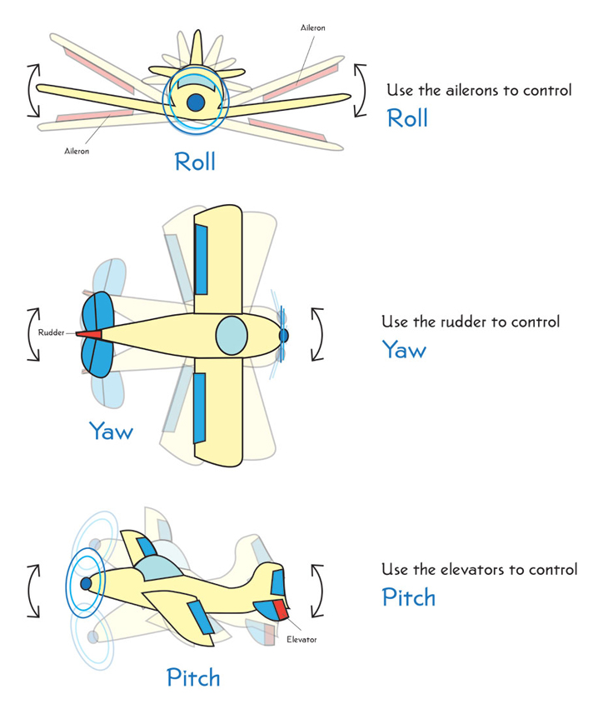
Formulate the Problem: Labels
6 Labels:
<x, y, z>: a vector from the center of a patch to the nose
<yaw, pitch, roll>: the rotation of the head
Image taken from [1]
Source:
http://howthingsfly.si.edu/flight-dynamics/roll-pitch-and-yaw

Slide 13
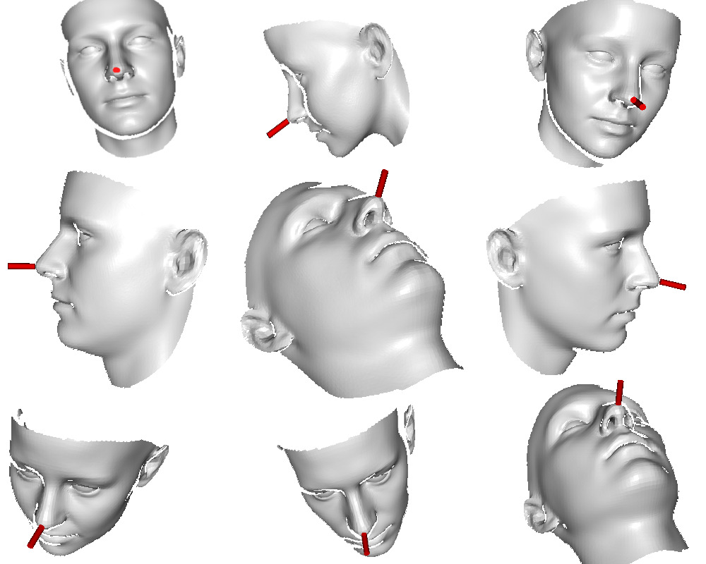
Training Set
Advantage of synthetic generated face images
Easy to obtain large amount images
Accurate label annotations
Zero noise
Image taken from [1]

Slide 14
Training Set
Training Set: generated using 3D model software
50,000 face images
All in 640x480 range
Random variation of <yaw, roll, pitch> = <±95, ±50, ±20>
Source: http://howthingsfly.si.edu/flight-dynamics/roll-pitch-and-yaw
Image taken from [1]

Slide 15
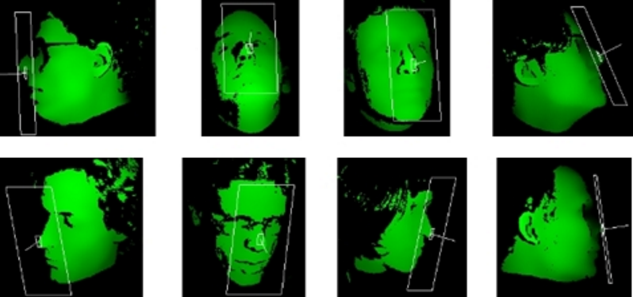
Test Set
Test Set: ETH Face Pose Range Image Data Set
https://www.vision.ee.ethz.ch/datasets/headposeCVPR08/

Slide 16
Test Set
Test Set: ETH Face Pose Range Image Data Set
Well-known published head pose data set
Big data set: over 10,000 images
Realistic data
Ground truth (labels) is provided
Each image is 640x480
head pose range: ±90 yaw and ±45 pitch
https://www.vision.ee.ethz.ch/datasets/headposeCVPR08/

Slide 17
What is Random Regression Forest?
A forest is a group of trees
Random: each tree is trained with only a random subset of training set
Random subset of features
Random subsamples
Each tree behaves just like regular decision/regression tree.

Slide 18
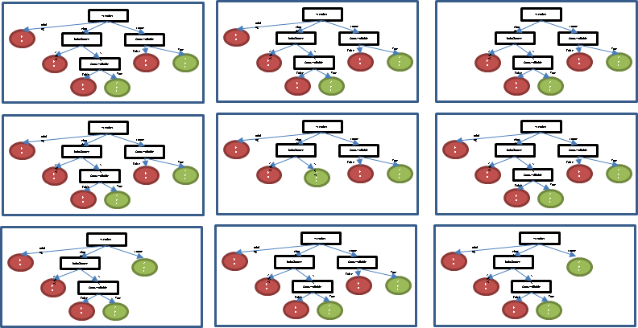
What is Random Regression Forest?
Since each tree is trained on different subset and different features, they might be the same or different from one another

Slide 19
What is Random Regression Forest?
One prediction per input per tree, the final prediction:
nominal class (decision forest): majority votes
numeric class (regression forest): average prediction
Advantage of random forest:
Smaller training set per tree = smaller prediction variance
Less overfitting than trees
Refer to reference [2] for more details

Slide 20
Random Forest in This Application
Each tree is trained on a set of patches randomly sampled from training set
The data are all images, the “features” are totally different from the “obvious” features,such as weather=sunny.
How do they use the image to
construct the tree?
Image taken from [1]

Slide 21
What They Actually Do
Map of Image Channels i.e. depth, x, y, z
3 | 5 | 9 | 7 | 11 | 13 | 25 | 35
7 | 22 | 30 | 35 | 35 | 40 | 30 | 32
11 | 22 | 33 | 44 | 55 | 66 | 77 | 88
15 | 30 | 45 | 30 | 32 | 64 | 23 | 12
12 | 12 | 12 | 13 | 15 | 15 | 12 | 13
35 | 45 | 43 | 23 | 95 | 65 | 43 | 21
23 | 56 | 75 | 93 | 65 | 32 | 21 | 43
56 | 58 | 43 | 21 | 65 | 47 | 95 | 23

Slide 22
What They Actually Do
Randomly pick 2 regions of equal size: F1 and F2
and randomly generated threshold value τ = 15
3 | 5 | 9 | 7 | 11 | 13 | 25 | 35
7 | 22 | 30 | 35 | 35 | 40 | 30 | 32
11 | 22 | 33 | 44 | 55 | 66 | 77 | 88
15 | 30 | 45 | 30 | 32 | 64 | 23 | 12
12 | 12 | 12 | 13 | 15 | 15 | 12 | 13
35 | 45 | 43 | 23 | 95 | 65 | 43 | 21
23 | 56 | 75 | 93 | 65 | 32 | 21 | 43
56 | 58 | 43 | 21 | 65 | 47 | 95 | 23

Slide 23
What They Actually Do
Sum the numbers in each region
F1 (green) = 187. F2 (blue) = 100
3 | 5 | 9 | 7 | 11 | 13 | 25 | 35
7 | 22 | 30 | 35 | 35 | 40 | 30 | 32
11 | 22 | 33 | 44 | 55 | 66 | 77 | 88
15 | 30 | 45 | 30 | 32 | 64 | 23 | 12
12 | 12 | 12 | 13 | 15 | 15 | 12 | 13
35 | 45 | 43 | 23 | 95 | 65 | 43 | 21
23 | 56 | 75 | 93 | 65 | 32 | 21 | 43
56 | 58 | 43 | 21 | 65 | 47 | 95 | 23

Slide 24
What They Actually Do
Compare F1 - F2 with threshold value.
If F1 - F2 > τ
right child
else
left child
In this case: F1 - F2 = 187 - 100 = 87 > 15
So this patch belongs to the right child

Slide 25
What They Actually Do
If we pick F1 (red) and F2 (blue)
Image 1: F1 – F2 = 0
Image 2: F1 – F2 = -1
Image 3: F1 – F2 = -18
Just by looking at F1 and F2, you can see image 3 is different from image 1 and 2 . The similar patches will move into the same leaves.

Slide 26
Summary of the Algorithm
For each non-leaf, there is a “binary test”
Each binary test is defined by: regions (F1 and F2), threshold (τ), and channel subset (I)
If the sum(F1. I_values) - sum(F2. I_values) > τ
This patch belongs to the right child
Otherwise the left child

Slide 27
Construction of the Forest
50,000 face images
3,000 face images
3,000 face images
3,000 face images
25 patches per image
25 patches per image
25 patches per image
Regression Tree 1
Regression Tree 2
Regression Tree 3

Slide 28
Construction of a Tree (in the Forest)
Randomly generated rules for a node
$$\left\{\begin{aligned}t_{1}= \{F1_{1}, F2_{1}, I_{1}, τ_{1}\} \\ t_{2}=\{F1_{2}, F2_{2}, I_{2}, τ_{2}\} \\ t_{3}=\{F1_{3}, F2_{3}, I_{3}, τ_{3}\}\end{aligned}\right.$$
75,000 patches

Slide 29
Construction of a Tree (in the Forest)
Separate patches with each rule. Compute entropy
$$\left\{\begin{aligned}t_{1}= \{F1_{1}, F2_{1}, I_{1}, τ_{1}\} \\ t_{2}=\{F1_{2}, F2_{2}, I_{2}, τ_{2}\} \\ t_{3}=\{F1_{3}, F2_{3}, I_{3}, τ_{3}\}\end{aligned}\right.$$
75,000 patches
Rule: t1
<yes, no> = <y1, n1> Entropy = e1
Rule: t2
<yes, no> = <y2, n2> Entropy = e2
Rule: t3
<yes, no> = <y3, n3> Entropy = e3

Slide 30
Construction of a Tree (in the Forest)
Select the rule that give the most information gain
$$\left\{\begin{aligned}t_{1}= \{F1_{1}, F2_{1}, I_{1}, τ_{1}\} \\ t_{2}=\{F1_{2}, F2_{2}, I_{2}, τ_{2}\} \\ t_{3}=\{F1_{3}, F2_{3}, I_{3}, τ_{3}\}\end{aligned}\right.$$
75,000 patches
Rule: t1
<yes, no> = <y1, n1> Entropy = e1
Rule: t2
<yes, no> = <y2, n2> Entropy = e2
Rule: t3
<yes, no> = <y3, n3> Entropy = e3
Most information gain = lowest entropy = e2 < e1 AND e2 < e3

Slide 31
Construction of a Tree (in the Forest)
Randomly generated rules for a node
75,000 patches
node
$$t_{2}=\{F1_{2}, F2_{2}, I_{2}, τ_{2}\}$$
no
Satisfy rule
n2 patches
y2 patches

Slide 32
Construction of the Forest
Each tree is trained on sampled 3,000 face images
25 120x80 patches of are generated from each face image
Tree construction
Generate a lot of binary tests randomly {F1, F2, I, τ}
Use each rule to split the data into left and right child
Choose rule that maximize information gain:

Slide 33
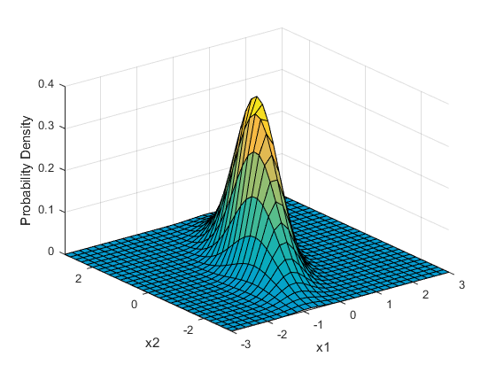
Construction of the Forest
For each leaf, Multivariate Gaussian distribution
Basically normal distribution on multiple dimensions
Gain Eq:
$Σ$ = covariate matrix (equivalent to standard deviation of 1 dimension)
v = offset vector. a = face angle
more info:
https://en.wikipedia.org/wiki/Multivariate_normal_distribution
http://www.mathworks.com/help/stats/multivariate-normal-distribution.html
Image taken from [1]
http://www.mathworks.com/help/stats/multivariate-normal-distribution.html

Slide 34
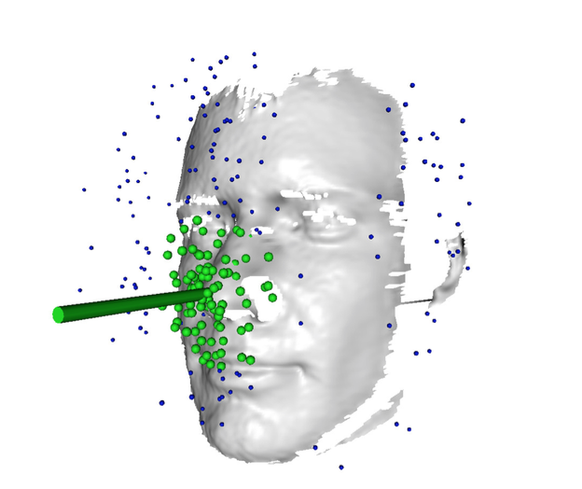
Experiments: Deal with Outliers
Discard all Gaussians with a variance > maxv = 400
Remove outliers using 10 mean-shift iterations
Intuition: use “mean” to draw a sphere to find outliers
Inside the sphere (green) = survive to the next iteration
Outside the sphere (blue) = eliminated
Green cylinder = estimated face direction from estimated nose center
Image taken from [1]

Slide 35
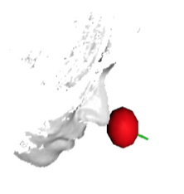
Results
Accuracy: 90.4% (“correct” threshold = ±10°)
Number of input channels (depth, x, y, z)
More = superior accuracy but slightly slower
Number of tree ≤ 15 and stride ≥ 20
≤ 40 ms/frame = 25 frames/sec = standard movie FPS
Intel Core i7 @ 2.67GHz
Increase tree = more accurate but slower
Decrease stride =more accurate but slower
Image taken from [1]

Slide 36
Real-Time Performance
Real-time System
Intel Core 2 Duo @ 2GHz. 2GB of RAM
Image taken from [1]

Slide 37
Discussion
Did they do as they claim?
Real-time
Number of tree ≤ 15 and stride ≥ 20
Accuracy
90.4% with 10° threshold
6.5%: all votes are deleted by mean-shift
In real-time system, video feed is 25 frames/seconds
There are a lot of room for error correction

Slide 38
Question and Answer

Slide 39
Additional Figures
Performance of the algorithm with only depth compared to depth + <x,y,z>
Graphs taken from [1]

