Slide 1
CS 548 - Spring 2016
Clustering Showcase II
Presented by
Alexander W. Witt and Chengle Zhang
Showcasing work by
Alaa El Masri, Harry Weschler, Peter Likarish, Christopher Grayson, Calton Pu, Dalal Al-Arayed, and Brent ByungHoonKang
A. El Masri, H. Weschler, P. Likarish, C. Grayson, C. Pu, D. Al-Arayed, and B. ByungHoonKang. “Active authentication using scrolling behaviors,” Information and Communication Systems (ICICS), 2015 6th International Conference on, Amman, 2015, pp. 257-262. doi: 10.1109/IACS.2015.7103185
Notes:
Good evening, my name is Alexander Witt and my name is Chengle Zhang. In this presentation, which marks the second showcase in this course that covers the topic of clustering, we will discuss a research paper produced by Alaa El Masri, Harry Weschler, Peter Likarish, Christopher Grayson, Calton Pu, Dalal Al-Arayed, and Brent ByungHoonKang that is titled, “Active authentication using scrolling behaviors”.

Slide 2
Presentation Outline
References
Abstract
Introduction
Terminology
The Dataset
Feature Representation
Classification
Clustering
Clustering Approaches
Classification Results
Clustering Results
Notes:
To clearly indicate the trajectory for our presentation, we provide here an outline. As can be seen, we will first indicate the works that we referenced. Then, we will provide an overview of the showcase work by covering its abstract. Next will come an introduction to the subject matter of the showcase work. Following afterward will then be a definition of some key terminology needed for understanding the domain. Once the terminology is defined, we will then start discussing the dataset that was used and the feature vectors that were used. After that, we will then talk about the classification and clustering approaches that were mentioned in the showcase work as well as the results recorded for those approaches. Finally, we will present the conclusion and then ask if there are any questions.

Slide 3
References
A. El Masri, H. Weschler, P. Likarish, C. Grayson, C. Pu, D. Al-Arayed, and B. ByungHoonKang. “Active authentication using scrolling behaviors,” Information and Communication Systems (ICICS), 2015 6th International Conference on, Amman, 2015, pp. 257-262. doi: 10.1109/IACS.2015.7103185
P.N Tan, M. Steinbach, V. Kumar, “Cluster Analysis: Basic Concepts and Algorithms,” in Introduction to Data Mining, 1st Edition, Boston, MA; Pearson Education, Inc. 2006, pp. 496-515
Notes:
In preparation for this showcase, we utilized two different references. The first work that is cited is the research paper on which this showcase is based, and the second work that is cited is the introductory textbook on data mining that is used for this course.

Slide 4
Part I
The Domain

Slide 5

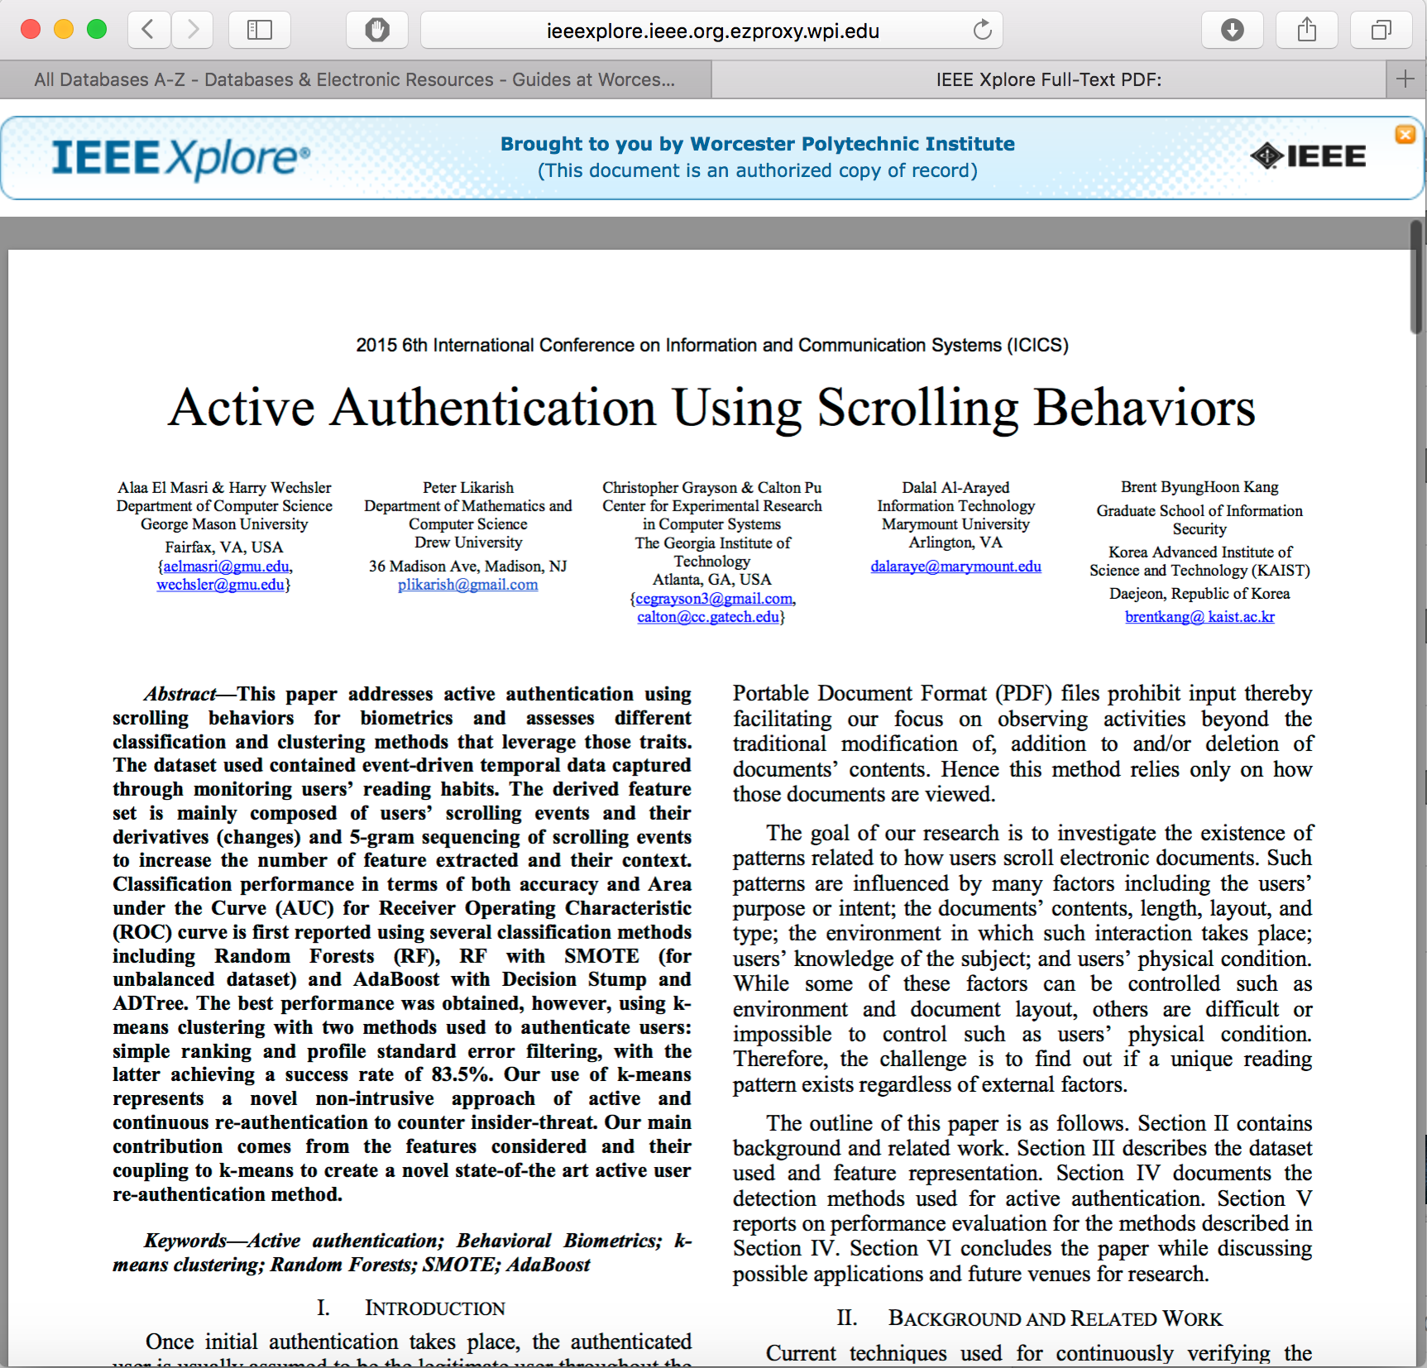


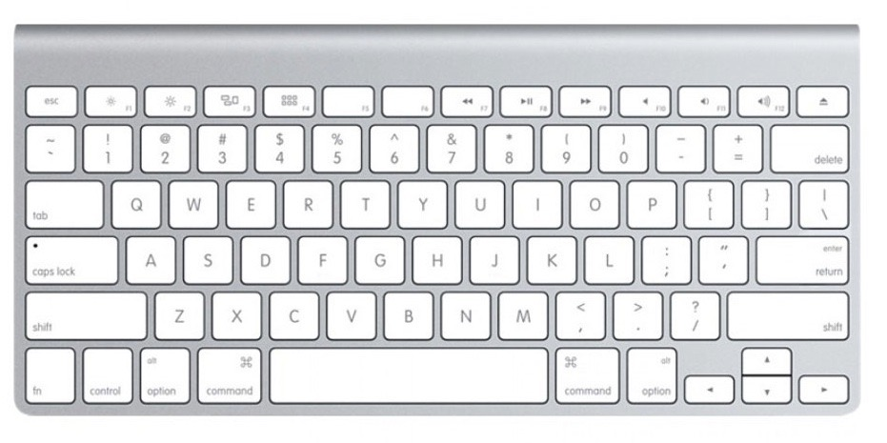
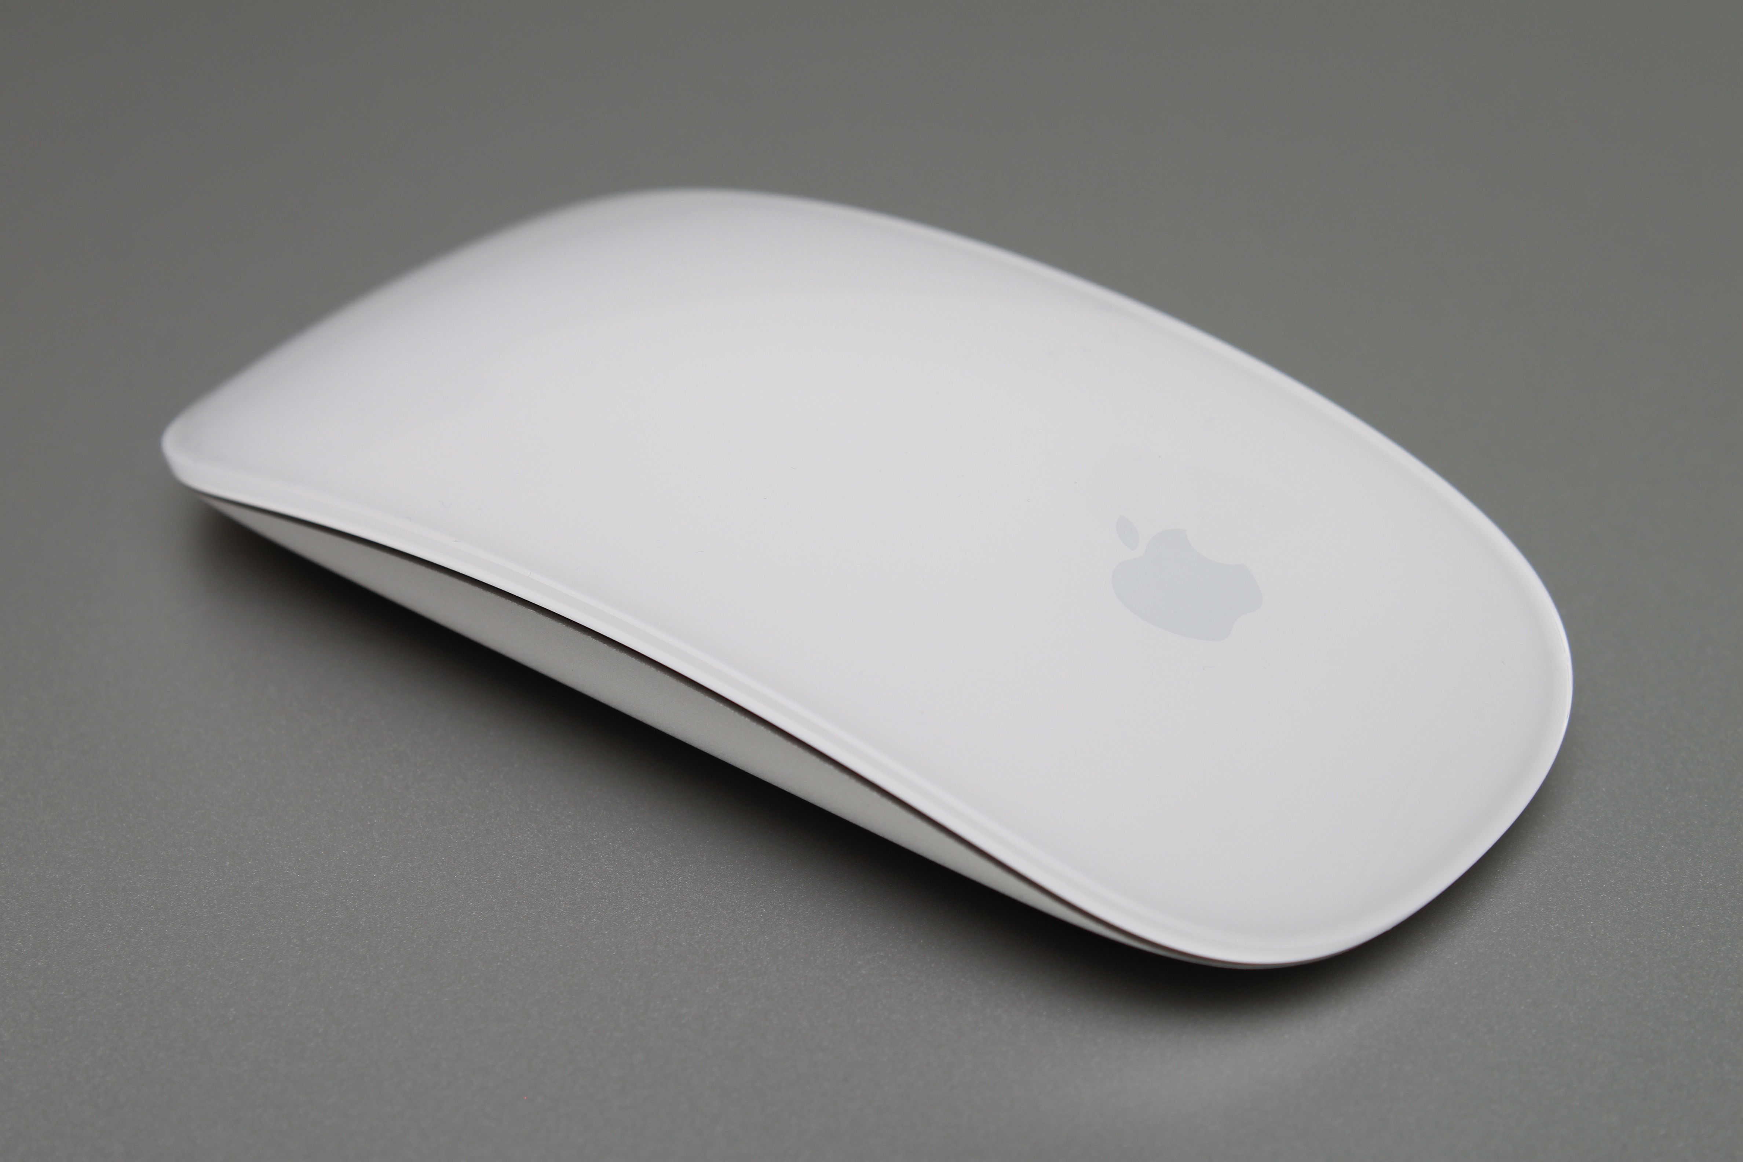
Abstract
Active authentication
Scrolling behavior biometrics
Event-driven temporal data
Monitoring user reading habits
Classification evaluation
K-means clustering evaluation
Contribution features
Contribution use of k-means
Notes:
According to the abstract, the research paper for this showcase focuses on developing a method for active authentication that relies on user scrolling behavior. In this case, the data is time-series data that is driven by scrolling events. These events in particular occur while a user is reading a read-only electronic document displayed in a web-browser on a traditional computer. To perform repeated authentication both different kinds of classification models and a k-means clustering model were trained and then evaluated over a set of reading sessions. The key contributions made by the authors included the features used as well as the application of k-means clustering to the task of authentication.

Slide 6
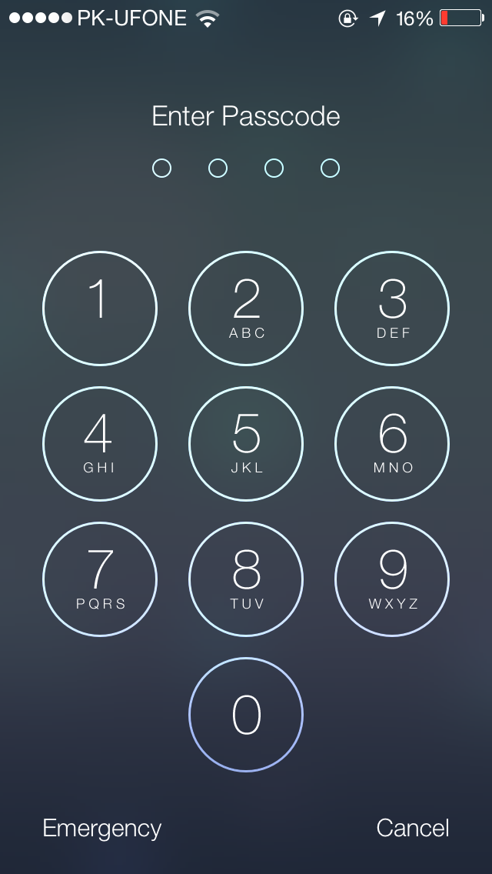
Introduction
Passive authentication does guarantee the identity of the user throughout a session
Scrolling is caused by keyboard or mouse events on a traditional computer
The goal is to investigate the existence of patterns related to how users scroll electronic documents
There are many factors that influence scrolling behavior
Example of passive authentication
Notes:
In the introduction to the showcase work, the authors clearly define the problem of the domain that they are addressing, the source that they use for collecting their data, the main objective of their work, and factors that influence the collected data. The specific problem that the authors identify is that authentication schemes that only authenticate the user at the start of a session can permit an unauthorized user to hijack the session and use it gain access to priveleged information. Consequently, the authors advocate for the use of a scheme called “active authentication” in which a user is repeatedly re-authenticated throughout the course of a session. To avoid interrupting the user for every re-authentication, the authors opt to use information recorded for the user’s scrolling behavior instead of asking for knowledge that the user knows (such as a passcode) or asking the user to input a code sent to another device that he or she owns (such as a smartphone). However, in order to use scrolling behavior successfully for re-authentication, the authors indicate that their goal is to first investigate the existence of patterns related to how users scroll electronic documents. This, as the authors indicate, is not a trivial task since a multitude of factors pertaining to documents, user knowledge, and physical condition can add noise to the data.

Slide 7
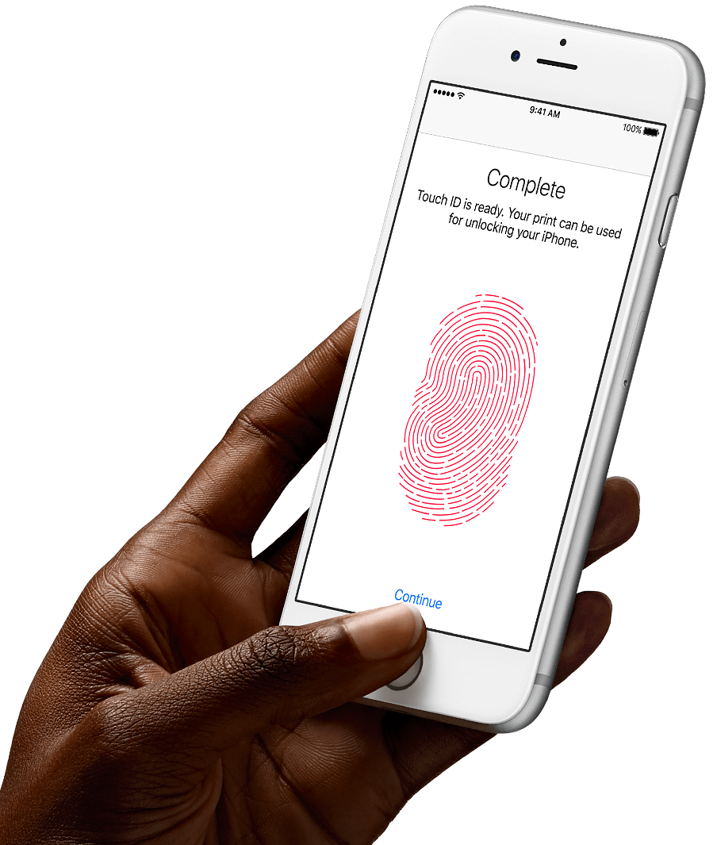
Terminology
Biometric
Authentication
Active Authentication
Reading Session (RS)
Feature Vector
Notes:
Before proceeding any further in the presentation for this showcase, we thought that it might be useful to clarify some of the terminology that had been used. The first term, biometric, refers to a collection of physical or behavioral characteristics collected from a user. The second term, authentication, refers to the task of proving something is true, such as whether or not an individual is who he or she claims to be. The third term, active authentication, refers to the task in which authentication is repeated throughout the course of a session. The fourth term, reading session, refers to a session in the showcase work in which a user is viewing a read-only document in a web-browser. Finally, the last term, feature vector, refers to a vector storing all of the features of scrolling behavior mined from a reading session that are used for authenticating a user.
In the image on the right, you can see an example of a profile of a fingerprint biometric being stored for passive authentication on a smartphone.

Slide 8
Part II
Dataset & Feature Representation

Slide 9

The Dataset
Repurposed a dataset obtained from a previous research project at Georgia Tech
The dataset was from an experiment aimed at detecting document access activities that indicate an insider threat
Subjects logged into a web application and read a PDF document in their browser
84 subjects, 54 documents, 529 reading sessions
Notes:
Now that the domain of the showcase work has been defined, the next step is to indicate how the raw data was collected. In this case, the authors repurpose a dataset obtained from a previous research project conducted at Georgia Tech. As they mention, the dataset was obtained from an experiment targeted toward detecting document access activities which indicate the presence of an insider threat. For each subject who participated in the experiment, they logged into a web application and read a PDF document in a web-browser. While engaging in this activty, the information for every scroll event and window resize event was stored to a database. Overall there were 84 subjects, 54 documents to choose from, and 529 reading sessions for which observations were recorded.

Slide 10

Feature Representation
Three different feature vectors were derived from the data collected in the dataset
The first feature vector contains statistical measurements for scrolling behavior
The second feature vector contains information on the polarity of scrolling and the pauses between scrolls
The 20 features present in the third feature vector were not mentioned specifically by the authors
Notes:
From this raw data which had been recorded, three different types of feature vectors were then derived so that the data could be used with classification and clustering techniques. The first feature vector that the authors derived contained statistical measurements for scrolling behavior such as average, standard deviation, and velocity of horizontal and vertical scrollings. In all, 14 features were contained within this feature vector. The second feature vector that the authors derived contained a representation on the polarity of scrolling and the pauses between scrolls. In all, 13 binarized features were contained within this feature vector. Finally, the third feature vector that the authors derived created a bipartite graph with the set of users in one set of nodes and the set of documents in the other set of nodes. Reading sessions were used to linked these two sets of nodes as edges. All documents read fewer than 5 times were removed and all users who read fewer than 8 documents were removed. This left 27 users and 35 documents. When a feature vector was extracted for each reading session in a way not described by the authors, the median for each feature in each vector was computed. Next, the feature vectors for all reading sessions were binarized to a value of 1 if the feature in the vector was greater than the median, otherwise they were binarized to a value of 0. In all there were 20 features contained within this third type of feature vector.

Slide 11
Part III
Authentication Methods

Slide 12
Classification
“Is the current user the authenticated user or not?”
Binary classification problem with two different classes Authenticated and Imposters
Random Forest (RF) with feature vector type 1
SMOTE and AdaBoost applied independently to RF to decrease classifier bias toward the majority class
Applied sub-sequencing to reduce classifier bias. Authors built a continuous feature vector across all reading sessions for a given user of the second feature vector type
Q1
Q2
Q3
P1
P2
P3
P4
Notes:
The first type of authentication method that the authors mention in their work is classification. Through the use of this particular scheme, the question that is being answered is the following: “Is the current user the authenticated user or not?”. Consequently, the type of classification considered in this work is binary classification using the two classes of Authenticated and Imposter. When using this scheme, the authors decide first to use a Random Forest (RF) classifier with feature vectors of type 1. They make this decision because RF tends to perform better for predicting individual profiles due to the multiple weak classifiers that it trains and the majority vote ranking scheme that it uses. In other experiments, the authors also applied SMOTE (Synthetic Minority Over-sampling Technique) and AdaBoost independently to decrease the classifier’s bias toward the majority class, Imposters. AdaBoost was used in particular to improve the performance of the weak classifiers used in the RF ensemble classifier. Finally, the last classification technique that the authors tried was a technique called sub-sequencing in which a continuous feature vector of type 2 is built across all reading sessions for a given user. With this approach every new scroll event gave a new subsequence for analysis.

Slide 13
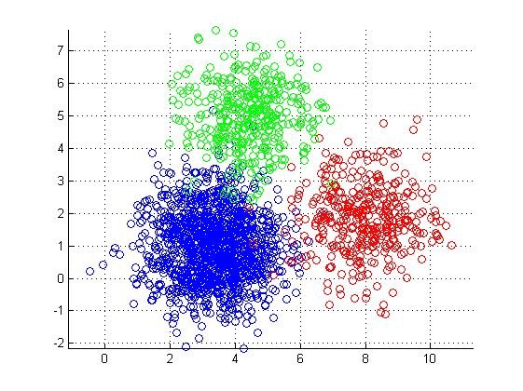
Clustering
Attention turned from authenticating user identity to narrowing down the possibility that the current reading pattern belongs to a small set of registered users
User profiles created from reading session data
Calculating distance to a profile
Notes:
The second type of authentication method that the authors mention in their work is clustering. Through the use of this particular scheme, the question that is being answered is the following: “Can we narrow down the possibility that the current reading pattern belongs to a small set of registered user profiles?”. A pattern not belonging to any set of profiles would be regarded as an Imposter.
To construct the required profiles for users each reading session from the data was first converted into a type 3 feature vector consisting of 20 features. Next, each of these type 3 feature vectors produced for a user’s reading sessions are clustered using the k-means algorithm and the centroids are extracted from the produced clusters.
The number of clusters used in this case for k-means was the square root of the number of data points, for the user, n, divided by 2 since this is a well-known rule of thumb. In this way, the number of clusters varied per profile. However, to reduce the squared error in some profiles more clusters were sometimes added until the squared error was less than 15. This acheived a balance between variance within each cluster and overfitting.
Once representation of each user as a set of centroids was acheived, the next step was to construct a clustering model for authentication which could be done through use of Euclidean Distance. Construction of the model was done through use of a Leave-one-out approach in which one reading session was left out as a target to match.

Slide 14
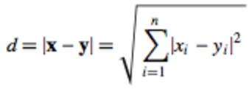
Clustering Approaches
Approach I : Simple ranking by distance
Approach II: Filtering possible users by profile standard error
Notes:
To determine the most likely readers in a reading session, two cluster-based approaches were used by the authors. In the first approach, which is based on simple ranking by distance, the most likely readers of a reading session are determined by ranking the Euclidean distances from a given reading session to each of the user profiles. In the second approach, which is based on filtering possible users by profile standard error, a per-profile threshold distance is calculated by taking the average distance between the reading sessions in each profile and the centroids for the profile and then adding one standard deviation to that distance. In this scheme the a profile would be marked as a possible candidate for a reading session if the distance was within the calculated threshold.

Slide 15
Part V
Results

Slide 16
Classification Results
Preprocessing: Eliminated sessions with less than 150 observations and for users with less than 6 reading sessions. This left 29 users.
RF with 10 fold cross-validation was run on the stratified data set. Best results with 40 trees and 9 features. F-measure was poor (0.27) for the Authenticated class and excellent (0.99) for the Imposter class. Poor performance due to imbalance.
Applying SMOTE yeild slight improvement: F-measure of 0.29 for the Authenticated class
AdaBoost increased F-measure for Authenticated class to 0.35 with DecisionStump and 0.39 with ADTree.
When subsequencing was used for 44 users the F-measure was 0.50 for the Authenticated class, meaning only neutral prediction capability
Notes:
The classification results overall were generally poor in predicting the minority class, Authenticated. However, slight improvements in F-score for the minority class were obtained when applying SMOTE and AdaBoost. Neutral prediction capability was reached when subsequencing was applied.

Slide 17
Clustering Results
Approach I : Simple ranking by distance - 19.75% of the time actual user profile predicted - 58% - 80% actual user in top 5 and 10 profiles
Approach II: Filtering by profile standard error - 33% of profiles marked as possible - 83.5% of the time actual user in possible profiles
Notes:
The clustering results indicated that for approach I 19.75% of the time the actual user profile could be predicted when using simple ranking by distance and 58% - 80% of the time the actual user is located in the top 5 and top 10 ranked profiles. Additionally, for approach II, the clustering results indicated that filtering by profiles standard error could be used to reduce the number of possible user profiles down to 33% of all user profiles in which the correct user profile would reside 83.5% of the time.

Slide 18
Questions ?

Slide 19
Image Sources
http://www.gadgetreview.com/wp-content/uploads/2012/11/apple-wireless-keyboard-2.jpg
http://nakedconsumerism.com/wp-content/uploads/2016/02/mousejack-explained.jpg
http://www.mrgeek.me/wp-content/uploads/2013/06/Passcode-iOS-7.png
http://www.thegoodguys.com.au/cs/groups/public/documents/graphic/apple-iphone6s-img-7.png
http://www.aoa.org/Images/public/GoodPosture.jpg
http://www.mathworks.com/matlabcentral/mlc-downloads/downloads/submissions/24616/versions/12/screenshot.jpg

