Slide 1
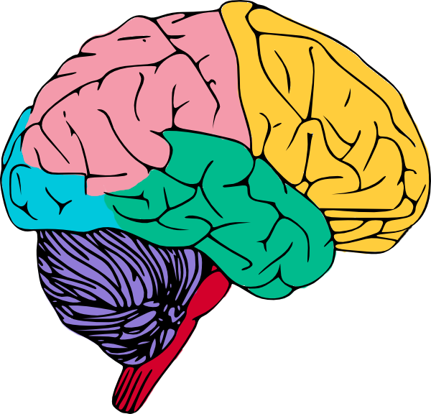
CS 548 Spring 2015 Showcase by Pankaj Didwania, Sarah Schultz, Mingchen Xie Showcasing Work by Malhotra, Chau, Sun, Hadjipanayis, & Navathe on
Temporal Event Sequence Mining for Glioblastoma
Survival Prediction
Notes:
Temporal Event Sequence Mining for Glioblastoma
Survival Prediction

Slide 2
Sources
Main paper:
Malhotra, K., Chau, D. H., Sun, J., Hadjipanayis, C., & Navathe, S. B. “Temporal Event Sequence Mining for Glioblastoma Survival Prediction” in Proceedings of the ACM SIGKDD Workshop on Health Informatics, New York, NY, 2014.
Other sources:
American Brain Tumor Association, (2014), Glioblastoma (GBM) [Online], Available: http://www.abta.org/brain-tumor-information/types-of-tumors/glioblastoma.html
N.R. Cooke, “Use and misuse of the receiver operating characteristic curve.” Circulation vol. 115, no. 7 pp. 928-935, 2007.
Notes:
Paper Available at: http://cci.drexel.edu/hi/hi-kdd2014/morning_1.pdf

Slide 3
The flow of this Showcase
Background
Authors’ Contribution
Data
Methods
Analysis and Results
Conclusion

Slide 4
Background
What is Glioblastoma Multiforme (GBM)??
It is the most lethal type of brain cancer.
It is biologically the most aggressive subtype of malignant gliomas.
From a clinical perspective, gliomas are divided into four grades and the most aggressive of these is GBM or grade IV glioma and is most common in humans.
Notes:
Explain this: [A glioma is a type of tumor that starts in the brain or spine. It is called a glioma because it arises from glial cells. The most common site of gliomas is the brain.Gliomas make up about 30% of all brain and central nervous system tumors and 80% of all malignant brain tumors.]

Slide 5
Background
Current treatment:
Surgical resection
Difficult to completely remove
Radiation therapy and chemotherapy
Oral medication Temodar
The median survival rate for GBM is one year
Notes:
This extreme mortality rate, where none have a long-term survival, has drawn significant attention to improving treatment for these tumors.

Slide 6
This Paper^{[1]} ’s Contribution
Formulate the problem of predicting which patients will survive more than a year
Leverage the existing sequential pattern mining algorithms and tailor them to mine significant treatment patterns from the available treatment data
Adopt a data driven approach to build and evaluate a predictive model
[1] (Malhotra, Chau, Sun, Hadjipanayis, & Navathe, 2014)

Slide 7
Data Representation
300 patients extracted from TCGA spanning over a period of 2 years.
Includes:
Demographic information
Clinical features
Treatment
Vital status of patient (living/deceased)
Analysis includes
Drugs prescribed and dosage
Therapy type and dates for treatment
Represented by graph
Nodes: patient and treatment
Edges: prescription and sequence
Notes:
drugs prescribed along with their dosage, therapy type, radiation type, radiation dosage, and start and end dates for the treatment. We model this data as a graph where nodes are of two types: `patient node' & `treatment type node' and edges are also of two types: `prescription edge' & `sequence edge'.
TCGA=The Cancer Genome Atlas

Slide 8
Predictive Modeling Pipeline
Data Standardization and Cleaning
Sequential Pattern Mining
Feature Construction
Prediction and Evaluation

Slide 9
Data Cleansing and Preparation
Impute missing start or end dates for drug treatments. If both missing, delete this instance.
Standardize elements such as ‘gender’ or ‘drug name’ with different nomenclature in different places
Leave out living patients with last visit within 365 days, since survival is unknown

Slide 10
Sequential Pattern Mining
Sequence of drugs/radiation prescribed.
Time of drug prescription.

Slide 11
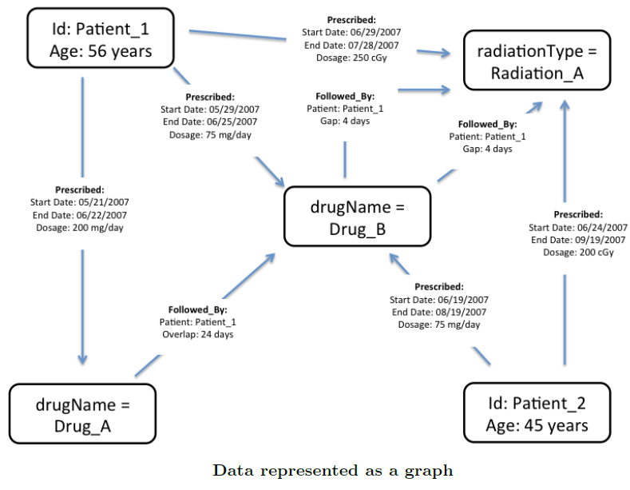
Example Sequences
Figure taken from (Malhotra, Chau, Sun, Hadjipanayis, & Navathe, 2014)

Slide 12
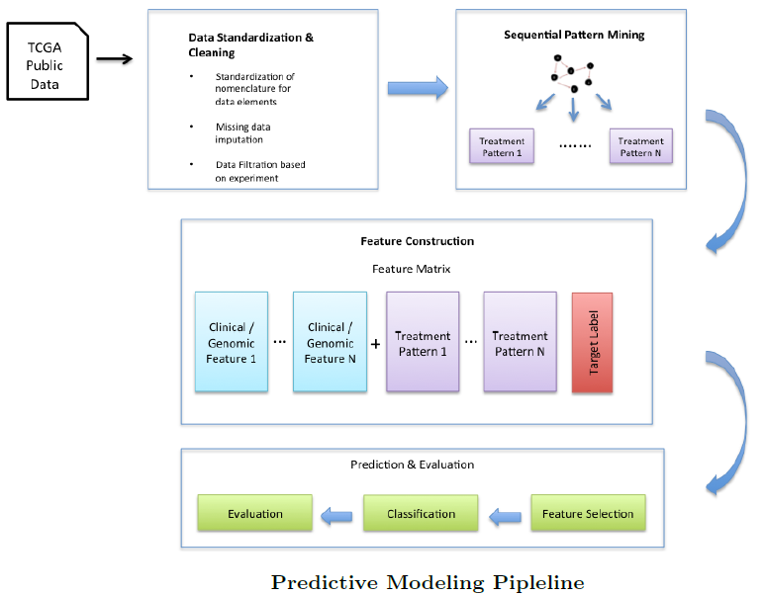
Modeling Pipeline
Figure taken from (Malhotra, Chau, Sun, Hadjipanayis, & Navathe, 2014)

Slide 13
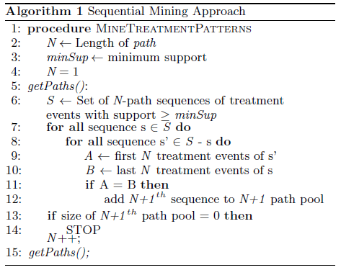
Predictive Modeling Pipeline - Algorithm
Figure taken from (Malhotra, Chau, Sun, Hadjipanayis, & Navathe, 2014)

Slide 14
Feature Construction
The clinical and the genomic datasets consists of both numeric and categorical data types.
To standardize the data set the dataset was converted into a binary feature matrix.
This was achieved by using the categorical data values as features in the feature vector and creating bins for numeric features such as Age, KPS scores, mRNA expression z-scores, etc.
E.g Age (in years) which was a numeric value was represented as 4 bins `Age < 25' , `25 < Age < 50', `50 < Age < 75' and 'Age > 75' which were treated as features.

Slide 15
Feature Construction
Significant sequence patterns are identified that were obtained in sequential mining module in the feature vector.
Each significant treatment pattern is treated as a feature.
Patients who exactly received that treatment = 1; Rest = 0.
The target variable in our study is constructed based on the patient's survival period.
`days to death' = number of days between the date of diagnosis and the death of the patient
`days to last follow up' = the number of days between the date of diagnosis and the date of the last follow up with the clinician.

Slide 16
Feature Construction
For deceased patients `days to death' is the indicator of the survival period.
Deceased patients who survived for more than a year are assigned a target variable of `1’ those who survived for less than a year are assigned `0'.
For living patients if the `days to last follow up' is greater than a year then we assign them a target variable of `1’ else we discard that patient since we cannot positively conclude anything about the survival period.

Slide 17
Results
Total Number of Patients: 300
Classified in two categories:
Surviving Less Than a Year
Surviving More Than a Year
For this study there are three domains of
features `Clinical' , `Genomic' and `Treatment'.

Slide 18
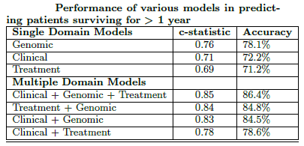
Results
C-statistic- same as AUC
Table taken from (Malhotra, Chau, Sun, Hadjipanayis, & Navathe, 2014)

Slide 19
Analysis
GABRA1 gene is indicative of survival rate
Older patients, especially the ones above the age of 75, have lesser chance of surviving for more than a year.
Standard first line of treatment for GBM patients consists of chemotherapy with Temodar coupled with radiation therapy.
Found that radiation by itself as second treatment led to lower survival rate
A positive influence on survival was observed with Procarbazine when prescribed second in the treatment
Notes:
Patients survive for less than a year if the mRNA expression of the GABRA1 gene is between -1 and -1.5 and longer than a year if mRNA expression levels are between -1 and 1
Higher GABRA1 gene expression is associated with `Neural' subtype of GBM and according to medical experts, patients in this category usually have longer survival periods. Hemizygous deletion of GABRA1 gene has also been observed to have a positive influence on survival.

Slide 20
Conclusion
Of the genomic features patient's age is the only clinical feature, which was selected by the model.
Amongst the treatment patterns, prescription of radiation therapy, CCNU and Procarbazine followed by stoppage of treatment seemed to influence survival.

Slide 21
Moving forward
This is a preliminary step in finding treatment guidance
Currently the treatment patterns consist of the drug names and their event of prescription
In the future enhance the model with more features:
gap between prescription of drugs
overlapping therapies
filtering clinically insignificant patterns at an early stage, etc.

Slide 22
Questions?

Slide 23
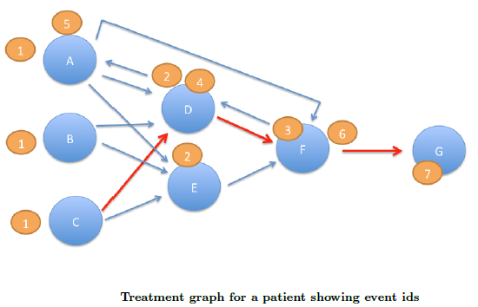
Figure taken from (Malhotra, Chau, Sun, Hadjipanayis, & Navathe, 2014)
Notes:
explain what this means

