Slide 1
CS548 Spring 2015 Anomaly Detection Showcase
Anomaly-based Network Intrusion Detection (A-NIDS)
by Nitish Bahadur, Gulsher Kooner,
Caitlin Kuhlman

Slide 2
References
PALANTIR CYBER An End-to-End Cyber Intelligence Platform for Analysis & Knowledge Management [Online]. Available: https://www.palantir.com/solutions/cyber/
Bhuyan, Monowar H., D. K. Bhattacharyya, and Jugal K. Kalita. "Network anomaly detection: methods, systems and tools." Communications Surveys & Tutorials, IEEE 16.1 (2014): 303-336.
Garcia-Teodoro, Pedro, et al. "Anomaly-based network intrusion detection: Techniques, systems and challenges." computers & security 28.1 (2009): 18-28.
Denning, Dorothy E., "An Intrusion Detection Model," Proceedings of the Seventh IEEE Symposium on Security and Privacy, May 1986, pages 119–131
Sommer, Robin, and Vern Paxson. "Outside the closed world: On using machine learning for network intrusion detection." Security and Privacy (SP), 2010 IEEE Symposium on. IEEE, 2010.
Dokas, Paul, et al. "Data mining for network intrusion detection." Proc. NSF Workshop on Next Generation Data Mining. 2002.
Minnesota INtrusion Detection System [Online]. Available: http://minds.cs.umn.edu/

Slide 3
Overview
Problem - Why is Network Intrustion Detection important?
Relevance - How is it related to Anomaly Detection / Data Mining?
Description - What is Anomaly Based Network Intrustion Detection?
Hypothetical Solution - Case Study

Slide 4
Problem
What is Network Intrustion Detection?
Why is Network Intrustion Detection important?

Slide 5
What is NIDS?
Network Instrusion Detection System monitors network traffic and attempts to identify unusual or suspicious activity
Passive system: alerts are reported to analyst for further investigation

Slide 6
Economic Impact
A conservative estimate would be $375 billion in losses in 2013, while the maximum could be as much as $575 billion
http://www.mcafee.com/us/resources/reports/rp-economic-impact-cybercrime2.pdf (Page 2)
https://media.licdn.com/mpr/

Slide 7
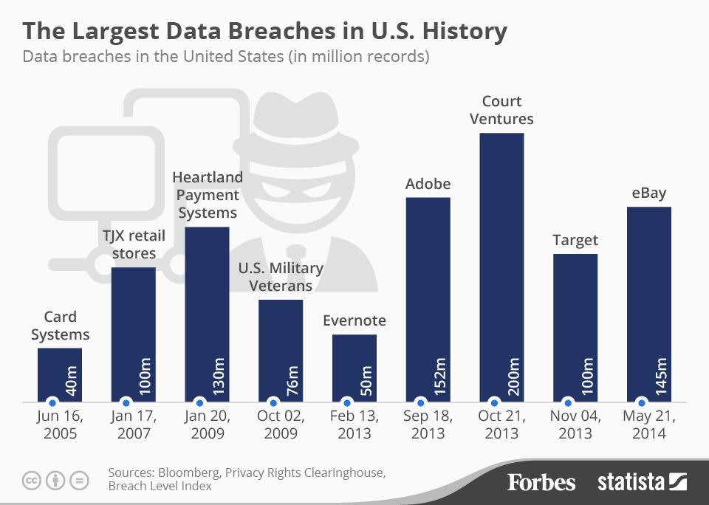

Slide 8
Types of computer attacks [2]
Virus
Worm
Trojan
Denial of service
Network Attack
Physical Attack
Password Attack
Information Gathering Attack
User to Root (U2R) attack
Remote to Local (R2L) attack
Probe

Slide 9
How is IDS related to Anomaly Detection?
Types of Intrusion Detection
Misuse based
Anomaly based
Hybrid
Misue (signature) Based – given a database of known misuses you compare a intrusion detection pattern against this database
Anomaly Based - estimate what is normal and raise an alarm when the event is an anomaly based on some metric.

Slide 10
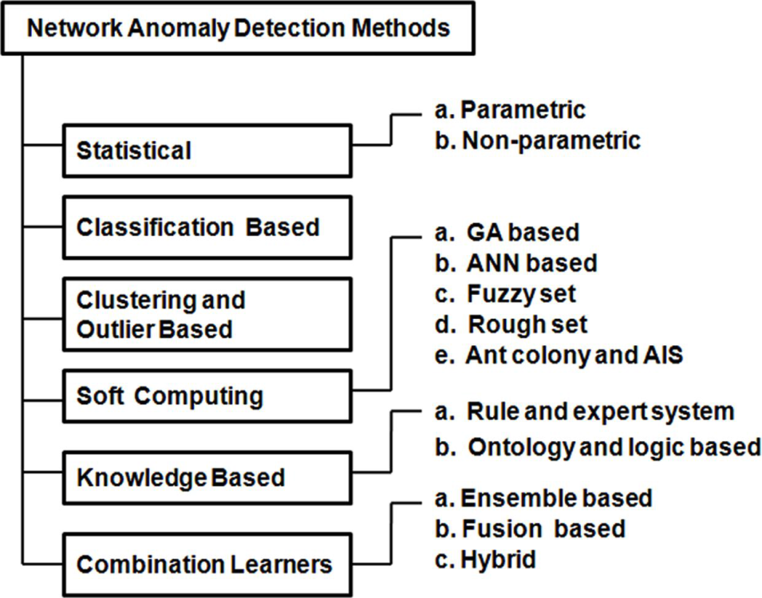
…is a little vague
Network Intrusion
Detection Systems
“…anomaly-based intrusion detection in networks refers to the problem of finding exceptional patterns in network traffic that do not conform to the expected normal behavior.” [2]
Systems have been developed since the 1980’s [4]
Still a robust research area
Many methods and tools available
[2]

Slide 11
Machine Learning for Intrusion Detection
Challenges with supervised methods
Data distribution is very skewed – attacks represent a very small amount of network activity
Training data is hard/impossible to obtain -network data often contains proprietary information, and is very labor intensive for an analyst to label.
Unsupervised Anomaly Detection
Doesn’t require training data
Can detect previously unseen attacks

Slide 12
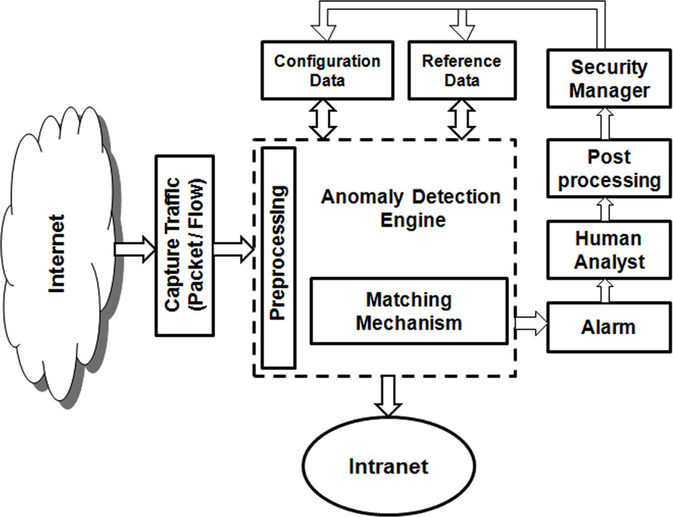
Common Intrusion Detection Framework
[2]

Slide 13
Data Collection
Types of features: Source and destination IP addresses, ports, packet headers, network traffic statistics
Tools
Tcpdump command line tool
Snort open source IDS packet capture and signature matching
Wireshark popular open source packet sniffer

Slide 14
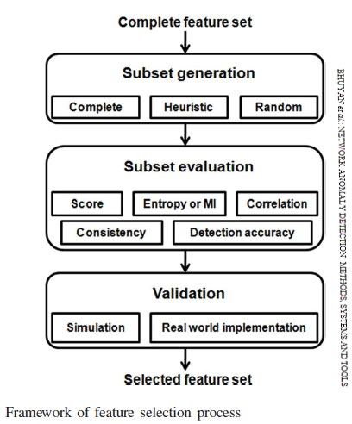
Features
Construction
Time based statistics
Ratio of data coming in and out of network
Packet inspection

Slide 15
Minnesota INtrusion Detection System (MINDS)
Density based clustering to detect outliers
[6]

Slide 16
Comparison of anomaly detection methods
Anomaly score assigned to each instance based on degree of being an outlier - local outlier factor (LOF)

Slide 17
Limitations of Anomaly Based NIDS
Challenges Possible Solutions
High Cost of Errors | Limit false positives with post processing
Semantic Gap | Better interpretation of results- find ways to distinguish “anomalies” from “attacks” Relate features to behaviors
Diversity of Network Traffic | Tailor system to environment Target certain types of attacks
Difficulties with Evaluation | Outdated benchmark datasets Need real publicly available network traffic

Slide 18
Solutions – Case Study
DISCLAIMER:
The software/solutions presented here is part of our research effort for Data Mining showcase. The presenters have no association with the corporation or institution developing or designing the software / solutions presented in this showcase. Please do your due diligence before using a solution.

Slide 19
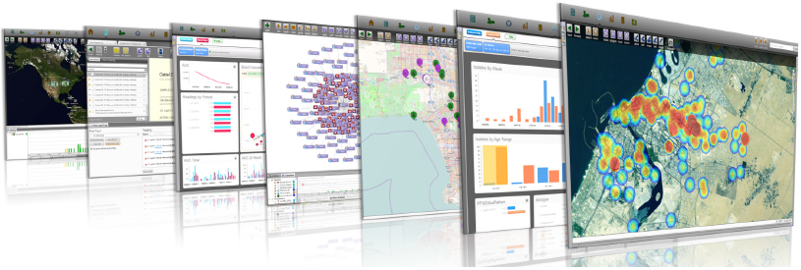
PALANTIR CYBER
An End-to-End Cyber Intelligence Platform for Analysis & Knowledge Management
Knowledge management
Complex & adaptive Threats
Against external and internal
FUSING INTERNAL AND EXTERNAL CYBER DATA
Structured network logs
Contextual data
Unstructured reporting and third party data

Slide 20
ANOMALY DETECTION
Clusterable, distributed data store
Open source technologies Apache’s™ Hadoop
Comb through data archives
Detect anomalies by creating clusters
Visualizations: risk scores, pie charts, and heat maps
Drill down and investigate further

Slide 21
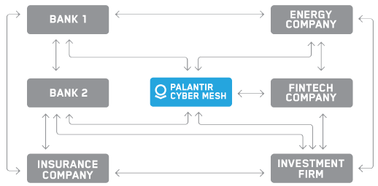
THE CYBER MESH
Shared set of cyber threats
P2P sharing among enterprises
Automatic censoring of sensitive data

Slide 22
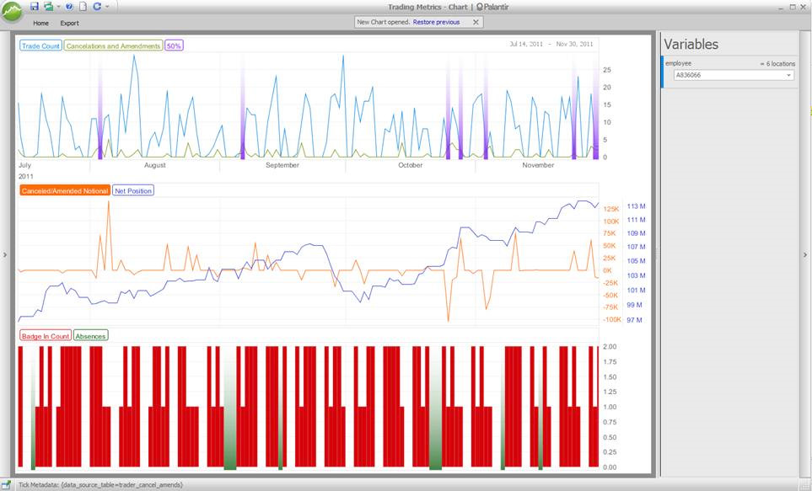
THE PALANTIR SOLUTION
INSIDER THREAT DETECTION
Identify suspicious or
abnormal employee behavior
IDENTITY ACCESS AND MANAGEMENT
Access logs, Active Directory records, HR files, VPN activity

Slide 23
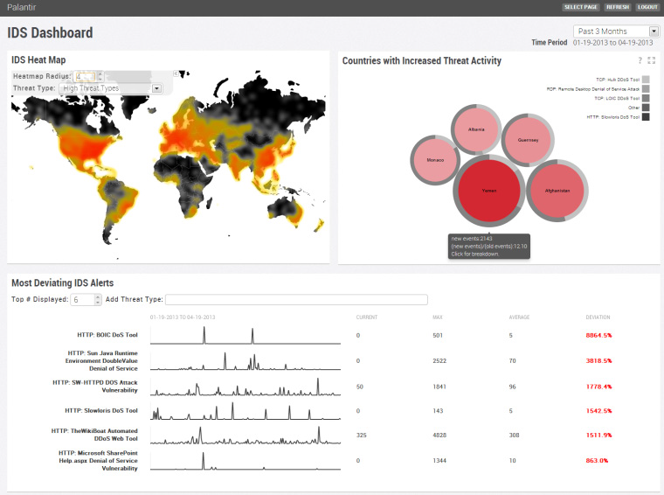
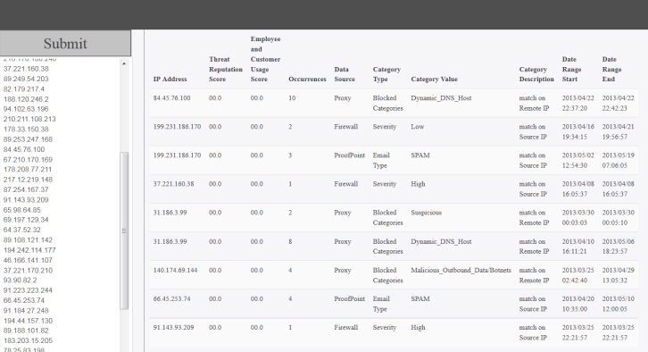
ANALYTICAL APPLICATIONS
NETWORK DASHBOARDS
WEB-BASED IP REPUTATION ENGINE

Slide 24
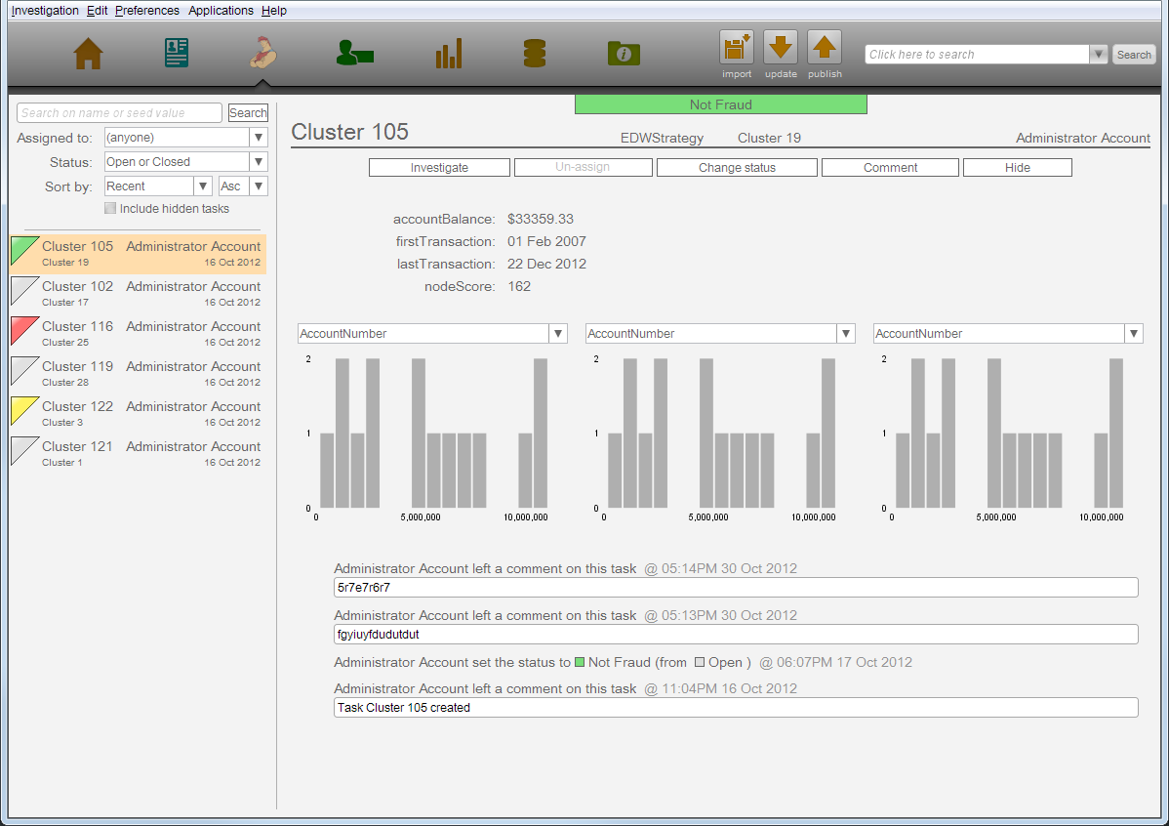
PATTERN DETECTION AND WORKFLOW

Slide 25
Palantir – Uncovering Cyber Fraud
Notes:
https://www.youtube.com/watch?v=l9aQqMZNI10

Slide 26
Thank You !!

Slide 27
Appendix – I – Statistical Network Anomaly Detection Methods

Slide 28
Appendix – 2 – Classification Network Anomaly Detection Methods

Slide 29
Appendix – 3 – Clustering & Outlier based Network Anomaly Detection Methods

Slide 30
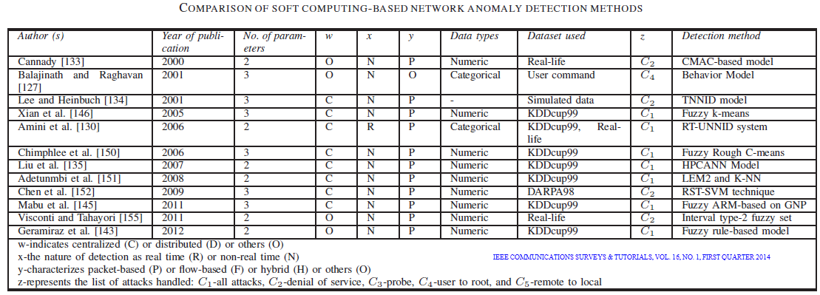
Appendix – 4 – Soft Computing based Network Anomaly Detection Methods

Slide 31
Appendix – 5 – Knowledge based Network Anomaly Detection Methods

Slide 32
Appendix – 6 – Fusion based Network Anomaly Detection Methods

